Slide 1



Business Data Analysis
MGM509
Orientation Lecture
Prepared by
Eng. Ahmed Hussein, MBA, PfMP©, PMP©, CMP APMG

Slide 2

Orientation
What we will cover
Lecture
Introduction
Learn about Course Objectives and Schedule
Brief Introduction to Business Data Analysis
0 – 2

Slide 3

Eng. Ahmed Hussein, MBA, PfMP©, PMP© and APMG-Change Management Practitioner
Lecturer and management consultant with >30 years of executive management experience
Lecturing experience over 15 years on:
  Portfolio/ Program / Project Management,
  Strategic Management and Organizational Change Management and Business Transformation,
  MIS and Decision Support
> 20 Years in Data Sciences
Delivered many courses in Data Science and Data Analysis to business professionals
Led Strategic Insights and MIS departments in several organizations across the region
0 – 3

Slide 4


Course Objectives and Schedule
Orientation
Lecture
0 – 4

Slide 5
Orientation
Course Objectives and Learning Outcomes
Lecture
1
  Define data analysis processes and techniques.
2
Develop the ability to gather, clean, and organize data for meaningful analysis.
3
Apply statistical tools and techniques for analyzing large data sets.
4
  Visualize data for clear and impactful presentations
5
  Interpret data results to support strategic decision-making
6
  Address ethical considerations in the use of data and its analysis
0 – 5

Slide 6

Orientation
Course Schedule and Topics
Lecture
Week | Lecture | Lecture Topic | Discussion Panel | Quiz
Week 1 | Orientation Lecture | Orientation Lecture
Week 2 | Lecture 1 | From Business Challenges to Data Science Solutions
Week 3 | Lecture 2 | Predictive Modeling Foundations: Correlation to Segmentation
Week 4 | Lecture 3 | Building Better Models: Regression, SVMs, and Model Fitting
Week 5 | Lecture 4 | Avoiding Pitfalls: Overfitting, Evaluation, and Complexity Control
Week 6 | Lecture 5 | Similarity and Segmentation: Neighbors, Clusters, and Business Use Cases
Week 7 | Lecture 6 | What Makes a Good Model? Decision-Analytic Thinking in Practice
Week 8 | Lecture 7 | Evaluating and Communicating Performance: ROC, Lift, and Profit Curves
Week 9 | Lecture 8 | Reasoning Under Uncertainty: Bayesian Thinking and Evidence Models
Week 10 | Lecture 9 | Working with Unstructured Data: Text Mining and Representation
Week 11 | Lecture 10 | Strategic Data Science: Engineering Solutions, Advanced Techniques, and Business Strategy
Week 12 | - | -
Week 13 | - | Beginning of Final Exams
0 – 6

Slide 7
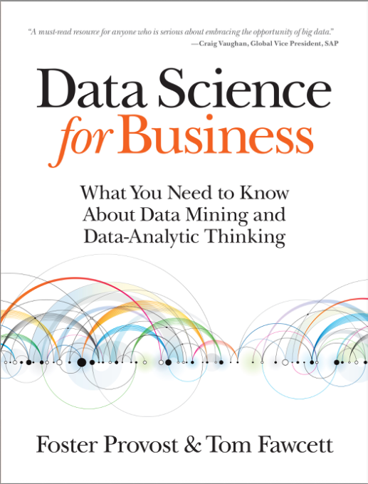
Orientation
Lecture
Required Textbook:
“Data Science for Business” by Foster Provost & Tom Fawcett
The main material and reference for the course will be the textbook, lecture notes and slides. and any additional resources that are prepared by the professor.
0 – 7

Slide 8
Introduction to Business Data Analysis
Orientation
Lecture
0 – 8

Slide 9
Orientation
Data as a Strategic Asset
Lecture
Data is more than byproduct—it’s an enabler of better decisions.
Smart use of data can outperform intuition or experience.
Investments in data infrastructure should align with business goals.
0 – 9

Slide 10
Orientation
Why Data Science Matters?
Lecture
Data is now a central business asset.
Competitive advantage increasingly comes form how well organizations use data.
Every business decision is a potential data science opportunity
0 – 10

Slide 11
Orientation
Data vs. Information
Lecture
Data: Raw, unprocessed facts and figures without context. Data can be numbers, symbols, characters, or images that on their own may not have meaning.
Information: Processed, organized, or structured data that has meaning and is useful for decision-making.
0 – 11

Slide 12
Orientation
Examples for Data and Information
Lecture
Data: 23, Red, 07/06/2025
Information: “Order #23 was delivered on 07/06/2025 in Red color”
Data: Sales amount was 1,000 USD
Information: Daily Sales amount has declined by 50% for a 7th day from yearly average of 2,000 USD to 1,000 USD.
0 – 12

Slide 13
Orientation
Definition of Data Science and Data Mining
Lecture
Data Science is a set of fundamental principles that guide the extraction of knowledge from data.
Data Mining is the extraction of knowledge from data, via technologies that incorporate data science principles.
Combines statistics, machine learning, and domain expertise
Not just about tools– it’s about thinking analytically
0 – 13

Slide 14


Orientation
Data Analytic Thinking
Lecture
A mindset that views business problems as analytical tasks.
Involves:
  Framing problems as data questions.
  Identifying the kind of data needed.
  Understanding what the data can and cannot tell you.
0 – 14

Slide 15
Orientation
From Big Data 1.0 to 2.0
Lecture
Big Data means data sets that are too large for traditional data processing systems and require new processing technologies.
Big Data 1.0: Infrastructure and storage.
Big Data 2.0: Analysis, modeling, and decision-making.
Focus shifts from “having data” to “using data intelligently.”
0 – 15

Slide 16
Orientation
Data Science vs. Data Engineering
Lecture
Data Engineering: Collecting, storing, and processing data.
Data Science: Extracting insights, creating models, and guiding action.
Both are essential, but serve different purposes.
0 – 16

Slide 17
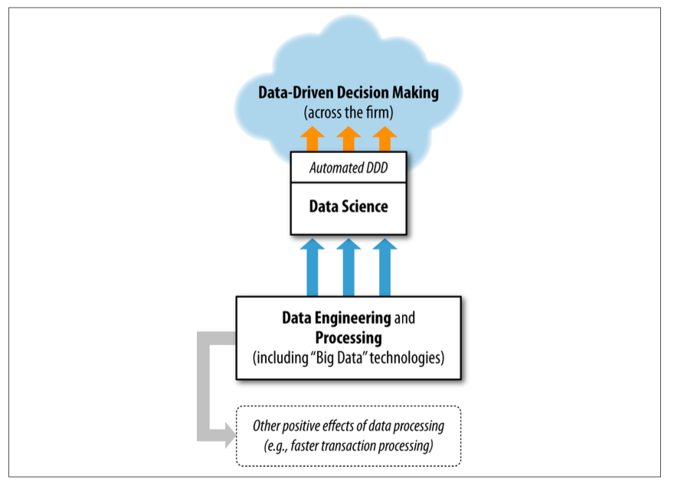
Orientation
Data Driven Decision-Making (DDD)
Lecture
Data-driven decision-making (DDD) refers to the practice of basing decisions on the analysis of data, rather than purely on intuition.
0 – 17

Slide 18

Data Driven Decision-Making (DDD) Example –
Customer Churn/Turnover
Orientation
Lecture
Problem: Identify which customers are likely to leave.
Approach: Use past behavior and attributes to predict churn.
Insight: Data enables proactive retention strategies.
0 – 18

Slide 19
Orientation
Key Points
Lecture
Data-analytic thinking is a must-have skill in today’s business world.
Success with data science begins by asking the right questions.
Data is a strategic business asset
Applying Data Science to analyze data and generate insights can be a source of Competitive Advantage.
0 – 19

Slide 20

For Discussion Panel and Next Lecture:
Reading, Chapter 1 from textbook: “Data Science for Business” by Fostor Provost & Tom Fawcett
Orientation
Lecture
For Discussion Panel and Next Lecture
0 – 20

Slide 21



Thank You

