Slide 1





Probability and Statistics
Prepared by Dr.Israa Lewaa
Lecture 10
STA 201
Chi-Square Tests and the F-Distribution

Slide 2


Chapter
10
Chapter Outline
10.1 Goodness of Fit
10.2 Independence
10.3 Comparing Two Variances
10.4 Analysis of Variance

Slide 3

Chapter
10
Section 10.1: Goodness of Fit
A multinomial experiment is a probability experiment consisting of a fixed number of trials in which there are more than two possible outcomes for each independent trial. (Unlike the binomial experiment in which there were only two possible outcomes.)
Example:
A researcher claims that the distribution of favorite pizza toppings among teenagers is as shown below.
Topping | Frequency, f
Cheese | 41%
Pepperoni | 25%
Sausage | 15%
Mushrooms | 10%
Onions | 9%
Each outcome is classified into categories.
The probability for each possible outcome is fixed.

Slide 4
Chapter
10
Chi-Square Goodness-of-Fit Test
A Chi-Square Goodness-of-Fit Test is used to test whether a frequency distribution fits an expected distribution.
To calculate the test statistic for the chi-square goodness-of-fit test, the observed frequencies and the expected frequencies are used.
The observed frequency O of a category is the frequency for the category observed in the sample data.
The expected frequency E of a category is the calculated frequency for the category. Expected frequencies are obtained assuming the specified (or hypothesized) distribution. The expected frequency for the ith category is E_{i} = np_{i}
where n is the number of trials (the sample size) and p_{i} is the assumed probability of the ith category.

Slide 5
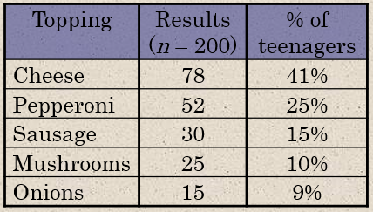
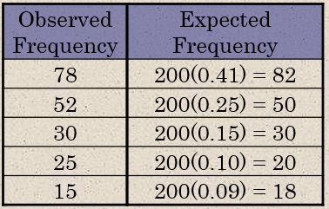
Chapter
10
Observed and Expected Frequencies
Example:
200 teenagers are randomly selected and asked what their favorite pizza topping is. The results are shown below.
Find the observed frequencies and the expected frequencies.

Slide 6
Chapter
10
Observed and Expected Frequencies
Example:
200 teenagers are randomly selected and asked what their favorite pizza topping is. The results are shown below.
Find the observed frequencies and the expected frequencies.

Slide 7
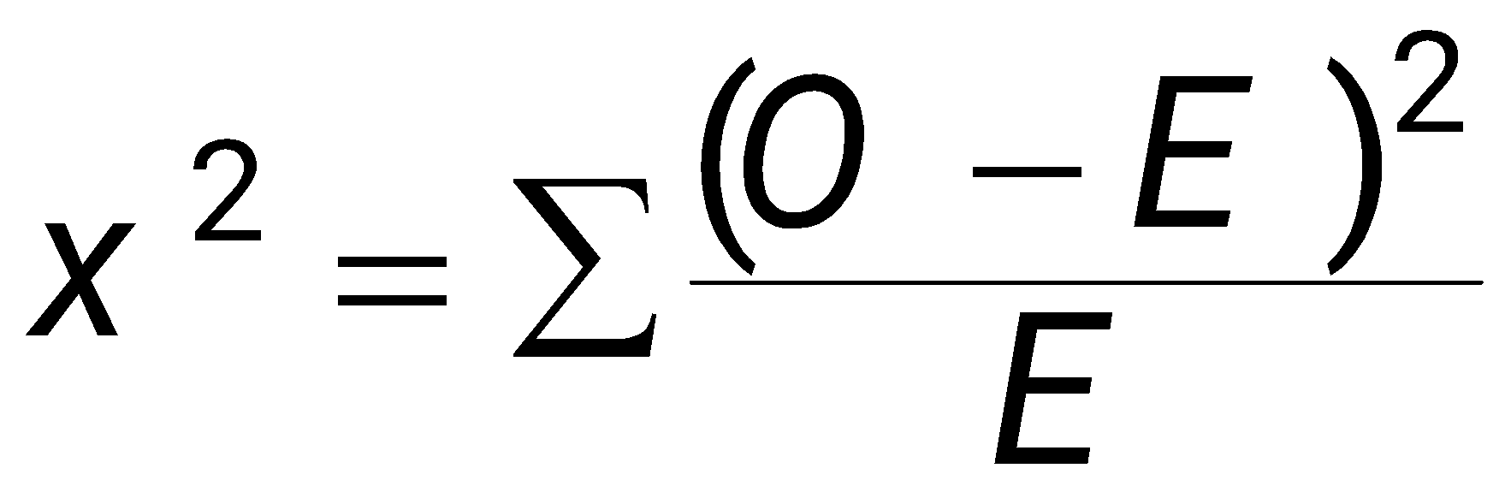
Chapter
10
Chi-Square Goodness-of-Fit Test
For the chi-square goodness-of-fit test to be used, the following must be true.
The observed frequencies must be obtained by using a random sample.
Each expected frequency must be greater than or equal to 5.
The Chi-Square Goodness-of-Fit Test
If the conditions listed above are satisfied, then the sampling distribution for the goodness-of-fit test is approximated by a chi-square distribution with k – 1 degrees of freedom, where k is the number of categories. The test statistic for the chi-square goodness-of-fit test is
where O represents the observed frequency of each category and E represents the expected frequency of each category.
The test is always a right-tailed test.

Slide 8
Chapter
10
Chi-Square Goodness-of-Fit Test
Performing a Chi-Square Goodness-of-Fit Test
In Words In Symbols
Identify the claim. State the null and alternative hypotheses.
Specify the level of significance.
Identify the degrees of freedom.
Determine the critical value.
Determine the rejection region.
State H₀ and H_{a}.
Identify α.
d.f. = k – 1
Use Table Chi Square.

Slide 9
Chapter
10
Chi-Square Goodness-of-Fit Test
Performing a Chi-Square Goodness-of-Fit Test
Word | Symbol
Identify the claim. State the null and alternative hypotheses. | State H₀ and H_{a}.
Specify the level of significance. | Identify α.
Identify the degrees of freedom. | d.f. = k – 1
Determine the critical value. | Use Table Chi Square.
Determine the rejection region.

Slide 10
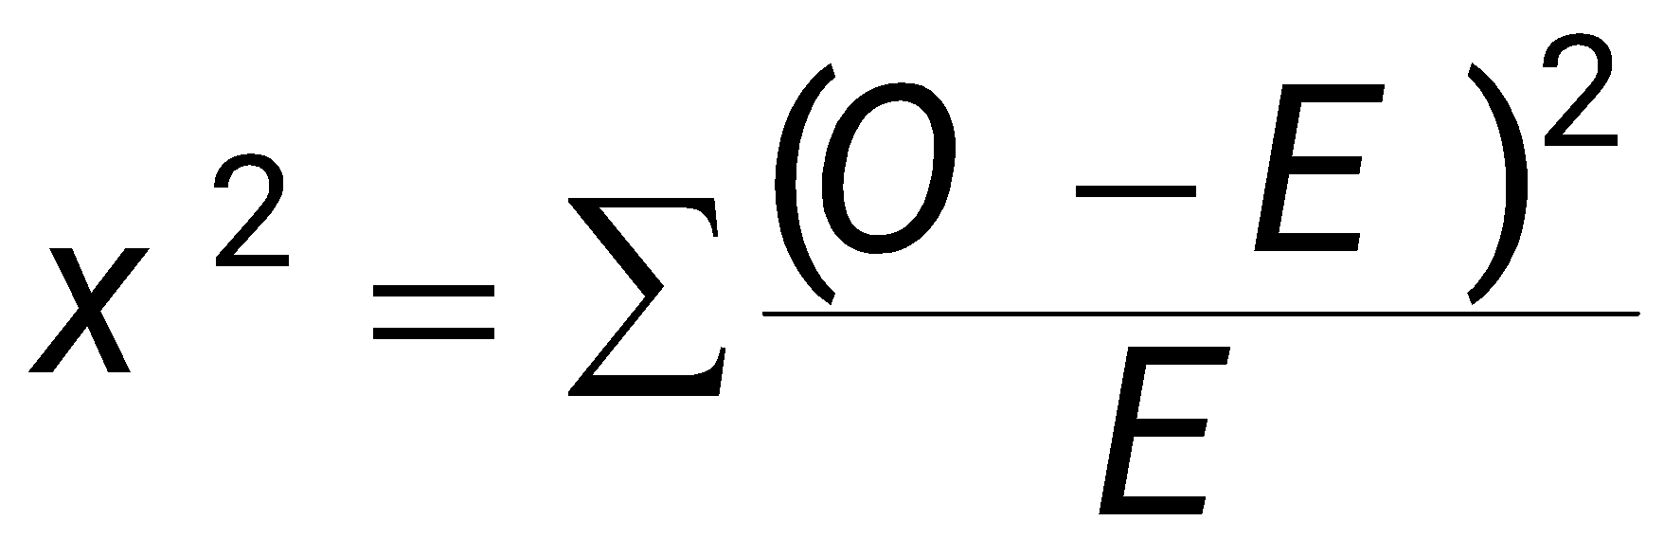
Chapter
10
Correlation coefficient
Word | Symbol
6- Calculate the test statistic.
Make a decision to reject or fail to reject the null hypothesis. | If χ² is in the rejection region, reject H₀. Otherwise, fail to reject H₀.
Interpret the decision in the context of the original claim.

Slide 11
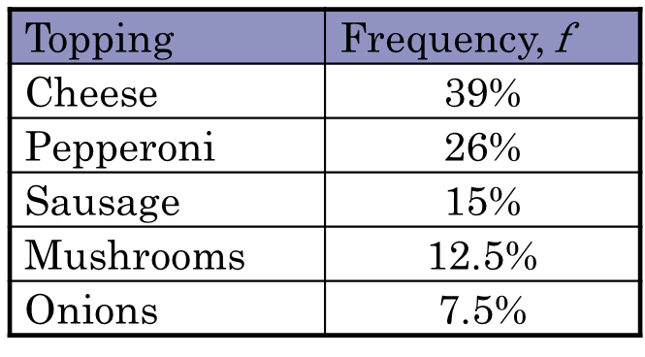
Chapter
10
Example
A researcher claims that the distribution of favorite pizza toppings among teenagers is as shown below. 200 randomly selected teenagers are surveyed.
Using α = 0.01, and the observed and expected values previously calculated, test the surveyor’s claim using a chi-square goodness-of-fit test.

Slide 12
Chapter
10
Solution
H₀: The distribution of pizza toppings is 39% cheese, 26% pepperoni, 15% sausage, 12.5% mushrooms, and 7.5% onions. (Claim)
H_{a}: The distribution of pizza toppings differs from the claimed or expected distribution.
Because there are 5 categories, the chi-square distribution has k – 1 = 5 – 1 = 4 degrees of freedom.
With d.f. = 4 and α = 0.01, the critical value is χ²₀ = 13.277.

Slide 13
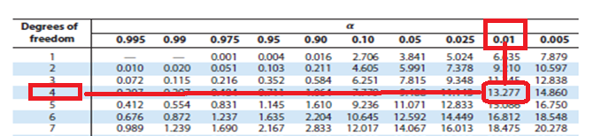
Chapter
10
Solution
Critical Value for χ²₀
With d.f. = 4 and α = 0.01
The critical value is χ²₀ = 13.277.

Slide 14
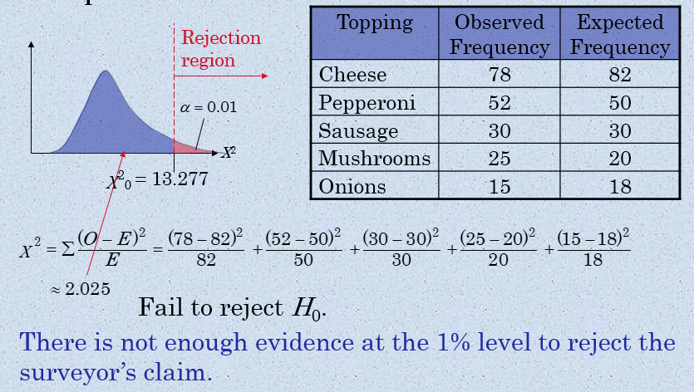
Chapter
10
Solution

Slide 15
Chapter
10
Solution

Slide 16
Chapter
10
10.2 Independence
An r × c contingency table shows the observed frequencies for two variables. The observed frequencies are arranged in r rows and c columns. The intersection of a row and a column is called a cell.
The following contingency table shows a random sample of 321 fatally injured passenger vehicle drivers by age and gender. (Adapted from Insurance Institute for Highway Safety)
Age
Gender
16 – 20
21 – 30
31 – 40
41 – 50
51 – 60
61 and older
Male
32
51
52
43
28
10
Female
13
22
33
21
10
6

Slide 17
Chapter
10
Expected Frequency
Assuming the two variables are independent, you can use the contingency table to find the expected frequency for each cell.
Finding the Expected Frequency for Contingency Table Cells
The expected frequency for a cell E_{r,c} in a contingency table is

Slide 18

Chapter
10
Example
Find the expected frequency for each “Male” cell in the contingency table for the sample of 321 fatally injured drivers. Assume that the variables, age and gender, are independent.
Age
Gender
16 – 20
21 – 30
31 – 40
41 – 50
51 – 60
61 and older
Total
Male
32
51
52
43
28
10
216
Female
13
22
33
21
10
6
105
Total
45
73
85
64
38
16
321

Slide 19
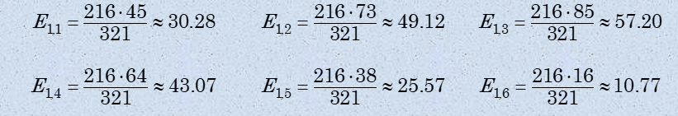
Chapter
10
Example
Age
Gender
16 – 20
21 – 30
31 – 40
41 – 50
51 – 60
61 and older
Total
Male
32
51
52
43
28
10
216
Female
13
22
33
21
10
6
105
Total
45
73
85
64
38
16
321

Slide 20
Chapter
10
Chi-Square Independence Test
A chi-square independence test is used to test the independence of two variables. Using a chi-square test, you can determine whether the occurrence of one variable affects the probability of the occurrence of the other variable.
For the chi-square independence test to be used, the following must be true.
The observed frequencies must be obtained by using a random sample.
Each expected frequency must be greater than or equal to 5.

Slide 21
Chapter
10
Chi-Square Independence Test
The Chi-Square Independence Test
If the conditions listed are satisfied, then the sampling distribution for the chi-square independence test is approximated by a chi-square distribution with
(r – 1)(c – 1)
degrees of freedom, where r and c are the number of rows and columns, respectively, of a contingency table. The test statistic for the chi-square independence test is
where O represents the observed frequencies and E represents the expected frequencies.

Slide 22
Chapter
10
Example
The following contingency table shows a random sample of 321 fatally injured passenger vehicle drivers by age and gender. The expected frequencies are displayed in parentheses. At α = 0.05, can you conclude that the drivers’ ages are related to gender in such accidents?
Age
Gender
16 – 20
21 – 30
31 – 40
41 – 50
51 – 60
61 and older
Total
Male
32 (30.28)
51 (49.12)
52 (57.20)
43 (43.07)
28 (25.57)
10 (10.77)
216
Female
13 (14.72)
22 (23.88)
33 (27.80)
21 (20.93)
10 (12.43)
6 (5.23)
105
45
73
85
64
38
16
321

Slide 23
Chapter
10
Solution
Because each expected frequency is at least 5 and the drivers were randomly selected, the chi-square independence test can be used to test whether the variables are independent.
H₀: The drivers’ ages are independent of gender.
H_{a}: The drivers’ ages are dependent on gender. (Claim)
d.f. = (r – 1)(c – 1) = (2 – 1)(6 – 1) = (1)(5) = 5
With d.f. = 5 and α = 0.05, the critical value is χ²₀ = 11.071.

Slide 24
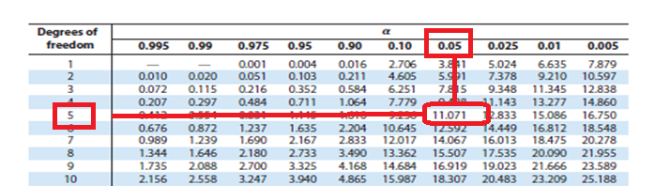
Chapter
10
Solution
Critical Value for χ²₀
d.f. = (r – 1)(c – 1) = (2 – 1)(6 – 1) = (1)(5) = 5 and α = 0.05
The critical value is χ²₀ = 11.071

Slide 25
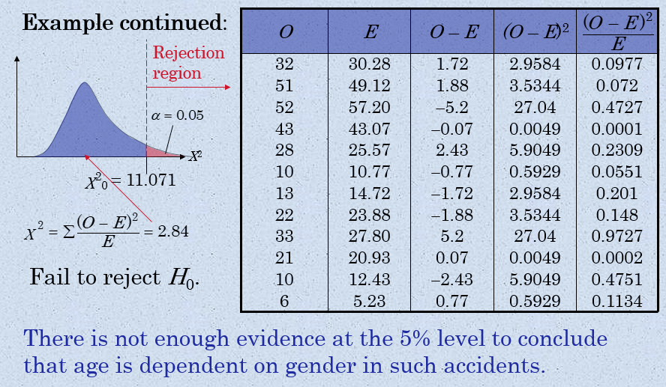
Chapter
10
Solution

Slide 26
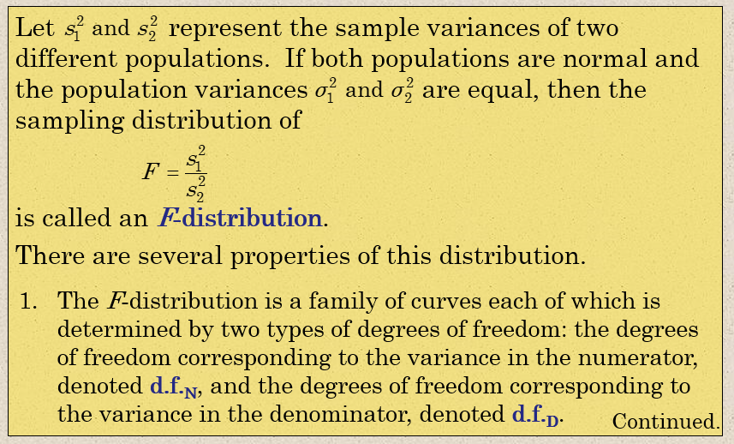
Chapter
10
10.3 Comparing Two Variances

Slide 27
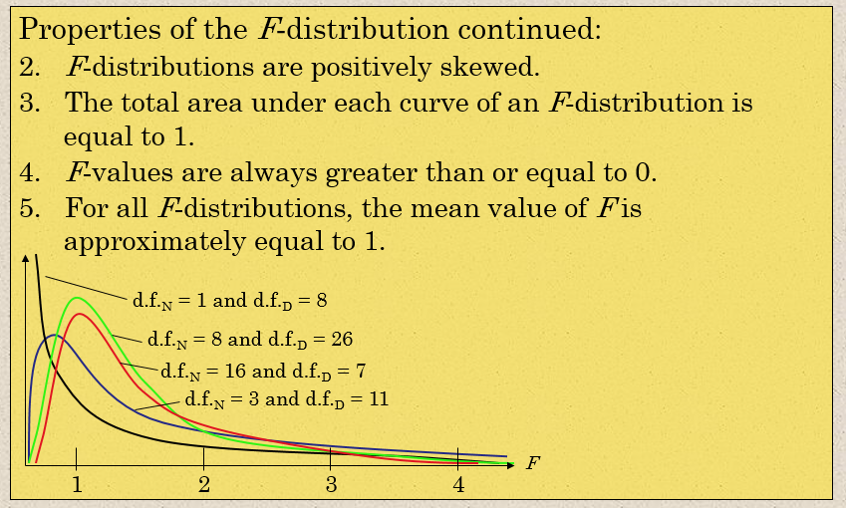
Chapter
10
F-Distribution

Slide 28

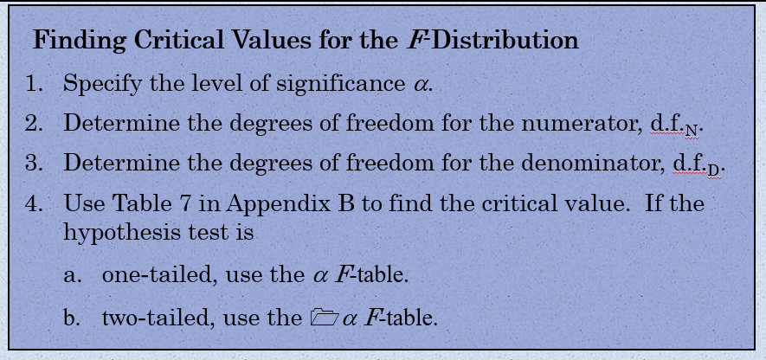
Chapter
10
Critical Values for the F-Distribution

Slide 29

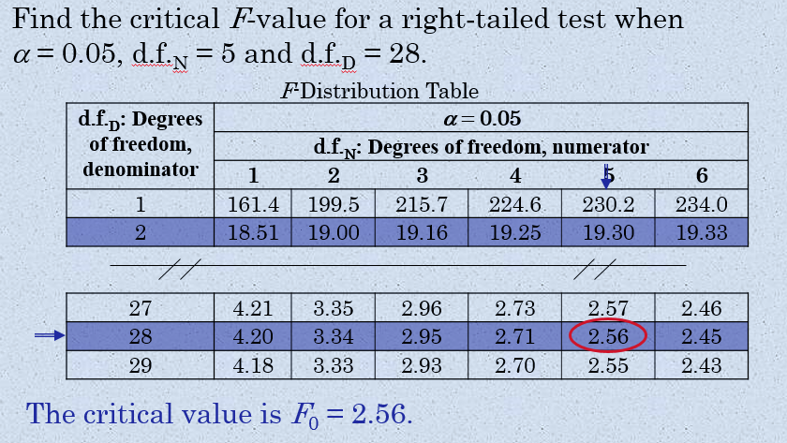
Chapter
10
Example

Slide 30
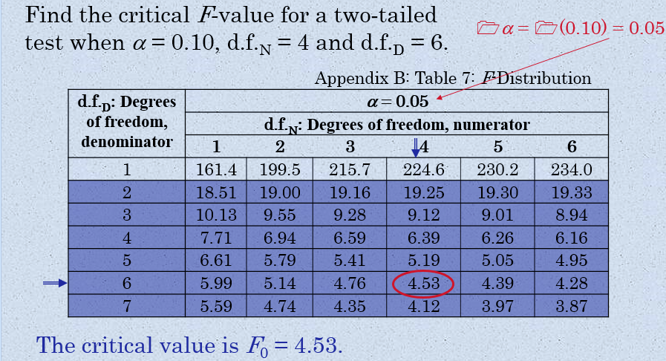
Chapter
10
Example

Slide 31
Chapter
10
Example

Slide 32
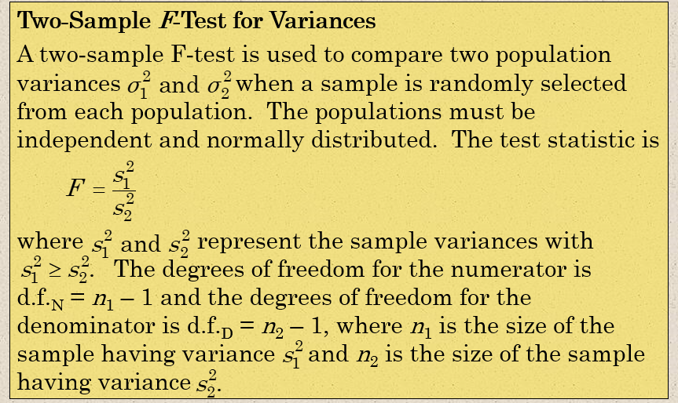
Chapter
10
Two-Sample F-Test for Variances

Slide 33

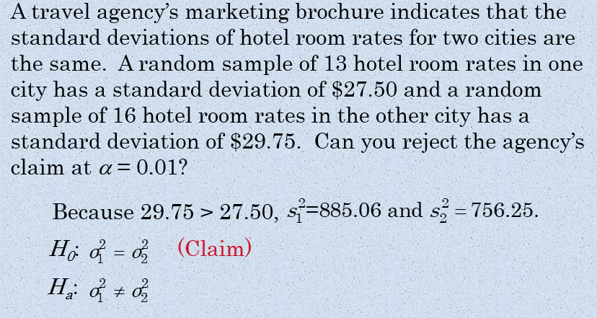
Chapter
10
Example:

Slide 34
Chapter
10
Example:

Slide 35
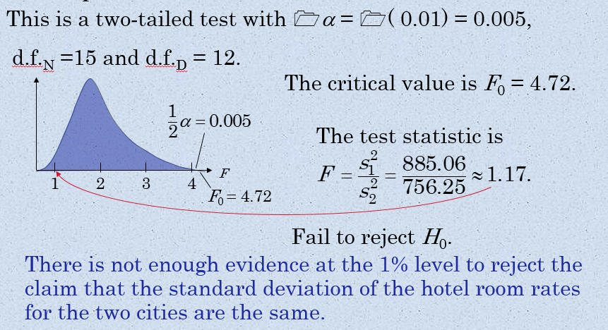
Chapter
10
Solution:

Slide 36
Chapter
10
10.4 Analysis of Variance (ANOVA)
One-way analysis of variance is a hypothesis-testing technique that is used to compare means from three or more populations. Analysis of variance is usually abbreviated ANOVA.
In a one-way ANOVA test, the following must be true:
Each sample must be randomly selected from a normal, or approximately normal, population.
The samples must be independent of each other.
Each population must have the same variance.

Slide 37


Chapter
10
Analysis of Variance (ANOVA)
The variance between samples MS_{B} measures the differences related to the treatment given to each sample and is sometimes called the mean square between.
The variance within samples MS_{W} measures the differences related to entries within the same sample. This variance, sometimes called the mean square within, is usually due to sampling error.

Slide 38
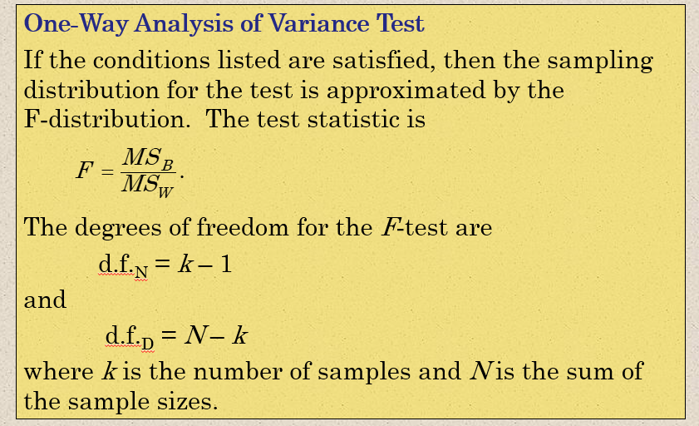
Chapter
10
Analysis of Variance (ANOVA)

Slide 39
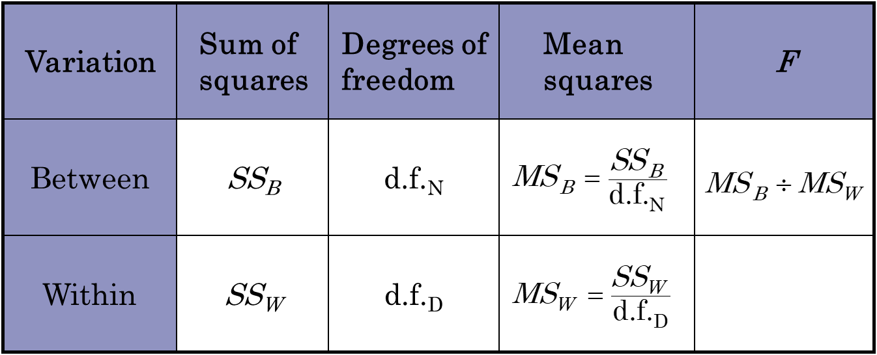
Chapter
10
ANOVA summary Table
A table is a convenient way to summarize the results in a one-way ANOVA test.

Slide 40
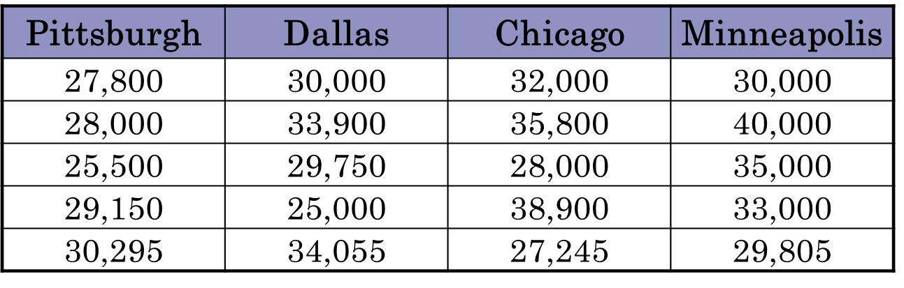
Chapter
10
Example
The following table shows the salaries of randomly selected individuals from four large metropolitan areas. At α = 0.05, can you conclude that the mean salary is different in at least one of the areas? (Adapted from US Bureau of Economic Analysis)

Slide 41
Chapter
10
Solution
1- State H0 and Ha
2- Critical value is F0
3- Test statistics F using ANOVA table

Slide 42
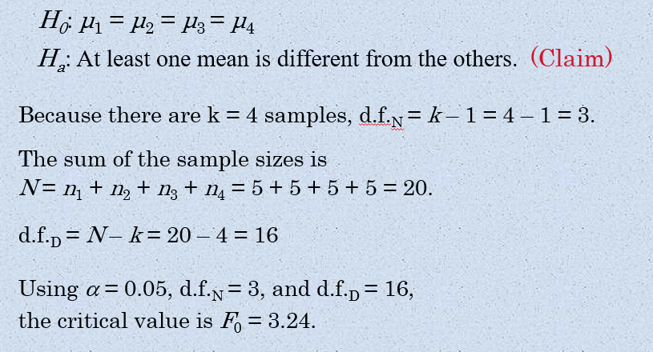
Chapter
10
Solution

Slide 43
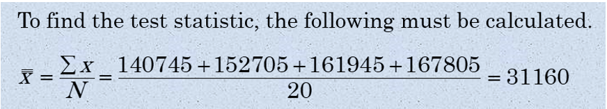
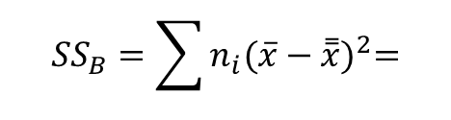

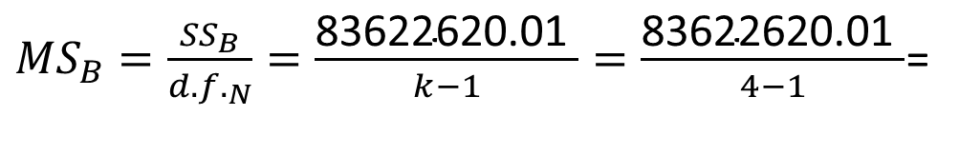

Chapter
10
Solution

Slide 44
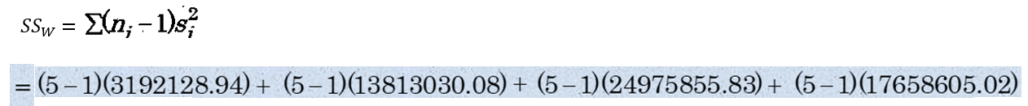
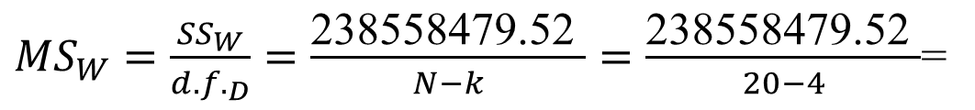

Chapter
10
Solution
=238558479.52

Slide 45
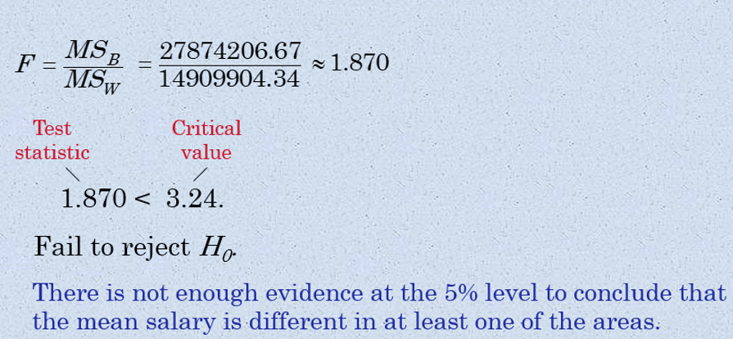
Chapter
10
Solution

Slide 46
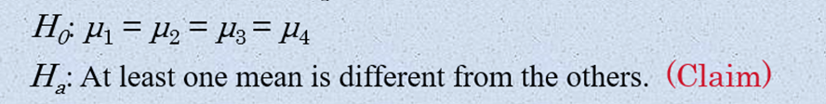

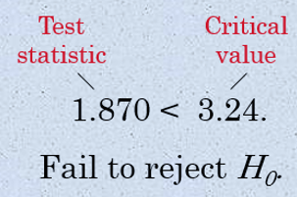
Chapter
10
Solution
Step 1:
Step 2: The Critical value F0=3.24 ( From F Table )
Step 4: Decision

Slide 47

Chapter
10
Solution
Variation | Sum of Squares | Degrees of freedom | Mean Squares | F
Between
Within

Slide 48
Chapter
10
Chapter Summary
10.1 Goodness of Fit (Chi-Square)
10.2 Independence (Chi-Square)
10.3 Comparing Two Variances (F-distribution)
10.4 Analysis of Variance (F-distribution)

Slide 49

Chapter
10
Thank you

