Slide 1

Prepared by
Dr. Hamada I. AbdulWakel
Lecture 10
CYB615
Network Programming

Slide 2
Module10: File Transfer Protocol Using
Python

Slide 3


Lecture 10
Agenda
The File Transfer Protocol.
FTP Python Module.
Creating an FTP Client.

Slide 4
Lecture 10
The File Transfer Protocol
FTP is a standard internet protocol provided by TCP/IP used for transmitting/downloading files between client and server.
FTP provides the sharing of files.
FTP overcomes the problem of transferring and translating file types between different operating systems.

Slide 5
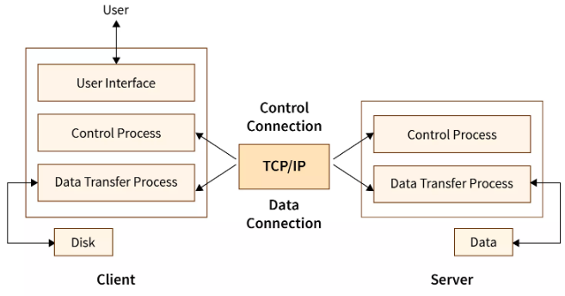
Lecture 10
Mechanism of FTP

Slide 6
Lecture 10
Mechanism of FTP
Cont'd
FTP client has three components:
  The user interface.
  The control process.
  The data transfer process.
The server has two components:
  The server control process.
  The server data transfer process.

Slide 7
Lecture 10
Mechanism of FTP
Cont'd
The control connection:
  Uses very simple rules for communication.
  Remains opened during the entire interactive FTP session.
The data transfer connection:
  Uses very complex rules as data types may vary.
  Opens when a command comes for transferring the files and closes when the file is transferred.

Slide 8
Lecture 10
Some FTP Commands in Control Connection
OPEN: used to open new connection with the server.
USER: sends the user identification to the server.
PASS: sends the user password to the server.
CWD: allows the user to work with a different directory without altering his login information.
MKD: causes the directory specified in the path-name to be created as a directory.
PUT: used to put a file in the server.
CLOSE: used to close connection with the server.

Slide 9
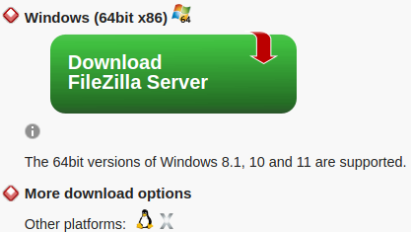
Lecture 10
Working with Local FTP Server
Download Filezilla server.
Run the executable and complete the installation. While installation, set the server administration password and remember the server administration port.

Slide 10
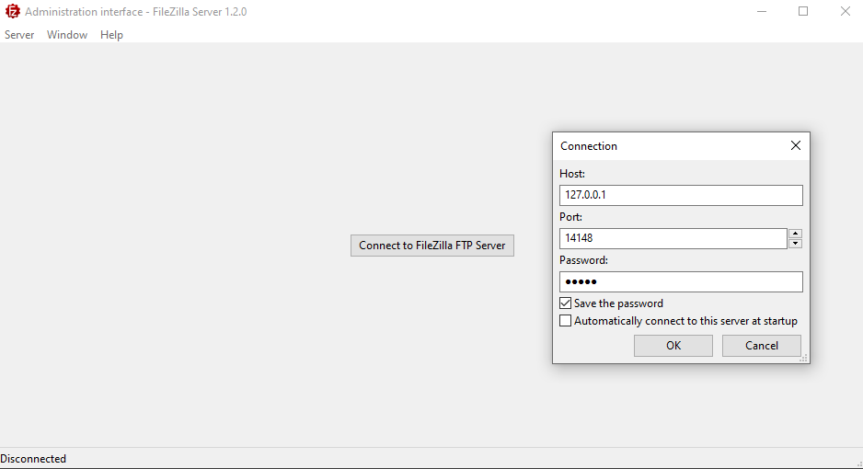
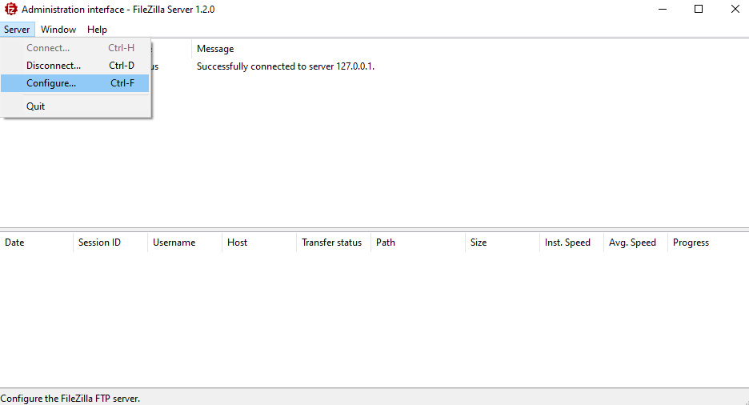
Lecture 10
Working with Local FTP Server
Cont'd

Slide 11
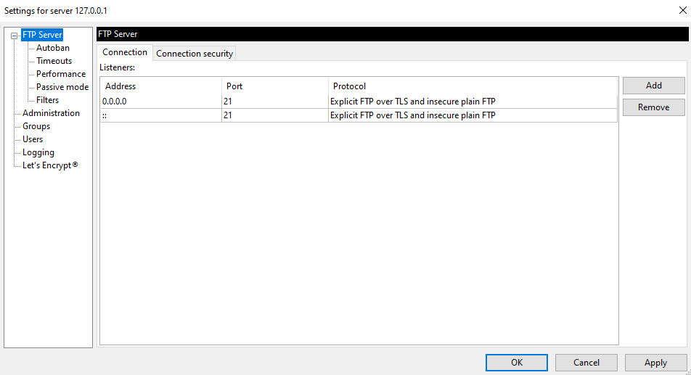
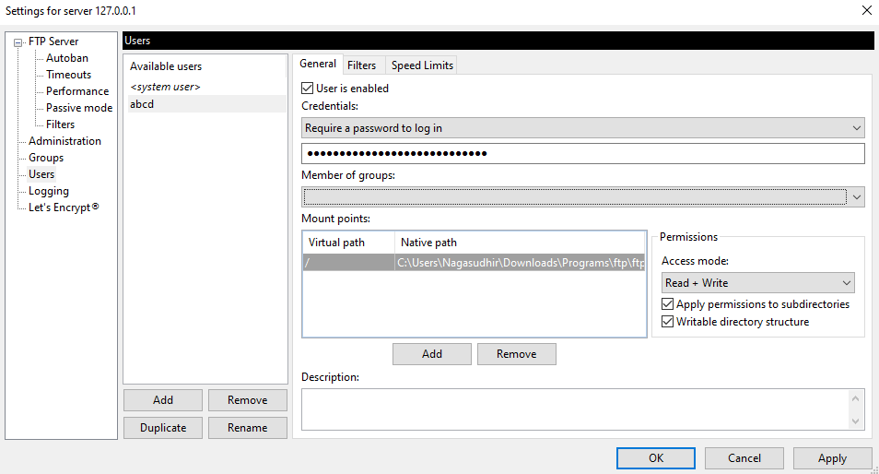
Lecture 10
Working with Local FTP Server
Cont'd

Slide 12
Lecture 10
FTP Python Module
Python provides FTP module in its standard library called ftplib that implements the client side of the FTP protocol.
Features:
  Connecting to an FTP server.
  Navigating its structure.
  Downloading files from the FTP server.
  Uploading files to an FTP server.

Slide 13
Lecture 10
ftplib Basic Methods
FTP(): create an FTP client instance.
FTP_TLS(): create an FTP client instance under a secure connection.
connect(): connect to an FTP server.
login(): login to an FTP server.
prot_p(): used with a secure FTP connection.
pwd(): get current working directory in FTP server.
cwd(): change the working directory.
nlst(): return a list of file and folder names in a working directory.

Slide 14
Lecture 10
ftplib Basic Methods
Cont'd
storbinary(): used to upload a file to an FTP server.
retrbinary(): used to download a file from an FTP server.
rename(): rename a file or folder in an FTP server.
delete(): delete a file or folder from an FTP server.
rmd(): delete a folder from an FTP server.
mkd(): create a folder in an FTP server.
size(): return the size of a file in an FTP server.
quit(): close an FTP server connection.

Slide 15
Lecture 10
Connection to a Local FTP Server
Connection steps:
  Set up connection parameters.
  Create an FTP client instance.
  Connect to FTP server.
  Login to FTP server.
  Perform required operation on FTP server.
  Close connection.

Slide 16
Lecture 10
Connection to A Local FTP Server Code
import ftplib
ftphost = "localhost"
ftpport = 21
ftpusername = "yourUserName"
ftppassword = "youPassword"
# # of seconds the server waits before ending the connection with the client.
ftp = ftplib.FTP(timeout=30) # to increase connection time
ftp.connect(ftphost, ftpport)
ftp.login(ftpusername, ftppassword)
ftp.quit()
print("FTP handling performed successfully")

Slide 17
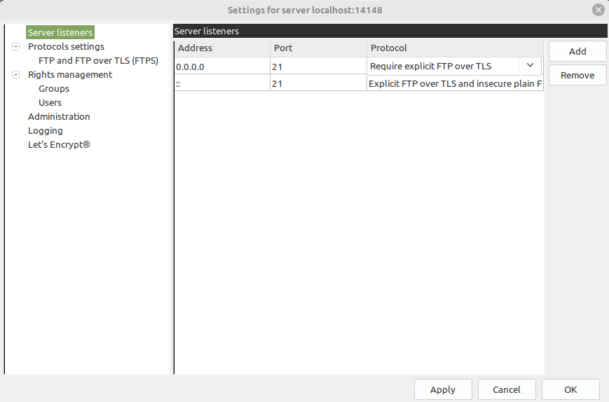
Lecture 10
Securing The FTP Server Connection

Slide 18
Lecture 10
Securing The FTP Server Connection Code
import ftplib
ftphost = "localhost"
ftpport = 21
ftpusername = "yourUserName"
ftppassword = "youPassword"
ftp = ftplib.FTP_TLS(timeout=30)
ftp.connect(ftphost, ftpport)
ftp.login(ftpusername, ftppassword)
ftp.prot_p()
ftp.quit()
print("FTP handling performed successfully")

Slide 19
Lecture 10
Performing Operations with FTP Connection
ftp.login(ftpusername, ftppassword)
#ftplib.error_perm
ftp.cwd('/mnt/3126D/Codes')
ftp.cwd('/test')
ftp.cwd('/testt')
ftp.pwd()
fileNames = ftp.nlst()
print(fileNames)
ftp.quit()
print("FTP handling performed successfully")

Slide 20
Lecture 10
Performing Operations with FTP Connection
Cont'd
ftp.login(ftpusername, ftppassword)
with open("message.txt", 'rb') as file:
rescode = ftp.storbinary("STOR message.txt", file, blocksize= 1024*1024)
if rescode.startswith("226"):
print("File uploaded seccussefuly")
else:
print("File not uploaded!")
ftp.quit()
print("FTP handling performed successfully")

Slide 21
Lecture 10
Performing Operations with FTP Connection
Cont'd
ftp.login(ftpusername, ftppassword)
with open("message.txt", 'wb') as file:
rescode = ftp.retrbinary("RETR message.txt", file.write)
if rescode.startswith("226"):
print("File downloaded seccussefuly")
else:
print("File not downloaded!")
ftp.quit()
print("FTP handling performed successfully")

Slide 22
Lecture 10
Performing Operations with FTP Connection
Cont'd
ftp.login(ftpusername, ftppassword)
ftp.rename("oldFileName.extension", "newFileName.extension")
ftp.delete("fileName.extension")
ftp.mkd("folderName")
ftp.rmd("folderName")
print(ftp.size("fileName.extension"))
print(ftp.dir())
ftp.quit()
print("FTP handling performed successfully")

Slide 23
THANK YOU

