Slide 1


Slide 2
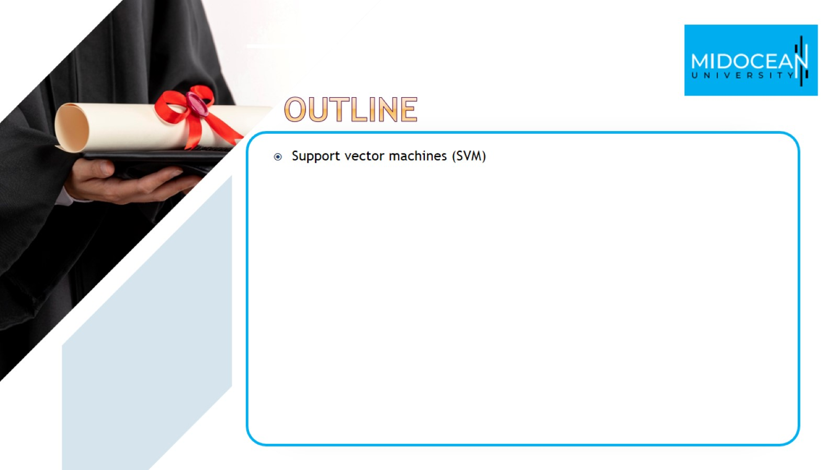

Slide 3
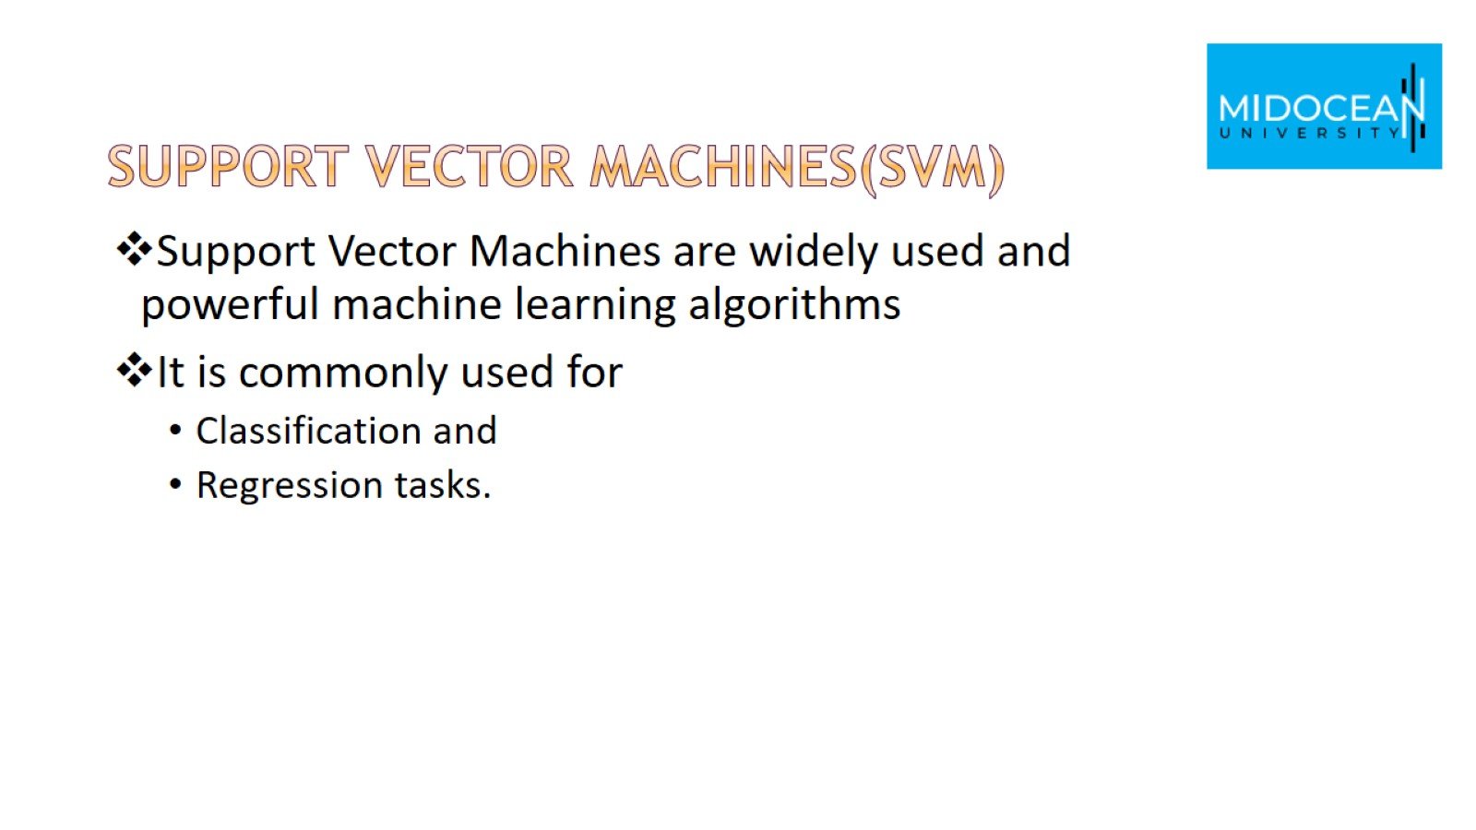
Support vector machines(SVM)

Slide 4
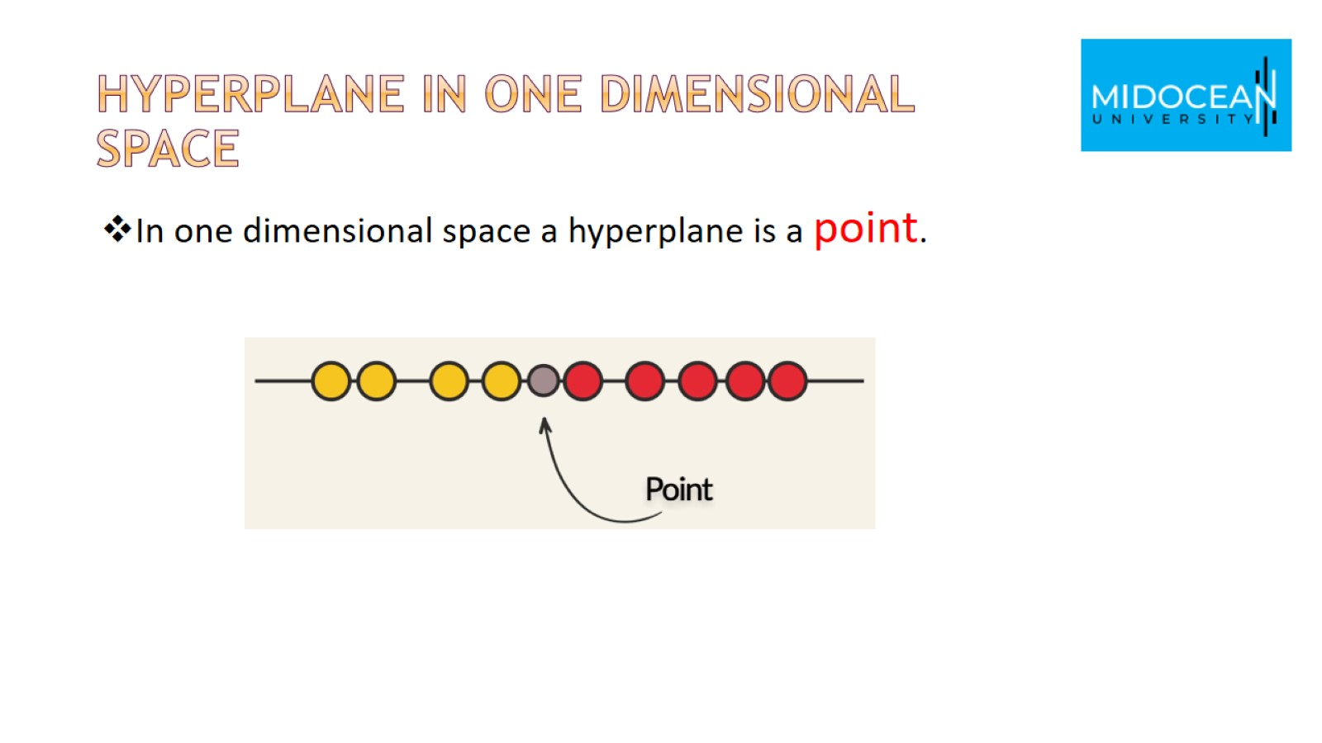
Hyperplane in one dimensional space

Slide 5
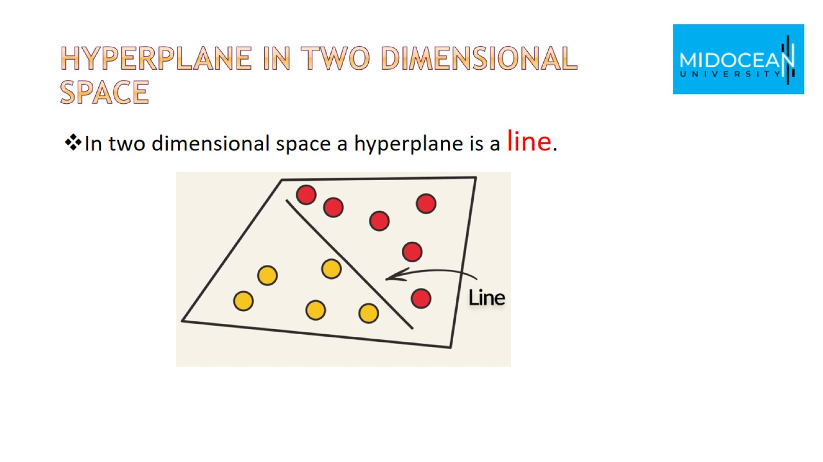
Hyperplane in two dimensional space

Slide 6
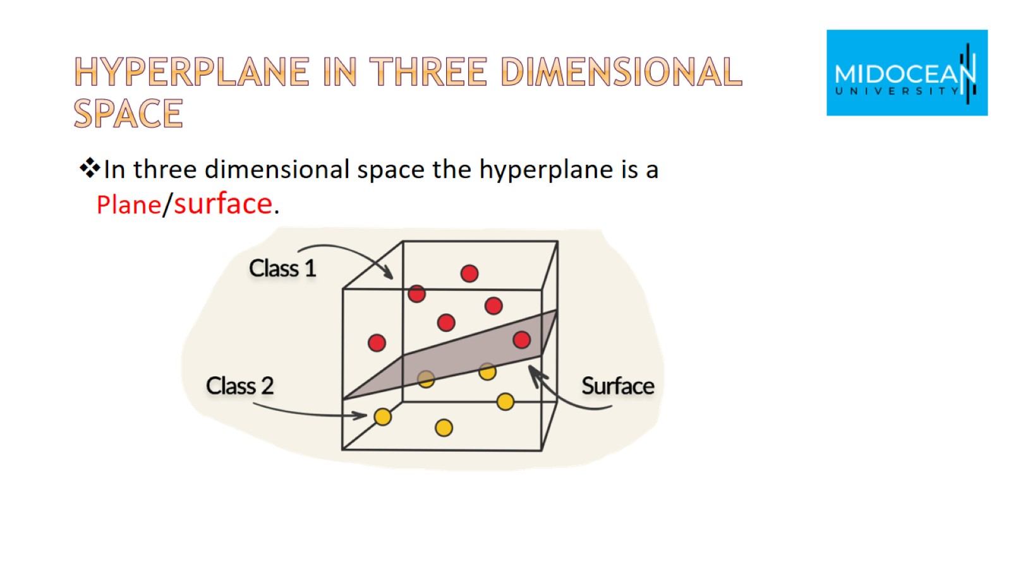
Hyperplane in Three dimensional space

Slide 7
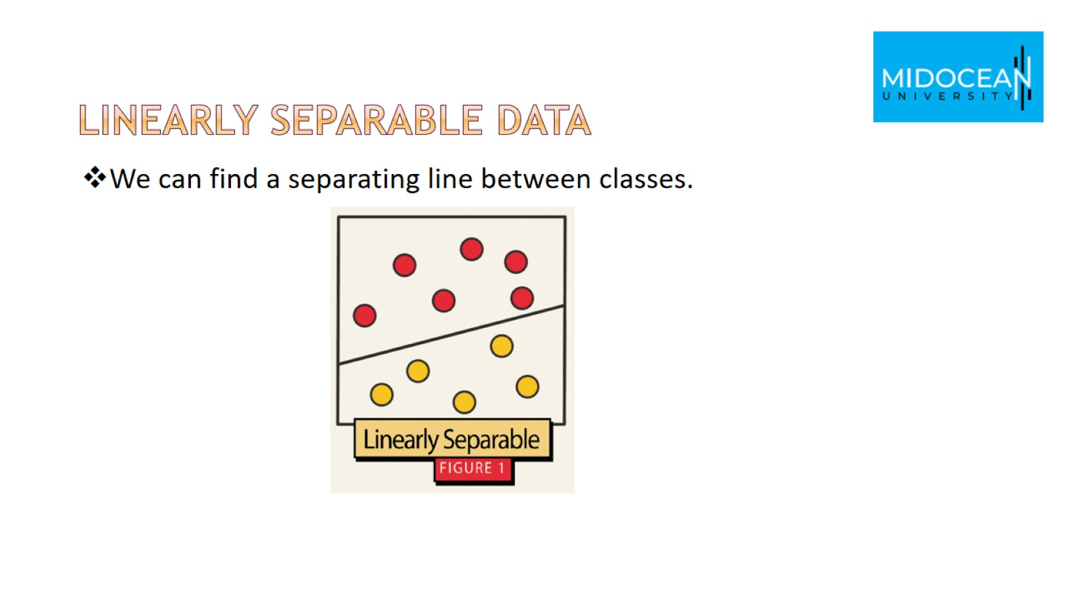
Linearly separable data

Slide 8
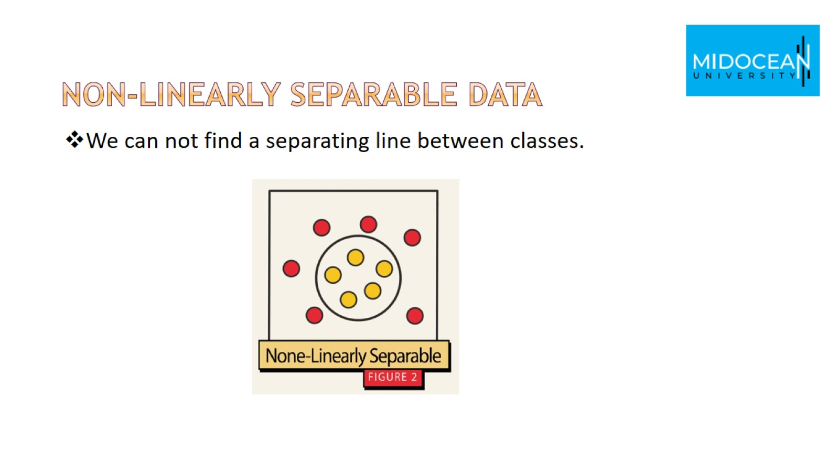
Non-linearly separable data

Slide 9
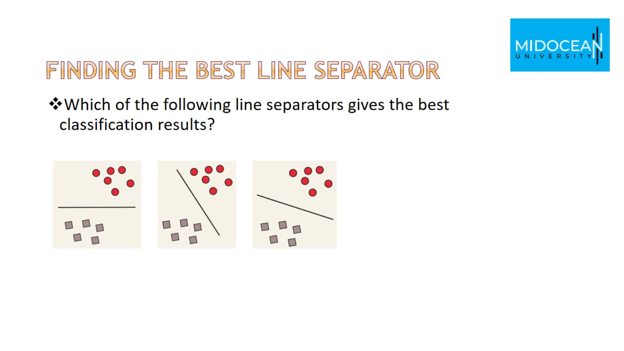
Finding the best line separator

Slide 10
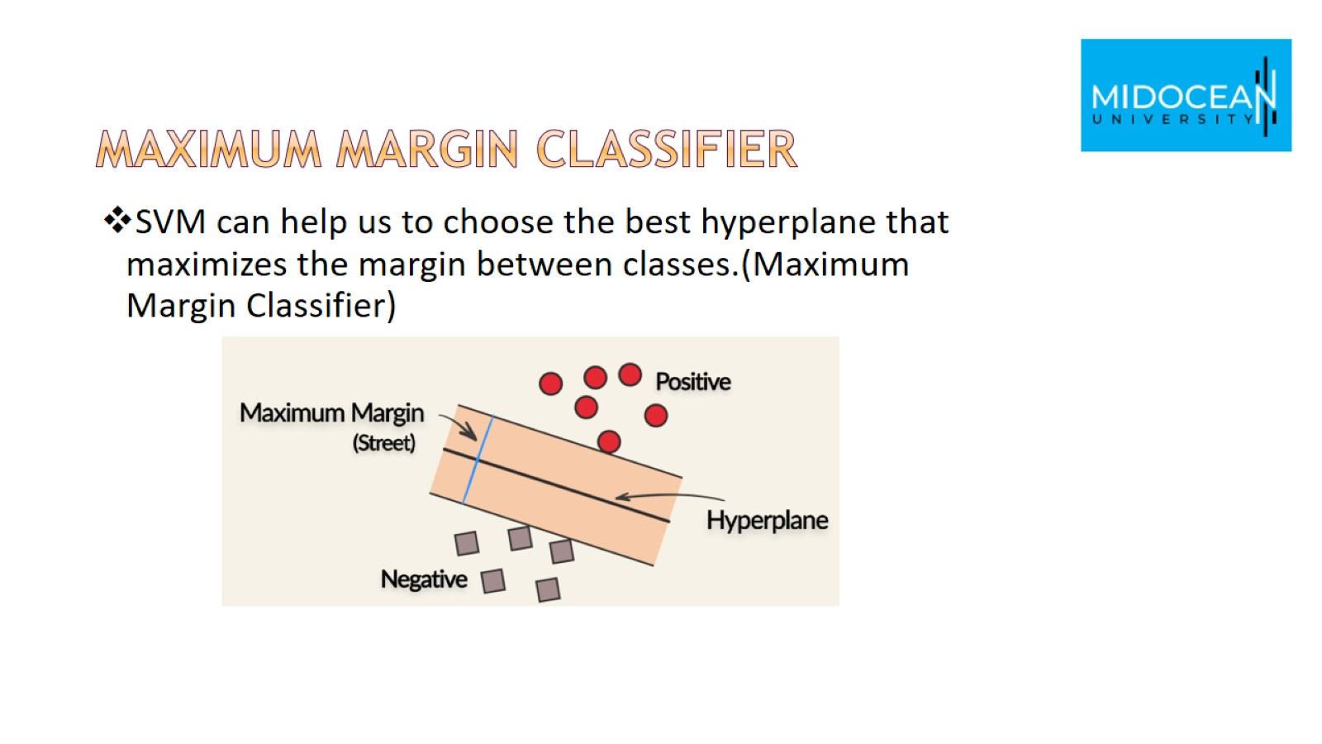
Maximum Margin Classifier

Slide 11
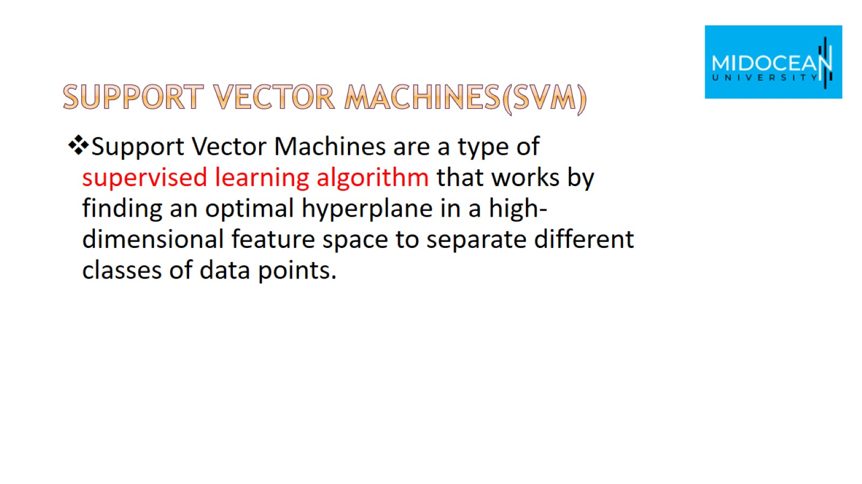
Support vector machines(SVM)

Slide 12
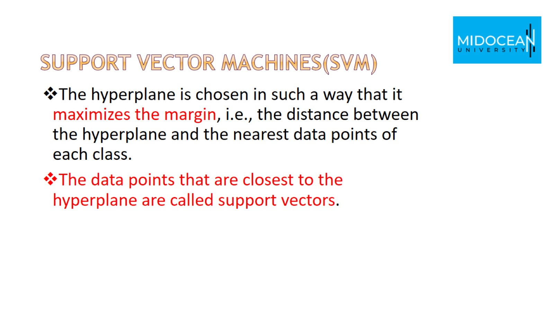
Support vector machines(SVM)

Slide 13
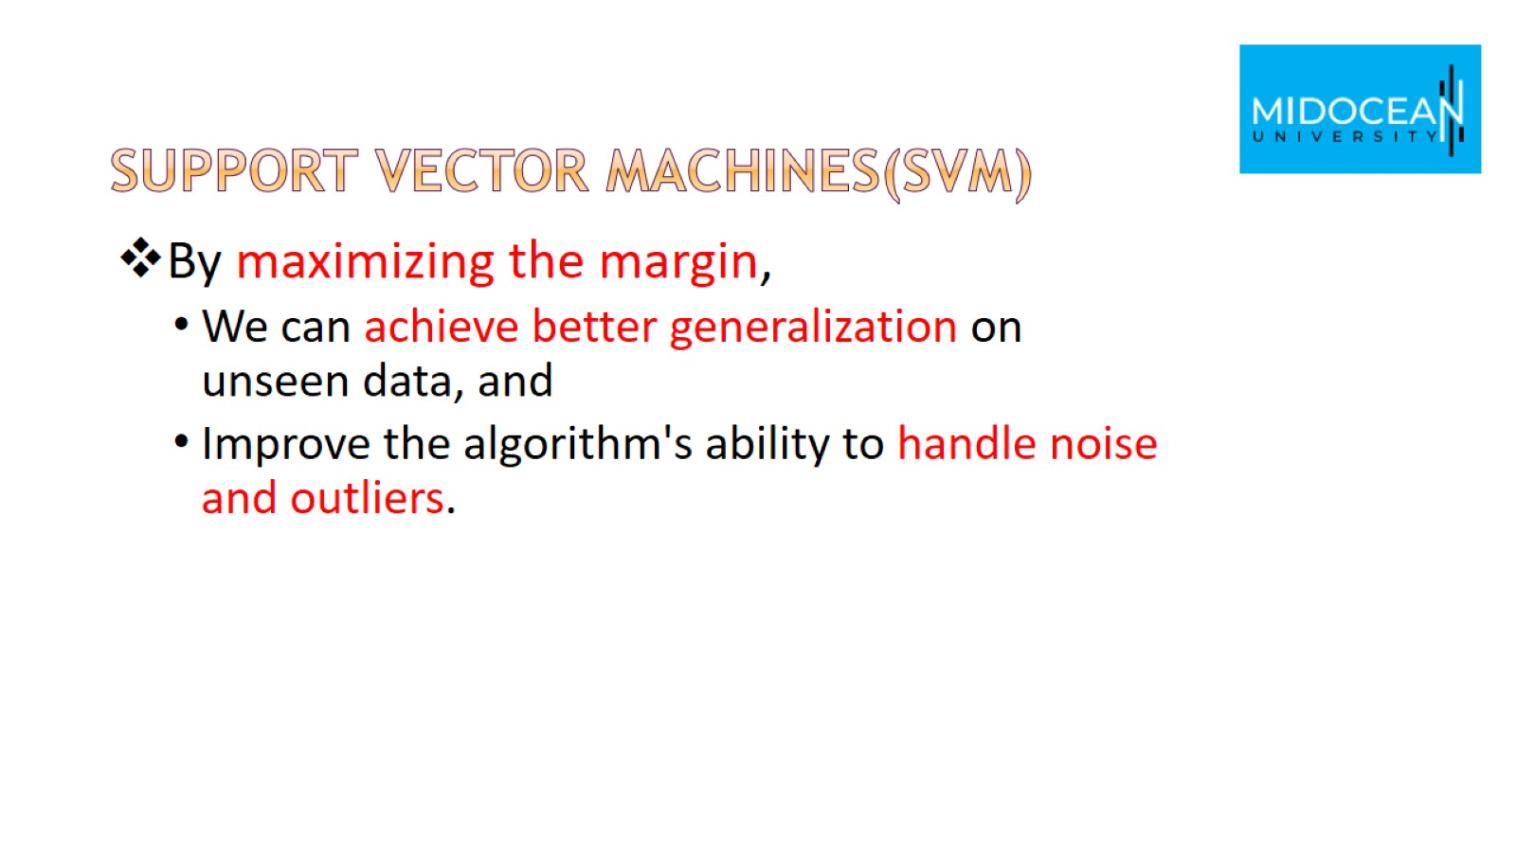
Support vector machines(SVM)

Slide 14
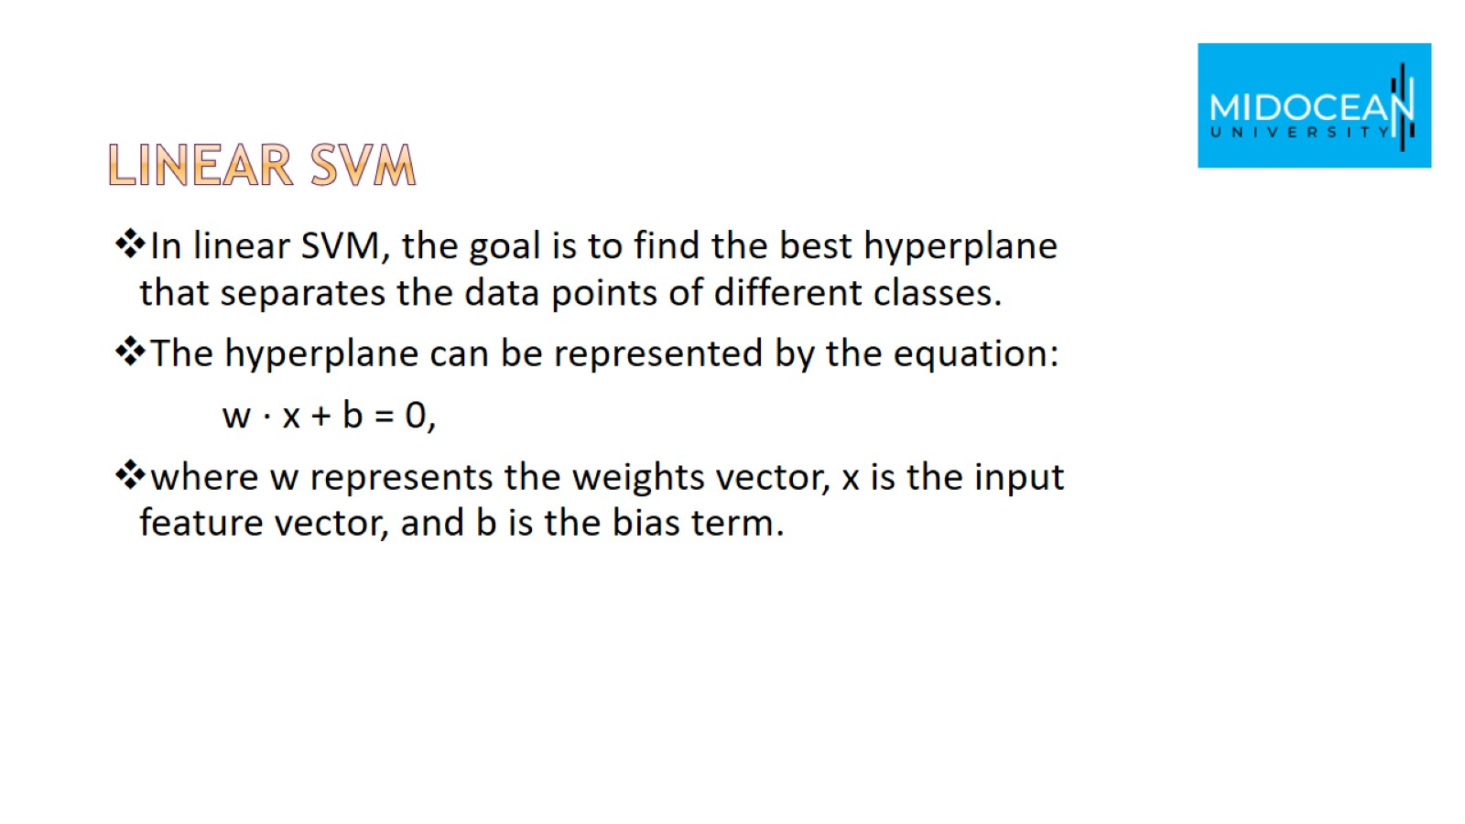
Linear SVM

Slide 15
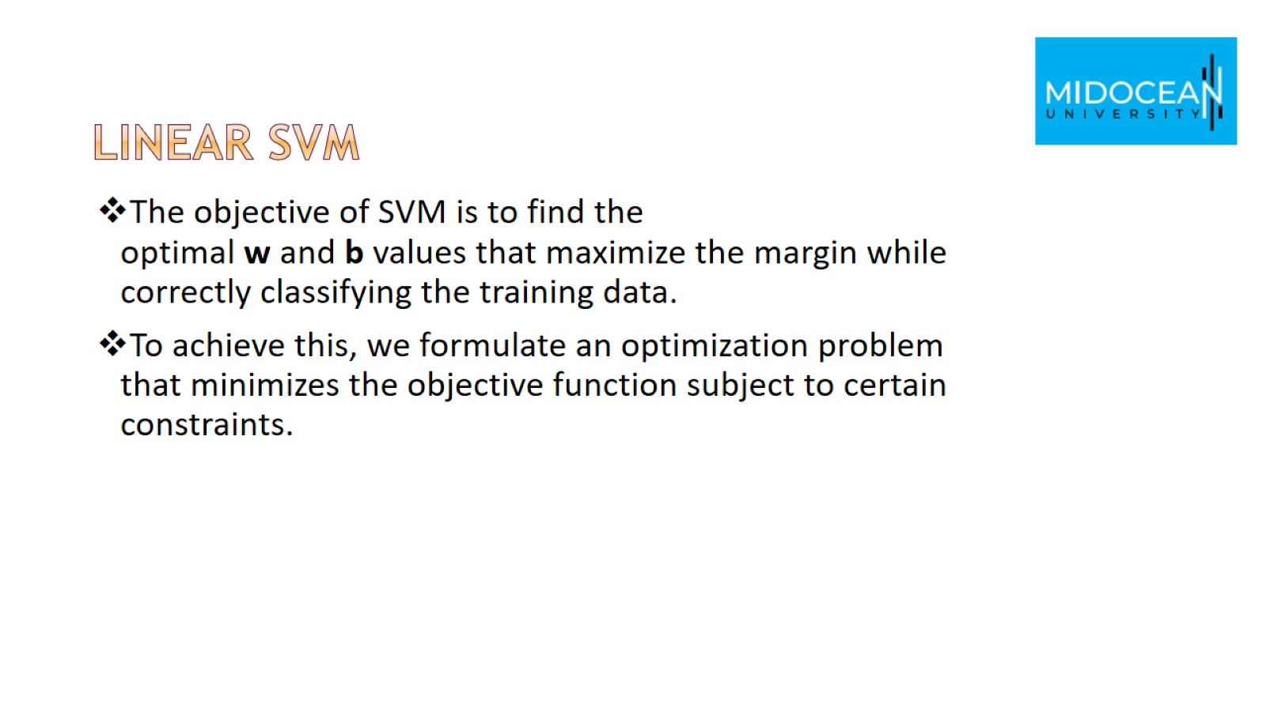
Linear SVM

Slide 16
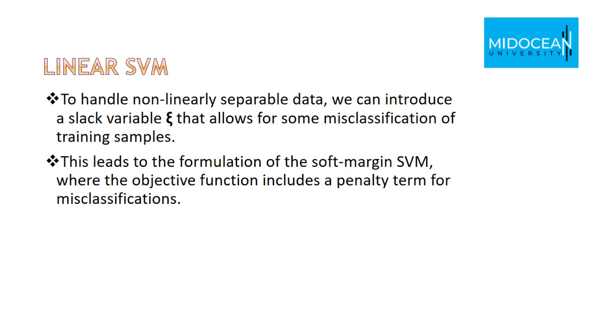
Linear SVM

Slide 17
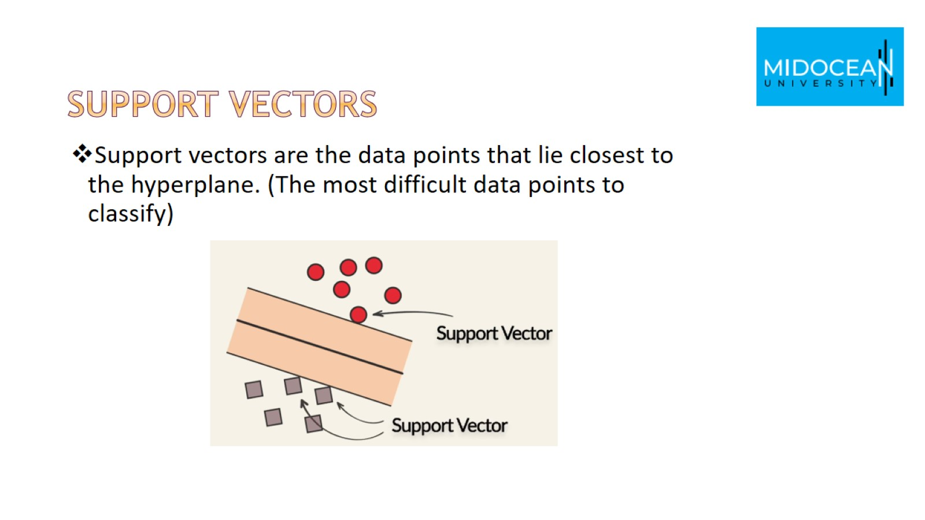
Support vectors

Slide 18
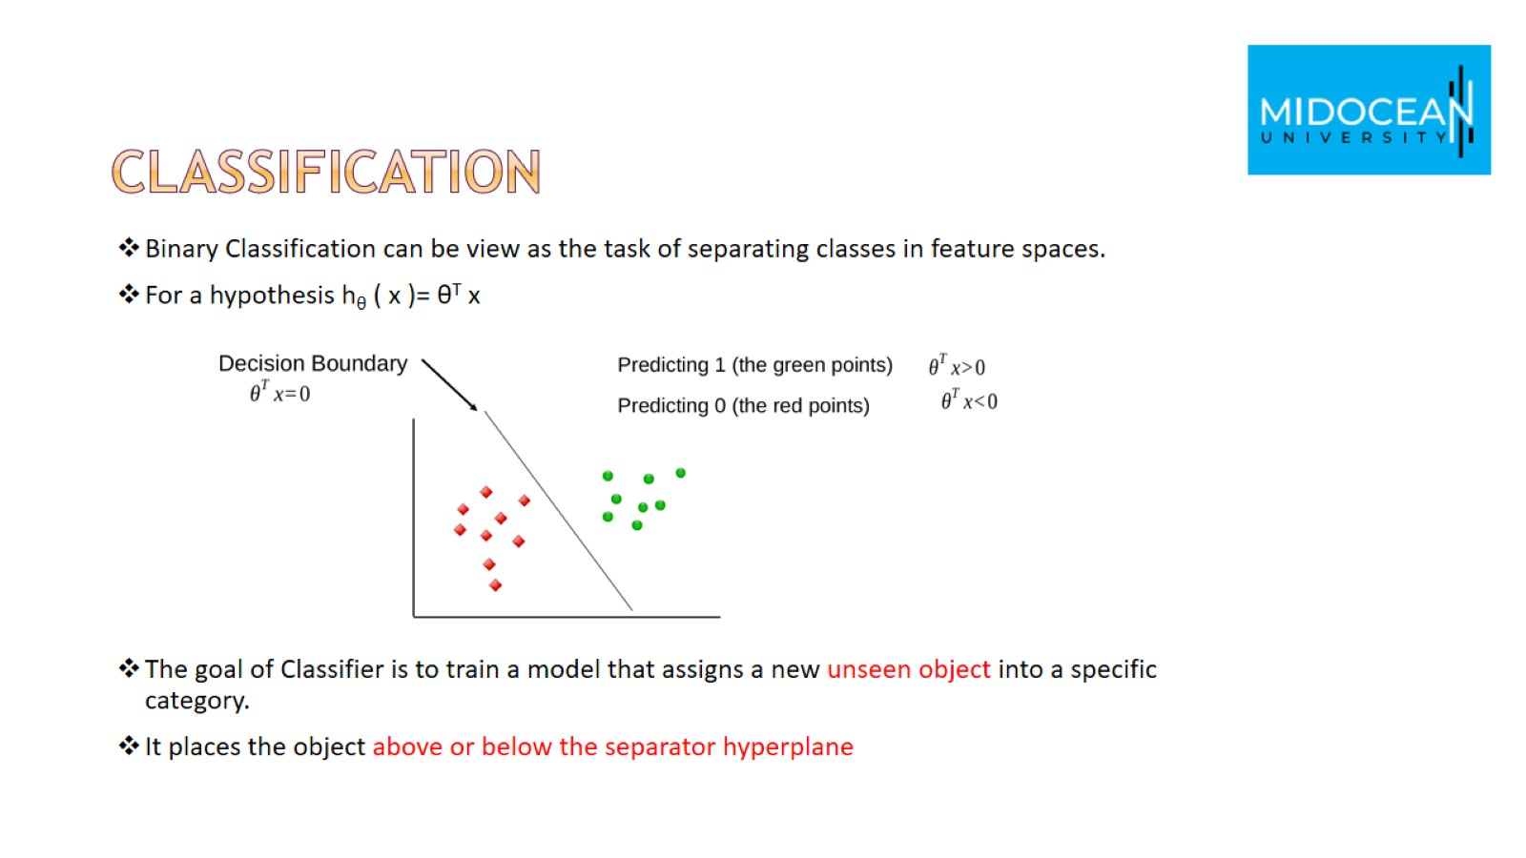
classification

Slide 19
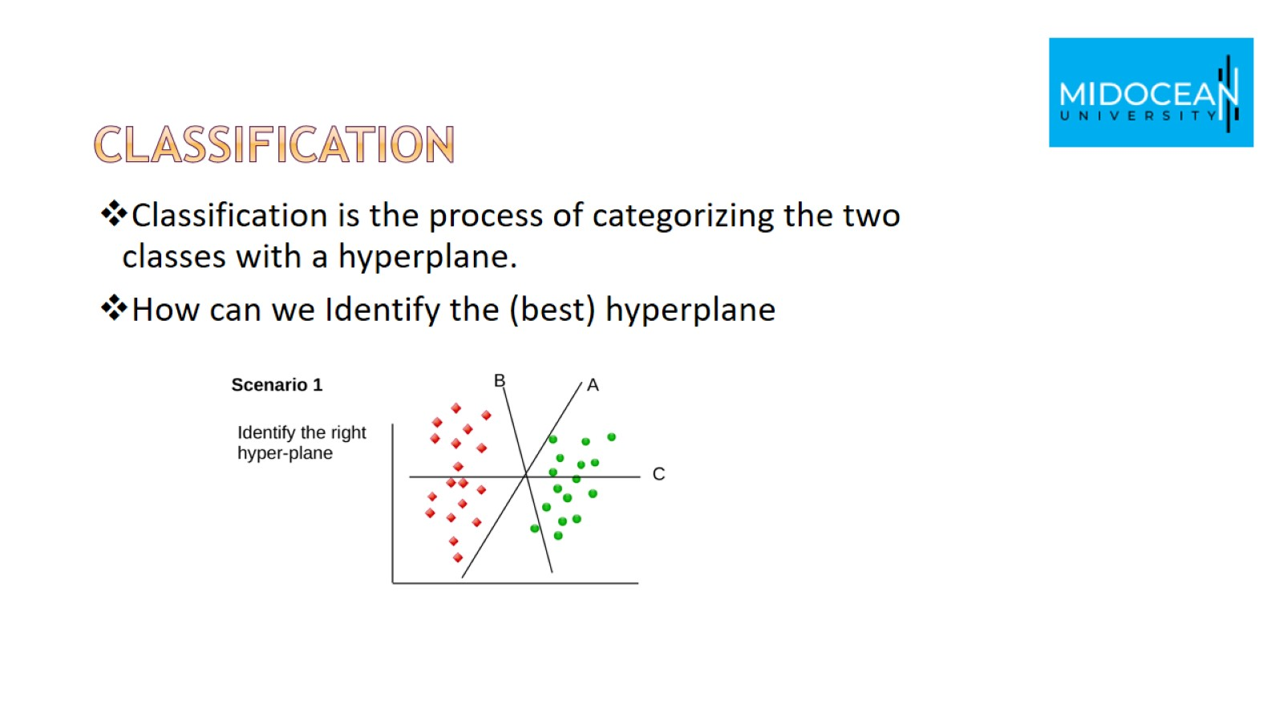
Classification

Slide 20
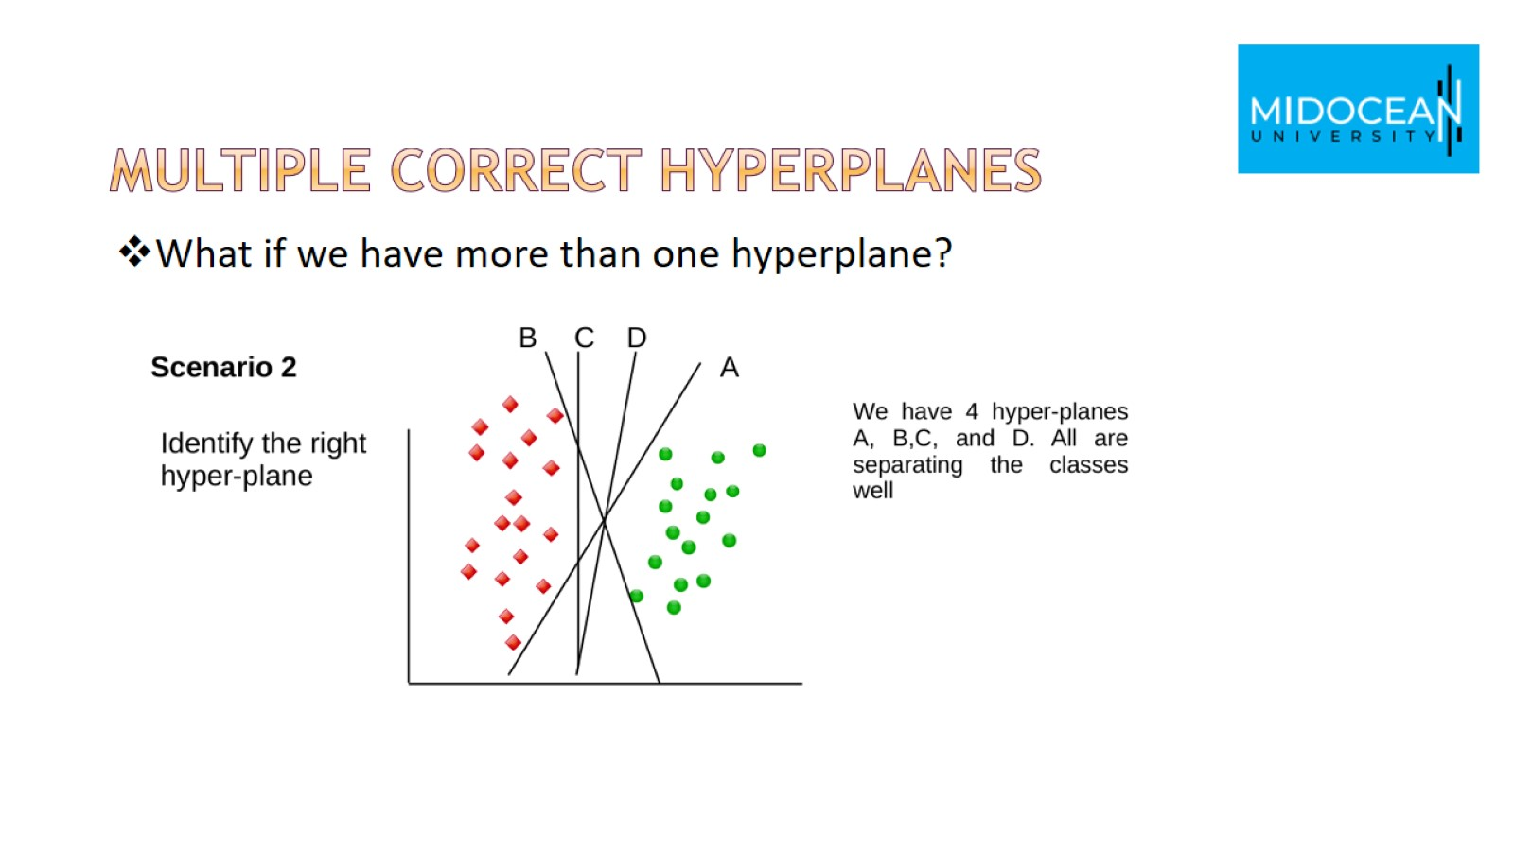
Multiple correct hyperplanes

Slide 21
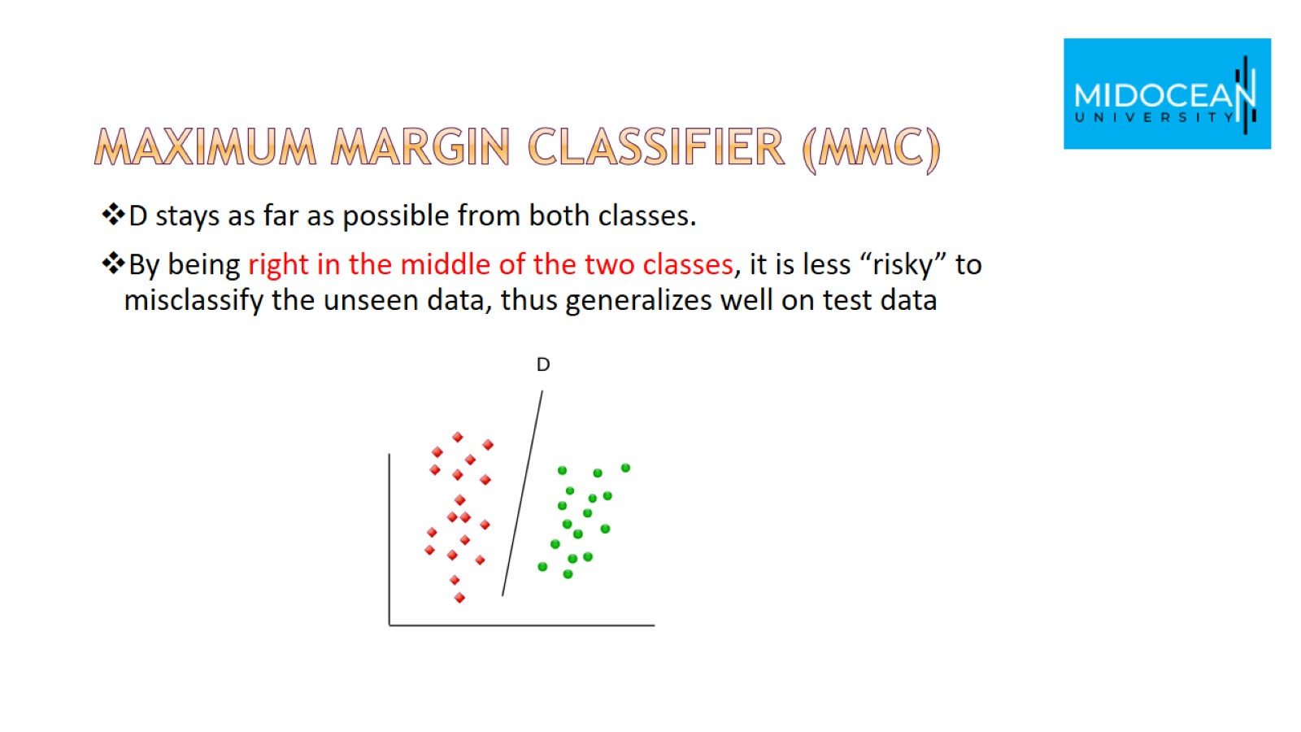
Maximum Margin Classifier (MMC)

Slide 22
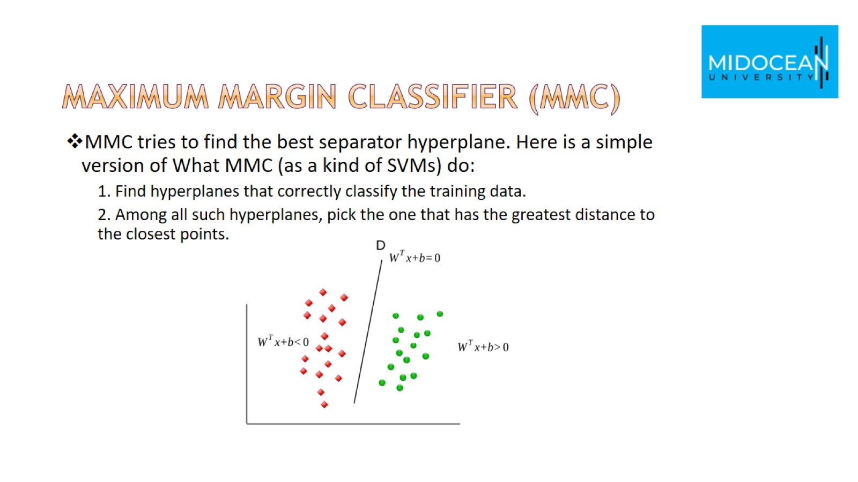
Maximum Margin Classifier (MMC)

Slide 23
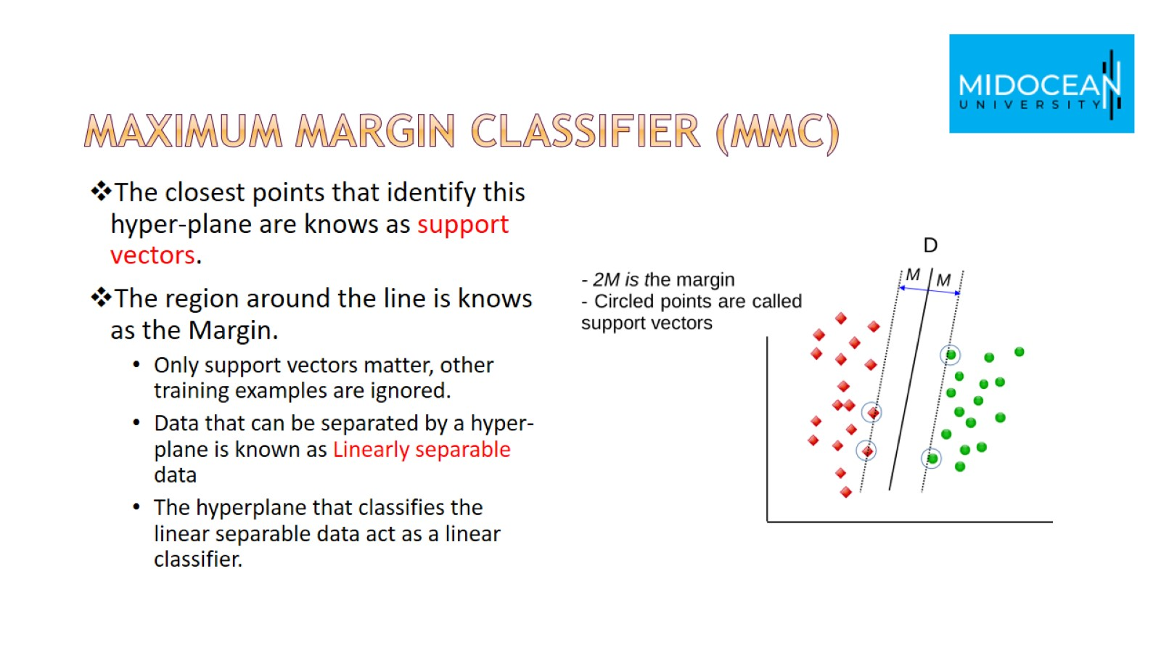
Maximum Margin Classifier (MMC)

Slide 24
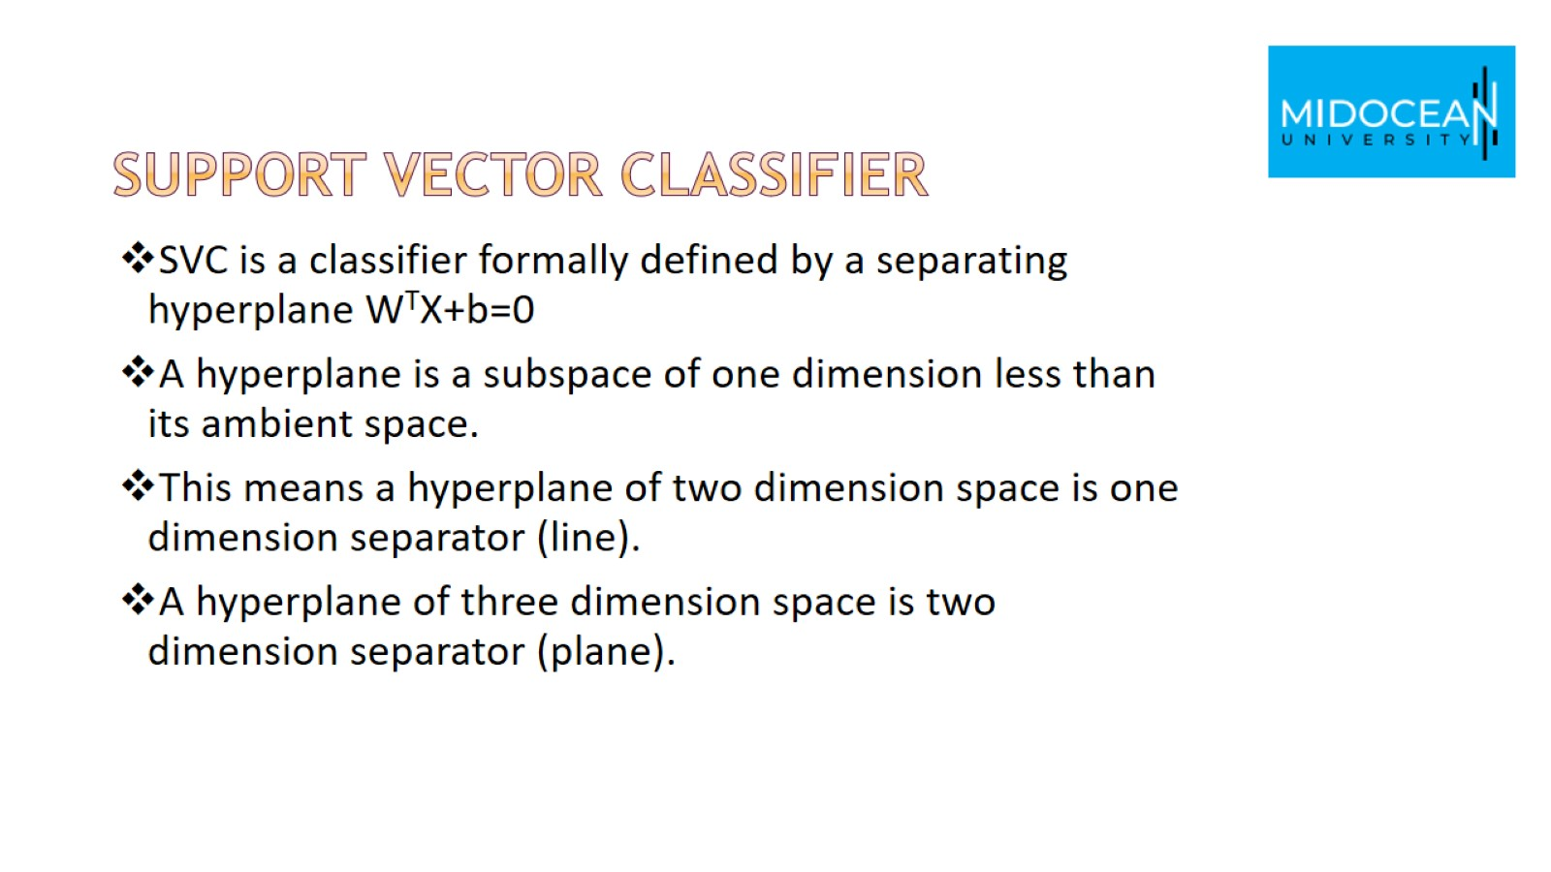
Support vector classifier

Slide 25
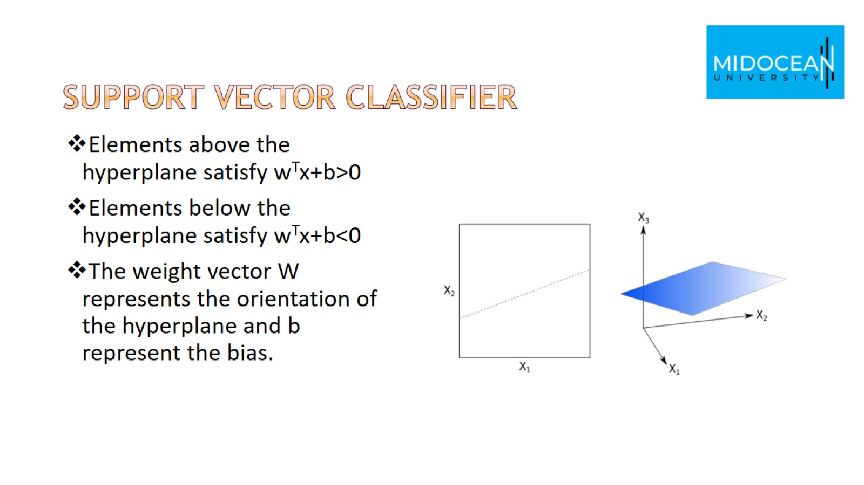
Support vector classifier

Slide 26
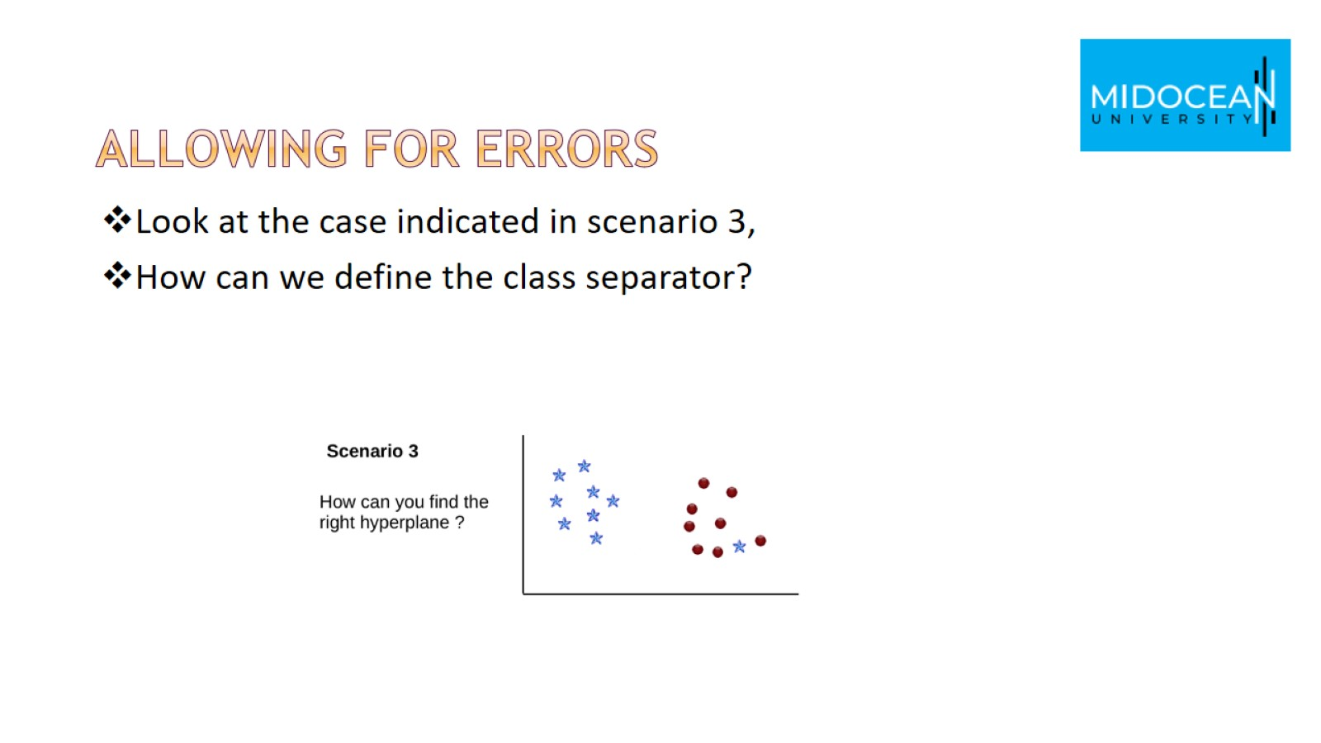
Allowing for Errors

Slide 27
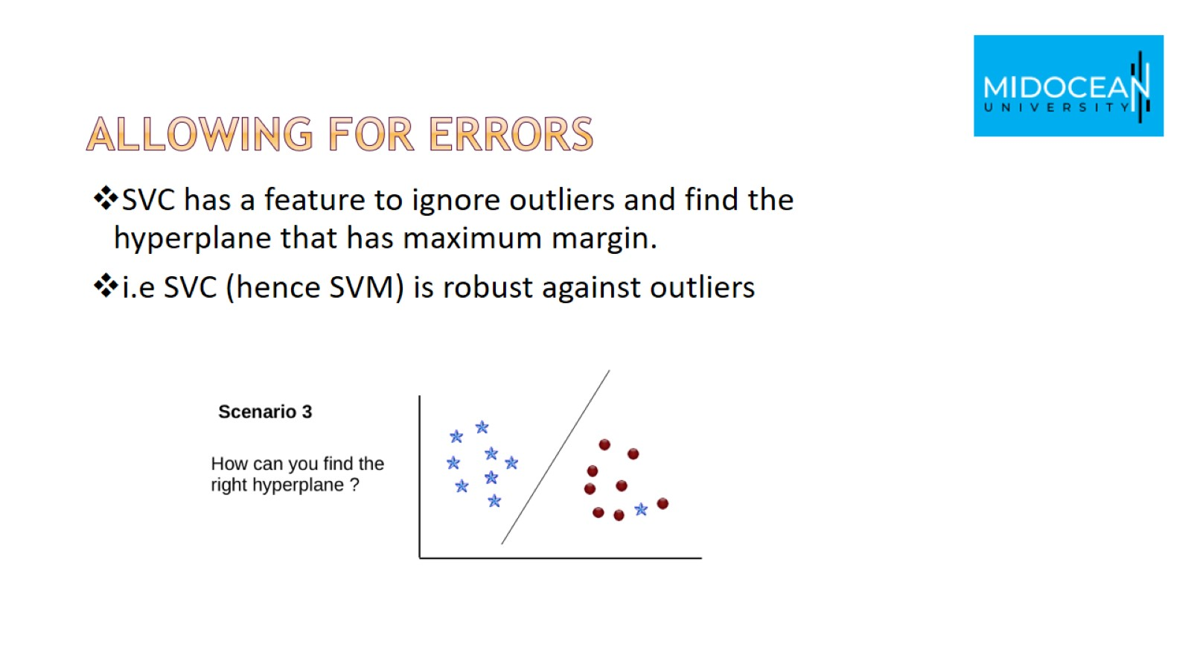
Allowing for Errors

Slide 28
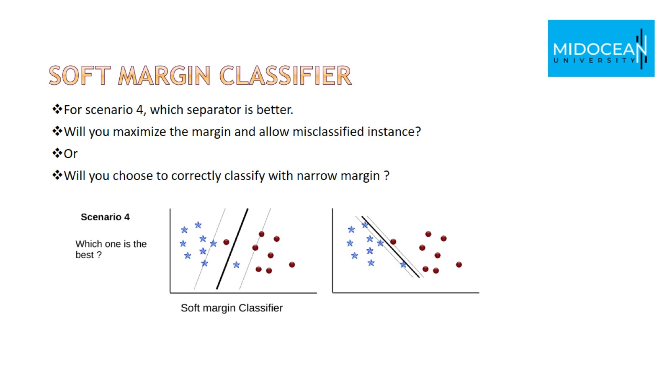
Soft margin classifier

Slide 29
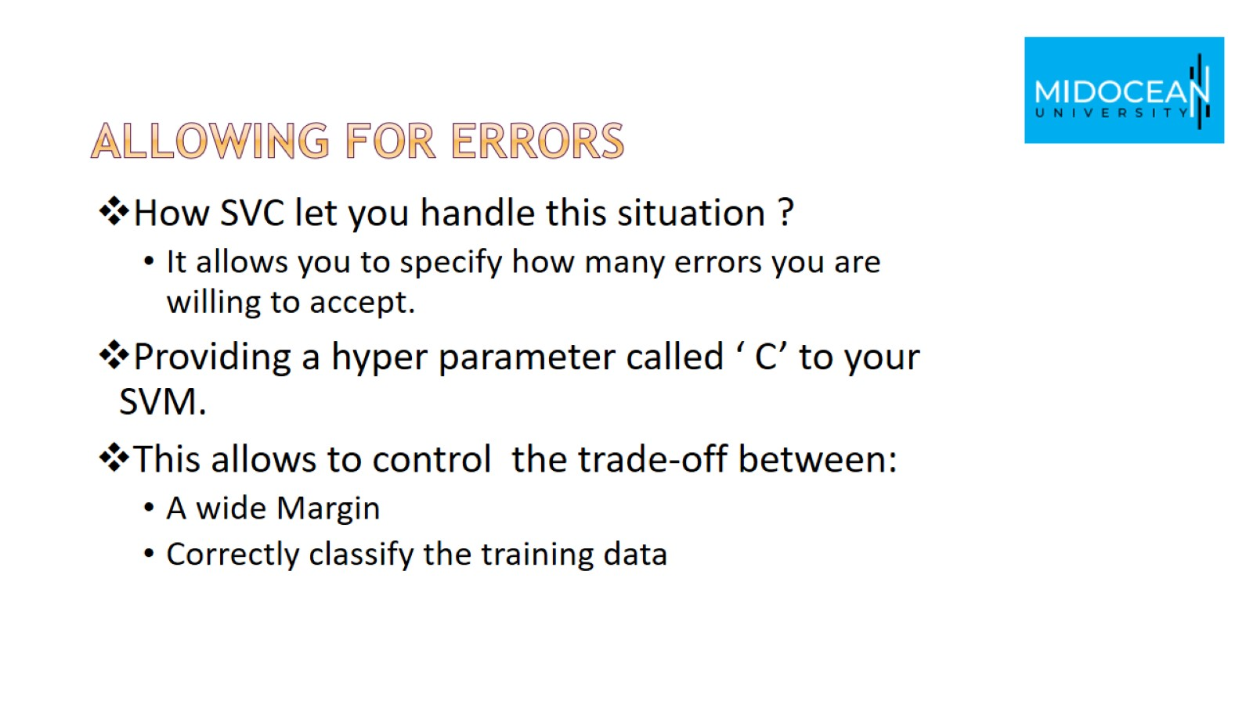
Allowing for Errors

Slide 30
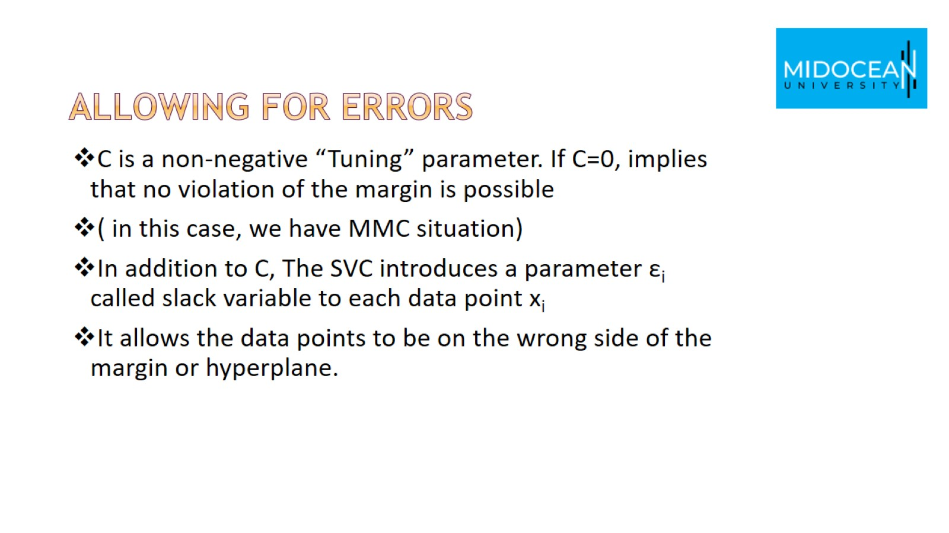
Allowing for Errors

Slide 31
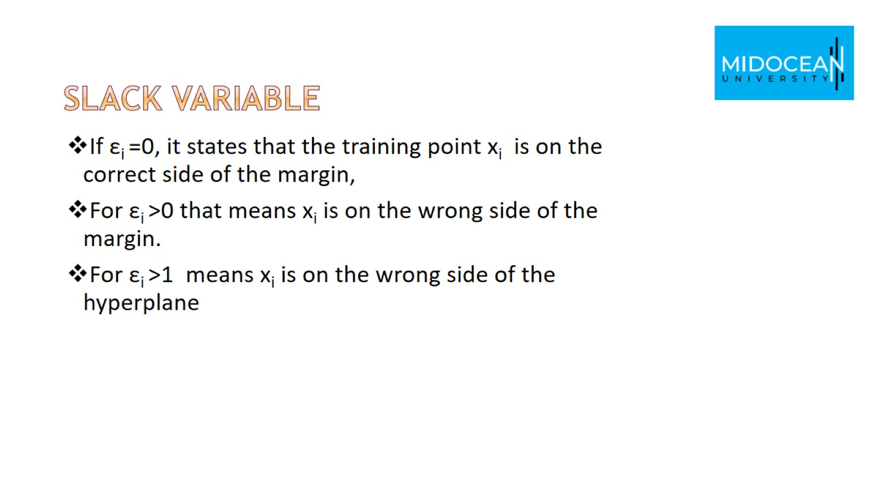
Slack variable

Slide 32
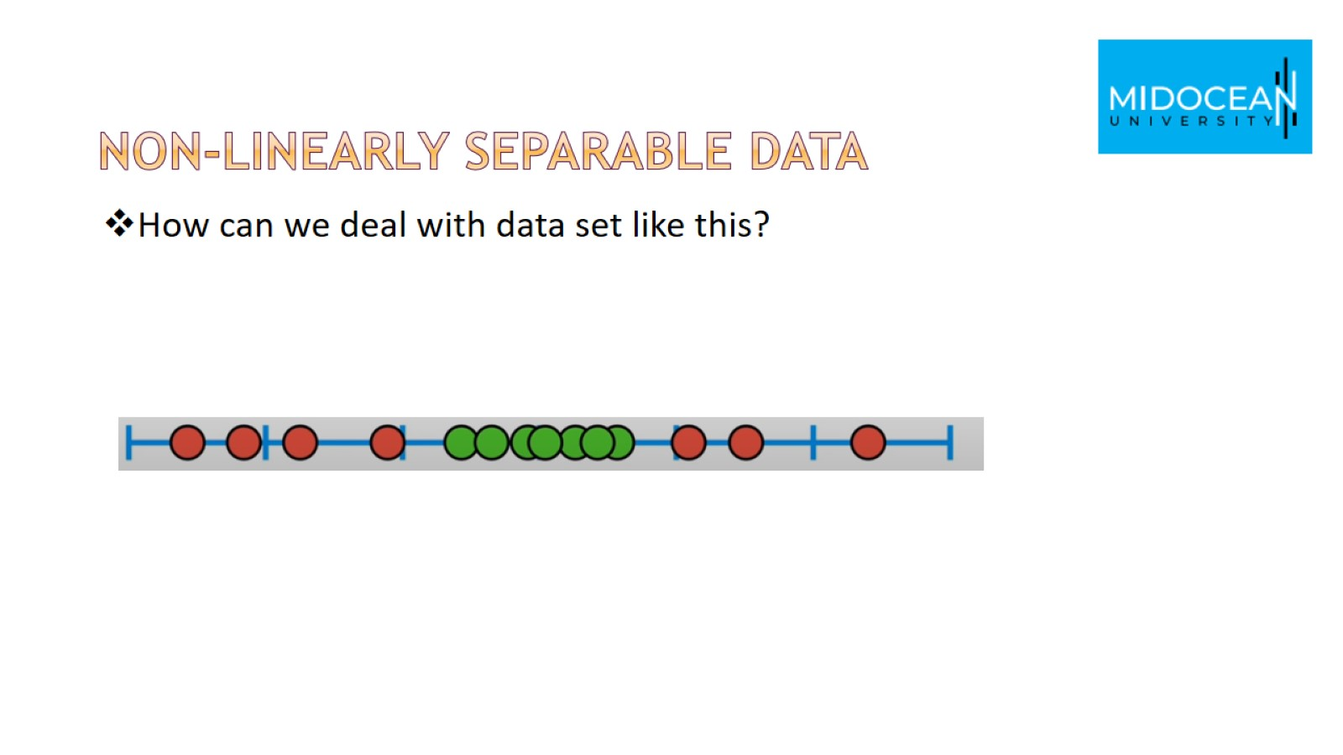
Non-linearly separable data

Slide 33
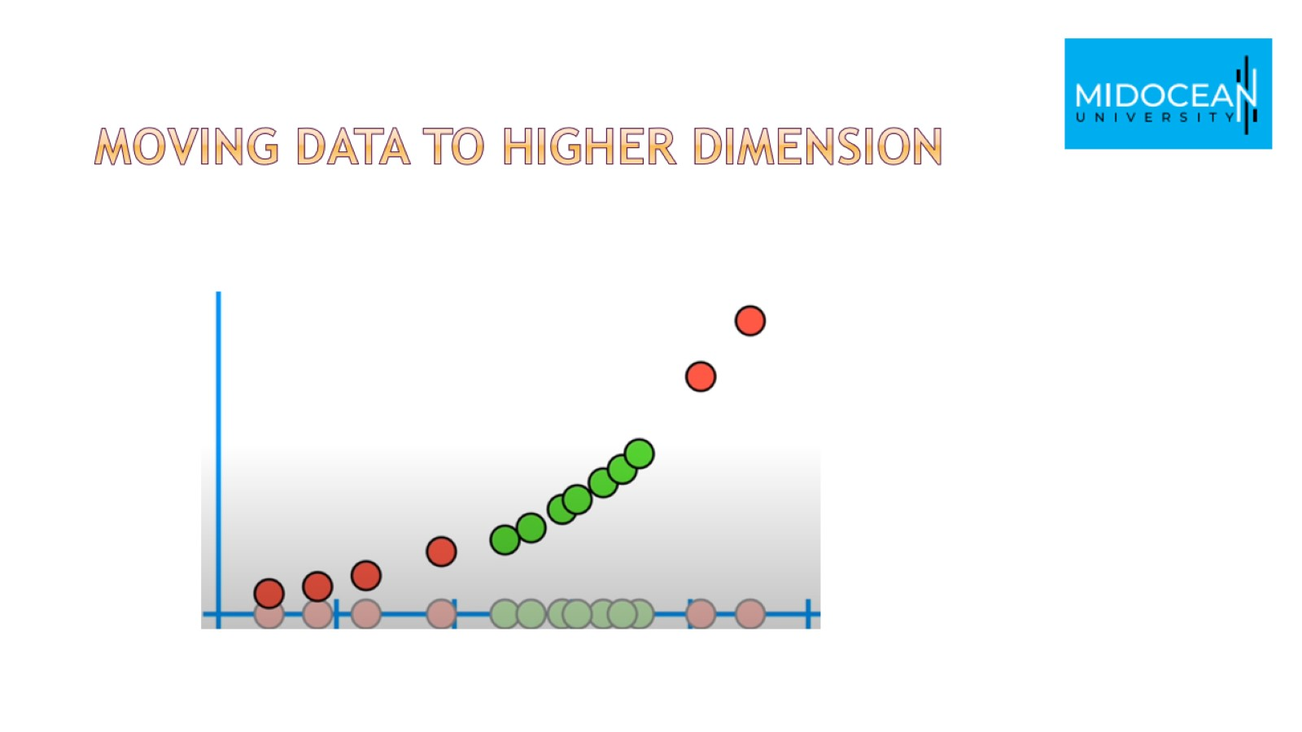
Moving data to higher dimension

Slide 34
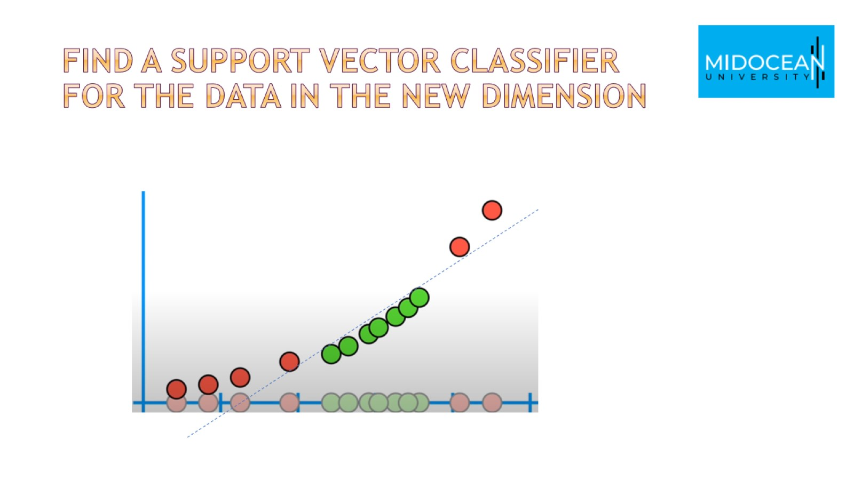
Find a support vector classifier for the data in the new dimension

Slide 35
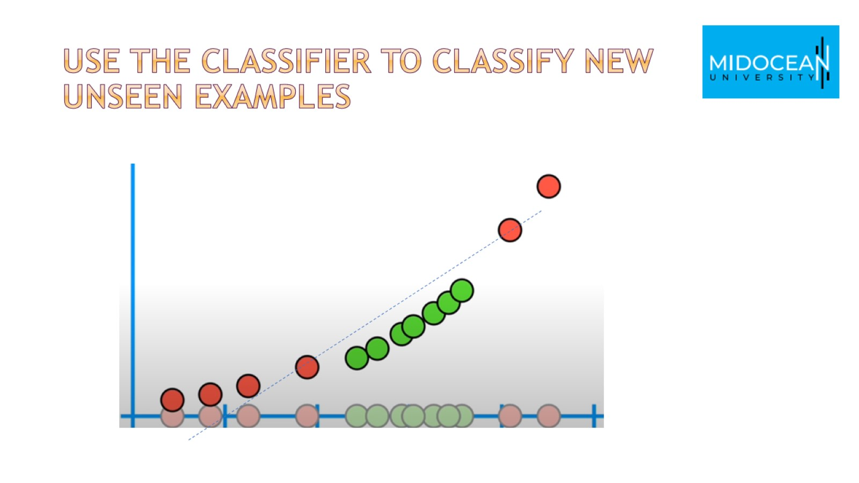
Use the classifier to classify new unseen examples

Slide 36
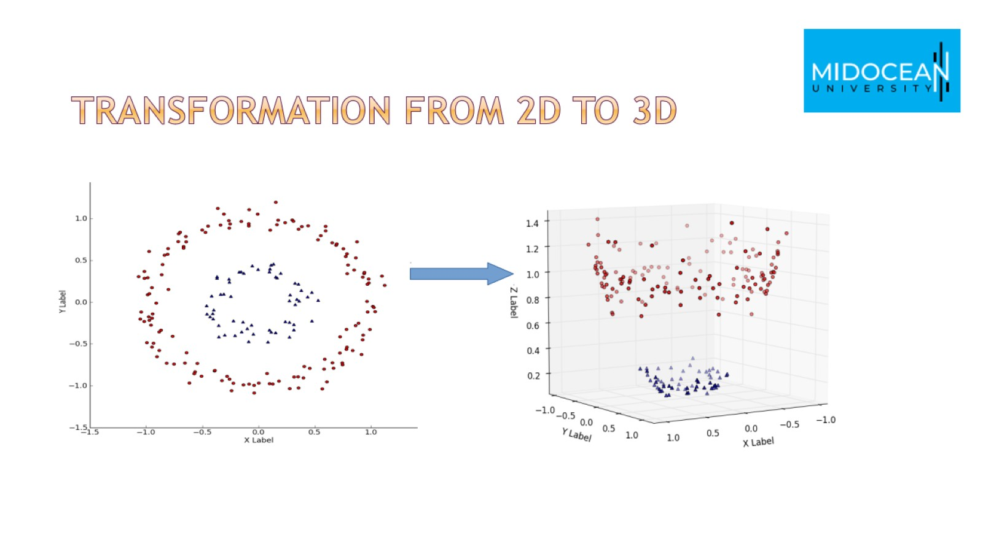
Transformation from 2D to 3D

Slide 37
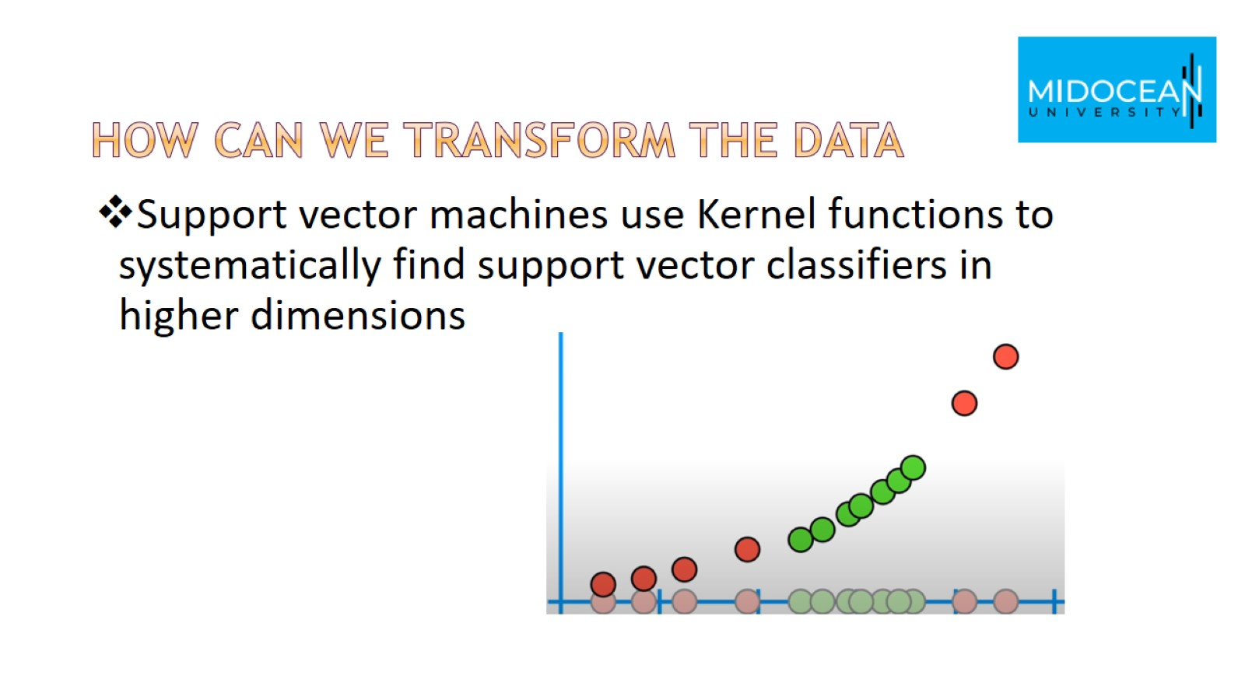
How can we transform the data

Slide 38
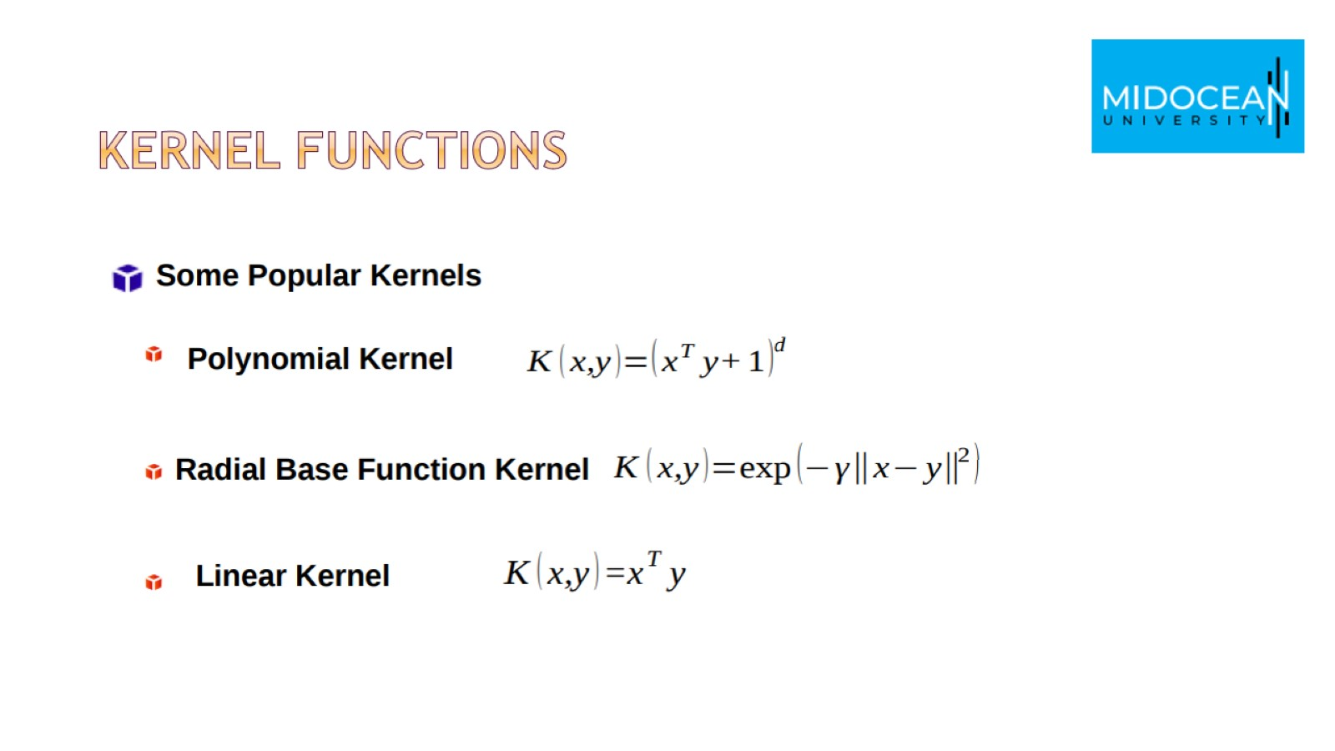
Kernel functions

Slide 39
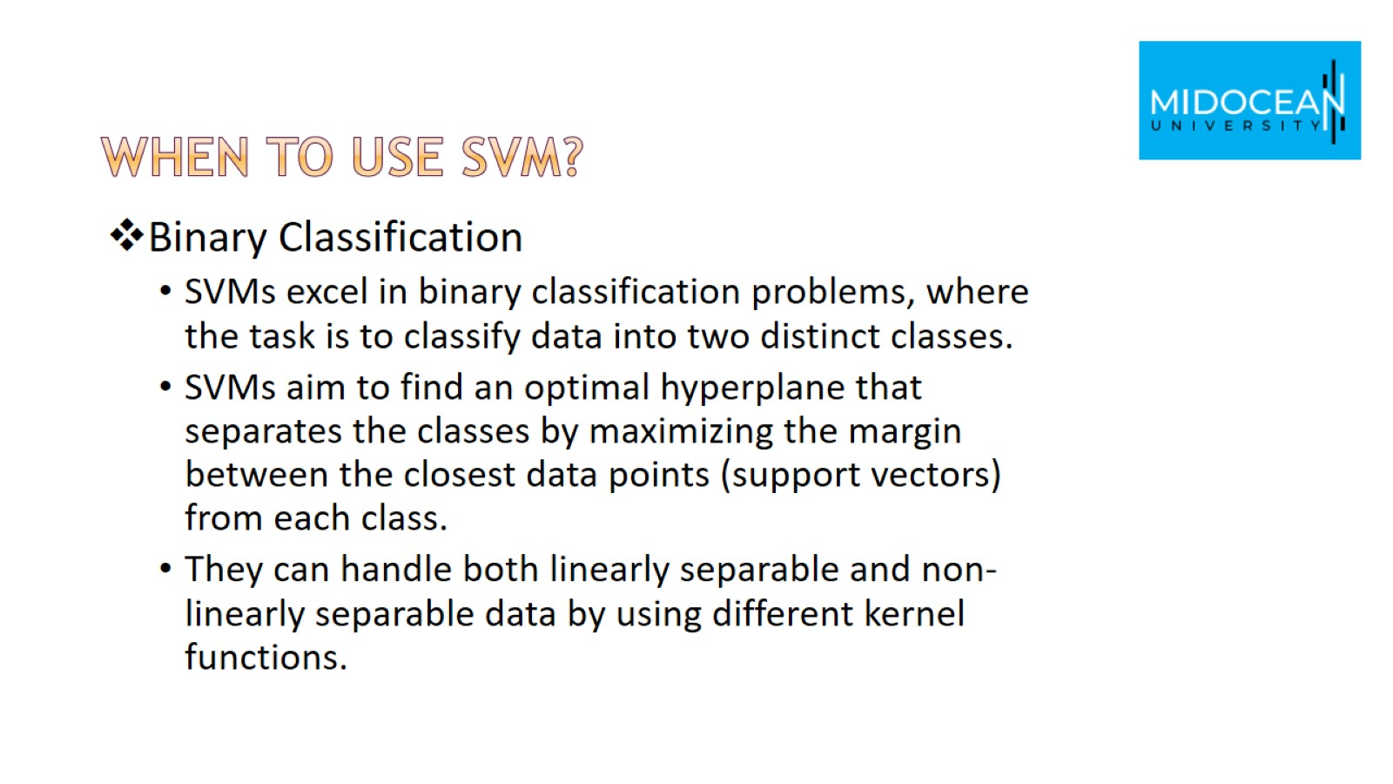
When to use SVM?

Slide 40
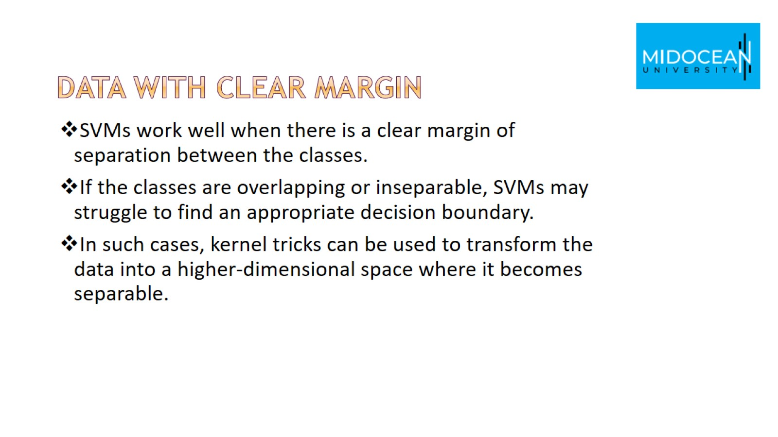
Data with Clear Margin

Slide 41
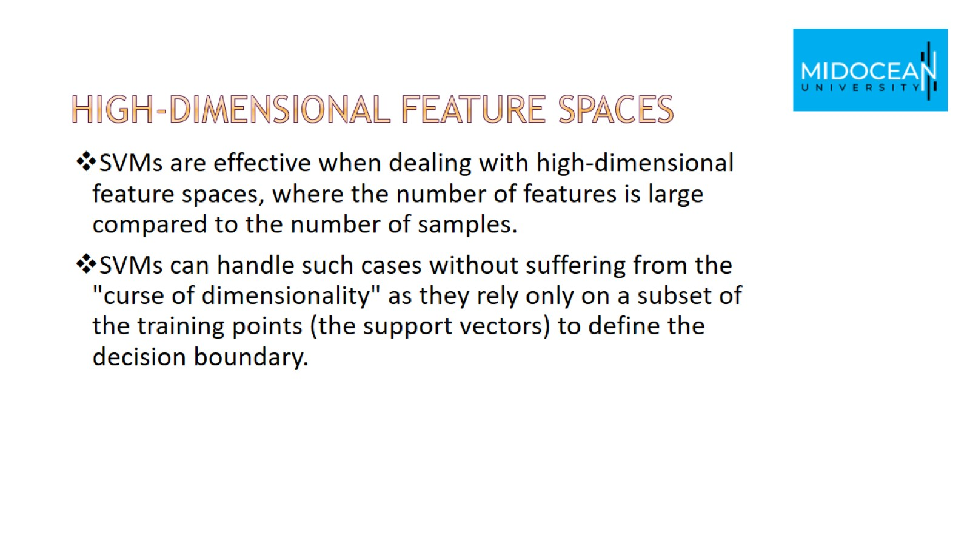
High-Dimensional Feature Spaces

Slide 42
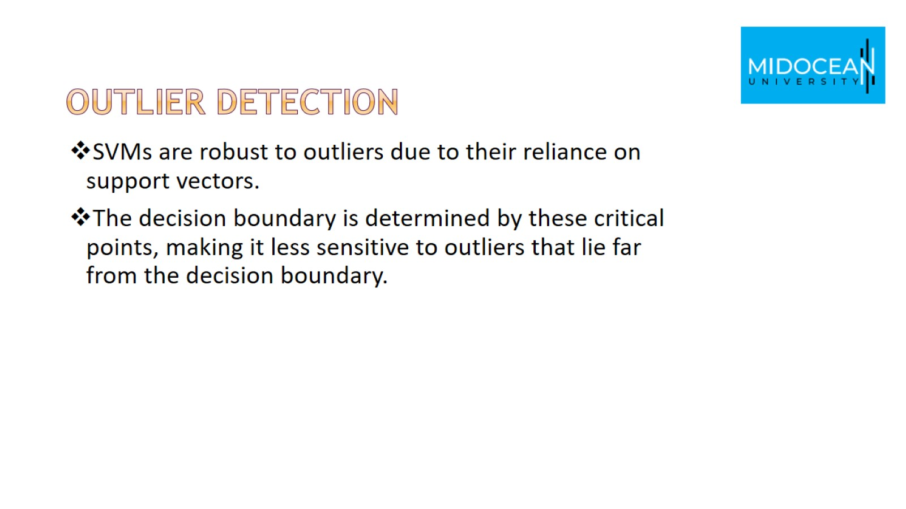
Outlier Detection

Slide 43


Slide 44


