Slide 1


Dave Carroll Case Study
W3 Lecture2

Slide 2




W3 Lecture2
Case Study
Dave’s $3,500 Guitar mishandled
by United Baggage handlers
In March 2008, Dave Carroll, a musician from Halifax, NS and his band, the Sons of Maxwell, traveled from Halifax to Nebraska via O’Hare Airport in Chicago. What happened on the journey became the subject of outrage, embarrassment, amusement, and transformed Carroll from country singer to customer service guru. Carroll claimed that his guitar was severely damaged by United Airlines baggage handlers at O’Hare. His attempts to pursue a damage claim with United having been frustrated, he posted two amusing videos about the incident on YouTube. The overwhelming response raised questions about brands and the nature of marketing communications in the internet age.

Slide 3
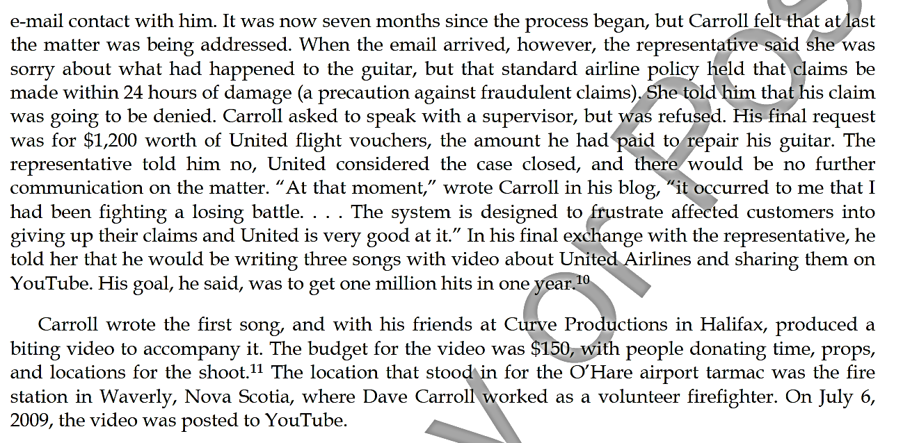
W3 Lecture2
Case Study
Dave’s $3,500 Guitar mishandled
by United Baggage handlers
جيتار ديف الذي يبلغ سعره 3500 دولار يتعرض للإهمال من قبل موظفي مناولة الأمتعة في شركة يونايتد

Slide 4
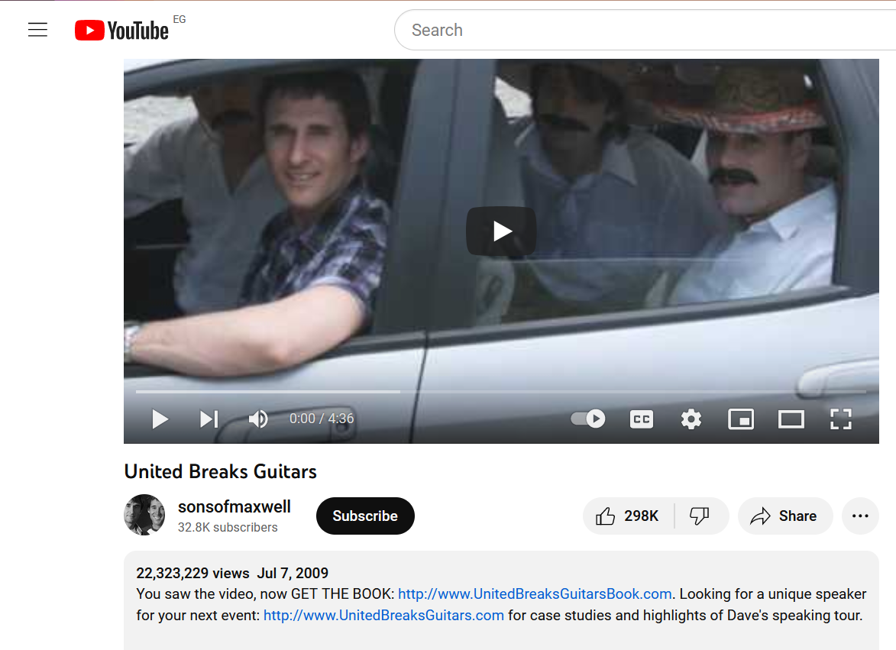
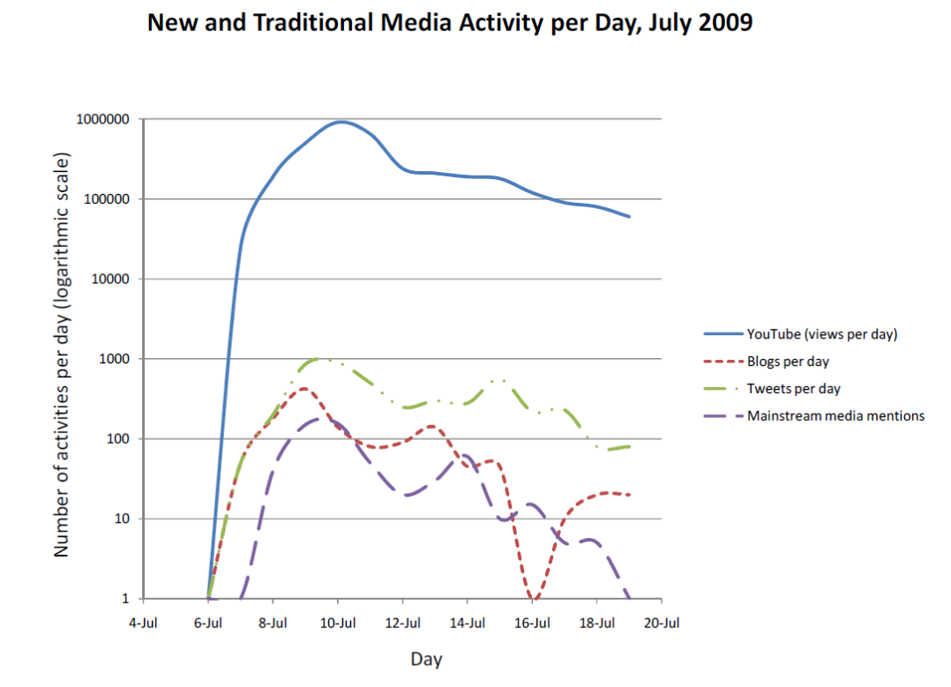
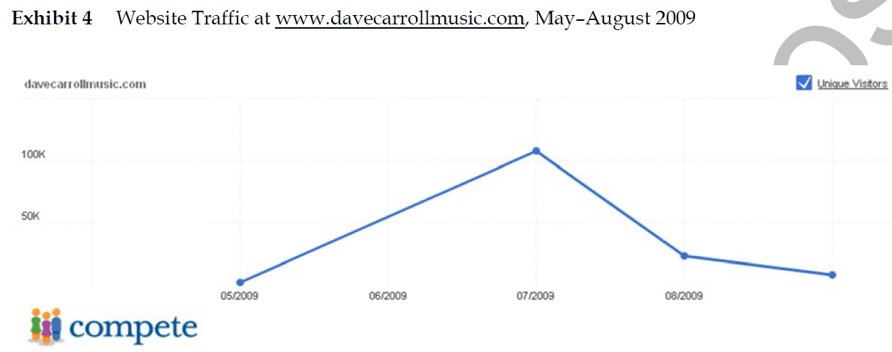
W3 Lecture2
Case Study
https://www.youtube.com/watch?v=5YGc4zOqozo
14y, About 1.5 Million/year
Currently, 26 M views 15 years ago
https://www.youtube.com/watch?v=5YGc4zOqozo

Slide 5
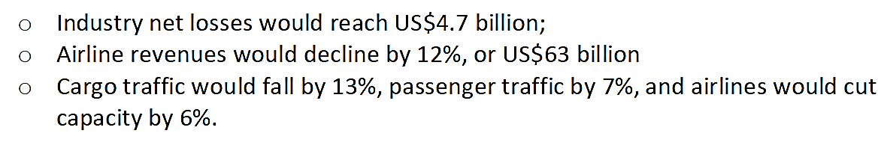
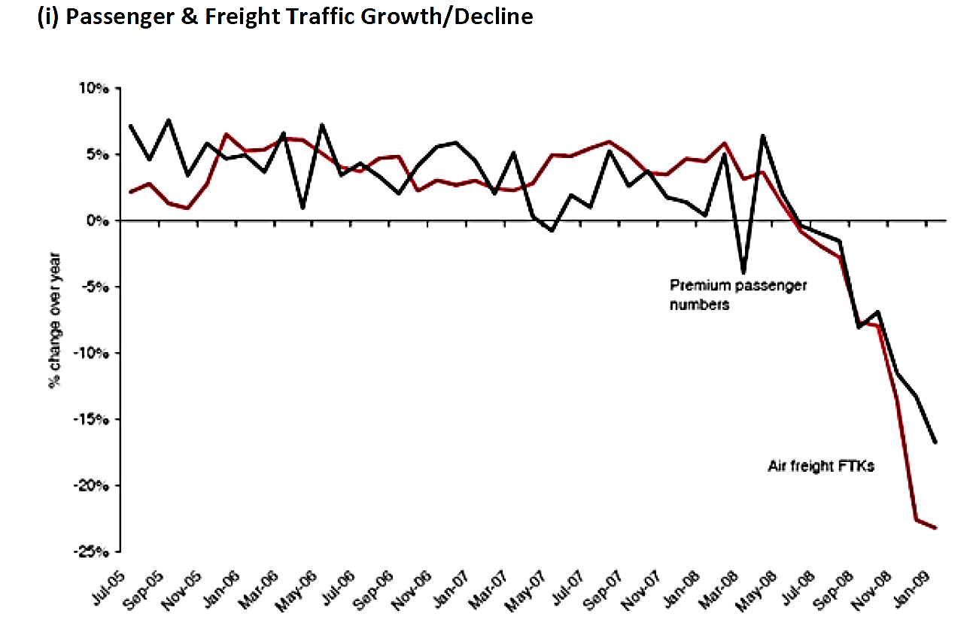
W3 Lecture2
Case Study

Slide 6
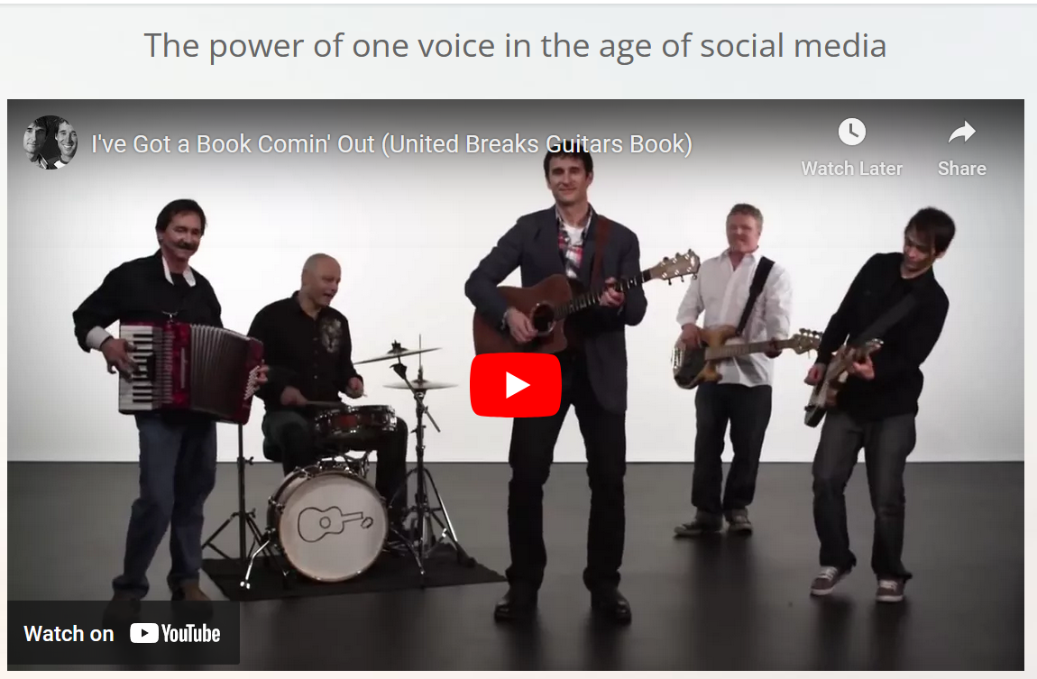
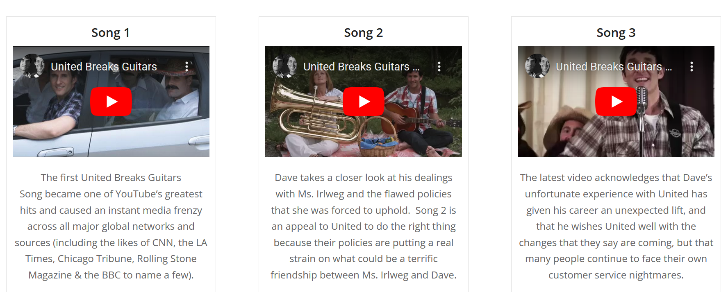

W3 Lecture2
Case Study

Slide 7

W3 Lecture2
Case Study
Download Dave Carroll’s Case Study files from here:
https://www.davecarrollmusic.com/speaking/#case-studies

