Slide 1


Prepared by Dr. Wesam Ahmed
IT402
Internet of Things
Lecture 10

Slide 2



Artificial Intelligence in IoT
Lecture 10
IT402‎
Internet of Things
Prepared by
Dr. Wesam Ahmed

Slide 3

10
Learning Objectives:
1.1 Hardware for the IoT
1.2 Artificial Intelligence in IoT
1.3 IoT Application Development

Slide 4
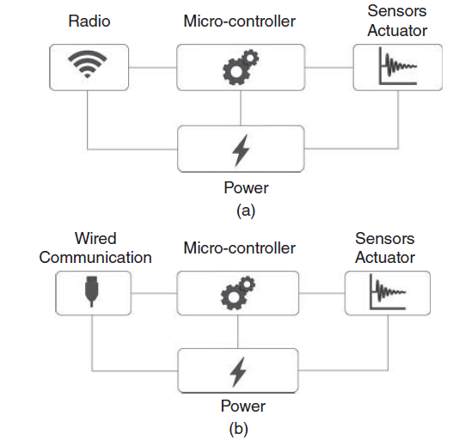
10
Hardware for the IoT
In order to provide a general definition for hardware platforms, Figure 10.1 shows an high-level view of the main hardware components in a smart object. The illustrated modules are:
Understand the Importance of Business Intelligence
Figure 10.1 Smart
object hardware, with
(a) radio network
interface and (b)
wired communication
interface.

Slide 5
10
Hardware for the IoT
Communication Module
Purpose: This allows the smart object to communicate with other devices or networks. Essentially, it’s how the device “talks” to the outside world.
Types:
  Wireless: Most common in IoT devices. Examples include:
    Radio transceivers like Wi-Fi, Bluetooth, Zigbee, LoRa, or 5G modules.
    Antenna: Enables the device to send and receive radio signals effectively.
  Wired: Some smart objects might use Ethernet, USB, or other physical connections.
Role in smart object: Without a communication module, the device is “isolated” and cannot share data, receive updates, or be remotely controlled.
Understand the Importance of Business Intelligence

Slide 6
10
Hardware for the IoT
Understand the Importance of Business Intelligence
Microcontroller (MCU)
Purpose: The microcontroller is the “brain” of the smart object. It executes software to define the device’s behavior.
Components of a microcontroller:
  CPU (Central Processing Unit): Executes program instructions.
  Memory:
    ROM (Read-Only Memory):
      Stores permanent program code (firmware) that dictates the device behavior.
      Usually set during manufacturing.
      Some modern MCUs allow in-field updates to rewrite ROM.
    RAM (Random Access Memory):
      Stores temporary data while the program runs.
      Example: variables, buffer for radio communication, sensor readings, etc.

Slide 7
10
Hardware for the IoT
Understand the Importance of Business Intelligence
Microcontroller (MCU):
  Timers:
    Help schedule tasks or create delays in the system.
    Example: triggering a sensor read every 10 seconds.
  Peripherals / I/O pins:
    Connect external devices like sensors, actuators, or communication modules.
    Microcontroller uses serial protocols to communicate:
      USART (Universal Synchronous/Asynchronous Receiver/Transmitter): Allows serial communication for sending/receiving data.
Power Source
Purpose: Smart objects are electrical devices; they need power to operate.
Common types:
  Battery: Standard, portable, commonly used in IoT devices.
Importance: Choosing the right power source is crucial for battery life, device autonomy, and deployment feasibility.

Slide 8
10
Hardware for the IoT
Understand the Importance of Business Intelligence
How Microcontrollers Work With Sensors and Actuators
Sensors and actuators are physically connected to the MCU pins.
The MCU communicates with these devices using serial interfaces (USART, SPI, I²C).
Example workflow:
  Sensor detects temperature → sends data to MCU via SPI.
  MCU processes data → determines if the fan should turn on.
  MCU sends a signal to the actuator (fan) via output pin → fan operates.
Memory and Update Mechanisms
ROM (Permanent storage):
  Stores the program controlling the smart object.
  In constrained devices, ROM is fixed and cannot change after deployment.
RAM (Temporary storage):
  Stores temporary variables, sensor readings, and communication buffers.
  Cleared when the device is powered off.

Slide 9
10
Artificial Intelligence in IoT
Understand the Importance of Business Intelligence
Artificial intelligence (AI) and Internet of Things (IoT) are two of the most talked about technologies in the recent years.
AI refers to the ability of machines to learn and make decisions without human intervention. IoT, on the other hand, is a network of devices that are connected to the internet and can communicate with each other.
The combination of these two technologies, known as AIoT, has the potential to revolutionise the way we live and work.
AI can bring human-like decision-making and awareness to the IoT environment, which can lead to increased efficiency and improved processes.
For example, AI can help in predictive maintenance of machines, which can save companies millions of dollars in repair costs.
It can also help in optimizing energy consumption in buildings, which can reduce energy bills and carbon footprint.

Slide 10
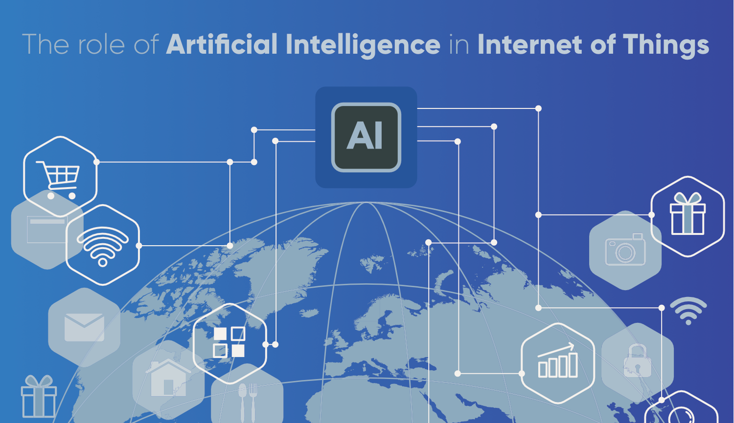
10
Artificial Intelligence in IoT
Understand the Importance of Business Intelligence

Slide 11
10
Artificial Intelligence in IoT
Understand the Importance of Business Intelligence
Artificial Intelligence (AI) is a subfield of computer science that aims to create intelligent machines that can work and learn like humans.
AI develops algorithms and models for machines to perform tasks requiring human intelligence, like natural language processing, image recognition, and decision-making.
AI is becoming increasingly important in the Internet of Things (IoT) ecosystem because it can help to extract insights from the vast amounts of data generated by connected devices.
AI can enable IoT devices to learn from their environment and make decisions based on that learning, without human intervention.
One of the key advantages of AI in IoT is that it can help to automate processes and improve efficiency.

Slide 12
10
Artificial Intelligence in IoT
Understand the Importance of Business Intelligence
For instance, AI can predict machine failures, enabling proactive maintenance actions. This can help to reduce downtime and improve overall productivity.
AI can also help to improve the accuracy of data analysis in IoT. By using machine learning algorithms, AI can identify patterns in data that would be difficult for humans to detect. This can help to identify trends and anomalies, enabling businesses to make more informed decisions.
There are several different types of AI that are relevant to IoT, including:
Machine Learning: AI that enables machines to learn from data without explicit programming. Machine learning algorithms identify patterns in data to make predictions or decisions.
Deep Learning: Machine learning using neural networks to process and analyse data. Deep learning is useful for tasks like image recognition and natural language processing.
Reinforcement Learning: Machine learning where machines make decisions based on feedback from their environment. Reinforcement learning is useful for tasks like robotics and autonomous vehicles.

Slide 13
10
Artificial Intelligence in IoT
Understand the Importance of Business Intelligence
There are several different types of AI that are relevant to IoT, including:
Language models and agentic AI. As hybrids of neural technology and ML, language models and agentic AI build data sets by analyzing information. Language models learn by examining things, and the model's size limits the complexity of what it can learn and do. Generative AI (see below) is an application of large language model (LLM) technology, and most agentic AI systems are based on large or small language models.
Generative AI. GenAI, popularized by ChatGPT, builds a knowledge base by examining millions of online documents and then answers plain-language queries based on that knowledge and a set of rules provided by engineers. The breadth of the knowledge base and the sophistication of the rules that govern queries can make this form of AI seem human, and it represents the state of the art for many involved in the field. However, generative AI requires enormous data centers to run and online documents with the scope of the internet to train.

Slide 14
10
Artificial Intelligence in IoT
Understand the Importance of Business Intelligence
Overall, AI is a powerful tool that can help to unlock the full potential of IoT. By enabling machines to learn from their environment and make decisions based on that learning, AI can help to improve efficiency, accuracy, and productivity in a wide range of industries.
Another area where AI and IoT intersect is in the field of smart homes. IoT devices such as smart thermostats, lighting systems, and security cameras can be controlled by AI algorithms to optimize energy usage and enhance security.
For example, a smart thermostat with smart systems can learn a user’s schedule and adjust the temperature accordingly, while a security camera can detect unusual activity and alert the homeowner.
AI and IoT also have the potential to improve healthcare. IoT devices such as wearables and medical sensors can collect data on a patient’s health, which can then be analysed by AI algorithms to detect early signs of disease or monitor chronic conditions. This can lead to earlier diagnosis and better treatment outcomes.
In conclusion, the intersection of AI and IoT has the potential to transform many industries and improve our daily lives. By combining the power of AI to analyse data with the interconnectivity of IoT devices, and smart environmental sensors, we can create smarter, more efficient systems that benefit everyone.

Slide 15
10
Artificial Intelligence in IoT
Understand the Importance of Business Intelligence
Applications of agentic AI in IoT include the following:
Agentic AI refers to AI systems capable of autonomous decision-making, planning, coordination, and action.
When combined with IoT—where devices continuously sense and interact with the physical world—agentic AI enables highly intelligent, self-governing systems.
In smart facilities (e.g., factories, warehouses, offices) and smart cities (traffic systems, utilities, infrastructure), agentic AI agents collaborate to manage complex environments.
How it works
Multiple AI agents monitor sensors across buildings, roads, parks, bridges, and utility grids.
Each agent specializes in a domain (lighting, HVAC, traffic, safety, energy usage).
A coordination layer lets agents negotiate and optimize operations automatically.
Examples
AI adjusts power consumption based on occupancy and weather.
Agents detect road congestion and autonomously reroute traffic.
Environmental sensors trigger agents to reduce pollution or increase ventilation.

Slide 16
10
Artificial Intelligence in IoT
Understand the Importance of Business Intelligence
Applications of agentic AI in IoT include the following:
Autonomous Vehicles and Drone Swarms:
Agentic AI enhances vehicles’ ability not only to perceive the environment but also to plan routes, coordinate with other vehicles, and adapt to changing conditions.
How it works
Agents onboard each vehicle communicate with IoT infrastructure (traffic signals, sensors).
Each vehicle behaves as an autonomous agent.
Swarm intelligence allows drones to collaborate in missions.
Applications
Self-driving cars communicating to avoid collisions.
Autonomous trucks optimizing logistics routes.
Drones coordinating for deliveries, surveillance, mapping, or disaster response.

Slide 17
10
Artificial Intelligence in IoT
Understand the Importance of Business Intelligence
Applications of agentic AI in IoT include the following:
Industrial Automation and Manufacturing
In Industry 4.0 environments, agentic AI powers self-optimizing, self-healing, and autonomously coordinated production lines.
How it works
Agents monitor assembly lines, robots, and equipment.
If a fault occurs, agents can reconfigure workflows or alert human supervisors.
IoT data feeds allow continuous optimization of machine performance.
Applications
Autonomous robotic arms that adjust behavior based on sensor input.
AI coordinating multiple machines to reduce downtime.
Predictive maintenance based on vibration, heat, or pressure sensors.

Slide 18
10
Artificial Intelligence in IoT
Understand the Importance of Business Intelligence
Benefits of AI in IoT
Artificial Intelligence (AI) offers numerous benefits when combined with the Internet of Things (IoT). Here are some of the key advantages:
Improved Efficiency
AI-powered IoT devices can automate routine tasks and processes, enabling businesses to operate more efficiently. For example, smart factories can use AI to optimise production lines, reducing waste and improving productivity. Similarly, smart homes can use AI to learn the behaviour of occupants and automatically adjust settings to maximise energy efficiency.
Enhanced Decision-Making
AI can process vast amounts of data from IoT devices, providing valuable insights and enabling better decision-making. For example, in healthcare, AI can analyse patient data from wearable devices to identify potential health issues before they become serious. In agriculture, AI can analyse data from sensors to optimise crop yields.

Slide 19
10
Artificial Intelligence in IoT
Understand the Importance of Business Intelligence
Benefits of AI in IoT
Increased Safety and Security
AI can enhance safety and security in a variety of contexts. For example, in smart cities, AI can analyse data from traffic sensors and cameras to optimise traffic flow and reduce accidents. In industrial settings, AI can monitor equipment and detect potential safety issues before they become serious. Similarly, in cybersecurity, AI can analyse network traffic and identify potential threats.
Personalisation
AI can enable highly personalised experiences for users of IoT devices. For example, in retail, AI can analyse customer data to provide personalised recommendations and offers. Similarly, in healthcare, AI can analyse patient data to provide personalised treatment plans.
Overall, the combination of AI and IoT has the potential to revolutionise a wide range of industries, improving efficiency, enhancing decision-making, increasing safety and security, and enabling highly personalised experiences.

Slide 20
10
Artificial Intelligence in IoT
Understand the Importance of Business Intelligence
AI in IoT and Its Impact on the Economy: The combination of AI and IoT has significant and far-reaching effects on the global economy:
Increased Productivity
AI-driven IoT systems automate repetitive tasks, optimize production processes, and minimize delays, boosting productivity across sectors such as manufacturing, agriculture, logistics, and healthcare.
Cost Reduction
Predictive maintenance, intelligent resource allocation, and reduced waste directly decrease operational costs for companies. Energy-efficient smart systems also help reduce utility expenses.
Job Transformation
While automation may reduce demand for some labor-intensive jobs, it also generates new roles in data science, AI engineering, IoT architecture, cybersecurity, and digital system management—leading to a more skilled workforce.
Enhanced Public Services
Smart cities powered by AI and IoT improve transportation, waste management and public safety—leading to long-term economic benefits through better quality of life and reduced government spending.

Slide 21
10
Artificial Intelligence in IoT
Understand the Importance of Business Intelligence
Challenges in Integrating AI with IoT:
Integrating Artificial Intelligence (AI) with the Internet of Things (IoT) presents several challenges that must be addressed for successful implementation. Here are some of the major challenges:
Data Management
One of the main challenges of integrating AI with IoT is managing the vast amount of data generated by IoT devices. IoT devices generate a huge amount of data, and AI algorithms require large amounts of data to train and improve their accuracy. Therefore, managing and storing this data in a way that is easily accessible to AI algorithms is crucial.
Security
Security is another major challenge in integrating AI with IoT. IoT devices are often deployed in unsecured environments, making them vulnerable to cyber-attacks. AI algorithms that are used to process the data generated by IoT devices must also be secured against attacks. Therefore, implementing robust security measures is critical to ensure the integrity of the data and the system.

Slide 22
10
Artificial Intelligence in IoT
Challenges in Integrating AI with IoT:
Interoperability
IoT devices are often developed by different manufacturers, using different protocols and standards. This can make it difficult to integrate these devices with AI algorithms. Interoperability issues can prevent data from being shared between devices, limiting the effectiveness of AI algorithms. Therefore, developing common standards and protocols for IoT devices is essential for successful integration with AI.
Power Consumption
IoT devices are often battery-powered, making power consumption a critical factor in their design. AI algorithms can be computationally intensive, requiring significant amounts of power to run. Therefore, developing energy-efficient AI algorithms that can run on low-power devices is an important consideration for integrating AI with IoT.
Cost
The cost of implementing AI with IoT can be prohibitive, particularly for small and medium-sized enterprises. The hardware and software required to implement AI algorithms can be expensive, and the cost of implementing security measures can also be significant. Therefore, finding cost-effective solutions is crucial for successful integration of AI with IoT.
Understand the Importance of Business Intelligence

Slide 23
10
Artificial Intelligence in IoT
Challenges in Integrating AI with IoT:
AI models, particularly LLMs, are prone to hallucinations that result from misinterpreted training data. Also, the inadvertent use of AI-generated data to train AI models can cause data pollution. These errors discourage the use of AI in truly autonomous applications, but even human oversight doesn't catch them all.
In IoT applications—especially critical systems—hallucinations can be dangerous.
Examples:
An AI-based monitoring system hallucinating incorrect equipment failures.
A quality control system misidentifying healthy production output as defective.
When AI errors feed into real-time decision-making, the consequences can be severe.
Understand the Importance of Business Intelligence

Slide 24
10
Artificial Intelligence in IoT
Challenges in Integrating AI with IoT:
Most practical AIoT applications require training models on internal data such as:
Operational logs
Machine sensor data
This data is often highly confidential, governed by security, compliance, and privacy policies.
To maintain control, organizations prefer:
On-premises (self-hosted) AI models
Private cloud environments
Instead of sending data to public cloud AI services.
The challenge: Hosting and training AI models internally requires:
Powerful GPUs or accelerators
Secure networking
MLOps, monitoring, and deployment tools
Skilled AI engineers, data scientists, and cloud/edge architects
This infrastructure is expensive and difficult to build for many companies.
Understand the Importance of Business Intelligence

Slide 25
10
Artificial Intelligence in IoT
Understand the Importance of Business Intelligence
Challenges in Integrating AI with IoT:
LLMs and complex neural networks require heavy computation. This leads to:
Longer inference time
Slower response
High round-trip latency if cloud processing is used
For general AI tasks like classification or prediction, slight delays are okay. But IoT often demands real-time responsiveness.
LLMs → too heavy, too slow
SLMs (Small Language Models) → lighter, faster, more efficient
Traditional ML models → extremely fast for numerical prediction tasks
For real-time IoT applications, simpler models often perform better because:
They process numeric sensor data quickly
They require less memory
They provide deterministic and predictable response times

Slide 26
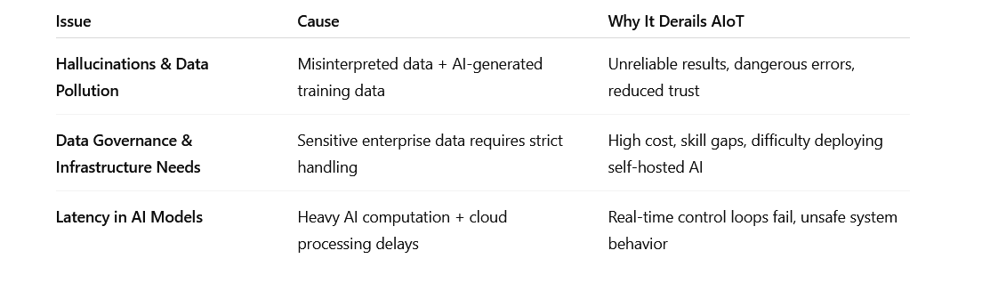
10
Artificial Intelligence in IoT
Understand the Importance of Business Intelligence
Challenges in Integrating AI with IoT:

Slide 27
10
IoT Application Development
IoT app development?
IoT app development is the process of creating software applications that interact with Internet of Things (IoT) devices. These applications allow users to monitor, control, and extract insights from smart devices connected to the internet.
These apps can connect with devices through sensors and internet connectivity to offer features such as remote monitoring, battery status updates, and even predictive maintenance alerts.
By developing IoT apps, we can improve the efficiency, convenience, and sustainability of device usage, ultimately benefiting both manufacturers and users.
Why develop an IoT application
During the worst pandemic in a century, IoT spending grew manifolds.
The trend seems to be continuing well into the future. The following graph shows the projected spending on IoT in the coming years..
Understand the Importance of Business Intelligence

Slide 28
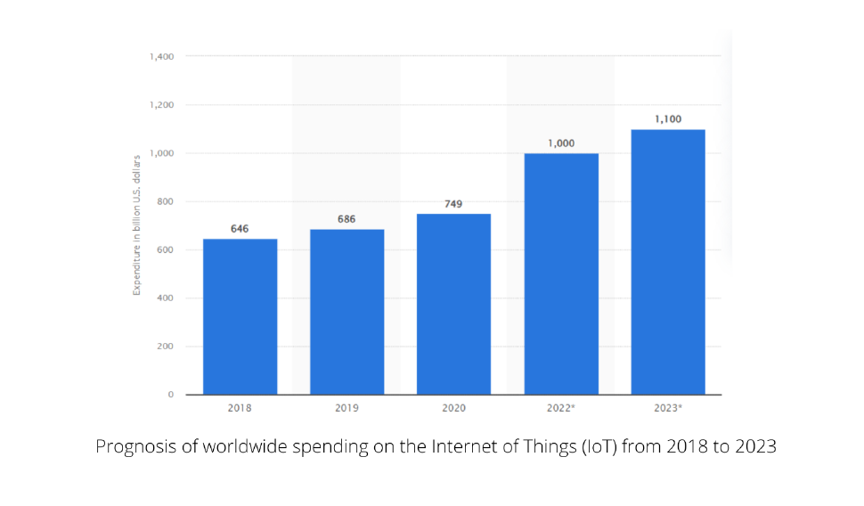
10
IoT Application Development
Understand the Importance of Business Intelligence

Slide 29
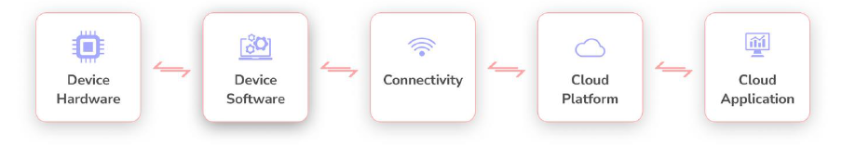
10
IoT Application Development
Understand the Importance of Business Intelligence
How to develop an IoT application in 5 steps :
Now that you have all the prerequisites in place, let’s take another look at the IoT architecture and see what needs to be done for each of the layers:

Slide 30
10
IoT Application Development
How to develop an IoT application in 5 steps :
Step 1: Define the requirements for the application:
Set the Goal:
Determine what you want your IoT app to achieve once it’s live. Goals should be specific, measurable, and aligned with the device’s purpose.
Examples of goals:
  Real-time tracking: Track location or movement of devices or vehicles, e.g., delivery vans or electric vehicles.
Define the Scope:
Decide on the features your app will support. Features define the boundaries of your project and determine what the app can do.
Common IoT app features:
Device Management: Register, update, or remove devices.
Dashboarding: Provide a visual overview of device status and data.
Understand the Importance of Business Intelligence

Slide 31
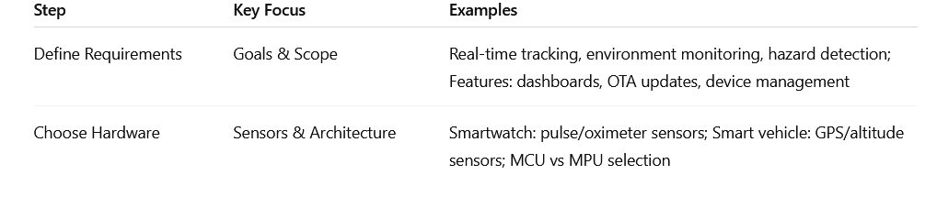
10
IoT Application Development
How to develop an IoT application in 5 steps :
Step 2: Choosing the Right Hardware
After defining the requirements, selecting the right hardware is critical. The hardware determines how effectively your IoT app can interact with the physical world.
Hardware decisions are hard to change later, and switching sensors or processors after deployment can be costly and time-consuming. Careful selection at this stage prevents redesigns in the future.
Understand the Importance of Business Intelligence

Slide 32
10
IoT Application Development
How to develop an IoT application in 5 steps :
Step 2: Choosing the Right Hardware
What is Arduino?
Open-Source Platform: Arduino provides both hardware and software that are open-source, meaning designs and code examples are freely available.
Purpose: Designed to read inputs (from sensors) and control outputs (like LEDs, motors, or relays).
Popularity: Widely used in IoT projects, robotics, and electronics prototyping.
Examples of Inputs/Outputs:
Inputs: light sensors, temperature sensors, motion detectors.
Outputs: turning on LEDs, activating motors, triggering alarms.
Arduino UNO: The most popular Arduino board, often used in beginner to intermediate IoT projects.
Understand the Importance of Business Intelligence

Slide 33
10
IoT Application Development
How to develop an IoT application in 5 steps :
Step 2: Choosing the Right Hardware
Why Arduino is Excellent for IoT?
Low cost, low power consumption, and direct hardware control.
Ideal for sensing and actuating tasks, like turning on devices when a sensor triggers.
Can communicate with other devices or cloud platforms if connectivity modules (shields) are added.
Suitable for small, embedded IoT devices rather than data-heavy or high-computation tasks.
Understand the Importance of Business Intelligence

Slide 34
10
IoT Application Development
How to develop an IoT application in 5 steps :
Step 2: Choosing the Right Hardware
Limitations of Arduino in IoT
Limited Built-in Security: Requires extra effort for secure communication.
Memory Constraints: Not suitable for data-heavy applications.
Connectivity: Needs additional modules for Wi-Fi, GSM, or Bluetooth in most models.
No Multitasking: Can't run multiple threads like advanced microcontrollers (e.g., Raspberry Pi Pico W)
Despite these limitations, Arduino is excellent for most small to medium-sized IoT projects.
Understand the Importance of Business Intelligence

Slide 35
10
IoT Application Development
How to develop an IoT application in 5 steps :
Step 2: Choosing the Right Hardware
Popular Arduino IoT Projects
1. Smart Home Automation System
Control fans, lights, and appliances using a mobile app or voice assistant.
2. IoT Weather Station
Tracks temperature, humidity, and atmospheric pressure and sends data to ThingSpeak.
3. Smart Parking System
Notifies users of empty parking slots using ultrasonic sensors and Wi-Fi.
These projects are beginner-friendly and scalable, making Arduino perfect for learning and prototyping.
Understand the Importance of Business Intelligence

Slide 36
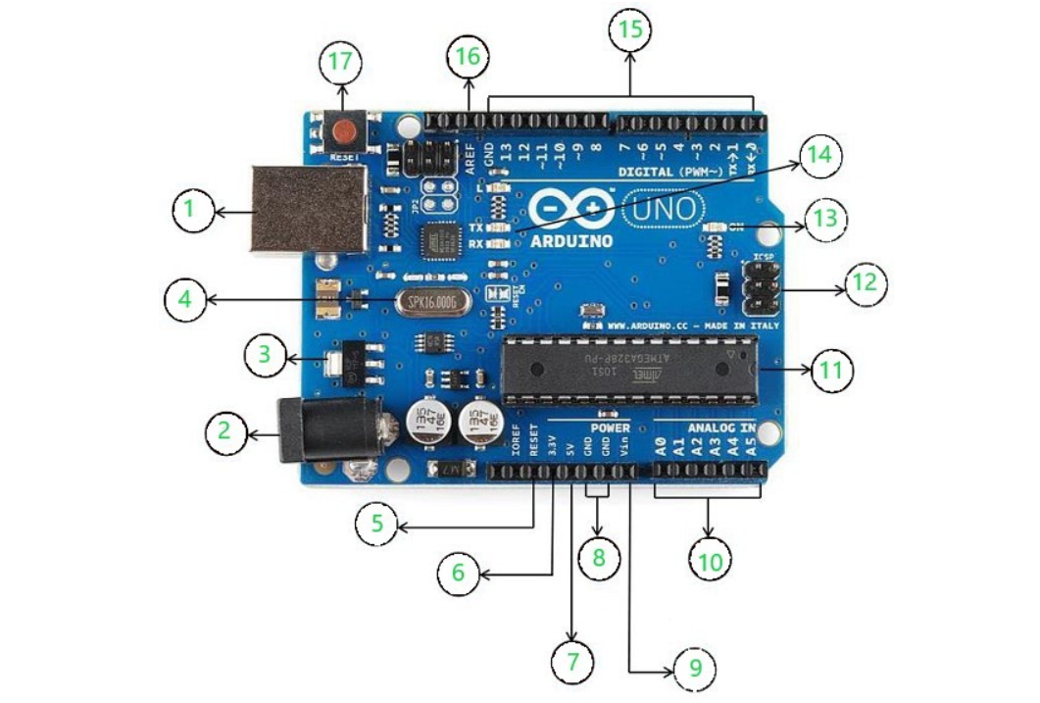
10
IoT Application Development
How to develop an IoT application in 5 steps :
Step 2: Choosing the Right Hardware
Understand the Importance of Business Intelligence
Figure 10.2 : Arduino Uno

Slide 37
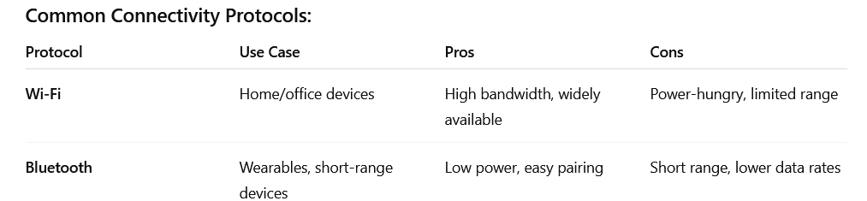
10
IoT Application Development
How to develop an IoT application in 5 steps :
Step 3: Find the Right Connectivity Protocols
Connectivity protocols determine how your IoT devices communicate with each other, with mobile apps, or with cloud servers. Choosing the right protocol is critical because it impacts range, power consumption, cost, and reliability.
Understand the Importance of Business Intelligence

Slide 38
10
IoT Application Development
Understand the Importance of Business Intelligence
How to develop an IoT application in 5 steps :
Step 4: Ensure the Firmware is Well-Equipped
Firmware is the software that runs on your IoT device. It controls how the device collects data, communicates, and responds to commands. Proper firmware is crucial for reliability, efficiency, and cost-effectiveness.
Embedded Software Expertise:
Embedded Programming:
Languages: C, C++, Python, or assembly for low-level hardware control.
Real-time processing, event handling, and interrupt management.
Data Handling & Storage: Local data persistence, batching, and compression to optimize transmission and reduce cost.

Slide 39
10
IoT Application Development
Understand the Importance of Business Intelligence
How to develop an IoT application in 5 steps :
Step 5: Pick the Right Cloud Platform
An IoT cloud platform is the backbone of your IoT application. It provides the infrastructure, tools, and services needed to collect, process, store, and visualize data from your connected devices. Choosing the right platform ensures your IoT solution is reliable, secure, and scalable.
Why the Cloud Platform Matters:
It connects all devices, manages device data, and provides analytics.
A robust platform reduces development effort, prevents data loss, and allows you to scale your IoT solution as demand grows.
Poor cloud selection can lead to downtime, security risks, and higher operational costs.
Cloud Platforms:
AWS IoT, Azure IoT, Google Cloud IoT, or custom platforms.
Managing device registration, authentication, and virtual device shadows.

Slide 40
Summary
10
Gorry and Scott-Morton (1971) proposed a framework that is a 3-by-3 matrix
IoT and AI
IoT Application Development

Slide 41


Thank You

