Slide 1


Machine Learning in Finance
Prepared by Dr. Sumaya Alkubaisi
FNT633
Machine Learning in Finance
Lecture 0

Slide 2
Agenda
Introduction
  Introduction to topics we will cover in this course.
  High-level overview to build a roadmap.
Chapter Overviews
  a. Chapter 1: Introduction to Machine Learning and Finance - Explore how machine learning is applied in finance and understand the life cycle of data-driven solutions, including key financial data types and sources.

Slide 3
  Agenda
  b. Chapter 2: Data Preparation I - Learn how to clean and preprocess financial data to ensure it’s accurate, consistent, and ready for analysis.
  c. Chapter 3: Data Processing and Feature Engineering II - Discover techniques to integrate multiple datasets and transform features for better model performance.

Slide 4
  Agenda
  d. Chapter 4: Statistical Foundations for Data Science - Understand the statistical methods and visualization tools used to summarize, explore, and interpret financial data.
  e. Chapter 5: Supervised Learning Fundamentals - Learn how to train models to predict financial outcomes using classification and regression techniques.

Slide 5
  Agenda
  f. Chapter 6: Decision Trees and Random Forests - Explore tree-based algorithms for prediction, risk assessment, and decision-making in finance.
  g. Chapter 7: Association Rule Learning and Naïve Bayes - Discover patterns in data and predict outcomes using probabilities for applications like fraud detection and market analysis.

Slide 6
Agenda
  h. Chapter 8: Unsupervised Learning in Finance - Understand how to group financial data into patterns or segments without labeled outcomes.
  i. Chapter 9: Time Series Analysis I – Models and Forecasting: Explore methods to analyze and predict financial data that changes over time, like stock prices or sales.
  j. Chapter 10: Time Series Analysis II – Models and Forecasting:
  Continue learning advanced time series techniques for accurate forecasting and trend analysis in finance.
Course Roadmap & Expectations
Closing Remarks

Slide 7

Course Description
This course provides a comprehensive introduction to machine learning and its applications in the financial sector.
Students will learn about various machine learning techniques, from fundamental concepts to advanced algorithms, and how these can be applied to solve real-world economic problems.
midocean.edu.km

Slide 8
Course Description
The course covers data processing, feature engineering, supervised and unsupervised learning, focusing on their relevance to financial forecasting, credit scoring, risk management, algorithmic trading, and regulatory compliance.
midocean.edu.km

Slide 9
Course Description
Through lectures and case studies, participants will gain practical experience implementing machine learning models using economic data. The course aims to equip students with the skills to analyze market behaviors, enhance decision-making processes, and innovate with new financial technologies.
midocean.edu.km

Slide 10
Introduction to ML & Finance
Machine Learning (ML) = computers learn from data, not fixed rules.
Used in finance for predictions, automation, and fraud detection.
Example: Predict loan approval chances based on income & credit score.
midocean.edu.km

Slide 11
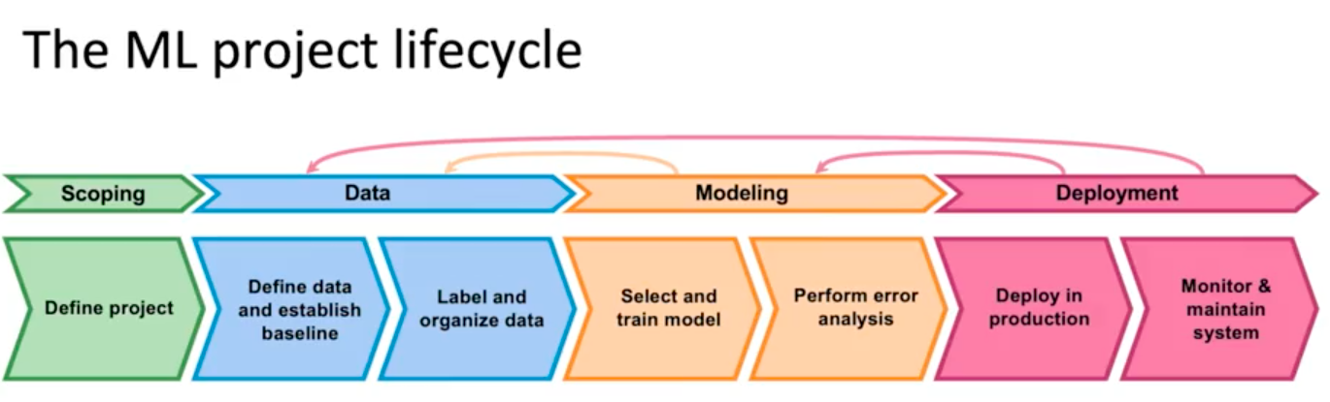
midocean.edu.km

Slide 12
What is Scoping? The Scoping stage is the foundational phase in which the following are defined:
What problem are we trying to solve? Is it a classification, regression, or prediction problem?
What is the practical objective of the model? Examples: Predicting loan default, Detecting financial fraud, Classifying emails as Spam or Not Spam
midocean.edu.km

Slide 13
Key Decisions in Scoping: In this stage, we determine:
Input features (Features)
Output variables (Labels)
Success criteria (Evaluation Metrics)
Constraints (time, data availability, resources)
midocean.edu.km

Slide 14
Any mistake made at this stage will affect all subsequent stages.
midocean.edu.km

Slide 15
Data Collection
This stage includes:
Collecting data from multiple sources
Assessing data quality
Handling: Missing values, Outliers
midocean.edu.km

Slide 16
Data Labeling and Organization
Organizing data into a format suitable for modeling
Encoding data
Splitting the dataset into: Training set and Test set
Data quality is often more important than model complexity.
midocean.edu.km

Slide 17
Model Selection and Training
In this stage:
Selecting an appropriate algorithm (e.g., Logistic Regression, Decision Trees, Neural Networks)
Training the model using the training data
Tuning hyperparameters
midocean.edu.km

Slide 18
Error Analysis and Evaluation
We perform:
Error analysis (False Positives / False Negatives)
Performance evaluation using: Accuracy, Precision, Recall, F1-score
This is where the true understanding of the model’s strengths and weaknesses emerges.
midocean.edu.km

Slide 19
What Does Deployment Mean? – (Out of Scope for This Course)
In real-world projects, deployment involves:
Integrating the model into a real system
Running the model on live data
Ensuring system performance and stability
midocean.edu.km

Slide 20
What We Will Do Instead?
In this course: We will not deploy models in a production environment,
Instead, we will:
Run models on Google Colab
Analyze results
Interpret performance and make improvement decisions
midocean.edu.km

Slide 21
Data Preparation (Cleaning & Preprocessing)
Raw financial data often has missing values, duplicates, and errors.
Preprocessing ensures clean, consistent datasets.
Example: Remove empty entries in customer loan applications.

Slide 22
Data Processing & Feature Engineering
Integration: Combine data from multiple sources (e.g., stock + economic reports).
Normalization: Scale values for fair comparison.
Example: Normalize transaction amounts to detect unusual spending patterns.

Slide 23
Statistical Foundations
Use descriptive statistics (mean, median, variance) and inferential statistics (hypothesis tests).
Visualize data with charts before modeling.
Example: Plot stock price distribution to check volatility.

Slide 24
Supervised Learning Fundamentals
Train models with labeled data (input → output).
Algorithms: K-Nearest Neighbors (KNN), Decision Trees.
Example: Predict if a customer will default on a loan (Yes/No).

Slide 25
Decision Trees & Random Forests
Decision Tree: Splits data into rules (if-else).
Random Forest: Combines multiple trees for stronger predictions.

Slide 26
Association Rule Learning & Naïve Bayes
Association Rules: Find relationships in data (e.g., products bought together).
Naïve Bayes: Simple, fast classifier based on probability.
Example: Detect unusual stock movements linked to news headlines.

Slide 27
Unsupervised Learning & Time Series
Unsupervised Learning: Group unlabeled data (e.g., customer segmentation).
Time Series Analysis: Forecast values based on time patterns.
Examples:
Cluster investors by trading behavior.
Predict future stock prices from past trends.

Slide 28
Course Roadmap & Expectations
We will cover all these methods step by step.
Focus on finance-specific applications.
By the end: students can collect, prepare, analyze, and model financial data using Python ML.

Slide 29
  Closing Remarks
  Over the coming weeks, we’ll explore key machine learning concepts and their applications in finance, from predicting risks to detecting fraud and forecasting trends.
  This course is designed to build both your understanding and practical skills.

Slide 30
Thank you!
Thank You

