Slide 1



Overview of Management 1
Lecture 1
MGM111
Principle of Management
Prepared by
Dr. Bothaina Mahmoud Fouad
www.midocean.ae
www.midocean.ae

Slide 2

www.midocean.ae
Explain the main concept and meaning of management
The difference between Management and Entrepreneurship
Nature and Characteristics of Management
Why study Management?
The Importance of Management
The 5Ms of Management
Learning Outcomes of the Lecture

Slide 3
What is Management ?
• Management is the process of working with people and resources to accomplish organizational goals.
• Management is the attainment of organizational goals in an effective and efficient manner through planning, organizing, leading and controlling organizational resources. (Daft,2012)
• Organizational resources include men(human beings), money, machines and materials.
www.midocean.ae

Slide 4
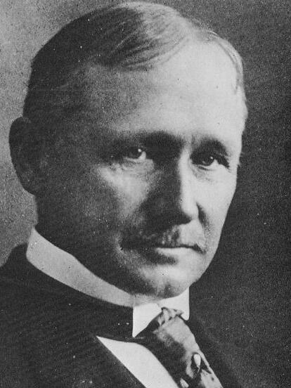
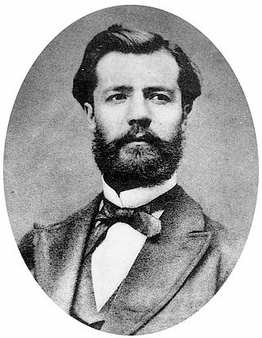
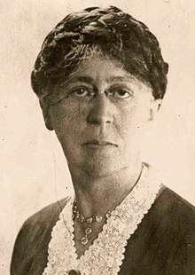
A few definitions by some of the prominent writers on Management
“Management is the art of knowing what you want to do and then seeing that it is done in the best and cheapest way”.
Frederick Winslow Taylor
“To manage is to forecast and to plan, to organize, to command, to coordinate and to control”.
Henri Fayol
Management is the art of getting things done through other people
Mary Parker Follet
www.midocean.ae

Slide 5
General definition
Management is the process of planning, organizing, leading and controlling, the efforts of organization members and of using all other organizational resources to achieve organizational goals.
www.midocean.ae

Slide 6
Difference between Management and Entrepreneurship
Entrepreneurship involves the creation of one's own enterprise
Management involves helping guide an already-established business. Understanding the differences between these two practices can help you decide which to pursue in your career.
www.midocean.ae

Slide 7
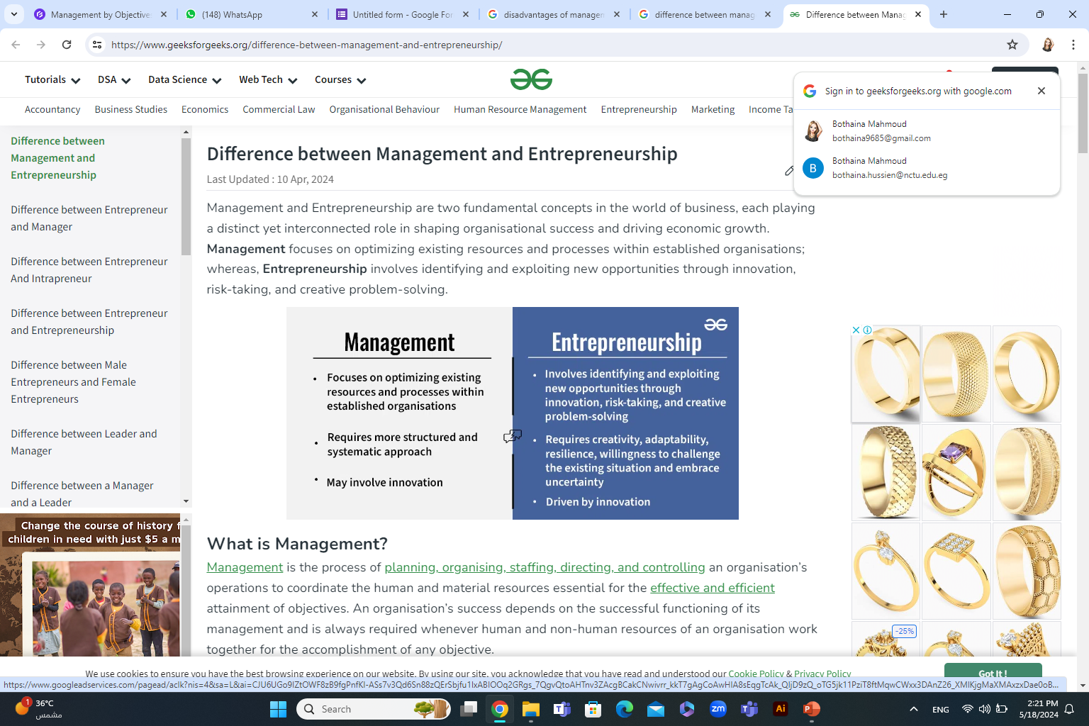
Difference between Management and Entrepreneurship
www.midocean.ae

Slide 8
Nature of Management
Management is concerned with using the resources of the organization to reach the organization’s objectives.
Management’s purpose is to use these resources effectively and efficiently so that the objectives of the organization are achieved with a minimum of cost.
Management activities share some common characteristics:
  All activities occur within the context of an organization.
  Managers are in charge of the organization’s resources—people, equipment, finances, data—and of using these resources to help the organization reach its objectives.
www.midocean.ae

Slide 9
Some Management Aspects
Core Competency: Specific set of departmental skills, abilities, knowledge and experience that allows one organization to outperform its competitors
Restructuring: Involves simplifying, shrinking, or downsizing an organization’s operations to lower operating costs
Outsourcing: Contracting with another company, to perform a work activity the company previously performed itself
Empowerment: Involves giving employees more authority and responsibility over the way they perform their work activities
www.midocean.ae

Slide 10
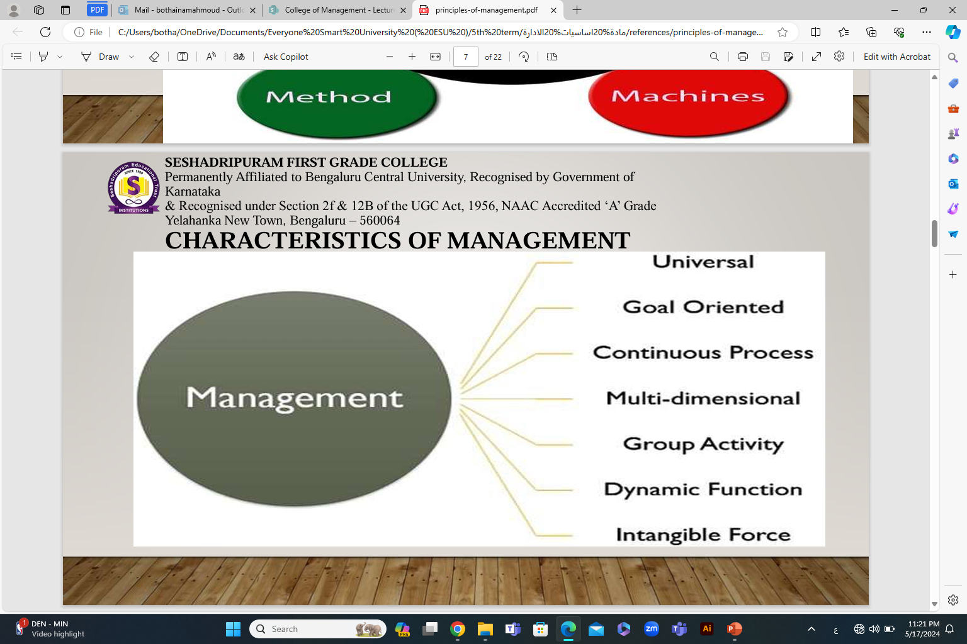
The Characteristics of Management
www.midocean.ae

Slide 11
The Characteristics of Management
1. Management is Universal: The principles and techniques of management can be applied to all types of organizations business, social, educational and religious.
2. Management is Social Process: because management is mainly related with the human activities of an enterprise.
3. Management is Goal-Oriented: The purpose of management is to achieve certain goals. The main objective of management is to maximize efficiency and economy of human efforts.
4. Management is Activity-Based: Management refers to a distinct class of activities which could be learnt and put into practice.
www.midocean.ae

Slide 12
The Characteristics of Management
5. Management is Integrative Process: The essence of management is integration of human and other resources in a manner that it leads to effective performance.
6. Management is a Group Activity: It is concerned with group efforts because it creates effective cooperation among persons working together in a group.
7. Management is Intangible: The management is not a tangible activity of business enterprise. It is the direction and control of the business activity which can be feeled but can not be seen or touched.
www.midocean.ae

Slide 13
The Characteristics of Management
8. Management is Dynamic: Management involves creating an internal environment or conditions, whereby people are able to perform their tasks efficiently. Management is a continuously growing process.
9. Management is a Multi-Disciplinary Subject: Management contains principles drawn from many social sciences like sociology, economics etc.
10. Management Accomplishes Results Through Others: The essence of management is integration of human and other resources in such a way that it leads to effective performance.
www.midocean.ae

Slide 14
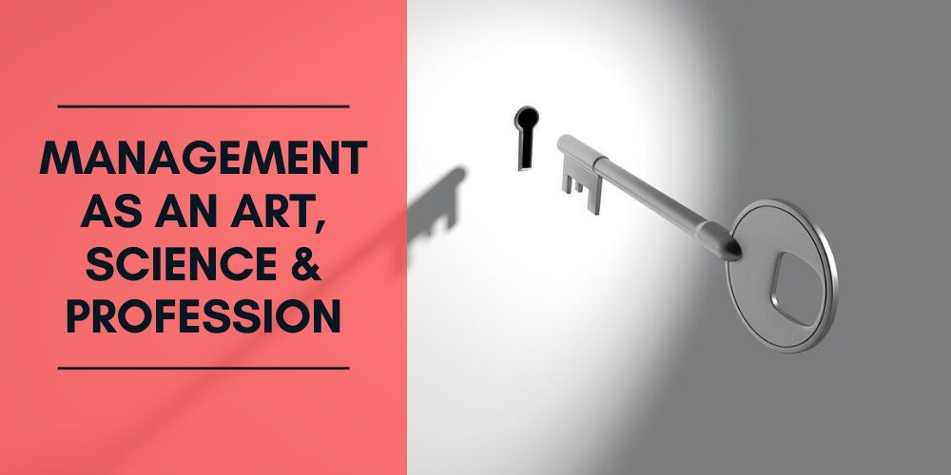
The Characteristics of Management
11. Management is Both a Science and an Art: The management, as a science provides general principles, which can guide the managers in their professional activities. The management, as an art, provides the best possible solutions of the problems and the best possible exploitation of available resources.
www.midocean.ae

Slide 15

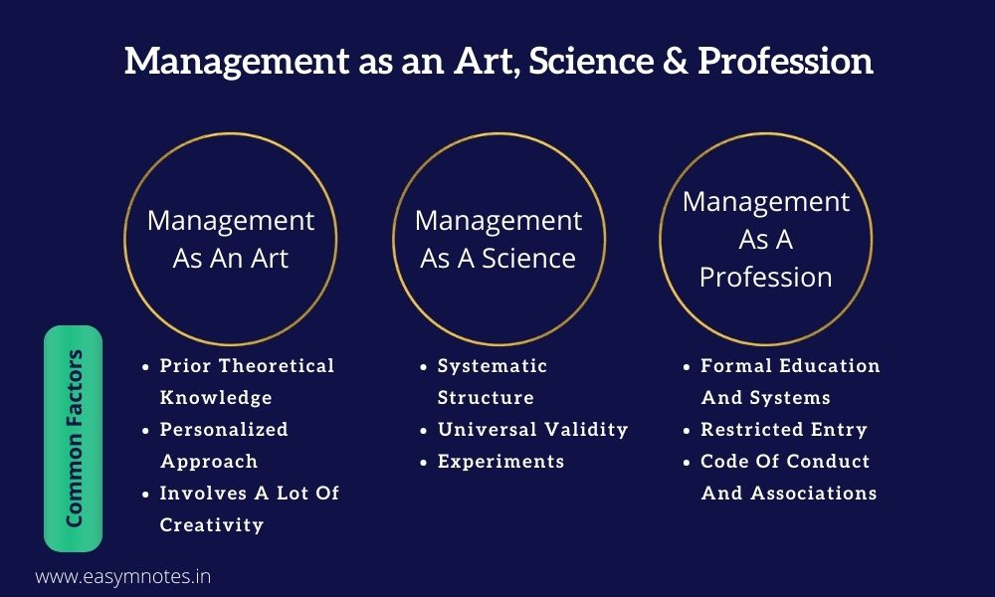
www.midocean.ae
https://www.easymanagementnotes.com/management-as-an-art-science-profession/

Slide 16

www.midocean.ae
To maximize the utilization of scarce resources
To face the increasing competition for inputs and outputs
To enhance the quality of the products and services
To adopt/plan for the changes in the business environment
Helps people deal with their bosses and coworkers
Opens a path to a well-paying job and a satisfying career
Management offers challenging, exciting and creative opportunities for meaningful and fulfilling work.
Why Study Management?

Slide 17
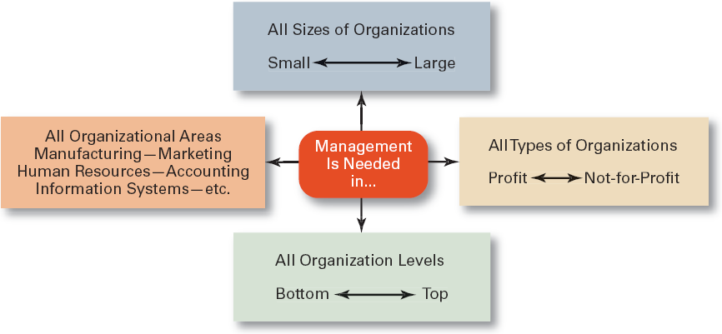
Universal Need for Management
www.midocean.ae

Slide 18
The Importance of Management
1. Higher Efficiency: Management seeks to obtain maximum output with minimum resources and efforts.
2. Satisfaction of Customers: Management attempts to produce products required by the customers.
3. Adequate Return on Capital: Management must achieve a reasonable rate of return for the owners of the business.
4. Satisfied Workforce: Management attempts to build a team of good workers who are happy and satisfied with the organization.
www.midocean.ae

Slide 19
The Importance of Management
5. Better Working Conditions: Management seeks to achieve a system to ensure fair wages for the work, security of employment and better working conditions for the work force.
6. Relations with Suppliers: Management seeks to achieve good relations with the suppliers of raw materials and capital so as to continue in production.
7. Contribution to Nationals Goals: The management must contribute to the national goals. It should use the judicious use of scarce resources of the country.
www.midocean.ae

Slide 20

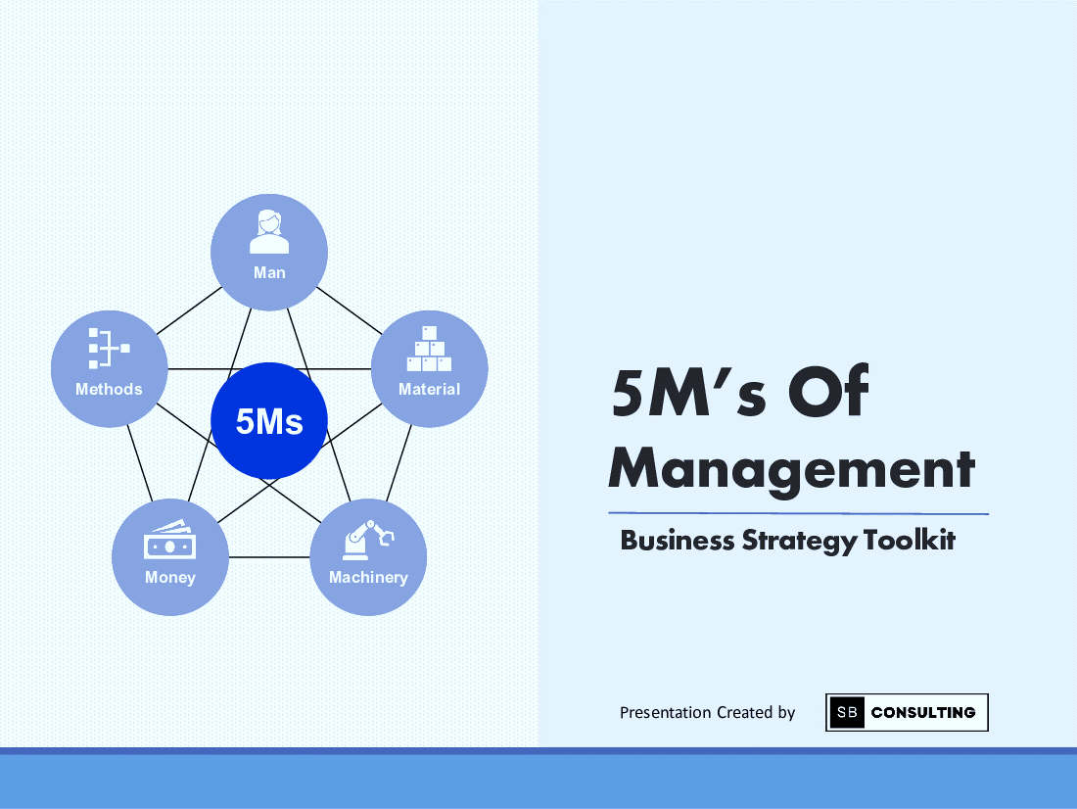
www.midocean.ae
The 5Ms of Management
https://dutchuncles.in/aspire/the-5-ms-of-management-key-components-of-every-business/

Slide 21
The 5Ms of Management
Manpower:
is a vital component of any organization as no other resource can function without it.
Managerial and non-managerial people who are part of the organization fall under this category. Having a qualified and competent workforce drives the success of any organization.
A manager must ensure that his team is functioning smoothly by resolving conflicts promptly. Work-life balance, sustainable working environment and adequate resources helps in gaining an employee’s loyalty in the long-run
www.midocean.ae

Slide 22
The 5Ms of Management
2. Money
Money is an all-purpose resource. A business needs capital to manufacture products or provide services. It is required for procuring raw materials, hiring staff, buying machines and the several other expenses that a business incurs. Availability of funds ensures smooth functioning of a business. A business requires adequate working capital and fixed capital.
Having inadequate capital can hamper the functioning of a business or in some worst cases, shut it down completely.
Having enough money ensures that you can hire the best people, the finest quality raw materials and well-functioning machines. This, in turn, will ensure that your end-product or service meets the quality standards and offers value for money.
www.midocean.ae

Slide 23
The 5Ms of Management
3. Material
The materials are those products which are utilized for creating the final product. Materials can be raw or even semi-finished products that are used for making the end-product that the company sells.
Raw materials are the primary building blocks of any production process. The management has to ensure that the quality and quantity is enough to meet the demand. They also have to note the transportation and conversion expenses of these raw materials.
EX: In cotton mills, cotton is considered as raw materials. Yarn or cloth sheets derived from these factories are then sent to the clothing factories. These sheets of cotton are viewed as raw materials in the clothing factory. The cotton is sewed, tailored and altered to make a desirable outfit. A final product for one factory can be the raw material for another.
www.midocean.ae

Slide 24
The 5Ms of Management
4. Machines
Machines are used for converting raw materials into finished goods. There can be several machines involved in the production process depending on the products the company is selling.
Purchasing modern machines helps in improving the process of manufacturing. The upcoming technology in machines plays a key role in production. Having well-functioning machines leads to quick production and may offer a competitive advantage over others.
www.midocean.ae

Slide 25
The 5Ms of Management
5. Method
The method, being a way of getting things done, definitely does revolve around management. Method is all about the time efficiency. There are several methods a manager can use to get the same thing done. Getting from point A to point B may have ten different routes, it is a challenge here for a manager to choose the best one. The best method usually is the one that is cost-efficient while meeting the quality standards.
Also, different methods require different time for the completion of the same tasks. Two managers can be given the same raw materials, machines, staff and budget but still, the result produced might be different. This is because every manager has his own way of getting things done.
www.midocean.ae

Slide 26
Theories of Management
Henri Fayol
www.midocean.ae

Slide 27
www.midocean.ae
Henri Fayol was a mining engineer who worked for the French mining company Commentry-Fourchambault and Decazeville, first as an engineer.
Then promoted to general manager and then director of administration from 1888 to 1918.
He wrote his famous “General and Industrial Management” as a director. He developed theories on management and work organization that were widely influential in the early 20th century;
his school of thought is known as the Classical Theory of Management
Theories of Management

Slide 28
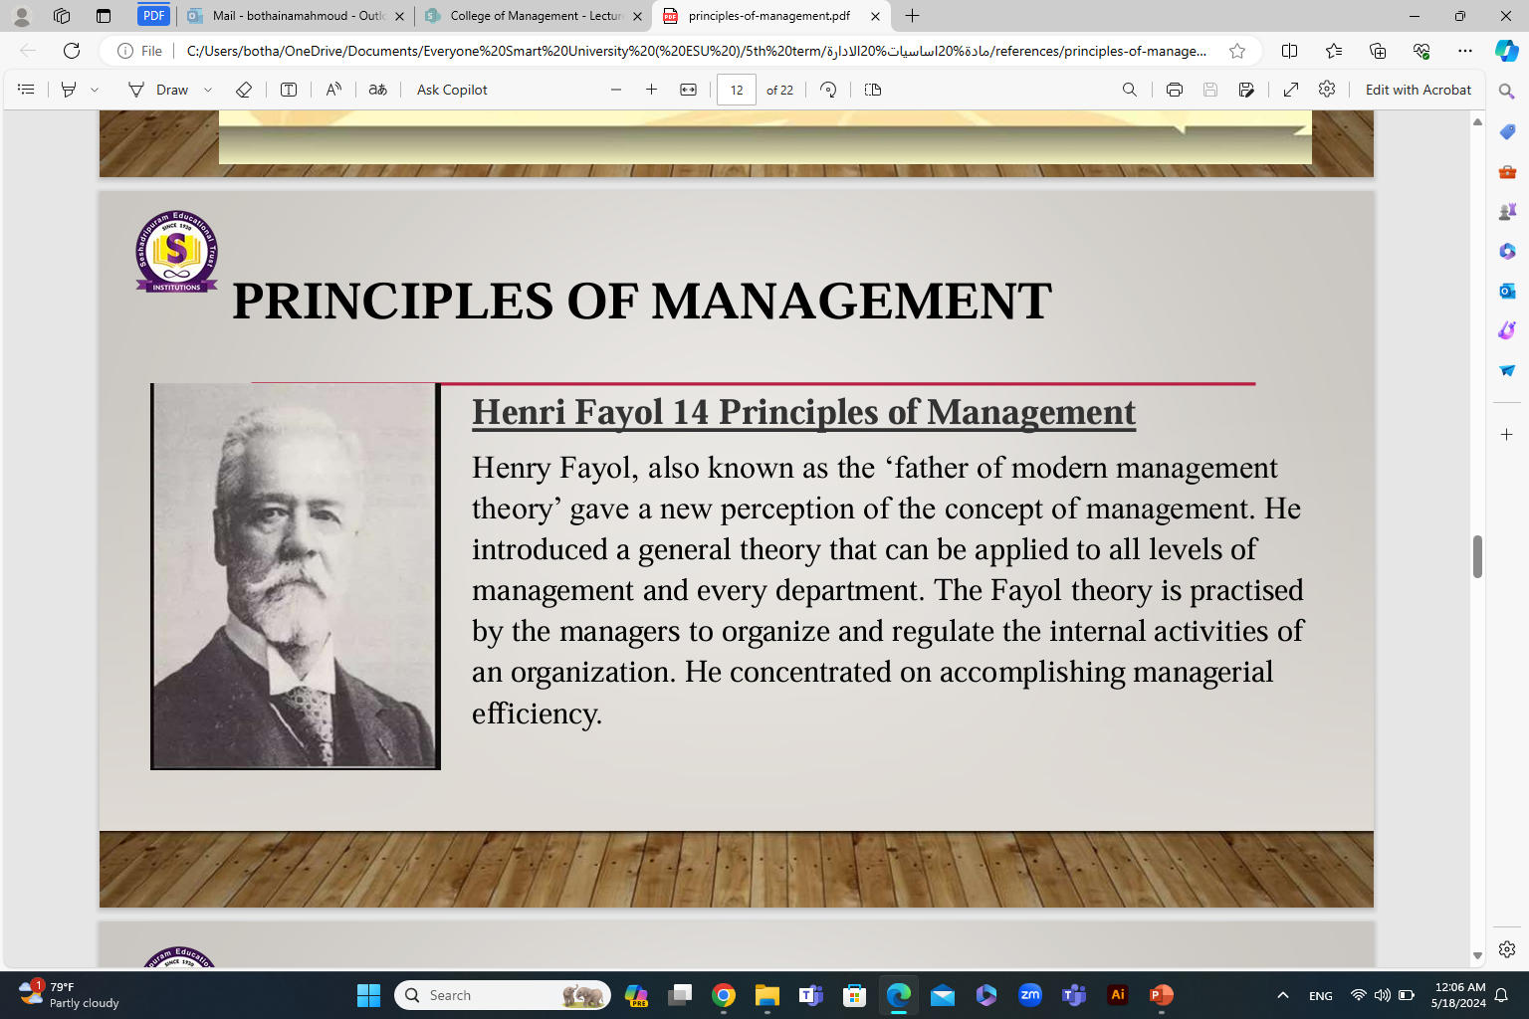
www.midocean.ae

Slide 29
www.midocean.ae
In 1916, Henri Fayol postulated the 14 principles of management for general use that are still followed by businesses and organizations today
Henri Fayol’s 14 principles of management helped early 20th-century managers manage work and interact with employees efficiently.
Theories of Management

Slide 30
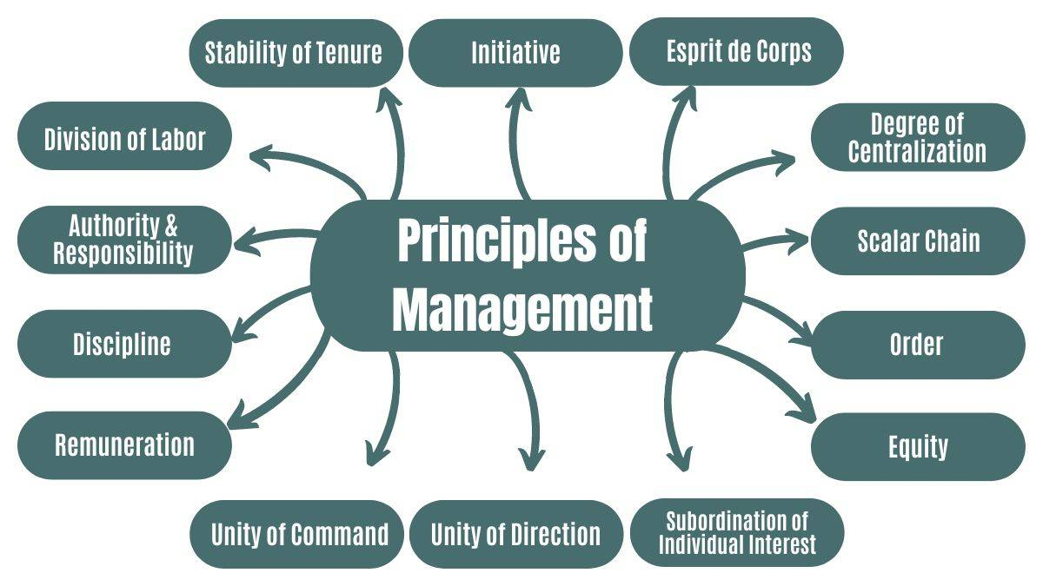
The principles of Management for the 20st Century
www.midocean.ae

Slide 31
The principles of Management
1. Division of Labor: involves dividing the tasks within any organization into different teams specialized in those tasks.
Ex: let’s take an example of any fast food joint, one person takes the order, the second person assembles the burger, the third prepares the fries, the fourth person readies the drink, and the first person serves the entire order.
2. Authority and Responsibility: Fayol defines authority as “the right to give orders and obedience,” where the worker must be responsible for complying with the order. Both authority and responsibility must be balanced. The managers should be able to ensure their tasks are being done without fail.
Ex: A company manager orders his employees to go to work the next day at an item exhibition. Therefore, they are responsible for complying with the request and showing up on time for the event.
www.midocean.ae

Slide 32
The principles of Management, Con’t
3. Discipline: The discipline principle of management depends on obedience and compliance with established rules, that is, on behaving correctly. A culture of mutual respect must be created within teams so that discipline doesn’t feel imposed but should be a part of the organizational flow. Good supervision forms the base of the discipline.
Ex: If the employees mentioned in the previous example arrive late or wear inappropriate clothing to the event, this principle will not be complied with.
4. Unity of Command: The chain of command within the teams needs to be clear. Unity of command means that every worker will always receive orders from a single boss or superior to avoid duality of information, that is, receiving two contradictory orders and not knowing which one to obey. The unity of command will help ensure no conflicts of authority.
Ex: Priya is a secretary in a small family business with two owners, Raj and Mahesh. Five minutes before the end of his workday, Raj asks her to print some sales reports. Shortly after, Mahesh tells him she must go to the bank to deposit some checks.
Who does Priya listen to? This would be an example of the duality of information, and the “unity of command” principle would not be fulfilled.
www.midocean.ae

Slide 33
The principles of Management
5. Unity of Direction: suggests that all employees work towards the goal. All activities must be led by a manager responsible for the plan. Unity of direction is dependent on good organizational skills and planning. There cannot be unity of command without unity of direction.
Ex: Production activities within a production unit should be supervised and managed by one manager, while its marketing activities, such as advertising, pricing, policy, etc., must be directed by only one manager.
6. Subordination of Individual Interest: In any organization, the company’s interests must always be privileged over the particular interests of the owners and employees. This is called subordination of individual interest against the company’s interest. It will always be necessary to give more importance to what happens in the company than personal issues.
Ex: Mini was responsible for meeting with a potential client for an event in a community hall on 10th August. Instead, she used that community hall to celebrate her birthday party. This way, she not only missed out on a potential client for her company but also put her reputation at stake.
www.midocean.ae

Slide 34
The principles of Management
7. Remuneration: The salary paid to staff (remuneration) must be equitable, fair, and guaranteed so that all company employees can perform the same task.
Ex: A company’s salespeople are paid a 3% commission as a sales award, but a newly hired employee is paid only 2%. In other words, this principle would not be fulfilled in this case.
It is also good to emphasize that there are still salary inequities due to gender issues, where women often earn less than men for the same positions and responsibilities.
8. Degree of Centralization: Centralization is the concentration of power and decision-making in the top hierarchy. In this situation, there is almost no or minor delegation of tasks or decision-making.
Ex: Centralization is very common in SMEs (small and medium-sized enterprises), where the owners generally make most of the decisions. They do not delegate them or involve middle management or other employees.
www.midocean.ae

Slide 35
The principles of Management
9. Scalar Chain: suggests that hierarchy is the order in the command lines from the highest levels. In this hierarchy, the directors and managers are at the top, the middle managers (bosses and supervisors), and the lower-level employees. Hierarchy defines authority and responsibility.
Ex: The lines of the hierarchy are evident in defence services with different degrees of importance. For instance, in the army, the hierarchy is as follows – Field marshal, General, Lieutenant general, Major general, Brigadier, Colonel, Lieutenant colonel, etc.
10. Order: suggests that there should be a fixed place for everything and everyone, and everything and everyone should be in its place. This will lead to improved productivity and efficiency.
This aligns with the scientific management theory.
Ex: In a company dedicated to manufacturing auto parts in the workshop, tools and equipment are not ordered. The staff also does not have a fixed place of work assigned, and each does different tasks without an assigned role. This example defies all the components of the principle or order.
www.midocean.ae

Slide 36
The principles of Management
11. Equity: In any company, consistently to achieve the employees’ loyalty, it will be necessary to treat the employees in a friendly manner, without any preferences, and fairly. Equity is a combination of kindness and justice.
Equity also makes it essential to talk about the importance of gender equality. This means men and women can access a position and receive the same salary.
Ex: Maxine is a manager at a production workshop. She allows choosing the simplest job to an employee with whom she plays golf on weekends, and to another colleague with whom she doesn’t get along, she allocates a more challenging job.
12. Initiative: Fayol defines initiative as “the ability to see a plan and ensure its success.” Extending this definition, we can add that initiative is linked to people’s ability to propose, develop, or devise projects that improve current situations and the chances of meeting business goals with lesser costs and time.
Ex: Alex is a production manager in a textile factory. He devised a plan to improve the manufacturing process to reduce costs by 2%, thereby making an initiative towards achieving business goals more efficiently.
www.midocean.ae

Slide 37
The principles of Management
13. Stability of Tenure of Personnel: Fayol argues that it is essential to ensure that employees last a long time in their positions and avoid staff turnover as much as possible. The idea of the stability of tenure of personnel is to inculcate a sense of job security and loyalty in the teams so they don’t think of leaving the organization. The sense of job insecurity is directly proportional to low labour efficiency and the high cost of training a new person to carry out their tasks.
Ex: Info Edge India Limited awards its employees for their contribution after they achieve a benchmark period (five years, ten years, and so on). This fosters loyalty toward the organization and encourages the employees to contribute their best.
14. Esprit de Corps
Esprit de Corps is a French term that means “Team Spirit.” Therefore, the management should create unity, cooperation, and team spirit among employees. Managers are responsible for fostering an environment of mutual trust, understanding, and empathy. Working as a team will achieve more meaningful results than independently. Therefore, it will be essential to achieve unity and harmony among employees.
Ex: The best example of Esprit de Corps is in military combat units. These units take pride in inspiring enthusiasm and devotion and working together to defeat their counter units.
www.midocean.ae

Slide 38
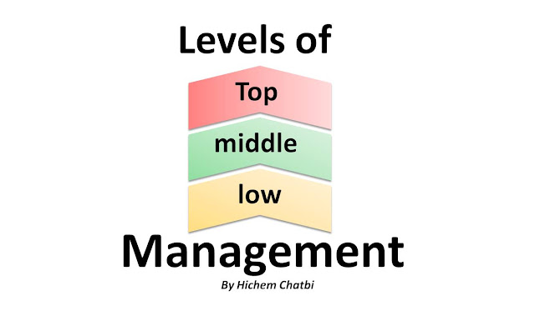
www.midocean.ae
Levels of Management

Slide 39
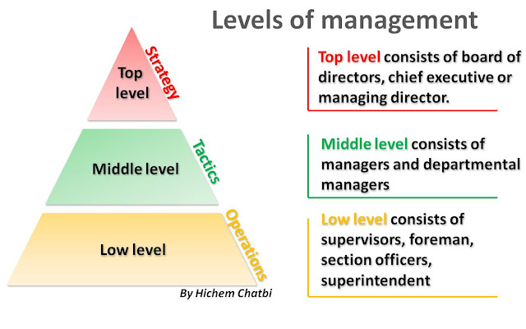
www.midocean.ae
Levels of Management

Slide 40


Chapter
1
Types of Managers
The Level of Authority (Levels of Managers)
First line managers
Middle managers
Top managers
Scope of the Activities
Functional managers
General managers
Responsibility of the Activities
Line managers
Staff managers
www.midocean.ae

Slide 41

Chapter
1
Differences Among Managers
The Three Levels of Management
  Top managers
    CEO, president, or vice president
  Middle managers
    Production manager, marketing manager, HR manager or financial manager
  First-line managers
    Crew leader, supervisor, head nurse, or office manager
  Non-management operative employees
    Workers in the organization who are supervised by first-line managers
www.midocean.ae

Slide 42
Top Management
Executives-CEO, CFO, COO, Presidents, Vice Presidents
Manage the entire organization or major parts
Develop the purpose, the goals, strategies, long-term plans
Report to board of directors or other executives
Supervise middle managers
www.midocean.ae

Slide 43
Middle Managers
Managers and department heads
Implement top manager’s strategies by developing short-term plans
Report to executives
Supervise first-line managers
www.midocean.ae

Slide 44
First-Line Managers
Supervisors, crew leaders, office managers
Implement middle manager’s plans
Report to middle managers
Supervise operative employees
www.midocean.ae

Slide 45
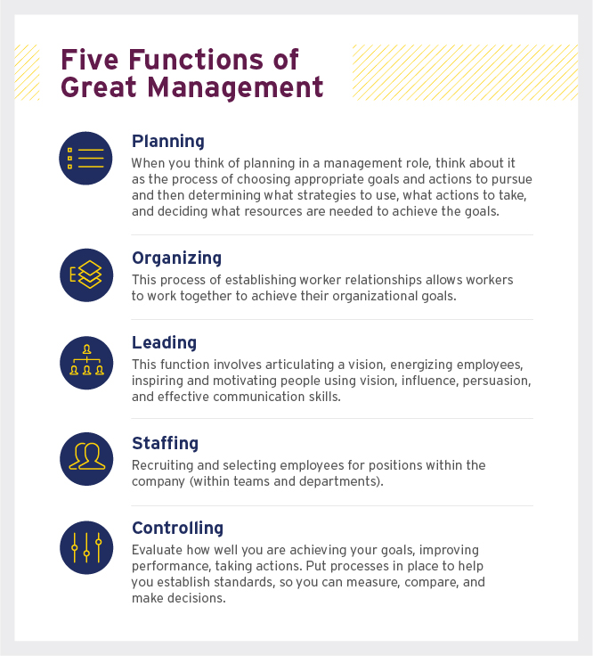
www.midocean.ae
5 Functions of Great Management

Slide 46
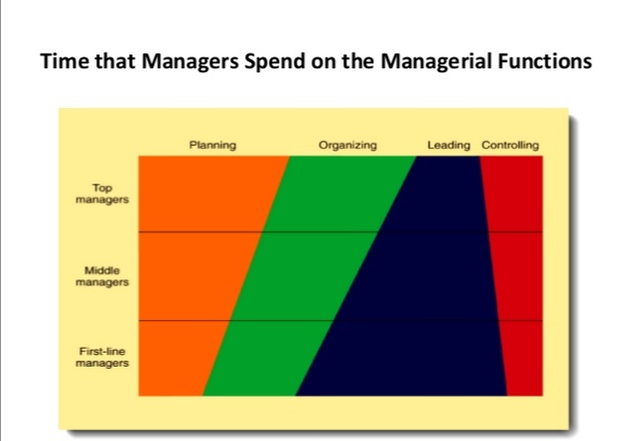
www.midocean.ae

Slide 47



Thank You

