Slide 1


Business English
Lecture 2
Prepared by
Ahmed Soliman

Slide 2
Job Interviews – Skills and Preparation

Slide 3
Lead-in: “You’re the Employer”
Imagine you are the hiring manager for a company. You have to interview someone for a job. Think for a moment: What kind of person would you want to hire?

Slide 4
✔ What 3 qualities would you look for?
✔ How would you know if someone has those qualities?
✔ What would make you choose one candidate over another?

Slide 5
Objectives
Understand what employers look for in interviews
Learn how to prepare for interviews
Practice common questions and answers
Discuss do’s and don’ts.

Slide 6
💡 1️⃣ Why Are Interviews Important?
Employers want to know if you can do the job
They want to see if you are a good fit for the team
It’s your chance to explain your experience, skills, and motivation

Slide 7
Interviews test:
✅ Communication skills
✅ Problem-solving
✅ Professional attitude
✅ Confidence

Slide 8
💼 2️⃣ Types of Job Interviews:
In-person (face-to-face)
Phone interviews
Video (online) interviews
Panel interviews (more than one interviewer)

Slide 9
✅ 3️⃣ Before the Interview – Preparation.
✔ Research the company (What do they do? Values? Mission?)
✔ Study the job description (Required skills and responsibilities).
✔ Prepare your CV and Cover Letter
✔ Think about your strengths and achievements
✔ Prepare answers to common questions
✔ Plan your outfit – dress professionally
✔ Prepare questions to ask the employer

Slide 10
✍️ 4️⃣ Common Interview Questions
Tell me about yourself.
Why do you want to work here?
What are your strengths and weaknesses?
Describe a difficult situation and how you handled it.
Where do you see yourself in 5 years?
Why should we hire you?
✅ Practice clear, honest, and structured answers.

Slide 11
🎤 5️⃣ STAR Technique
For behavioral questions (e.g. "Tell me about a time when..."), use STAR:
S – Situation: Explain the context
T – Task: What was your responsibility?
A – Action: What did you do?
R – Result: What was the outcome?

Slide 12
✅ Example:
"Tell me about a time you solved a problem."
S: Our sales dropped last quarter
T: I had to find out why
A: I analyzed customer feedback and improved the product
R: Sales increased 15% next quarter

Slide 13
💬 6️⃣ Body Language and Communication
Make eye contact
Smile naturally
Sit up straight
Use clear, polite language
Avoid slang
Listen carefully and respond thoughtfully

Slide 14
⚠️ 7️⃣ Common Mistakes to Avoid
❌ Being late
❌ Not researching the company
❌ Giving very short answers
❌ Speaking negatively about previous employers
❌ Lying about experience
❌ Forgetting to ask questions

Slide 15
✅ 8️⃣ Questions YOU Can Ask
Employers want to see you are interested.
Examples:
✔ What does a typical day look like in this role?
✔ What are the biggest challenges?
✔ How do you measure success?
✔ What is the company culture like?
✔ What are the next steps in the hiring process?
✔ Can you tell me about the working hours?

Slide 16

📝 9️⃣ After the Interview
Say thank you at the end
Send a polite thank-you email (if appropriate)
Reflect: What went well? What can you improve?

Slide 17
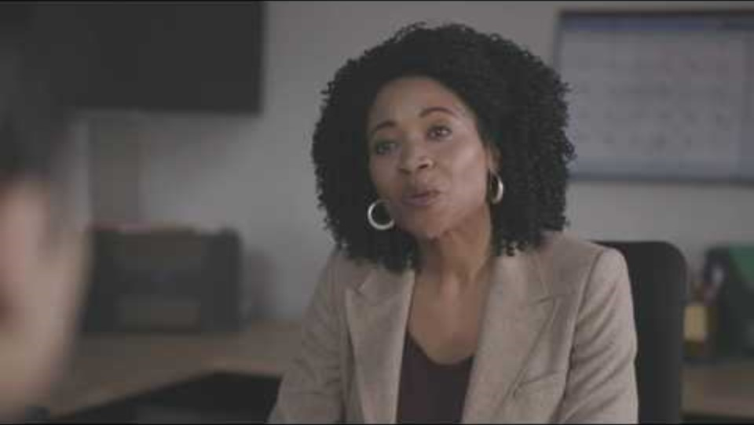
A Mock Interview https://www.youtube.com/watch?v=ExJZAegsOis

Slide 18
🎭 Interview Dialogue 1: Entry-Level Accountant
👨 Interviewer: Good morning, Mohamed. Thank you for coming in today.
👤 Candidate: Good morning. Thank you for having me.
👨 Interviewer: Let’s start with something simple. Can you tell me a bit about yourself?
👤 Candidate: Sure. I graduated with a degree in Accounting from Ain Shams University. During university, I completed an internship at a local accounting firm where I gained hands-on experience with bookkeeping and preparing financial statements. I'm passionate about numbers and eager to apply what I’ve learned in a real work environment.

Slide 19
👨Interviewer: Why do you want to work at our company?
👤 Candidate: I’ve researched your company and I admire your reputation for supporting young professionals and encouraging innovation in financial services. I believe I can grow here and contribute to your finance team.
👨 Interviewer: What would you say is one of your strengths?
👤 Candidate: I’m very detail-oriented. During my internship, I was praised for identifying an error in a tax report that would have caused a penalty.

Slide 20
👨 Interviewer: And a weakness?
👤 Candidate: Sometimes I focus too much on getting everything perfect. But I’m learning to balance quality with deadlines.
👨 Interviewer: Do you have any questions for me?
👤 Candidate: Yes, thank you. What does a typical day look like for a junior accountant in your team?
👨 Interviewer: Great question! Let me explain...

Slide 21
🎭 Interview Dialogue 2: Business Graduate – Marketing Role
👩 Interviewer: Hello Salma. Welcome. Let's begin—why did you apply for this role?
👩‍🎓 Candidate: Hello! I applied because I’m very interested in digital marketing. Your company has exciting campaigns, and I’d love to be part of a creative team.
👩 Interviewer: Can you describe a time when you worked under pressure?
👩‍🎓 Candidate: Sure. In my final year, I managed a marketing project with a tight deadline. One of our team members dropped out, so I took on extra tasks. I organized the timeline and delegated clearly. We delivered the project on time and received excellent feedback.

Slide 22
👩 Interviewer: How do you handle teamwork?
👩‍🎓 Candidate: I enjoy working in teams. I listen to others’ ideas, give feedback respectfully, and always focus on the goal.
👩 Interviewer: Where do you see yourself in 5 years?
👩‍🎓 Candidate: I hope to be a marketing manager, leading campaigns and mentoring junior staff.
👩 Interviewer: Do you have any questions for us?
👩‍🎓 Candidate: Yes, what kind of training do you provide for new hires?
👩 Interviewer: That’s a great question! We have a 3-week onboarding program...

Slide 23
Job Interview Role-Play

Slide 24
📝 Instructions
Work in pairs: one student is the interviewer; the other is the candidate.
Choose a job from the list below, or create your own.
The interviewer asks questions from the list.
The candidate answers as if they are really applying for the job.
After 7–8 minutes, switch roles.

Slide 25
💼 Choose a Job Position
Pick one to role-play:
Junior Accountant
Sales Assistant
Marketing Intern
Customer Service Representative
Office Administrator
HR Assistant

Slide 26
❓ Interview Questions (Interviewer’s Role)
Ask at least 5–6 questions from this list:
Can you tell me about yourself?
Why did you apply for this position?
What are your strengths?
What is one of your weaknesses?
Describe a time you worked in a team.
Tell me about a time you faced a challenge at work or school.

Slide 27
6. Why should we hire you?
7. What do you know about our company?
8. Where do you see yourself in five years?
9. Do you have any questions for us?
✅ Use follow-up questions like:
– Can you give me an example?
– What was the result?

Slide 28
🗣️ Useful Language – Candidate
Function | Useful Expressions
Starting | Thank you for the opportunity.
Describing yourself | I’m a recent graduate in...
Strengths | I’m very organized / reliable / detail-oriented.
Weakness (politely) | I used to struggle with... but I’ve improved by...
STAR technique | In that situation... / What I did was...
Asking questions | Could you tell me more about...?
Ending | Thank you again. I look forward to hearing from you.

Slide 29
✍️ Reflection
After the role-play, answer these questions with your partner:
What did the candidate do well?
What could be improved?
What expressions sounded professional?
Did the answers match the job position?

Slide 30
⭐ Conclusion
A successful interview = Preparation + Practice + Professionalism.
✅ Know the company.
✅ Know yourself.
✅ Communicate clearly.
✅ Show enthusiasm and confidence.

Slide 31


Thank You

