Slide 1



Influence and Negotiation Skills
Negotiation Barriers
Prepared by:
Dr. Bothaina Mahmoud Fouad
College of
Entrepreneurship and Innovation
Code ENT623
Week 10

Slide 2

Lec. 9 Overview
The main points:
Identify the negotiation barriers and challenges
How to overcome these barriers and challenges

Slide 3



01
Difference between challenge, barrier, issue and problem

Slide 4

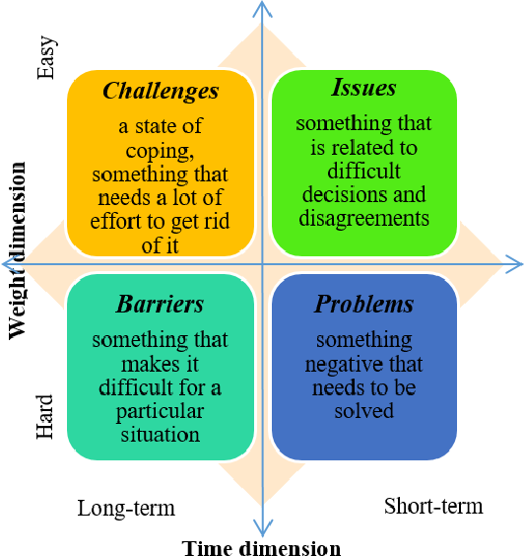

Slide 5
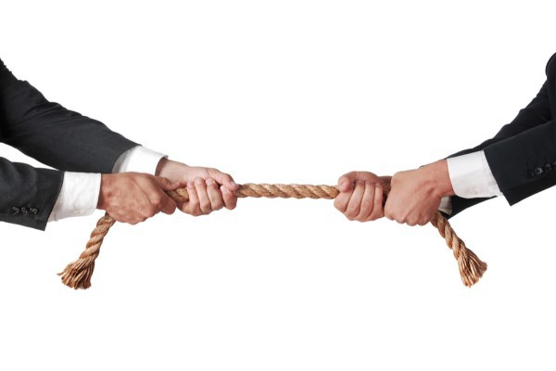
Negotiation barriers refer to obstacles or challenges that can hinder the progress or effectiveness of a negotiation process. These barriers can arise due to various factors, including communication issues, psychological biases, conflicting interests, and power imbalances. Here are some common negotiation barriers:
02
Negotiation Barriers & Challenges

Slide 6
common barriers
Lack of information
Poor and impaired communication
Power imbalances
Lack of alternatives
Cultural differences
Suspicion and mistrust
Being too rigid
Time constraints
Blame game
Failure to understand
11. Lack of confidence
12. Going unprepared for a negotiation
13. Criticism, sarcasm, derogatory remarks
14. Lack of patience
15. Negative Outlook Towards the Negotiation Process
16. Try to win at all costs attitude
17. Strong Emotions Factors
18. Lack of Empathy
19. Wrong Focus
https://www.slideshare.net/AyeshaAsif74/obstacles-to-negotiationpptx

Slide 7
1. Lack of Information
Negotiations can be impeded when one or both parties lack essential information about the subject matter, market conditions, or the other party's interests and constraints. Insufficient information can lead to misunderstandings and an inability to find mutually beneficial solutions.

Slide 8
1. Lack of Information
Other or both sides fail to provide necessary information about issues, criteria, desired outcomes, or interests
Failure to provide necessary information can be unintentional or intentional ( for example in the form of selective disclosure).

Slide 9
1. Lack of Information
For instance, during the sale of aircrafts, a mandate agreement and an NCND ( Non- Circumvent non- Disclosure Agreement ) is required.
Without these documents, the buyer and seller will not trust each other and will doubt each other’s ability to sign the contract successfully.
Not having these documents will lead to the deal falling apart

Slide 10
2. Poor and impaired communication
Effective communication is crucial for successful negotiations. Barriers such as language barriers, misinterpretation of messages, selective listening, and ineffective questioning techniques can hinder understanding and prevent parties from reaching a satisfactory agreement.

Slide 11
2. Poor and impaired communication
Communication is considered the first step towards the ladder of success.
Poor communication in negotiation results in actions that have some serious consequences.
For instance, we are trying to make a deal with a party that is not native.

Slide 12
2. Poor and impaired communication
When negotiating our agenda we will face problems in understandably delivering our message, the party will fall prey to lingual and cultural biases as this party does not have any idea how systems operate in the respected area so the level of effective negotiation drops here.

Slide 13
3. Power imbalances
When one party has significantly more power or leverage than the other, it can create an imbalance that affects the negotiation process. The stronger party may exploit their power, making it challenging for the weaker party to assert their interests or secure a fair outcome

Slide 14
4. Cultural differences
Negotiating across different cultures can present additional barriers. Varying communication styles, norms, values, and decision-making processes can lead to misunderstandings and hinder effective negotiation.

Slide 15
5. Lack of alternatives
When parties feel that they have no viable alternatives or options outside of the negotiation, they may be less willing to make concessions or reach a mutually beneficial agreement. This can lead to a stalemate or unsatisfactory outcomes.

Slide 16
6. Suspicion and mistrust
Building trust is crucial for successful negotiations. If the parties have a history of conflict, lack confidence in each other's integrity, or feel that their interests are not being respected, it can impede open and collaborative negotiation.

Slide 17
6. Suspicion and mistrust
Suspicion and mistrust may make parties conclude that the other side is not committed to the negotiation process and may withdraw.
There is the Dilemma Honesty
On one hand, telling the other party everything about your situation may give that person an opportunity to take advantage of you.
However, not telling the other person anything may lead to a stalemate

Slide 18
6. Suspicion and mistrust
The Dilemma of trust concerns how much you should believe of what the other party tells you.
Believing everything, the person could take advantages of you.
Believing nothing, then reaching an agreement will be very difficult.

Slide 19
6. Suspicion and mistrust
Ex: party A and party B are negotiating for a deal consisting of large number of barrels of petroleum.
Party A ( the buyer ) is suspicious about the quality of petroleum that party B is supplying because of a recent conflict of part B with another customer over quality control.
Party B did not disclose the reasons of this conflict during the negotiation with party A. as party B is not being fully honest and is unable to eliminate these suspicious of party a, the deal falls apart.

Slide 20
To overcome this barrier
Building trust
Gain the trust of the other part before negotiating
Treat your negotiators fairly
Repairing breach of trust
Arrange a personal meeting to discuss the conflict and any surrounding issues.
Taking responsibility for all or some aspects of underlying relationship tension is important to disarm conflict.

Slide 21
7. Being too rigid
If both parties approach negotiations with fixed positions and have a rigid mindset, it becomes challenging to explore creative solutions or make concessions. Inflexibility can lead to a stalemate or an unsatisfactory compromise.

Slide 22
7. Being too rigid
Negotiations will fail if you are too rigid about your opinions rather than simply being clear about your end purpose, and open to how to design the deal and where flexibility can be practiced.

Slide 23
7. Being too rigid
EX: if a shopkeeper is selling an antique glass vase but he is being too rigid and is not willing to lower the price a bit so as to make it more affordable, not only he is losing customers but also the potential customer will be deprived of the product he liked and wanted to purchase.
In this case, it will be a lose – lose situation.

Slide 24
To overcome this barrier
Be a little flexible, compromise to your best extent possible and don’t crib always.
One should adopt a positive attitude and try his level best to adjust with each other and find out a solution which will satisfy all.

Slide 25
8. Time constraints
Negotiations that are rushed or subject to tight deadlines can create pressure and limit the ability to thoroughly explore options and find mutually beneficial agreements. Time constraints can increase tension and hinder the development of trust and rapport between the parties.

Slide 26
8. Time constraints
It is a major challenge to effective negotiation. One should never be in a hurry.
You need time to convince others
Never be in rush to purchase things or close a deal.
Analyze things carefully and then only come to conclusions.

Slide 27
8. Time constraints
EX: if you’re trying to get a new job quickly, you may take a position with lower pay than you deserve, or you may compromise too much on benefits.
In this case, you may find yourself unsatisfied with you decision long- term

Slide 28
9. Blame game
While negotiating, favoring the statement of one party over another without listening to the point of view of the other results in bad negotiation due to lack of empathy towards the other party.

Slide 29
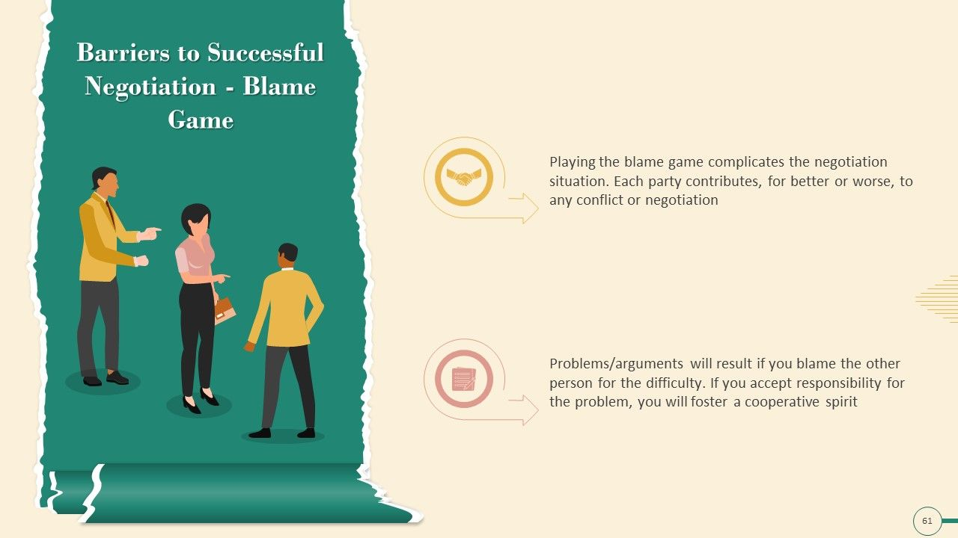
Playing the blame game complicates the negotiation situation. Each party contributes for better or worse to any conflict or negotiation
Problem/ arguments will result if you blame the other person for the difficulty
If you accept responsibility for the problem, you will foster a cooperative spirit
Blame Game

Slide 30
9. Blame game
EX: in any conflict, or negotiation, both parties are striving to get their desirable outcomes without listening to the queries of the other party

Slide 31
To overcome this barrier
We should be gentle and assertive in our negotiation
We should show sense of empathy for the second party’s argument
We should try to build a rapport with the other party

Slide 32
10. Failure to understand
The biggest challenge to negotiation is when individuals are not ready to understand the second party at all. There are individuals who only think about their interests and tend to ignore the interest and needs of the other.

Slide 33
10. Failure to understand
EX: Jim wanted to buy a shirt for himself, he was only concerned with his pocket and never bothered about the store owner.
He quoted an unusually low price and the store owner refused to sell the shirt.
The outcome was a big zero, nobody could get what they wanted.
Jim failed to understand the fact that the store owner is not sitting for charity.
He also has a family to look after and thus even his profits are important.
Why would he sell something at a less rate which would not earn him his profits?

Slide 34
To overcome this barrier
Try to find out the expectations and interests of the other party too

Slide 35
11. Lack of confidence
If you lack confidence, chances are that you will make an ineffective negotiator.
Confidence has a huge impact on negotiator’s behaviour and what they ultimately achieve

Slide 36
11. Lack of confidence
EX: negotiating with someone more powerful than you, can feel intimidating, especially when you are just starting with our career. The common reason so is because of what’s at stake.

Slide 37
To overcome this barrier
Don’t forget to make an eye contact with the person sitting on the other side of the table.
Prepare and practice it is natural to feel nervous and anxious ahead of time.
Preparing ahead of time can help calm your nerves.
It’s important to be serious but that does not mean you will not even greet the other person.
Be straight forward and crisp in your communication.
Take care of your dressing and appearance as well.

Slide 38
12. Going unprepared for a negotiation
is unacceptable. Don’t underestimate the second party. Check out even the smallest details before going for a negotiation.
Don’t think that the other person is not as smart as you, he can ask you anything and remember even he will try his level best to convince you.
You need to have valid answers for his questions.

Slide 39
13. Criticism, sarcasm, derogatory remarks
Never ever say anything which might hurt others.
Remember everyone is here to do business and make profits, so be logical and justified.
Don’t get too involved and over emotional.
One should be a little diplomatic and intelligent for an effective negotiation

Slide 40
14. Lack of patience
Every individual has the right to express his views and one should not interfere in his speech.
You might not agree to him but at least listen to him first.
Sit with the second party and make him realize how the deal would benefit you as well as him.
If possible take a note pad and a pen with you to explain things in a better way.
Carry all the necessary documents which you might require at the time of negotiation.

Slide 41
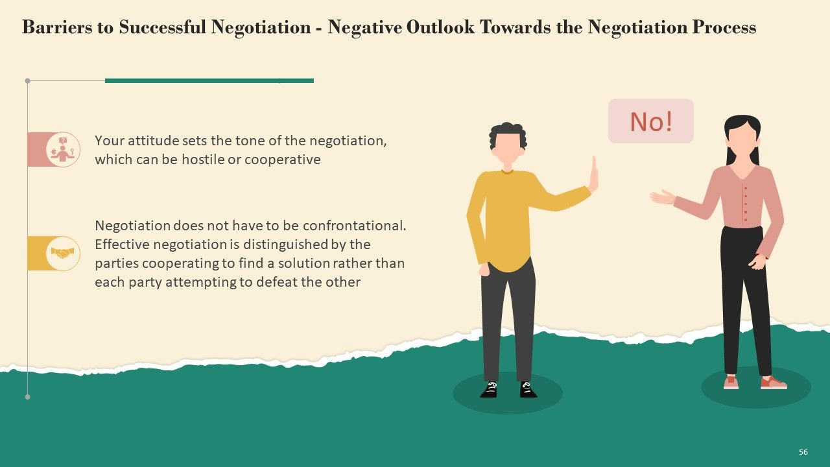
Your attitude sets the tone of the negotiation, which can be hostile or cooperative.
Negotiation does not have to be confrontational, effective negotiation is distinguished by the parties cooperating to find a solution rather than each party attempting to defeat the other
Your attitude sets the tone of the negotiation, which can be hostile or cooperative.
Negotiation does not have to be confrontational, effective negotiation is distinguished by the parties cooperating to find a solution rather than each party attempting to defeat the other
15. Negative Outlook Towards the Negotiation Process

Slide 42
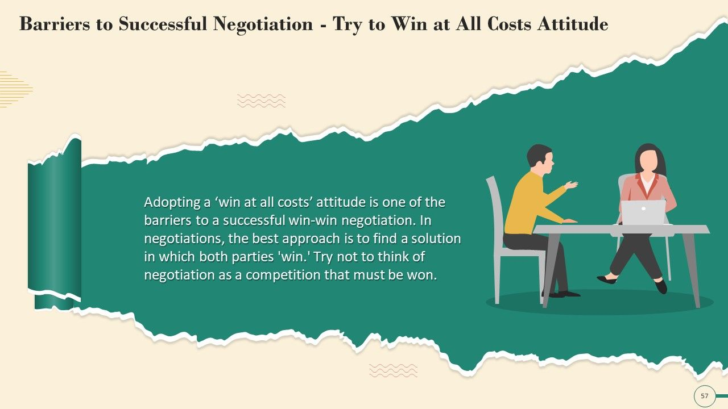
Adopting a ‘ win at all costs ‘ attitude is one of the barriers to a successful win – win negotiation
The best approach is to find a solution in which both parties
“ win “
Try not to think of negotiation as a competition that must be won.
16. Try to win at all costs attitude

Slide 43
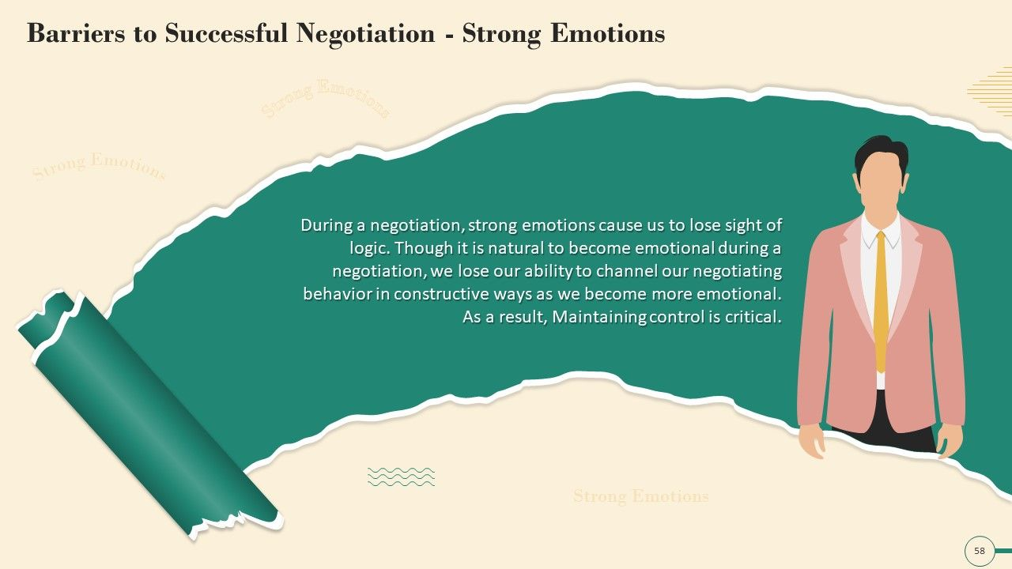
Emotions can play a significant role in negotiations. Strong emotions like anger, fear, ego, or personal biases can cloud judgment and lead to irrational decision-making. Emotional barriers can escalate conflicts and make it difficult to find common ground.
17. Strong Emotions Factors

Slide 44
During a negotiation, strong emotions cause us to lose sight of logic.
Through it is natural to become emotional during a negotiation
We lose our ability to channel our negotiating behavior in constructive ways as we become more emotional
As a result, maintaining control is critical
17. Strong Emotions factors

Slide 45
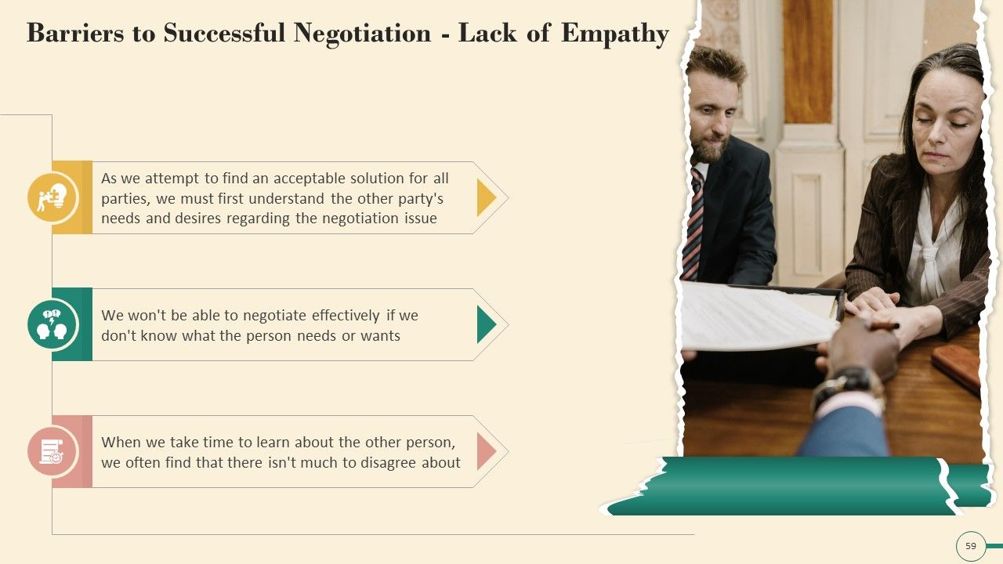
As we attempt to find an acceptable solution for all parties, we must first understand the other party’s needs and desires regarding the negotiation issue
We won’t be able to negotiate effectively if we don’t know what the person needs or wants
When we take time to learn about the other person, we often find that there isn’t much to disagree about
18. Lack of Empathy

Slide 46
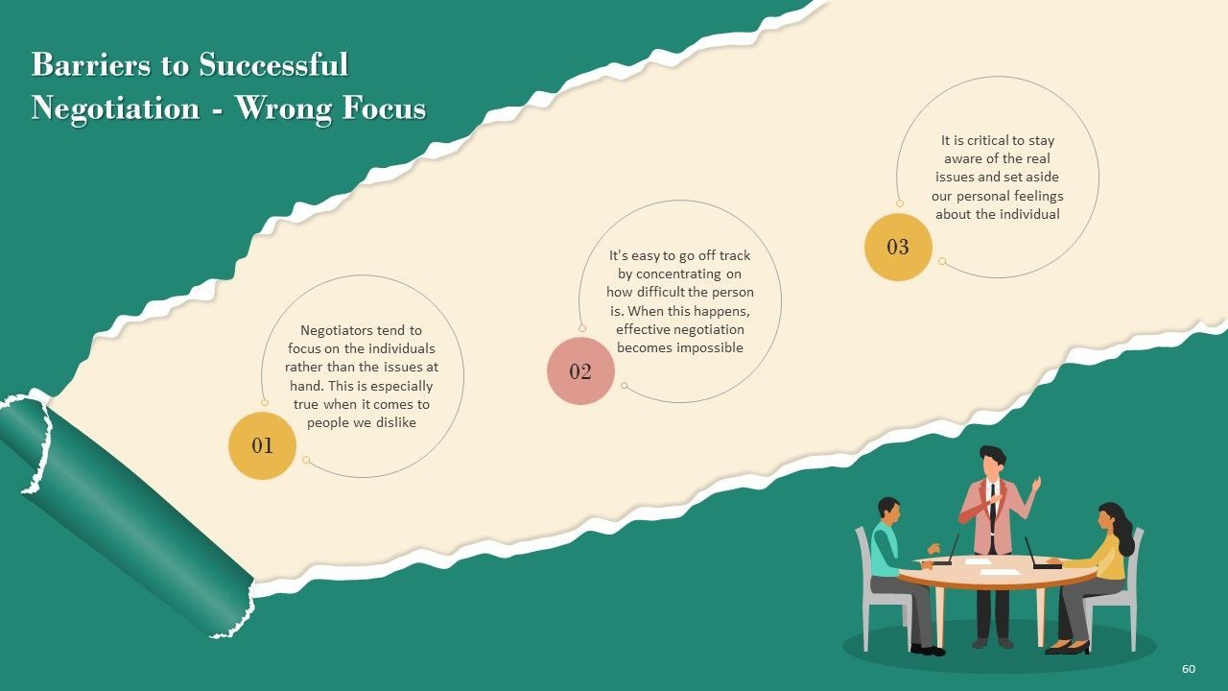
Negotiators tend to focus on the individuals rather than the issues at hand. This is especially true when it comes to people we dislike
It’s easy to go off track by concentrating on how difficult the person is. When this happens effective negotiation become impossible
It is critical to stay aware of the real issues and set aside our personal feelings about the individual
19. Wrong Focus

Slide 47
Overcoming negotiation barriers requires awareness, effective communication, empathy, creativity, and a willingness to explore win-win solutions. Skilled negotiators understand these barriers and employ strategies to address them, fostering a collaborative and constructive negotiation process.

Slide 48


Thank You

