Slide 1

PMG 622
Agile Project Management
LECTURE 07: ANNEX A3
OVERVIEW OF AGILE AND LEAN FRAMEWORKS [1/2]
Everyone’s Smart
University
دكتور مهندس استشاري ادارة المشروعات
Eng. Dr. Akram Mustafa Suliman Ali,
PhD. AU, BEng. & MSc. AAST, CEng CMarEng MIMarEST, PE, PMP®,
ASQ CSSBB, ISO Lead Auditor, NDT Level II,

Slide 2
FREE PROJECT MANAGEMENT AND RELATED RESOURCES
Infringement of intellectual property is a violation of Project Management Code of Ethics.
There is a free alternative to all resources requiring special license.
Based on your specialty list the software and other resources that require a license and their free alternative.
Could your organization recognize the free alternatives and if not what do you think are the obstacles.
Forum Topic: FREE RESOURCES

Slide 3
Introduction TO AGILE AND LEAN FRAMEWORKS
These approaches can be used as is or combined to adapt to what works best for a given environment or situation.
It is NOT necessary to use any of these; an agile approach can be developed from scratch as long as it adheres to the mindset, values, and principles of the Agile Manifesto.
If the agile principles are followed to deliver value at a sustainable pace, and the developed approach promotes collaboration with the customer, a specific approach is not required.

Slide 4
SELECTION CRITERIA FOR THE AGILE PRACTICE GUIDE
Designed for holistic use
  Intended to guide a broad set of project activities
Formalized for common use
  Intended for common use in a variety of contexts
Popular in modern use
  Adopted by a significant number of industries

Slide 5
Agile approaches Breadth and detail

Slide 6
scrum

Slide 7
SCRUM
Scrum is a single-team process framework used to manage product development.
The framework consists of Scrum roles, events, artifacts, and rules, and uses an iterative approach to deliver working product.
Scrum is run on timeboxes of 1 month or less with consistent durations called sprints where a potentially releasable increment of product is produced.

Slide 8
The Scrum team (roles)
The product owner is responsible for maximizing the value of the product.
The development team is a cross-functional, self-organizing team consisting of team members who have everything they need within the team to deliver working product without depending on others outside of the team.
The scrum master is responsible for ensuring the Scrum process is upheld and works to ensure the Scrum team adheres to the practices and rules as well as coaches the team on removing impediments.

Slide 9
Scrum events and artifacts

Slide 10
EXTREME PROGRAMMING

Slide 11
XP
eXtreme Programming (XP) is a software development method based on frequent cycles.
The name is based on the philosophy of distilling a given best practice to its purest, simplest form, and applying that practice continuously throughout the project.
XP is most known for popularizing a holistic set of practices intended to improve the results of software projects.
The method was first formalized as a set of twelve primary practices, but then gradually evolved to adopt several other corollary practices.

Slide 12
Notes:
Information Radiators

Slide 13
core values
communication,
simplicity,
feedback,
courage,
respect

Slide 14
key principles
Humanity
Economics
mutual benefit
self-similarity
Improvement
Diversity
Reflection
Flow
Opportunity
redundancy
Failure
Quality
baby steps
accepted responsibility
Notes:
Redundancy
Remove redundant code
Testing is a redundancy we want to keep

Slide 15
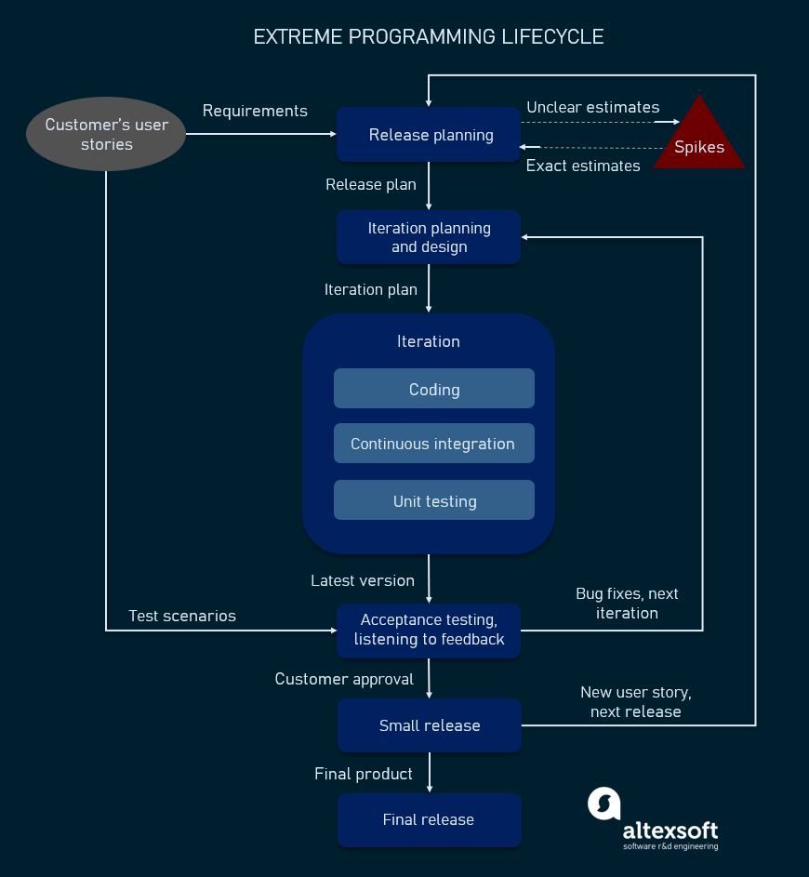

Slide 16
KANBAN METHOD

Slide 17
KANBAN METHOD [1/2]
Kanban in lean manufacturing is a system for scheduling inventory control and replenishment.
This process of “just-in-time” inventory replenishment was originally seen in grocery stores when shelves were restocked based on the gaps in the shelves and not supplier inventory.
Inspired by these just-in-time inventory systems, Taiichi Ohno developed Kanban and it was applied at the main Toyota manufacturing facility in 1953.
The Kanban Method is a holistic framework for incremental, evolutionary process and systems change for organizations.

Slide 18
KANBAN METHOD [2/2]
The method uses a “pull system” to move the work through the process. When the team completes an item, the team can pull an item into that step.
In the Kanban Method, it is more important to complete work than it is to start new work.
There is no value derived from work that is not completed so the team works together to implement and adhere to the work in progress (WIP) limits and get each piece of work through the system to “done.”

Slide 19
KANBan
The word kanban is literally translated as “visual sign” or “card.”
Physical kanban boards with cards enable and promote the visualization and flow of the work through the system for everyone to see.
This information radiator (large display) is made up of columns that represent the states the work needs to flow through in order to get to done.
The simplest of boards could have three columns (i.e., to do, doing, and done), but it is adaptable to whatever states are deemed needed by the team utilizing it.

Slide 20
Applicability and utilization
The Kanban Method is utilized and applicable in many settings and allows for a continuous flow of work and value to the customer.
The Kanban Method is less prescriptive than some agile approaches and thus less disruptive to begin implementing as it is the original “start where you are” method.
Organizations can begin applying Kanban Methods with relative ease and progress toward fully implementing the method if that is what they deem necessary or appropriate.

Slide 21
emphasis
Unlike most agile approaches, the Kanban Method does not prescribe the use of timeboxed iterations.
Iterations can be used within the Kanban Method, but the principle of pulling single items through the process continuously and limiting work in progress to optimize flow should always remain intact.

Slide 22
Conditions for best use [1/2]
Flexibility. Teams are typically not bound by timeboxes and will work on the highest priority item in the backlog of work.
Focus on continuous delivery. Teams are focused on flowing work through the system to completion and not beginning new work until work in progress is completed.
Increased productivity and quality. Productivity and quality are increased by limiting work in progress.
Increased efficiency. Checking each task for value adding or nonvalue-added activities and removing the non-value adding activities.

Slide 23
Conditions for best use [2/2]
Team member focus. Limited work in progress allows the team to focus on the current work.
Variability in the workload. When there is unpredictability in the way that work arrives, and it becomes impossible for teams to make predictable commitments; even for short periods of time.
Reduction of waste. Transparency makes waste visible so it can be removed.

Slide 24
Defining Principles and Properties of the Kanban Method

Slide 25
Kanban board
Kanban boards are a low-tech, hightouch technology that may seem overly simplistic at first, but those using them soon realize their power.
Utilizing policies for entry and exit to columns, as well as constraints such as limiting work in process, kanban boards provide clear insight to workflow, bottlenecks, blockers, and overall status.
Additionally the board acts as an information radiator to anyone who sees it, providing up-to-date information on the status of the work of the team.

Slide 27
CRYSTAL METHODS

Slide 28
Crystal methodologies
Crystal is a family of methodologies.
Crystal methodologies are designed to scale, and provide a selection of methodology rigor based on project size (number of people involved in the project) and the criticality of the project.
Crystal Methodology realizes that each project may require a slightly tailored set of policies, practices, and processes in order to meet the project's unique characteristics.
The family of methodologies use different colors based on “weight” to determine which methodology to use.
The use of the word crystal comes from the gemstone where the various “faces” represent underlying core principles and values.

Slide 29
Crystal faces
Core Values | Common Properties (SUCCESS FACTORS)
People | Frequent delivery
Interaction | Reflective improvement
Community | Close or osmotic communication
Skills | Personal safety
Talents | Focus
Communications | Easy access to expert users
 | Technical environment with automated tests, configuration management, and frequent integration

Slide 31
SCRUMBAN

Slide 32
SCRUMBAN
Scrumban is an agile approach originally designed as a way to transition from Scrum to Kanban.
As additional agile frameworks and methodologies emerged, it became an evolving hybrid framework in and of itself where teams use Scrum as a framework and Kanban for process improvement.
In Scrumban, the work is organized into small “sprints” and leverages the use of kanban boards to visualize and monitor the work.
The stories are placed on the kanban board and the team manages its work by using work-in-progress limits.
Daily meetings are held to maintain the collaboration between the team and to remove impediments.
A planning trigger is set in place for the team to know when to plan next, typically when the work-in-progress level is lower than a predetermined limit.
There are no predefined roles in Scrumban—the team retains their current roles.

Slide 33
FEATURE-DRIVEN DEVELOPMENT

Slide 34
FDD
Feature-Driven Development (FDD) was developed to meet the specific needs of a large software development project.
Features relate to a small business value capability

Slide 35
FDD ROLES
There are six primary roles on a Feature-Driven Development project where individuals can take on one or more of the following roles:
  Project manager,
  Chief architect,
  Development manager,
  Chief programmer,
  Class owner, and/or
  Domain expert.

Slide 36
FDD PROCESSES/ ACTIVITIES
A Feature-Driven Development project is organized around five processes or activities, which are performed iteratively:
  Develop an overall model,
  Build a features list,
  Plan by feature,
  Design by feature, and
  Build by features.

Slide 37
FDD LIFE CYCLE

