Slide 1


Project Governance
Prepared by Dr. Fayez Jrad
PMG 424
Lecture 04

Slide 2



Project Governance
Lecture 04
PMG 424
Transparent and Accountable Organizations
Prepared by
Dr. Fayez Jrad
www.midocean.ae

Slide 3
Chapter
Learning Outcomes
04
Understanding why organizational view of projects.
Identifying the forces of project management quality.
Explaining the three-step process of project management governance framework.
Discussing how much project management is enough.
www.midocean.ae

Slide 4
Why Organizational Governance
Corporations have differing levels of projectization; that is, the extent to which their business is based on projects.
A framework is needed to enable corporations to choose their own appropriate governance structure for project management.
To develop this framework, one must look at the forces that foster good quality in project management delivery and from there develop the steps for economic implementation of governance structures for project management.
www.midocean.ae

Slide 5
Quality of Project Management
There are three forces which impact and determine the quality of project management:
Education: What Can Be Done?
Management Demands: What Should Be Done?
Perceived Economic Pressure: What is Done?
www.midocean.ae

Slide 6
Project Management Quality Forces
Education: What Can Be Done?
Education impacts the skill level and project management knowledge of the project manager.
Better educated project managers have a greater repertoire of methods, tools and techniques to manage projects and their inherent management problems.
This force determines what can be done by the project manager.
www.midocean.ae

Slide 7
Project Management Quality Forces
Management Demand: What Should Be Done?
Corporate management determines the extent to which specific project management practices are demanded, for example, by Sponsors, Steering Groups, or Program Managers.
This force determines how project management should be done by the project manager; which methodology to be used, the frequency and contents of status reports and the type of planning and control techniques to be applied.
Anything not specifically demanded by management is often neglected by project managers, with an adverse effect on project performance.
Management demand determines what should be done for good quality project management.
www.midocean.ae

Slide 8
Project Management Quality Forces
Perceived Economic Pressure: What is Done?
This is the project managers’ perception of the economics of the project (for example, costs overruns) and the resulting pressure on them.
Project managers with low perceived economic pressure (the project is being successfully managed within constraints) tend to have a long-term view of the project, possibly planning follow-on projects.
High pressure from steering groups or other stakeholders because of plan deviation or unrealistic goals reduces the time horizon view of the project manager drastically.
Being threatened with bad project results and the possibility of being fired, project managers tend to drastically shorten their time horizon when making project decisions.
This force has a major impact on what is done (or compliance) by the project manager in a project.
www.midocean.ae

Slide 9
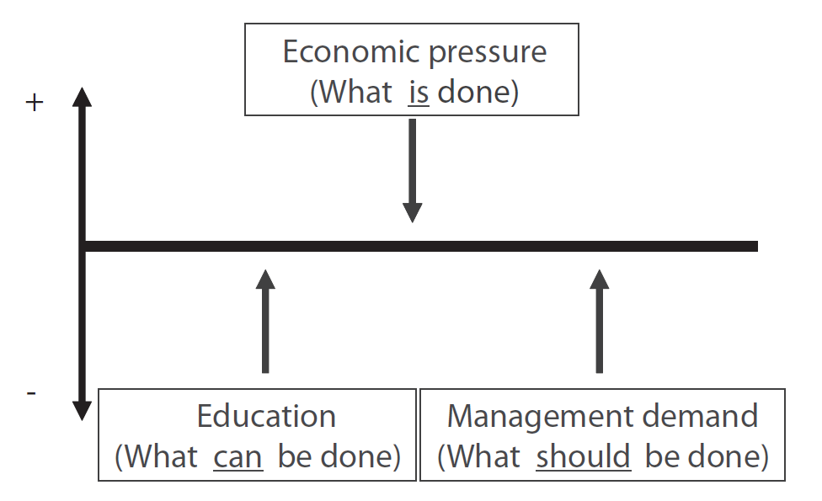
Related Force Field Analysis
Increasing education and management demand has positive effects on the quality of project management, while the perceived economic pressure has a negative effect.
www.midocean.ae

Slide 10
Responding To These Three Forces
Each corporation needs to balance financial investment in project management capabilities against return – that is, measuring Return-on-Investment (ROI) for project management.
Corporations whose project-based part of the business is relatively small naturally invest less in project management capabilities.
As there are relatively few project improvements in the quality of project management this results in only minor financial gains for the wider organization.
In contrast, corporations whose business is totally project-based, invest more in their project management capabilities, which results in far more significant financial organizational gains.
www.midocean.ae

Slide 11
A Framework For Organizational Migration
The governance framework includes a three-step process; each of which constitutes the equilibrium of the three discussed forces.
Migration from step one to step three indicates an increasingly stronger organizational focus on project management capabilities.
This focus on project management capabilities is associated with an increase in investment in these capabilities, which leads to more potential organizational return from project management maturity.
www.midocean.ae

Slide 12
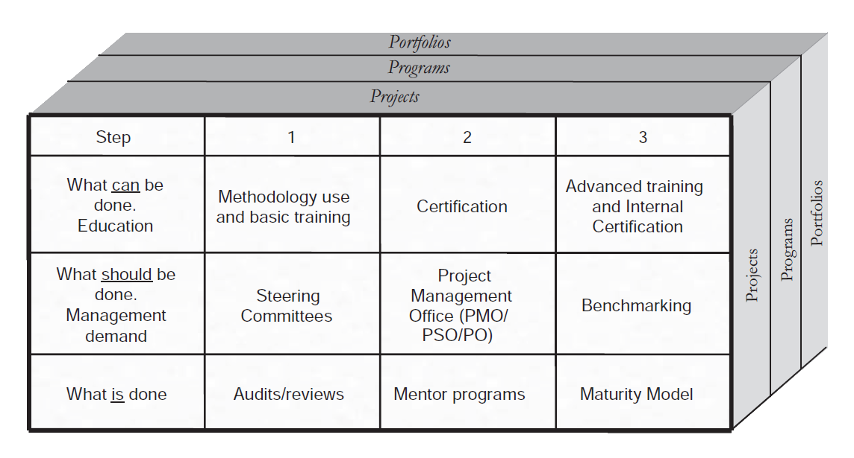
Governance Framework for Project Management
www.midocean.ae

Slide 13
Elements of the Framework – Step 1
Step 1 constitutes the lowest level of investment and return (ROI), and is indicated when the amount of project-based work is increasing.
The move from zero project management capabilities to those of Step 1 may be inhibited by the focus on the technical expertise resulting in ignoring business improvement.
Corporations at Step 1 often use the Conformist or Agile Pragmatist paradigm of governance.
At this step project management emerges as a set of procedures extracted from the technical development processes.
www.midocean.ae

Slide 14
Step 1 Governance Measures
Step 1 governance includes measures related to education, management demand, and what is done that should be used by all corporations that have at least some project-based work.
Corporations implementing and synchronizing these measures achieve a good balance between investment in and return on (ROI) project management capability improvement.
These corporations may wish to keep their investment in project management governance to this level; higher investment would merely lead to diminishing return (ROI).
Corporations with a higher quantity of project-based work may also stay at this step for a while and, following evaluation of the improvements made in terms of project results, move on to step two.
www.midocean.ae

Slide 15
Step 1 Measure 1
Education: Basic Training
This may include short project management courses for technical specialists in charge of projects who then become the change agents in the corporation.
This often takes the form of beginning to use project management terminology and introducing a new process for managing projects.
This fosters the development of a formal project management methodology to define and integrate the process, techniques and tools to be used, as well as the roles and responsibilities of the project stakeholders.
www.midocean.ae

Slide 16
Step 1 Measure 2
Management Demand: Steering Groups and Sponsors
Steering groups and/or sponsors are put in place to foster use of the new methods and to ensure new skills learned during project management training are put into practice.
For this to be effective, the managers involved require a good understanding of modern project management.
Unfortunately, managers may be unwilling to spend time updating their skills in this area, which results in steering groups and sponsors are unable to judge what constitutes good project management, leading to two negative effects:
www.midocean.ae

Slide 17
First Negative Effect
Bad Prioritization
Project managers will tend to prioritize their work according to their own perceived importance and not necessarily the priorities of the steering group/sponsor.
They may thus neglect those deliverables perceived as not being necessary for their own work (for example, forecasts, or performance reporting using Earned Value) but important for effective governance.
This leads to management and steering of the project that is less than its optimum.
www.midocean.ae

Slide 18
Second Negative Effect
Conflict on Authority
Instead of being managed by the sponsor/steering group, senior project managers will tend to manage them.
This may reverse the intention of the project governance hierarchy.
This extends the agency problem with possible adverse effects for the corporation.
www.midocean.ae

Slide 19
Step 1 Measure 3
What is Done: Review of Projects in Trouble
Here different types of reviews are carried out for troubled projects.
Projects may end up in trouble due either to:
Project managers have neither the skills nor the training to be effective.
Project managers do not apply the skills and techniques they learned during training effectively to the actual work.
The need for training and methodology use often arises from reviews of troubled projects, but these training efforts do not guarantee that the trained behavior is put into practice.
www.midocean.ae

Slide 20
Types of Review - Audit
Audit is the most formal type of review, and is often carried out by certified auditors from external organizations.
It is usually indicated when the project places high financial amounts at stake, such as very large projects or those with public interest (for example, infrastructure projects).
In such cases the audit is planned as part of the project planning, implementationand control phase.
www.midocean.ae

Slide 21
Types of Review - Formal Review
A Formal Review is less rigorous than the audit.
Formal review is the most common type of assessment.
It is often carried out by senior project managers from the same company but not necessarily from the same organization within the company.
Projects are selected for review mainly because of lower than planned performance.
The review process focuses primarily on project management; technical review of project achievements and deliverables may, or may not, be done as well.
www.midocean.ae

Slide 22
Types of Review - Health Check
A health check is the most informal type of project review.
It is often carried out by as simple a process as sending a questionnaire to the project managers.
Success of this type of review depends on the honesty and professionalism of the project manager involved, as his or her answers to the questionnaire cannot be independently verified.
This review type is not very credible unless the project manager is well known and held in high esteem by the company.
www.midocean.ae

Slide 23
The Result of An Established Step 1 Allows Organizations To Improve Project Management Quality In Terms of the Classic Iron Triangle of Time, Budget, and Quality Goals
www.midocean.ae

Slide 24
Elements of the Framework – Step 2
Many corporations will use Step 1 techniques.
Corporations with a medium amount (approx. 40–70 per cent) of project-based work tend to progress to Step 2 techniques in addition to those of Step 1.
Step 2 is the level in which the majority of projectized organizations have progressed.
It is associated with Flexible Economist and Versatile Artist paradigms for project management governance.
www.midocean.ae

Slide 25
Step 2 Governance Measures
Step 2 governance includes measures related to education, management demand, and what is done that should be used by all corporations that have at least some project-based work.
Properly applying these measures has enablers and constraints:
Enablers
Acknowledgement of project management as a role within the organization.
Definition of a career path for project managers.
Constraints
Insufficient amount of project-based business to warrant the investment.
Strong organizational emphasis on the Conformist governance paradigm.
www.midocean.ae

Slide 26
Step 2 Measure 1
Education: External certification of project managers
External certification ensures that the professionalism of project managers is assessed independently by an organization dedicated to doing this.
Two main approaches for certification exist:
Certification of knowledge, as in PMI’s PMP® certification.
Certification of skills, as in IPMA’s Level C certification.
Certifications (3 to 5 years) allow the acknowledgement of professionalism and reduce the agency problem between project sponsor and project manager, due to the credibility of the project manager.
www.midocean.ae

Slide 27
Step 2 Measure 2
Management Demand: Project Management Offices (PMOs)
Tactical PMOs are used to improve project management execution within the organization.
The PMO project management governance typically starts with identification and reviewing of projects in trouble.
Subsequently they work with the respective project managers to improve project management delivery.
PMOs may identify skills gaps and train or consult project managers in methodologies, techniques and tools.
www.midocean.ae

Slide 28
Stronger PMO Roles
Some PMOs take on even stronger governance roles by developing or deciding on the methodologies to use and the training programs for project managers.
Such PMOs implement the measures of Step 2 (and Step 3 measures), thus becoming the unit which extends the organization’s project management capabilities.
These PMOs are staffed with the most senior project management resources in order to leverage the skills and experience of these experts across the whole of the corporation.
Tactical PMOs remain close to the individual projects and often form part of productive delivery in geography or functionality-based units.
www.midocean.ae

Slide 29
The Variation of the PMO Approach
A variation of the PMO approach is the Project Office (PO) or Project Support Office (PSO), which is staffed with administrative personnel to offload project administrative work.
Such POs and PSOs ensure good quality administrative work, appropriate documentation, planning data and status updates.
Although PSOs and POs are important and useful, it is the tactical PMOs that determine the best practices for the community of project managers within their organization.
They define what management expects from project managers thus addressing the management demand at Step 2.
www.midocean.ae

Slide 30
Step 2 Measure 3
What is Done: Mentor Programs
At Step 2, mentor programs identify and influence what is done by project managers.
These programs address the attitude project managers develop towards their work, communication and teamwork with their teams, sponsors/steering groups and project stakeholders.
A variety of techniques exist, which range from internal swapping of managers from one unit to another, junior project managers being mentored by senior project managers or PMO members through to mentoring by external consultants.
The aims are to improve cooperation between the project managers and other organizational parts and to improve leadership skills for better project management delivery.
www.midocean.ae

Slide 31
Successful Implementation of Step 2
The best way to achieve a successful and economic implementation of Step 2 techniques is to ensure a healthy balance between the three Step 2 measures.
Project success is thus more complex than just the iron triangle, addressing a diverse set of critical success factors for projects and their surrounding organization, including:
Customer satisfaction appropriateness of planning techniques.
The general quality of project management.
The impact of project management on follow-on projects with customers.
www.midocean.ae

Slide 32
The Result of Step 2 Investments In Project Management Is An Improvement That Is Generally Higher Than In Step 1 and So Are the Expected Returns
www.midocean.ae

Slide 33
Elements of the Framework – Step 3
The third step comprises introduction of advanced project management capabilities.
This is typically used by companies whose business consists almost entirely of project-based work.
The underlying governance paradigm is Flexible Economist or Versatile Artist.
Step 1 and Step 2 techniques are prerequisites (and always in active use) for these Step 3 techniques.
www.midocean.ae

Slide 34
Step 3 Governance Measures
Step 3 governance includes measures related to education, management demand, and what is done that should be used by all corporations that have at least some project-based work.
Enablers
Management belief that competitors are only bypassed through leapfrog improvements in capabilities.
Belief that project management capabilities are a core corporate strength and competitive advantage.
Constraints
Lack of trust in the current project management resources’ capabilities.
Resistance to change corporate processes and roles to make them more supportive of project work.
Unwillingness to prioritize project-based work over traditional hierarchies in the company.
www.midocean.ae

Slide 35
Step 3 Measure 1
Education: Advanced Training and Internal Certification
This element consists of advanced training in particular areas, such as specialized planning tools, industry knowledge, technical skills, or other focused improvements of project management capabilities.
Many companies at this step develop an internal certification program in which project managers are required to demonstrate the specific industry and technology skills peculiar to their own company’s needs.
They also need to prove their ability to run projects successfully using established project management principles.
The amalgamation of management, technical and industry skills should allow for thought leadership of project managers when working with the company’s customers.
www.midocean.ae

Slide 36
Step 3 Measure 2
Management Demand: Benchmarking
The Step 3 extension of this measure consists of benchmarking project management capabilities against those of other companies.
Companies are benchmarked either against their competitors or across industries.
Benchmarking against competitors is undertaken within industry clusters allows for identification of strengths and weaknesses relative to other companies in the same industry.
Benchmarking across industries allows for leapfrog improvements and development of enhanced capabilities, beyond those typical of the corporation’s own industry.
www.midocean.ae

Slide 37
Step 3 Measure 3
What is Done: Maturity Model
Use of (organizational) project management maturity models addresses the Step 3 element what is done.
These maturity models aim to ensure predictable and consistent delivery of good project results.
Typically, they distinguish five levels of maturity ranging from ad-hoc to optimized maturity models.
Most of these models assess project management capabilities only and provide one level of overall project management maturity.
www.midocean.ae

Slide 38
How PMI Maturity Model Works
PMI’s Organizational Project Management Maturity Model benchmarks project, program and portfolio management against a build-in database of best-practices for several industries.
It then provides suggestions for improvement together with maturity levels measured across various dimensions.
This allows for development of the organization’s internal capabilities to manage their projects, resources and processes simultaneously and with maximum efficiency.
These maturity models are also suitable for organizations at Step 1 and Step 2, but theybare deeper and broader at Step 3.
www.midocean.ae

Slide 39
Successful Implementation of Step 2
A healthy balance between the three Step 3 measures is required for their successful and economic implementation.
No matter how far an organization develops, the techniques associated with the earlier Steps will not disappear.
Step 3 organizations still apply Step 1 and Step 2 measures, but Step 3 requires the corporation to make significant investments in:
Money and resources.
Adapting and streamlining the organization’s processes to make them more supportive of the project way of working.
www.midocean.ae

Slide 40
The Results of the Result Of Step 3 Investments Is Having Project Management As a Strategic Capability of the Corporation
www.midocean.ae

Slide 41
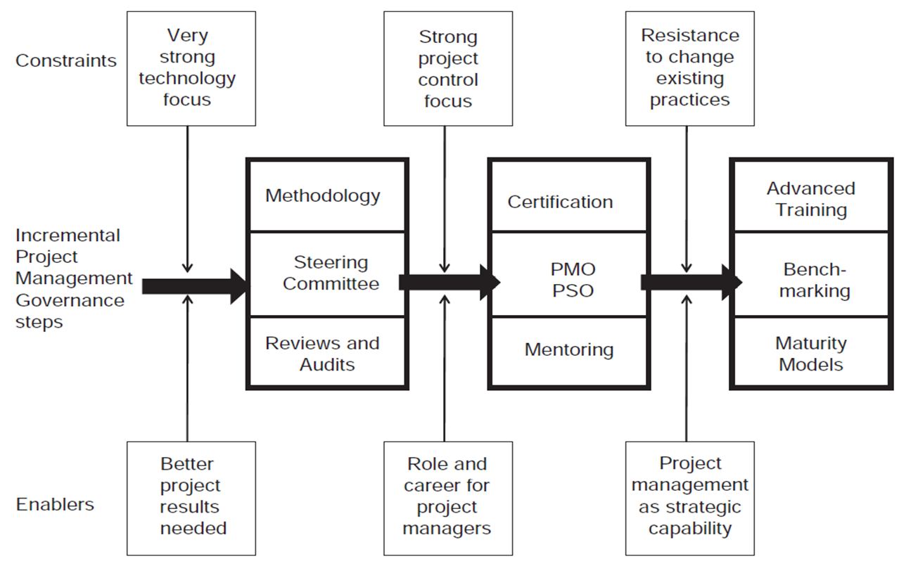
Project Management Governance Model
www.midocean.ae

Slide 42
Conclusion
There are three forces which impact and determine the quality of project management: education; management demands; and perceived economic pressure.
The governance framework includes a three-step process; each of which constitutes the equilibrium of the three discussed forces.
The result of an established step 1 allows organizations to improve project management quality in terms of the classic iron triangle of time, budget, and quality goals.
The result of step 2 investments in project management is an improvement that is generally higher than in step 1 and so are the expected returns.
The results of the result of step 3 investments is having project management as a strategic capability of the corporation.
www.midocean.ae

Slide 43
Conclusion
The governance model described does not imply that all organizations should aim for the highest step (that is, Step 3).
The best economic mix of project management governance measures with a healthy balance between the need for improving project management against increased investment.
The correct application of the model lies in the identification of the extent of project management needed and the balanced application of the measures in that step of the model.
While enablers show what needs to be in place from an organizational perspective to move up to a particular step, constraints indicate threats to successful implementation.
www.midocean.ae

Slide 44
Task 1
Think of a given international company, and based on its project management performance, try to figure out its situation according to the step of project management governance model?
www.midocean.ae

Slide 45
Task 2
Look for three local companies, each is having different project management governance and maturity levels and explain the enablers and constraints that led to these companies adopting such positions?
www.midocean.ae

Slide 46

Reference
www.midocean.ae

Slide 47



Thank You

