Slide 1

PMG 202
Project Planning
Prepared by Dr. Maryam ZORGUI
PART I :
Initiate & Plan a Project
Lecture 2
Components of Project Planning Process

Slide 2
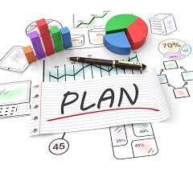
In the last lesson…
Planning provides a nexus between the managerial functions required to activate a project and the elements needed for successful project completion.
It is concerned with deciding in advance what, when, how and who will take the necessary actions to accomplish established objectives.
This lesson has examined the project environment for planning, considered the purposes of planning, focused on the stages of project planning, evaluated the elements and stages of planning and discussed the role of decision making in project planning.
Project managers seeking success should master these concepts.

Slide 3

Chapter objectives
Identify key components of the Project Management Institute (PMI) ® Planning Process Group
Explain the process of developing and managing the Project Management Plan
Discover the key planning processes needed to plan and implement a successful project.
Learn the order in which they need to occur.

Slide 4
Syllabus
.
I- Project Plan v/s Project Planning
III- How to make a Project
II- Initiating a Project

Slide 5

I- Project Plan v/s Project Planning
1-What is a project plan?
A Project Plan, according to the Project Management Body of Knowledge (PMBOK), is:
"...a formal, approved document used to guide both project execution and project control. The primary uses of the project plan are to document planning assumptions and decisions, facilitate communication among project stakeholders, and document approved scope, cost, and schedule baselines. A project plan may be summarized or detailed."
Notes:
PMBOK is an internationally recognized standard edited by the PMI, that provides fundamental concepts of project management regardless of the type of the project, be it a construction project, a software development project, heavy-engineering project or automotive project.

Slide 6
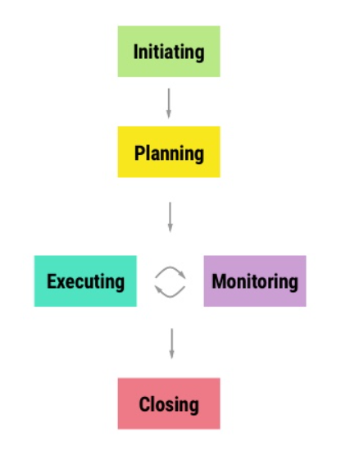
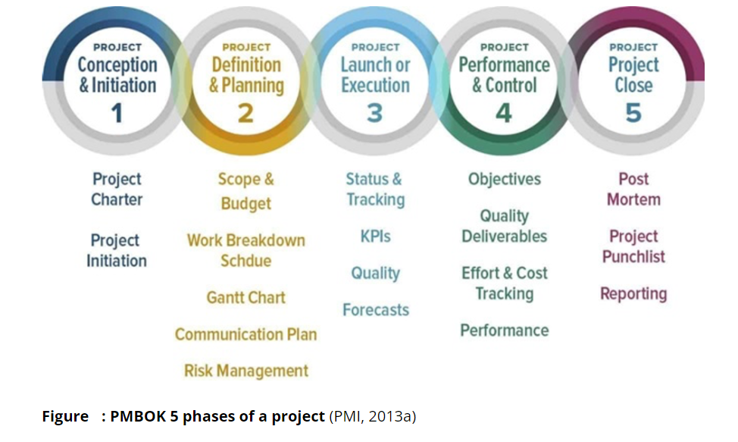
I- Project Plan v/s Project Planning

Slide 7

I- Project Plan v/s Project Planning
2- Project Plan Purpose
A well-prepared plan should address and consequently answer the following questions:

Slide 8
I- Project Plan v/s Project Planning
Why? This question is about the reasons why a project is sponsored and the problem it addresses.
Who? This is about involved people, their roles and responsibilities as well as the way they are supposed to be organized.
What? This is about involved people, their roles and responsibilities, and how they are organized.
When? It is about the project’s schedule/timeline.

Slide 9
I- Project Plan v/s Project Planning
3- Project planning
It’s created during the project planning phase and is a compilation of several other documents. It is more than just a schedule or a task list, though it does include those things.
The project management plan is formally approved at the beginning of the project and then progressively updated throughout the course of the project

Slide 10

I- Project Plan v/s Project Planning
The project planning process starts before work on the actual project begins and continues throughout the life cycle of the project. Its main goal is to adequately plan the time, cost and resources needed for the project and thus to minimize risk. The main output of the project planning process is the project plan (or project management plan), which includes the project schedule as well as various supporting plans.

Slide 11
I- Project Plan v/s Project Planning
4- Why is project planning important?
Project planning is a crucial stage that comes right after initiation in project management phases. Through proper planning, you streamline the entire project into a series of steps and ensure the availability of all the resources on time.
Project constraints such as time, scope, and costs are discussed in the project planning process, and mitigation plans are developed after the identification of potential risks. By comparing the actual progress with the project plan, you can also monitor the performance of your team and take the necessary steps to improve it.

Slide 12
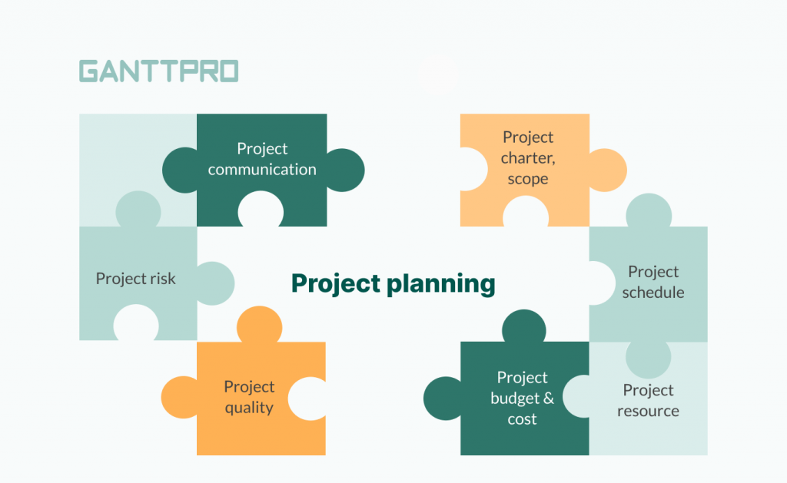
I- Project Plan v/s Project Planning
Check out the 7 main areas (PMBOK)where
project planning is important for successful projects.

Slide 13
II- Initiating a Project
The first step of the project management lifecycle is the initiating phase. During this phase, one of your key objectives is to ensure that the project will deliver strategic value to the organization. If the project is approved and deemed a good use of resources, then proceed to the next step of the project management lifecycle - the planning phase.
During the initiating phase, you ensure that a project is strategically valuable before proceeding to the planning phase.

Slide 14
II- Initiating a Project
During this phase examine potential candidates for future projects and ask yourself 3 main questions that can be answered by researching and creating 3 documents:
1-Should we do this? The business case
2- Are we able to do this? The feasibility study
3- If we are going to do this, what kind of process would we have?
The project charter

Slide 15
II- Initiating a Project
1 -The business case:
The business case examines whether a project idea is desirable and considers several solutions (with a cost benefit analysis for each).
2- The feasibility study:
The feasibility study includes an in-depth study of the chosen solution to determine if the project can be delivered after technological, economic, legal, operational, and scheduling factors are considered.

Slide 16
II- Initiating a Project
3- The project charter:
The project charter clarifies who the decision-makers and stakeholders are, what the cost and budget of the project is, major milestones, a list of deliverables, and a communication strategy.
This document describes how the project should progress.

Slide 17
III- How to make a Project
A project plan is a formal document reflecting the entire project planning process. It is the product of each element of your project, framed into a structured model that your employees can refer to if and when they get stuck somewhere. In essence, a project plan guides you on how to execute and control for favorable results.
But how does one make a project plan?
We break it down with a simple step-by-step formula to make a project plan in PowerPoint.
Follow these steps, and you will have your project plan ready in no time

Slide 18
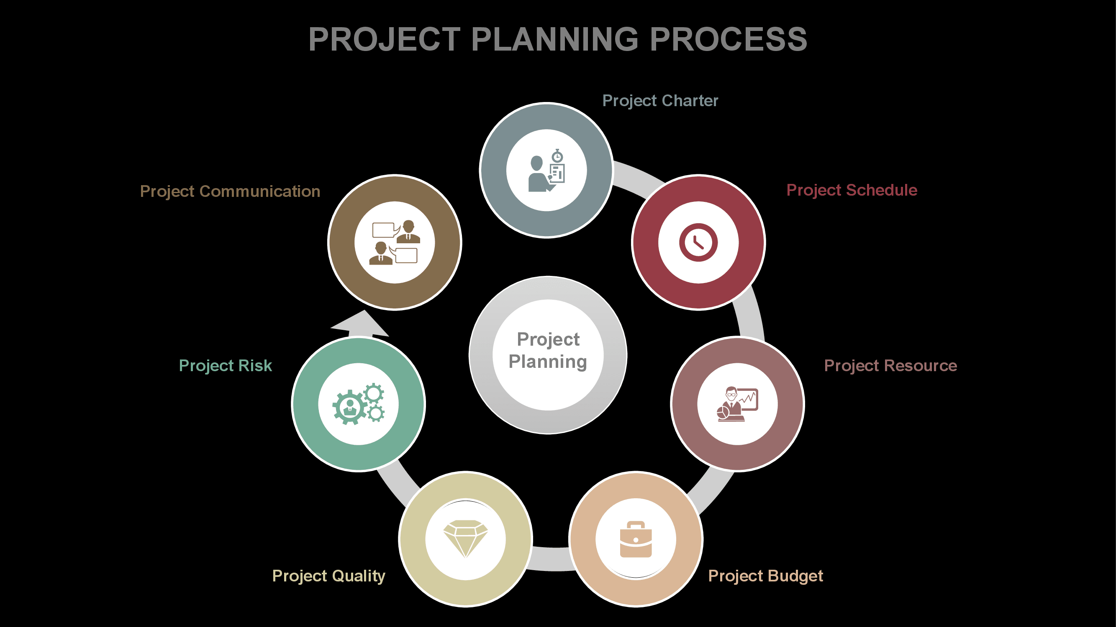
III- How to make a Project

Slide 19
III- How to make a Project
1-Establish the project Charter and Scope
The main starting point for your project planning process is a solid definition for your project. The definition needs to state what your project is, and what it is not. We document this in a ‘Project Definition Statement’, or a ‘Project Charter’.
This is a formal document that describes the objectives and the stakeholders of a project. Typically clubbed with project scope, this component gives the stakeholders a clear vision of the target they need to achieve. Project managers submit the project charter to the stakeholders for approval on their proposal.

Slide 20
III- How to make a Project
By the end of your Definition Stage, you should have a good idea of the scope of your project, in terms of both:
*work to do (tasks, or activities)
*deliverables, or products, to create
In the project planning stage, you will need to put precision on both of these aspects of scope.
The tool we use for that is the Work Breakdown Structure, WBS.
there are two approaches to creating a WBS, depending largely on which side of the Atlantic you are from
*the UK and Europe
*the US

Slide 21
III- How to make a Project
The main elements of your project definition are your project’s:
Goal: A project goal is the bedrock of defining your project. They aren’t even your foundation: they are more like the groundwork you do before laying your foundation.
Objectives: A project objective is a statement that describes the “what” of your project. The tangible and measurable “what”.
Scope: The project scope details exactly what will be delivered at the end of the project, and the parameters of the work to be done. The purpose of the project scope is to get your stakeholders and team on the same page. It also provides a concise summary of your meetings, deliverables, and agreements for everyone to refer back to.

Slide 22
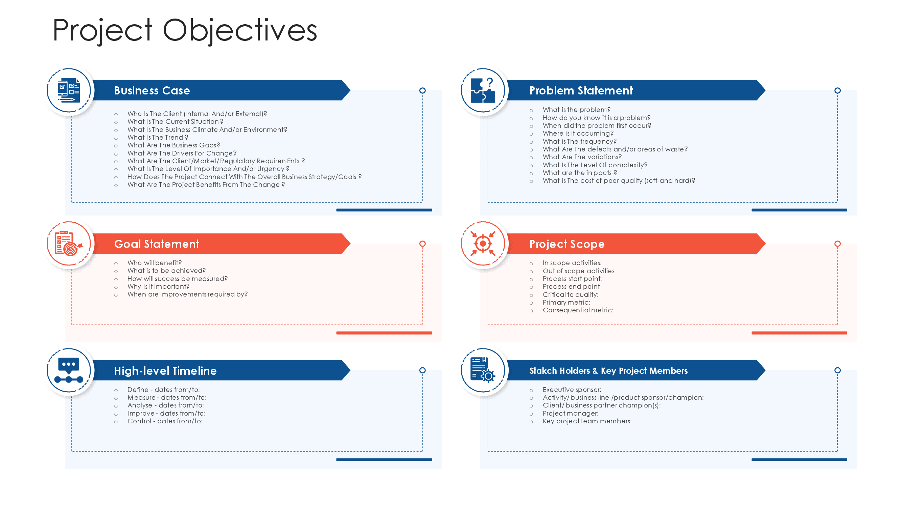
III- How to make a Project
1

Slide 23
III- How to make a Project
2. Define requirements and resources
This component defines the equipment and human capital required for a project. These can include technology, third-party providers, staffing solutions, and material goods. In other words, project resources are the supplies you need to get it done.

Slide 24
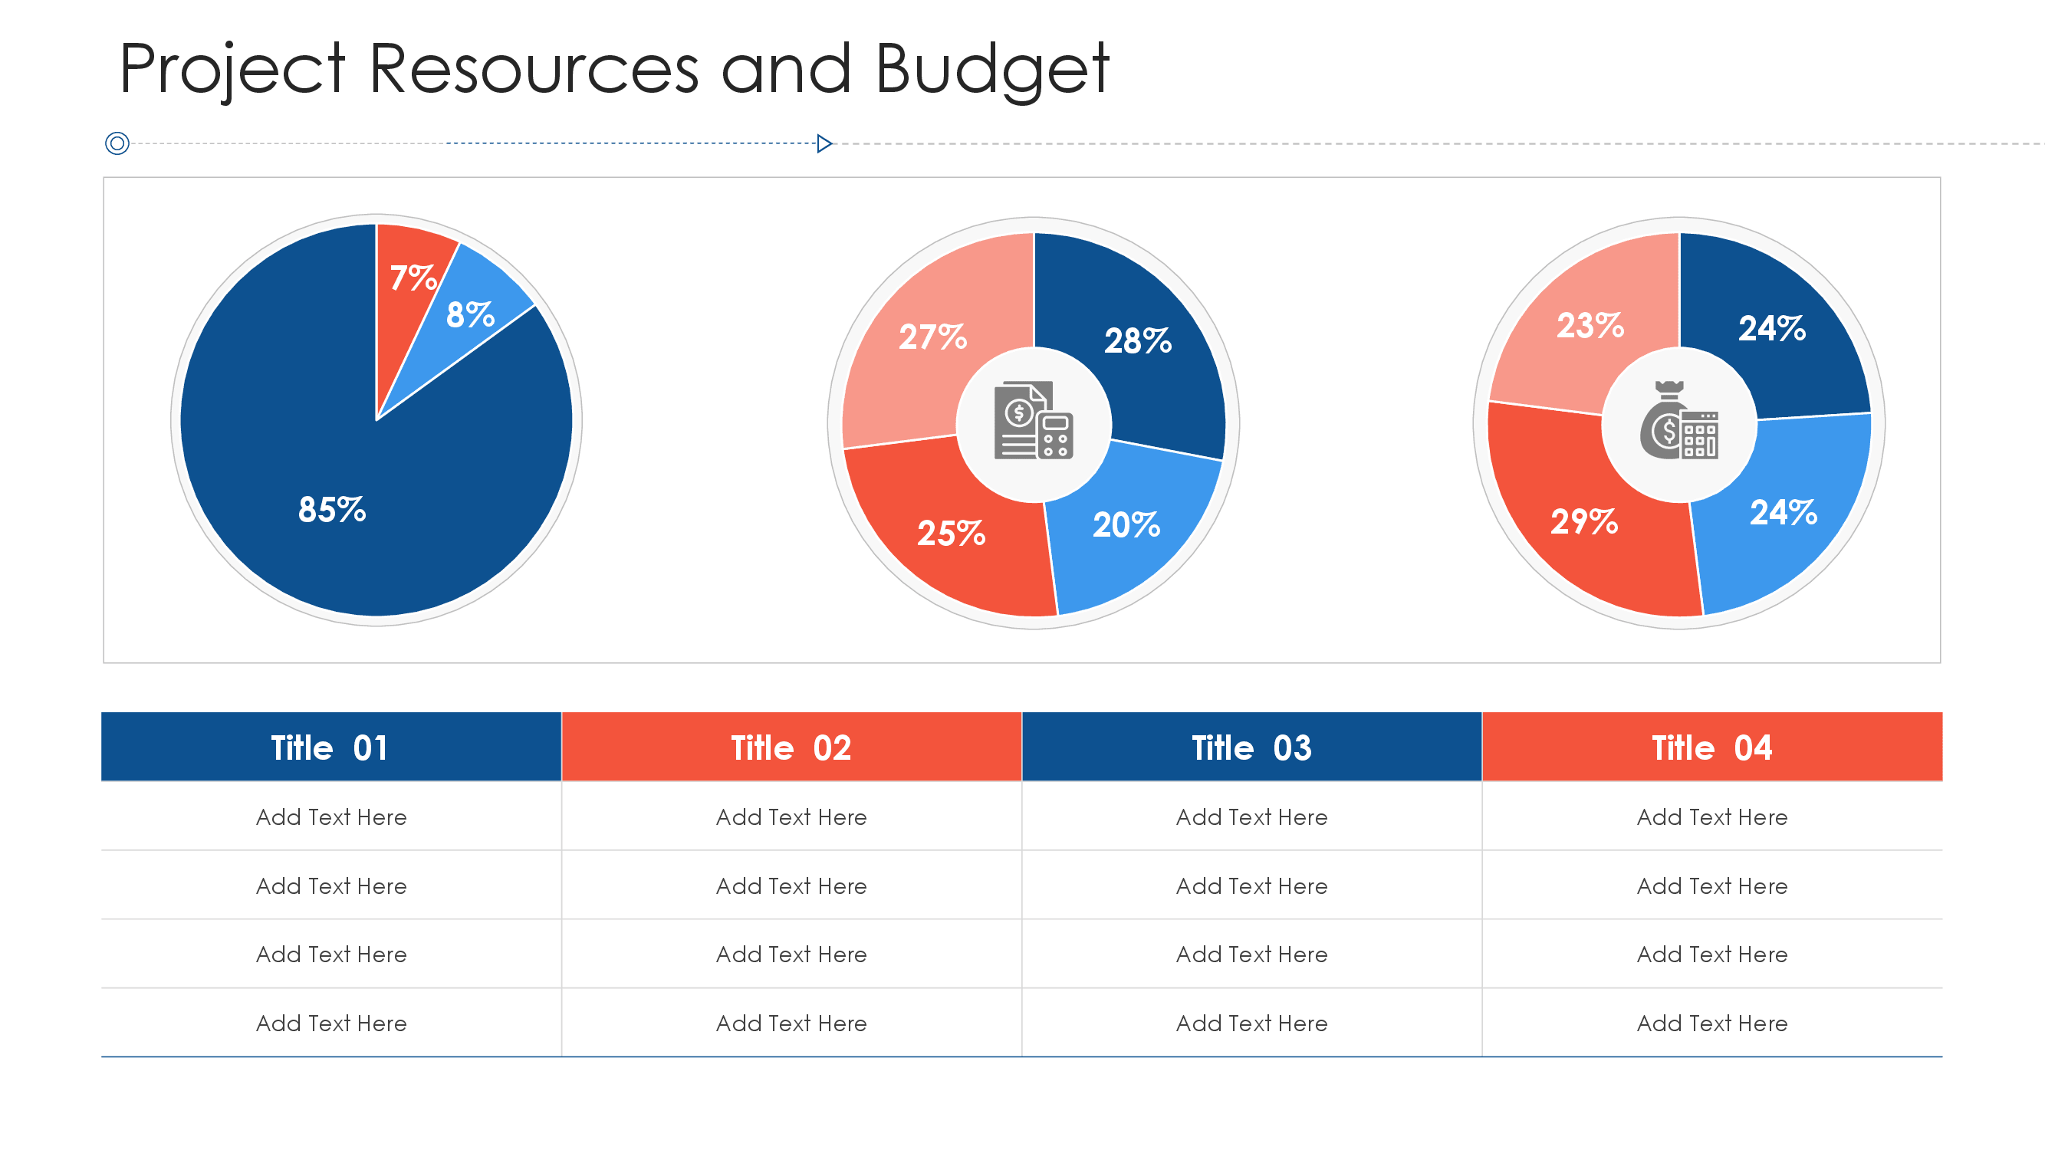
III- How to make a Project
2

Slide 25
III- How to make a Project
3- Designate a team
Showcase the human capital that you are going to invest in your project at this step. You can include the designations and contact information of the project task force in this component of your project plan.
Here’s what the corresponding slide will look like.

Slide 26
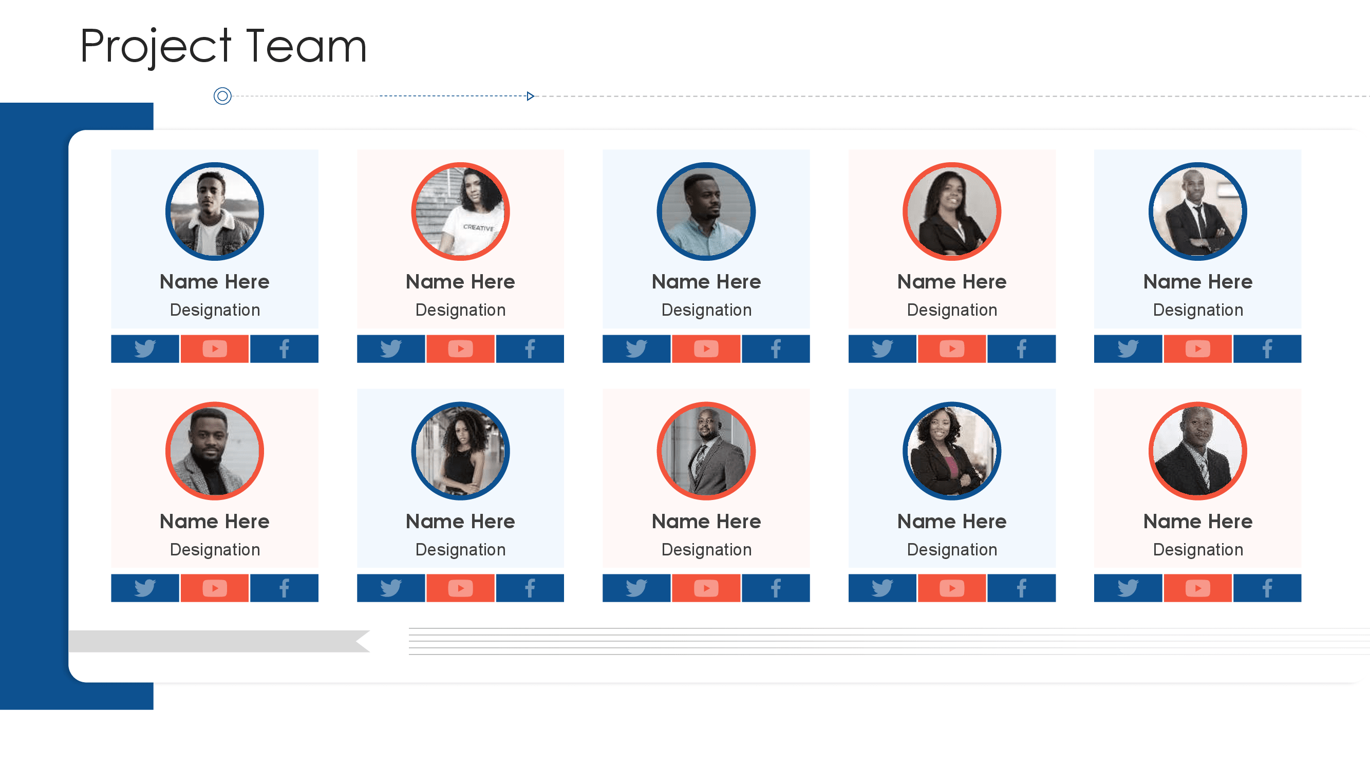
III- How to make a Project
3

Slide 27
III- How to make a Project
4. Set a Schedule
This component defines the time frame for the project using various scheduling tools. Ideally, companies either use formal templatized documents with Gantt charts or project management software to keep track of the project activities and develop specific deadlines.

Slide 28
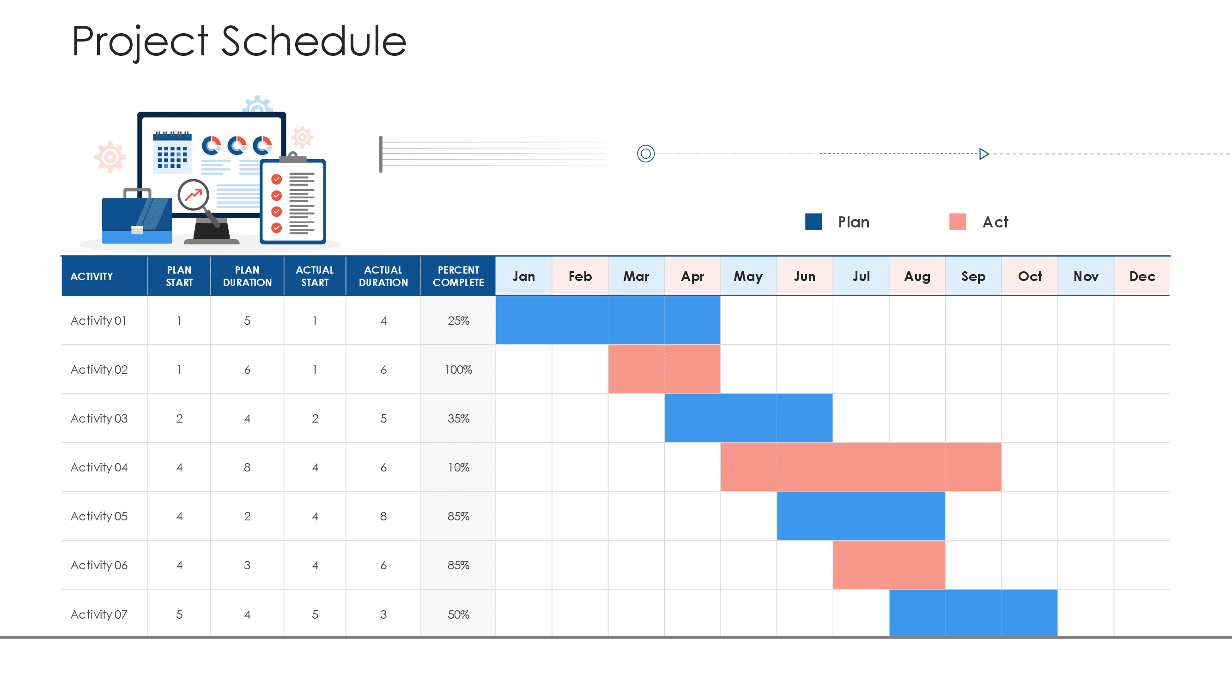
III- How to make a Project
5

Slide 29
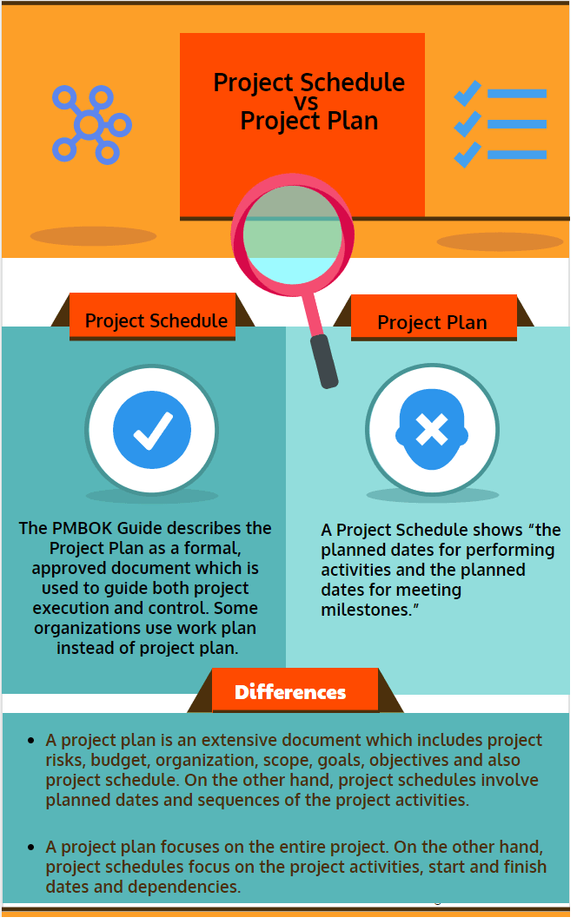
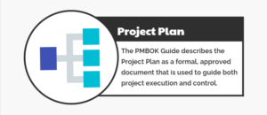
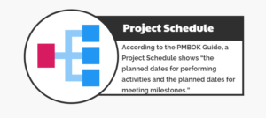
III- How to make a Project

Slide 30
III- How to make a Project
Project Scheduling Steps
Project Scheduling is the act of determining which activities need to get done and which resources will be assigned to complete these activities in a specific period.
There are some steps to be taken in order to create a serviceable schedule
Analyze the project scope and create the WBS (Work Breakdown Structure)
Determine the activities

Slide 31
III- How to make a Project
Determine the resources
Estimate the duration of each activity
Assign the activity relationships
Assign the resources
Detail the schedule and analyze
Monitor and control the schedule

Slide 32
III- How to make a Project
5- Assign quality parameters
What are the parameters to judge the success of your project? What are the key performance indicators? Project quality defines the measure of satisfaction that the final delivery achieves. This is, of course, guided by well-defined project policies and objectives as decided and approved by the stakeholders

Slide 33
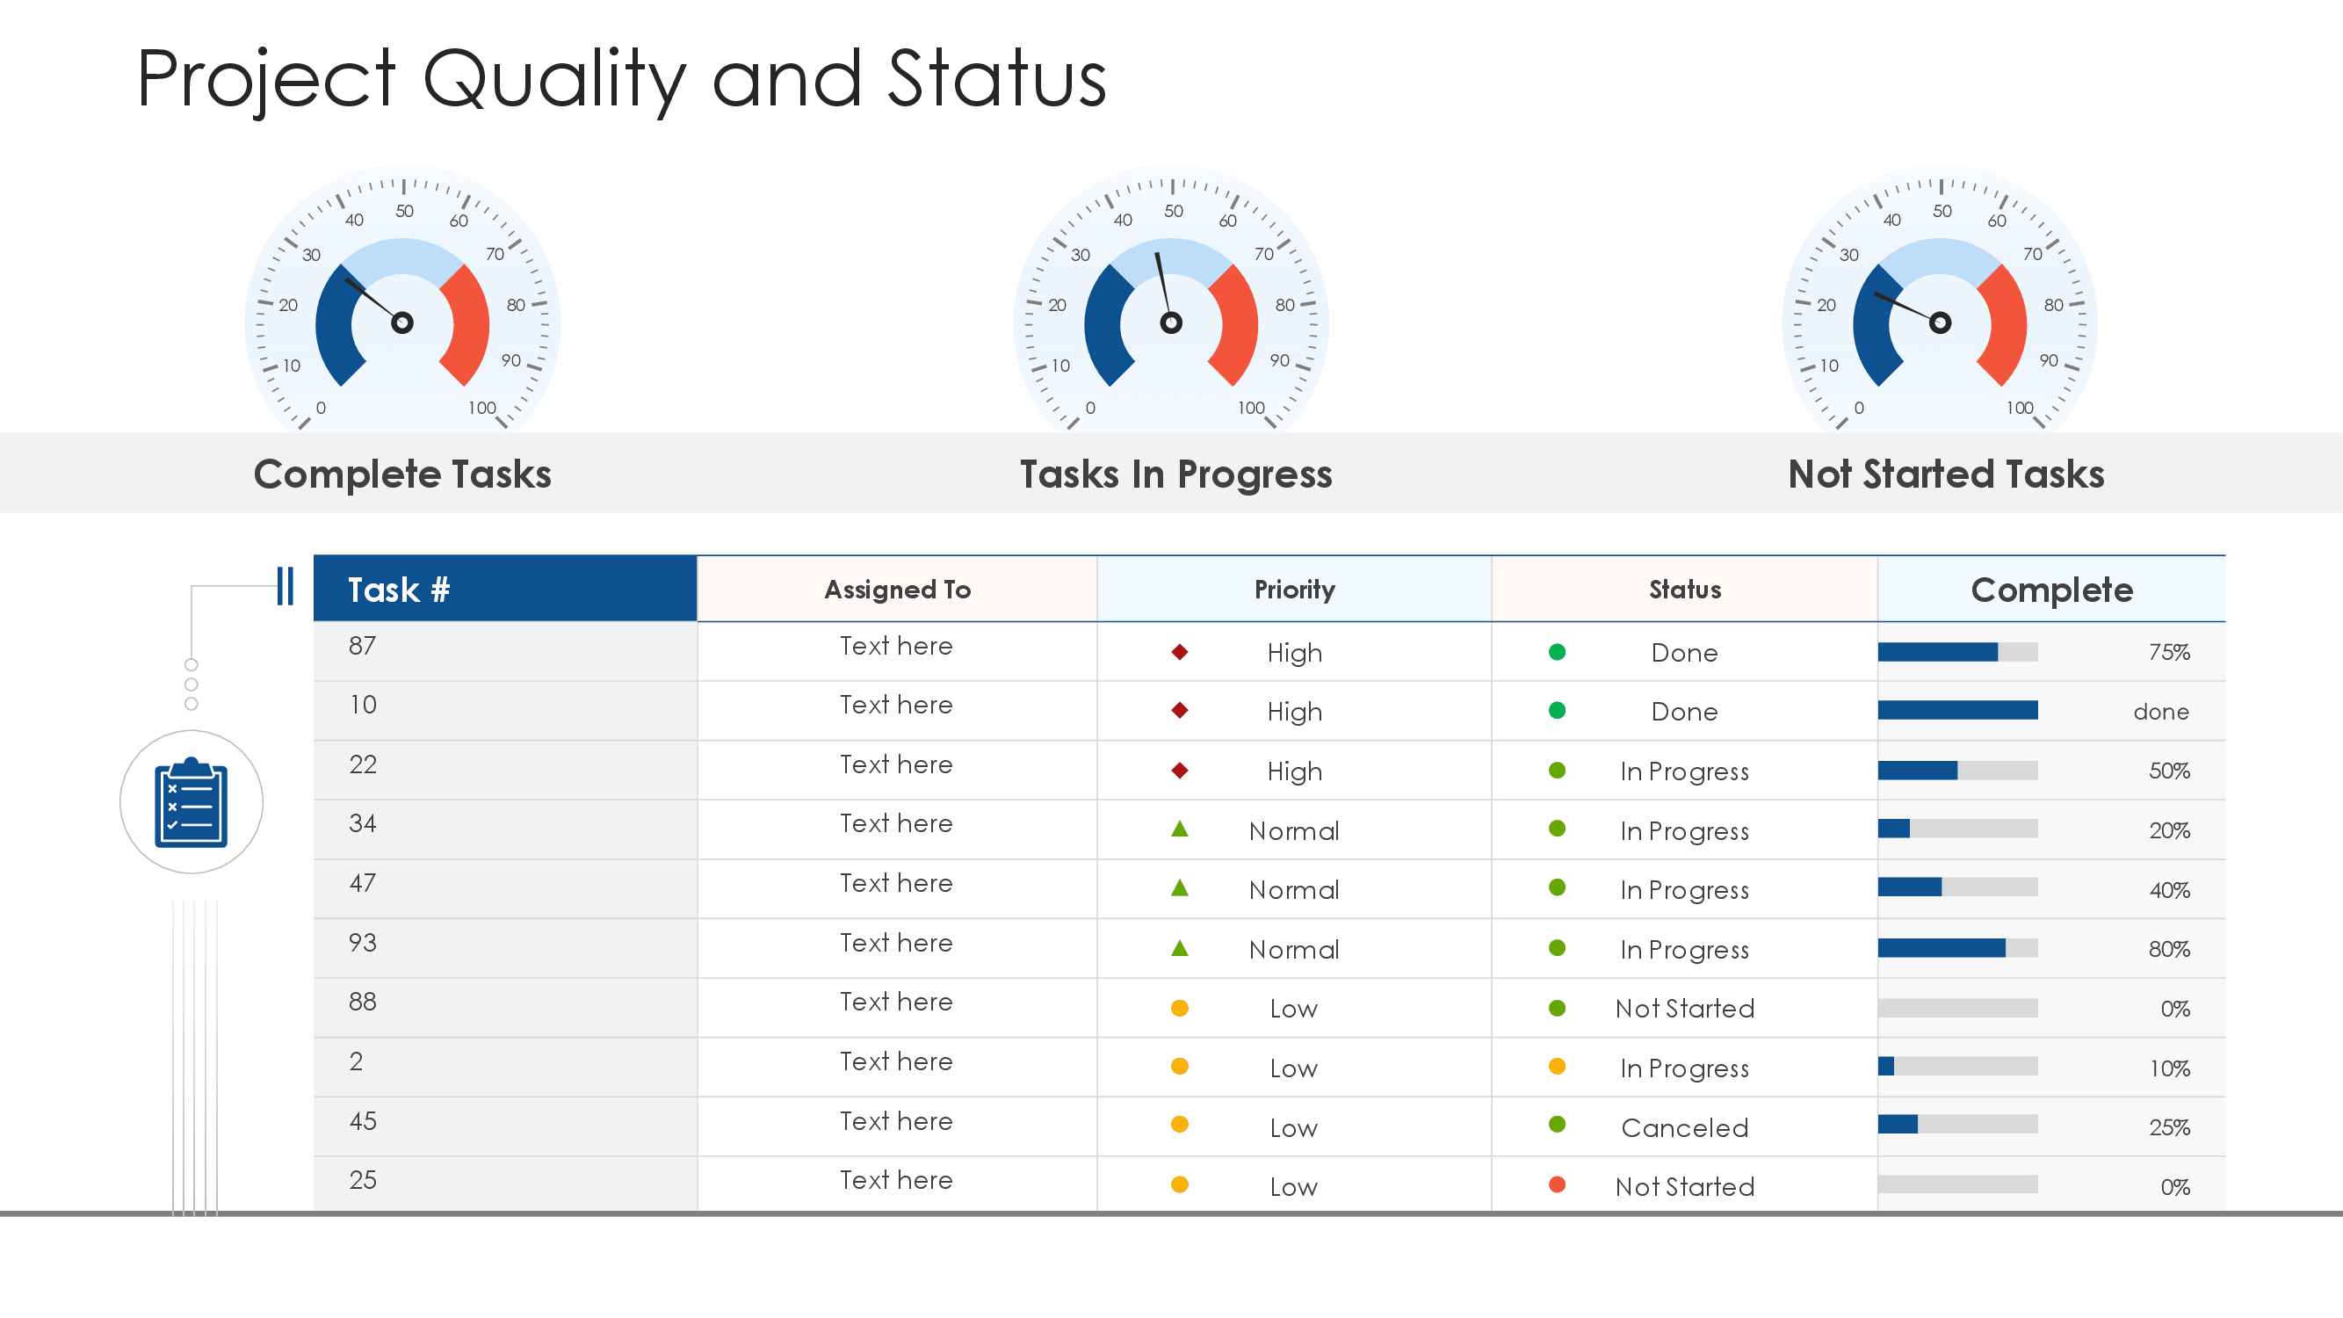
III- How to make a Project
6

Slide 34
III- How to make a Project
6- Define risks and coping strategies
This is the element that project planning is basically done for. It involves the foresightedness of project managers regarding all the possible hazards and loopholes that the project might run into. This also entails the containment and resolution mechanisms for the said hazards.

Slide 35
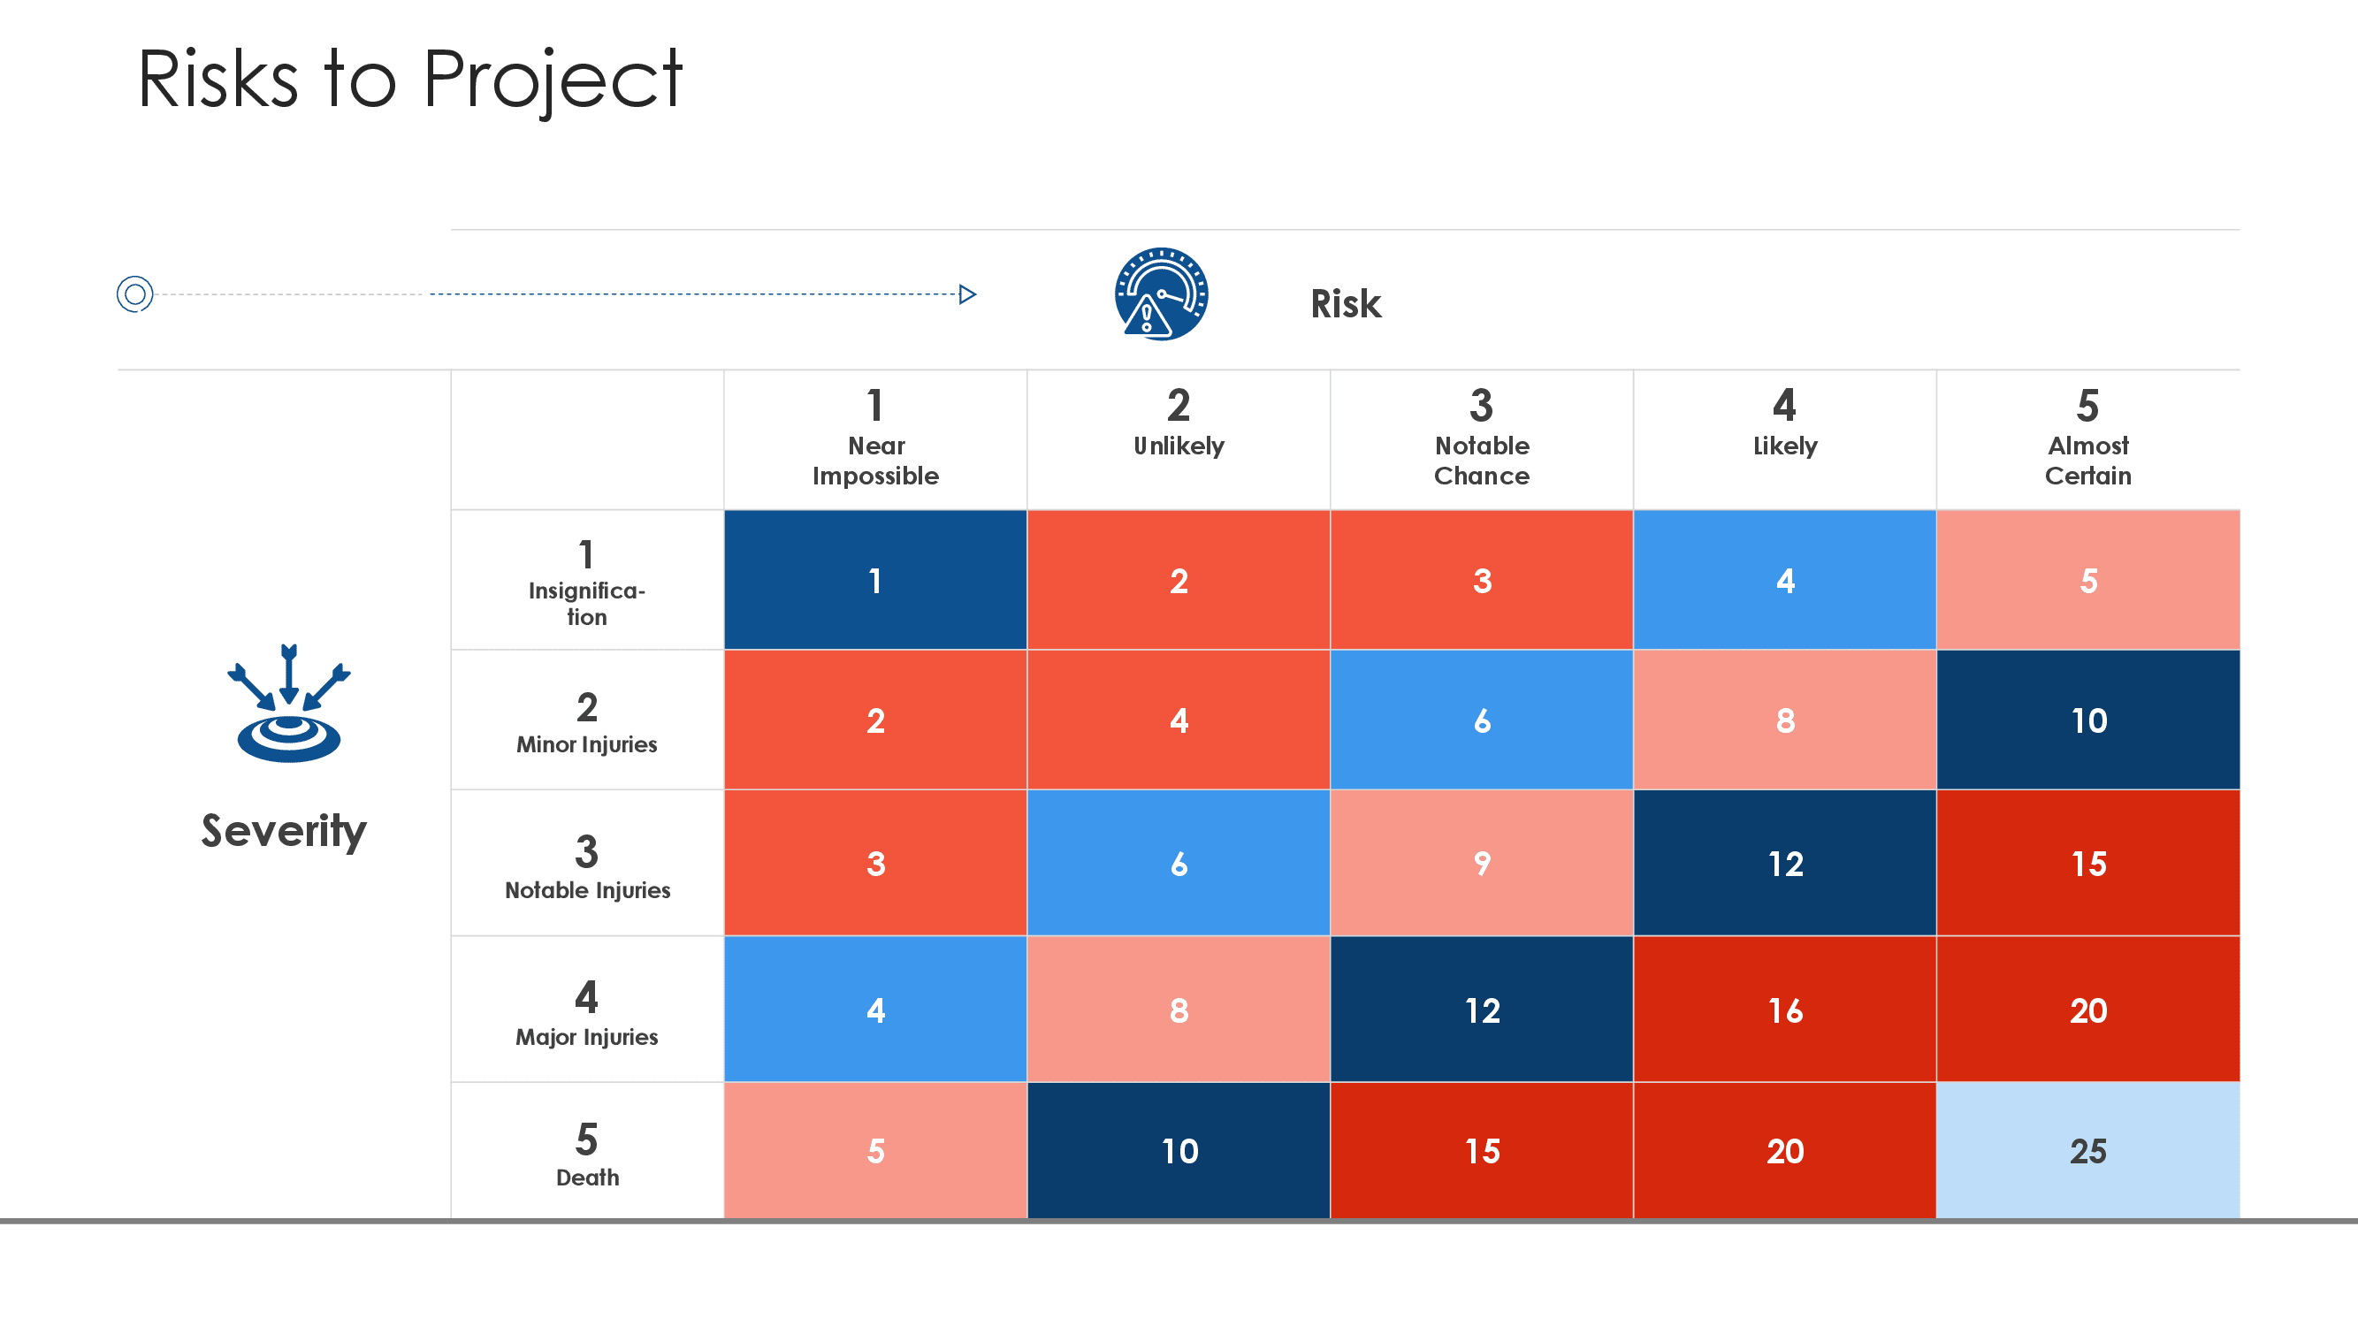
III- How to make a Project
7

Slide 36
III- How to make a Project
7- Devise a communication plan
This component is the consistent reporting mechanism that keeps the stakeholders and the management on the same page. Project communication keeps confusion and crisis at bay while also building trust and cooperation within the team at every step of the project management lifecycle.

Slide 37
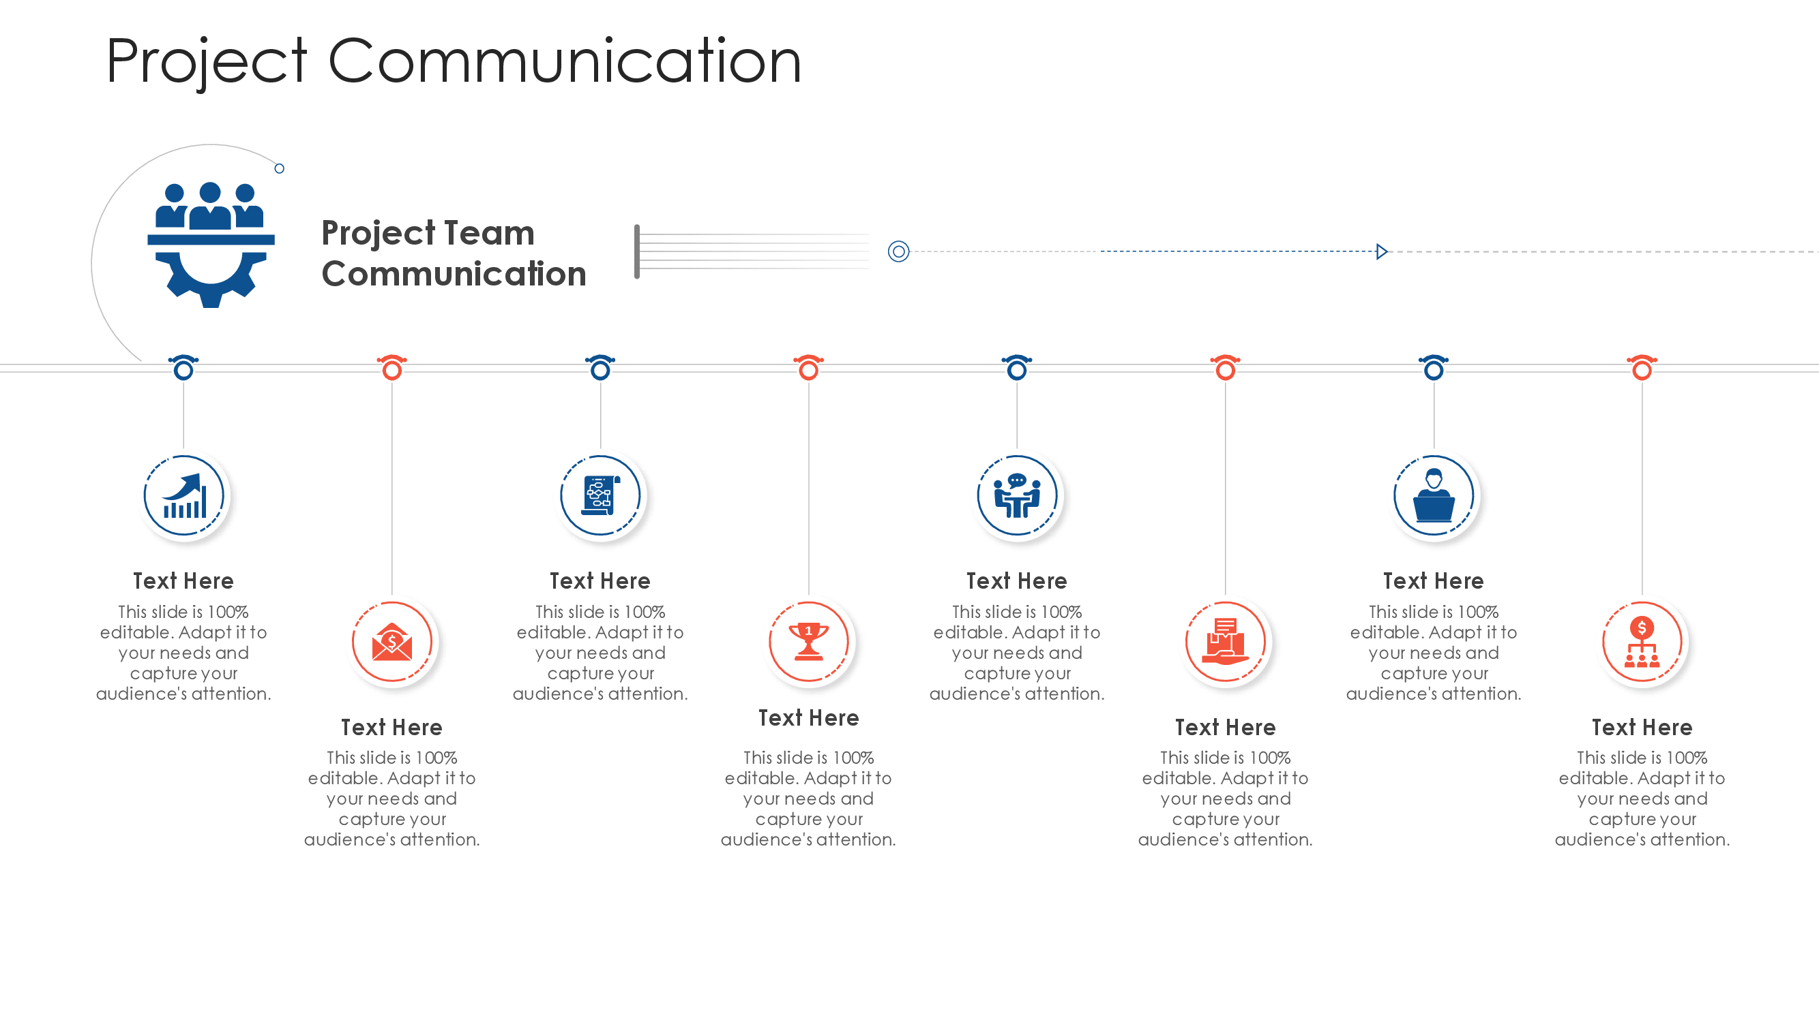
III- How to make a Project
7

Slide 38


Slide 39
I- Project Plan v/s Project Planning

Slide 40
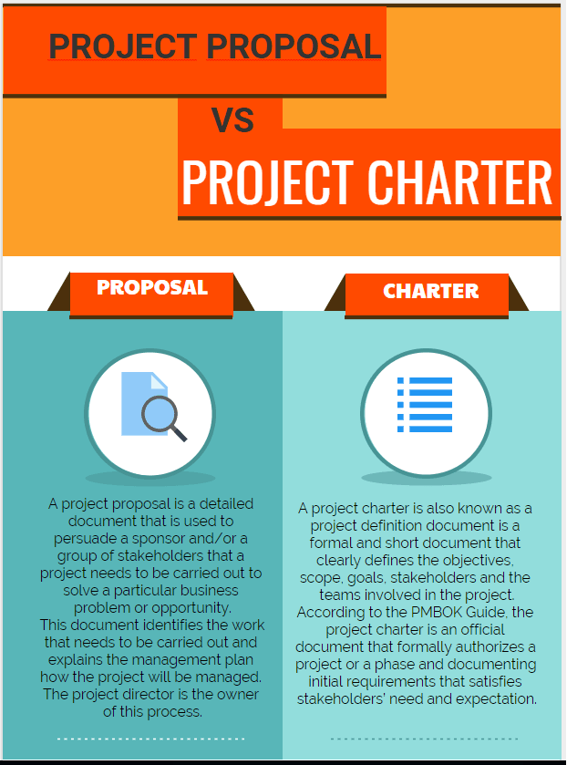
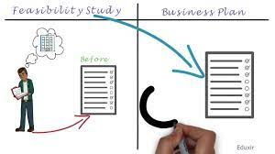
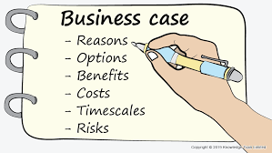
II- Initiating a Project

Slide 41
III- How to make a Project

Slide 42


