Slide 1

The Digital Public Sphere
Prepared by Dr. Shereen Kedwany
Lecture 8
DGM 711
Introduction to Digital Media

Slide 2

Chapter
08
Reminder
Digital technologies facilitate the active participation of individuals in media production.
Digital collaborations rely on the culture of participation.
Digital platforms offer possibilities for users to become content producers or contribute to assessing and improving the content provided by a service.
Wikipedia, social media and mashup services are examples of digital collaboration.
Legal systems have adapted copyright laws to facilitate the spread of self‐publishing platforms such as YouTube.
Digital media users contribute only marginally to decision‐making processes.
The work of users is aggregated for profit purposes by private companies, removing power and decisions from the users.

Slide 3

Chapter
08
Outline
I. The Media System .
II. The Networked Public Sphere .
III. The Journalism and Public Sphere .
IV. WikiLeaks.
V. Panama Papers .
VI. Communicative Capitalism .
VII. Conclusion.

Slide 4

Chapter
08
I. The Media System :
Transformations that involve the media system are deeply related to political change.
The public sphere, a fundamental component of modern democracies, opens to new practices and actors.
In this sphere, the separation between public and private life is questioned, and communications are subject to forms of control and surveillance.
The political evolution of today’s societies rests on the ability to manage the power of communication networks.

Slide 5

Chapter
08
I. The Media System :
Traditionally, media and communication studies consider the media audiences as active.
Individuals who receive a message do not passively perceive it according to predefined meanings, but rather are able to interpret, evaluate, and respond to it in different ways.
If this is true for broadcast media that are distributed from few to many, such as television, radio, and print, within the more complex ecosystems of digital media the public further diversifies.
Indeed, media studies refer to a plurality of media publics (McQuail).

Slide 6
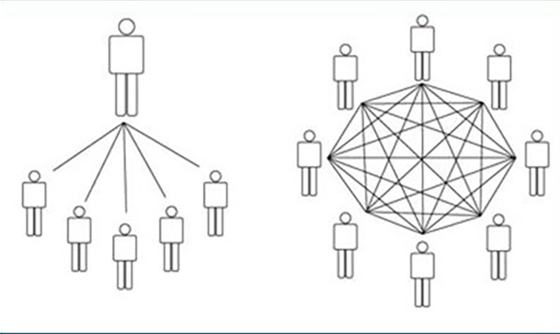
Chapter
08
I. The Media System :
Publics are increasingly important not only in choosing or interpreting media content, but also in the direct production and distribution of such content.
Broadcast media such as newspapers or TV channels are based on a centralized, one‐way architecture.
Decisions on the news or on the information to be reported is taken by a few people who work within a hierarchical organization.

Slide 7
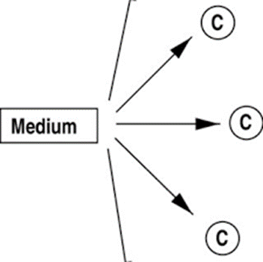
Chapter
08
I. The Media System :
The communication travels from one point, for example a television studio, to a potentially unlimited number of receivers that cannot provide immediate feedback.
Professional journalists and publishers, as well as companies and political parties, have privileged access to broadcast media, and can therefore reach the public more easily.

Slide 8
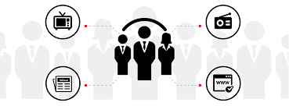
Chapter
08
I. The Media System :
Mass media may be commercial, and thus mainly supported by sales and advertising, but also public or non‐profit.
In all cases, the system they compose is characterized by processes of concentration, in which the political or economic control of many media channels is centralized in the hands of one corporation, institution, or even a single person.

Slide 9

Chapter
08
I. The Media System :
Yet one of the major effects of the emergence of digital media is the creation of a more complex communication system, shaped by diverse technologies, accessible to non‐commercial and nonstate actors.
This transition both aligns with ideas about the democratizing potential of the information society and generates new challenges.
First, digital media increase accessibility: the cost of opening a communication channel, as well as producing and distributing information, is lowering.

Slide 10

Chapter
08
I. The Media System :
If in the nineteenth and twentieth centuries the costs required to enter the mass media system (for example by founding a newspaper or television channel) tended to increase, digital technologies provide tools that put media production in the hands of a broader set of actors.
Collaborative tools such as blogs, online newspapers, social media platforms, and mobile platforms are instruments that allow the production and distribution of information at a low cost, and make it accessible to individual users or groups that are not equipped with the financial means to start a business in broadcast mass media .

Slide 11

Chapter
08
I. The Media System :
Platforms for sharing video content, such as YouTube or Vimeo, or photographs, for example Instagram, allow all users to publish and circulate information.
These tools facilitate debate through systems that organize comments, rating, and sharing.
Through social media and other interactive environments, users can publish, comment on, and share news and information.

Slide 12

Chapter
08
I. The Media System :
In addition to the typical dynamics of “friendship” that characterize most social networks, these platforms use hashtag systems to encourage the creation of temporary and ephemeral publics around a news story or theme.
For example, all the posts that contain the word “#elections” (hashtags are preceded by a #) are easily searchable by anyone who wants to read news or participate in the debate about that topic.

Slide 13

Chapter
08
I. The Media System :
A key characteristic of communications on digital media is that they tend to be organized around a blurring of public and private: participation in public life is based upon the sharing of personal content through individual social media profiles.
Thus conversations are neither strictly private nor completely public, but rather assume hybrid characteristics.

Slide 14

Chapter
08
I. The Media System :
Finally, most of the activities that take place through digital technologies are subject to systematic surveillance.
In fact, web companies and governments alike collect information on or retain a copy of most digital communications.
These actors are able to determine when, where, with whom, and with which content we interact.
Media publics are thus subject to widespread, continuous, and systematic control .

Slide 15

Chapter
08
I. The Media System :
In sum, media publics can successfully become politically active thanks to the emergence of an information‐rich digital environment and its related communication tools.
These changes impact on many aspects of information societies’ communicative sphere.

Slide 16

Chapter
08
I. The Media System :
Thanks to digital media more and more people have the opportunity to participate directly in the media system, increasing the degree of pluralism .
Web platforms and the participatory practices they foster change in depth the role of traditional cultural industry intermediaries, for example in journalism and political communication.
Previous positions of privilege make room for an expansion of the public who can access processes of information production.

Slide 17

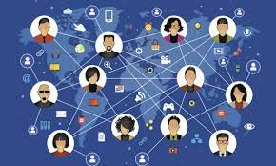
Chapter
08
II. The Networked Public Sphere :
These changes are the basis of what Yochai Benkler has called “networked public sphere” (2006).
The public sphere is the place where people meet for discussion in modern societies.
This metaphor includes physical spaces, such as public squares, as well as mediated spaces, such as the press or digital environments.
Although the public sphere was not born with digital media, network technologies contribute to its evolution.

Slide 18
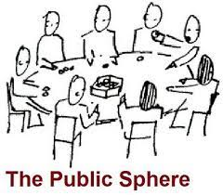
Chapter
08
II. The Networked Public Sphere :
Political theorist Hannah Arendt (1958) defined the public sphere as the place where citizens gather and act together to negotiate the rules of coexistence.
It is therefore an open system that can be accessed and used in a flexible way.
Arendt was referring to spaces in the city, but without an independent media system there would not exist a modern democratic public sphere.

Slide 19
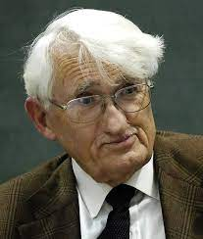
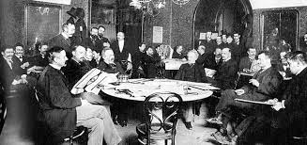
Chapter
08
II. The Networked Public Sphere :
German philosopher Jürgen Habermas (1984) placed the emergence of a modern public sphere in the Western world, independent of state and religious powers, and based on media such as newspapers, books, and magazines, but also on hangouts such as cafes, in the eighteenth century 1984.
In this space individuals that make up civil society are free to discuss politics without being subject to an external authority, and can thus form a public opinion.

Slide 20
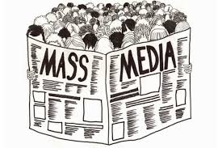
Chapter
08
II. The Networked Public Sphere :
In modern liberal societies, a rich and vital public sphere is crucial to both the functioning of democracy and the legitimacy of political power.
Mass media independent of governments and political parties help create a free public sphere and can monitor the actions of the powerful, a vital democratic function.
For example, they can sustain professional journalists who identify the most important issues to be put on the public agenda for debate.

Slide 21
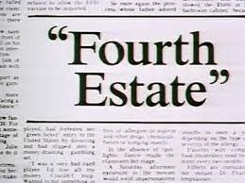

Chapter
08
II. The Networked Public Sphere :
However, the concentration of power in the hands of professional information producers (the so‐called “fourth power” or “fourth estate”) makes professional media a crucial bottleneck of information flow, giving them the ability to filter and direct news.
Moreover, their independence from government control may result in an increased influence of economic interests, for example those of advertisers.

Slide 22

Chapter
08
II. The Networked Public Sphere :
Digital media have transformed the functioning of the public sphere, while preserving some of its crucial dynamics.
For example, digital media have the potential to diversify sources of information.
Individuals have access to an unprecedented variety of sources, including independent, alternative, and foreign sources which can hardly be controlled by state authorities or big media corporations.

Slide 23
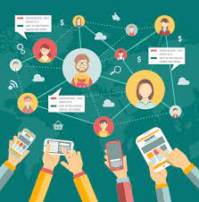
Chapter
08
II. The Networked Public Sphere :
According to the most utopian visions of the role of digital media, individuals can break free from a public sphere led and controlled by professional and hierarchical structures associated with economic and political power, abandon the political passivity that characterizes the societies dominated by traditional mass media, and assume a direct and active role in the public debate.
The networked public sphere would thus provide a wider pool of information and let individuals choose topics of interest and relevant opinions.

Slide 24

Chapter
08
II. The Networked Public Sphere :
Indeed, one of the transformations that characterize the public sphere in the digital age is disintermediation, a process of increased independence from professionals who traditionally have the role of intermediary between publics and information (Bardoel and Deuze 2001).
Thanks to digital technologies, individuals have direct access to an immense amount of information that was previously the preserve of experts, technicians, or professionals, such as medical information or direct communications by politicians on social media.

Slide 25
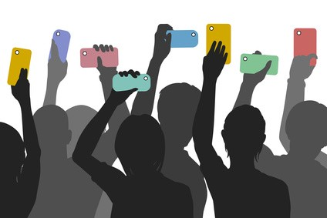
Chapter
08
III. The Journalism and Public Sphere :
Also new processes of communication, cooperation, discussion, and public opinion formation emerge as independent of the traditional mass media system.
This phenomenon includes epochal transformations of journalism’s role.
For example, citizen journalism is the production and distribution of news by individuals who are not professional journalists and through channels other than those controlled by broadcast communication incumbents (Goode 2009).

Slide 26

Chapter
08
III. The Journalism and Public Sphere :
Among the main tools available to citizens who wish to produce news are social media, but the historical evolution of such tools is worth mentioning.
Indymedia, an information site created during the demonstrations against the World Trade Organization that took place in Seattle in 1999, was one of the first successful examples of a platform for user‐led publication of journalistic content.
Anyone, without the need to be a professional journalist, could post news or comments that were then automatically published and thus made accessible to and commented on by other users.

Slide 27
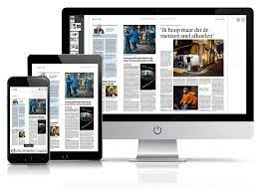
Chapter
08
III. The Journalism and Public Sphere :
In the 2000s, legacy newspapers gradually adapted to this change, opening online editions in which not only content was made available through new technologies (for example computers, smartphones, or tablets), but also communication started being increasingly focused on the interaction with readers.
The boundaries between mass media and new forms of communication thus changed as newspapers integrated online news with interactive systems such as blogging at first, comments and rating later, and eventually moved part of their content to social media.

Slide 28

Chapter
08
III. The Journalism and Public Sphere :
As a consequence, the role of professional Journalists has changed.
For example, through the use of commercial social media platforms such as Twitter or Facebook, individual reporters can acquire a visibility comparable to that of the newspapers for which they work (Weaver and Willnat 2016).
Social media also gradually became sources of information for journalists, as politicians and other actors started using platforms such as Twitter and Facebook to announce decisions or comment on politics (Paulussen and Harder 2014).

Slide 29
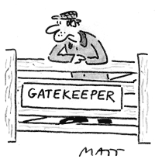
Chapter
08
III. The Journalism and Public Sphere :
A key political function of journalism is gatekeeping, i.e. the power to select which news will reach the public and which will not.
In today’s public sphere, the gatekeeping function is no longer exclusively in the hands of broadcast media, but rather at least partially distributed among users who produce, select, and examine news and information, as well as to new powerful actors such as social media companies.

Slide 30

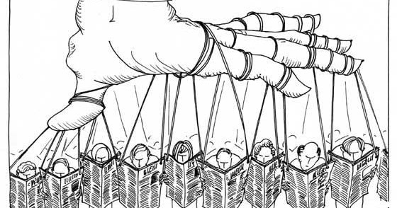
Chapter
08
III. The Journalism and Public Sphere :
This challenges the agenda setting power of mass media, i.e. the ability to dictate the agenda of public debate by choosing the news and topics that will be deemed relevant for discussion in the public sphere (McQuail1969).
Relevant news can now emerge through diffusion on social media and eventually reach online newspapers or broadcast media.
In sum, digital tools for information production and sharing allow users to participate in the processes that assess and make visible relevant, as well as reliable and verified, news and content.

Slide 31
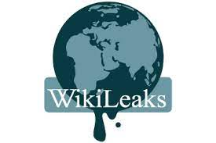
Chapter
08
IV. WikiLeaks :
Digital technologies also favored the emergence of new kinds of players in the contemporary public sphere.
An example is WikiLeaks, a platform for publishing leaks, or confidential information, which has played an important role in the redefinition of the public sphere in a renewed media landscape (Hindman and Thomas 2014).
WikiLeaks is an international non‐profit organization that collects and releases collections of documents covered by state or trade secrets restrictions.
Individuals can submit leaked information anonymously through encryption systems.

Slide 32

Chapter
08
IV. WikiLeaks :
The organization is then responsible for verifying the documents’ authenticity and publishing them while guaranteeing anonymity to its sources.
Its goal is to bring to light “restricted official materials involving war, spying, and corruption” for both governments and corporations.
The purpose of WikiLeaks is therefore to increase the transparency of governments and businesses through a form of distributed control practiced by all its users.

Slide 33

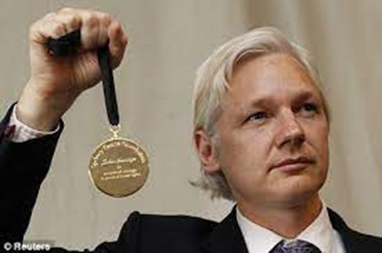
Chapter
08
IV. WikiLeaks :
Founded in 2006, the organization became famous with the publication of confidential and restricted documents from Western governments.
To spread these enormous amounts of information, WikiLeaks has worked in collaboration with major newspapers such as The Guardian, The New York Times, and Der Spiegel.
At the same time, WikiLeaks has received awards for its role in the evolution of free speech.

Slide 34
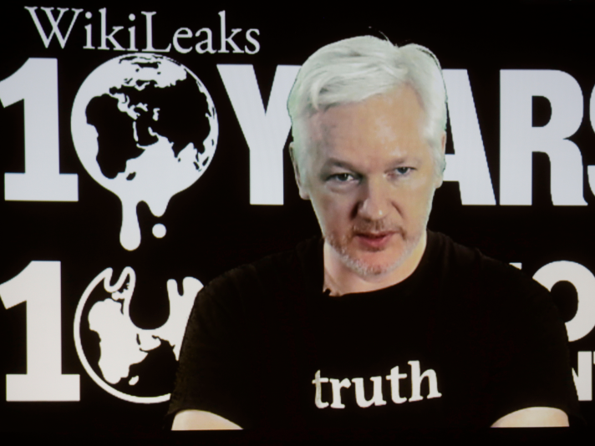
Chapter
08
IV. WikiLeaks :
Throughout its history, WikiLeaks has experienced censorship and boycotts.
Financial institutions such as Bank of America, Visa, MasterCard, and PayPal have blocked its cash flow, hampering its funding model which is based on donations.
Some US politicians even got to the point of publicly demanding the judgement of WikiLeaks’ founder and spokesperson, the Australian hacker Julian Assange.

Slide 35

Chapter
08
V. Panama Papers :
Following this example, similar journalistic initiatives have followed.
In 2016 an anonymous source provided the International Consortium for Investigative Journalism (ICIJ) with a set of more than 11 million classified documents originating from a financial firm based in Panama which provided services for transferring offshore funds to tax havens and thus shield them from tax authorities.

Slide 36

Chapter
08
V. Panama Papers :
The documents, dubbed “Panama papers,” involve heads of state and other politicians (Harding 2016).
Political information leaks are not new, but digital media have changed their scope by allowing the publication of millions of documents and providing the public with an opportunity to read, analyze, and use them without professional intermediation.

Slide 37
Chapter
08
V. Panama Papers :
Though fascinating, examples such as citizen journalism or WikiLeaks do not mean than the networked public sphere is inherently democratic in nature.
Analyzing the powerful role of private corporations and the new forms of control and censorship that characterize digital media, several critics have pointed out the importance of avoiding representing the new public sphere as perfectly democratic.

Slide 38


Chapter
08
VI. Communicative Capitalism :
For example, Zizi Papacharissi has argued that the internet is a “highly privatized public space,” rather than an accomplished public sphere (2002).
Political theorist Jodi Dean has described communicative capitalism as a system of appropriation that resembles a public sphere but is actually subject to exploitation and surveillance processes enacted by web corporations, which are the very actors that create digital participation opportunities.

Slide 39

Chapter
08
VI. Communicative Capitalism :
In fact, most interactions within the networked public sphere occur on digital platforms that are developed, owned, and controlled by private corporations.
This has led to new forms of media concentration, as corporations tend to exploit processes of merging and acquisition in order to become dominant.
These companies take on the role of new intermediaries, and although they have proved able to dent the dominance of traditional players, such as broadcast media or newspapers, they are not necessarily more accessible, open, or democratic.

Slide 40

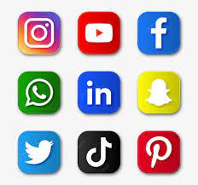
Chapter
08
VI. Communicative Capitalism :
Indeed, they can leverage their position to exercise forms of power typical of monopolistic telecom companies (Wu 2010).
For example, thanks to its technology for searching information and providing free services (maps, video streaming, news, and countless others), Google has established itself as one of today’s core intermediaries between users and information.
In a few years its Google News service has become one of the leading global news websites.
Similarly, social media have become crucial services used to access political and journalistic content.

Slide 41
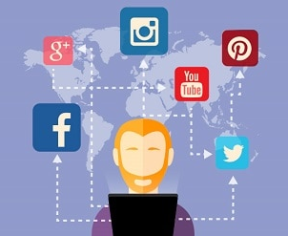
Chapter
08
VI. Communicative Capitalism :
For other players, such as newspapers or news agencies, services like Facebook, Twitter, or Snapchat have become the main battleground on which to compete for reader attention.
Newspapers are investing increasing amounts of time and money to boost their presence on social media.
Inside the newsroom, the figure of the social media manager has acquired a central role, while individual journalists have now become social media managers of themselves, and need to support the spread of the content they create for their newspapers .

Slide 42

Chapter
08
VI. Communicative Capitalism :
Although they circulate content produced by other actors, such as newspapers or television channels, services such as Google News or Facebook implement a new form of gatekeeping, or information filter.
Furthermore, this filter function is often outsourced to the service’s algorithms rather than journalists.
Indeed, the algorithms that underpin digital platforms such as Google News or Facebook shape political and social interactions.
These are new forms of “algorithmic gatekeeping,” often monopolistic.

Slide 43

Chapter
08
VI. Communicative Capitalism :
Facebook’s algorithms have been accused of playing a crucial political role by presenting selected information to specific users, thus limiting news diversity and immersing us in so‐called “filter bubbles” .
These new intermediaries are commercial enterprises driven by profit.
They are not neutral but, as most players in the world of mass media, express specific worldviews, values, and interests.

Slide 44

Chapter
08
VII. Conclusion
The public sphere, a fundamental component of modern democracies, where individuals are free to discuss politics without being subject to an external authority, and can thus form a public opinion.
Media publics can successfully become politically active thanks to the emergence of an information‐rich digital environment and its related communication tools..
Digital technologies also favored the emergence of new kinds of players in the contemporary public sphere , such as WikiLeaks and “Panama papers .
The networked public sphere is not inherently democratic in nature.
The algorithms that underpin digital platforms shape political and social interactions.
These are new forms of “algorithmic gatekeeping,”

Slide 45
Thank you for listening
DGM 711
Introduction to Digital Media

