Slide 1


Prepared by Eng. Eman Hamdy
Introduction to Information Systems – IT111
Flowchart Part 1
Lecture 7 (Practical)

Slide 2

Lec
Flow Chart component
07
A computer program is a set of instructions that the computer can understand which it will obey sequentially one after the other.
A program must be planned and written down as a set of steps to follow.
One method is using visual tools such as Flowcharts.

Slide 3
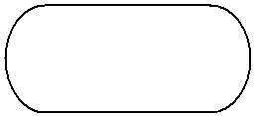
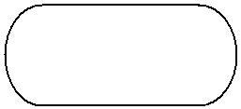
Lec
Flow Chart component
07
Flowchart Symbols
a. Start and end symbols, represents start and end of a process
Start
end
b. Arrows, showing what's called "flow of control". An arrow coming from one symbol and ending at another symbol represents that control passes to the symbol the arrow points to.
c. Processing, represented as rectangles. Examples: "Add 1 to X"; "replace identified part"; "save changes" or similar.

Slide 4
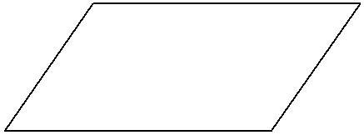
Lec
Flow Chart component
07
Flowchart Symbols
d. Input/output, represented as a parallelogram. Examples: Get X from the user; display X.
e. Conditional (or decision), represented as a diamond. These typically contain a Yes/No question or True/False test. This symbol is unique in that it has two arrows coming out of it, usually from the bottom point and right point, one corresponding to Yes or True, and one corresponding to No or False. The arrows should always be labeled. More than two arrows can be used.

Slide 5
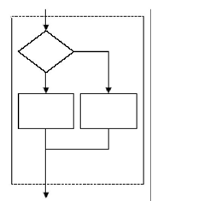
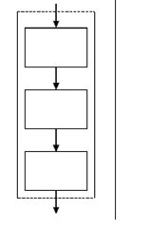
Lec
Flow Chart component
07
Introduce the different structures in flowcharts
a. Sequence Structure
b. If‐ then‐else structure

Slide 6
Lec
Flow Chart
07
start
a. Sequence Structure
Read radius (R) and calculate circle area
Input r
A = 0
A = 3.14 * r *r
print A
End

Slide 7
Lec
Flow Chart
07
start
Calculate sum of 2 numbers
Input n1,n2
sum = 0
Sum = n1+ n2
Print sum
End

Slide 8
Lec
Flow Chart
07
start
Input n1,n2
Calculate average of 2 numbers
sum = 0 , avg =0
Sum = n1+ n2
Avg= sum/ 2
Print Avg
End

Slide 9
Lec
Flow Chart
07
start
Input mm
Read distance in millimeter and print distance centimeters and meters.
cm = 0 , m =0
cm= mm/10
m= mm/1000
Print cm
Print m
End

Slide 10
Lec
Flow Chart
07
start
b. If‐ then‐else structure
Display student pass or fail
Input grade
No
yes
Print fail
Grade >= 50
Print pass
End

Slide 11
Lec
Flow Chart
07
start
Draw flowchart to simulate a state police radar gun , the program should take a car speed
And display the message “speeding” if the speed exceeds 65 mph , “Not speeding” otherwise
Input speed
No
yes
Print “not speeding”
Speed >65
Print ”speeding”
End

Slide 12
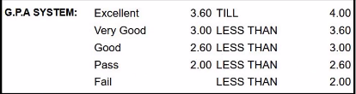
Lec
Flow Chart
07
Draw flowchart to display GPA Grade based on the following:

Slide 13
Lec
Flow Chart
07
start
Input GPA
No
GPA>= 3.6
yes
Print “Excellent”
No
yes
GPA>= 3
Print “Very Good”
No
yes
GPA>= 2.6
Print “Good”
Print “fail”
No
yes
GPA>= 2
Print “pass”
End

Slide 14



Thank You

