Slide 1


Accounting for Managers
Prepared by Dr. Emad Zaher
Assistant Professor of Accounting
MGM341
Lecture (1)
Basic Financial Statements &Closing of Accounts

Slide 2

  Learning outcomes
LO 1 Identify the income statement (Profit & loss).
LO 2 Explain the statement of changes in owner’s Equity.
LO 3 Describe the classified balance sheet(Statement of financial position).
LO 4 State the different types of Accounts & closing entries.

Slide 3
The Four Basic Financial Statements
Financial Statements are prepared directly from the Trial Balance.
Companies prepare four financial statements:
Income Statement (Profit & loss statement) |  | Changes in owner’s Equity Statement |  | Statement of Financial Position (Balance Sheet) |  | Statement of Cash Flows
Period of time
Period of time
Point in time
Period of time
Prepared by Dr. Emad Zaher

Slide 4
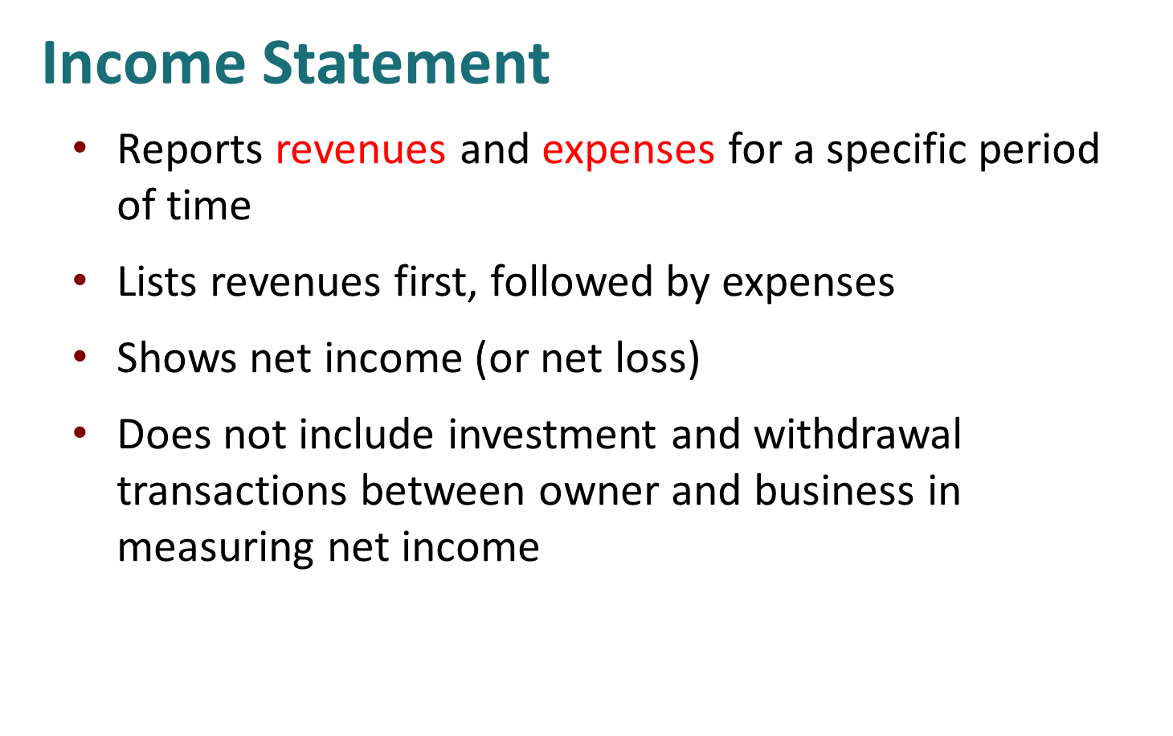
Prepared by Dr. Emad Zaher

Slide 5
Business Name…. Single-Step income statement for the year ended Dec. 31, 2022
Revenues :
Sales Revenue | ×
Service Revenue | ×
Fees Earned | ×
Commission Revenue | ×
Consulting revenue | ×
Dividends Revenue | ×
Rental revenue | ×
Total Revenues | ××
Expenses:
Salary expenses | (×)
Wages expenses | (×)
Rent expenses | (×)
Utility expense | (×)
Repair expense
Insurance expense | (×)
Interest expense | (×)
Depreciation expense | (×)
Advertising expense | (×)
Supplies expense | (×)
Total expenses | (××)
Net income | ××
Prepared by Dr. Emad Zaher

Slide 6
Revenues and expenses determine if a net income or net loss occurs as follows:
a. Revenues > Expenses: Net Income(Profit).
b. Revenues < Expenses: Net Income (loss).
Prepared by Dr. Emad Zaher

Slide 7
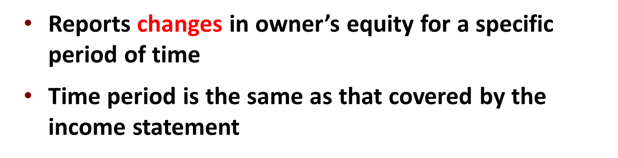
Changes in Owner’s Equity Statement
Prepared by Dr. Emad Zaher

Slide 8
Business Name…. Changes in Owner’s equity statement For the year ended Dec 31.2024
Beginning Capital | ×
Add (+) | +
Additional Investment | ×
Net income (Profit) ….from the income statement | ×
Less (-)
Drawings (Withdrawals) | (×)
Net income (Loss) …. from the income statement
Ending Capital | ××
Prepared by Dr. Emad Zaher

Slide 9
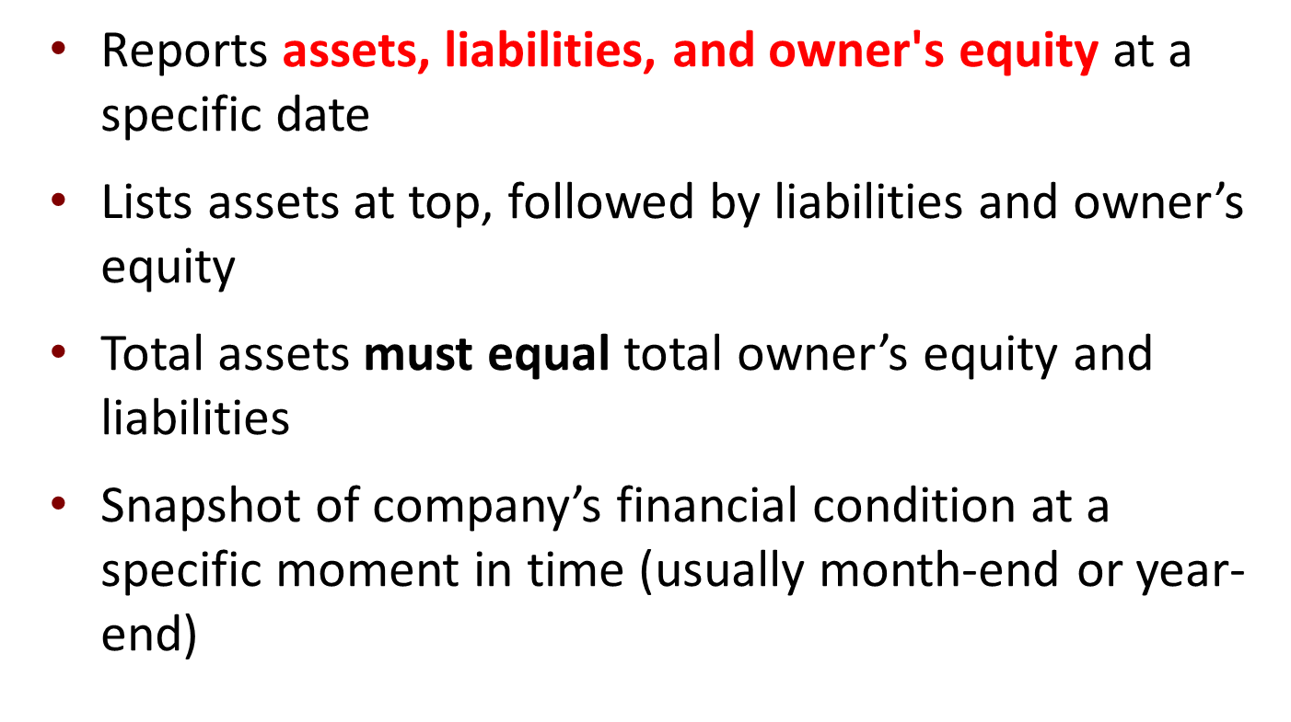
Statement of Financial Position (Balance sheet)

Slide 10
Balance Sheet At the year ended Dec 31.2024
Assets
Current assets
Cash | xx
Short-term investment | xx
Account receivable | xx
Notes receivable | xx
Inventories | xx
Prepaid expenses | xx
Total current assets |  | xx
Property, plant, and equipment (Fixed Assets) |  | xx
Land | xx
Building ( - ) Accumulated Depreciation | xx
Equipment ( - ) Accumulated Depreciation | xx
Machinery ( - ) Accumulated Depreciation | xx
Furniture ( - ) Accumulated Depreciation | xx
Total property, plant, and equipment |  | xx
Intangible assets | xx
Goodwill | xx
Copyright | xx
Trademark | Xx
Total intangible assets |  | xx
Total assets | xx
Liabilities & owner's equity
Liabilities |  | xx
Current liabilities |  | xx
Notes payable | xx
Account payable | xx
Unearned revenue | Xx
Total current liabilities |  | xx
Long term liabilities
Mortgage payable | xx
Bank loan payable | xx
Total long-term liabilities |  | xx
Total liabilities |  | xx
Owner's equity
Capital …..From the changes in owner’s equity statement |  | xx
Total liabilities & owner's equity |  | xx
Prepared by Dr. Emad Zaher

Slide 11
Example (1)
Mohamed Emad has the following Activities during the year:
Service revenue $52800- Rent expense $4800 - wages expense $33080 - advertising expense $5400- utilities expense $3600 - Mohamed withdrawals $2800- Cash $6200- Accounts receivable $3000-supplies $400- land 4000- Accounts payable $1800 - Mohamed beginning capital $8680
Required
Prepare the income statement.
Prepare the statement of owner's equity.
Prepare the balance sheet for Mohamed Emad proprietorship.
Prepared by Dr. Emad Zaher

Slide 12
Mohamed Emad Balance Sheet At the year ended Dec 31.2022
Assets
Current assets:
Cash | 6200
Accounts receivable | 3000
Supplies | 400 | 9600
Fixed Assets
Land | 4000 | 4000
Total Assets |  | 13600
Liabilities and owner's’s equity
Short term liabilities
Accounts Payable |  | 1800
Long term liabilities
Loans (If found)
Owner's equity
Capital |  | 11800
Total liabilities and Owner's equity |  | 13600
Mohamed Emad Single-Step income statement for the year ended Dec. 31, 2022
Revenues :
Service Revenue | 52800
Expenses:
Rent expenses | (4800)
Wages expenses | (33080)
Advertising expense | (5400)
Utility expense | (3600)
Total expenses | (46880)
Net income | 5920
Mohamed Emad Owner’s equity statement For the year ended Dec 31.2022
Beginning Capital | 8680
Add (+) | +
Additional Investment | 0
Net income (Profit) | 5920
Less (-)
Drawings (Withdrawals) | (2800)
Ending Capital | 11800
Prepared by Dr. Emad Zaher

Slide 13
Example(2)
Given the following trial balance:
FastForward
Trial Balance
December 31, 2011
Debits
Credits
Cash
$
4,350
Accounts receivable
-
Instructions
Prepare the income statement.
Prepare the statement of owner's equity.
Prepare the statement of financial position.
Supplies
9,720
Prepaid Insurance
2,400
Equipment
26,000
Accounts payable
$
6,200
Unearned consulting revenue
3,000
C. Taylor, Capital
30,000
Owner's Withdrawals
200
Consulting revenue
5,800
Rental revenue
300
Salaries expense
1,400
Rent expense
1,000
Utilities expense
230
Total
$
45,300
$
45,300

Slide 15
STATEMENT OF OWNER'S EQUITY
FASTFORWARD
Statement of Owner's Equity
For the Month Ended December 31, 2011
C. Taylor, Capital 12/1/11
$
-
Connections
Net income for December
3,470
Plus: Investments by Owner
30,000
33,470
Less: Owner Withdrawals
200
C. Taylor, Capital, 12/31/11
$
33,270

Slide 16
Balance Sheet
FASTFORWARD
Statement of Owner's Equity
For the Month Ended December 31, 2011
C. Taylor, Capital 12/1/11
$
-
Net income for December
3,470
Plus: Investments by Owner
30,000
33,470
Less: Owner Withdrawals
200
C. Taylor, Capital, 12/31/11
$
33,270
Connections

Slide 17
Example(3)
Given the following trial balance:
Account title | Dr | Cr
Cash | 100,000
Accounts receivable | 30,000
Building | 90,000
Accumulated Depreciation -Building |  | 20,000
Equipment | 350,000
Accumulated Depreciation -Equipment |  | 50,000
Notes payable |  | 60,000
Accounts Payable |  | 90,000
Zaher ,Capital |  | 280,000
Zaher , Withdrawals | 30,000
Service revenue |  | 140,000
Salaries expense | 20,000
Insurance expense | 8,000
Advertising expense | 9,000
Rent expense | 3,000
Total | 640,000 | 640,000
Instructions
Prepare the income statement.
Prepare the statement of owner's equity.
Prepare the statement of financial position.

Slide 18
income statement for the year ended Dec. 31, 2022
Revenues :
Service Revenue | 140000
Expenses:
Salaries Expense | (20000)
Insurance expenses | (8000)
Advertising Expense | (9000)
Rent expense | (3000)
Total expenses | (40000)
Net income (Profit) | 100,000
Balance Sheet At the year ended Dec 31.2022
Assets
Fixed assets (Non-Current Assets) :
Building | 90,000 | 70,000
(-) Accumulated Depreciation | ( 20,000)
Equipment | 350,000
(-) Accumulated Depreciation | (50,000)
Current Assets |  | 300,000
Cash |  | 100,000
Accounts receivable |  | 30,000
Total Assets |  | 500,000
Liabilities and stockholder’s equity
Short term liabilities
Accounts payable |  | 90,000
Notes payable |  | 60,000
Long term liabilities
Loans (If found)
Owner's equity
Capital |  | 350,000
Total liabilities and Owner's equity |  | 500,000
Owner’s equity statement For the year ended Dec 31.2022
Beginning Capital | 280,000
Add (+) | +
Additional Investment | Zero
Net income (Profit) | 100,000
Less (-)
Drawings (Withdrawals) | (30,000)
Ending Capital | 350,000
Prepared by Dr. Emad Zaher

Slide 19
DO IT! Financial Statement Items
Presented below is selected information related to Li Fashions at December 31, 2020. Li reports financial information monthly.
Equipment | $10,000 | Utilities Expense | $4,000
Cash | 8,000 | Accounts Receivable | 9,000
Service Revenue | 36,000 | Salaries and Wages Expense | 7,000
Rent Expense | 11,000 | Notes Payable | 16,500
Accounts Payable | 2,000 | Owner’s Drawings | 5,000
a. Determine the total assets at December 31, 2020.
b. Determine the net income reported for December 2020.
c. Determine the owner’s equity at December 31, 2020.

Slide 20
Multiple Choice Questions

Slide 21
1. The following items are taken from the financial statements of the Postal Service for the year ending December 31, 2014:
Accounts payable $ 18,000
Accounts receivable 11,000
Accumulated depreciation – equipment 28,000
Advertising expense 21,000
Cash 15,000
Owner’s capital (1/1/14) 102,000
Owner’s drawings 14,000
Depreciation expense 12,000
Insurance expense 3,000
Note payable, due 6/30/15 70,000
Prepaid insurance (12-month policy) 6,000
Rent expense 17,000
Salaries and wages expense 32,000
Service revenue 133,000
Supplies 4,000
Supplies expense 6,000
Equipment 210,000
What is the company’s net income for the year ending December 31, 2014?
a. $12,000
b. $28,000
c. $42,000
d. $133,000

Slide 22
income statement for the year ended Dec. 31, 2014
Revenues :
Service Revenue | 133000
Expenses:
Advertising Expense | (21000)
Depreciation expenses | (12000)
Insurance Expense | (3000)
Rent expense | (17000)
Salaries & wages expense | (32000)
Supplies expense | (6000)
Total Expenses | (91000)
Net income (Profit) | 42000
The correct Answer is c
Prepared by Dr. Emad Zaher

Slide 23
2. Misra Company compiled the following financial information as of December 31, 2023:
Revenues $340,000
Owner’s Capital (1/1/23) 140,000
Equipment 80,000
Expenses 250,000
Cash 90,000
Owner’s Drawings 20,000
Supplies 10,000
Accounts payable 40,000
Accounts receivable 70,000
Misra’s owner’s equity on December 31, 2023 is
a. $90,000.
b. $140,000.
c. $210,000.
d. $250,000.

Slide 24
income statement for the year ended Dec. 31, 2023
Revenues : | 340,000
Less (-) | (-)
Expenses | 250000
Net income (Profit) | 90,000
Owner’s equity statement For the year ended Dec 31.2023
Beginning Owner’s Capital | 140,000
Add (+) | +
Additional Investment | Zero
Net income (Profit) | 90,000
Less (-)
Drawings (Withdrawals) | (20,000)
Ending Owner’s Capital | 210,000
The correct Answer is c

Slide 25
3.The following items are taken from the financial statements of the Postal Service for the year ending December 31, 2014:
Accounts payable $ 18,000
Accounts receivable 11,000
Accumulated depreciation – equipment 28,000
Advertising expense 21,000
Cash 15,000
Owner’s capital (1/1/14) 102,000
Owner’s drawings 14,000
Depreciation expense 12,000
Insurance expense 3,000
Note payable, due 6/30/15 70,000
Prepaid insurance (12-month policy) 6,000
Rent expense 17,000
Salaries and wages expense 32,000
Service revenue 133,000
Supplies 4,000
Supplies expense 6,000
Equipment 210,000
What are total current assets at December 31, 2014?
a. $26,000
b. $36,000
c. $32,000
d. $42,000
Total current assets =
Accounts receivable 11,000+ Cash 15,000+
Prepaid insurance 6000+ Supplies 4000
= $36000
The correct Answer is B

Slide 26
Total current liabilities =
Accounts payable 130,000+ Salaries&Wages payable 50,000+
= $180,000
The correct Answer is c

Slide 27
5 .The income statement for the year 2023 of Nour Emad Co. contains the following information:
Revenues $70,000
Expenses:
Salaries and Wages Expense $45,000
Rent Expense 12,000
Advertising Expense 10,000
Supplies Expense 6,000
Utilities Expense 2,500
Insurance Expense 2,000
Total expenses 77,500
Net income (loss) $ (7,500)
At January 1, 2023, Nour reported owner’s equity of $50,000. Owner drawings for the year totalled $10,000. At December 31, 2023, the company will report owner’s equity of
a. $17,500.
b. $32,500.
c. $40,000.
d. $42,500.

Slide 28
Owner’s equity statement For the year ended Dec 31.2023
Beginning Owner’s Capital | 50,000
Add (+) | +
Additional Investment | Zero
Net income (loss) | (7500)
Less (-)
Drawings (Withdrawals) | (10,000)
Ending Owner’s Capital | 32,500
The correct Answer is b

Slide 29
6. The income statement and balance sheet columns of Iron and Wine Company's worksheet reflect the following totals:
Income Statement Balance Sheet
Dr. Cr. Dr. Cr.
Totals $72,000 $44,000 $60,000 $88,000
The net income (or loss) for the period is
a. $28,000 loss.
b. $28,000 income.
c. $24,000 income.
d. not determinable.
The correct Answer is a

Slide 30
7.Misra Company compiled the following financial information as of December 31, 2014:
Revenues $340,000
Owner’s Capital (1/1/14) 140,000
Equipment 80,000
Expenses 250,000
Cash 90,000
Owner’s Drawings 20,000
Supplies 10,000
Accounts payable 40,000
Accounts receivable 70,000
Misra’s assets on December 31, 2014 are
a. $180,000.
b. $250,000.
c. $360,000.
d $490,000.
Total Assets=
Equipment 80,000+ Cash 90,000+Supplies 10,000+ Accounts receivable 70,000
= $250,000
The correct Answer is b

Slide 31
8. As of December 31, 2014, Calexico Company has assets of $42,000 and owner's equity of $20,000. What are the liabilities for Calexico Company as of December 31, 2014?
a. $22,000.
b. $20,000.
c. $42,000.
d. $62,000.
9. Net income results when
a. Assets > Liabilities.
b. Revenues = Expenses.
c. Revenues > Expenses.
d. Revenues < Expenses.
10. Owner's capital at the end of the period is equal to
a. owner's capital at the beginning of the period plus net income minus liabilities.
b. owner's capital at the beginning of the period plus net income minus drawings.
c. net income.
d. assets plus liabilities.
The correct Answer is a
The correct Answer is c
The correct Answer is b

Slide 32
Closing the Books
TEMPORARY These accounts are closed |  |  |  | PERMANENT These accounts are not closed
 | All revenue accounts |  |  |  | All asset accounts
 | All expense accounts |  |  |  | All liability accounts
 | Owner's drawings account |  |  |  | Owner's capital account

Slide 33
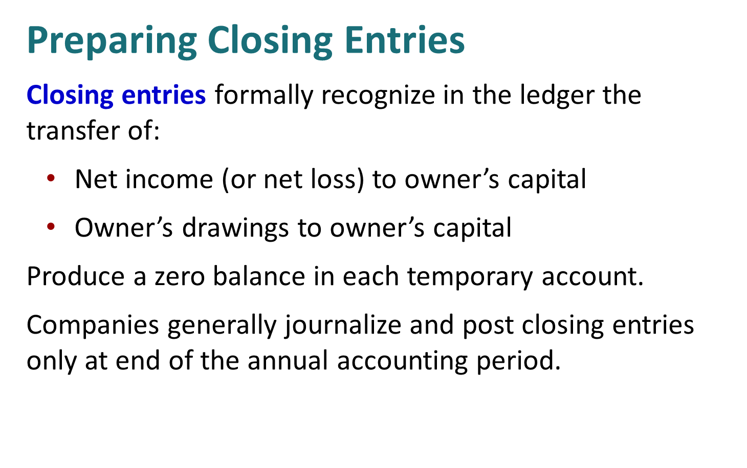

Slide 34
Preparing Closing Entries
Expenses
Income Summary
Revenues
2
1
3
Key:
Close Revenues to Income Summary.
Close Expenses to Income Summary.
Close Income Summary to Owner’s Capital.
Close Owner’s Drawings to Owner’s Capital.
Owner’s Drawings
Owner’s Capital
4

Slide 35
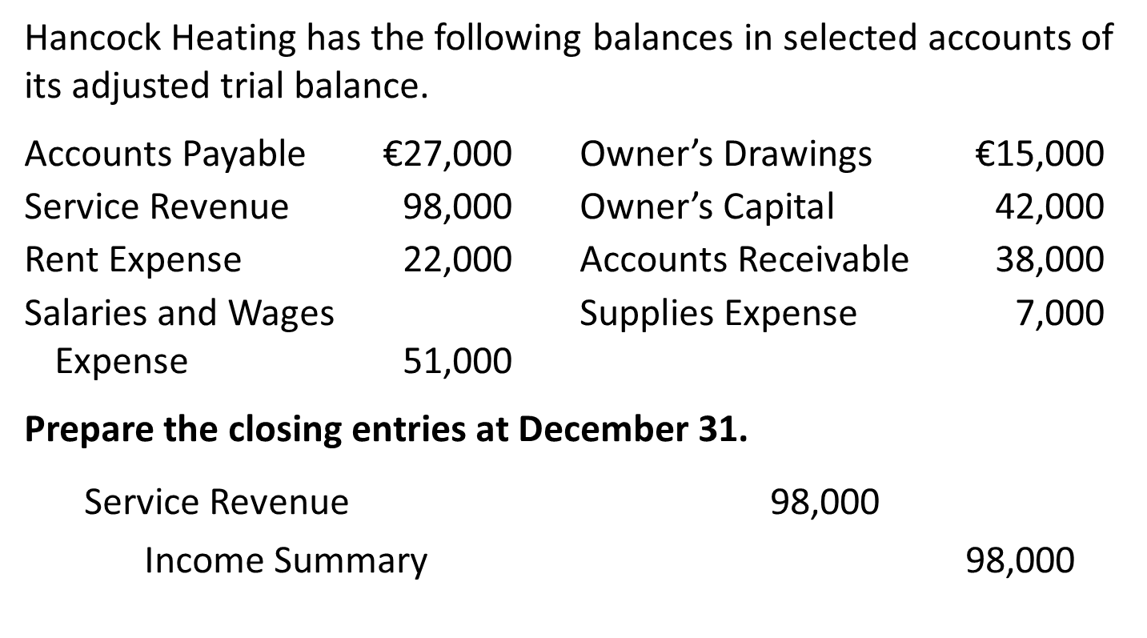
Example (1) Closing Entries

Slide 36
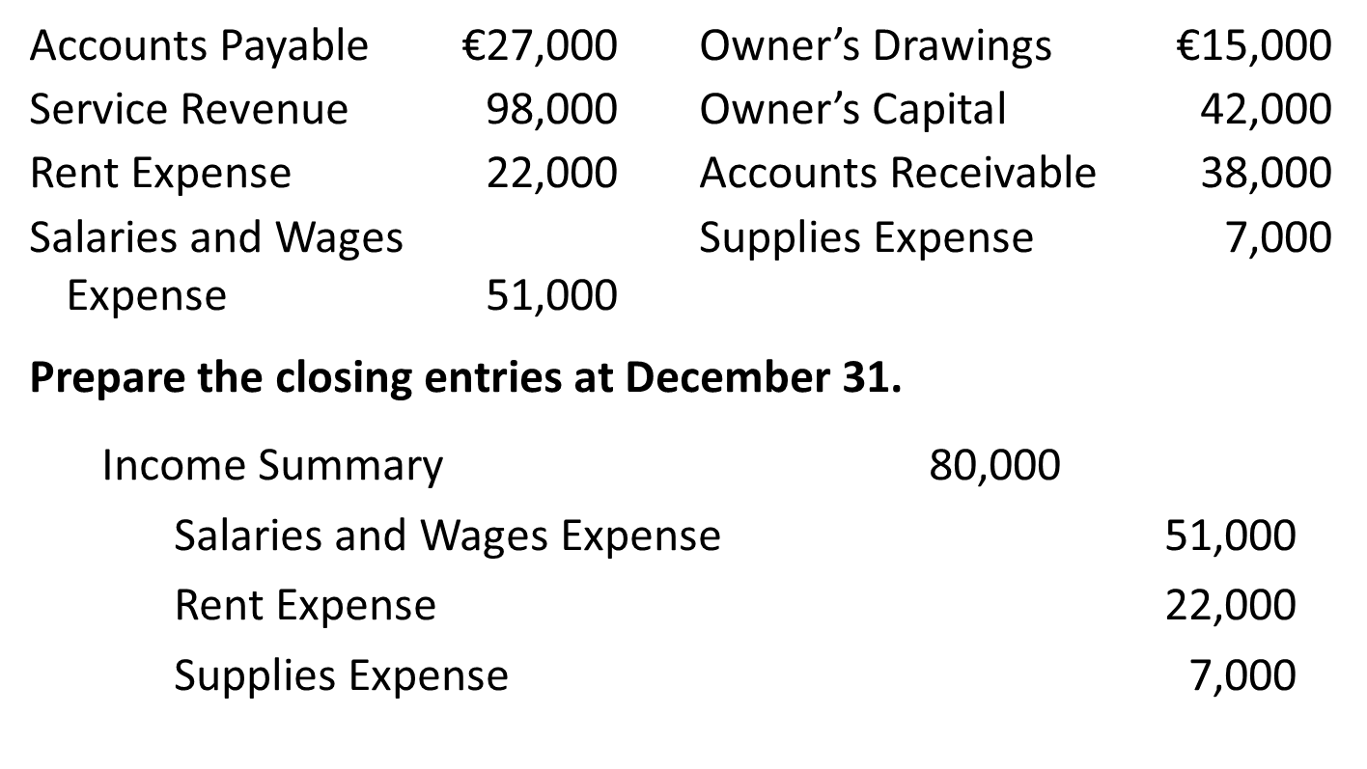

Slide 37
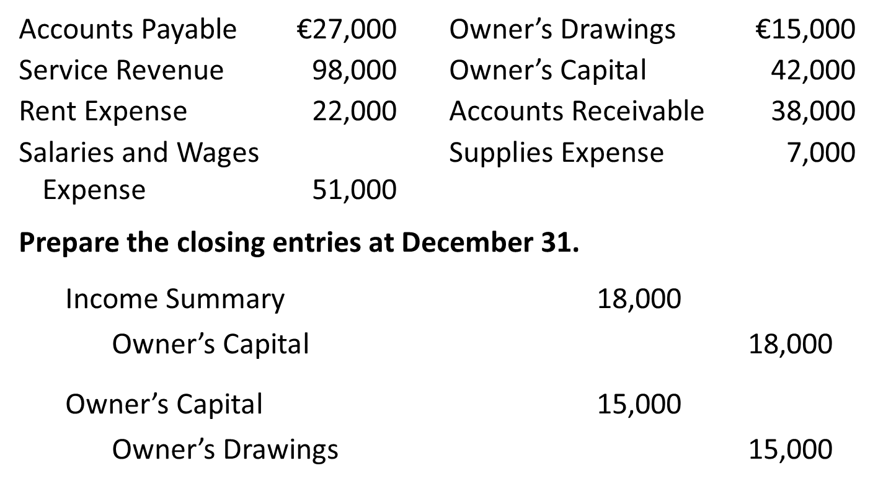

Slide 38
Yazici Advertising Adjusted Trial Balance October 31, 2020
 | Debit |  | Credit
Cash | ₺15,200
Accounts Receivable | 200
Supplies | 1,000
Prepaid Insurance | 550
Equipment | 5,000
Accumulated Depreciation—Equipment |  |  | ₺ 40
Notes Payable |  |  | 5,000
Accounts Payable |  |  | 2,500
Interest Payable |  |  | 50
Unearned Revenue |  |  | 800
Salaries and Wages Payable |  |  | 1,200
Owner’s Capital |  |  | 10,000
Owner’s Drawings | 500
Service Revenue |  |  | 10,600
Salaries and Wages Expense | 5,200
Supplies Expense | 1,500
Rent Expense | 900
Insurance Expense | 50
Interest Expense | 50
Depreciation Expense | 40
 | ₺30,190 |  | ₺30,190
Example (2)
Required:
Prepare the closing entries

Slide 39
Closing Entries
Date | Account Titles and Explanations |  | Debit | Credit
2020 Oct. 31 | Service Revenue |  | 10,600
 | Income Summary |  |  | 10,600
 | (To close revenue account)
31 | Income Summary |  | 7,740
 | Supplies Expense |  |  | 1,500
 | Depreciation Expense |  |  | 40
 | Insurance Expense |  |  | 50
 | Salaries and Wages Expense |  |  | 5,200
 | Rent Expense |  |  | 900
 | Interest Expense |  |  | 50
 | (To close expense accounts)

Slide 40
Multiple Choice Questions

Slide 41
1. The closing entry process consists of closing
a. all asset and liability accounts.
b. out the owner's capital account.
c. all permanent accounts.
d. all temporary accounts.
The correct Answer is d
2. In preparing closing entries
a. each revenue account will be credited.
b. each expense account will be credited.
c. the owner's capital account will be debited if there is net income for the period.
d. the owner's drawings account will be debited.
The correct Answer is b
3. In order to close the owner's drawings account, the
a. income summary account should be debited.
b. income summary account should be credited.
c. owner's capital account should be credited.
d. owner's capital account should be debited.
The correct Answer is d

Slide 42
4. The income statement for the month of June, 2014 of Camera Enterprises contains the following information:
Revenues $7,000
Expenses:
Salaries and Wages Expense $3,000
Rent Expense 1,500
Advertising Expense 800
Supplies Expense 300
Insurance Expense 100
Total expenses 5,700
Net income $1,300
The entry to close the revenue account includes a
a. debit to Income Summary for $1,300.
b. credit to Income Summary for $1,300.
c. debit to Income Summary for $7,000.
d. credit to Income Summary for $7,000.
The correct Answer is d

Slide 43
76. The income statement for the month of June, 2014 of Camera Obscura Enterprises contains the following information:
Revenues $7,000
Expenses:
Salaries and Wages Expense $3,000
Rent Expense 1,500
Advertising Expense 800
Supplies Expense 300
Insurance Expense 100
Total expenses 5,700
Net income $1,300
The entry to close the expense accounts includes a
a. debit to Income Summary for $1,300.
b. credit to Rent Expense for $1,500.
c. credit to Income Summary for $5,700.
d. debit to Salaries and Wages Expense for $3,000.
The correct Answer is b

Slide 44



Thank You

