Slide 1

Sentiment Analysis from Images using VGG19 based Transfer Learning Approach‏
Advisor: Dr. Ashraf Elsayed.
Student : Turki Arif
Midocean University

Slide 2


Pepper
Sentiment Analysis from Images using VGG19 based Transfer Learning Approach
Magazine name:
Procedia Computer Science 218 (2023) 1640–1649
Year of publication : 2022
Authors' names:
Gaurav Meena*, Krishna Kumar Mohbey, Ajay Indian, Sunil Kumar Department of Computer Science, Central University of Rajasthan, Ajmer, India
Link: ScienceDirect Article

Slide 3
Research methodology
This study relied on the VGG19 model using transfer learning, a technique that transfer knowledge from a model previously trained on a large dataset to a specific application.
Detailed explanation of the VGG19 model consists of 19 layers, including: 16 convolutional layers for feature extraction, 3 fully connected layers responsible for classification and MaxPooling layers are used between the convolutional and reducer the size of the extracted.
The input 124X124 Pixel and output Sentiment classification (positive, negative, neutral

Slide 4
Data preprocessing
Rescaling the images to values ranging from0 to 255
Horizontal flipping of the images to increase the date size and diversify it.
Used the TensorFlow and Karas

Slide 5
Data Characterization and size:
FER2013- The data consists 35,887 of 48x48 pixel grayscale images of faces- 28709 training images, 3589 test images- Database was built with seven expressions per subject: neutral, happiness, disgust, fear, angry, surprise and sadness
JAFFE - This database contains 213 frontal facials images corresponding to 10 Japanese females with 7 different expressions (Happy, sad, angry, disgust, surprised, natural, and fear)
CK+ - dataset contains 593 anger, contempt, disgust, fear, happiness, sadness, and surprise

Slide 7


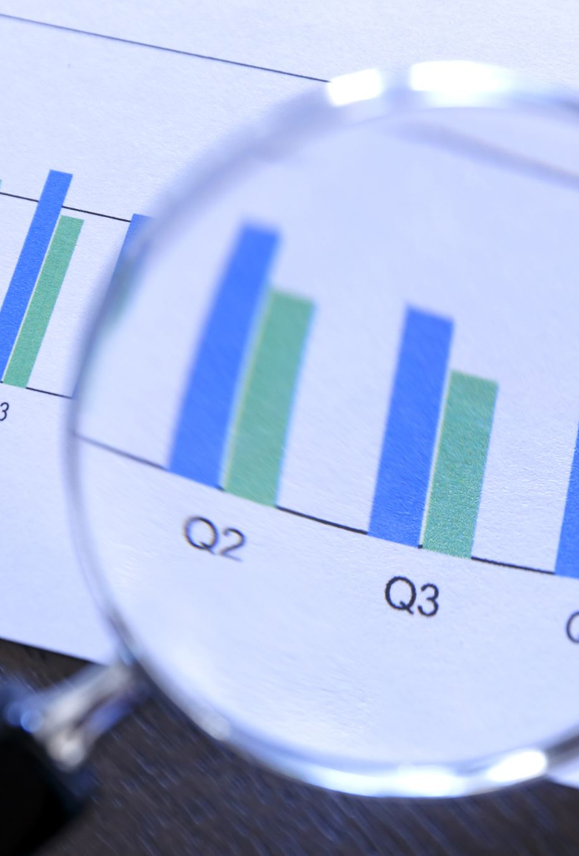
Results
CK+ Dataset: Accuracy up to 99.47%
.FER2013 Dataset: Accuracy up to 65.41%
.JAFFE Dataset: Accuracy up to 94%.

Slide 8
Advantages and disadvantages
Advantages
Disadvantages
Very high accuracy on CK+ and JAFFE data.
Uses transfer learning technology, which saves time and effort in training.
Achieves superior results compared to previous studies..
Relatively lower performance compared to FER2013 due to challenges such as data imbalance, some labeling errors, and image clipping.

Slide 9
dataset Source
https://www.kaggle.com/code/superheroy/jaffe-vgg19
https://www.kaggle.com/code/farneetsingh24/ck-pixel-facial-emotion-recognition

Slide 10

Thank you

