Slide 1

Project Risk &Supply Chain Risk
Prepared by Dr. Dalia Hosni
Lecture 4
PMG 663
Project Risk &Supply Chain Risk

Slide 2

Chapter
4
Project Risk Topics
Plan Risk Management
Identify Risks
Perform Qualitative Risk Analysis
Perform Quantitative Risk Analysis
Plan Risk Responses
Monitor and Control Risks

Slide 3
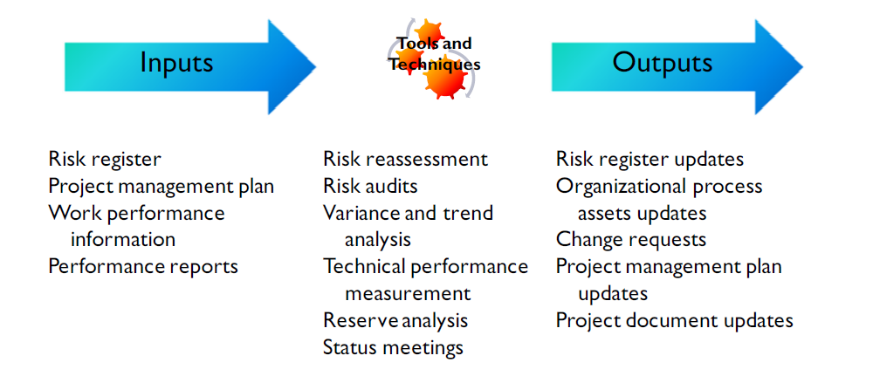
Chapter
4
Monitor and Control Risks
Goal: Change requests,
updates

Slide 4
Chapter
04
Monitor and Control Risks
As in other monitor and controlling activities, it is assumed you have performed all the necessary elements to identify and quantify project risk, and have a created the necessary strategies to respond to risk on the project.

Slide 5
Chapter
04
Monitor and Control Risks
Part of the process of monitoring and controlling risks is to perform risk reassessments of the project on a regular basis:
Have the risk elements changed?
Have lower level, low priority risks become high priority risks?
Have certain risks been addressed, and be considered closed on the risk log?
Do contingency or management reserves need to be adjusted?

Slide 6
Chapter
04
Risk Audits and Reviews
In most large organizations, there are individuals who specialize in risk auditing and conducting risk reviews.
You would do well to learn as much as you can from these individuals about project risk - it will help you do a better job of identifying risks and planning risk responses.
Usually, risk audits are periodically scheduled throughout the project.
They are typically conducted by people outside of your immediate organization.
Why do you think that is so?

Slide 7
Chapter
04
Risk Audits and Reviews
There are several reasons why auditors are not part of the project team:
Provides for an objective review of risks
Provides a fresh pair of eyes to review risk elements from a different perspective
Can help identify risks not considered by the team

Slide 8
Chapter
04
Risk reassessment or risk reviews
Periodic and scheduled
Should occur to determine if any risk priorities or ratings have Changed
Risk audits
Carried out throughout project life
Typically performed by experts outside project team

Slide 9
Chapter
04
Risk reassessment or risk reviews
Additional Risk Tools
Variance and Trend analysis compares planned results to the actual results. Variance tools such as earned value analysis can be used for monitoring overall project performance. As a result, potential forecasts of deviation at the project’s completion from cost and schedule targets are possible.
Technical Performance Measurement compares technical accomplishments during project execution to
the project management plan schedule of technical achievement. Quantifiable measurements are taken
and compared against actual results.
Reserve Analysis compares the amount of contingency reserves remaining to the amount of risk
remaining at any time in the project.

Slide 10
Chapter
04
Risk reassessment or risk reviews
Notes
reserve analysis and the funds set aside for contingencies apply only to the specific risks on the project for which they were set aside

Slide 11
Chapter
04
Risk reassessment or risk reviews
Workarounds
Workarounds are usually employed when no contingency plan exists, and are generally executed ‘on the-fly' to address some unplanned event.
The result of implementing a workaround can be the identification of an undiscovered risk for which the contingency and fallback planning can now be addressed.

Slide 12
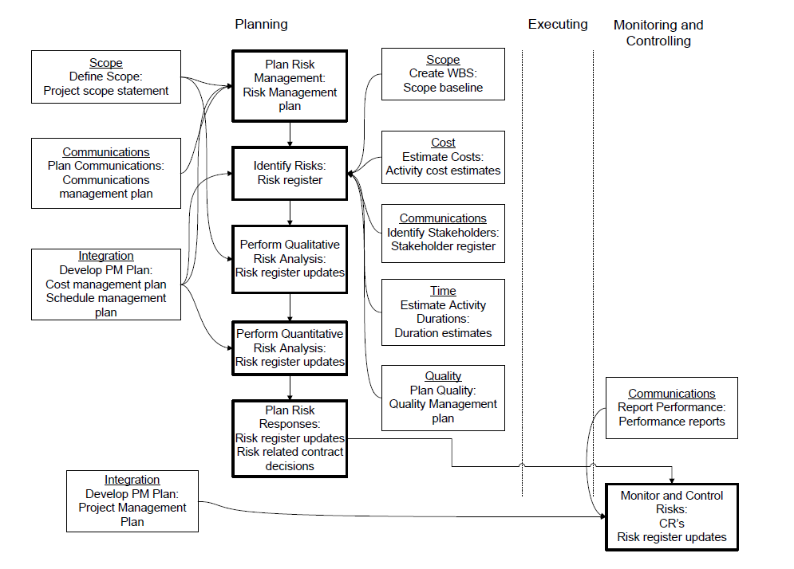
Chapter
04
Project Risk Management: Key Process Interactions

Slide 13
Chapter
04
In Summary
The benefit of using a risk breakdown structure
Information gathering techniques: brainstorming, Delphi technique, interviewing, root cause identification, and SWOT analysis
Importance and components of the risk register
Deciding on the best risk response strategy: avoid, transfer, mitigate, exploit, share, enhance, or accept risk events

Slide 14
Chapter
04
Supply Chain Management
A supply chain is a set of organizations directly linked by one or more of the upstream and downstream flows of products, services, finances, and information from a source to a customer.
Managing a supply chain is 'supply chain management 'Supply chain management (SCM) is the management of a network of interconnected businesses involved in the ultimate provision of product and service packages required by end customers.

Slide 15
Chapter
04
Supply Chain Management
Supply chain management spans all movement and storage of raw materials, work- in-process inventory, and finished goods from point of origin to point of consumption (supply chain).

Slide 16
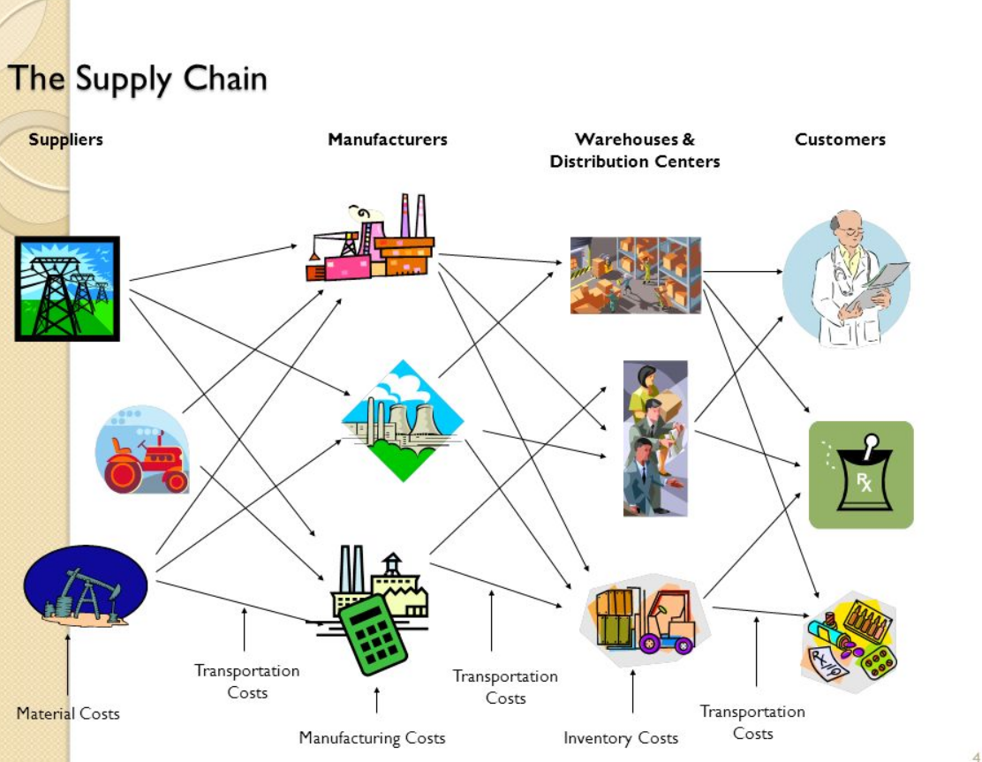
Chapter
04
Supply Chain Management

Slide 17
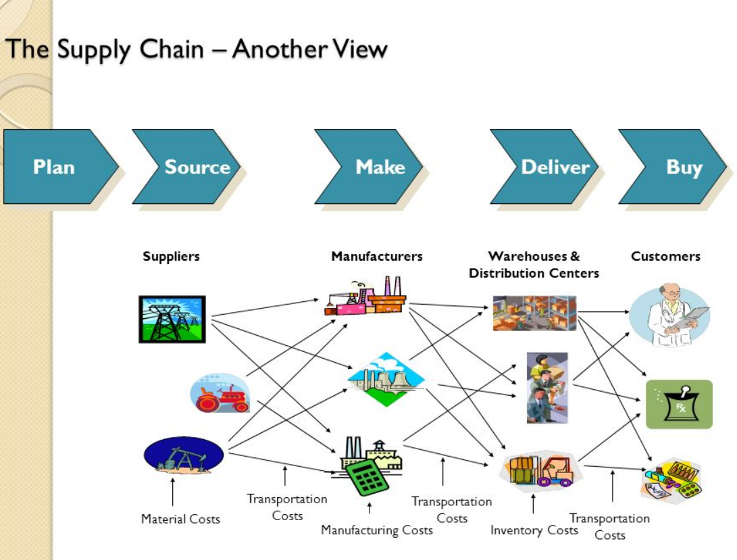
Chapter
04
Supply Chain Management

Slide 18
Chapter
04
Supply Chain for Service Providers
More difficult than manufacturing
Focuses on human resources and support services
More compact and less extended
Does not focus on the flow of physical goods

Slide 19




Chapter
04
Supply chain management
- A supply chain consists of
Supplier
Manufacturer
Distributor
Retailer
Customer
Upstream
Downstream
- aims to Match Supply and Demand, profitably for products and services
SUPPLY SIDE
DEMAND SIDE
- achieves
+
+
+
+
+
=
The right
Product
The right
Price
The right
Store
The right
Quantity
The right
Customer
The right
Time
Higher
Profits

Slide 20
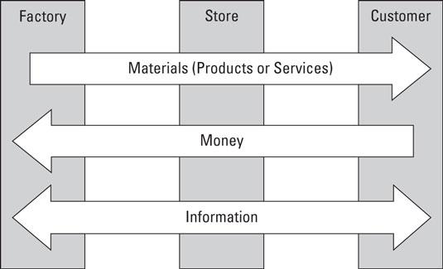
Chapter
04
Supply chain management

Slide 21
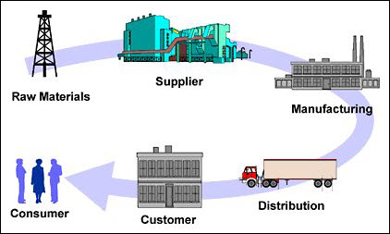
Chapter
04
Supply chain flow diagram

Slide 22
Chapter
04
Supply chain flow diagram
Supply chain management is control of supply chain as process from supplier to manufacture to wholesaler to retailer to consumer.
Supply chain management flow can be divided into three main flow
                The product flow
                The information flow
                The finance flow

Slide 23
Supply chain management flow
Information flow
Reverse product flow
supplier
producer
customer
Primary product flow
Primary product flow
Primary cash flow

Slide 24
Chapter
04
Knowledge management in SC
Knowledge management is the process of capturing, developing, sharing and effectively using organizational knowledge
Knowledge management system refer to any kind of IT system that stores and retrieves knowledge, improves collaboration locates knowledge source

Slide 25
Chapter
04
Supply chain knowledge management
The KM adoption in supply chain makes the environment collaborative that enables the chain to be more adaptive and response.
This helps to organization to achieves an improvement strategic competitive position in the market.
More cost effective, efficient and competitively response and adaptive supply chain.

Slide 26
Chapter
04
Benefits of supply chain knowledge management
Improve project management
Customer participation
Reduced process cycle time
Supply chain

Slide 27
Chapter
04
Key Issue in supply chain management
Bullwhips effect- In supply chain increasing demand and supply variation from retailer, customer to manufacturing. Away from customer the always fluctuated demand like increase and suddenly decrease in supply chain such case is effected on production management and supply chain management, price of product. The effect is known as Bullwhip effect
  Cost/pricing issues
  Managing inventory and supplier
  Primary manufacturing process PUSH
  Maintaining safety and quality

Slide 28
Chapter
04
Key challenges in supply chain management
Customer service - Supply chain management is all about providing the right product in the right quantity to the right place and the right time. Seems simple, but can get complicated...quickly.
Cost control - Operating costs are under extreme pressure by rising energy/fuel and freight costs, greater number of global customers, technology, increasing labor rates and new regulations and rising commodity prices.

Slide 29
Chapter
04
Key challenges in supply chain management
Planning & risk management - In order to stay as efficient and effective as possible, periodic assessments and redesigns are needed. These adjustments are in response to changes in the market - changes such as new product launches, global sourcing, credit availability and the need to protect intellectual property. These risks must be identified and quantified in order to control and mitigate.
Supplier/partner relationship management - It is important to create, understand and follow mutually agreed upon standards to better understand current performance and opportunities for improvement. Having two different methods for measuring and communicating performance and results wastes time and effort. Trust the system that was put in place for consistent results and better supplier/partner relationships.

Slide 30
Chapter
03
Supply Chain Management (SCM)
Managing flow of information through supply chain in order to attain the level of synchronization that will make it more responsive to customer needs while lowering costs
Keys to effective SCM
Information
Communication
Cooperation
trust

Slide 31
Chapter
04
What Is Supply Chain Management (SCM)?
A set of approaches used to efficiently integrate
Suppliers
Manufacturers
Warehouses
Distribution centers

Slide 32
Chapter
04
What Is Supply Chain Management (SCM)?
So that the product is produced and distributed
In the right quantities
To the right locations
And at the right time
System-wide costs are minimized and
Service level requirements are satisfied

Slide 33
Chapter
04
WHAT IS SUPPLY CHAIN MANAGEMENT
Is the strategic management of activities involved in the acquisition and conversion of materials to finished products delivered to the customer"
Supplier Management
Customer Management
Material Flow
Information Flow
Schedule /Resources
Conversion
Stock Deployment
Delivery
Leads to Business Process Integration

Slide 34
Chapter
04
SUPPLY CHAIN MANAGEMENT
Supply chain is the system by which organizations source, make and deliver their products or services according to market demand.
Supply chain management operations and decisions are ultimately triggered by demand signals at the ultimate consumer level.
Supply chain as defined by experienced practitioners extends from suppliers’ suppliers to customers’ customers.

Slide 35
Chapter
03
Why is SCM Difficult
Uncertainty is inherent to every supply chain
Travel times
Breakdowns of machines and vehicles
Weather, natural catastrophe, war
Local politics, labor conditions, border issues
The complexity of the problem to globally optimize a supply chain is significant
Minimize internal costs
Minimize uncertainty
Deal with remaining uncertainty

