Slide 1




IT111 - Introduction to Information Technology
Bachelor of Science in Information Technology
Eng. Eman Hamdy
Lecture 3 - Data Storage

Slide 2


Lecture
Objectives
03
Upon successful completion of this course, students should be able to:
List five different data types used in a computer.
Describe different methods to store integers inside a computer.
Describe how reals are stored in a computer.
IT111 - Introduction to Information Technology
Lecture 03– Learning Outcome
Eng. Eman Hamdy

Slide 3
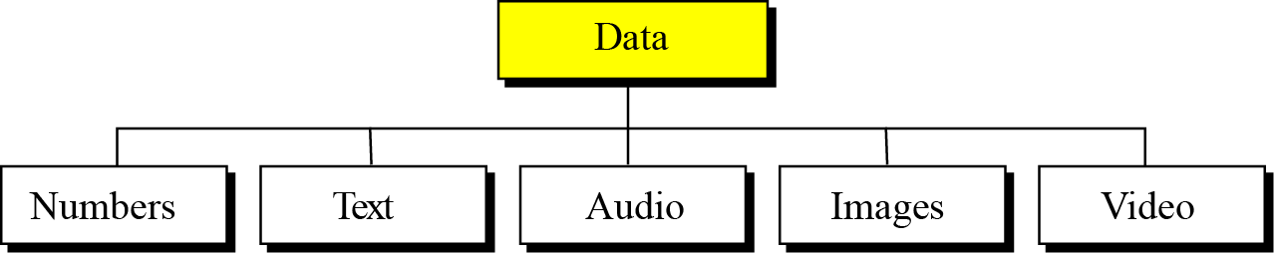

Introduction
Lecture
03
Data today come in different forms including numbers, text, audio, image, and video.
Different types of data
IT111 - Introduction to Information Technology
Eng. Eman Hamdy

Slide 4
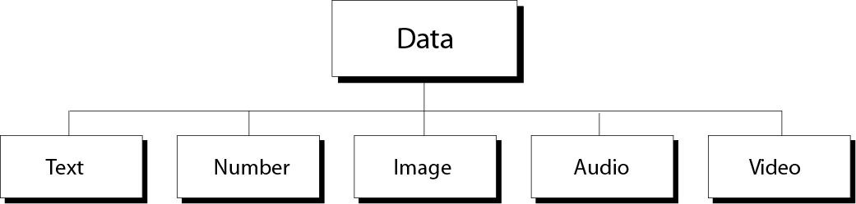
Data Types
Lecture
03
The computer industry uses the term “multimedia” to define information that contains numbers, text, images, audio, and video.
Multimedia
Word processing programs
Engineering programs
Image processing programs
Audio play program
Video display programs
IT111 - Introduction to Information Technology
Eng. Eman Hamdy

Slide 5
Bit Pattern
Lecture
03
A bit is the smallest unit of data that the computer deals with.
a bit can take two values (0 or 1).
A two-state electrical switch (transistor) is used to represent a bit
(on state →1, off state →0).
To store 16 bits you need 16 switches, to store million bits you need million switches.
In computer memory data are stored as blocks of bits (bit-patterns), the length of bit-patterns is the number of bits in the bit-patterns.
A bit-pattern of 8 bits length is called a byte
IT111 - Introduction to Information Technology
Eng. Eman Hamdy

Slide 6
Data inside the computer
Lecture
03
All data types are transformed into a uniform representation when they are stored in a computer and transformed back to their original form when retrieved. This universal representation is called a bit pattern (string of bits).
A bit pattern
IT111 - Introduction to Information Technology
Eng. Eman Hamdy

Slide 7
Information coding and decoding
Lecture
03
Human senses deal with a variety of information (signals).
Input devices of computer translates these information into electrical signals.
Electrical signals are then translated into universal format (0s,1s), this is known as coding.
After processing, output devices transform back data into their original form, this is known as decoding
IT111 - Introduction to Information Technology
Eng. Eman Hamdy

Slide 8
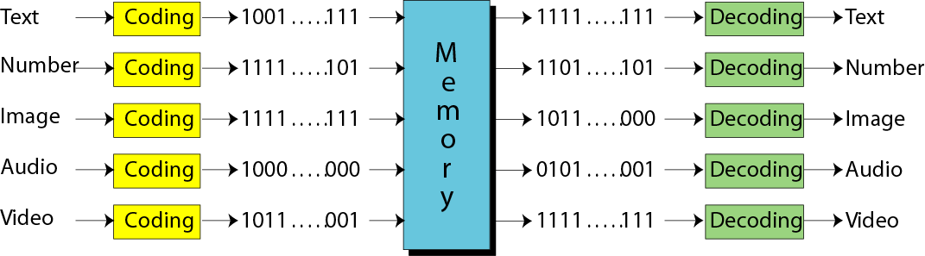
Information coding and decoding
Lecture
03
IT111 - Introduction to Information Technology
Eng. Eman Hamdy

Slide 9
Storing Numbers
Lecture
03
A number is changed to the binary system before being stored in the computer memory, as described in Chapter 2. However, there are still two issues that need to be handled:
How to store the sign of the number.
How to show the decimal point.
Computers use two different representation:
  fixed-point (store a number as an integer)
  floating-point (store a number as real)
IT111 - Introduction to Information Technology
Eng. Eman Hamdy

Slide 10
Unsigned representation
Lecture
03
An unsigned integer is an integer that can never be negative and can take only 0 or positive values. Its range is between 0 and positive infinity.
An input device stores an unsigned integer using the following steps:
The integer is changed to binary.
If the number of bits is:
less than n → 0s are added to the left.
Greater than n → the integer cannot be stored (overflow).
IT111 - Introduction to Information Technology
Eng. Eman Hamdy

Slide 11
Example
Lecture
03
Store 7 in an 8-bit memory location using unsigned representation.
Solution
First change the integer to binary(Convert from Decimal to binary)
7/2= 3.5 Remainder 1
3/2= 1.5 Remainder 1
1/2= 0.5 Remainder 1
(7)₁₀ = (111)₂
Add five 0s to make a total of eight bits, (00000111)₂.
The integer is stored in the memory location.
IT111 - Introduction to Information Technology
Eng. Eman Hamdy

Slide 12
Example
Lecture
03
IT111 - Introduction to Information Technology
Eng. Eman Hamdy

Slide 13
Example
Lecture
03
Store 258 in a 16-bit memory location using unsigned representation.
Solution
First change the integer to binary
(258)₁₀
258/2= 129 Remainder 0
129/2= 64.5 Remainder 1
64/2 = 32 Remainder 0
32/2 = 16 Remainder 0
16/2 = 8 Remainder 0
8/2 = 4 Remainder 0
4/2 = 2 Remainder 0
2/2 = 1 Remainder 0
1/2 = 0.5 Remainder 1
(258)₁₀ = (100000010)₂
IT111 - Introduction to Information Technology
Eng. Eman Hamdy

Slide 14
Example
Lecture
03
(100000010)₂.
Add seven 0s to make a total of sixteen bits, (0000000100000010)₂. The integer is stored in the memory location.
IT111 - Introduction to Information Technology
Eng. Eman Hamdy

Slide 15
Example
Lecture
03
What is returned from an output device when it retrieves the bit string 00101011 stored in memory as an unsigned integer.
Solution
The binary integer is converted to the unsigned integer 43.
binary 0 0 1 0 1 0 1 1
Weight 128 64 32 16 8 4 2 1
= 32+8+2+1= 43
IT111 - Introduction to Information Technology
Eng. Eman Hamdy

Slide 16
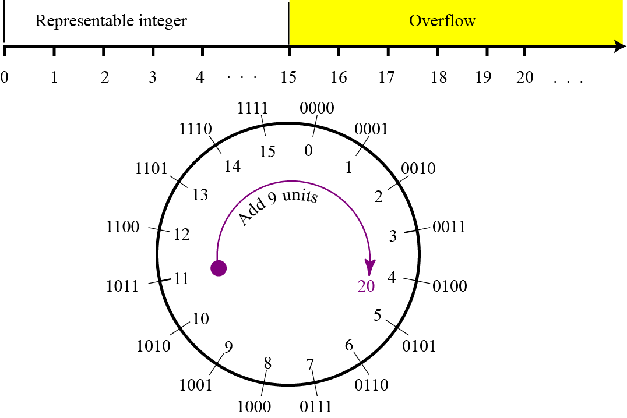
Overflow in unsigned integers
Lecture
03
Figure shows what happens if we try to store an integer that is larger than
2⁴ − 1 = 15 in a memory location that can only hold four bits.
20/2= 10 → 0
10/2= 5 → 0
5/2 = 2 → 1
2/2 = 1 → 0
½ = 0 → 1
(20)₁₀ = ( 10100)₂
IT111 - Introduction to Information Technology
Eng. Eman Hamdy

Slide 17
Sign-and-magnitude representation
Lecture
03
In this method, the available range for unsigned integers (0 to 2^{n} − 1) is divided into two equal sub-ranges. The first half represents positive integers, the second half, negative integers.
In sign-and-magnitude representation, the leftmost bit
defines the sign of the integer.
If it is 0, the integer is positive.
If it is 1, the integer is negative.
IT111 - Introduction to Information Technology
Eng. Eman Hamdy

Slide 18
Example
Lecture
03
Store +28 in an 8-bit memory location using sign-and-magnitude representation.
28/2= 14 → 0
14/2= 7 → 0
7/2 = 3.5 → 1
3/2 = 1.5 → 1
1/ 2 = 0.5 → 1
⁽²⁸⁾₁₀⁼ ⁽¹¹¹⁰⁰⁾₂
Solution
The integer is changed to 7-bit binary. The leftmost bit is set to 0. The 8-bit number is stored.
IT111 - Introduction to Information Technology
Eng. Eman Hamdy

Slide 19
Examples
Lecture
03
Store −28 in an 8-bit memory location using sign-and-magnitude representation.
Solution
The integer is changed to 7-bit binary. The leftmost bit is set to 1. The 8-bit number is stored.
IT111 - Introduction to Information Technology
Eng. Eman Hamdy

Slide 20
Examples
Lecture
03
Retrieve the integer that is stored as 01001101 in sign-and-magnitude representation.
Solution
Since the leftmost bit is 0, the sign is positive. The rest of the bits (1001101) are changed to decimal
Binary ( 1 0 0 1 1 0 1)₂
Weight ( 64 32 16 8 4 2 1)
= 64+ 8+4+1=(77)₁₀
IT111 - Introduction to Information Technology
Eng. Eman Hamdy

Slide 21
Examples
Lecture
03
Retrieve the integer that is stored as 10100001 in sign-and-magnitude representation.
Solution
Since the leftmost bit is 1, the sign is negative. The rest of the bits (0100001) are changed to decimal as 33. After adding the sign, the integer is −33.
IT111 - Introduction to Information Technology
Eng. Eman Hamdy

Slide 22
Lecture
03
Two’s complement representation
Almost all computers use two’s complement representation to store a signed integer in an n-bit memory location.
Two operations: One’s complement and Two’s complement.
IT111 - Introduction to Information Technology
Eng. Eman Hamdy

Slide 23
Lecture
03
One’s complement
This operation can be applied to any integer, positive or negative.
This operation simply reverses (flips) each bit.
A 0-bit is changed to a 1-bit, a 1-bit is changed to a 0-bit.
The following shows how take the one’s complement of the integer 00110110.
IT111 - Introduction to Information Technology
Eng. Eman Hamdy

Slide 24
Lecture
03
Two’s complement
The second operation is called two’s completing or taking the two’s complement of an integer in binary.
This operation is done in two steps.
First, we copy bits from the right until a 1 is copied;
then, we flip the rest of the bits.
IT111 - Introduction to Information Technology
Eng. Eman Hamdy

Slide 25
Lecture
03
Two’s complement
The following shows how we take the two’s complement of the integer 00110100.
IT111 - Introduction to Information Technology
Eng. Eman Hamdy

Slide 26
Lecture
03
Two’s complement
The following shows that we always get the original integer if we apply the two’s complement operation twice.
IT111 - Introduction to Information Technology
Eng. Eman Hamdy

Slide 27
Examples
Lecture
03
Find the 1's complement and 2's complement for each of the following binary numbers:
Binary number | 1's complement (invert all bits) | 2's complement
10101010 | 01010101 | 01010110
01110001 | 10001110 | 10001111
IT111 - Introduction to Information Technology
Eng. Eman Hamdy

Slide 28
Important Note
Lecture
03
To store an integer in two’s complement:-
the integer is changed to n-bits binary.
If the integer is Zero or positive, → it is stored as it is
If the integer is negative → take two’s complement → store it.
To retrieve an integer in two’s complement:-
If the leftmost bit is 1 → apply two’s complement
If the leftmost bit is 0 → no operation applied
+ve →0
Sign bit
-ve →1
IT111 - Introduction to Information Technology
Eng. Eman Hamdy

Slide 29
Examples
Lecture
03
Store the integer 28 in an 8-bit memory location using two’s complement representation.
Solution
The integer is positive (no sign means positive), so after decimal to binary transformation no more action is needed. Note that five extra 0s are added to the left of the integer to make it eight bits.
IT111 - Introduction to Information Technology
Eng. Eman Hamdy

Slide 30
Examples
Lecture
03
Store −28 in an 8-bit memory location using two’s complement representation.
Solution
The integer is negative, so after changing to binary, the computer applies the two’s complement operation on the integer.
IT111 - Introduction to Information Technology
Eng. Eman Hamdy

Slide 31
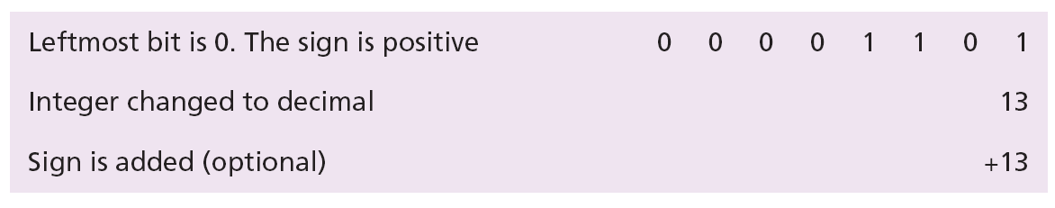
Examples
Lecture
03
Retrieve the integer that is stored as 00001101 in memory in two’s complement format.
Solution
The leftmost bit is 0, so the sign is positive. The integer is changed to decimal, and the sign is added.
IT111 - Introduction to Information Technology
Eng. Eman Hamdy

Slide 32
Examples
Lecture
03
Retrieve the integer that is stored as 11100110 in memory using two’s complement format.
Solution
The leftmost bit is 1, so the integer is negative. The integer needs to be two’s complemented before changing to decimal.
IT111 - Introduction to Information Technology
Eng. Eman Hamdy

Slide 33
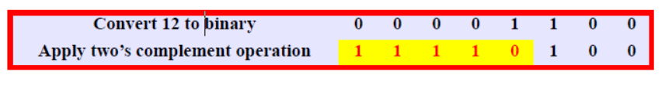
Examples
Lecture
03
Change the following decimal numbers to 8-bit two’s complement integers
-12
IT111 - Introduction to Information Technology
Eng. Eman Hamdy

Slide 34
Integer Representations
Lecture
03
IT111 - Introduction to Information Technology
Eng. Eman Hamdy

Slide 35

Thank you

