Slide 1


Slide 2
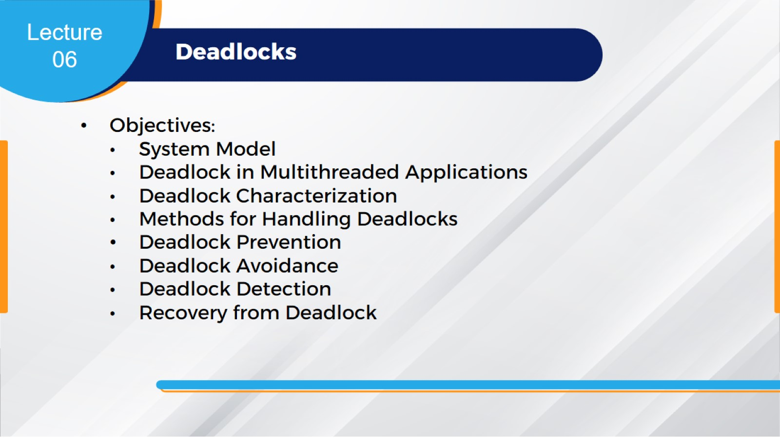

Slide 3
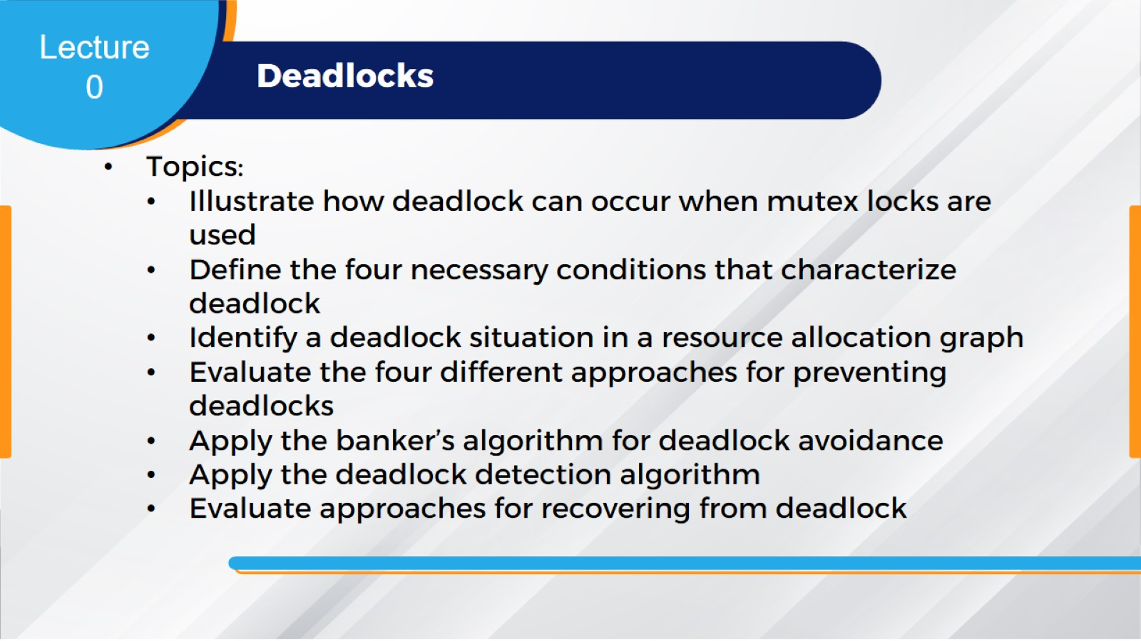

Slide 4
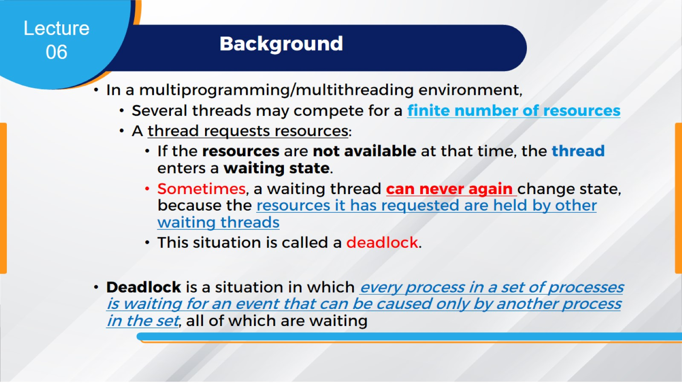
Background

Slide 5
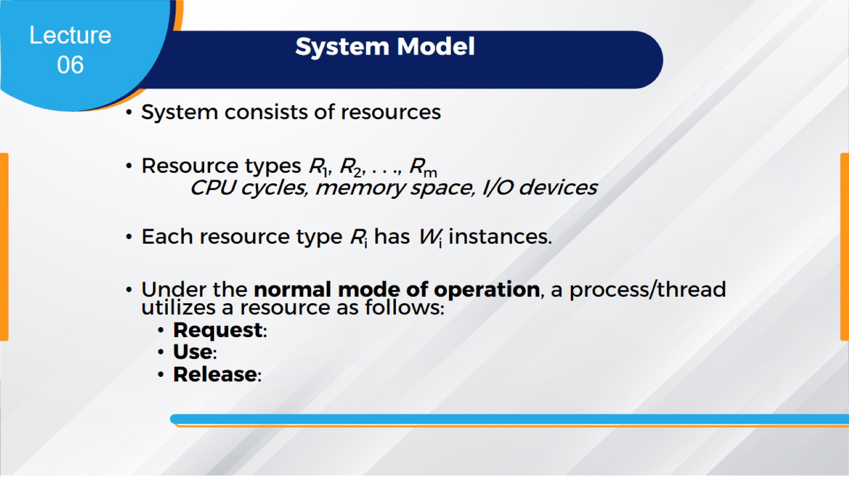
System Model

Slide 6
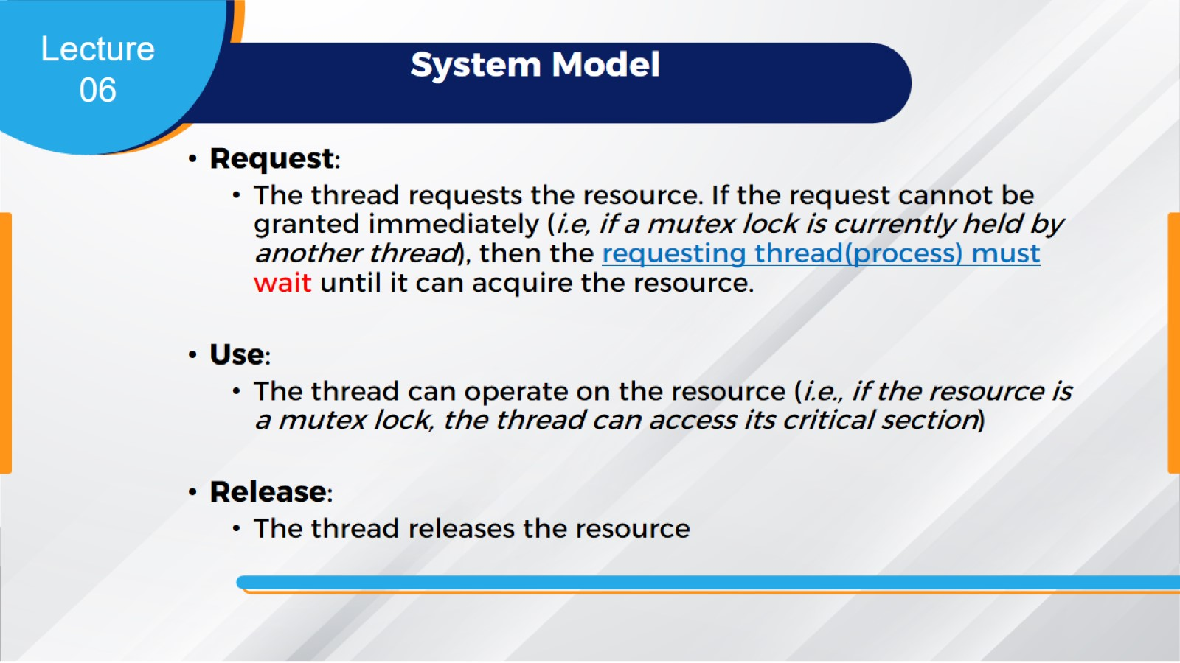
System Model

Slide 7
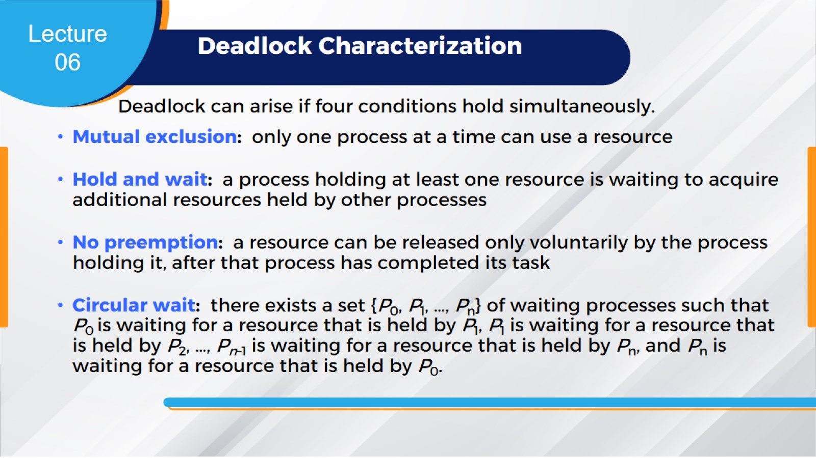
Deadlock Characterization

Slide 8
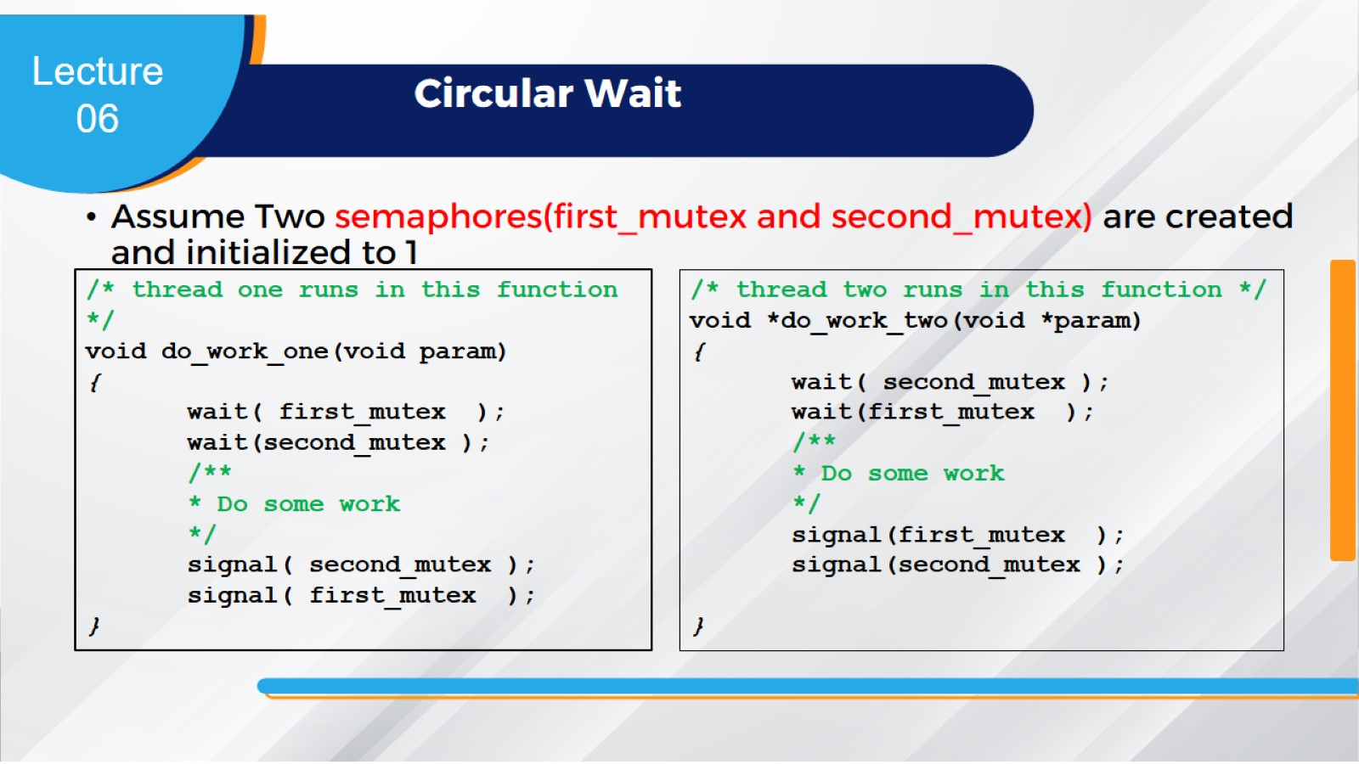
Circular Wait

Slide 9
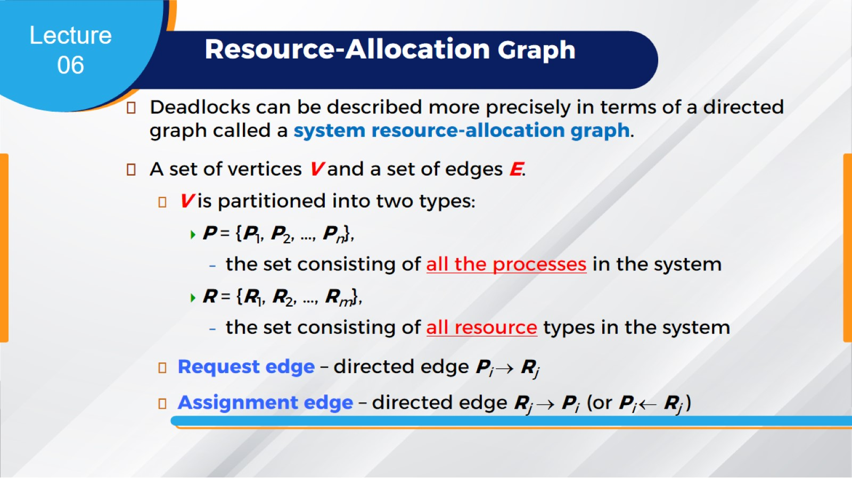
Resource-Allocation Graph

Slide 10
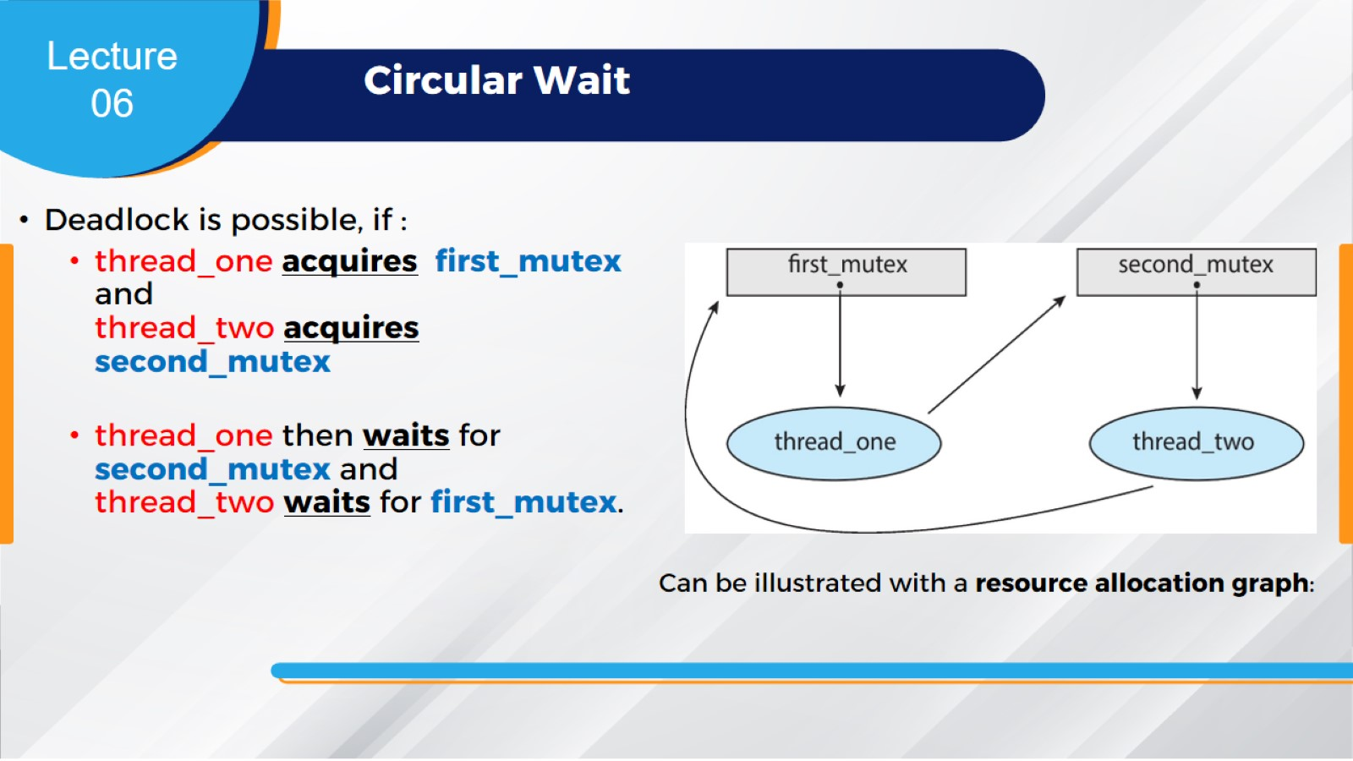
Circular Wait

Slide 11
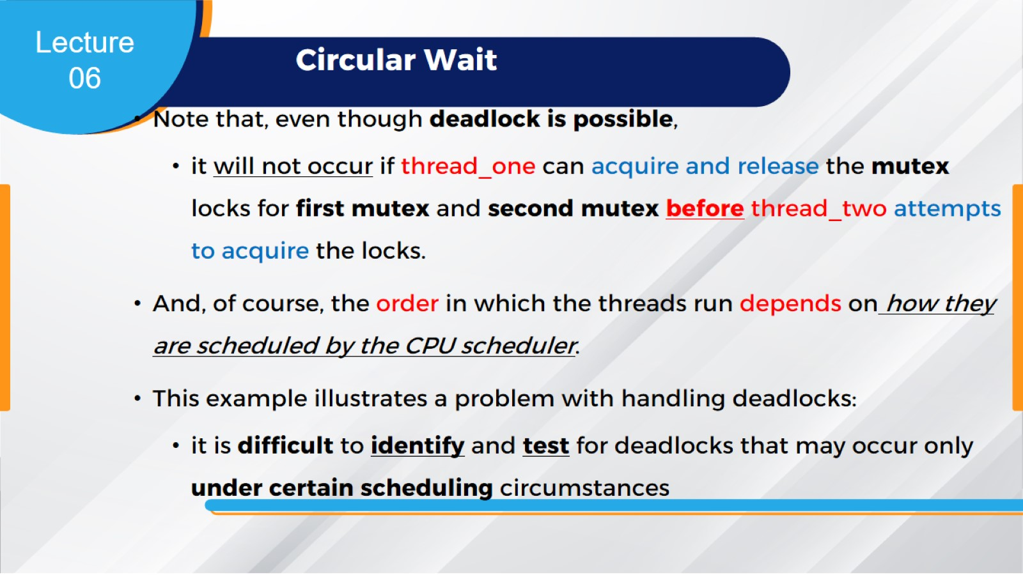
Circular Wait

Slide 12
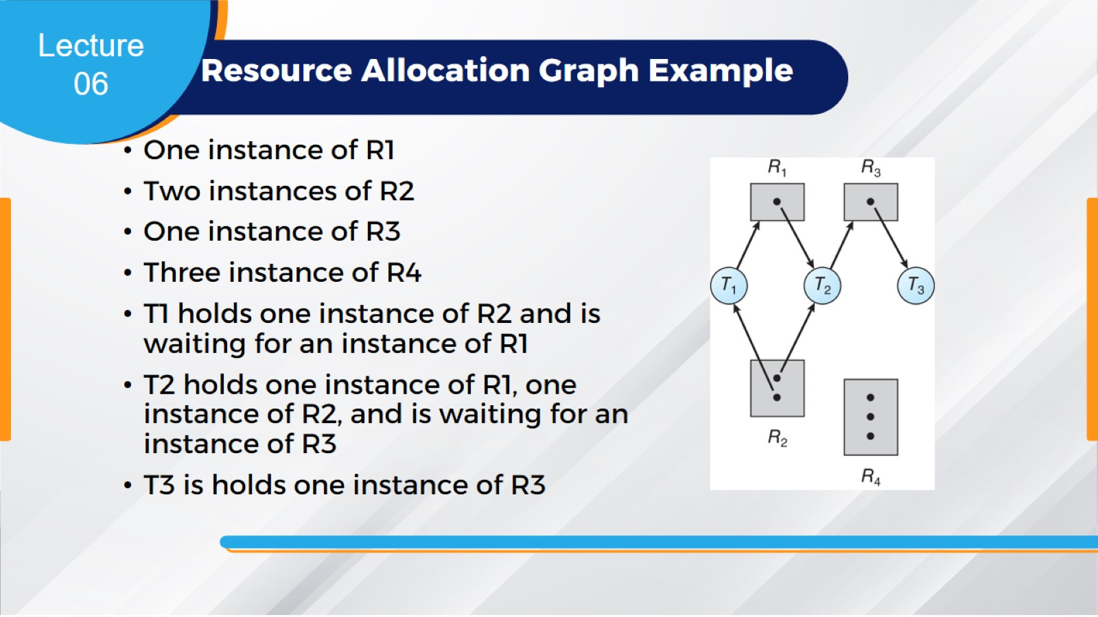
Resource Allocation Graph Example

Slide 13
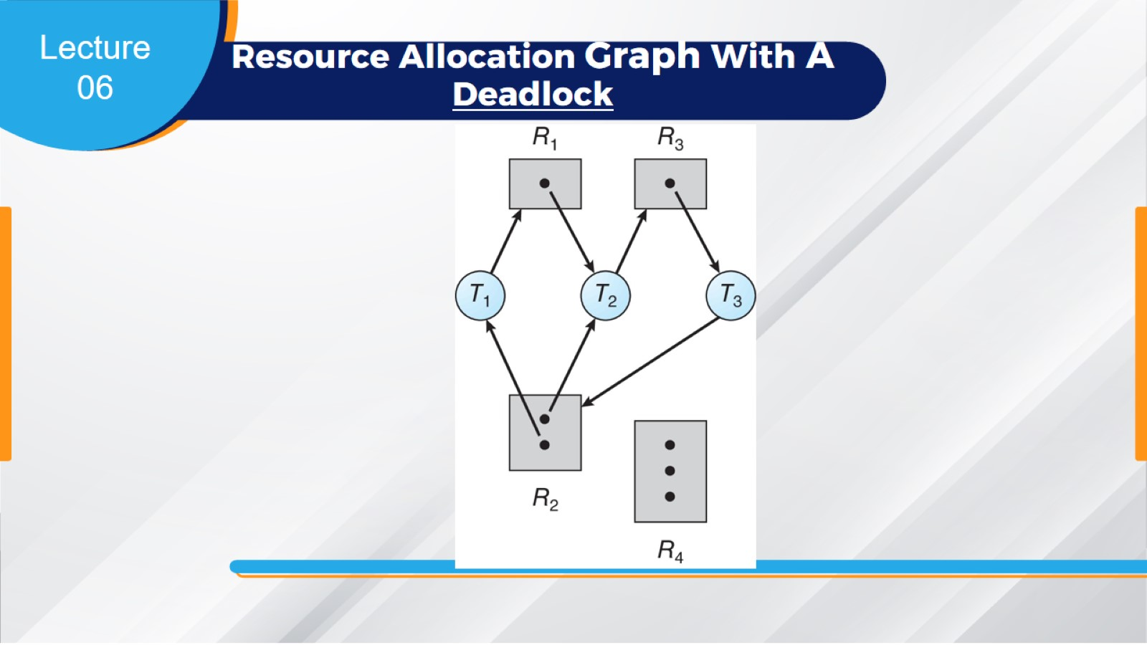
Resource Allocation Graph With A Deadlock

Slide 14
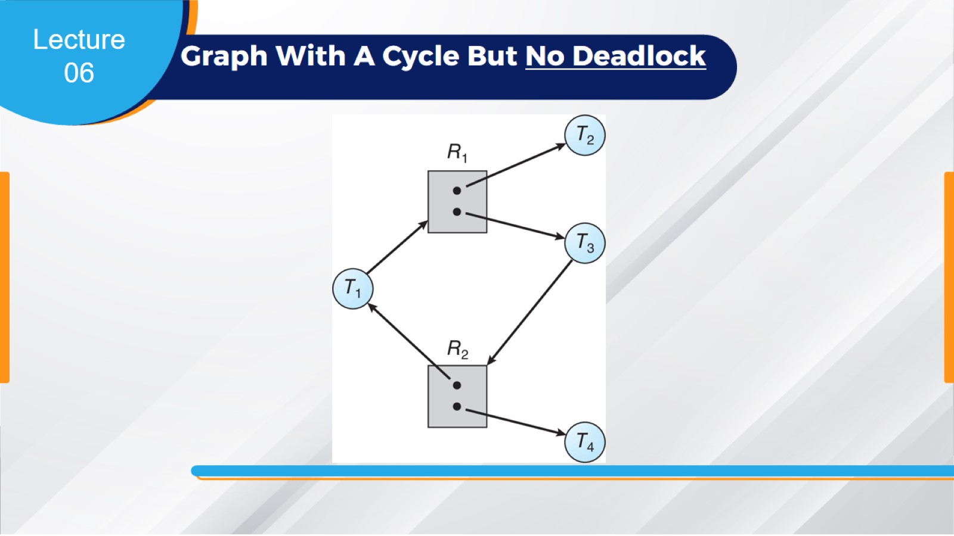
Graph With A Cycle But No Deadlock

Slide 15
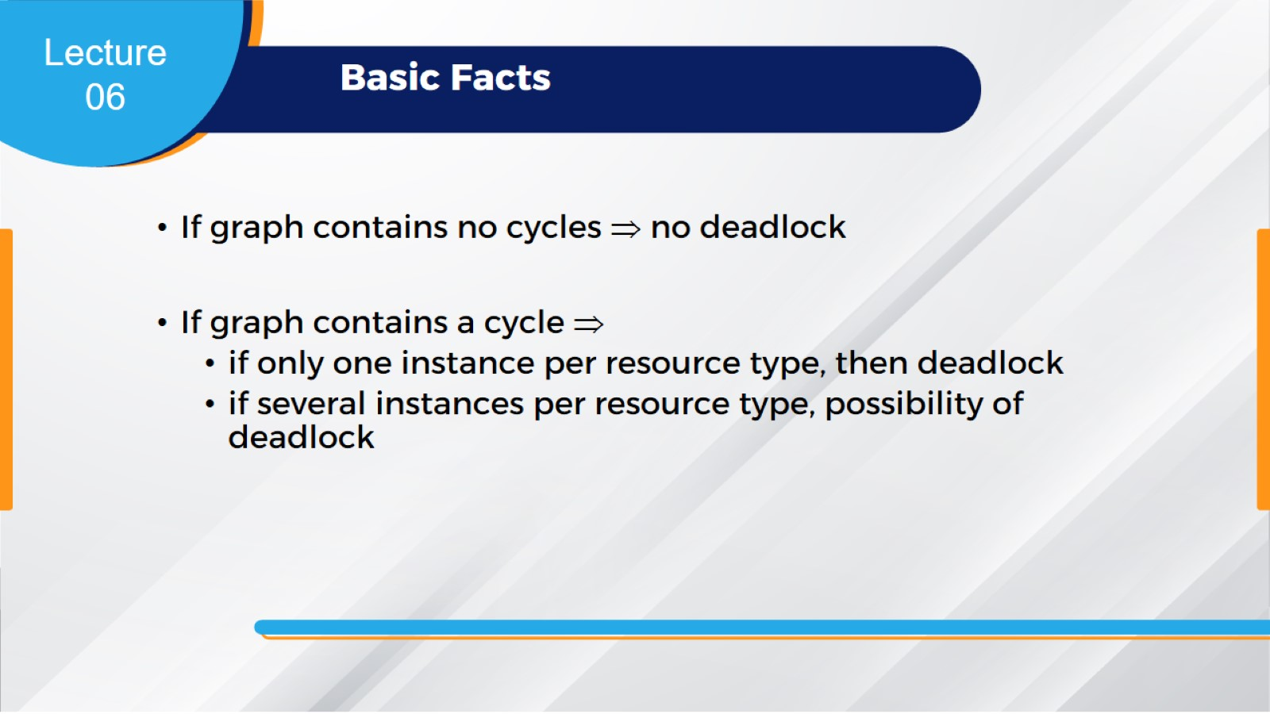
Basic Facts

Slide 16
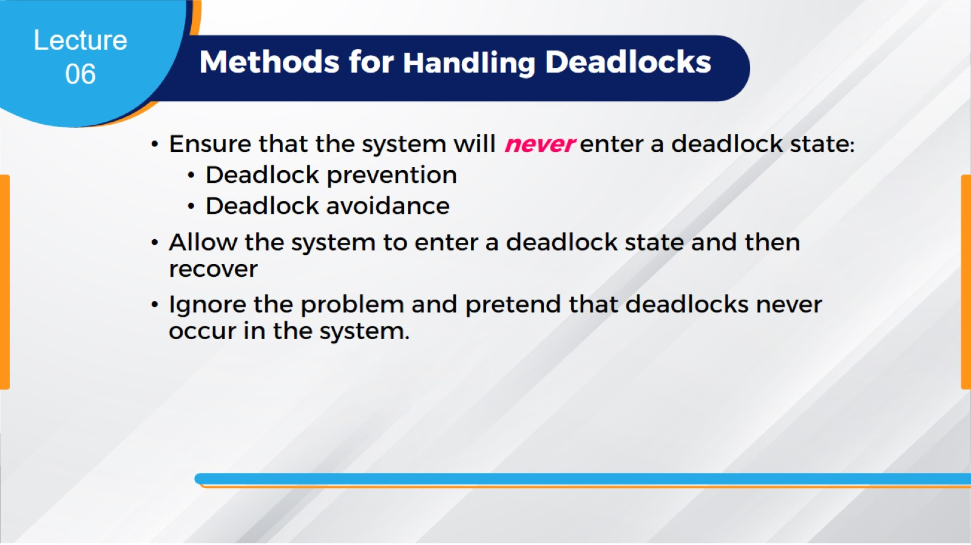
Methods for Handling Deadlocks

Slide 17
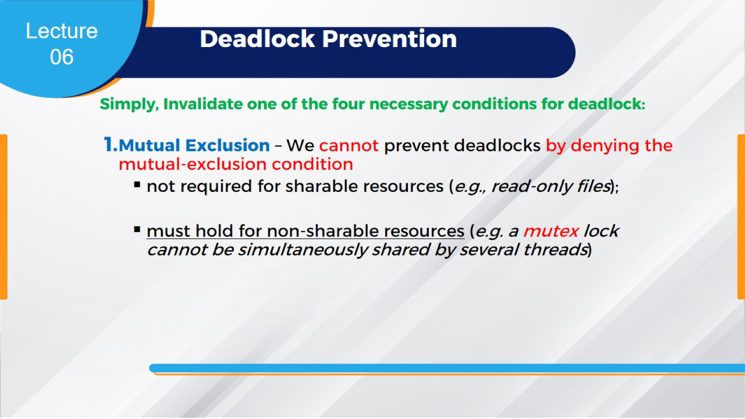
Deadlock Prevention

Slide 18
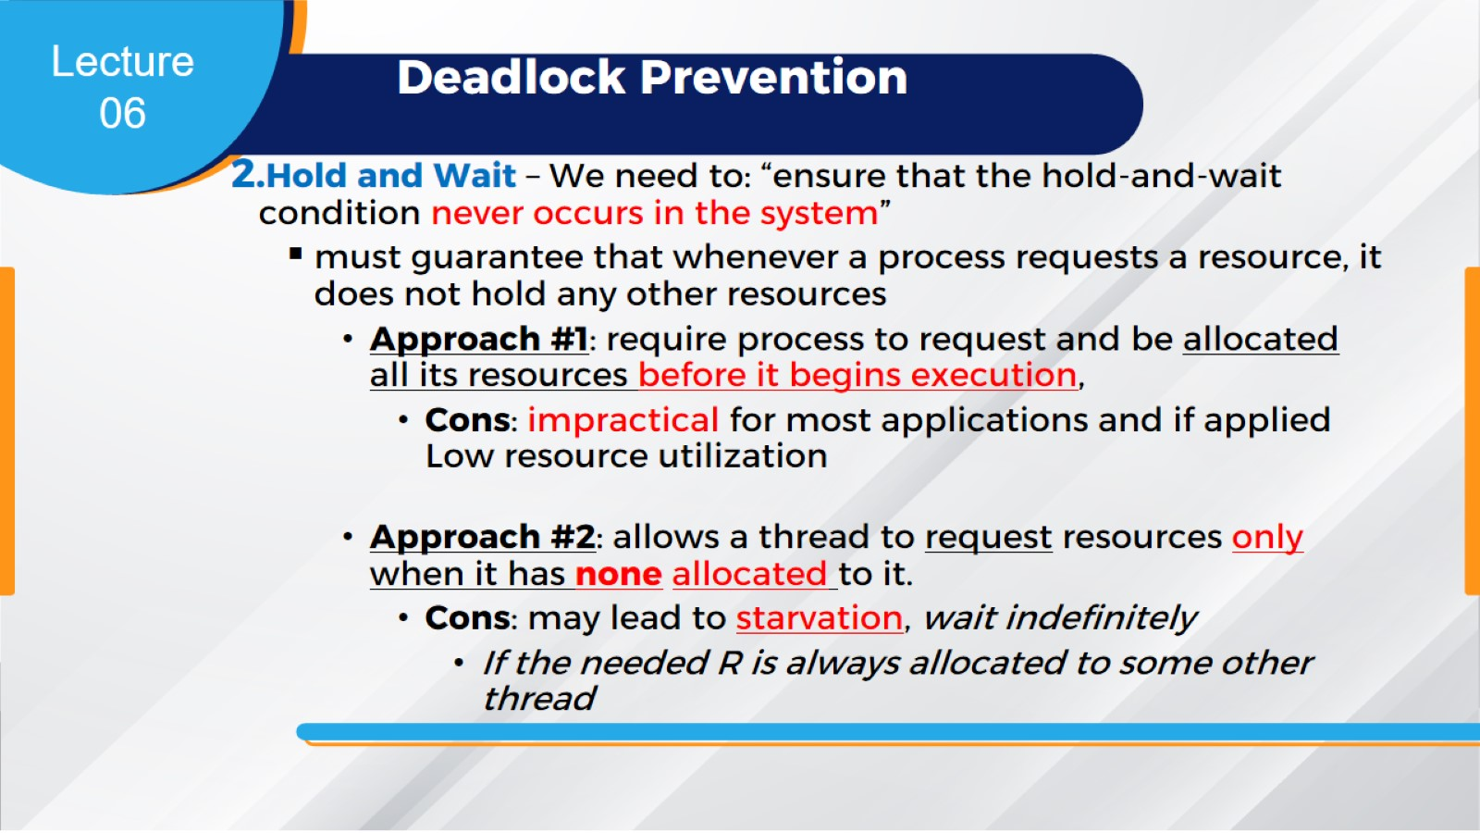
Deadlock Prevention

Slide 19
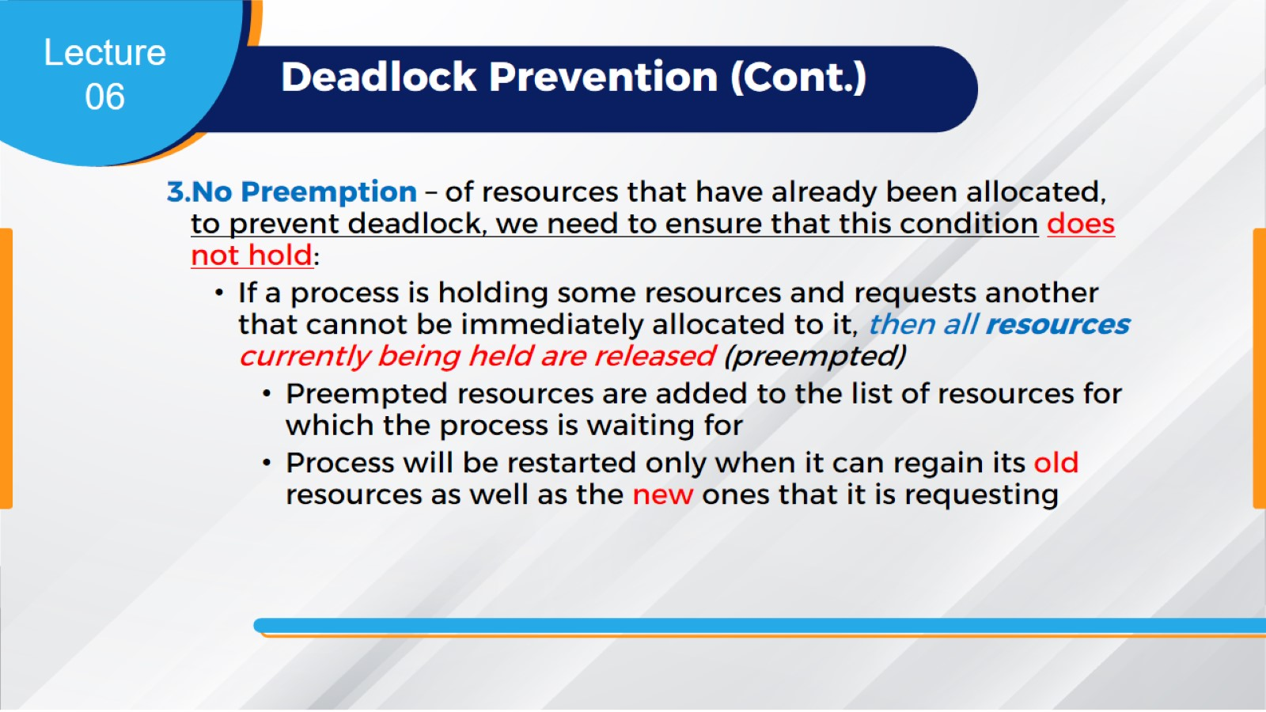
Deadlock Prevention (Cont.)

Slide 20
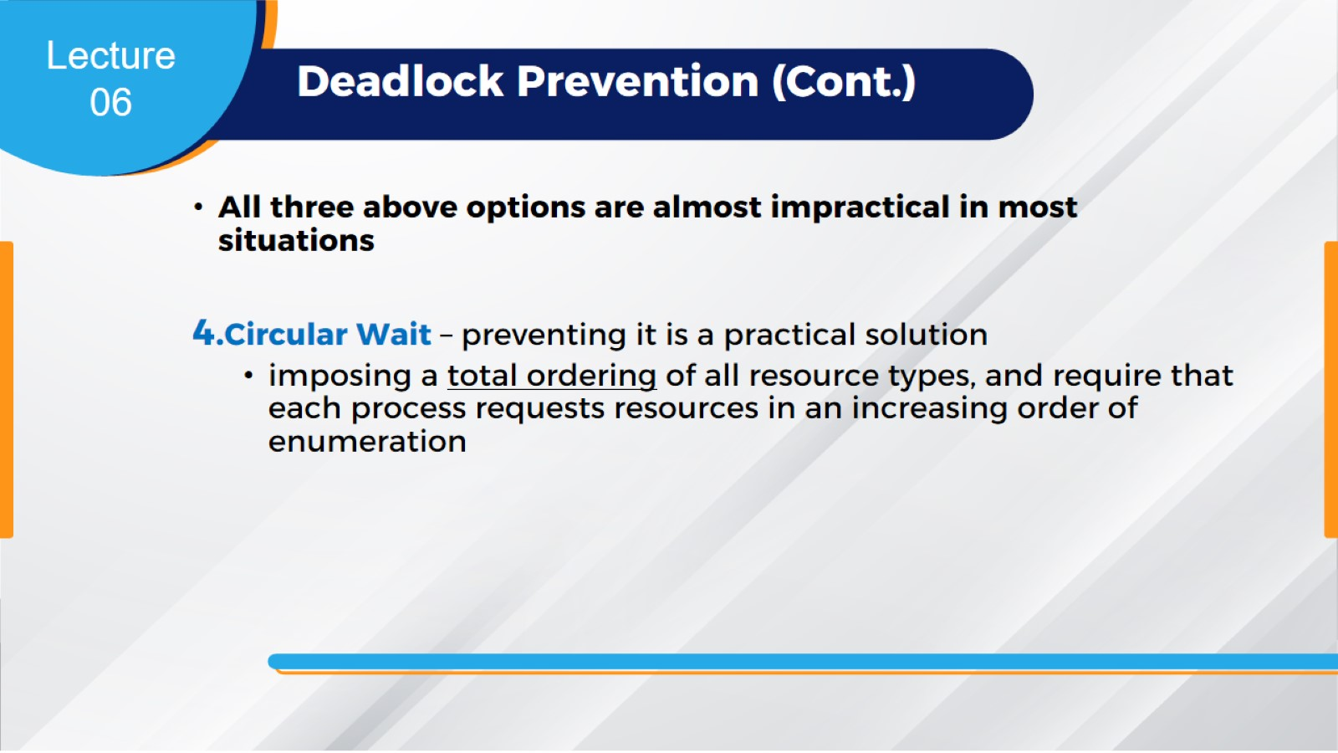
Deadlock Prevention (Cont.)

Slide 21
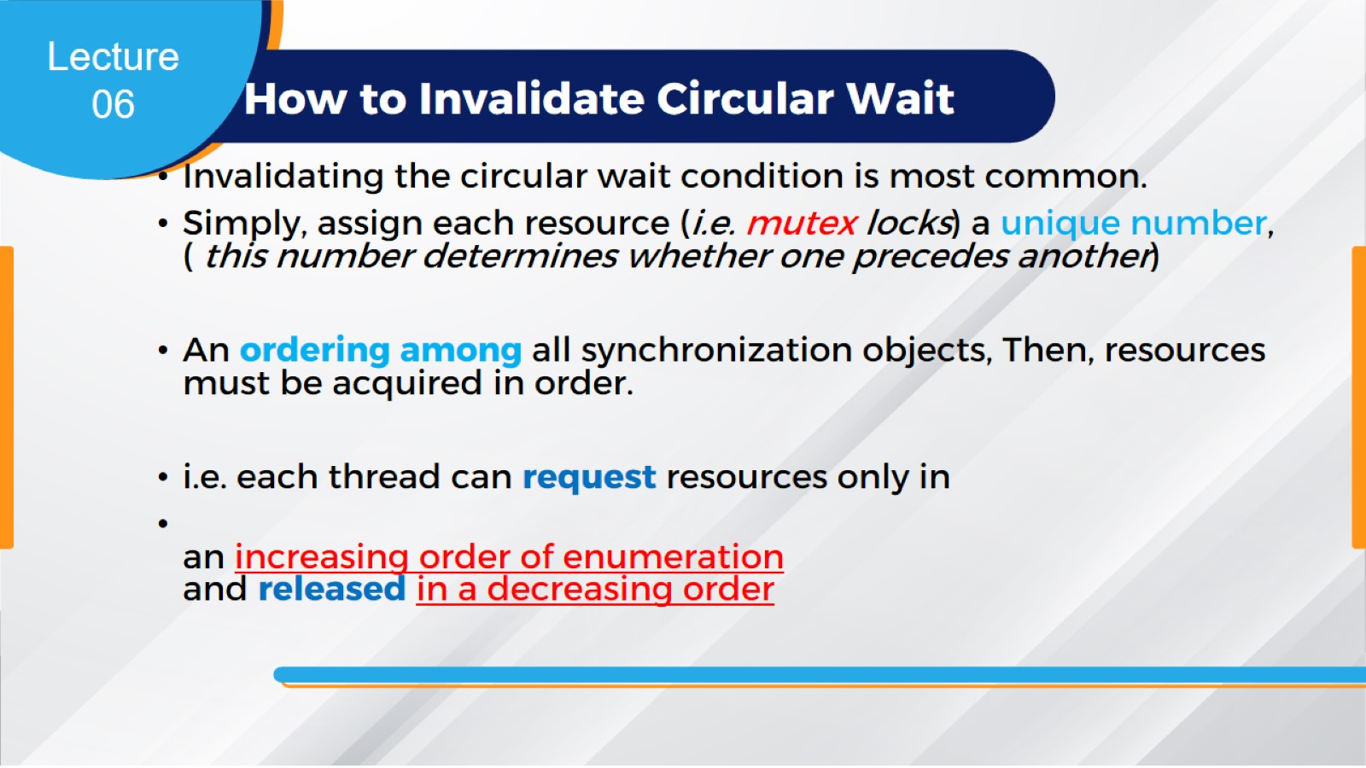
How to Invalidate Circular Wait

Slide 22
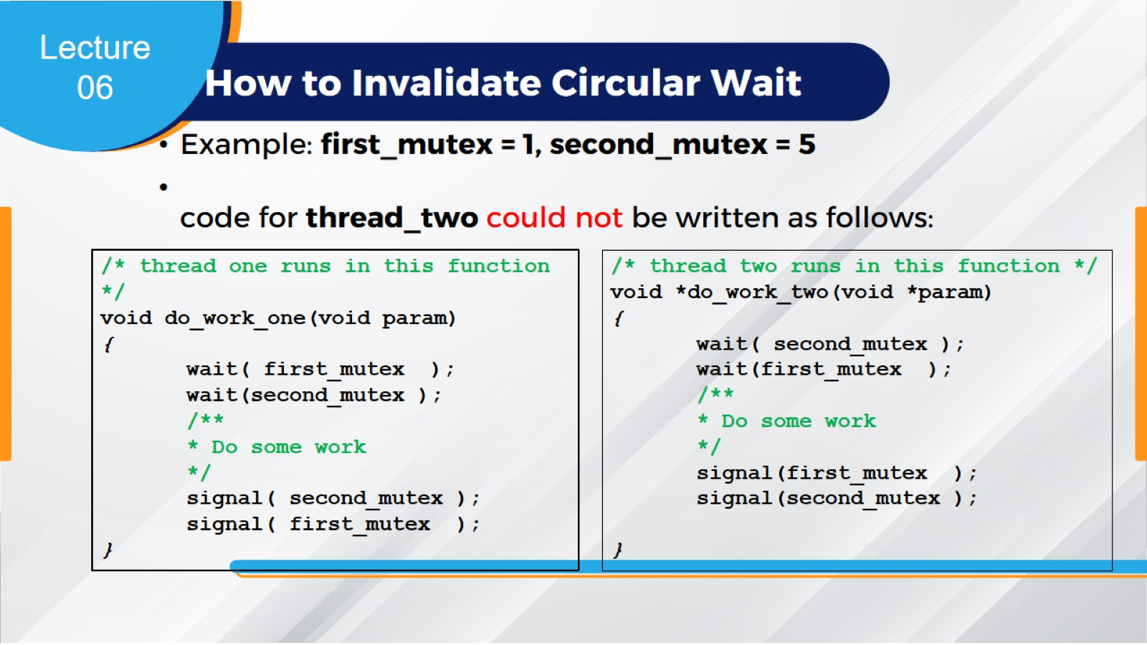
How to Invalidate Circular Wait

Slide 23
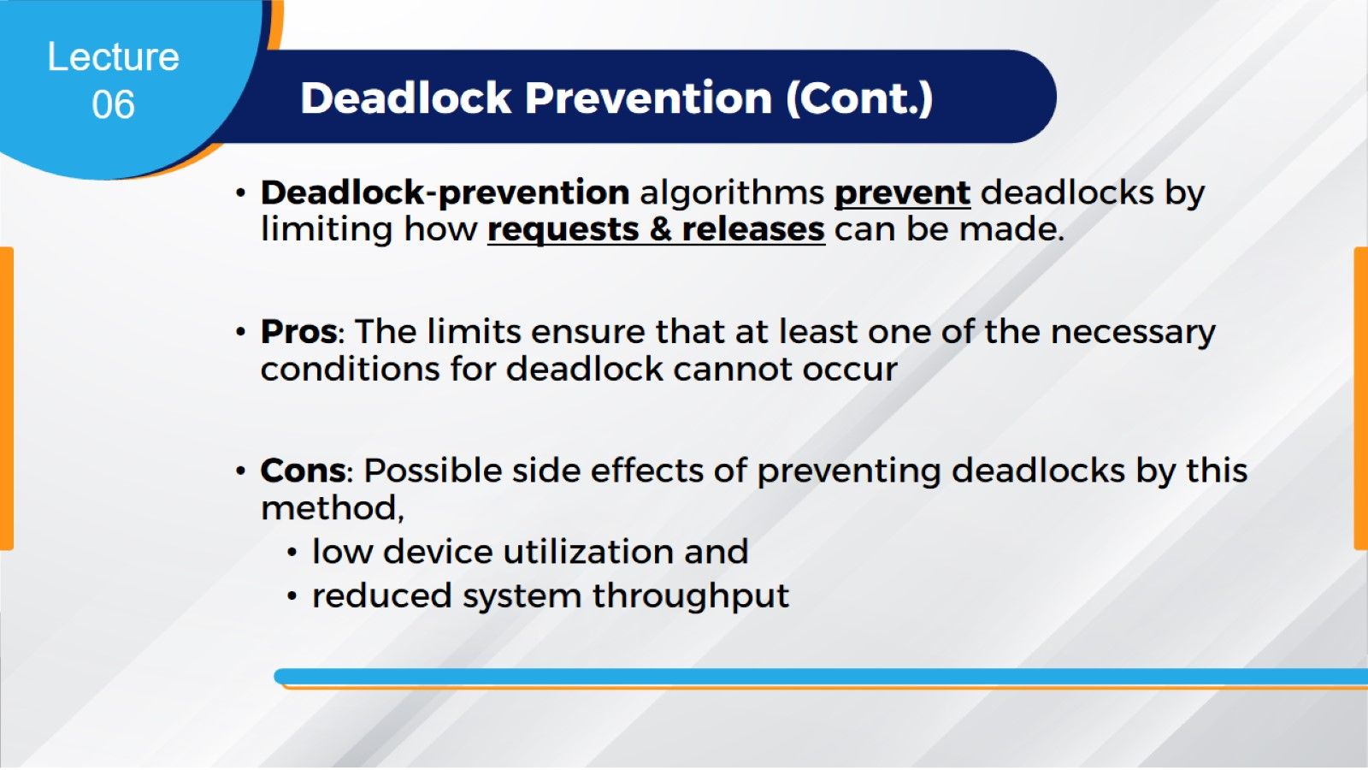
Deadlock Prevention (Cont.)

Slide 24
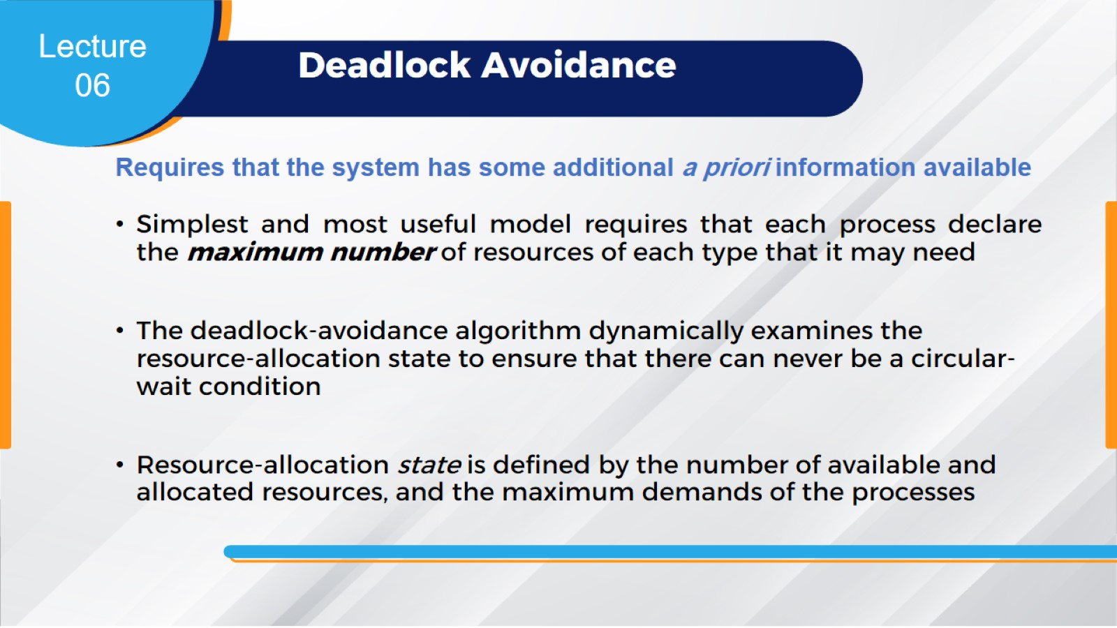
Deadlock Avoidance

Slide 25
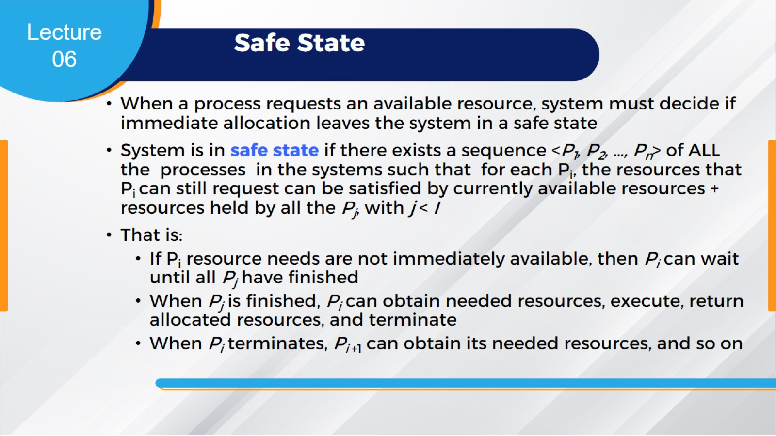
Safe State

Slide 26
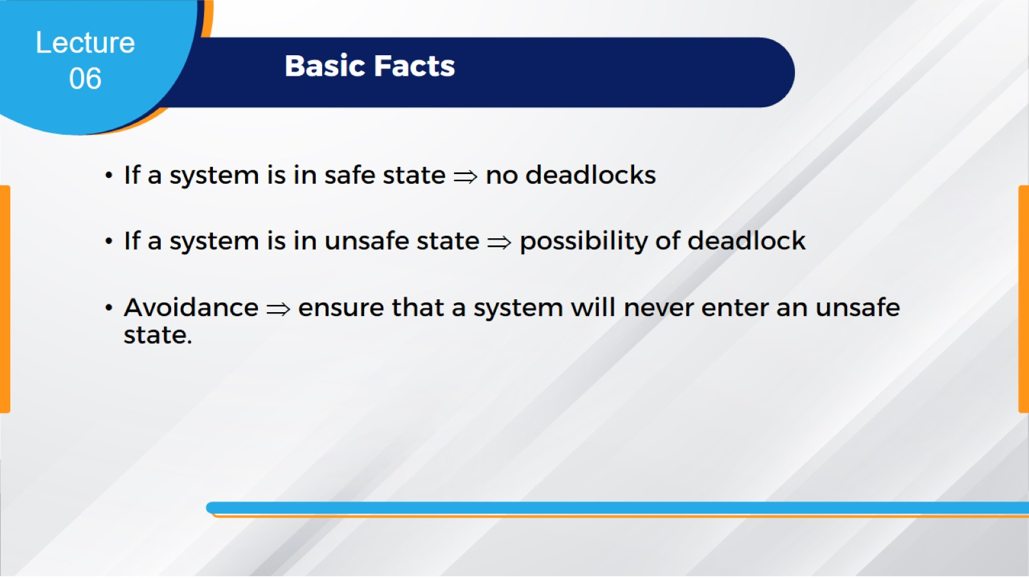
Basic Facts

Slide 27
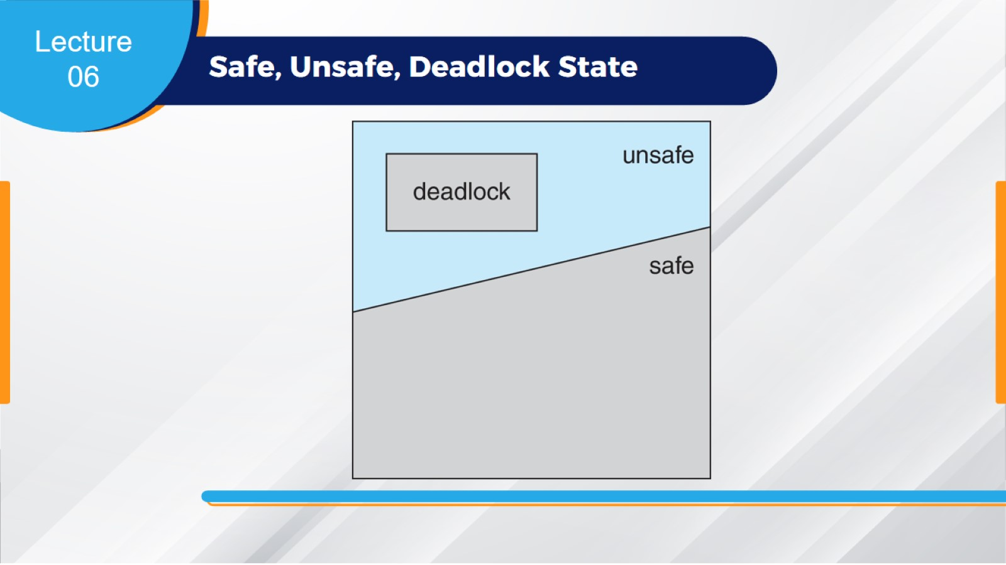
Safe, Unsafe, Deadlock State

Slide 28
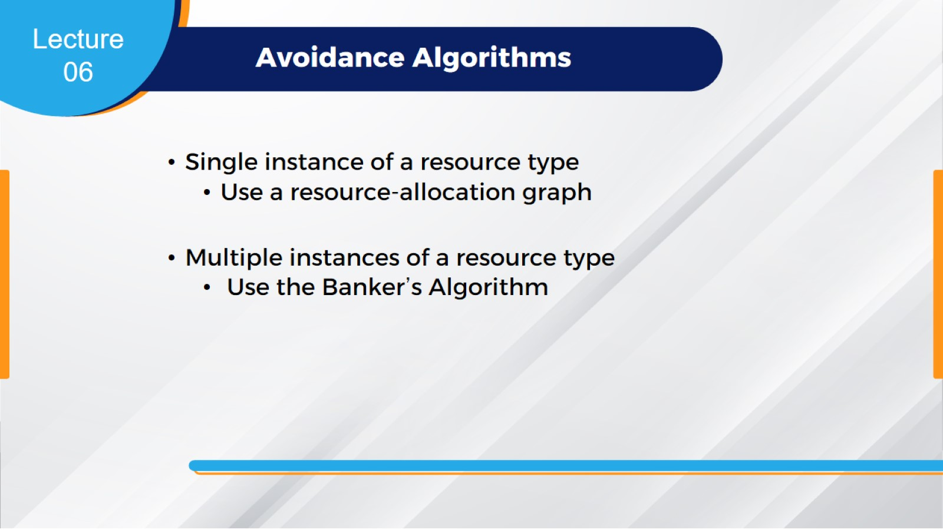
Avoidance Algorithms

Slide 29
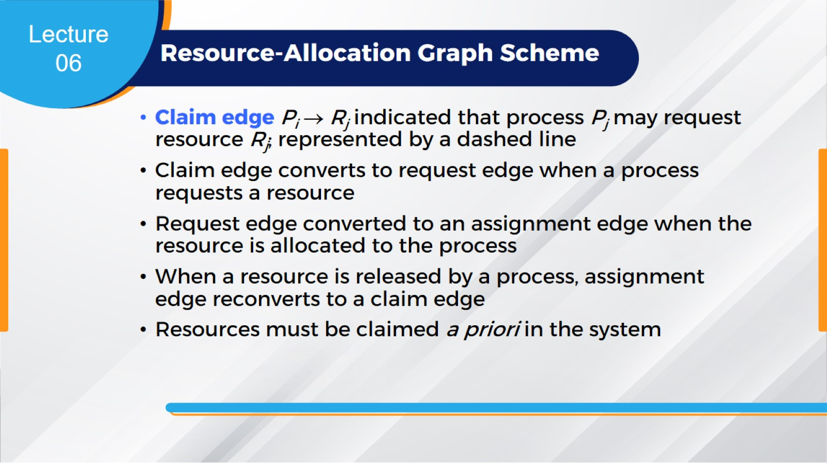
Resource-Allocation Graph Scheme

Slide 30
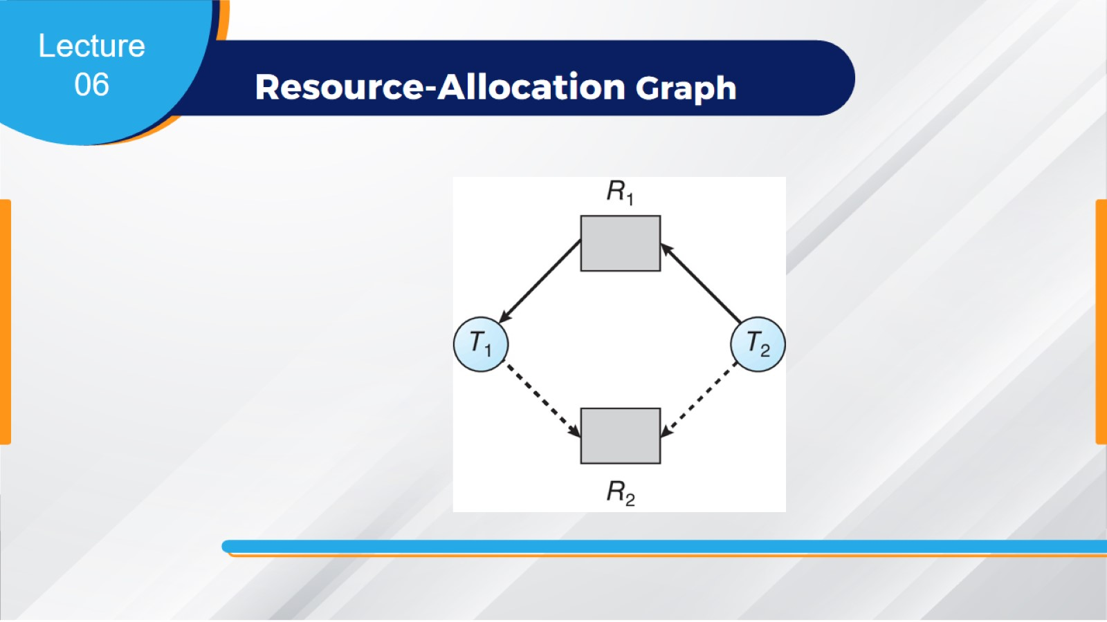
Resource-Allocation Graph

Slide 31
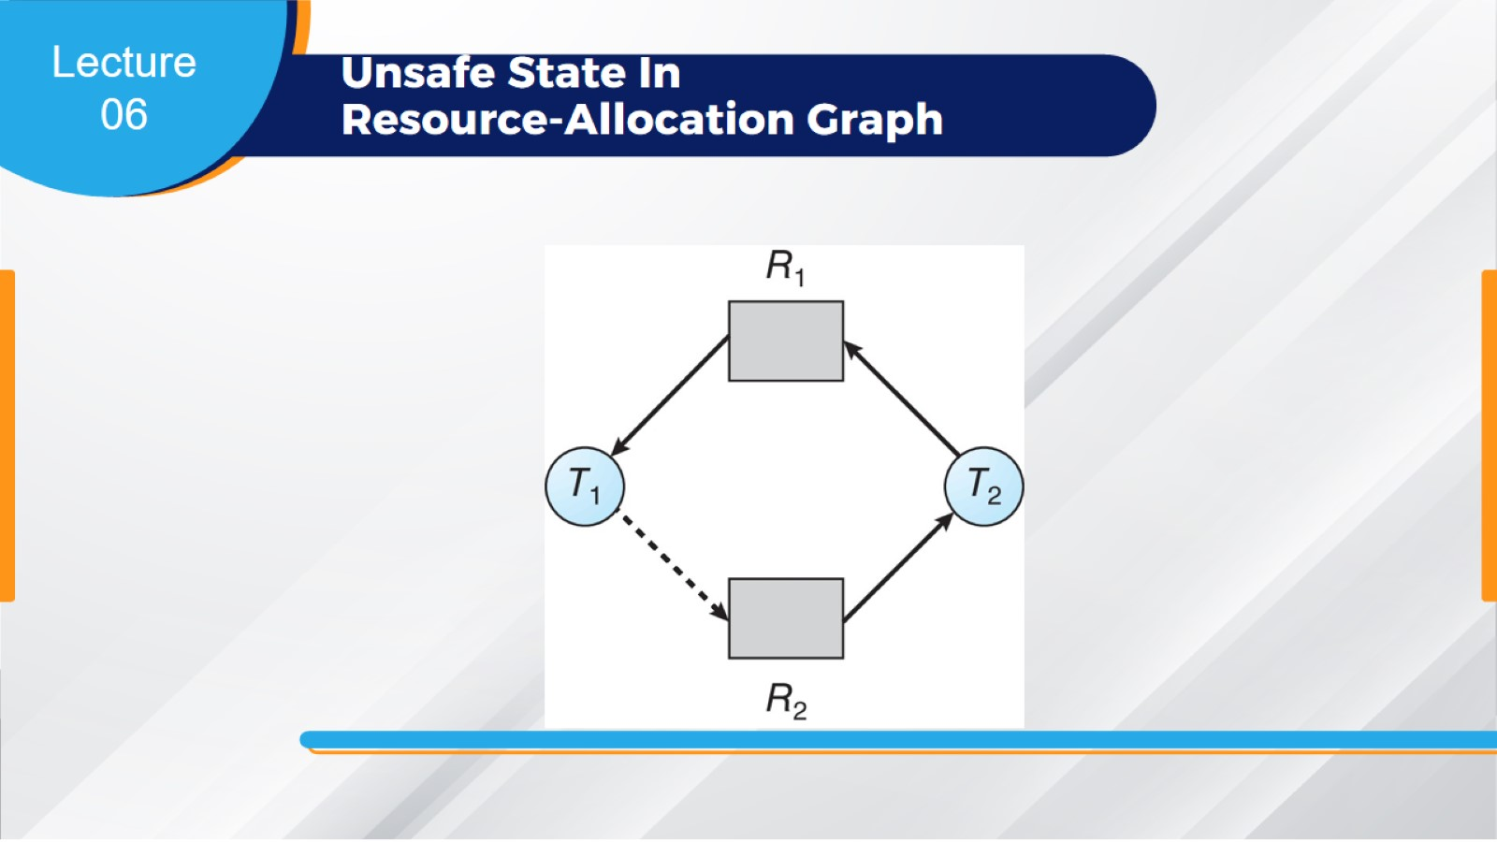
Unsafe State In
Resource-Allocation Graph

Slide 32
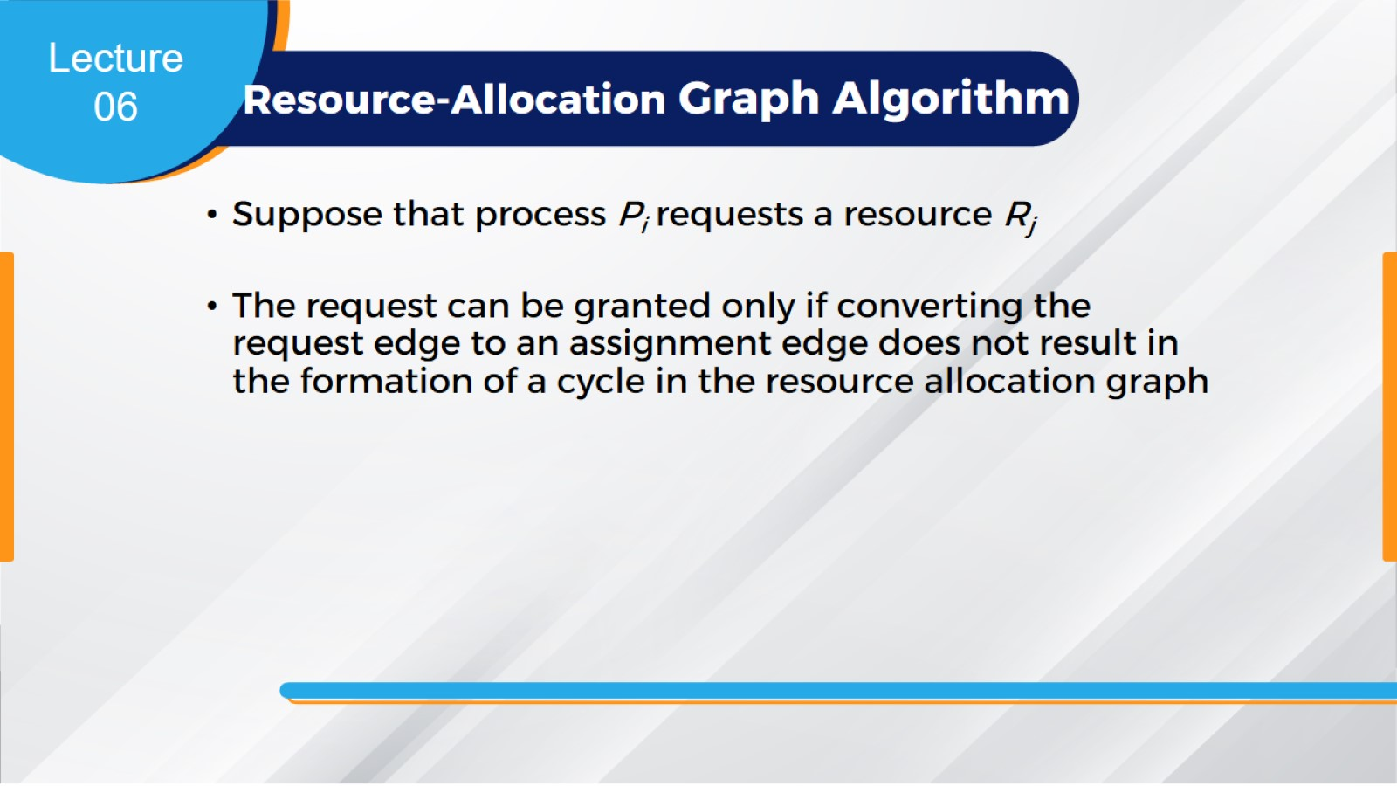
Resource-Allocation Graph Algorithm

Slide 33
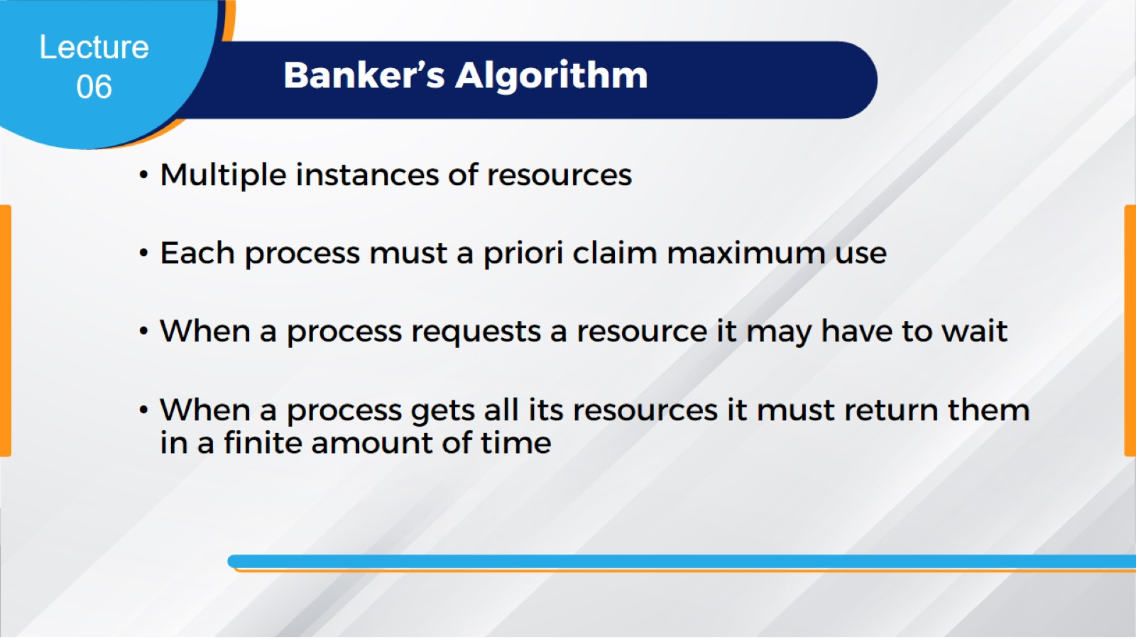
Banker’s Algorithm

Slide 34
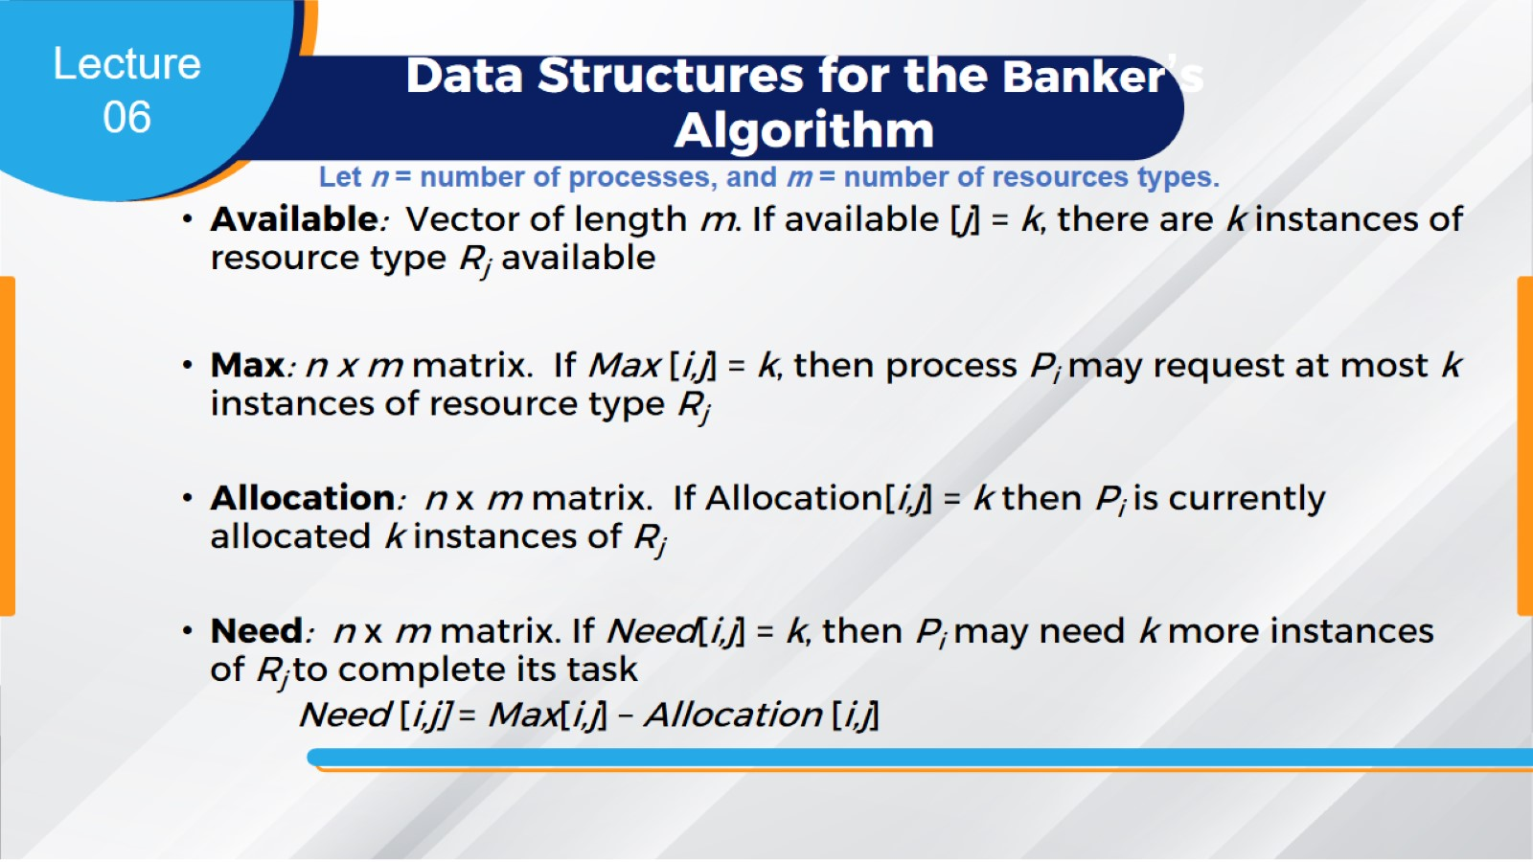
Data Structures for the Banker’s Algorithm

Slide 35
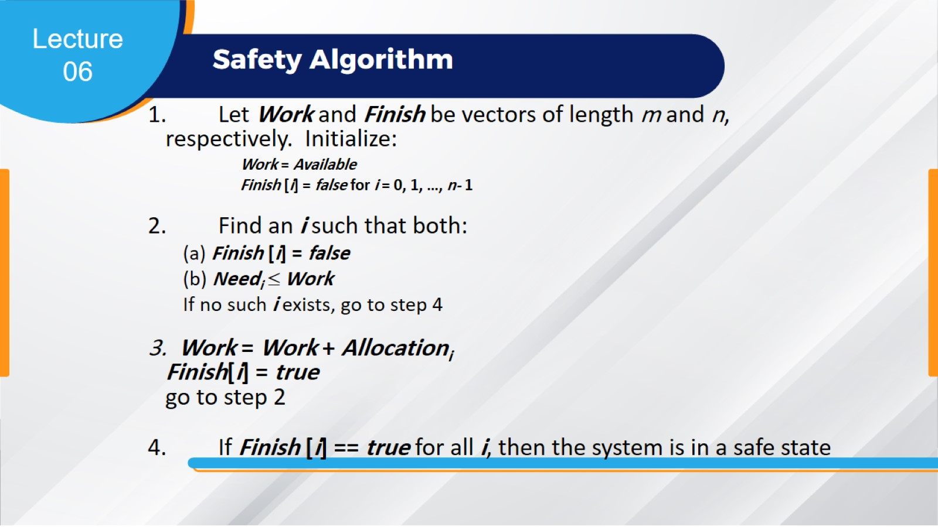
Safety Algorithm

Slide 36
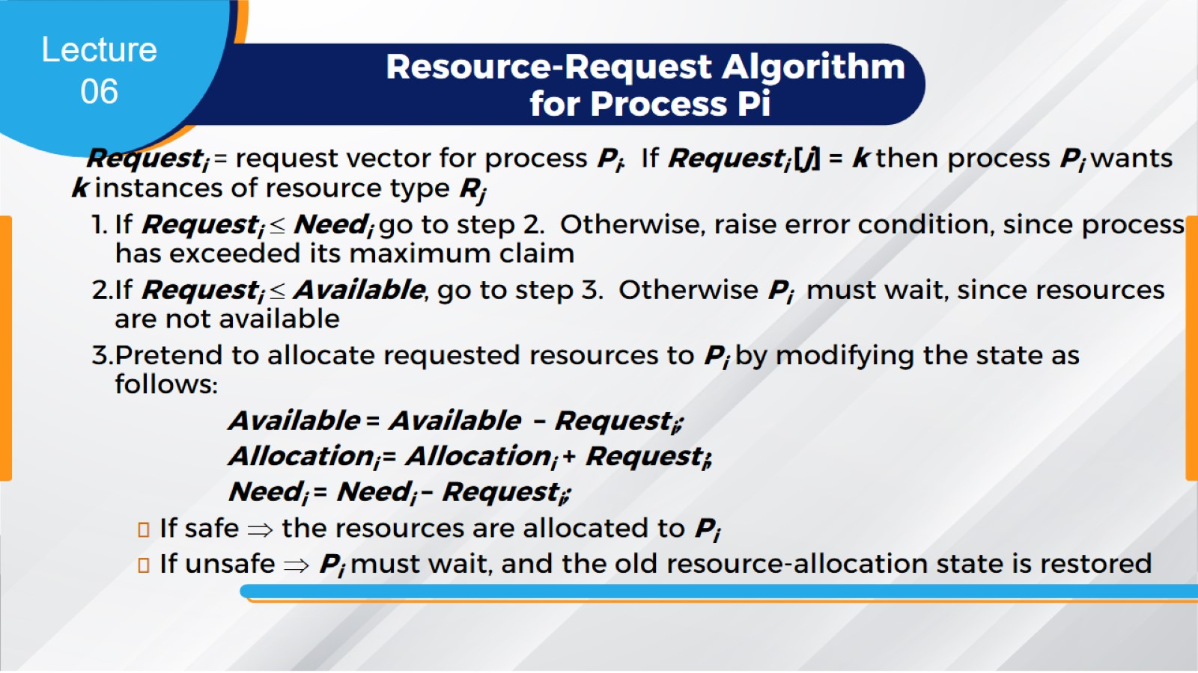
Resource-Request Algorithm for Process Pi

Slide 37
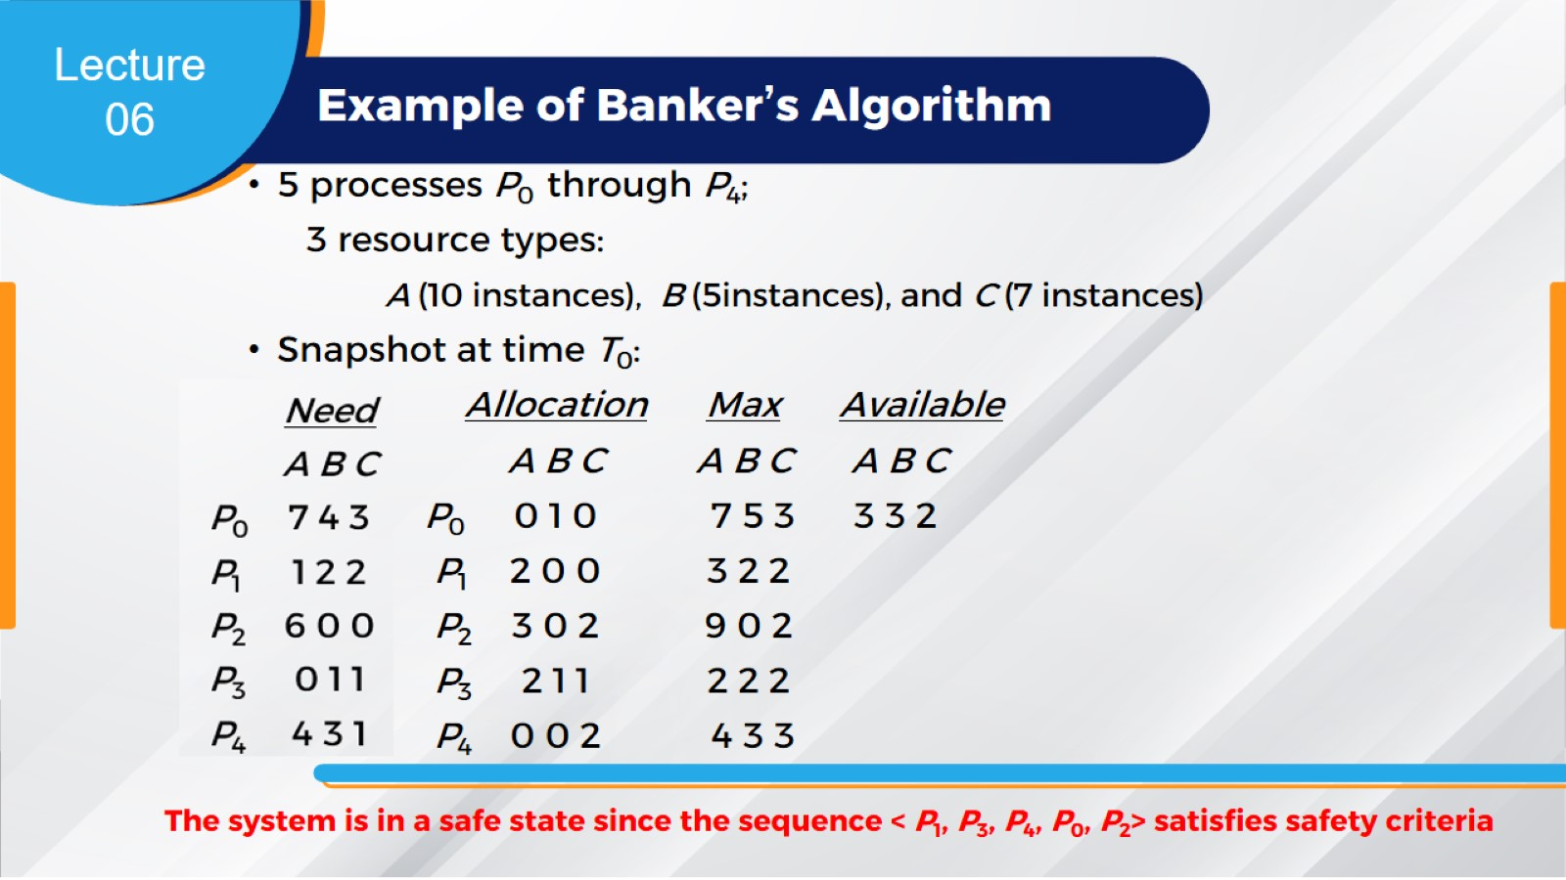
Example of Banker’s Algorithm

Slide 38
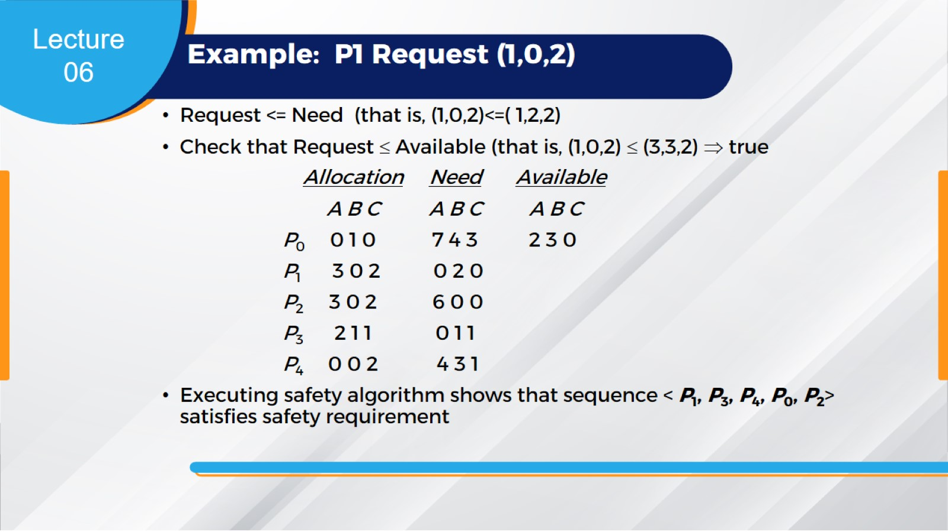
Example: P1 Request (1,0,2)

Slide 39
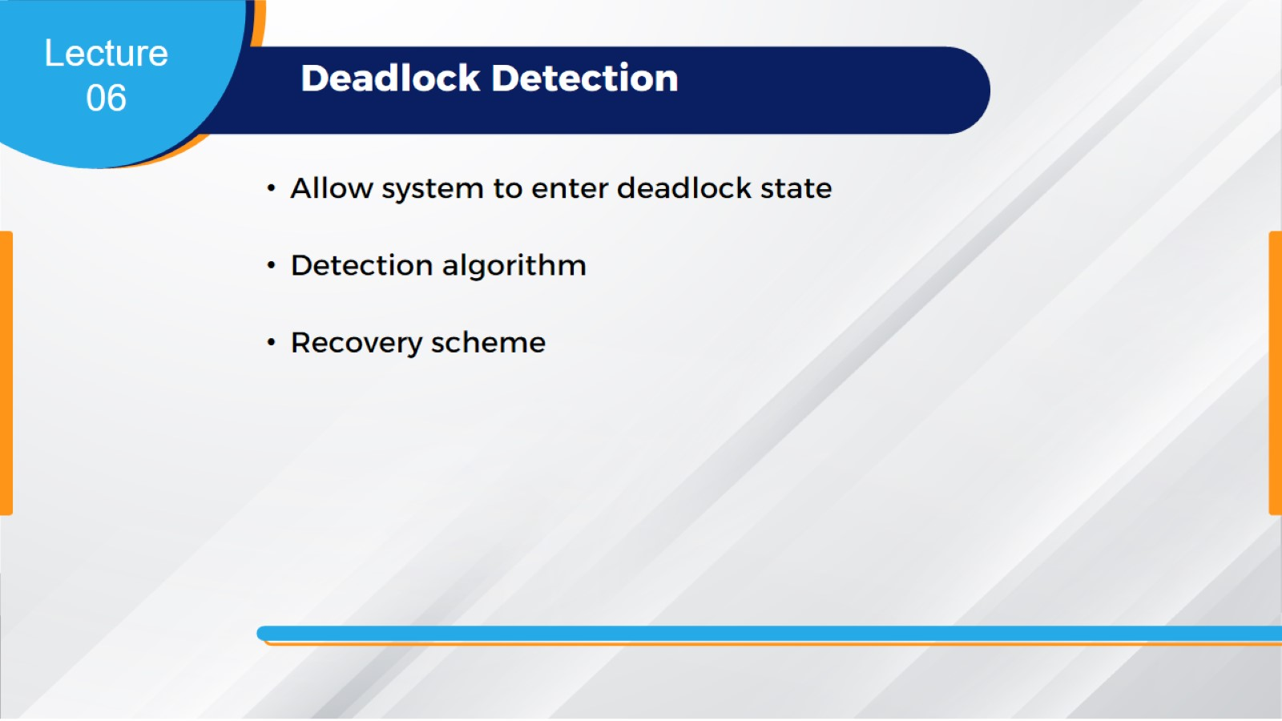
Deadlock Detection

Slide 40
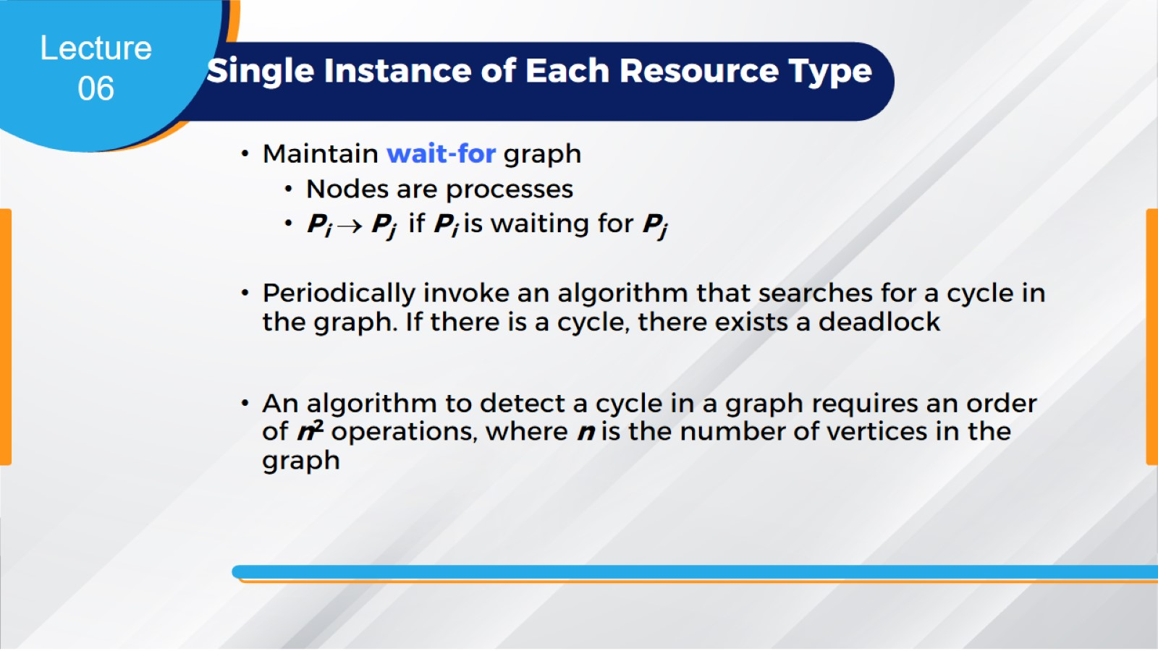
Single Instance of Each Resource Type

Slide 41
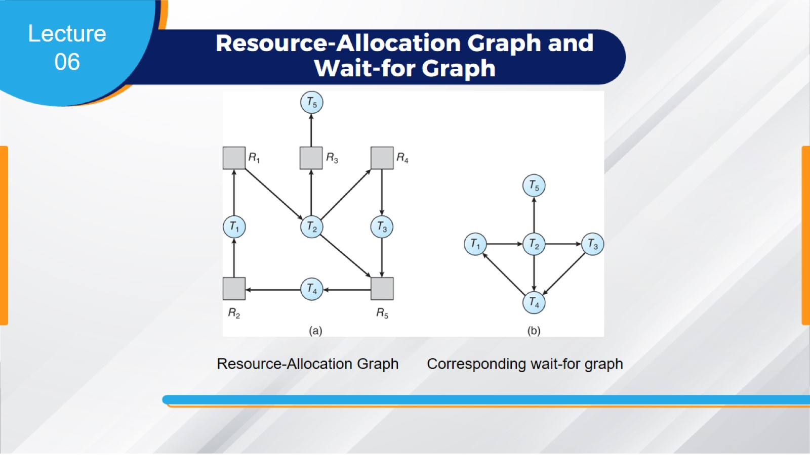
Resource-Allocation Graph and
Wait-for Graph

Slide 42
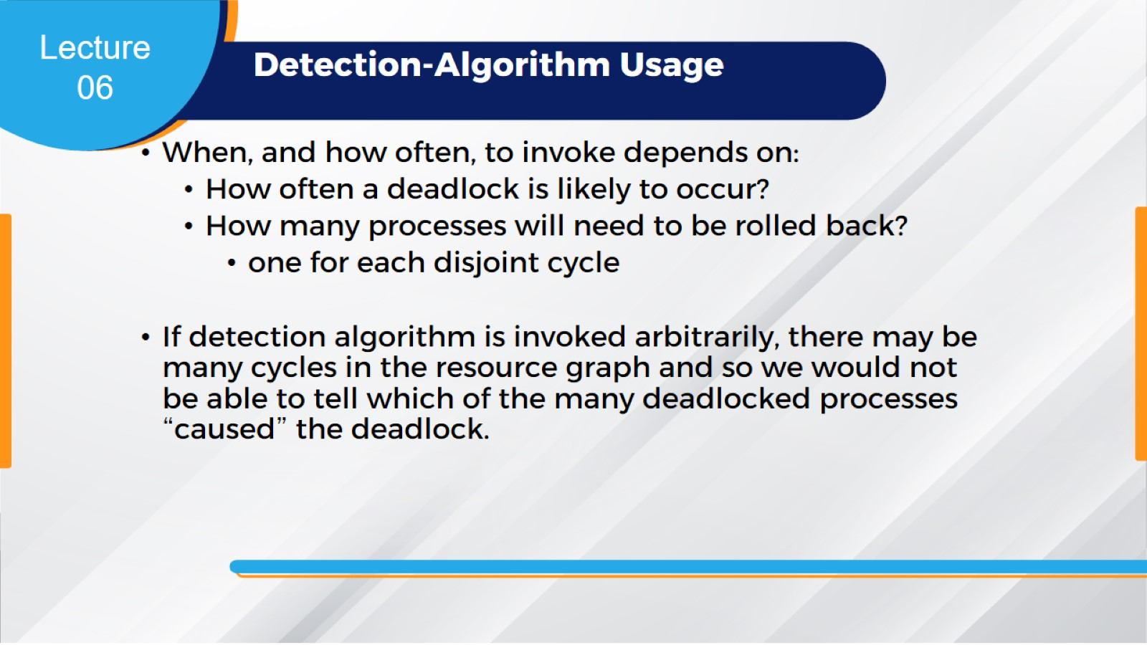
Detection-Algorithm Usage

Slide 43
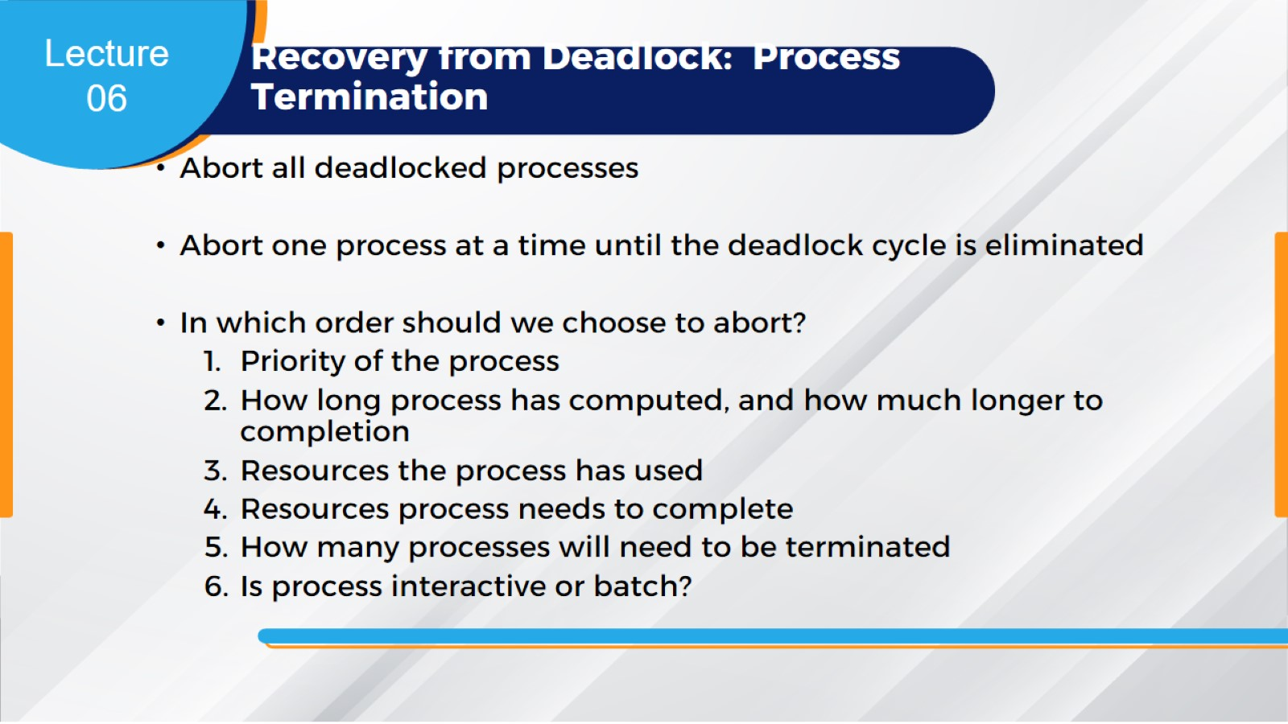
Recovery from Deadlock: Process Termination

Slide 44
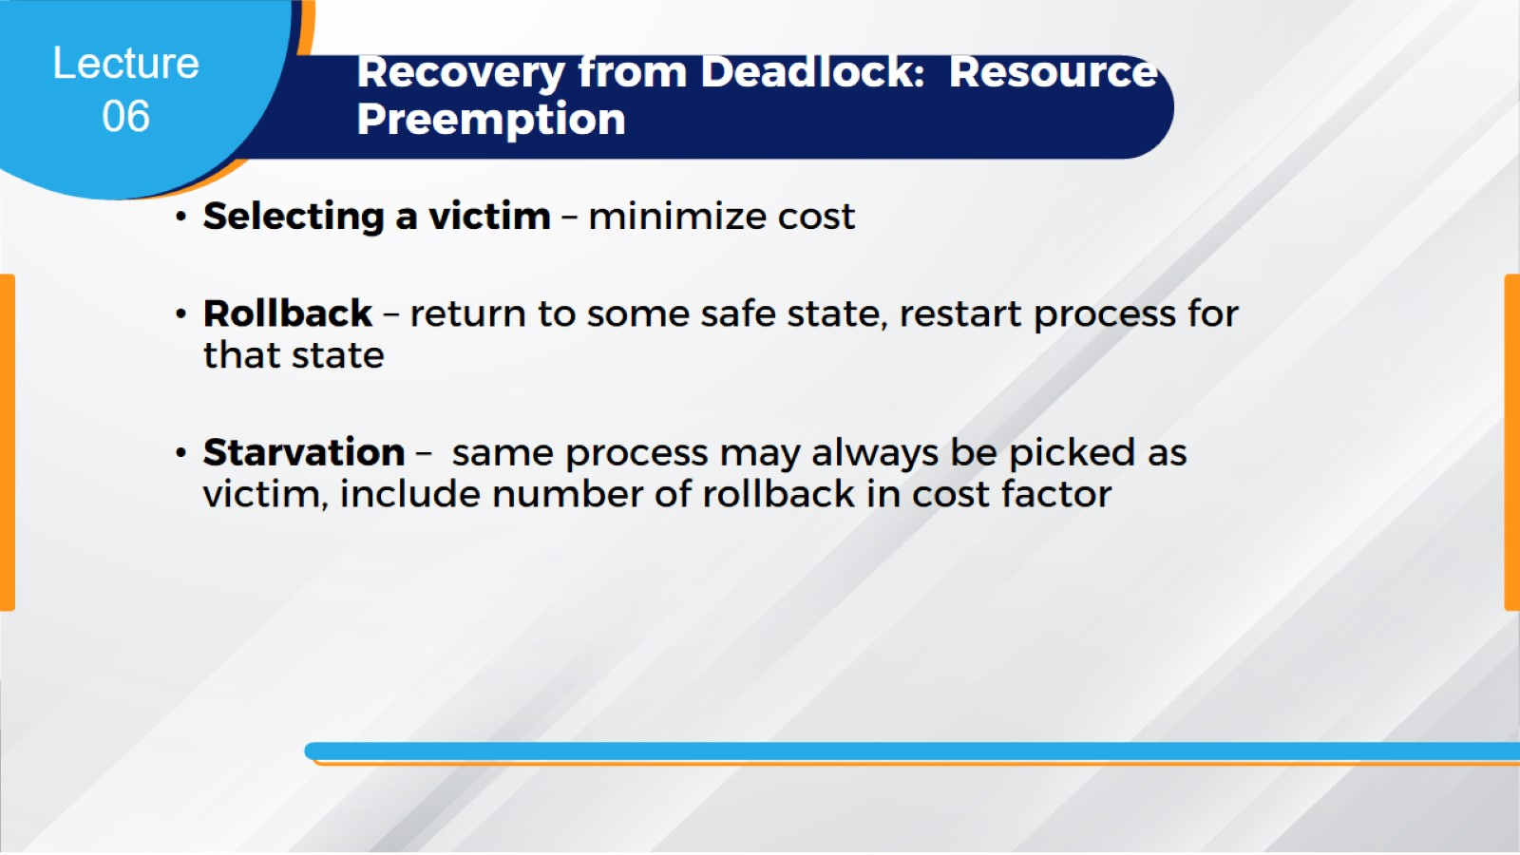
Recovery from Deadlock: Resource Preemption

Slide 45


