Slide 1


PMG 671
Leadership& Organizational
Behavior
Prepared by
Dr. Walid El Leithy
Chapter 9

Slide 2



Chapter 9
www.midocean.ae

Slide 3

Chapter
Agenda
09
After studying this chapter, you should be able to:
- Relate institutionalization to organizational culture.
- Define organizational culture and describe its common characteristics.
- Compare the functional and dysfunctional effects of organizational culture on people and the organization.
- Explain the factors that create and sustain an organization’s culture.
www.midocean.ae

Slide 4
Chapter
Agenda
09
  Show how culture is transmitted to employees.
  Demonstrate how an ethical culture can be created.
  Describe a positive organizational culture.
  Identify characteristics of a spiritual culture.
  Show how national culture may affect the way organizational culture is transported to a different country.
www.midocean.ae

Slide 5
Chapter
Organizational Culture definition
09
Organizational culture is a set of values, principles, beliefs that may be reflected through attitudes, eventually behaviour of the employees of any organisation.
www.midocean.ae

Slide 6
Chapter
Organizational Culture definition
09
  Organizational culture is rather a dynamic process that might be affected and changed by the learning experiences accumulated within group members as well as the new beliefs, values, and assumptions brought in by new members and leaders.
.
www.midocean.ae

Slide 7
Chapter
Organizational Culture definition
09
  The outcome of that is work processes could be run smoothly inside the organisation and no culture clashes might exist among members, so all employees can act in a harmonised way towards achieving the organisation’s objectives and hence improve organisational performance and effectiveness.”
www.midocean.ae

Slide 8
Chapter
Do Organizations have a uniform culture?
09
Dominant Culture
  Expresses the core values that are shared by a majority of the organization’s members
www.midocean.ae

Slide 9
Chapter
Do Organizations have a uniform culture?
09
Subcultures
  Mini cultures within an organization, typically defined by department designations and geographical separation
www.midocean.ae

Slide 10
Chapter
Do Organizations have a uniform culture?
09
Strong Culture
  A culture in which the core values are intensely held and widely shared
www.midocean.ae

Slide 11
Chapter
What do Cultures do?
09
Culture’s Functions
  Defines the boundary between one organization and others
  Conveys a sense of identity for its members
  Facilitates the generation of commitment to something larger than self-interest.
  Serves as a sense-making and control mechanism for fitting employees in the organization
www.midocean.ae

Slide 12
Chapter
How does culture begin?
09
Stems from the actions of the founders:
  Founders hire and keep only employees who think and feel the same way they do.
  Founders indoctrinate and socialize these employees to their way of thinking and feeling.
  The founders’ own behavior acts as a role model that encourages employees to identify with them and thereby internalize their beliefs, values, and assumptions.
www.midocean.ae

Slide 13
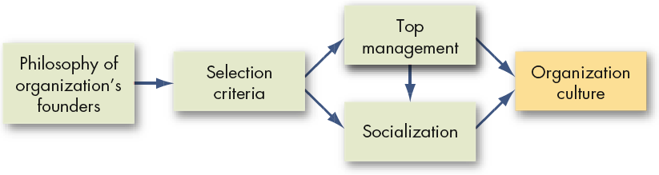
Chapter
How Organizational Culture form?
09
Organizational cultures are derived from the founder
They are sustained through managerial action
www.midocean.ae

Slide 14
Chapter
How Organizational Culture is transferred to employees?
09
Schein (1992), states the method through which cultures are transferred from founders to their employees. He believes the leaders transfer their cultures to their followers through some internal mechanisms:
(1) Through what they pay attention to and reward.
(2) Through the ways they allocate resources.
www.midocean.ae

Slide 15
Chapter
How Organizational Culture is transferred to employees?
09
(3) Through the role modeling they do.
(4) Through the way they react and deal with different problems and critical situations.
(5) Through the criteria they use for recruitment, selection, and promotion.
And accordingly organisations in general transfer their cultures to new employees through same mechanism as above.
www.midocean.ae

Slide 16
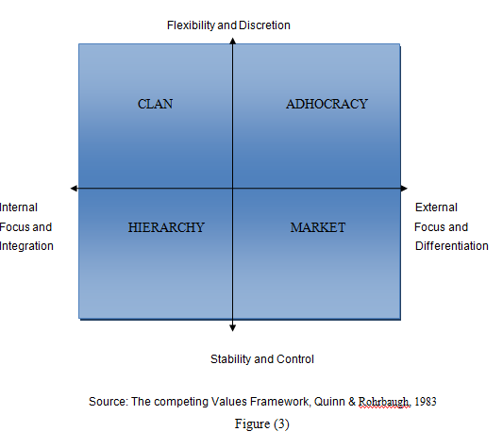
Chapter
Organizational Culture: Quinn Rohrbaugh’s types of organizational culture
09
www.midocean.ae

Slide 17
Chapter
Hierarchy Culture
09
Hierarchy culture can be described by clear lines of decision-making, authority, standardized rules and procedures, and control and accountability mechanisms were valued as the keys to success.
www.midocean.ae

Slide 18
Chapter
The Market Culture
09
The term market is not synonymous with the marketing; rather, it refers to a type of organisation that functions as a market itself. It is a result oriented organisation. The major concern is getting the job done. People are competitive and goal oriented. The leaders are hard drivers, producers, and competitors. They are tough and demanding. The glue that holds the organisation together is the emphasis on winning.
www.midocean.ae

Slide 19
Chapter
The Market Culture
09
Reputation and success are common concerns. The long term focus is on competitive actions and achievement of measurable goals and targets. Success is defined in terms of market share and penetration. The organisational style is hard-driving competitiveness.
www.midocean.ae

Slide 20
Chapter
The Clan Culture
09
It is called a Clan because of its similarity to a family-type organisation. Organisations in which the clan culture is dominant seem more like extended families than economic entities. Instead of the rules and procedures of hierarchies, the clan culture is typified by a friendly place to work where people share a lot of themselves.
www.midocean.ae

Slide 21
Chapter
The Clan Culture
09
Leaders are thought of as mentors and perhaps as parent figures. Organisation is held together by loyalty and tradition. Commitment is high. The organisation emphasises the long-term benefit of individual development, with high cohesion and morale being important. Success is defined in terms of internal climate and concern for people. Organisation places a premium on teamwork, participation, and consensus
www.midocean.ae

Slide 22
Chapter
Adhocracy Culture
09
It is characterized by a dynamic, entrepreneurial, and creative work place. People are encouraged to take risks and initiate new and innovative ideas. Effective leadership is visionary, innovative, and risk-oriented. The glue that holds the organisation together is commitment to experimentation and innovation.
www.midocean.ae

Slide 23
Chapter
Adhocracy Culture
09
The emphasis is on being at the leading edge of new knowledge, products, and services. Readiness for change and meeting new challenges are important. The long-term emphasis of organisations is on rapid growth and acquiring new resources. Success means producing unique and original products and services.
www.midocean.ae

Slide 24
Chapter
Organizational Culture and Organizational Life Cycle
09
According to Cameron and Quinn (1983), researches evidently show that both new and small organizations tend to progress through a predictable pattern of organization culture changes without recognizing that they do so,
www.midocean.ae

Slide 25
Chapter
Organizational Culture and Organizational Life Cycle
09
while culture change occurs in a less predictable pattern in large and mature organizations in a way that must generally be managed consciously. Moreover, they align organizations' progresses over time with the type of culture they acquire or must acquire
www.midocean.ae

Slide 26
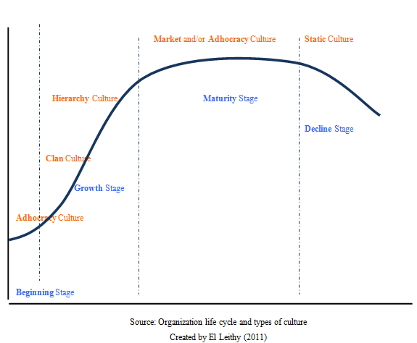
Chapter
Organizational Culture and Organizational Life Cycle
09
The Pragmatics: These individuals will not stand behind controversial or unique ideas until the majority of the group has expressed their support. These individuals often remain in the background of the group.
www.midocean.ae

Slide 27
Chapter
Organizational Culture Change Program Example
09
On Feb 1, 2003, the space shuttle Columbia and its crew of seven were lost during return to earth.
A group of distinguished experts was appointed and spent 6 months conducting a thorough investigation of the causes of the accident.
The group of investigators found that Nasa’s current organizational culture contributed to Columbia’s accident.
.
www.midocean.ae

Slide 28
Chapter
Organizational Culture Change Program Example
09
As a result, Nasa decided to conduct an organizational culture change program.
BST was selected to assess Nasa’s current organizational culture, decide on the new preferred culture and develop and implement a culture change program.
www.midocean.ae

Slide 29
Chapter
Organizational Culture Change Program Example
09
Negative aspects includes:
(1) Nasa’s current organizational culture does not reflect the agency’s espoused core values of (a) safety ( Nasa has not created an organizational culture that is fully supportive of safety and its people do not feel comfortable to raise their safety concerns to their management) , (b)people ( Do not feel that they are highly respected and appreciated by the organization),
www.midocean.ae

Slide 30
Chapter
Organizational Culture Change Program Example
09
(C) excellence ( is only seen and valued when it comes to technical work, yet the culture does not value other organizational aspects like management skills, supportive administrative functions and creating an environment that encourages excellence in communication) and (d) integrity ( there are some signals that raising of issues by people is not welcome)
www.midocean.ae

Slide 31
Chapter
Organizational Culture Change Program Example
09
The current culture reflects an organization transformation with many on going initiatives and lack of a clear sense at working level of how it all fits together.
www.midocean.ae

Slide 32
Chapter
Organizational Culture Change Program Example
09
Recommended Organizational culture change plan includes:
(1) Change in processes: Guiding principles must underlie the definition of Nasa’s desired culture , serve as a frame work for mission safety improvements at Nasa and help inform every one about the consideration that should be reflected in day to day actions and decisions.
www.midocean.ae

Slide 33
Chapter
Organizational Culture Change Program Example
09
Recommended Organizational culture change plan includes:
(2) Leadership behavior: Through a set of behavior- based tools , they will work on changing Nasa’s leaders’ behavior as they are key to changing Nasa’s organizational culture.
www.midocean.ae

Slide 34
Chapter
The Impact of National Culture on Organizational Culture
09
National culture tends to influence the organizational culture. Culture is the function of social norm, ethics, value system and behavioral pattern, which may vary from country to country. It is difficult to transport and implant Organizational culture in another country.
www.midocean.ae

Slide 35
Chapter
Global Implications
09
Organization cultures, while strong, can’t ignore local culture
Managers should be more culturally sensitive by:
  Speaking slowly and in a low tone
  Listening more
  Avoiding discussions of religion or politics
All global firms (not just U.S. firms) need to be more culturally sensitive
www.midocean.ae

Slide 36
Chapter
Summary and Managerial Implications
09
Strong cultures are difficult for managers to change
  In the short run, strong cultures should be considered fixed
Selecting new hires that fit well in the organizational culture is critical for motivation, job satisfaction, commitment, and turnover
www.midocean.ae

Slide 37
Chapter
Summary and Managerial Implications
09
Socialization into the corporate culture is important
As a manager, your actions as a role model help create the cultural values of ethics, spirituality, and a positive culture
www.midocean.ae

Slide 38




Thank You

