Slide 1


Ethical Hacking Essentials (EHE)
Master of Science in Cybersecurity
Dr. Kamal Alieyan
Everyone Smart University
Faculty of IT – 2022/2023

Slide 2


Module 07
Web Application Attacks and Countermeasures

Slide 3

Module Objectives
1
Understanding Web Server Concepts and Attacks
2
Understanding Different Web Server Attack Tools and Countermeasures
3
Overview of Web Application Architecture and Vulnerability Stack
4
Understanding Different Web Application Threats and Attacks
5
Understanding Different Web Application Attack Tools and Countermeasures
6
Overview of Different Types of SQL Injection Attacks
7
Understanding Different SQL Injection Tools
8
Understanding Different SQL Injection Attack Countermeasures
Notes:
https://www.shutterstock.com/image-illustration/web-design-concept-122664079

Slide 4
SQL Injection Attacks
Notes:
Modern font you can download by link: https://www.dafontfree.net/freefonts-thenautigal-f62324.htm

Slide 5
Module Flow
1
2
Discuss Types of SQL Injection Attacks
Discuss SQL Injection Attack Countermeasures

Slide 6

What is SQL Injection?
SQL injection is a technique used to take advantage of un-sanitized input vulnerabilities to pass SQL commands through a web application for execution by a backend database
It is a basic attack used to either gain unauthorized access to a database or retrieve information directly from the database

Slide 7

Why Bother about SQL Injection?
Based on the use of applications and the way they process user supplied data, SQL injections can be used to implement the following types of attacks:
1
Authentication Bypass
Compromised Data Integrity
4
2
Authorization Bypass
Compromised Availability of Data
5
3
Information Disclosure
Remote Code Execution
6

Slide 8

SQL Injection and Server-side Technologies
Server-side Technology
Powerful server-side technologies like ASP.NET and database servers allow developers to create dynamic, data-driven websites, and web apps with incredible ease
Exploit
The power of ASP.NET and SQL can easily be exploited by hackers using SQL injection attacks
Susceptible Databases
All relational databases, SQL Server, Oracle, IBM DB2, and MySQL, are susceptible to SQL-injection attacks
Attack
SQL injection attacks do not exploit a specific software vulnerability, instead they target websites and web apps that do not follow secure coding practices for accessing and manipulating data stored in a relational database

Slide 9


Types of SQL Injection
SQL Injection
Error-based SQL Injection
System Stored Procedure
In-band SQL Injection
UNION SQL Injection
Illegal/Logically Incorrect Query
Blind/Inferential SQL Injection
Tautology
End of Line Comment
Time Delay
Inline Comment
Boolean Exploitation
Out-of-Band SQL Injection
Piggybacked Query
Heavy Query

Slide 10
In-Band SQL Injection
Attackers use the same communication channel to perform the attack and retrieve the results
Error-based SQL Injection
Illegal/Logically Incorrect Query
Attackers intentionally insert bad input into an application, thereby causing it to throw database errors
Attackers send an incorrect query to the database intentionally to generate an error message that may be helpful in performing further attacks
Types of in-band SQL Injection
System Stored Procedure
Union SQL Injection
Attackers exploit databases' stored procedures to perpetrate their attacks
Attackers use a UNION clause to add a malicious query to the requested query
SELECT Name, Phone, Address FROM Users WHERE Id=1 UNION ALL SELECT creditCardNumber,1,1 FROM CreditCardTable

Slide 11
In-Band SQL Injection (Cont’d)
Types of in-band SQL Injection
Tautology
In-line Comments
  Attackers inject statements that are always true so that the queries always return results after evaluating the WHERE condition
  SELECT * FROM users WHERE name = ‘’ OR ‘1’=‘1’;
Attackers integrate multiple vulnerable inputs into a single query using inline comments
INSERT INTO Users (UserName, isAdmin, Password) VALUES(‘Attacker', 1, /*’, 0, ‘*/’mypwd’)
End of Line Comment
Piggybacked Query
After injecting the code into a specific field, legitimate code that follows is nullified using end of line comments
SELECT * FROM user WHERE name = 'x' AND userid IS NULL; --';
Attackers inject additional malicious query into the original query. Consequently, the DBMS executes multiple SQL queries
SELECT * FROM EMP WHERE EMP.EID = 1001 AND EMP.ENAME = ’Bob’; DROP TABLE DEPT;

Slide 12

Error Based SQL Injection
Error based SQL Injection forces the database to perform some operation in which the result will be an error
This exploitation may differ depending on the DBMS
Consider the SQL query shown below:
SELECT * FROM products WHERE id_product=$id_product
Consider the following request to a script that executes the query above:
http://www.example.com/product.php?id=10
The malicious request would be (e.g., Oracle 10g):
http://www.example.com/product.php?
id=10||UTL_INADDR.GET_HOST_NAME( (SELECT user FROM DUAL) )—

Slide 13
Union SQL Injection
This technique involves joining a forged query to the original query
The result of a forged query will be joined to the result of the original query, thereby allowing it to obtain the values of fields of other tables
`
Example:
SELECT Name, Phone, Address FROM Users WHERE Id=$id
Now set the following Id value:
$id=1 UNION ALL SELECT creditCardNumber,1,1 FROM CreditCardTable
The final query is as shown below:
SELECT Name, Phone, Address FROM Users WHERE Id=1 UNION ALL SELECT creditCardNumber,1,1 FROM CreditCardTable
The above query joins the result of the original query with all the credit card users

Slide 14
Blind/Inferential SQL Injection
No Error Message
Generic Page
Time- intensive
Blind SQL Injection is used when a web application is vulnerable to an SQL injection, but the results of the injection are not visible to the attacker
Blind SQL injection is identical to a normal SQL Injection, except that a generic custom page is displayed when an attacker attempts to exploit an application rather than seeing a useful error message
This type of attack can become time-intensive because a new statement must be crafted for each bit recovered
Note: An attacker can still steal data by asking a series of True and False questions through SQL statements

Slide 15


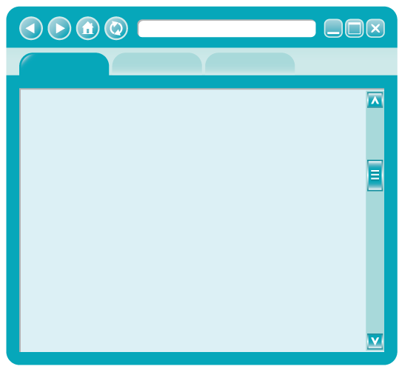

Blind SQL Injection: No Error Message Returned
certifiedhacker'; drop table Orders --
SQL Injection Attack
Attacker
Blind SQL Injection (Attack Successful)
Simple SQL Injection
http://www.certifiedhacker.com
http://www.certifiedhacker.com
Oops!
Microsoft OLE DB Provider for ODBC Drivers error '80040e14'
[Microsoft][ODBC SQL Server Driver][SQL Server]Unclosed quotation mark before the
character string ''.
/shopping/buy.aspx, line 52
We are unable to process your request. Please try back later.

Slide 16




Blind SQL Injection: WAITFOR DELAY (YES or NO Response)
; IF EXISTS(SELECT * FROM creditcard) WAITFOR DELAY '0:0:10'--
http://www.certifiedhacker.com
Check
if database “creditcard” exists or
not
Oops!
NO
We are unable to process your request. Please try back later.
Since no error messages are returned, use 'waitfor delay' command to check the SQL execution status
YES
WAIT FOR DELAY 'time' (Seconds)
This is just like sleep, wait for a specified time. The CPU is a safe way to make a database wait.
WAITFOR DELAY '0:0:10'--
http://www.certifiedhacker.com
Oops!
Sleep for 10 seconds
BENCHMARK() (Minutes)
This command runs on MySQL server.
BENCHMARK(howmanytimes, do this)
We are unable to process your request. Please try back later.

Slide 17
Blind SQL Injection: Boolean Exploitation
Multiple valid statements that evaluate true and false are supplied in the affected parameter in the HTTP request
By comparing the response page between both conditions, the attackers can infer whether or not the injection was successful
For example, consider the following URL:
http://www.myshop.com/item.aspx?id=67
An attacker may manipulate the above request to
http://www.myshop.com/item.aspx?id=67 and 1=2
SQL Query Executed
SELECT Name, Price, Description FROM ITEM_DATA WHERE ITEM_ID = 67 AND 1 = 2

Slide 18

Blind SQL Injection: Heavy Query
Attackers use heavy queries to perform a time delay SQL injection attack without using time delay functions
A heavy query retrieves a significant amount of data and takes a long time to execute in the database engine
Attackers generate heavy queries using multiple joins on system tables
For example,
SELECT * FROM products WHERE id=1 AND 1 < SELECT count(*) FROM all_users A, all_users B, all_users C

Slide 19

Out-of-Band SQL Injection
01
03
In Out-of-Band SQL injection, the attacker needs to communicate with the server and acquire features of the database server used by the web application
Attackers use DNS and HTTP requests to retrieve data from the database server
02
04
Attackers use different communication channels to perform the attack and obtain the results
For example, in a Microsoft SQL Server, an attacker exploits the xp_dirtree command to send DNS requests to a server controlled by the attacker

Slide 20
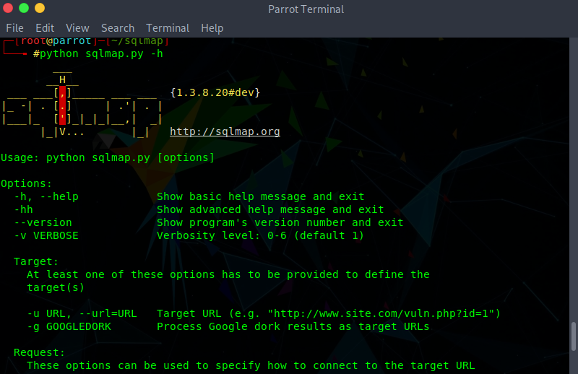
SQL Injection Tools
sqlmap automates the process of detecting and exploiting SQL injection flaws and the taking over of database servers
sqlmap
Mole
https://sourceforge.net
Blisqy
https://github.com
blind-sql-bitshifting
https://github.com
NoSQLMap
https://github.com
SQL Power Injector
http://www.sqlpowerinjector.com
http://sqlmap.org

Slide 21
Module Flow
1
2
Discuss Types of SQL Injection Attacks
Discuss SQL Injection Attack Countermeasures

Slide 22
SQL Injection Attack Countermeasures
1
2
3
Make no assumptions about the size, type, or content of the data that is received by your application
Test the size and data type of input and enforce appropriate limits to prevent buffer overruns
Test the content of string variables and accept only expected values
4
5
6
Reject entries that contain binary data, escape sequences, and comment characters
Never build Transact-SQL statements directly from user input and use stored procedures to validate user input
Implement multiple layers of validation and never concatenate user input that is not validated

Slide 23
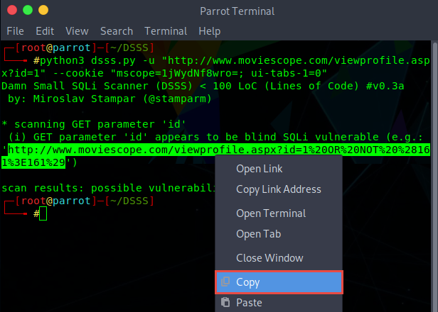
SQL Injection Detection Tools
Damn Small SQLi Scanner (DSSS)
DSSS is an SQL injection vulnerability scanner that scans the web application for various SQL injection vulnerabilities
OWASP ZAP
https://www.owasp.org
Snort
https://www.snort.org
Burp Suite
https://portswigger.net
HCL AppScan
https://www.hcltech.com
w3af
https://w3af.org
https://github.com
Notes:
icons

Slide 24

Module Summary
This module has discussed web server concepts and attacks
It has covered various web server attack tools and countermeasures
It discussed web application architecture and vulnerability stack
It also discussed various web application threats and attacks
It demonstrated different web application attack tools
It discussed various countermeasures against web application attacks
This module also discussed different types of SQL injection attacks and SQL injection tools
Finally, this module ended with a detailed discussion on various countermeasures against SQL injection attacks
In the next module, we will discuss in detail on various wireless attacks and countermeasures

