Slide 1


Probability and
Statistics
Prepared by Dr. Alfaisal Hasan
STA 201
Probability and Statistics
Lecture NO 7

Slide 2



Probability and
Statistics
Lecture NO 7
STA 201
Probability and Statistics
Prepared by
Dr. Alfaisal Hasan
www.midocean.ae

Slide 3

Chapter
Topics
Chapter 1: Introduction To Statistics
Chapter 2: Descriptive Statistics
Chapter 3: Probability
Chapter 4: Discrete Probability Distributions
Chapter 5: Normal Probability Distributions
Chapter 6: Confidence Intervals
Chapter 7: Hypothesis Testing with One Sample
Chapter 8: Hypothesis Testing with Two Samples
Chapter 9: Correlation And Regression
Chapter 10: Chi-Square Tests and The F-Distribution
www.midocean.ae

Slide 4
Chapter
Hypothesis Testing with One Sample
7.1 Introduction to Hypothesis Testing
7.2 Hypothesis Testing for the Mean (Large Samples)
7.3 Hypothesis Testing for the Mean (Small Samples)
7.4 Hypothesis Testing for Proportions
www.midocean.ae

Slide 5
7.1 Introduction to Hypothesis testing
Chapter
Hypothesis test
A process that uses sample statistics to test a claim about the value of a population parameter.
For example: An automobile manufacturer advertises that its new hybrid car has a mean mileage of 50 miles per gallon. To test this claim, a sample would be taken. If the sample mean differs enough from the advertised mean, you can decide the advertisement is wrong.
www.midocean.ae

Slide 6
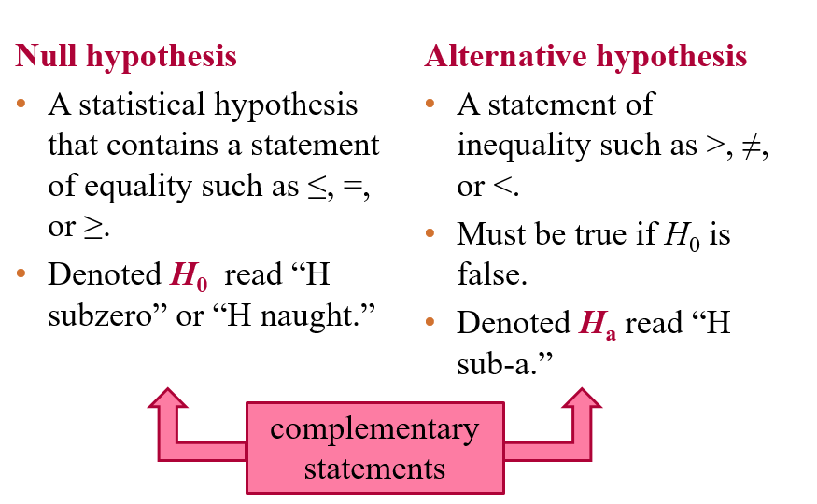
Chapter
Stating a Hypothesis
www.midocean.ae

Slide 7
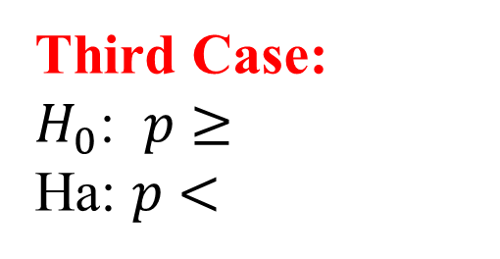
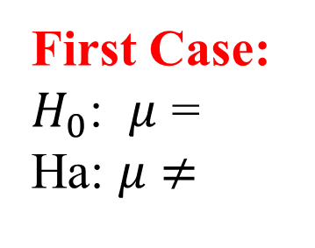
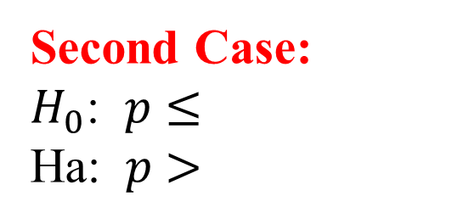
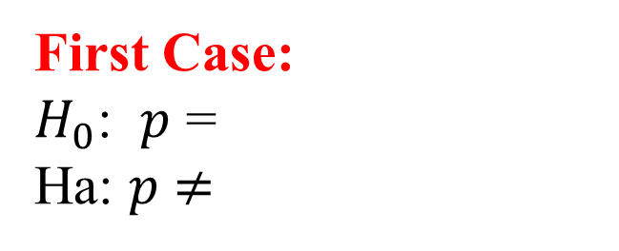


Stating a Hypothesis
Chapter
Population Mean Population Proportion
First Case:
$H_{0}$: $μ$ =
Ha: $μ$ $≠$
First Case:
$H_{0}$: $p$ =
Ha: $p$ $≠$
Second Case:
$H_{0}$: $μ$ $≤$
Ha: $μ$ $>$
Second Case:
$H_{0}$: $p$ $≤$
Ha: $p$ $>$
Third Case:
$H_{0}$: $μ$ $≥$
Ha: $μ$ $<$
Third Case:
$H_{0}$: $p$ $≥$
Ha: $p$ $<$
www.midocean.ae

Slide 8
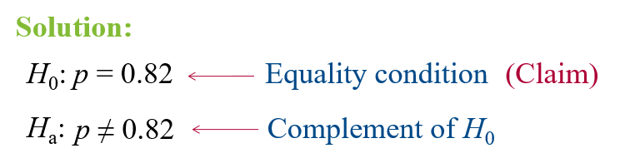
Example: Stating the Null and Alternative Hypotheses
Chapter
Write the claim as a mathematical sentence. State the null and alternative hypotheses and identify which represents the claim.
A university publicizes that the proportion of its students who graduate in 4 years is 82%.
www.midocean.ae

Slide 9
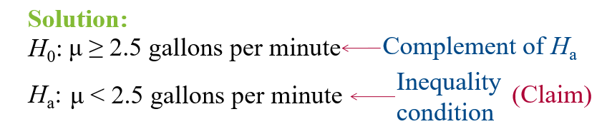
Chapter
Example: Stating the Null and Alternative Hypotheses
Write the claim as a mathematical sentence. State the null and alternative hypotheses and identify which represents the claim.
A water faucet manufacturer announces that the mean flow rate of a certain type of faucet is less than 2.5 gallons per minute.
www.midocean.ae

Slide 10
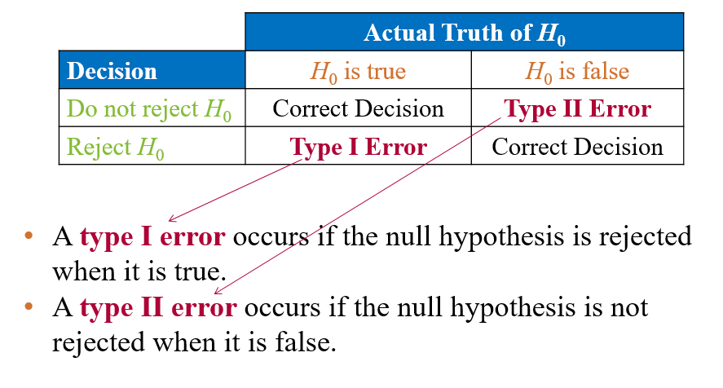
Chapter
Types of Errors
www.midocean.ae

Slide 11
Chapter
Types of Errors
www.midocean.ae

Slide 12

Example: Identifying Type I and Type II Errors
The USDA limit for salmonella contamination for chicken is 20%. A meat inspector reports that the chicken produced by a company exceeds the USDA limit. You perform a hypothesis test to determine whether the meat inspector’s claim is true. When will a type I or type II error occur? Which is more serious? (Source: United States Department of Agriculture)
www.midocean.ae

Slide 13
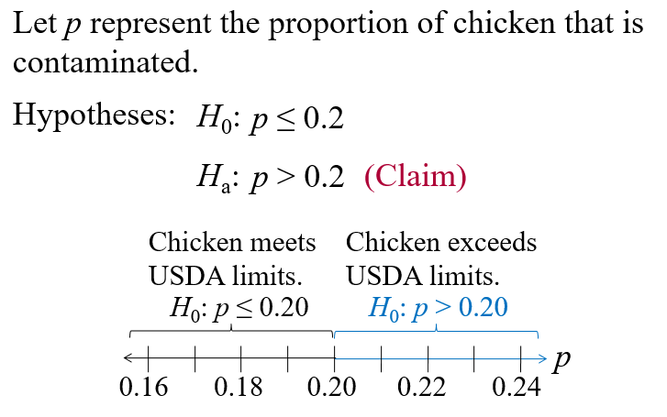
Solution: Identifying Type I and Type II Errors
www.midocean.ae

Slide 14
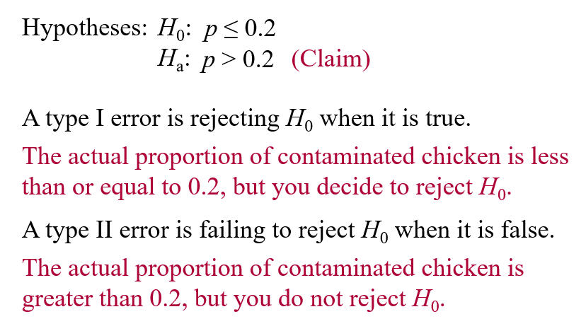
Solution: Identifying Type I and Type II Errors
www.midocean.ae

Slide 15
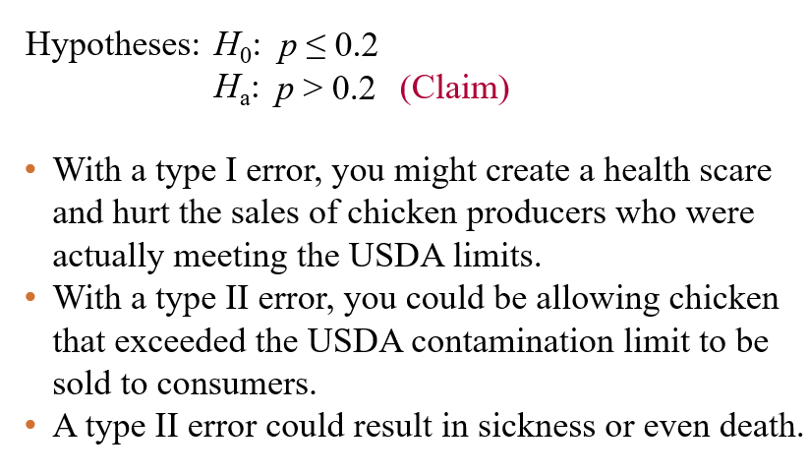
Solution: Identifying Type I and Type II Errors
www.midocean.ae

Slide 16
Level of significance
www.midocean.ae

Slide 17
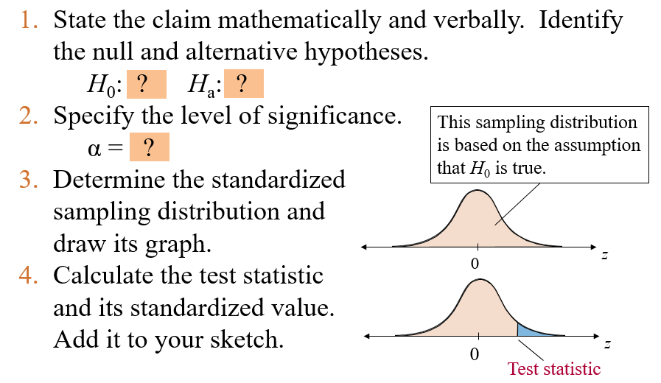
Taking decision by Traditional way - First way
www.midocean.ae

Slide 18
Making a Decision by P-value – Second way
P-value (or probability value)
The probability, if the null hypothesis is true, of obtaining a sample statistic with a value as extreme or more extreme than the one determined from the sample data.
Depends on the nature of the test.
www.midocean.ae

Slide 19
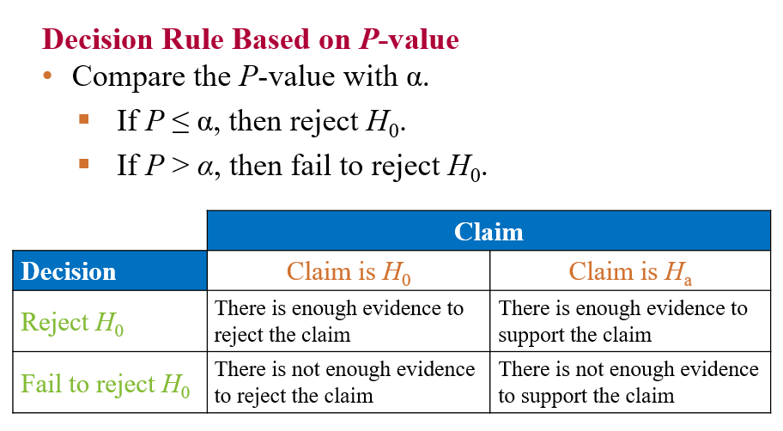
Making a Decision by P-value – Second way
www.midocean.ae

Slide 20

Example: Interpreting a Decision
You perform a hypothesis test for the following claim. How should you interpret your decision if you reject H₀? If you fail to reject H₀?
H_{a} (Claim): Consumer Reports states that the mean stopping distance (on a dry surface) for a Honda Civic is less than 136 feet.
Solution:
The claim is represented by H_{a}.
H₀ is “the mean stopping distance…is greater than or equal to 136 feet.”
www.midocean.ae

Slide 21
Solution: Interpreting a Decision
If you reject H₀ you should conclude “there is enough evidence to support Consumer Reports’ claim that the stopping distance for a Honda Civic is less than 136 feet.”
If you fail to reject H₀, you should conclude “there is not enough evidence to support Consumer Reports’ claim that the stopping distance for a Honda Civic is less than 136 feet.”
www.midocean.ae

Slide 22
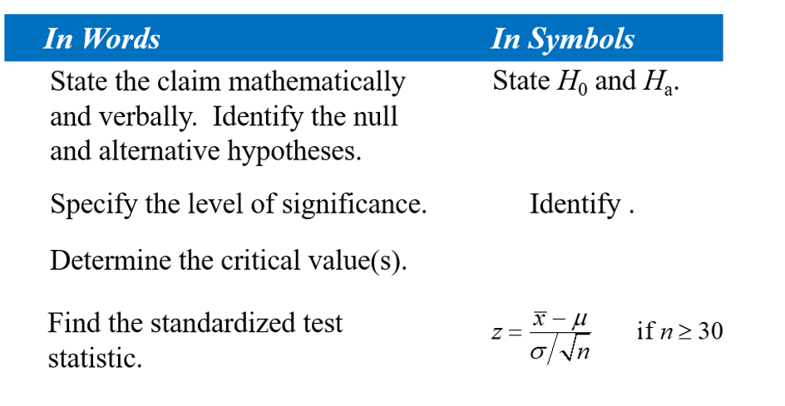
7.2 Hypothesis Testing for the Mean (Large Samples)
When n ≥ 30, the sample standard deviation s can be substituted for σ.
www.midocean.ae

Slide 23



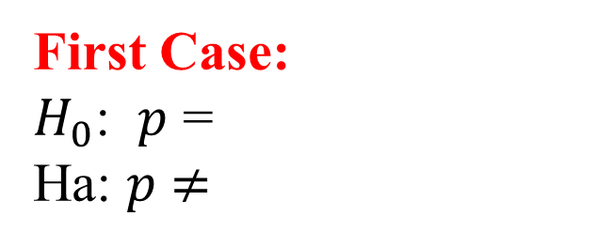


Taking Decision – Graphically
Population Mean Population Proportion
First Case:
$H_{0}$: $μ$ =
Ha: $μ$ $≠$
First Case:
$H_{0}$: $p$ =
Ha: $p$ $≠$
Two Tail Test
Second Case:
$H_{0}$: $μ$ $≤$
Ha: $μ$ $>$
Second Case:
$H_{0}$: $p$ $≤$
Ha: $p$ $>$
Right Tail Test
Third Case:
$H_{0}$: $μ$ $≥$
Ha: $μ$ $<$
Third Case:
$H_{0}$: $p$ $≥$
Ha: $p$ $<$
Left Tail Test
www.midocean.ae

Slide 24
Example: Testing with Rejection Regions ( First way )
Employees in a large accounting firm claim that the mean salary of the firm’s accountants is less than that of its competitor’s, which is $45,000. A random sample of 30 of the firm’s accountants has a mean salary of $43,500 with a standard deviation of $5200. At
α = 0.05, test the employees’ claim.
Note: Critical value = -1.645
www.midocean.ae

Slide 25
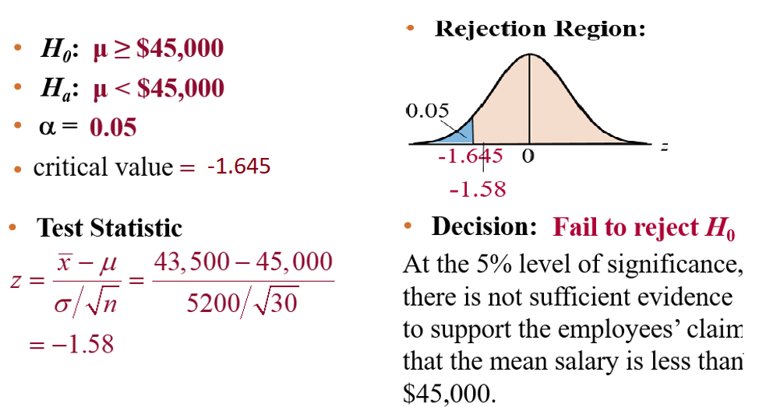
Solution: Testing with Rejection Regions ( First way )
www.midocean.ae

Slide 26
Hypothesis Testing by P-value – Second way
Decision Rule Based on P-value
To use a P-value to make a conclusion in a hypothesis test, compare the P-value with α.
  If P ≤ α, then reject H₀.
  If P > α, then fail to reject H_{0.}
www.midocean.ae

Slide 27
Example: Hypothesis Testing Using P-values
In an advertisement, a pizza shop claims that its mean delivery time is less than 30 minutes. A random selection of 36 delivery times has a sample mean of 28.5 minutes and a standard deviation of 3.5 minutes. Is there enough evidence to support the claim at α = 0.01? Use a P-value. P-value = 0.0051
www.midocean.ae

Slide 28
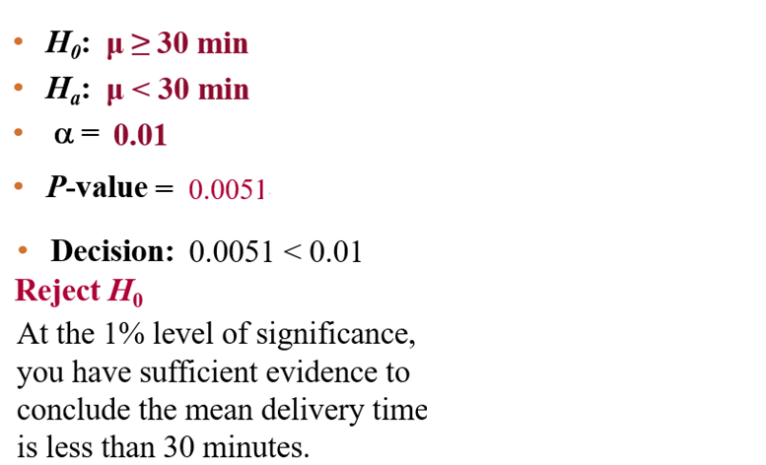
Solution: Hypothesis Testing Using P-values
www.midocean.ae

Slide 29
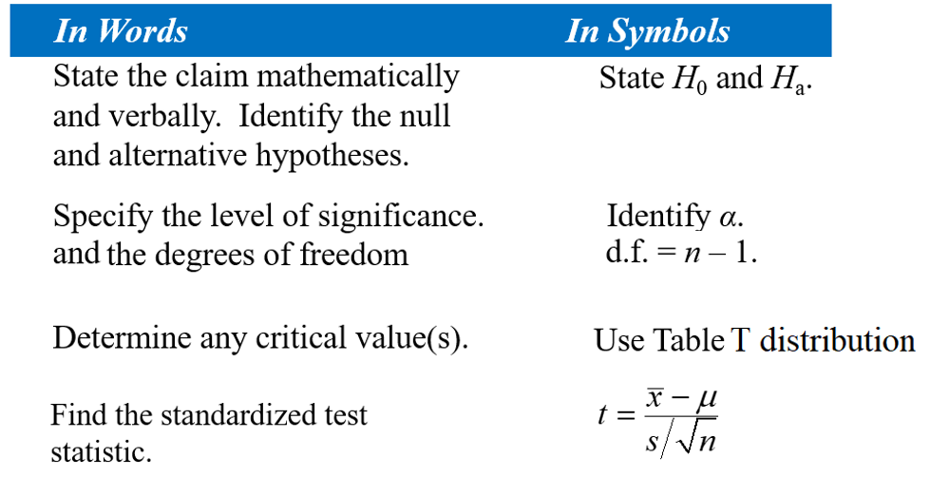
7.3 Hypothesis Testing for the Mean (Small Samples)
www.midocean.ae

Slide 30
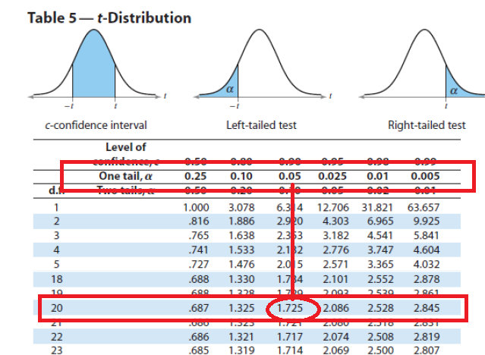
Example: Finding Critical Values for t
Find the critical value t₀ for a left-tailed test
given α = 0.05 and n = 21.
Solution:
The degrees of freedom are d.f. = n – 1 = 21 – 1 = 20.
Look at α = 0.05 in the “One Tail, α” column.
Because the test is left-tailed, the critical value is negative.
0.05
-1.725
0
t
www.midocean.ae

Slide 31
Example: Testing μ with a Small Sample – First Way
A used car dealer says that the mean price of a 2005 Honda Pilot LX is at least $23,900. You suspect this claim is incorrect and find that a random sample of 14 similar vehicles has a mean price of $23,000 and a standard deviation of $1113. Is there enough evidence to reject the dealer’s claim at α = 0.05? Assume the population is normally distributed. (Adapted from Kelley Blue Book)
www.midocean.ae

Slide 32
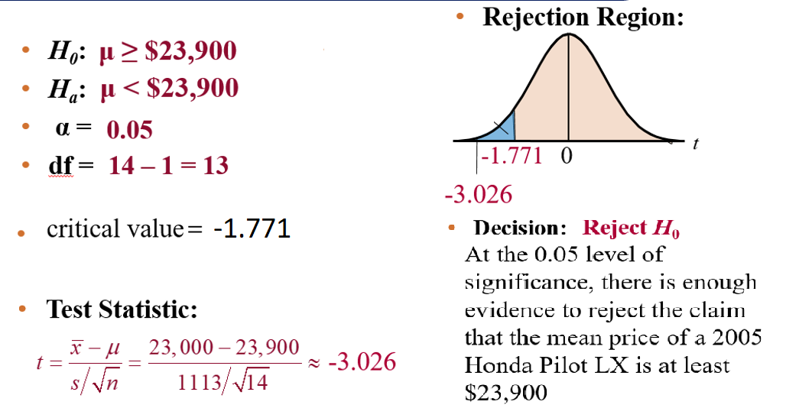
Solution: Testing μ with a Small Sample
www.midocean.ae

Slide 33
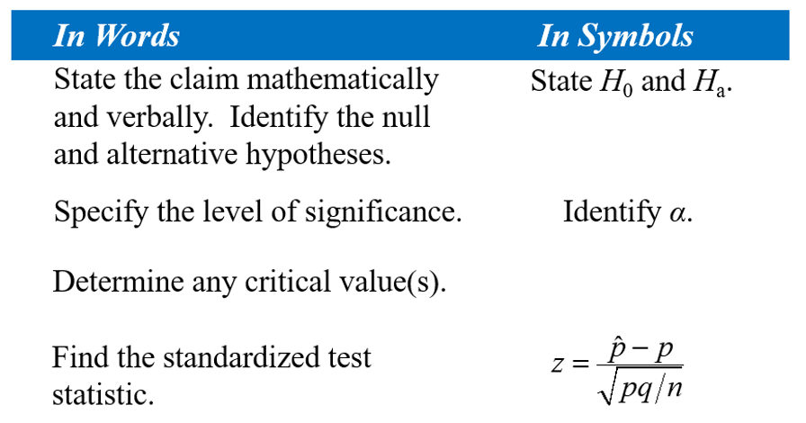
7.4 Hypothesis Testing for the Proportion p
Verify that np ≥ 5 and nq ≥ 5
www.midocean.ae

Slide 34

Example: Hypothesis Test for Proportions
Zogby International claims that 45% of people in the United States support making cigarettes illegal within the next 5 to 10 years. You decide to test this claim and ask a random sample of 200 people in the United States whether they support making cigarettes illegal within the next 5 to 10 years. Of the 200 people, 49% support this law. At α = 0.05 is there enough evidence to reject the claim?
Note: Critical values = -1.96 and 1.96
np = 200(0.45) = 90 and nq = 200(0.55) = 110
www.midocean.ae

Slide 35
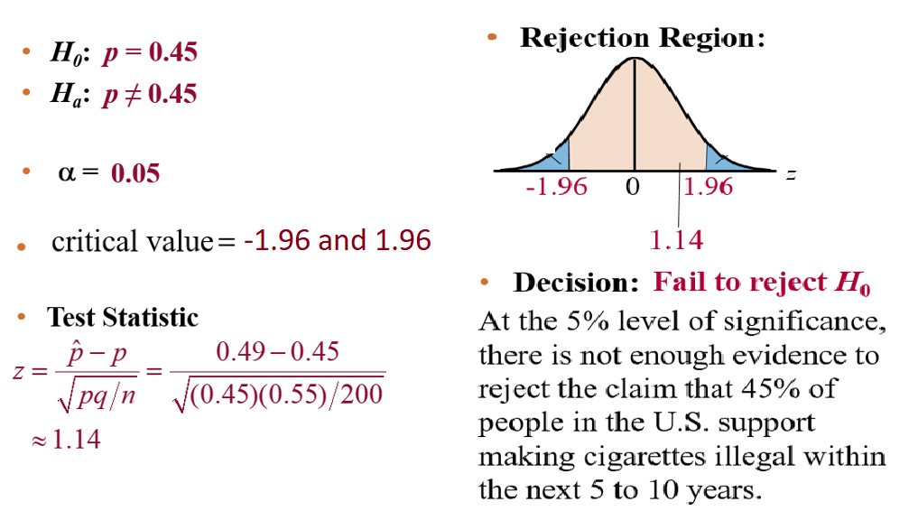
Solution: Hypothesis Test for Proportions
www.midocean.ae

Slide 36
Chapter Summary
7.1 Introduction to Hypothesis Testing
7.2 Hypothesis Testing for the Mean (Large Samples)
7.3 Hypothesis Testing for the Mean (Small Samples)
7.4 Hypothesis Testing for Proportions
www.midocean.ae

Slide 37
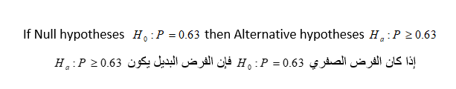
Un Solved Examples
Chapter
www.midocean.ae

Slide 38
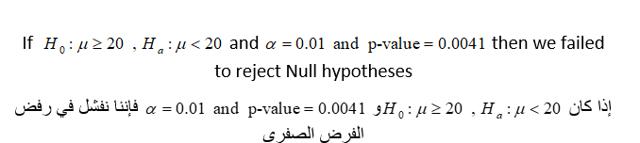
Un Solved Examples
Chapter
www.midocean.ae

Slide 39


Thank You

