Slide 1

Digital Media and Society
Prepared by Dr. Shereen Kedwany
Lecture 4
DGM 711
Introduction to Digital Media

Slide 2

Chapter
04
Reminder
The concept of information society refers to a form of society characterized by the importance of the production and management of information and knowledge.
The ability to produce, manipulate, and distribute information becomes one of the main factors related to wealth and power.
The birth of the information society was described as a third industrial revolution .
The economic system of the information society is characterized by being informational, global, and networked.
In an information society, intellectual property rights are divided in three main types: (copyright, trademarks , patents).
A globalized economy is characterized by multinational companies, which own digital media, and foster the emergence of a global consumer culture .

Slide 3

Chapter
04
Outline
I. The relation between technology and society .
II. Users Matter.
III. Space of flows.
VI. The Global Village
V. Conclusion.

Slide 4
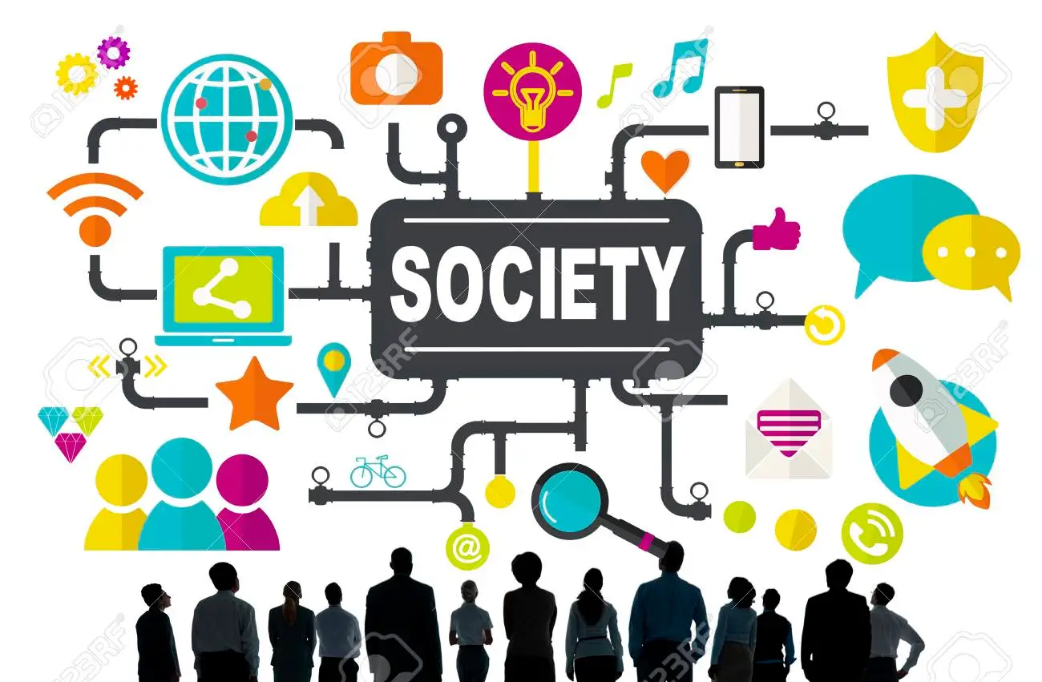
Chapter
04
I. The relation between technology and society
The social sciences, like sociology and anthropology, have developed theories that allow for an in‐depth analysis of the link between technology, media, and society.
These can help us develop a critical view on the role and evolution of digital media.

Slide 5
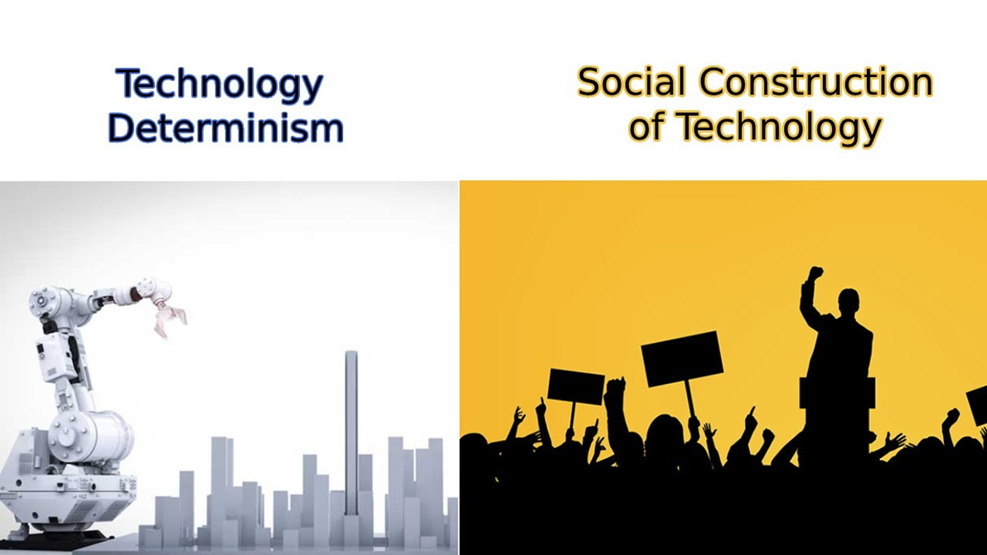
Chapter
04
I. The relation between technology and society

Slide 6
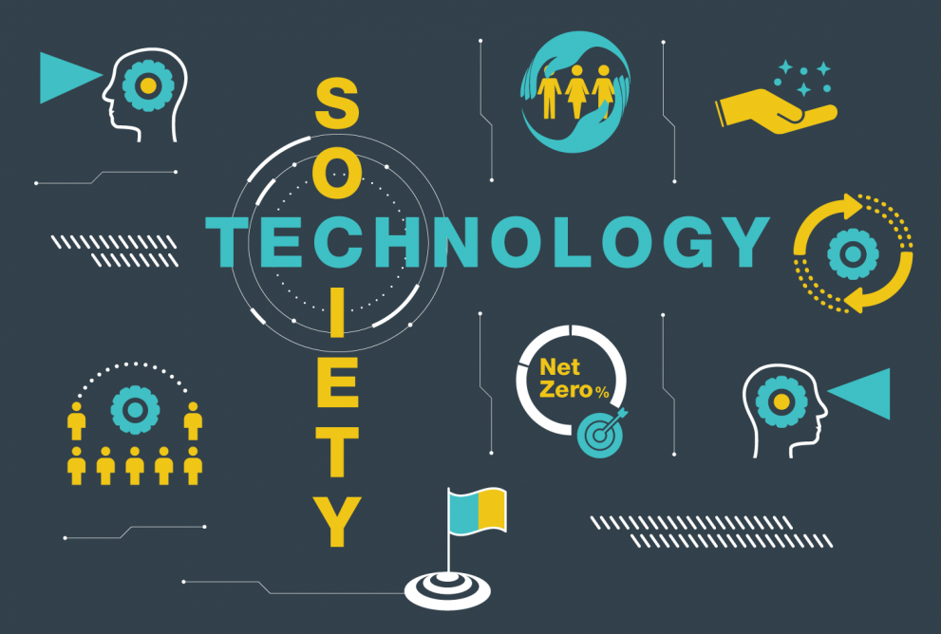
Chapter
04
I. The relation between technology and society
Some theories of the relation between technology and society see technology as an external force that develops independently of social phenomena.
Here the important thing is not so much how a particular technology has developed, but what function it performs in relation to a society.
In this view, computers are functional to the aims of the institutions or social groups that use them.

Slide 7

Chapter
04
I. The relation between technology and society
A similar approach is technological determinism, which understands technology as an independent force that can determine the development of a society.
From this perspective, the characteristics of digital media affect the way in which individuals interact with each other, giving rise to particular forms of social organization.
They are also seen as responsible for changes in economic structures or business models.

Slide 8
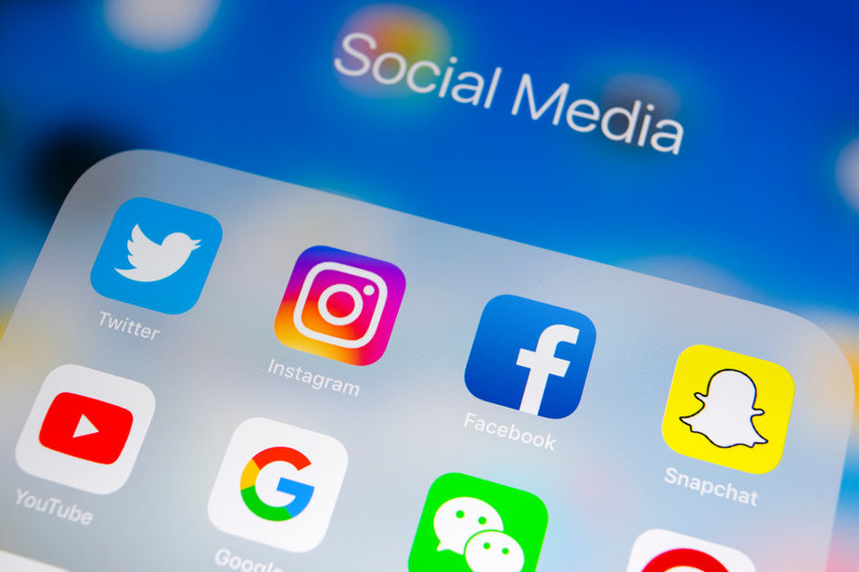
Chapter
04
I. The relation between technology and society
Some form of technological determinism is widespread in common‐sense accounts, such as policy initiatives relating to digital technologies or journalism describing the changes that they bring about.
For example, it has been common for some time to attribute the upheavals to the spread of social media technologies like Facebook and Twitter .

Slide 9
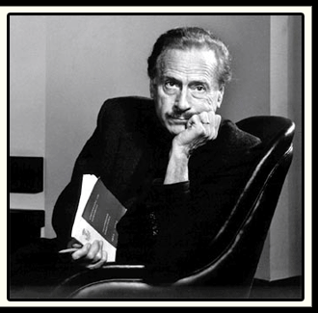

Chapter
04
I. The relation between technology and society
According to Marshall McLuhan, “the medium is the message.”
McLuhan, perhaps the most influential media theorist of the 1960s, thought that the “media form” of communication technologies used in any given society had a decisive impact on its development, regardless of the content of the communications, that is, the message they transmitted.

Slide 10

Chapter
04
I. The relation between technology and society
One of his most famous books, Understanding Media, opens by stating that “the personal and social consequences of any medium result from the new scale that is introduced into our affairs by any new technology”.
To simplify this position, we could say that the most important factor is not what is transmitted on television, but that the technology of television itself has been introduced into people’s life, therefore allowing the transmission of moving image and sound regardless of space and time bounds.

Slide 11
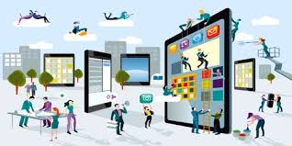
Chapter
04
I. The relation between technology and society
The determinist perspective remains one of the main ways used to interpret the social and economic dimension of digital media.
It would be simplistic to think that new technologies do not have an impact in and by themselves: inventions like the wheel or means of communicating across distances, like the telegraph, have influenced deeply the development of human societies.

Slide 12

Chapter
04
I. The relation between technology and society
However, this view is too one‐dimensional. It does not take adequate account of complexities that mark the relationship between technology and society.
For example, technologies are often used in a different way and for different purposes by different social actors.
The technological determinist approach, however, can be tempered by recognizing that, with their values and choices, individuals and social groups help to determine the role played by technology.

Slide 13
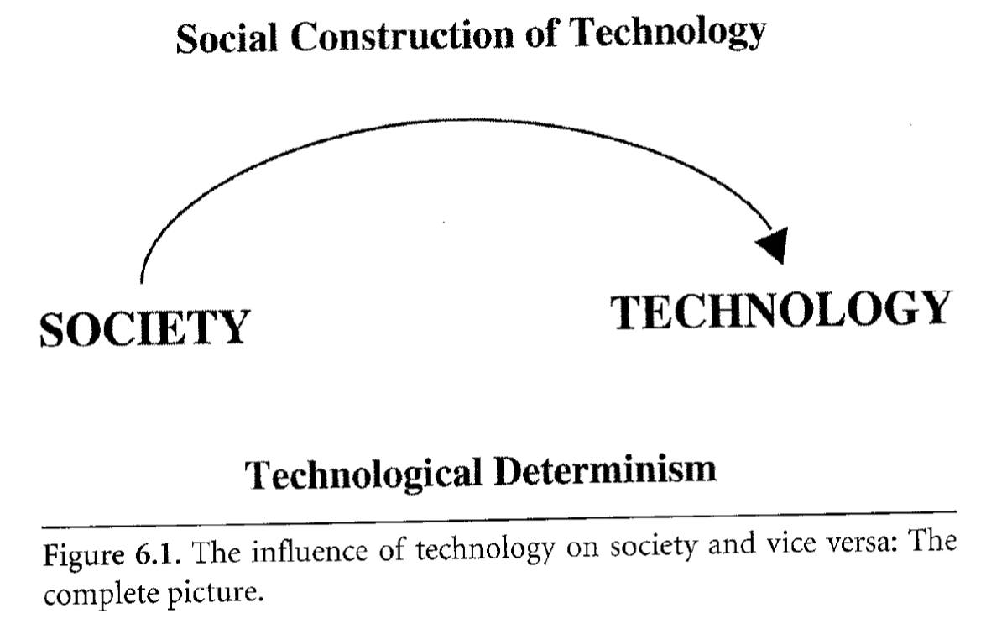
Chapter
04
I. The relation between technology and society
An opposite perspective is social construction of technology.
This theoretical approach suggests that the development, structure, and significance of a technology depends on the strength, needs, and values of the social groups that promote and design it (Bijker 1997).
The evolution of a technology is something in which people participate actively.

Slide 14

Chapter
04
I. The relation between technology and society
This approach emphasizes how the design and meaning of technologies depend on the social processes by which their development is shaped.
According to this perspective, the open and distributed architecture of the internet is not emerging from a vacuum, but rather due to the values and choices of the scientists and engineers who have designed its network structure and standards.

Slide 15


Chapter
04
I. The relation between technology and society
Indeed, according to the definition of Science and Technology Studies theorist Langdon Winner (1980), technologies are not neutral but rather have a “politics.”
The way they are designed or the decision to adopt them in different contexts might strengthen the agenda of a particular group.
This approach leads to the question of what are the actors who have contributed to its development and evolution of a certain technology , and why it has been chosen over competitive technologies.

Slide 16

Chapter
04
I. The relation between technology and society
Others have focused on the “bias” that certain actors can build into a certain technological system (Friedman and Nissembaum 1997).
For example, as the values of the engineers who design an algorithm play a role in their technical choices, this algorithm can reflect such values by favoring or discriminating against certain individuals or groups .

Slide 17

Chapter
04
I. The relation between technology and society
Similar approaches also recognize the active role of users of technologies.
Often early adopters or new users of a new technology develop practices that were never intended by the people who designed and commercialized it or assign new meanings to a certain technology and thus contribute to shaping it.

Slide 18
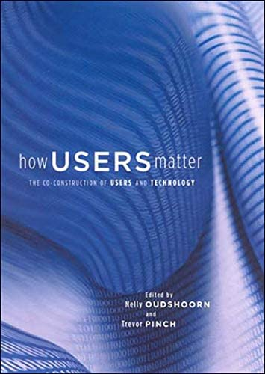


Chapter
04
II. Users Matter
In studies of the relation between technology and society, the user is a crucial object of research.
Indeed, the user represents the human factor interacting with the machine, and must not be overlooked: “users matter,” to use the title of one of the most important books on the subject (Oudshoorn and Pinch 2003).
In this perspective, consumption is a complex cultural activity not only related to purchasing, but also to how users repurpose, modify, and resist technology.

Slide 19

Chapter
04
II. Users Matter
On the one hand, the design of technologies has the power to “configure” users (Woolgar 1990).
For example, the lack of interoperability of the software and standards of an Apple laptop pushes its users to interact only with gadgets and services commercialized by the same company, such as iPhones, iPads, or iTunes.
This constrains and guides the user’s online behavior.

Slide 20

Chapter
04
II. Users Matter
In turn, users are not just passively configured by technologies, and can contribute to shaping digital media in ways that often go beyond those imagined by those who designed and programmed a specific platform.
One example of this is the practice of jailbreaking, that is, the removal of limitations built into a computer system, for example Apple’s iOS operating system that runs Apple products.
Thanks to software tools that provide access to the operating system, these practices allow users to install applications that are not officially provided by the manufacturer .

Slide 21

Chapter
04
II. Users Matter
Users’ power to reconfigure digital media also has to do with the degree to which technologies are open to transformative interventions.
Technologies are indeed marked by different levels of openness .
They can be designed to be accessible and easily transformable or may have blocks or obstacles that prevent users from changing a system or using it for unintended purposes, as is the case with Apple products.

Slide 22

Chapter
04
II. Users Matter
Scholars have also noted the existence of “superusers” with specific technical skills and professional positions.
In the case of digital media, these would be figures such as software engineers, system administrators (sys‐admins), or hackers (Brunton and Coleman 2014).
As they design and maintain digital networks and algorithms, these users occupy a privileged position.
Their cultures and practices are thus particularly interesting for the study of digital technologies.

Slide 23


Chapter
04
II. Users Matter
For example, sociologists use the term affordances, borrowed from design and engineering, to describe how technologies both enable and limit what users can do with them.
As Donald Norman put it, “affordances specify the range of possible activities” (1999)..

Slide 24

Chapter
04
II. Users Matter
New technologies can provide solutions and enable new forms of action, but at the same time this is only possible within the boundaries of the technology itself.
Platforms like Twitter softwares are enabling technologies that allow users to create certain types of actions within specific limits.
Twitter allows temporary publics to join an event and follow and comment on it. But at the same time this needs to be done within a format of messages that does not exceed a certain number of characters.
This way, Twitter drives users to follow an established pattern that derives from the constraints imposed by the platform.

Slide 25
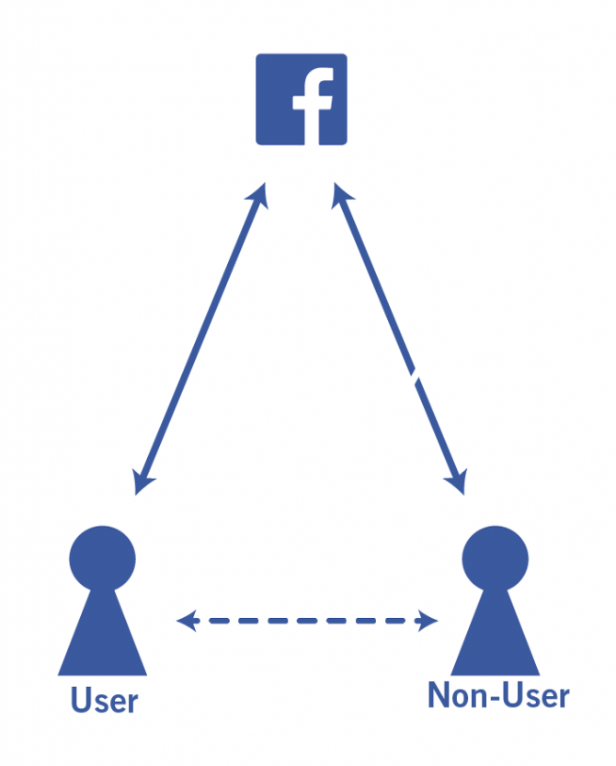
Chapter
04
II. Users Matter
Finally, non‐users also matter: the individuals who resist or reject technologies tend to be invisible to scholars who study digital media, but their motivations and choices can shed light on the relation between technology and society .
For example, deciding not to participate in social media communication can be a form of resistance to the widespread corporate surveillance carried on within such platforms .

Slide 26

Chapter
04
II. Users Matter
Finally, some social theories speak of the co‐production of technology and society.
In this framework, both the above perspectives, which state that social forces shape technologies or that technologies determine social development, are seen as limited.
Rather, society and technology influence and shape each other in a process of coevolution where one level continuously influences the development of the other.
These, and other, theoretical approaches are updated and adapted to the study of digital media and their specific characteristics.

Slide 27


Chapter
04
III. Space of flows
According to Castells, as a result of their importance in the world of economic production, networks have become dominant also in the social dimension.
He described a “space of flows” composed of the spaces, both physical and mediated, where information, money, and people circulate.
This space is configured as an open network, in which national borders and boundaries among organizations, communities, and groups are becoming less important.

Slide 28

Chapter
04
III. Space of flows
In this space, a growing part of wealth is created through exchanges among people from different countries, organizations, or communities.
Therefore, individuals who have access to the space of flows are the ones who possess the skills necessary to efficiently and productively exchange information or move freely in different places, or between one organization and another.
These people can collaborate regardless of factors such as their ethnic or religious identity.

Slide 29

Chapter
04
III. Space of flows
At the other end of the spectrum, individuals who remain cut off from the space of flows do not have access to the internet or other channels that underpin flows of information and money, such as the financial market or transnational labor markets.
They do not belong to the new class of knowledge workers who have a university education, are familiar with digital media, and have a cosmopolitan mindset based on a globalized consumer culture.

Slide 30

Chapter
04
III. Space of flows
For Castells, in information societies the main split is no longer linked only to the conflict between capital and workers, but rather expands to conflicts between those who have access to flows and those who are excluded from them.
The latter tend to counteract the globalized culture of the space of flows by reinforcing their ethnic or cultural identities, which can become modes of resistance and opposition.
Castells' examples of identity‐based reactions to globalization were US far‐right movements, and Islamic fundamentalism.

Slide 31

Chapter
04
III. Space of flows
On the contrary, in the space of flows that dominate and drive the information society, conflicts are dampened, and individuals compete freely for a success (or failure) which depends mainly on their ability to succeed as entrepreneurs.

Slide 32

Chapter
04
VI. The Global Village
The Canadian media theorist Marshall McLuhan was one of the proponents of the role of new media as instruments of this kind of deep social change.
According to McLuhan, electronic media were destined to transform humanity into a “global village,” by the ability to communicate in real time at a great distance provided by new media.
Forms of face‐to‐face relationships that are typical of traditional societies would extend on a global scale.

Slide 33


Chapter
04
VI. The Global Village
McLuhan advocated the liberation from centralized and bureaucratic societies , the differences between rich and poor countries, and the birth of a “global community” .
Yet his view was too nuanced to be described simply as utopian.

Slide 34

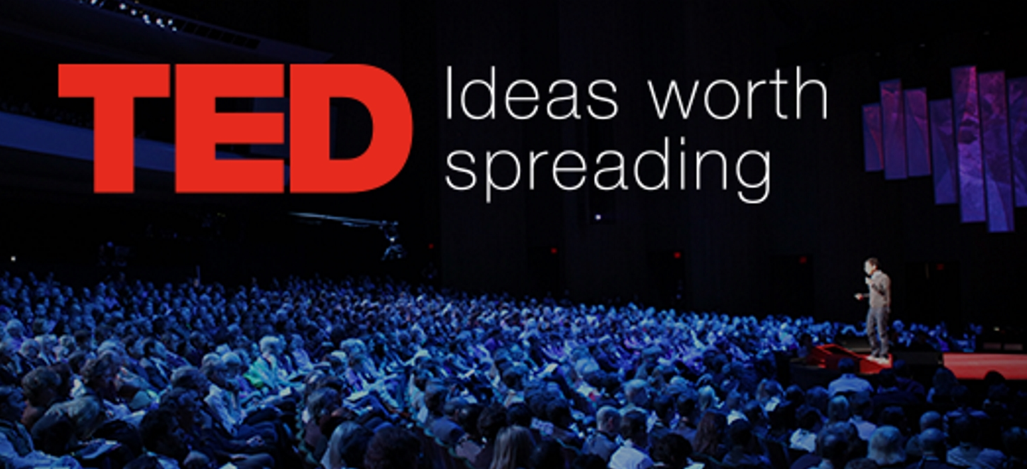
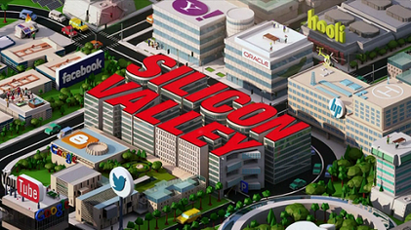
Chapter
04
VI. The Global Village
A group of opinion leaders such as Kevin Kelly, Nicholas Negroponte, Stewart Brand, and Chris Anderson gathered around the magazine Wired, founded in 1993, and events such as TED conferences (Technology, Entertainment, and Design).
They began to articulate a vision that derived from the culture that was already widespread within the entrepreneurial circles of Silicon Valley, located south of San Francisco in California.

Slide 35

Chapter
04
VI. The Global Village
They were painting digital networks as technologies that allow the spatial and bureaucratic barriers that characterize nation‐states to be transcended .
In this vision, the individual is a consumer or an entrepreneur who lives in a space and market freed from the influence of the state.

Slide 36
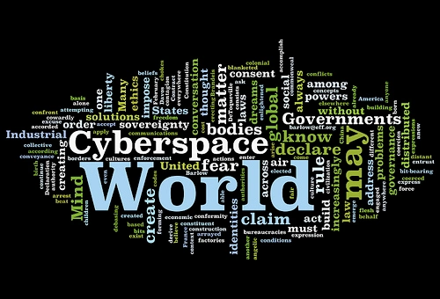
Chapter
04
VI. The Global Village
For example, in 1996 the influential manifesto A Declaration of the Independence of Cyberspace described digital networks as free from government control and censorship: “We are creating a world where anyone, anywhere may express his or her beliefs, no matter how singular, without fear of being coerced into silence or conformity” .

Slide 37
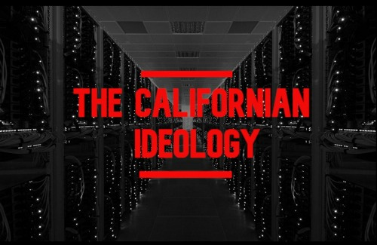
Chapter
04
VI. The Global Village
This wave of techno‐libertarianism was later summarized in the formula “Californian Ideology,” a denunciation of the view that the spread of the internet will lead to widespread access to knowledge and information and thus erase differences between consumers and producers, workers and employers, and state and citizens.

Slide 38
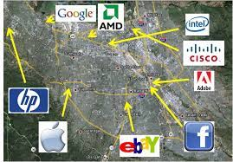
Chapter
04
VI. The Global Village
This formula has been used to criticize the idea, widespread in Silicon Valley capitalism, according to which the free flow of information will bring about political democratization, while an economy based on hi‐tech companies will open new possibilities for enrichment for those with the necessary flexibility and entrepreneurial spirit .

Slide 39

Chapter
04
VI. The Global Village
Although the concept of a Californian Ideology seemed to exacerbate the internet’s liberating potential, it also allowed the importance of radical movements and ideas in the development of the digital economy to be grasped.
One can focus on how specific groups linked to the evolution of digital media have been crucial actors in the evolution of contemporary digital technologies while infusing them with their political ideas.
For example, by intervening in designing and repurposing computers and networks hacker communities can intervene in and redefine the political sphere.

Slide 40

Chapter
04
VI. The Global Village
The very informational capitalism described by Castells has been said to be based on cultural foundations that are quite different from those of industrial capitalism.

Slide 41

Chapter
04
V. Conclusion
Technological determinism approach understands technology as an independent force that can determine the development of a society.
The social construction of technology approach suggests that the development, structure, and significance of a technology depends on the strength, needs, and values of the social groups that promote and design it.
Technologies are not neutral but rather have a “politics.”
Similar approaches also recognize the active role of users of technologies repurpose, modify, and resist technology.
Scholars have also noted the existence of “superusers” with specific technical skills and professional positions.
Electronic media were destined to transform humanity into a “global village”.

Slide 42
Thank you for listening
DGM 711
Introduction to Digital Media

