Slide 1
The 7th Lecture :
HPMQC
The Efficiency of the “Resultant deliverables” with PVA

Slide 2





Welcome to the professional quality track!
BASED ON THE HPMQA
Building the project's efficiency
Adding new role
Planning HPMQC activities
The role of the HPMQA at the design quality system and build quality system
-the relationship between the HPMQA and the GCOQ(good cost of quality )
What is the relationship between the HPMQC and the PVA??

Slide 3

Lecture outline
1st section contents :
The HPMQC base line
Identifying the Performing the HPMQC process and procedures :
2nd section contents :
The role of the HPMQC with the HPMQA
3rd section contents :
The impact of HPMQC corrective action during the execution phase with the preventive cost
The impact of HPMQC corrective action after the execution phase with the appraisal cost

Slide 4
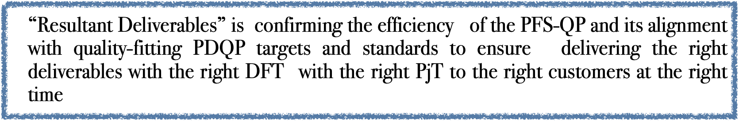
HPMCP
HPMQC comprehensive validation process helps :
1-builds trust and confidence among stakeholders, as it
2-demonstrates a commitment to delivering high-quality and accurate results by alignment with the PFS_QP and PDQP.
3-can minimize the risk of errors or inconsistencies in the final deliverables, ultimately leading to successful project outcomes and deliver the “Resultant Deliverables”
4- focusing on stakeholder satisfaction

Slide 5
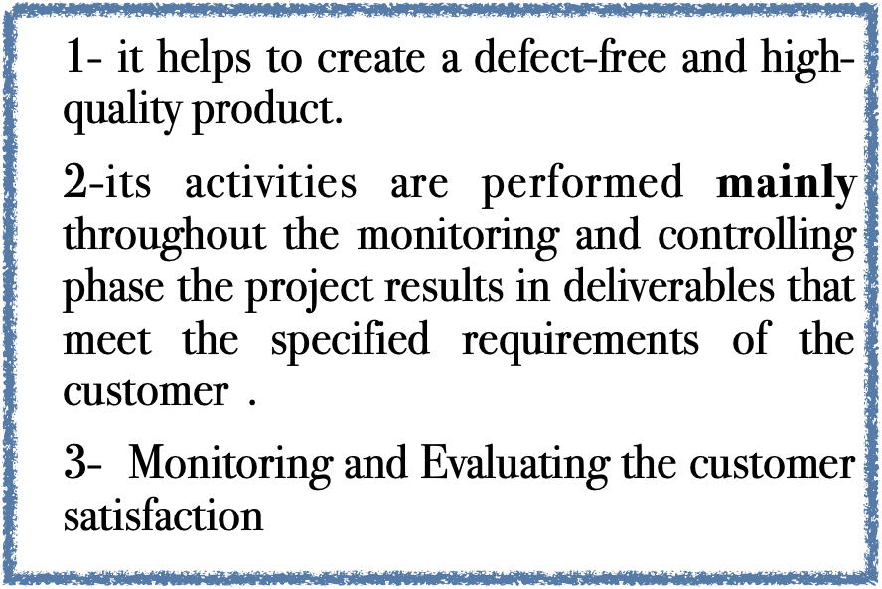
Is having a resultant deliverables

Slide 6
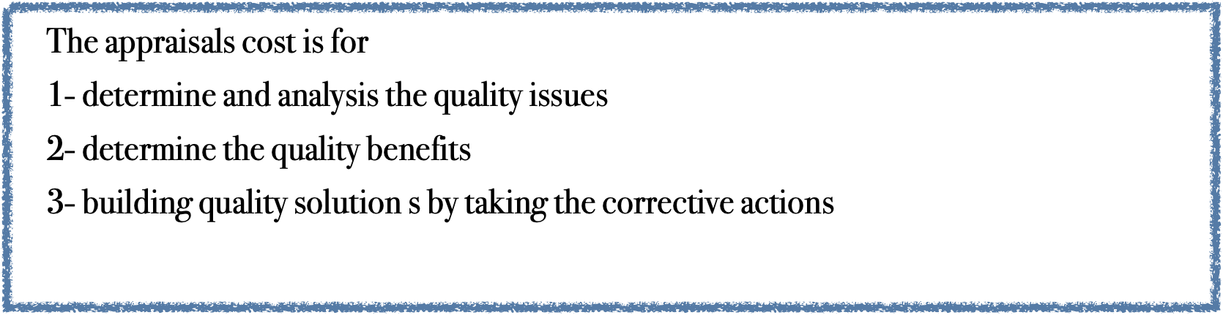
The appraisal costs

Slide 7


Slide 8
1- The Role of HPMQC during the execution phase with the preventive cost

Slide 9
Minimizing the rework
If there is to be rework, focus on finding it as early in the life cycle as possible.
-Remember that errors in the analysis will generate into errors in design and errors in construction. If you don't find the errors until the execution Phase, there might be rework required throughout the life cycle .

Slide 10
The role of the HPMQC during the execution phase
(PjT with the project procurement management )
During the Milestones and Phase reviews
1-This comprehensive validation process helps to identify any potential errors or discrepancies, allowing for necessary adjustments and improvements to be made before the deliverables are finalized.
2-Additionally, it ensures that the deliverables are aligned with the project's quality objectives and can effectively meet the needs and expectations of stakeholders.

Slide 11
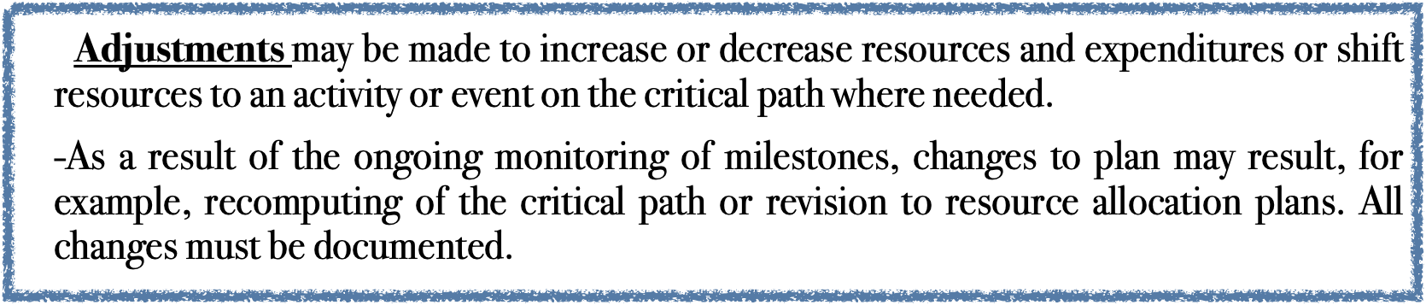
3-Confirm Performance Milestones Reached
The first step in managing a supplier's performance is to identify the contract milestones that trigger a formal performance review.
Each time a milestone is reached, a formal review is initiated to assess the supplier's overall level of performance against the terms of the contract.

Slide 12
4-Phase Reviews
review the progress of the project to date and determine whether the project has met its stated objectives. By assessing the deliverables produced by the project to date, the Project Board determine whether the project is "on track" and ready to progress to the next phase within the project lifecycle.

Slide 13
2- The role of HPMQC after the execution phase with the appraisal cost

Slide 14
is to conduct a thorough review of the quality of the executed deliverables . This review will help identify any discrepancies or unexpected costs that may have occurred during the production process.
Additionally, it is important to analyze the quality of the deliverables and assess if any rework or improvements are necessary, as this can also impact the overall cost appraisal.
Additionally, it may be necessary to identify any areas where cost overruns occurred and implement measures to prevent similar issues in future projects.

Slide 15
The reviewing process of each executed deliverable,
1-For each executed deliverable, the HPMQC Review shall evaluate major components or subsystems as necessary to establish acceptable workmanship.
2- Each HPMQC report will be a separate Deliverable with all applicable quality checklists completed and attached.
3-HMPQA shall conduct scheduled QC reviews by following thePDQP, and the approved Quality Standards, and Quality Checklists.
4- PDQP Quality Standards, and Quality Checklists will indicate the type of review expected, e.g. data analysis, schedule analysis, standards or process conformance analysis, and additional analysis based on subject matter expertise.
5-The completed checklists will be provided with the QC Deliverables and shall become input to the Quarterly QA Status and Improvements Report ,Project Assessment Report, and the Project Budget & Schedule Variance Report

Slide 16
the HPMQC and the PCOQ
(Keeping the quality issues )

Slide 17
Appraisal costs are those associated with any activity meant to ensure high levels of quality across a process or organization. If a manufacturing plant hires a quality control specialist, and that person’s job is to review parts that come down the manufacturing line and either return the work for correction or report the level of quality as a metric, then the salary of that person and any expenses related to his or her employment are appraisal costs.

Slide 18
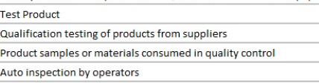
Appraisal(evaluation) Costs
Appraisal costs are those associated with any activity meant to ensure high levels of quality across a process or organization. If a manufacturing plant hires a quality control specialist, and that person’s job is to review parts that come down the production process and either return the work for correction or report the level of quality, then the salary of that person and any expenses related to his or her employment are appraisal costs.
In some cases, those expenses might also be considered prevention costs, but they would not be counted twice when calculating CoQ.

Slide 19
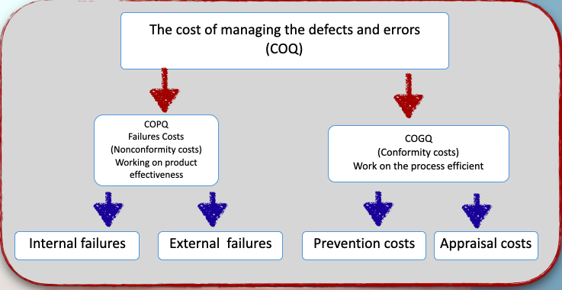

Quality cost is a HPMQC success factor
Not taking the right corrective action

Slide 20
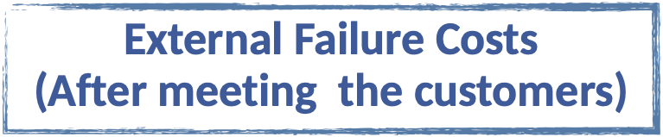
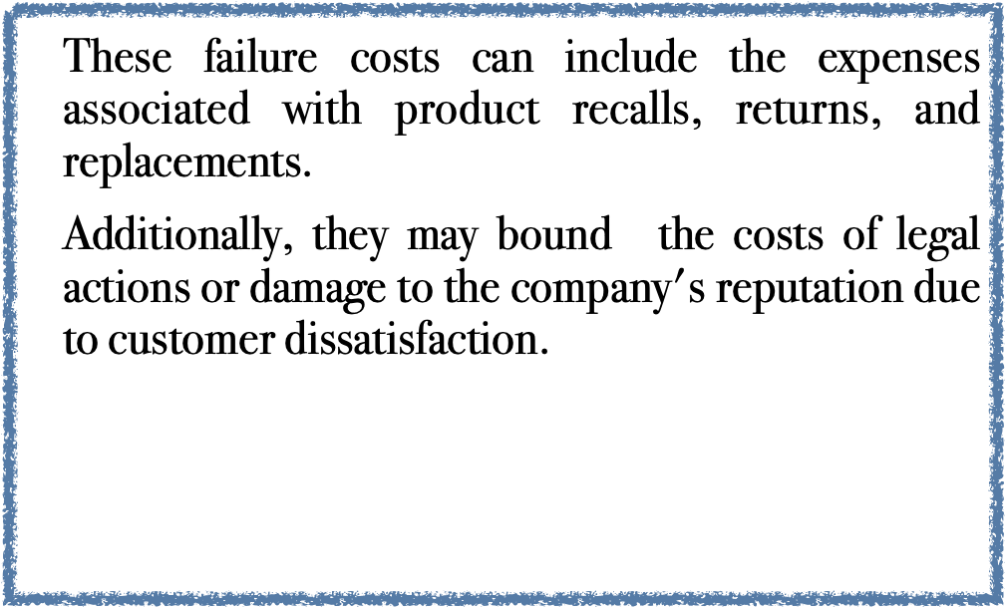
Internal Failure Costs
(Before dealing with the customers)
These costs can include not only the direct expenses associated with redoing the work or making modifications, but also the indirect costs such as lost productivity, wasted materials, and potential damage to the company's reputation.
It is crucial for project to minimize rework costs by ensuring proper planning, effective communication, and thorough quality control measures throughout the project lifecycle.

Slide 21

Examples of the (failure costs ) cost of poor quality-include:
Warranty work. This includes work that is performed on a product or application for free (or a reduced price) under a warranty.
Repairs / maintenance. This is work that is done to fix problems after the solution goes live.
Client dissatisfaction. If a solution is of poor quality, the client will not be happy and may not buy from you again at a later date. If the project is internal, the client may not want to use the project manager and team members on subsequent projects.

Slide 22
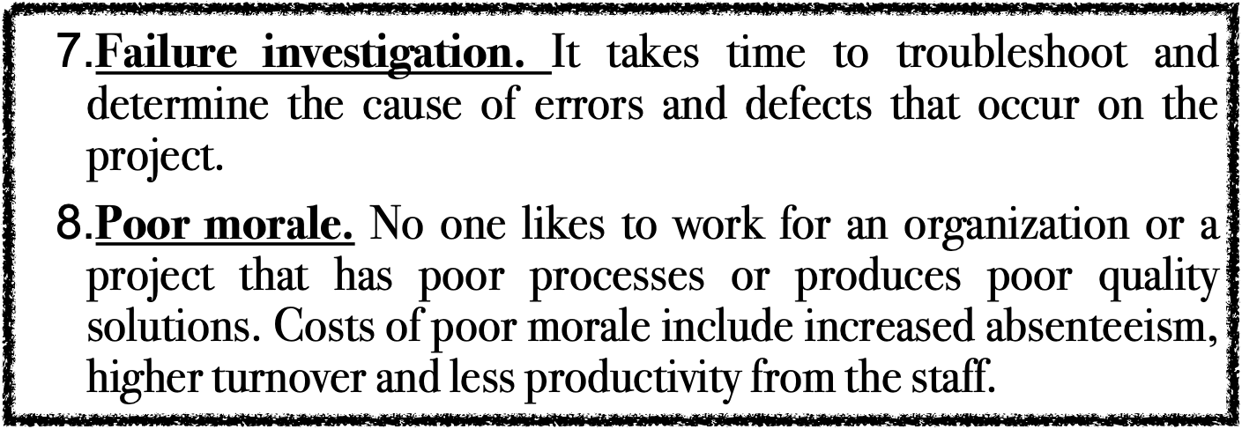
Support staff. Much of the effort and cost associated with a support staff is needed to maintain and support a solution because of problems, errors, questions, etc.
Rework. This is work that is required to fix deliverables that you thought were already complete and correct.
Bad decisions. If there are errors in your systems you will end up making decisions based on bad information.

Slide 23
Uncontrolled changes
Uncontrolled changes in the project are often referred to as process creep, scope creep, effort creep, or cost creep.

Slide 24
The process of the HPMQC

Slide 25
1-Discovering The quality issues

Slide 26
1-assessing the deliverables produced
By assessing the deliverables produced by the project to date, the Project Board determines whether the project is "on track" and ready to progress to the next phase within the project lifecycle or not. So we need to determine the targets very carefully as follows :
1- Monitoring the performance of the PFS outcomes and controlling their changes.
2-Controlling the project quality plan ensures that all requested changes and recommending corrective actions on the deliverable outcomes
3-Managing the actual changes of the quality process that is related to outcomes when they occur and are integrated with the other control processes.

Slide 27

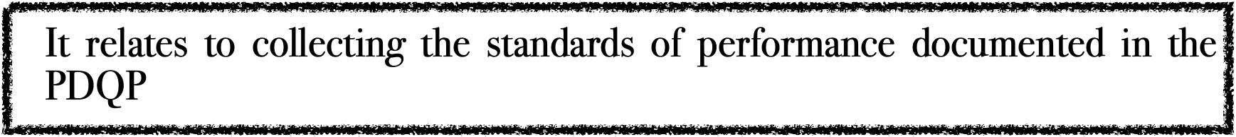

Slide 28
3- Plan and collect the right DATA
Planing and Collecting Appropriate Data on the chosen “Control subject”— through inspection and testing in order to determine the actual performance of the execution process at the mentioned critical milestones or the quality level of characteristics of its outcomes.

Slide 29
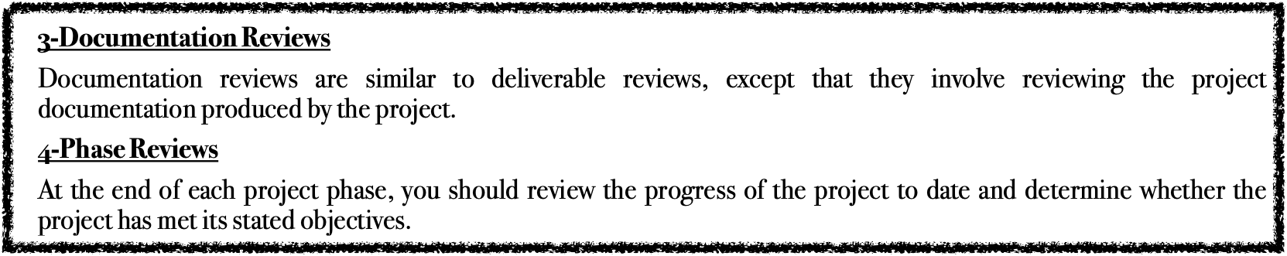
The TECH. of the HPMQC
1-Peer Reviews
Asking team members to review each other's deliverables to control the level of quality achieved by the project. Peer Reviews will also allow you to identify any quality issues early in the Execution phase of the project.
2-Deliverable Reviews
You can plan and perform formal reviews of deliverables across the project to increase your likelihood of meeting the Quality Targets.

Slide 30

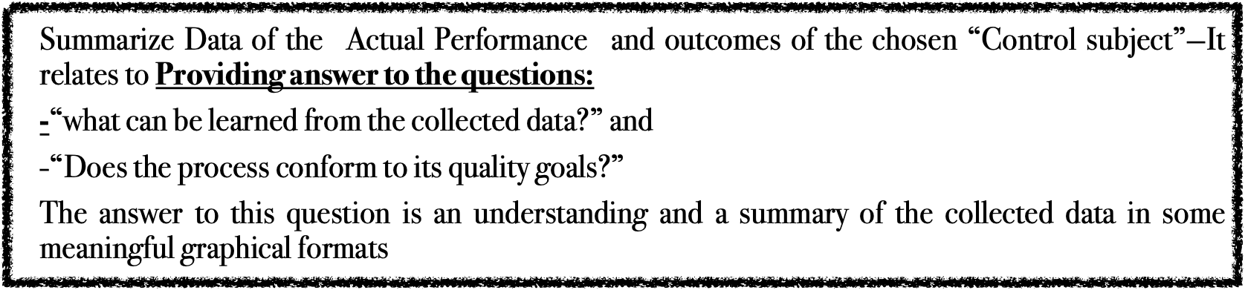

Slide 31
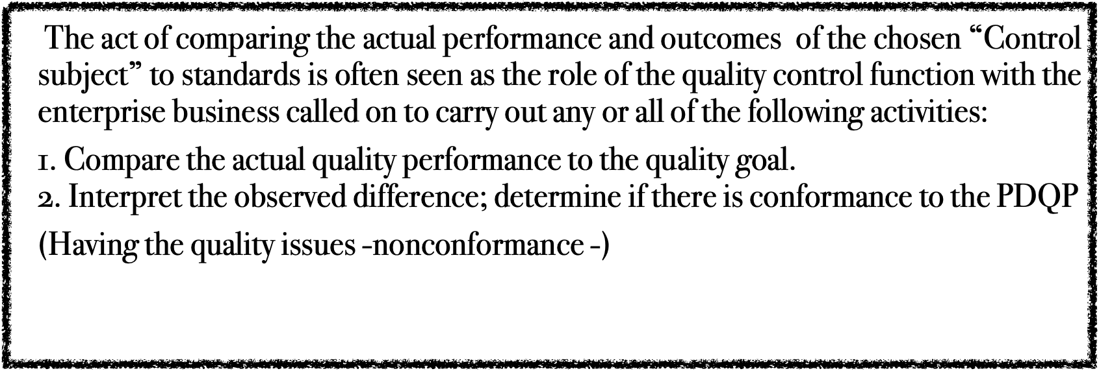
5- Compare Actual Performance and outcomes to original quality Standards

Slide 32
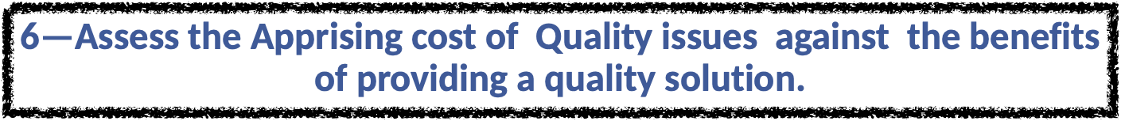

Slide 33

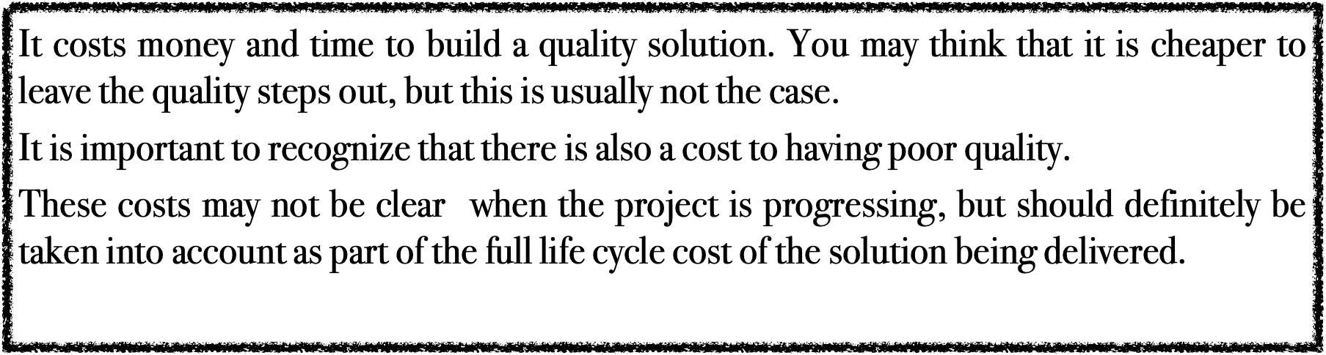
Whereas many of the costs of quality show up in the project, life cycle of the solution. The benefits of quality may include:

Slide 34
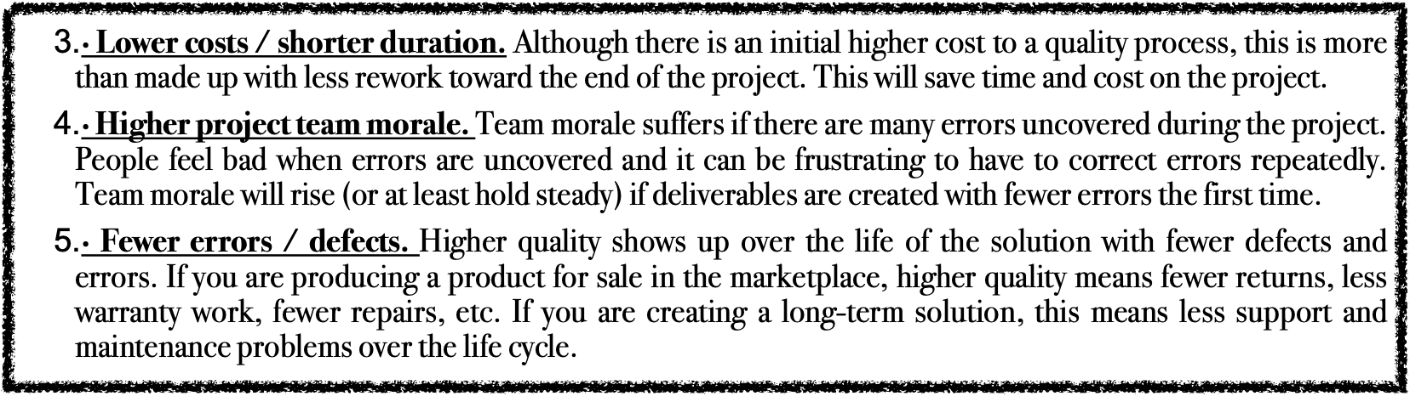
· Increased client satisfaction. Fewer defects mean that the client will be more satisfied. Higher service quality will also make the client experience much more pleasant. If you are in a “for-profit” business, this will result in goodwill and may translate into additional sales, or higher margins on future products.
·Higher productivity. Fixing errors and reworking previously-completed deliverables are a drain on productivity. In fact, they contribute to negative productivity.
If the deliverables are produced with higher quality and less rework, the overall project productivity will go up.

Slide 35
7— initiate change requests
The outcome of the HPMQA and HPMQC actions is a set of quality results. These results describe the overall status of the project as well as the current quality level of the deliverables produced by the project (
1-The PDQP Manager reviews the results and determines whether any actions are required to correct quality issues. If any change to the project is required, then the PDQP Manager completes a Change Request Form and forwards it to the Project Manager for approval, along with the list of corrective actions.
2-Recommended and alternative correction actions plans, with options identified, presented for each identified risk to prevent and/or reduce potential for the risk occurring or the danger escalating

Slide 36

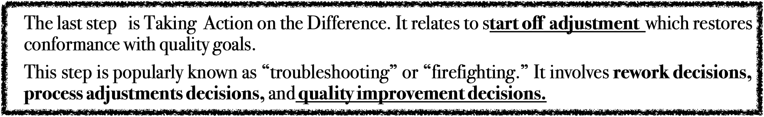
The corrective action is taken when a non-conformance is detected, aiming to heal the issue and prevent its recurrence. This may involve HPMQA which is analyzing the root cause, implementing necessary changes, and conducting follow-up checks to verify the effectiveness of the corrective measures.
Additionally, preventive costs refer to investments made upfront to avoid potential quality issues .

Slide 37

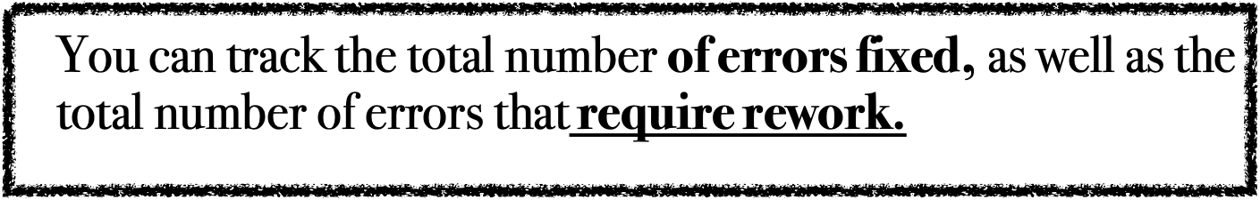
9—Tracking rework
You can track rework to determine how much of your project time is spent “thrashing” or working on the same problems twice.

Slide 38
Causing of rework.
-you may find that the change does not work to fix the problem adequately, will cause rework.
-You may also find that the fix of one change may break something else. This second, unintended error will cause rework as well.

Slide 39
10—Validate Control Subject
It relates to acceptance decisions from the quality control results, which will indicate how well the chosen “Control subject” has achieved quality assurance specifications and project quality objectives and customer acceptance criteria

Slide 40
Output
Having resultant deliverables that are validated with the PFS -QP and quality-fitted with the PDQP ensures that the final output meets the desired standards and specifications of the customers requirements

Slide 41


