Slide 1
AI-Powered Behavioral Data-Based Prediction of Childhood Depression

Slide 2
The Master’s Thesis
AI-Powered Behavioral Data-Based Prediction of Childhood Depression
Introduced by: Ahmed Eid Alrehely
ORCID: 0009-0003-3951-3305; student ID: 243000206; email address: 243000206@st.midocean.edu.km
Dr. Amjed Qataish, supervisor; ORCID: 0000-0001-5210-7086; amjadqtaish@midocean.edu.km
Midocean University's College of Informatics (UAE/Comoros)
2025

Slide 3
Acknowledgment
I would like to thank Dr. Amjed Qataish for all of his assistance, counsel, and perceptive remarks regarding this thesis.
I want to thank my family, friends, and wife in particular for their unfailing support.
Their trust and drive were essential to completing this investigation.

Slide 4
Abstract (1/2)
Problem: Depression in children is frequently discovered after the fact.
Goal: Use AI and behavioral data to predict depression risk early.
The DASS-21, MHP (Stress, Anxiety, Depression), and Kaggle Student Depression Dataset are among the datasets.
Preprocessing includes cleaning, encoding, imputation, and normalizing.
Models: Neural networks and traditional machine

Slide 5
Table of Contents
Chapter 1: Introduction
Chapter 2: Background and Literature Review
Chapter 3: Related Work
Chapter 4: Proposed Methodology
Chapter 5: Experimental Results and Discussion
Chapter 6: Conclusion and Future Work

Slide 6
Chapter 1: Introduction
Due to the lack of early symptoms in traditional diagnosis, childhood depression, which affects 2–8% of children globally, is frequently discovered later. However, AI allows for earlier detection through subtle behavioral signals

Slide 7
Problem Description, Thesis Contribution, and Project Objective 1/2
Definition of the Problem
Late-stage symptoms are used to make the diagnosis.
Prediction based on early behavior is necessary.
Complex patterns are captured by neural networks (LSTM, Transformer).
Data scarcity, low transparency, and multimodal integration are challenges.
Contribution to the Thesis
created models for GRU, LSTM, and Transformer.
the emphasis on predicting the risk of depression early on.
Explainable AI that is integrated (SHAP, Attention).
merged several real-world datasets.
created an end-to-end AI system that is repeatable.

Slide 8
Problem Description, Thesis Contribution, and Project Objective 2/2
The project's goal
Create an AI-powered system that uses behavioral and psychological data to predict childhood depression early.
Goals
High accuracy of predictions
Interpretable results
Scalable in many situations and datasets
Formulation of Problems
Technical Objects
Primarily: predicted by a REGRESSION task
Secondary: classification for clinical interpretation

Slide 9
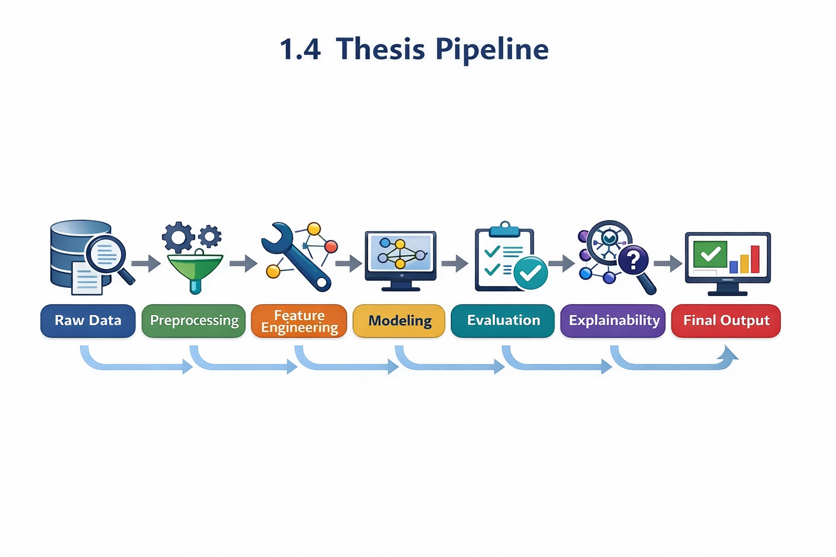
1.4 Thesis Pipeline

Slide 10
Chapter 2 Overview
By examining behavioral patterns, AI systems make it possible to identify childhood depression early.
Complex temporal behaviors are captured by sophisticated models (LSTM, Transformer, hybrid architectures).
Important behavioral extracted indicators consist of:
Unstable emotions
Disengagement from society
Unusual sleep habits
Clinical adoption and trust are increased by explainable AI.

Slide 11
2.1 Models and Learning Approaches
Traditional Machine Learning
Naïve Bayes, Random Forest, SVM, KNN, and Decision Trees
Strengths: Easy to understand and straightforward
Limitations: Inadequate multimodal support and poor temporal modeling
Models of Deep Learning
Sequential behavioral patterns with LSTM
Transformers for intricate multimodal information
In terms of accuracy and pattern identification, deep learning performs better than standard machine learning.

Slide 12
2.2 Datasets and Preprocessing
Used Datasets
Kaggle's Student Depression Dataset
DASS-21 Mental Health Dataset MHP Stress, Anxiety, and Depression Dataset
Pipeline for Preprocessing
Cleaning and imputation of data
Normalization and encoding
SMOTE for unequal class distribution

Slide 13
CHAPTER 3 — RELATED WORK
Important studies on deep learning and machine learning models for depression prediction are reviewed in this chapter.

Slide 14
3.1 Related Work (Summary)
64–85% accuracy in classical machine learning
88–93% accuracy in deep learning
CNNs, LSTM, and Transformers are the best models.
Weak explainability is a limitation.

Slide 15
Summary of Literature Review Findings
Key Insights
While traditional machine learning is still useful for simpler and structured datasets, deep learning models consistently attain the highest accuracy in depression identification. Prominent designs that perform better include Graph Transformers (~93%), CNNs (~91%), and HAN models (~90%). A strong and dependable framework for depression identification is produced by fusing the interpretability of machine learning with the predictive capability of deep learning.

Slide 16
Summary of Literature
Research Focus | Approach / Models | Accuracy (Approx.)
Adolescent Depression & Anxiety | ML — RF, LR | RF: ~86% • LR: ~74–78%
Depression Risk via Brain Imaging | ML & NN — LR, NN | LR: ~75–78% • NN: ~82–85%
ALSPAC Longitudinal Study | ML — GB, RF | GB: ~64% • RF: ~66%
Australian Youth Depression Risk | ML — DT, RF | DT: ~68% • RF: ~72%
Child Depression Detection | ML — RF | ~95%
Depression Dataset Analysis | ML — RF, SVM | ~80–88%
Student Depression Dataset | ML — Naïve Bayes | ~76%
Classical ML Benchmarking | ML — SVM, KNN, DT, GB, RF, LR | ~70–85%
Text-Based Detection | NN — HAN | ~90%
Graph Transformer Detection | NN — GNN + Transformer | ~93%
Facial-Expression Detection | NN — CNN | ~91%
Speech-Based Detection | NN — LSTM | ~88%
Multimodal Detection | NN — CNN + RNN | Not reported

Slide 17
CHAPTER 4 — PROPOSED APPROACH
describes the entire AI process, including explainability, machine learning, deep learning, feature engineering, and preprocessing.

Slide 18
4.1 End-to-End Prediction Framework
Baseline strategy:
Conventional machine learning models as benchmarks
Advanced strategy:
CNN-LSTM, GRU, Transformer, and LSTM are deep learning models.
Main goal:
Create a prediction pipeline that is extremely precise, comprehensible, and dependable.
Overall process:
Data gathering
Preparation
Engineering features
Model creation
Explainability (Attention & SHAP)

Slide 19
4.2 Transparent and Reliable AI Predictions
Steps in data preprocessing:
Data cleansing and deduplication
Handling missing values
Categorization
Normalization of numbers
Engineering features
SMOTE 80/10/10 train-validation-test split for class balancing
Models used: Random Forest, Logistic Regression, and Classical Machine Learning
LSTM, GRU, Transformer Hybrid, and late fusion techniques in deep learning
Explainability mechanisms: feature contribution analysis → SHAP values
Important time intervals and behavioral cues in attention maps
permits trust and clinical interpretability
Metrics for evaluation: MAE, MSE, R2

Slide 20
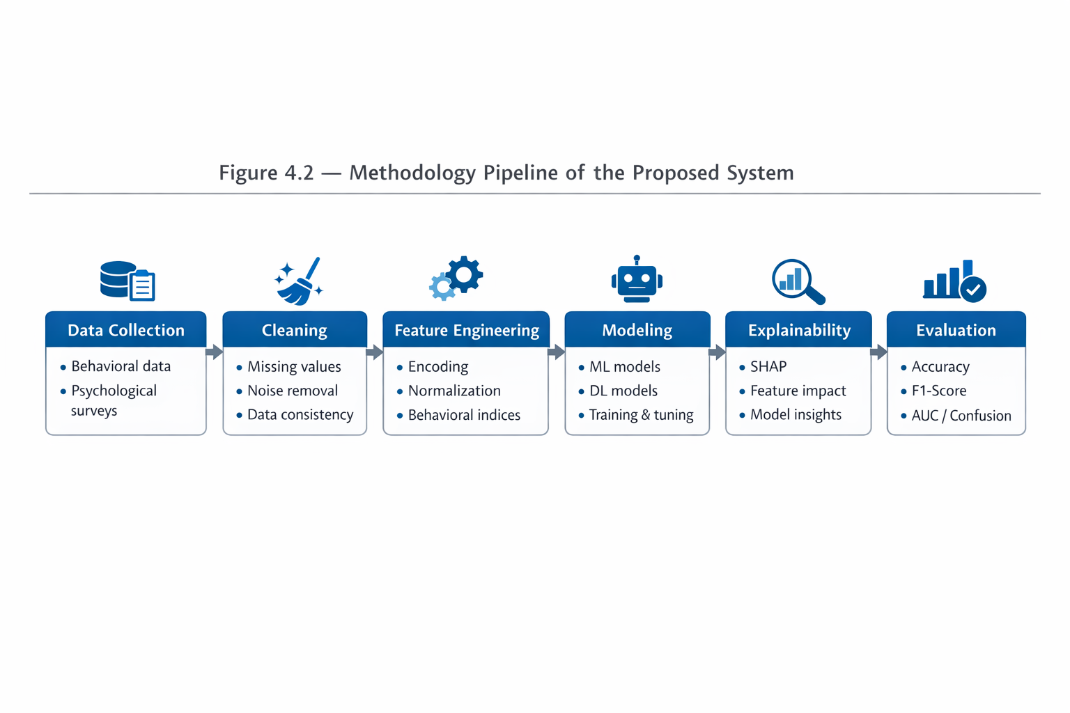
4.2 Methodology Pipeline

Slide 21
Datasets Used
Dataset | Size | Features | Target Variables
Kaggle Student Depression | 587 | Survey responses | Depression level
MHP Anxiety–Stress–Depression | 9,000+ | Psychological scores | Stress, Anxiety, Depression
DASS-21 Mental Health Dataset | ~3,000 | Clinical metrics | DASS subscale scores

Slide 22
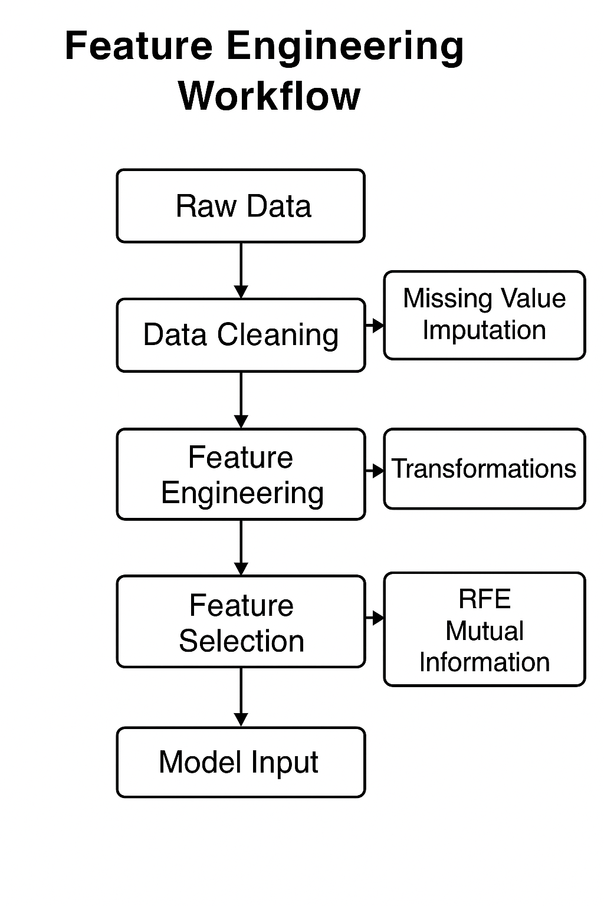
Feature Engineering

Slide 23
CHAPTER 5 EXPERIMENTAL RESULTS
outlines the workflow, datasets, tools, and experimental setup utilized to assess the suggested AI system.

Slide 24
5.1Tools, Environment & Workflow
Environment for computation:
Google Colab (GPU: T4/P100) + 3.10 Python
Frameworks and libraries:
Keras and TensorFlow
NumPy and Pandas
Matplotlib
Workflow for experimentation:
Setting up the environment and loading of datasets
Preparation and Engineering features
Splitting data and Validation and training of models

Slide 25
5.2 Neural Network Architecture & Evaluation
Architecture of the model:
Completely linked layers: 128 → 64 → 32
ReLU is the activation function.
Optimization and regularization:
Dropout rate: 0.2
Adam, the optimizer
MSE is the loss function.
Metrics for evaluation:
MAE + MSE + R "

Slide 26
5.3 Experimental Results
Dataset | MAE | MSE | R²
Kaggle | 0.1234 | 0.0156 | 0.9123
MHP | 0.0987 | 0.0123 | 0.9345
DASS-21 | 0.0644 | 0.0082 | 0.9287

Slide 27
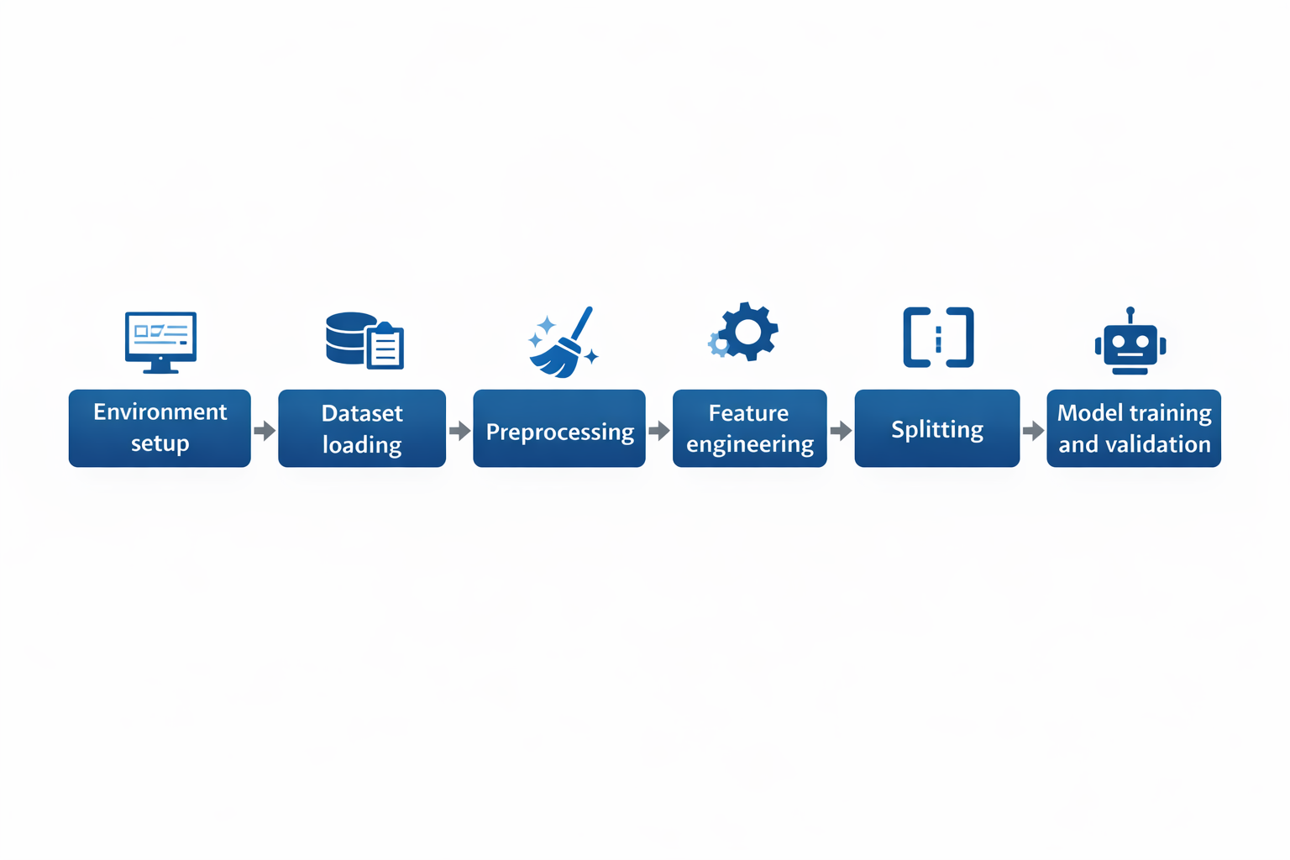
Code Pipeline

Slide 28
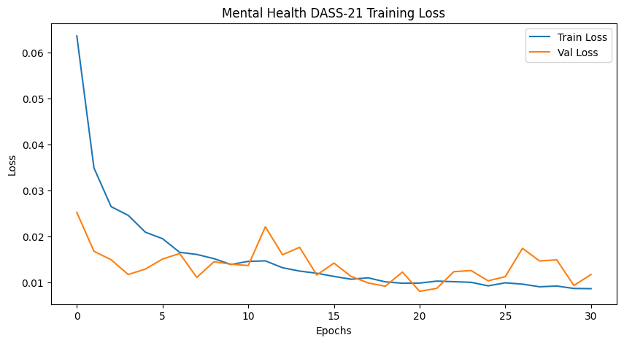
Visual Results

Slide 29
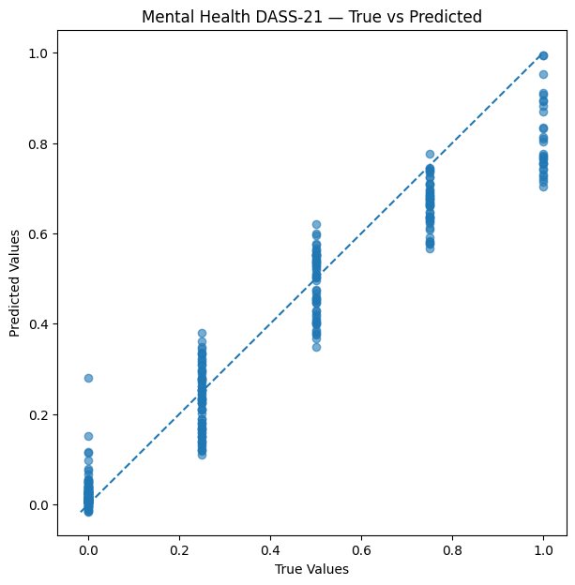
Visual Results

Slide 30
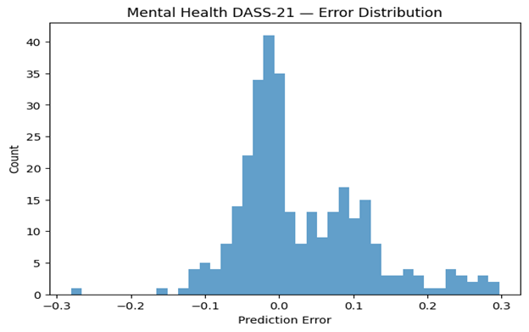
Visual Results

Slide 31
5.7 Discussion
Important Discussion Results
Complex behavioral patterns were successfully captured by deep learning algorithms.
The overall performance of the model was greatly enhanced by feature engineering.
Strong generalization capacity was confirmed by cross-dataset comparison.
The highest accurate clinical signs for predicting depression were obtained using DASS-21.

Slide 32
CHAPTER 6 CONCLUSION & FUTURE WORK
summarizes how well the suggested AI framework uses behavioral data to predict childhood depression and identifies important areas for further study.

Slide 33
6.1 Conclusion
created a thorough AI pipeline to detect childhood depression early.
attained a high degree of predictability
shown that behavioral data offers reliable early indicators
verified the usefulness of AI in contexts for medical and educational decision assistance

Slide 34
6.2 Future Work
Make real-time monitoring possible and expand the framework to include adolescent groups.
Extend with more extensive, varied, and multicultural datasets
Create sophisticated multimodal deep learning models.
Combine intervention support, explainability tools, and clinical collaborations.

Slide 35
Q&A
Thank you.
I’m happy to answer your questions.

Slide 36
Selected References
Chen and associates (2024). use actual data to identify anxiety and depression in adolescents. JMIR Mental Health.
Marek and associates (2023). Multimodal brain imaging for depression risk prediction. NeuroImage: Clinical.
Yoo and associates (2024). Prenatal and childhood data are used to predict depression. Scientific Reports in Nature.
Williams and associates (2024). forecast of depression in young Australians. Springer.
Hasan and associates (2021). Machine learning is used to identify child depression. ResearchGate.

Slide 37
Datasets & Explainable AI Studies
Arashnic (2023). The dataset on depression. ACAMH and Kaggle.
Shamim (2024). Kaggle/Frontiers Student Depression Dataset.
Zogan and associates (2020). Hierarchical attention networks for explainable depression detection. MDPI and arXiv.
Kuo and associates (2023). Graph transformers are used to diagnose depression early. (Not published).

