Slide 1


Cash Flows and Capital Budgeting
Prepared by Dr. Omar Al-kasasbeh
FNT 615
Finance Concepts
Lecture 10

Slide 2



Finance Concepts
FNT 615
Finance Concepts
Prepared by
Dr. Omar Al-kasasbeh

Slide 3
Lecture
10
Table of contents
1. Capital Budgeting - The Strategic Foundation
2. Fundamentals of Cash Flows
3. Discount Rate and Cost of Capital Application
4. Risk Analysis and Scenario Planning
5. Capital Structure and Cost of Capital
6. International Capital Budgeting

Slide 4
Lecture
10
Capital budgeting refers to the process of evaluating and selecting long-term investments that align with the firm’s objective of maximizing shareholder wealth. These investments involve significant, long-term commitments of funds, typically in fixed assets such as land, plant, and equipment, which form the foundation of a firm’s earning capacity.
Capital expenditures are long-term investments expected to generate benefits beyond one year, unlike operating expenditures which provide short-term benefits within a year.
Firms undertake capital expenditures for several key reasons: to expand operations, replace or renew existing assets, and achieve long-term strategic or intangible benefits that enhance value and competitiveness.

Slide 5
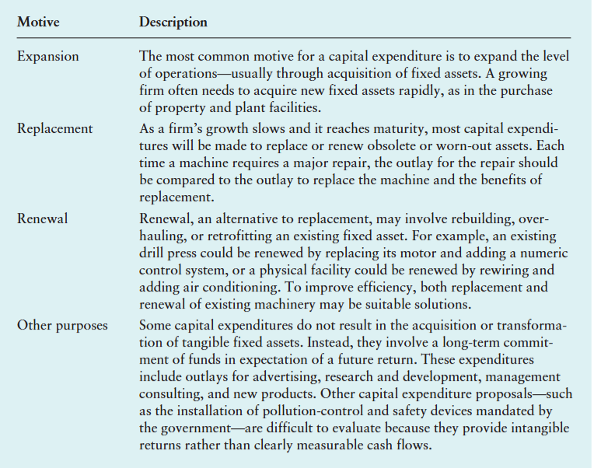
Lecture
the key motives for making capital expenditures
10

Slide 6
Lecture
capital budgeting process consists of five distinct but interrelated steps.
10
1. Proposal generation. Proposals are made at all levels within a business organization and are reviewed by finance personnel. Proposals that require large outlays are more carefully scrutinized than less costly ones.
2. Review and analysis. Formal review and analysis is performed to assess the appropriateness of proposals and evaluate their economic viability. Once the analysis is complete, a summary report is submitted to decision makers.
3. Decision making. Firms typically delegate capital expenditure decision making on the basis of dollar limits. Generally, the board of directors must authorize expenditures beyond a certain amount.
4. Implementation. Following approval, expenditures are made and projects implemented.
5. Follow-up. Results are monitored, and actual costs and benefits are compared with those that were expected. Action may be required if actual outcomes differ from projected ones.

Slide 7
Lecture
10
Two basic approaches to capital budgeting decisions are available. The accept– reject approach involves evaluating capital expenditure proposals to determine whether they meet the firm’s minimum acceptance criterion. This approach can be used when the firm has unlimited funds, as a preliminary step when evaluating mutually exclusive projects, or in a situation in which capital must be rationed.
The second method, the ranking approach, involves ranking projects on the basis of some predetermined measure, such as the rate of return. The project with the highest return is ranked first, and the project with the lowest return is ranked last. Only acceptable projects should be ranked. Ranking is useful in selecting the “best” of a group of mutually exclusive projects and in evaluating projects with a view to capital rationing.

Slide 8
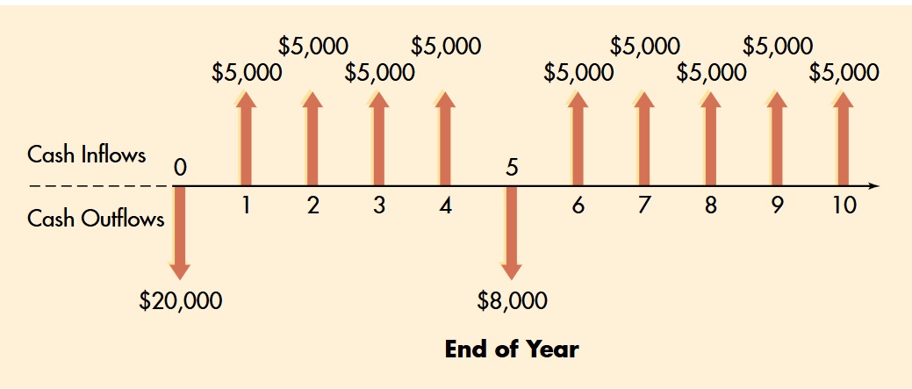
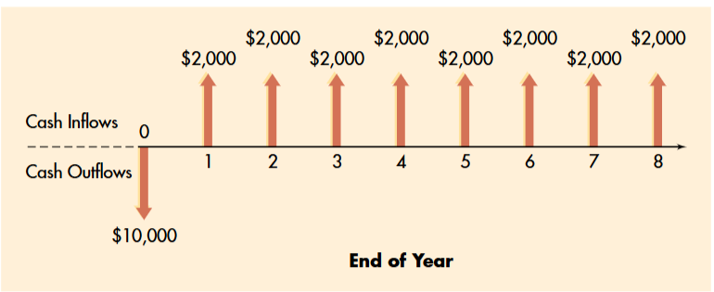
Lecture
Conventional versus Nonconventional Cash Flow Patterns
10

Slide 9
Lecture
Capital Budgeting - Why Long-Term Investment Decisions
10
Capital budgeting focuses on the most critical decisions a firm makes those involving large, long-term investments that shape its future. Unlike routine operational choices that can be easily adjusted, investments such as building new facilities or adopting advanced technology require substantial upfront costs and are largely irreversible. This makes them inherently risky and strategically significant. The core purpose of capital budgeting is to ensure that such decisions are carefully evaluated using a systematic approach, primarily by analyzing expected cash flows relative to their cost. Ultimately, the goal is to maximize shareholder wealth by accepting projects that generate returns exceeding the cost of capital, thereby increasing the firm’s value over time.

Slide 10
Lecture
10
Accepting projects that generate returns below the cost of capital leads to clear value destruction, as the firm effectively loses the difference in economic terms. For this reason, capital budgeting goes beyond being a purely financial calculation it is a strategic function that shapes the firm’s long-term position. Over time, companies that consistently invest in value-creating projects build a strong competitive advantage, while those that allocate capital poorly gradually erode their value. It is therefore essential to distinguish between capital and operational decisions: operational decisions are short-term, reversible, and limited in impact, whereas capital decisions involve significant, long-term, and largely irreversible commitments. As a result, capital investments require rigorous analysis, particularly through discounted cash flow techniques, to ensure sound and value-enhancing decision-making.

Slide 11
Lecture
10
Fundamentals of Cash Flows
A fundamental principle in capital budgeting is that cash flows not accounting profits drive investment decisions. Accounting profits are based on accrual rules that match revenues and expenses over time, but they often misrepresent the actual cash generated by a project. For example, depreciation reduces reported profit without involving any cash outflow, while capital expenditures require immediate cash payments but are only gradually reflected in the income statement. Similarly, changes in working capital such as increasing inventory consume real cash without clearly appearing in profits. As a result, a project may appear profitable on paper while generating weak cash flows, or vice versa.

Slide 12
Lecture
10
At the core of project evaluation lies the concept of incremental cash flows only the cash flows that arise directly because a project is undertaken should be considered. Costs or revenues that would exist regardless of the decision are irrelevant, while any change caused by accepting or rejecting the project must be included. In practice, applying this principle requires discipline, especially when firms allocate overhead or shared resources in ways that may distort true project value. Project cash flows are typically structured into three categories: operating cash flows, which reflect ongoing revenues, costs, and taxes; investment cash flows, which include the initial outlay and any terminal recovery; and financing cash flows, which are excluded to avoid double counting since their cost is already captured in the discount rate.

Slide 13
Lecture
10
Estimating Project Cash Flows
Estimating project cash flows requires translating theory into a structured, realistic timeline of an investment’s life: initial outlay, operating period, and termination. At the outset (time zero), the initial investment includes not only the purchase price of assets but also all associated costs such as installation, transportation, training, and system integration any omission here leads to overstating project value. A critical and often underestimated component is net working capital, as firms must commit cash upfront to inventory, receivables, and operational readiness before generating revenue. Although supplier credit (accounts payable) partially offsets this, the net effect is typically a significant cash outflow. Accurately capturing these elements ensures that the project’s true economic cost is properly reflected from the very beginning.

Slide 14
Lecture
10
Basically, when evaluating a project, you start by calculating the actual cost after subtracting the after-tax proceeds from selling any old assets. During the project's life, focus on the cash coming in by taking your profit and adding back depreciation, since it’s not an actual cash payout; using accelerated depreciation is a smart move here because it saves you tax money sooner. Finally, at the end, you collect the asset's salvage value and recover your initial working capital, making sure to discount all these future amounts to see what they are worth in today's pocket.

Slide 15
Lecture
10
Principles of Cash Flow Analysis
Cash flow analysis in capital budgeting follows four key principles to avoid misleading results. One main idea is to focus only on incremental cash flows the real changes caused by the project. For example, if a new product reduces sales of an existing one (called cannibalization), you must subtract the lost sales to get the true benefit.
Another important concept is opportunity cost. Even if a resource seems “free,” like a company-owned warehouse, it still has value. If the company could rent it out, that lost income should be counted as a cost of the project. Ignoring these factors can make a project look more profitable than it really is.

Slide 16
Lecture
10
Sunk costs should not be included in project decisions because they are already spent and cannot be recovered. What matters is future costs and benefits. Including past expenses can lead to the sunk cost fallacy, where managers continue a bad project just because they’ve already invested a lot.
The last principle is inflation consistency. Cash flows can be measured either with inflation (nominal) or without it (real), but you must match them with the correct discount rate. Mixing the two like using inflated cash flows with a real discount rate gives misleading results and makes a project seem more valuable than it actually is.

Slide 17
Lecture
10
Capital budgeting uses different methods to decide if a project is worth it.
The most important one is Net Present Value (NPV). It calculates the value of all future cash flows today and compares them to the initial cost. If NPV is positive, the project adds value and should be accepted; if negative, it should be rejected. NPV is reliable because it considers all cash flows and uses the correct discount rate.
Another method is Internal Rate of Return (IRR), which shows the project’s return as a percentage. If IRR is higher than the cost of capital, the project is acceptable. However, IRR can be misleading, especially when cash flows change direction more than once or when it assumes unrealistic reinvestment rates.

Slide 18
Lecture
10
The payback period measures how long it takes to recover the initial investment. It’s simple and helps assess liquidity risk, but it has major flaws: it ignores cash flows after the cutoff point and doesn’t consider the time value of money, making it unreliable for decision-making.
The discounted payback period improves this by considering the time value of money, but it still ignores later cash flows and relies on an arbitrary cutoff, so it’s only useful as a secondary tool.
The profitability index (PI) compares the present value of future cash flows to the initial investment. A value above 1 means the project is good. It’s especially useful when the company has limited funds and must choose between projects. However, when there’s no budget constraint, NPV remains the best method.

Slide 19
Lecture
10
The discount rate is essentially the return investors expect for putting their money into a project, and it should reflect the level of risk they are taking. Since firms usually finance projects using both equity and debt, they use the Weighted Average Cost of Capital (WACC) to combine the required returns of both sources based on their market values, not book values. Debt is cheaper because interest is tax-deductible, so its cost is adjusted after tax. The most complex part is estimating the cost of equity, which is commonly done using the Capital Asset Pricing Model (CAPM). This model links expected return to risk through beta, where higher beta means higher risk and therefore higher required return. Overall, WACC provides a structured and realistic way to determine the appropriate discount rate instead of relying on arbitrary assumptions.

Slide 20
Lecture
10
WACC is only the right discount rate when the project has similar risk to the firm’s existing operations and follows the same capital structure. If these conditions don’t hold, using the firm’s WACC leads to wrong decisions. For example, using a high rate (like 12%) for a low-risk project undervalues it and may cause the firm to reject a good investment, while using the same rate for a very risky project can make it look profitable when it actually destroys value. Therefore, the discount rate must always match the project’s risk. Based on this, the NPV rule becomes clear: accept any project with a positive NPV and reject any with a negative one, because a positive NPV directly represents real value created for shareholders beyond alternative investments of similar risk.

Slide 21
Lecture
10
Project Comparison and Evaluation
In real-world capital budgeting, projects are often not independent they compete for the same resources or serve the same purpose, meaning firms must choose between them rather than evaluate each separately. In such mutually exclusive cases, the key question becomes which project creates the most value, not just whether each one is acceptable. Here, NPV provides the correct decision rule: select the project with the highest NPV, as it adds the greatest value to the firm. Problems arise when using IRR, as it can give misleading rankings, especially when projects differ in size or timing of cash flows. A smaller project may show a higher IRR but generate less total value than a larger project with a lower IRR. This happens because IRR assumes reinvestment at its own rate, which is often unrealistic, while NPV assumes reinvestment at the cost of capital a more practical assumption. Therefore, when NPV and IRR conflict, NPV should always be the basis for decision-making.

Slide 22
Lecture
10
The crossover rate is the discount rate at which two mutually exclusive projects have the same NPV, and it helps explain why NPV and IRR sometimes give different rankings. It is calculated by taking the IRR of the incremental cash flows between the two projects. If the firm’s WACC is below or above this rate, it immediately shows whether the conflict between NPV and IRR actually matters for the decision.
To strengthen the analysis, firms also use sensitivity tools because all cash flow estimates are uncertain. Break-even analysis shows the point where NPV becomes zero, giving a clear margin of safety. Scenario analysis evaluates the project under different realistic conditions, capturing how variables move together. At a more advanced level, Monte Carlo simulation generates many possible outcomes using probability distributions, providing a full picture of risk. Together, these methods move beyond a single NPV figure and give a more realistic understanding of the project’s potential outcomes and risks.

Slide 23
Lecture
10
Risk Analysis and Scenario Planning
Risk analysis recognizes a simple reality: all forecasts are uncertain, so a single NPV number cannot fully capture a project’s true risk. Instead, the goal is to understand how much outcomes might vary, in which direction, and whether the project remains viable across different scenarios. Since key inputs like sales volume, price, costs, and discount rate are only estimates, the resulting NPV is also uncertain, and relying on one base-case value can be misleading.
Sensitivity analysis is the most straightforward way to address this. It examines how changes in one variable at a time affect NPV while keeping others constant. This helps identify which factors the project is most sensitive to, allowing the firm to focus on improving the most critical forecasts and managing the most important risks. In practice, it guides better decision-making by highlighting where uncertainty matters most and where risk mitigation efforts should be directed.

Slide 24
Lecture
10
Break-even analysis complements sensitivity analysis by identifying the exact point at which a project’s NPV becomes zero the threshold between value creation and value destruction. It provides a clear measure of the project’s margin of safety. For example, if the required sales to break even are far below even the pessimistic forecast, the project is relatively safe; but if the break-even point is close to uncertain forecasts, the risk is much higher and requires careful evaluation.
However, both break-even and sensitivity analysis have a limitation: they assume variables change independently, which is rarely realistic. In practice, key variables like price and sales volume tend to move together under the same economic conditions. Scenario analysis addresses this issue by evaluating the project under a few consistent and realistic situations (e.g., best case, worst case, most likely), where multiple variables change simultaneously. This provides a more accurate and practical view of risk compared to analyzing each variable in isolation.

Slide 25
Lecture
10
Traditional DCF analysis treats investment decisions as fixed and immediate, ignoring the fact that managers can adapt their decisions over time. In reality, projects often include valuable flexibility such as expanding, delaying, or abandoning which creates additional value beyond what standard NPV captures. This is the essence of real options: applying financial options logic to real investments, where managers have the right, but not the obligation, to adjust their strategy as new information emerges.
One of the most important examples is the option to expand. When a firm starts with a small-scale investment (like a pilot project), it is not just generating initial cash flows it is also securing the opportunity to grow if results are favorable. This flexibility is especially valuable when future demand is uncertain and the upside potential is large. As a result, standard NPV may underestimate the true value of such projects because it ignores this embedded growth option.

Slide 26
Lecture
10
The option to abandon gives the firm the flexibility to exit a poorly performing project and recover part of its investment, which reduces potential losses. This creates real value by placing a “floor” on the downside, especially in projects with high salvage value or flexible cost structures. In contrast, standard NPV ignores this protection and may underestimate the project’s true worth.

Slide 27
Lecture
10
Valuing real options precisely is more complex than standard NPV, as it often requires adapting models like Black-Scholes or binomial trees. These approaches need inputs such as the asset’s value, exercise price, time horizon, risk-free rate, and especially volatility which is difficult to estimate for real projects. Because of this, many firms use real options more as a qualitative or semi-quantitative tool, recognizing the value of flexibility even if they cannot measure it exactly.
More importantly, real options change how managers think about investment decisions. Instead of viewing projects as fixed commitments, they see them as flexible and adaptive.

Slide 28
Lecture
10
International Capital Budgeting
International capital budgeting follows the same core NPV logic, but becomes more complex due to factors like foreign currencies and different economic environments. The main challenge is exchange rate risk since projects generate cash flows in a foreign currency, their value in the firm’s home currency can change significantly depending on exchange rate movements. Even a profitable project in local terms can lose value if the foreign currency depreciates, so managing this risk (through hedging or financing strategies) is essential.

Slide 29
Lecture
10
Political risk adds a unique layer of uncertainty in international projects, covering risks like expropriation, capital controls, sudden tax changes, or regulatory actions that disadvantage foreign firms. Unlike typical financial risks, it is difficult to quantify, so firms often handle it using scenario analysis (evaluating specific adverse events) or by adding a country risk premium to the discount rate, although this method has limitations.
Another critical issue is repatriation constraints, which affect not only how much cash the parent company receives but also when it receives it. Governments may restrict profit transfers, require reinvestment, or delay approvals, meaning that not all generated cash flows are actually accessible to the parent. Therefore, firms must clearly distinguish between total project cash flows and the portion that can realistically be repatriated, incorporating these timing and restriction factors directly into the analysis for a more accurate valuation.

Slide 30
Lecture
10
Transfer pricing and intercompany transactions make international capital budgeting more complex because internal pricing affects where profits are reported and how much tax is paid in each country. Although regulations require prices to be close to market levels, firms still have flexibility, often using it for tax optimization. Therefore, the key for analysis is not to focus only on the subsidiary’s reported profits, but to model the actual after-tax cash flows for the entire firm.
Choosing the right discount rate is also more challenging internationally. It must reflect the project’s global market risk, additional country and political risk, differences in capital market integration, and the currency used in the analysis. Since these factors do not point to a single clear formula, the process involves significant judgment. As a result, analysts must pay close attention to how sensitive NPV is to changes in the discount rate, especially in high-risk international environments.

Slide 31
Lecture
10
Post-Audit and Project Control
Capital budgeting does not stop at the approval stage it continues through implementation and requires ongoing evaluation. The post-audit is a key tool that compares actual project performance with the original forecasts, helping firms understand why results differ. These differences may come from overly optimistic demand estimates, underestimated costs, unexpected competitive changes, or external factors like exchange rates, and analyzing them improves future decision-making.

Slide 32
Lecture
10
Project control recognizes that approval alone does not guarantee success the real challenge lies in execution. During implementation, firms must manage construction, costs, timelines, and operational setup. Effective control means setting clear milestones, assigning responsibility, monitoring budgets, and detecting deviations early. Financial tools like earned value analysis help track whether the project is on budget and on schedule by comparing work completed to resources used, allowing timely corrective action.
A critical outcome of this process is knowing when to abandon or restructure a failing project. This is difficult because of the sunk cost fallacy the tendency to continue investing simply because resources have already been committed.

Slide 33
Lecture
10
Building an effective post-audit culture requires strong support from senior management because it can be uncomfortable it exposes forecasting mistakes and highlights underperforming projects. If handled poorly, it can turn into a blame game, leading managers to become defensive and even more optimistic in future forecasts to protect themselves.
The key is to treat post-audits as a learning and diagnostic tool, not a performance evaluation. The focus should be on understanding what happened, why outcomes differed from expectations, and how to improve future decisions. When done correctly, this approach encourages honesty, reduces bias, and ultimately leads to better capital allocation and more reliable investment decisions over time.

Slide 34
Lecture
10
Behavioral Biases in Capital Budgeting
Capital budgeting is built on the assumption that decision-makers are rational, meaning they objectively analyze information and make sound investment decisions using tools like NPV. However, research in psychology and behavioral economics shows that this assumption is often unrealistic, as human decisions are influenced by cognitive biases and emotions. Therefore, understanding these biases is essential to improve investment decisions and ensure outcomes reflect the true quality of projects rather than human judgment errors.

Slide 35
Lecture
10
Optimism bias is one of the most common problems in capital budgeting, where managers tend to overestimate revenues, underestimate costs and timelines, and ignore potential risks. This leads to inflated NPVs and poor investment decisions. A related concept, the planning fallacy, explains how individuals focus on best-case scenarios despite knowing that similar projects often face delays and cost overruns. To reduce this bias, firms can use reference class forecasting, which relies on data from similar past projects rather than relying only on internal expectations, helping produce more realistic and accurate forecasts.

Slide 36
Lecture
10
Overconfidence reinforces optimism bias by making decision-makers underestimate uncertainty, leading them to consider a narrow range of possible outcomes and understate risks in their analyses. This results in weak sensitivity and scenario analyses and ultimately poor risk assessment. Anchoring further distorts decisions by causing initial estimates such as early NPV calculations or target returns to heavily influence final judgments, even when new information suggests otherwise. Additionally, escalation of commitment (or the sunk cost trap) leads managers to continue investing in failing projects due to psychological factors like loss aversion and fear of admitting mistakes, instead of making rational decisions based on future value.

Slide 37
Lecture
10
Herding and social pressure can distort capital budgeting decisions by pushing individuals to conform to dominant opinions, even when they have valid concerns. This leads to groupthink, where decisions reflect overly optimistic views instead of balanced analysis, increasing the risk of poor investments. To address these biases, organizations must rely on structured approaches rather than expecting individuals to be fully objective. Tools such as pre-mortem analysis, independent project reviews, tracking forecast accuracy, and encouraging structured dissent (e.g., devil’s advocate roles) help surface hidden risks and opposing views. While these methods cannot eliminate bias entirely, they significantly improve the quality and objectivity of investment decisions.

Slide 38

Lecture
10

Slide 39
Lecture
Summary
10
The lecture summarizes capital budgeting by emphasizing that the goal is to choose projects that increase firm value using tools like NPV and IRR, with NPV as the most reliable criterion. It highlights the importance of accurate cash flow estimation based on incremental cash flows while excluding sunk costs. It also stresses that the discount rate (WACC) must match the project’s risk level to ensure sound investment decisions.
The advanced topics show that capital budgeting goes beyond basic tools. Real options highlight the value of flexibility, while international projects require careful treatment of risks like exchange rates and politics. Risk analysis emphasizes that relying on a single NPV is insufficient, and better decisions come from using scenarios and simulations. Post-audit practices help improve future decisions. The lecture also stresses that behavioral biases can distort decisions, so structured processes are needed to reduce them. Finally, financing and investment decisions are interconnected through WACC, meaning firms must optimize both together.

Slide 40


Thank You

