Slide 1


College of Management
Project Communications
Lecturer: Dr. Raef Baraka
PMG 112
Lecture 09

Slide 2

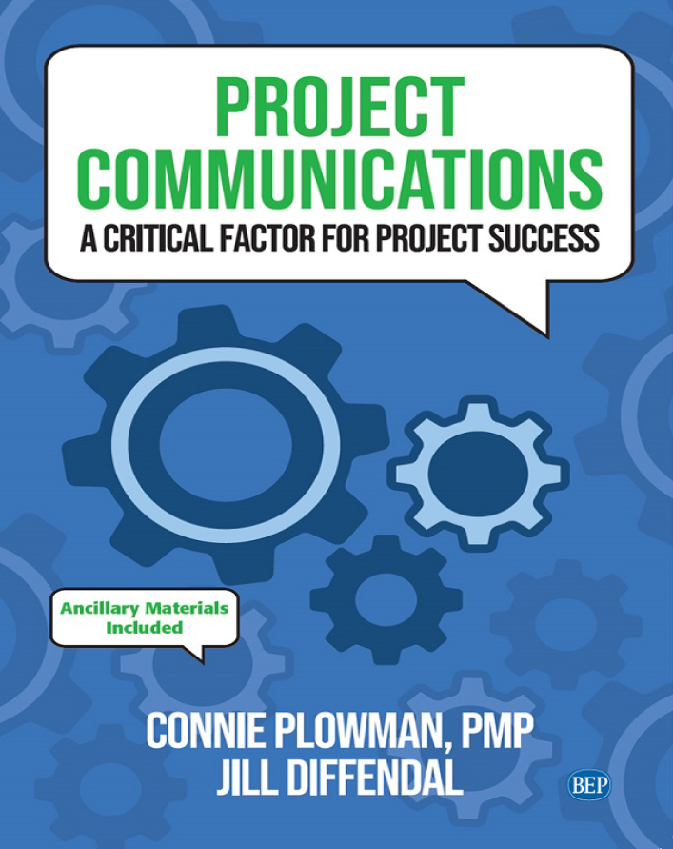
Reference Book:
Ch1: Introduction.
Ch2: Exploring Communication Theories.
Ch3: Knowing Your Audience.
Ch4: Starting with the Basics.
Ch5: Planning Project Communications.
Ch6: Managing and Monitoring Project Communications.
Ch7: Using Project Communication Tools.
Ch8: Communicating Change.
Ch9: Managing Conflict through Communication.
Ch10: Closing.

Slide 3
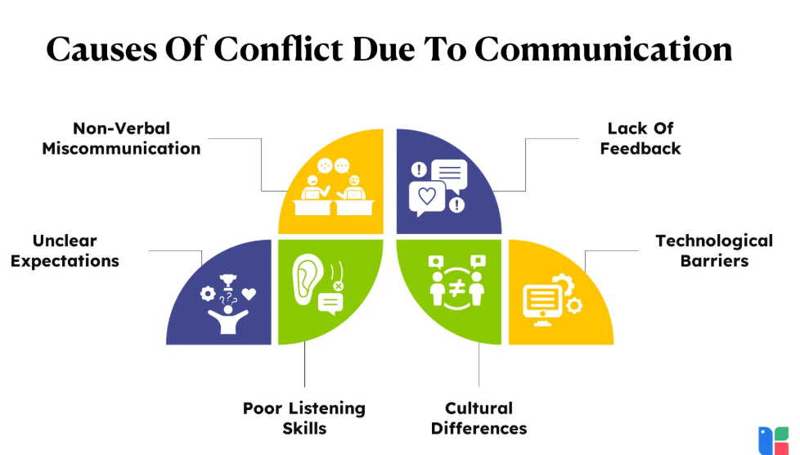
Chapter 9: Managing Conflict through Communication
The purpose of this chapter is to help you:
Examine two different types of conflict and how they can affect the project and the team•
Explore strategies for understanding and resolving conflict within the project team.

Slide 4
Chapter 9: Managing Conflict through Communication
The purpose of this chapter is to help you:
Consider ways to communicate with stakeholders when they do not support the project, when their expectations conflict with one another, or when the project deviates from the plan
Put it into practice: Managing conflict through communication in traditional, agile, and virtual project teams.

Slide 5

Chapter 9: Managing Conflict through Communication
Projects are, in their very nature, major sources of emotion.
—Nicholas Clarke, management researcher, and Ranse Howell, conflict resolution expert

Slide 6
Managing Conflict through Communication
Managing Conflict through Communication
Projects are done by people. When there are people involved, there are emotions.
Emotions readily lead to conflict.
This means that conflict is likely to occur in almost every project, especially when stakes are high, resources are thin, budgets are tight, and time is limited.
When those interests contradict one another or are put in jeopardy (either in a real or perceived way), conflict occurs.
Unresolved conflict can be one of the biggest challenges a project team faces. It can lead to stress, negative attitudes, decreased commitment to the project, and ultimately project failure.
Dr. Raef Baraka

Slide 7
Managing Conflict through Communication
Managing Conflict through Communication
Conflict resolution is therefore a critical project management skill—and a critical communication skill.
It requires sensitivity, knowledge, and the ability to resolve the conflict in a timely, effective manner that enables the project to continue moving forward smoothly.
This chapter offers conflict management strategies that build upon the project communication concepts already introduced in this book
Dr. Raef Baraka

Slide 8
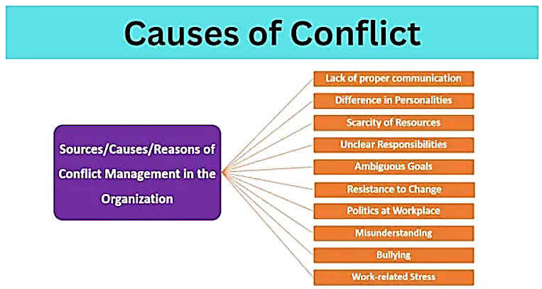
Managing Conflict through Communication
Sources of Conflict
Dr. Raef Baraka

Slide 9
Managing Conflict through Communication
Managing Conflict through Communication
Conflicts generally fall into one of two categories: interpersonal conflict and task conflict.
These two sources of conflict are parallel to the two types of needs—personal and practical—that should be addressed when managing conversations.
Interpersonal and task conflict have different origins and can affect the team differently.
Being able to identify which type of conflict you are facing can help you decide whether to intercede directly, and what to focus on if you do. Remember, however, that both types of conflict need resolution and effective communication.
Further, a conflict that starts as one type can evolve into both types, especially when left unchecked.
Dr. Raef Baraka

Slide 10
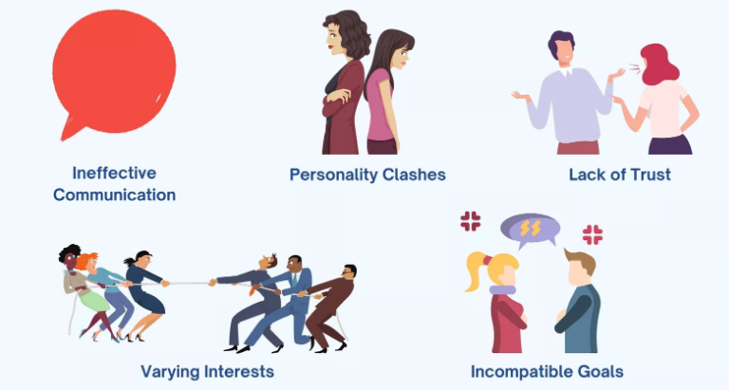
Communicating Change
Managing Conflict through Communication
Interpersonal conflict:
Interpersonal conflict also referred to as relational or relationship conflict, arises from incompatibilities among team members based on individual factors like personality, values, background, behavior, or communication style.
The team is a social structure made up of individuals working together, and it functions most effectively when all team members feel like they belong and are working toward a common goal.
Dr. Raef Baraka

Slide 11
Communicating Change
Managing Conflict through Communication
Interpersonal conflict:
When interpersonal conflict occurs, it can impact the involved team members’ sense of team identity.
They become uncertain about their place within the team and may start to withdraw, thereby undermining group efforts to get the project done.
The conflict can also have negative effects on members of the team who are not directly involved.
Interpersonal conflict can be the most damaging kind of conflict. It takes time and effort to build relationships that result in optimal team functioning.
Dr. Raef Baraka

Slide 12
Communicating Change
Managing Conflict through Communication
Interpersonal conflict:
However, conflict can damage those relationships very quickly.
Once they are damaged, the relationships can take even more time and work to repair.
According to research, it can take up to five positive interactions to overcome the damage of one negative interaction
Dr. Raef Baraka

Slide 13
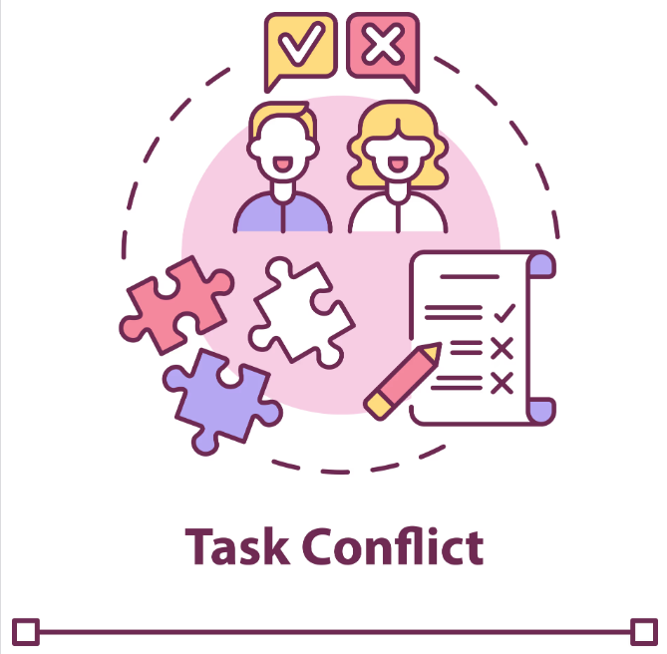
Communicating Change
Managing Conflict through Communication
Task conflict:
Task conflict occurs when team members hold different perspectives on how to approach the work to be done. This can involve disagreements over the distribution of resources, the best way to accomplish tasks, or differing interpretations of information.
Task conflict occurs because team members come to the project from different personal and professional backgrounds, different units within the organization that have their own culture and approach to tasks, and/or different levels of project experience and expertise.
These different influences lead team members to think about and approach tasks in different ways.
Dr. Raef Baraka

Slide 14
Managing Conflict through Communication
Managing Conflict through Communication
When people talk about conflict being good for teams, they generally mean task conflict.
Different viewpoints and a wide range of experiences can reveal better ways to approach tasks that result in increased efficiencies in the project.
This can lead to learning, creativity, and more flexibility in thinking.
An example of this is when two project team members disagree on which process or method should be used to complete a project task.
Dr. Raef Baraka

Slide 15
Managing Conflict through Communication
Managing Conflict through Communication
To make this conflict productive, the project manager can have the two team members present the pros and cons of their preferred solutions.
This can help all team members better understand the implications of each choice and come to a well-informed decision; it can also improve team members’ communication skills and demonstrate the value of remaining open to new ideas.
Next table provides an overview of the two types of conflict, their sources, and their effects on the project team.
Dr. Raef Baraka

Slide 16
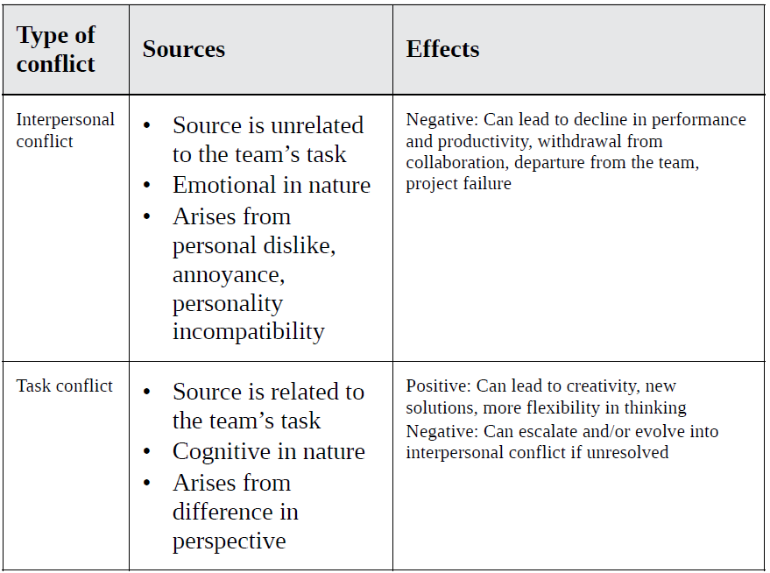
Managing Conflict through Communication
Dr. Raef Baraka

Slide 17
Managing Conflict through Communication
Managing Conflict through Communication
Keep in mind, however, that there is a limit to the benefits of conflict.
A review of research on both task and interpersonal conflict found that “whereas a little conflict may be beneficial, such positive effects quickly break down as conflict becomes more intense, cognitive load increases, information processing is impeded, and team performance suffers.”
Thus, even productive conflict must be managed to maintain team cohesiveness and keep the project running smoothly.
Dr. Raef Baraka

Slide 18
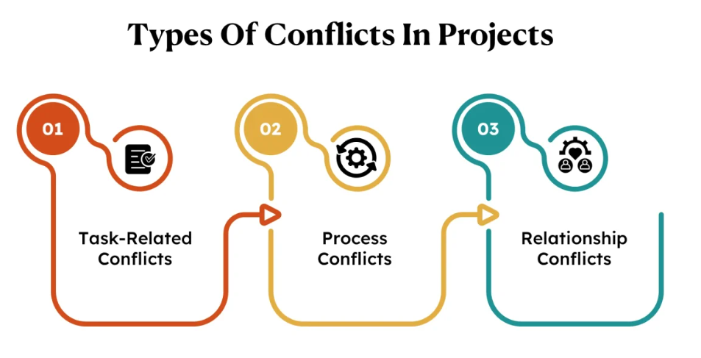
Managing Conflict through Communication
Conflict within the Project Team
Dr. Raef Baraka

Slide 19
Managing Conflict through Communication
Conflict within the Project Team
Effective conflict management has been shown to enhance team performance.
Teams that can resolve conflict are more cohesive, and cohesion positively impacts perceived performance, satisfaction, and team viability.
On the other hand, unresolved conflict can lead to team members’ dissatisfaction, decreased motivation and performance, frustration, anxiety, and even departure from the team.
It can affect the project through misunderstandings about responsibilities, missed deadlines, lack of collaboration and decreased communication between team members, and unidentified inefficiencies that may result in the project exceeding its schedule and budget
Dr. Raef Baraka

Slide 20
Managing Conflict through Communication
Conflict within the Project Team
The first step of managing conflict within the project team is knowing when to get involved. This can be a delicate balance for the project manager, who is responsible for the project and for leading the team but most likely does not have functional authority over project team members.
You should consider interceding if:
  You believe the conflict is having or will have a negative effect on the project,
  The conflict involves you directly, or
  Anyone involved in the conflict comes to you for advice or help.
Dr. Raef Baraka

Slide 21
Managing Conflict through Communication
Conflict within the Project Team
Carefully weigh whether you should involve other organizational resources.
If the conflict involves a team member’s responsibilities on the project interfering with their other functional responsibilities, it may be prudent to communicate with or involve the individual’s functional manager.
If the conflict is interpersonal and highly emotional, you may want to consult human resources before proceeding.
Dr. Raef Baraka

Slide 22
Managing Conflict through Communication
Conflict within the Project Team
When you do step in to help manage conflict, remember this basic rule: Focus on the project or the problem, not the person!
While there are a number of conflict resolution strategies and approaches available, many involve some aspect of the following three steps: de-escalate, redirect, and exit.
You may recognize aspects of the five-step approach to managing conversations we introduced in Chapter 6.
Note that this approach can be applied whether you are involved in the conflict directly or are mediating a conflict between others.
Dr. Raef Baraka

Slide 23
Managing Conflict through Communication
Conflict within the Project Team
Step 1: De-escalate
De-escalating the conversation is an effort to avoid additional damage to the team members’ relationships.
Managing emotions is particularly difficult in conflict—these situations can elicit physiological responses that are difficult to control, such as increased heart rate, sweating palms, or tensing muscles.
These are symptoms of the fight-or-flight response, and they happen because the subconscious mind can interpret conflict as a threat.
Dr. Raef Baraka

Slide 24
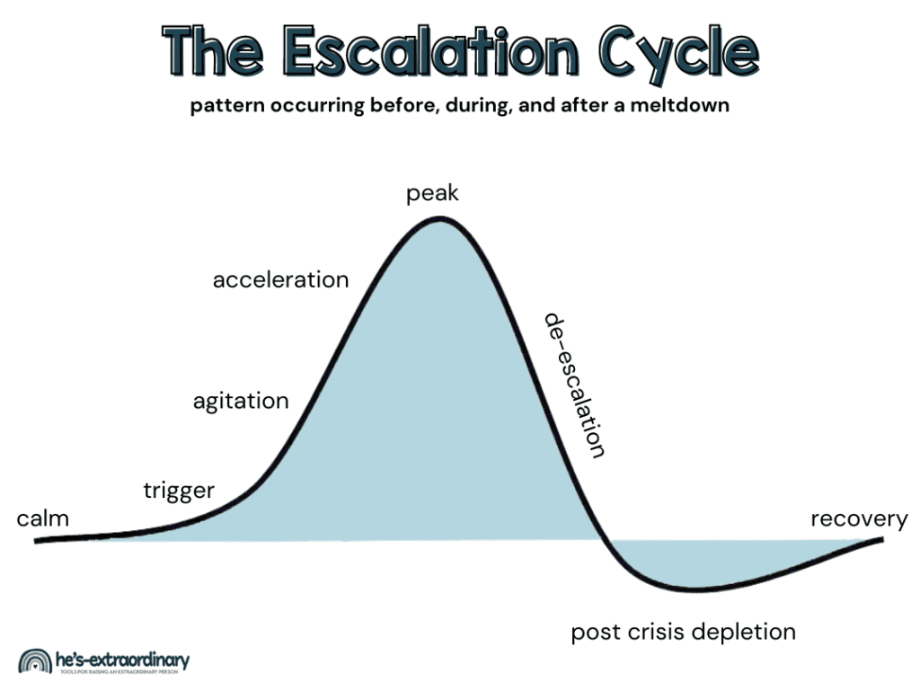
Managing Conflict through Communication
Dr. Raef Baraka

Slide 25
Managing Conflict through Communication
Conflict within the Project Team
Step 1: De-escalate
They also interfere with the part of the brain that controls rational thinking.
As a result, individuals in conflict may raise their voices or bring up unrelated or unproductive issues in an attempt to attack the other person.
This pattern of communication and behavior does not resolve the conflict, and ends up damaging relationships between team members.
Dr. Raef Baraka

Slide 26
Managing Conflict through Communication
Conflict within the Project Team
Step 1: De-escalate
Take a break, if necessary, especially if emotions are high. Stopping for a few minutes can give everyone a chance to process their emotions and allow physiological fight-or-flight responses to diminish.
Call for a break—to get a drink of water, use the restroom, or get some fresh air—and allow everyone to come back to the conversation with clearer heads.
Dr. Raef Baraka

Slide 27
Managing Conflict through Communication
Conflict within the Project Team
Step 2: Redirect
Bring the conversation back to the issue at hand. Intensified conversation (e.g., raised voices, unproductive criticisms or insults, etc.) is not the same as important communication—the intensity becomes what’s important instead of the source of the conflict.
Allow each party to explain their intent to dispel any assumptions. Conflict, after all, often arises from uncertainties; by helping to reduce or manage these uncertainties, you can reduce or manage the conflict they have sparked.
Skip the blame and focus on the outcome.
Dr. Raef Baraka

Slide 28
Managing Conflict through Communication
Conflict within the Project Team
Step 2: Redirect
Clearly communicate that your goal is to resolve the conflict in a way that allows the entire team to move forward together to accomplish the project objective. In conflict, people frequently get hung up on the idea of assigning blame.
Make it clear what the consequences are, if any; this will reduce uncertainty and allow those involved to move forward in the resolution process. Then, work on the outcome with input from all parties, which should focus on compensating for any problems or issues that have affected the project and putting mechanisms in place to attempt to prevent the issue from occurring again.
Dr. Raef Baraka

Slide 29
Managing Conflict through Communication
Conflict within the Project Team
Step 3: Exit
Once a resolution has been found, make sure both parties accept it.
Give each of them an opportunity to communicate any additional thoughts or concerns so that you can be sure the conflict is truly resolved.
If the situation has impacted the project, make the necessary updates to the project plan, schedule, or other project documents. If appropriate, add it to your lessons learned document as well.
Dr. Raef Baraka

Slide 30
Managing Conflict through Communication
Conflict within the Project Team
Step 3: Exit
If you are unable to come to a satisfactory resolution, ask the involved parties to table the issue for now. This allows you to step back from the conflict and consider more potential solutions. You may want to call upon additional resources such as functional managers, subject matter experts, human resources personnel, the client or sponsor, or other stakeholders for input on the best way to resolve the issue. Be sure to set a time to reconvene so that everyone has a clear expectation about when the issue will be addressed again.
Dr. Raef Baraka

Slide 31

Managing Conflict through Communication
Managing Conflict with Stakeholders Outside the Project
Dr. Raef Baraka

Slide 32
Managing Conflict through Communication
Managing Conflict with Stakeholders Outside the Project
Managing conflict within the project team involves direct conflict management approaches and skilled communication.
The goal is to preserve team cohesion and come to an agreement on the best way to resolve the conflict so that the team can move forward in achieving the project objectives.
However, conflict outside the project team can materialize in very different ways that may require different approaches.
Here are three common scenarios where you must work through conflict with stakeholders outside of the project team:
  Working with stakeholders who are resistant to the project.
  Communicating project setbacks to stakeholders.
  Handling conflict between project stakeholders.
Dr. Raef Baraka

Slide 33
Managing Conflict through Communication
When Stakeholders Do Not Support the Project
Once you identify stakeholders who may be resistant to your project, the following recommendations may help minimize their resistance, reduce the likelihood of conflict or its intensity when it arises, and even move them toward being more supportive of the project.
Communicate early and frequently. Keep resistant stakeholders in the loop. This can help build trust by demonstrating that you understand and respect their interest and/or impact on the project, and want to engage with them despite their disposition toward the project. Build these communications into your project communications management plan.
Dr. Raef Baraka

Slide 34
Managing Conflict through Communication
When Stakeholders Do Not Support the Project
Seek feedback regularly. Check in with these stakeholders either with a set frequency (e.g. monthly) or at project milestones. Encourage honest feedback, and provide direct responses to their concerns to the greatest extent possible. Don’t forget to refer back to your stakeholder analysis and project communications management plan when communicating with stakeholders.
Get the stakeholder involved. If the stakeholder is particularly resistant, or if you are not successfully able to address their concerns on your own, engage them in working with you toward a solution. Get their input on what it will take to reduce or resolve their resistance to the project, and then ask them to help in putting that solution into practice
Give these strategies a try, and make the necessary adjustments when needed.
Dr. Raef Baraka

Slide 35
Managing Conflict through Communication
Managing Conflict with Stakeholders Outside the Project
If conflict occurs between stakeholders, address it early to prevent it from escalating and putting the project at risk. Communication approaches such as the five-step technique for managing conversations outlined in Chapter 6, or the more basic three-step approach to addressing conflict noted earlier in this chapter may be sufficient to mitigate the conflict.
However, because project managers and team members have no functional authority over most stakeholders, seeking support from other organizational resources such as project leadership, senior management, or human resources may be necessary.
Dr. Raef Baraka

Slide 36
Managing Conflict through Communication
Managing Conflict with Stakeholders Outside the Project
In any given project, there’s a good chance something will not go according to plan.
Sometimes, these are identified risks that materialize, and sometimes they are unexpected.
No matter what the issue, conflict can result. Using effective communication strategies like those discussed in this chapter can have a major impact on how the conflict affects the project and on your reputation and effectiveness as a project manager.
Remember: It’s not about whether things go wrong; it’s about how you handle them when they do
Dr. Raef Baraka

Slide 37
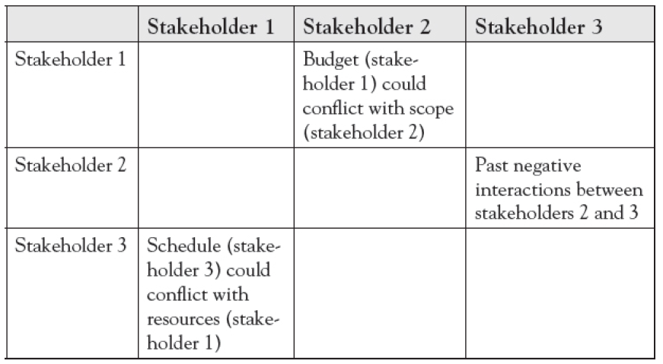
Managing Conflict through Communication
Managing Conflict with Stakeholders Outside the Project
Dr. Raef Baraka

Slide 38
Managing Conflict through Communication
Lecture Summary
Since projects are done by people, conflict is likely to occur. This is where your communication skills are most needed to manage conflict effectively within the project team and among stakeholders outside the team. There are two sources of conflict: interpersonal conflict (relational conflict) and task conflict (objective disagreements). Task conflict can be a good thing.
Positive conflict can be the foundation for stronger relationships and greater results. Interpersonal conflict and unresolved task conflict, however, can have negative effects on the project and the team.

Slide 39
Managing Conflict through Communication
Lecture Summary
Project professionals handle and manage conflict through various communication strategies.
Handling conflict within the project team requires knowing when to intercede and how to address the situation when you do.
Project teams who can resolve conflict quickly and effectively are more cohesive and achieve greater results than those teams who let conflict go unresolved, hindering project and team success.

Slide 40
Managing Conflict through Communication
Lecture Summary
Conflict with stakeholders outside the project team can occur when stakeholders are unsupportive of the project, when you must communicate problems or delays in the project to the stakeholder, or when two different stakeholders have conflicting expectations or personalities.
Respond to these situations quickly, honestly, and with support from organizational resources when necessary.
When addressing conflict, you may find some strategies work, and other approaches need to be modified based on the situation and people involved. Make the necessary adjustments in your communications—with the goal of conflict resolution

Slide 41



Thank You

