Slide 1

PMG 622
Agile Project Management
Course Introduction
Everyone’s Smart
University
دكتور مهندس استشاري ادارة المشروعات
Eng. Dr. Akram Mustafa Suliman Ali,
PhD. AU, BEng. & MSc. AAST, CEng CMarEng MIMarEST, PE, PMP®,
ASQ CSSBB, ISO Lead Auditor, NDT Level II,

Slide 2


How course is delivered and how to study
Primary Course Delivery Method:
  LECTURE
How to study:
  Print material;
  watch video and
  take notes

Slide 3
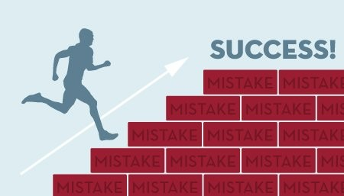

The secret to success?
The proven best learning technique . . .
  Is simply hard work . . .
Please be prepared to put in the time and effort necessary to be successful

Slide 4
اختبار الاسبوع الاول
اختبار الاسبوع الاول تجريب للتمرس على الاجابة على اسئلة المقرر و لا يدخل في عملية تقيم الدارسين

Slide 5
Why Agile??????????????
According to studies of traditional project management methods by Standish Group and others as of 1998, only 44% of projects typically finish on time. Projects typically complete at 222% of the duration originally planned, 189% of the original budgeted cost, 70% of projects fall short of their planned scope (technical content delivered), and 30% are cancelled before completion.^{[2]}
[2] "The Standish Group Report Chaos“ ww.projectsmart.co.uk.
Retrieved 2017-07-20.

Slide 6



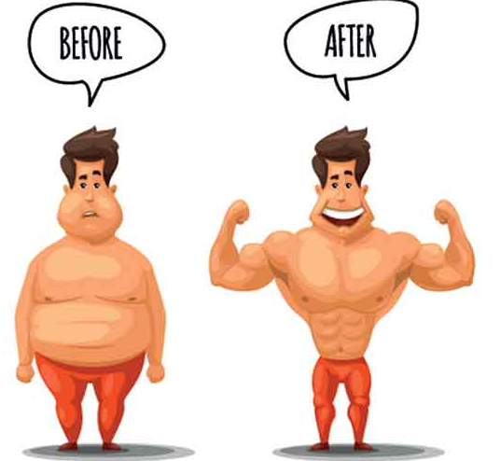
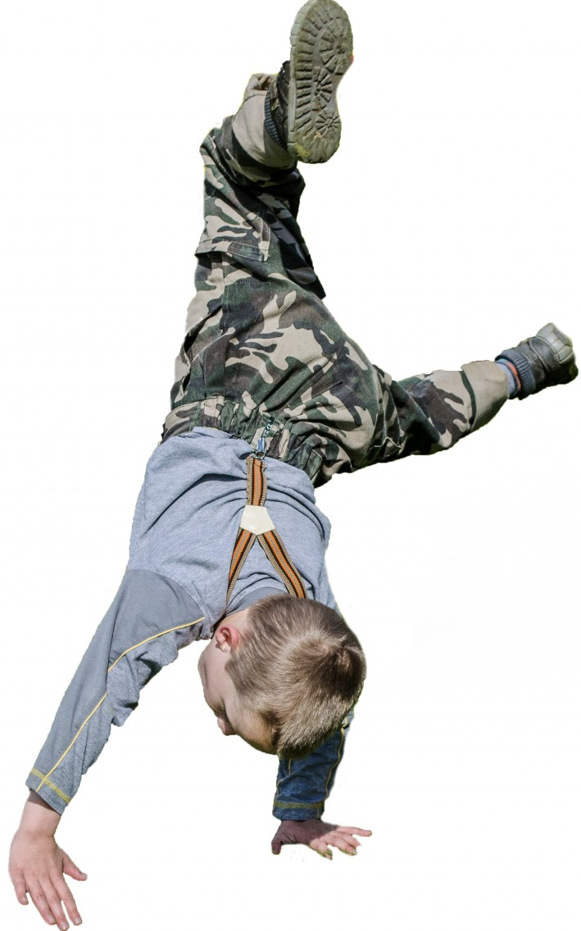
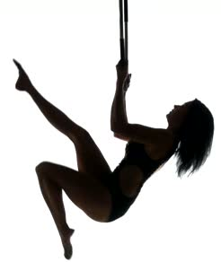


Lean and Agile كله عند العرب رشيق

Slide 7
Lean and Agile
Lean
Agile

