Slide 1



Digital Content Direction
Prepared by Dr. Sherihan Mohamed
DGM 733
Lecture 4

Slide 2




Lecture 4
Lecture 3 Conclusion:
Remember the last Lecture we talk about:
* Public Relations: What Is PR?
* Copywriting, Editing and Other Essentials.
* Risk and Crisis Management.
* Convergence and SMIs.
* Who Are SMIs?
* Conclusion
* References

Slide 3
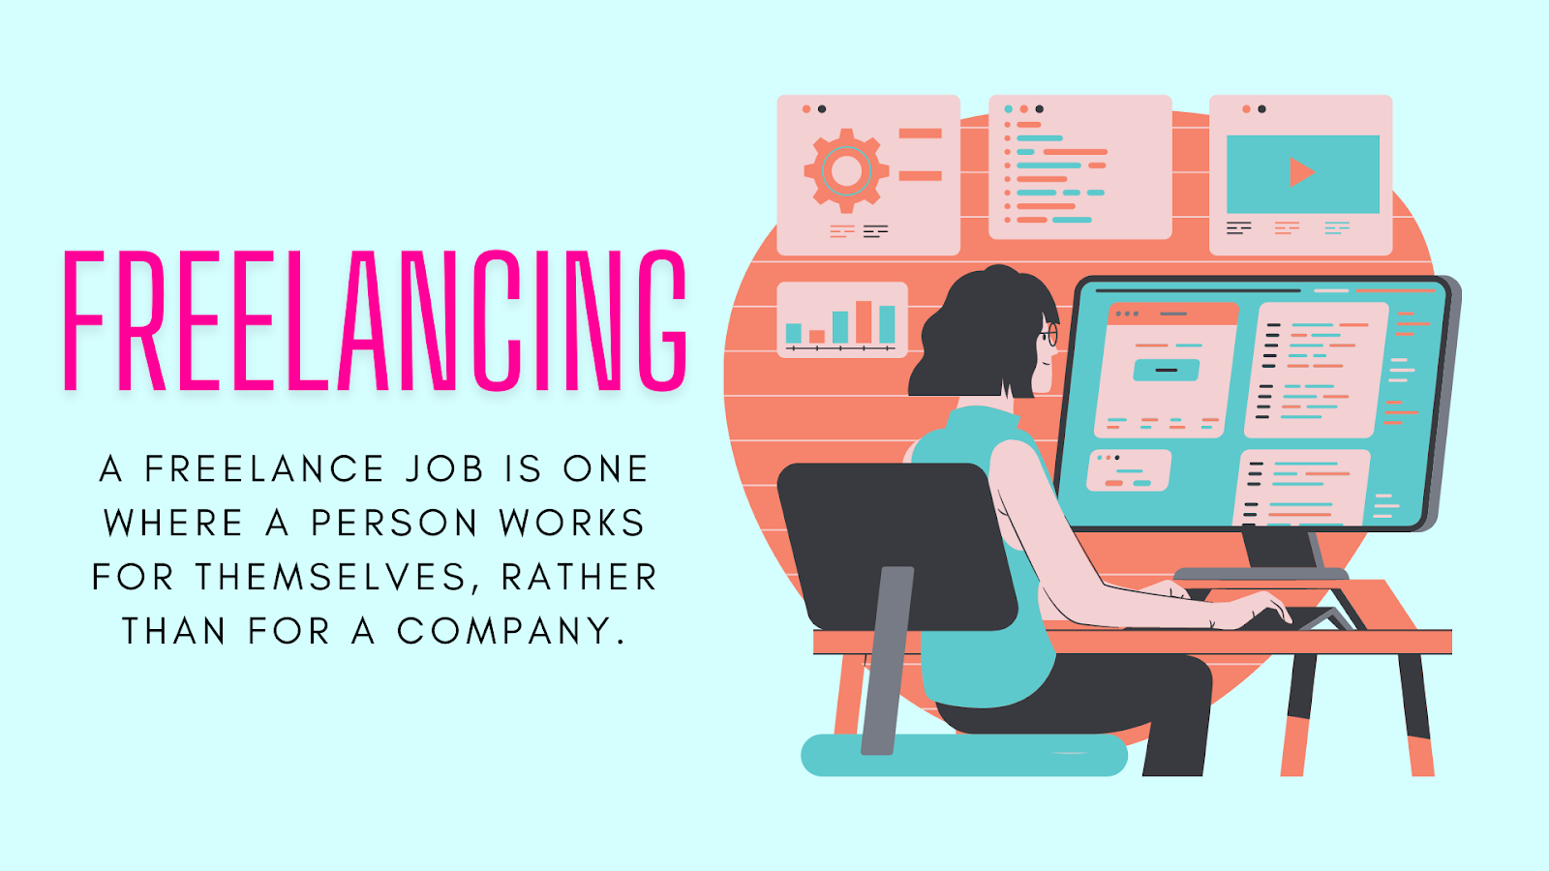
Digital Content: production media
Lecture 4

Slide 4

Lecture 4
Lecture Outlines:
* What Is Freelancing?
* Understanding Freelancers.
* Benefits and Drawbacks of Being a Freelancer.
* Types of Freelancers.
* Conclusion
* References

Slide 5

Lecture 4
Digital Content Direction
What Is Freelancing?

Slide 6

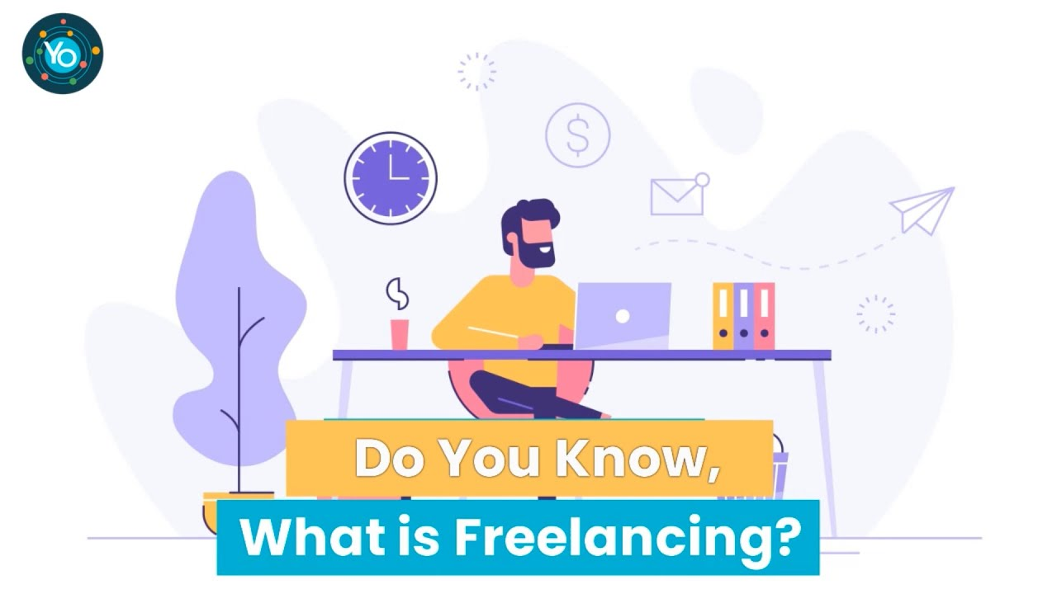
It is likely that every content producer will at some time or another Freelance, either as their main gig or as a side hustle.
This can seem to be a liberating way to make a living, at least from a distance.

Slide 7

Freelancers need to think like CEOs and act like entrepreneurs. Everyone else’s business is their business—literally!
They must be able to seamlessly slot into, or add value to, the operations of often quite disparate clients.

Slide 8

Freelancing means working for yourself. It means conceptualising and actualising yourself as a small business, which sells or leases its products or services to various clients.

Slide 9
Freelancing gives content producers the illusion of control, but in reality, such work is a constant negotiation between what you want to produce and sell and what the market wants to buy.
Rather than working for one employer, it can feel like you’re working for an ever-changing array of short-term bosses each with their own rules, demands and ways of working.

Slide 10

A freelancer Is Not an employee of a firm and may therefore be at liberty to complete different jobs concurrently by various individuals or firms unless contractually committed to working exclusively until a particular project is completed.

Slide 11
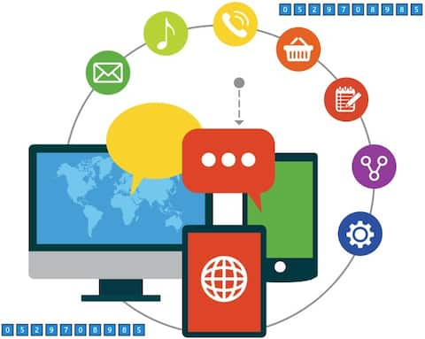
A freelancer is an individual who earns money on a per-job or per- ask basis, usually for short-term work as an independent contractor.

Slide 12
Lecture 4
Digital Content Direction
Understanding Freelancers

Slide 13

Typically, freelancers are considered independent workers and may do their contract work full-time or as a side job to supplement full-time employment, time permitting.

Slide 14

Freelancers, as independent contractors, typically require signed contracts for the job to be done and will agree to a predetermined fee based on the time and effort required to complete the task. This fee may be a flat fee or a per-hour, per-day, or per-project fee, or some other similar measure.

Slide 15

A freelancer tends to work in the creative, skilled, or service sector, such as in film, art, design, editing, copywriting, proofreading, media, marketing, music, acting, journalism, video editing and production, illustration, tourism, consulting, website development, computer programming, event planning, photography, language translation, tutoring, catering, and many more.

Slide 16

Some media professionals have freelancing thrust upon them by circumstance, e.g., redundancy or retrenchment. Others freelance because they are new to an industry and see it as a way of building a portfolio as they chase ongoing positions.

Slide 17

For some freelancers, it is the way they choose to work. Regardless of where you fit on that spectrum, to be successful, you need to remain open to that idea of negotiation, and to be flexible and adaptable, so as to be able to change as the nature of the work you take on does.

Slide 18

The digital revolution in the late 1990s and early 2000s made working across great distances easier.
It removed the need for anything other than an online relationship between producer and client in many cases.

Slide 19

This and other factors, such as the Global Financial Crisis of 2008 saw a push from employers in media industries to make such working relationships short-term and insecure and to rely more heavily on freelancers, as this allowed them to scale their workforces up and down as necessary, thereby minimising financial risk.

Slide 20

The emergence in the 2010s of the gig economy saw the further normalisation of short-term and contingent work via the introduction of digital apps and platforms to industries that had traditionally operated in an employer employee relationship— think Uber versus taxi driving.

Slide 21
Lecture 4
Digital Content Direction
Benefits and Drawbacks of Being a Freelancer

Slide 22

The benefits of being a freelancer include:
* having the freedom to work from home or other unconventional workspaces.
* a flexible work schedule, and a better work-life balance.

Slide 23
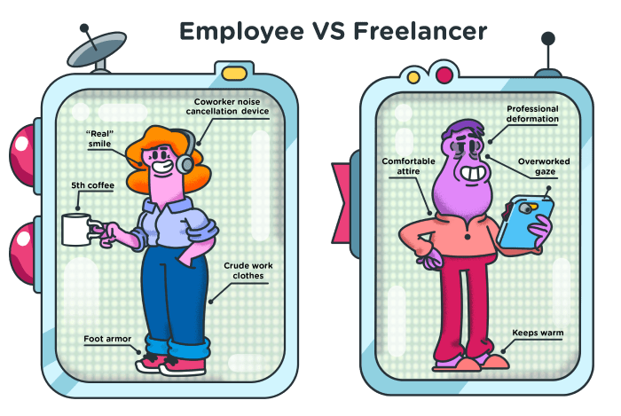
* Freelance work can benefit workers who have been laid off, reducing the incidence of overall unemployment in an economy.
* A freelancer, are their own boss. they choose their workload, their schedule, their dress code, and every other aspect of how they run things.

Slide 24

* Freelancing means you take on various projects from multiple clients. Each project brings something new to the table and provides an opportunity to expand your skill set. You’ll likely find yourself learning new things as you go.

Slide 25
The Drawbacks of being a freelancer include:
* uncertainty about future income.
* job stability, and consistency with getting new work.
* There is also a lack of employer benefits, such as insurance and retirement plans, and sometimes lower per-hour rates compared with employed salary earners.

Slide 26

* One of the disadvantages of freelancing is the lack of benefits you would otherwise receive when working for a company.
* The income as a freelancer will depend entirely on the amount of work the freelancer do.

Slide 27

* Being self-employed requires to create your own workspace. That can mean designating part of your home as your office or finding a workspace outside of your home. Both can come with costs such as rent, furnishings, supplies, and internet service.

Slide 28

* While the idea of working without office politics or a required dress code can sound appealing, in time, the freelancer may miss some aspects of having coworkers.

Slide 29
Lecture 4
Digital Content Direction
Types of Freelancers

Slide 30

An example of a freelancer would be an independent journalist who reports on stories of their own choosing and then sells their work to the highest bidder. Another example is a web designer or an app developer who does one-time work for a client and then moves on to another client.

Slide 31

Other contexts in which freelancers often work include:
1. Content Producer: The opportunities are virtually endless for freelance writing and content-producing jobs. Content production is among the most popular types of freelance jobs today on platforms like WriterAccess.

Slide 32
As long as you are reliable and quick and can produce unique and quality content, you can keep yourself pretty busy.
Medical and technical writing jobs tend to pay more, as well as press releases, but there are also plenty of options for website content, blogs, and social media content.

Slide 33

2. Web Designer or Web Developer: Since every business needs a website to be successful online, it makes sense that web designers and web developers are in high demand.
A web designer or web developer will work with their clients to plan, design, and code websites that look great and bring in traffic.

Slide 34
Many designers have the capability of working in any industry as well as other design projects outside of websites, including brochures, emails, logos, and more.
Web developers, on the other hand, tend to specialize in different areas.
There is a significant amount of web design work on various freelance platforms, so make sure to check it out.

Slide 35
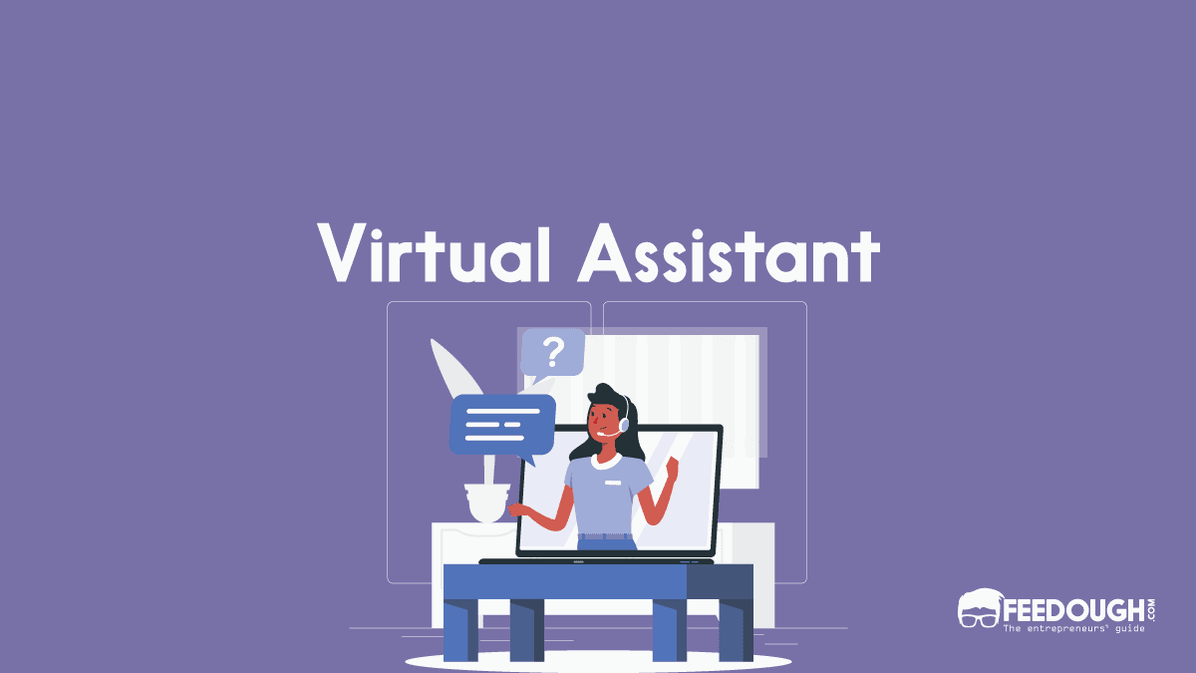
3. Virtual Assistant: Virtual assistants are growing in popularity due to the fact that more companies are looking to outsource some of their more day-to-day tasks.

Slide 36

A virtual assistant can help clients free up some of their time so it can be spent on more business-related projects.
These individuals offer a variety of administrative-related services remotely. They can take phone calls, schedule appointments and meetings, manage emails, make travel arrangements, and so much more.

Slide 37

4. Accountant/Financial Consultant: Every company is in need of financial expertise at some point in the duration of their business, which makes accountants, bookkeepers, and financial consultants in high demand.

Slide 38

Plus, there’s the fact that most people don’t like to deal with this side of the business, leading them to outsource.
From handling a company’s finances to evaluating its financial status, these freelancers can handle most financial tasks for a client.

Slide 39
5. Bilingual Services: With more businesses taking a global stance with their presence, the need for freelancers with bilingual skills is more important than ever before.
Translators for Spanish, French, and German tend to be the most popular, and remote bilingual jobs are steadily increasing on FlexJobs.
These freelancers may be called upon to produce content, translate and transcribe, and more.

Slide 40

6. Social Media Specialist: In order to succeed in today’s day and age, it is imperative for all businesses to have an online presence and a brand following.
However, when it comes to social media efforts, it takes up a lot of time. As a result, many organizations opt-out.

Slide 41
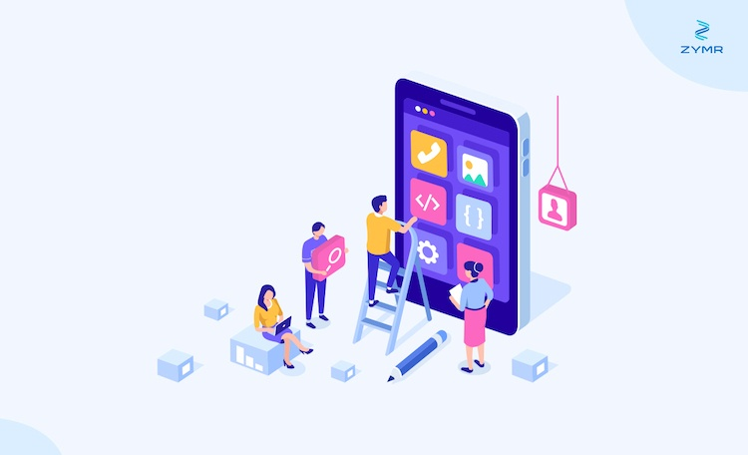
7. App Developer: Businesses are constantly looking for new ways to get into the hands of their customers, which is where a custom app can come into play.
After all, most consumers today have a smartphone that they spend the majority of their time on.

Slide 42

8. Graphic Designer: At some point, every business will need some form of graphic design. This may be a logo, website design, or advertisement.
With that being said, graphic design pertains to various aspects of business, including advertising, marketing, business cards, outdoor signage, and more.

Slide 43
Lecture 4
Lecture Outlines:
* What Is Freelancing?
* Understanding Freelancers.
* Benefits and Drawbacks of Being a Freelancer.
* Types of Freelancers.

Slide 44


Lecture 3
Lecture References:
* Jenkins, H., Ford, S., & Green, J. (2013), Spreadable media: Creating value and meaning in a networked culture, New York University Press.
* Jay Daniel Thompson & John Weldon (2022), Content Production for Digital Media: An Introduction, Springer Nature Singapore.

Slide 45


Thank You

Slide 46

Digital Content
Direction
Lecture 4
DGM 733
Prepared by:
Dr. Sherihan Mohamed

