Slide 1


Entrepreneurship
& Innovation
Prepared by Dr. Amany Ramadan
PMG 611
Lecture 10

Slide 2




Lecture 10
PMG ( 611)
Prepared by
Dr. Amany Ramadan
www.midocean.ae

Slide 3

Chapter
Recruiting & staffing For Entrepreneurs
(Strategy and Planning)
10
www.midocean.ae

Slide 4

Learning objectives
Explain what human resource management is and how it relates to the management process.
Give at least eight examples of how all managers can use human resource management concepts and techniques.
Illustrate the human resource responsibilities of line and staff (HR) managers.
Provide a good example that illustrates HR’s role in formulating and executing company strategy.
Write a short essay that addresses the topic: Why metrics and measurement are crucial to today’s HR managers.
www.midocean.ae

Slide 5
Introductory Overview of Human Resource Management
www.midocean.ae

Slide 6






The Management Process
Planning
Controlling
Organizing
Leading
Staffing

Slide 7
Human Resource Management at Work
What is Human Resource Management (HRM)?
    The policies and practices involved in carrying out the ‘people’ or human resource aspects of a management position, including:
      Recruiting, managing, screening, developing, orienting, training, rewarding, and appraising employees at work.

Slide 8

Human Resource Management at Work
Acquisition
Fairness
Training
Human
Resource Management
(HRM)
Health and Safety
Appraisal
Labor Relations
Compensating

Slide 9
Personnel Aspects of a Manager’s Job
Conducting job analyses
Planning labor needs and recruiting job candidates
Selecting job candidates
Orienting and training employees
Managing wages and salaries
Providing incentives and benefits
Appraising performance
Communicating (interviewing, counseling, disciplining)
Training and developing managers
Building employee commitment

Slide 10
Personnel Mistakes
www.midocean.ae

Slide 11
Personnel Mistakes
Hire the wrong person for the job.
Experience high turnover.
Have your people not doing their best.
Waste time with useless interviews.
Have your company taken to court because of unfair actions against employees.
Have your company taken to court for unsafe practices.
Have some employees think their salaries are unfair relative to others’ in the organization.
Allow a lack of training to undermine your department’s effectiveness.
Commit any unfair labor practices.

Slide 12
Basic HR Concepts
The bottom line of managing is getting results.
HR creates value by engaging in activities that produce the employee behaviors that the company needs, to achieve its strategic goals.

Slide 13
Line and Staff Aspects of HRM
Line manager
    A manager who is authorized to direct the work of subordinates and is responsible for accomplishing the organization’s tasks
Staff manager
    A manager who assists and advises line managers

Slide 14
Line Managers’ Human Resource Duties
Placing the right person in the right job
Starting new employees in the organization (orientation)
Training employees for jobs that are new to them
Improving the job performance of each person
Gaining creative cooperation and developing smooth working relationships
Interpreting the company’s policies and procedures
Controlling labor costs
Developing the abilities of each person
Creating and maintaining department morale
Protecting employees’ health and physical condition

Slide 15
Human Resource Managers’ Duties
Line Function
Line Authority
Implied Authority
Coordinative Function
Functional Authority
Functions of
HR Managers
Staff Functions
Staff Authority
Innovator

Slide 16
Human Resource Specialties
Recruiters
Labor Relations Specialists
Job Analysts
Human Resource Specialties
Training Specialists
Compensation Managers

Slide 17
The changing Role of the HRM
www.midocean.ae

Slide 18

The Changing Role of Human Resource Management
Strategic Human Resource Management
Managing with the HR Scorecard Process
New Responsibilities for HR Managers
Creating High- Performance Work Systems
Measuring the HRM Team’s Performance

Slide 19
Technological Applications for HR
Application service providers (ASPs) and technology outsourcing
Portals
PCs and high-speed access
Streaming desktop video
The mobile internet and wireless net access
E-procurement
Internet- and network-monitoring software
Bluetooth
Electronic signatures
Electronic bill presentment and payment
Data warehouses and computerized analytical programs

Slide 20
High-Performance Work System Practices
Employment security
Selective hiring
Extensive training
Self-managed teams/decentralized decision making
Reduced status distinctions
Information sharing
Pay-for-performance rewards
Transformational leadership
Measurement of management practices
Emphasis on high-quality work

Slide 21
Benefits of a High-Performance Work System (HPWS)
Reduces wasta (use of family and other close networks to obtain work-related favors unrelated to merit)
Generates more job applicants
Screens candidates more effectively
Provides more/better training and lower employee turnover
Links pay more explicitly to performance and appraisals
Fosters a safer work environment
Produces more qualified applicants per position
Results in higher profits and lower operating costs
Uses more self-managing work teams

Slide 22
TABLE 1-3 Five Sample HR Metrics
HR Metric | How to Calculate It
Absence rate | # of days absent in month |  | × 100
 | Average # of employees during month × # of workdays
Cost per hire | Advertising + agency fees + employee referrals + travel cost of applicants and staff + relocation costs + recruiter pay and benefits
 | Number of hires
HR expense factor | HR expense
 | Total operating expense
Time to fill | Total days elapsed to fill job requisitions
 | Number hired
Turnover rate | # of separations during month | × 100
 | Average # of employees during month
Notes:
Sources: Robert Grossman, “Measuring Up,” HR Magazine, January 2000, pp. 29–35; Peter V. Le Blanc, Paul Mulvey, and Jude T. Rich, “Improving the Return on Human Capital: New Metrics,” Compensation and Benefits Review, January/February 2000, pp. 13–20; Thomas E. Murphy and Sourushe Zandvakili, “Data and Metrics-Driven Approach to Human Resource Practices: Using Customers, Employees, and Financial Metrics,” Human Resource Management 39, no. 1, Spring 2000, pp. 93–105; [HR Planning, Commerce Clearing House Incorporated, July 17, 1996;] SHRM/BNA 2000 Cost Per Hire and Staffing Metrics Survey; www.shrm.org. See also, SHRM Research “2006 Strategic HR Management Survey Report,” Society for Human Resource Management.

Slide 23
Key Terms
authority
ethics
functional authority or functional control
globalization
high-performance work system
HR Scorecard
human capital
human resource management
(HRM)
implied authority
line authority
line manager
management process
metrics
outsourcing
staff authority
staff manager
strategic human resource management (SHRM)
strategic plan
strategy

Slide 24
The Strategic Management Process
Strategy
    A course of action
Strategic Plan
    How an organization intends to match its internal strengths and weaknesses with its external opportunities and threats to maintain a competitive advantage
Strategic Management
    The process of identifying and executing the organization’s mission by matching its capabilities with the demands of its environment

Slide 25
Business Vision and Mission
Vision
A general statement of an organization’s intended direction that evokes emotional feelings in its members
Mission
    Spells out who the company is, what it does, and where it is headed

Slide 26
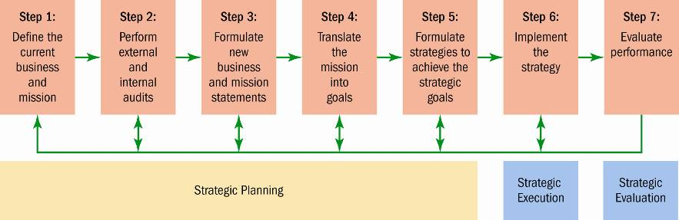
FIGURE 3-1 The Strategic Management Process

Slide 27
The Recruitment and Selection Process
Decide what positions to fill through personnel planning and forecasting.
Build a pool of candidates for these jobs, by recruiting internal or external candidates.
Have candidates complete application forms and perhaps undergo initial screening interviews.
Use selection tools such as tests, background investigations, and physical exams to identify suitable candidates.
Decide who to make an offer to, by having the supervisor and perhaps others interview the candidates.

Slide 28
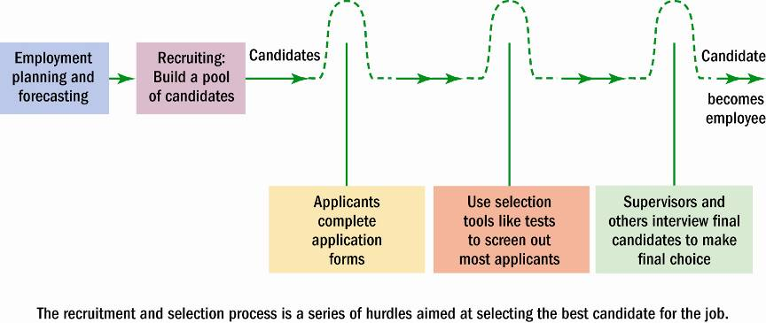
FIGURE 5-1 Steps in the Recruitment and Selection Process

Slide 29
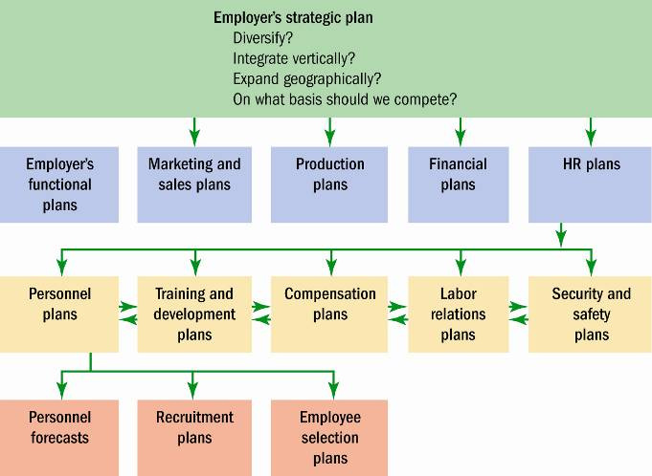
FIGURE 5-2 Linking Employer’s Strategy to Plans

Slide 30
Planning and Forecasting
Employment or Personnel Planning
    The process of deciding what positions the firm will have to fill, and how to fill them
Succession Planning
    The process of deciding how to fill the company’s most important executive jobs
What to Forecast?
    Overall personnel needs
    The supply of inside candidates
    The supply of outside candidates

Slide 31
The Complexities of Recruiting
Recruitment efforts should make sense in terms of the company’s strategic plans.
Some recruiting methods are superior to others, depending on the type of job recruited for.
Recruitment success depends greatly on non-recruitment issues and policies such as higher pay.
Good recruiting preferably requires simultaneously prescreening employees – by providing a realistic preview of the job in the ad, and during the initial call or contact.
The firm’s image affects its recruiting results. For instance, the better the image and reputation of a company, the more it will attract candidates.

Slide 32
Effective Recruiting
Advantages of Centralizing Recruitment
    Facilitates applying strategic priorities
    Strengthens employment brand
    Reduces duplication of HR activities
    Spreads the cost of new HR technologies
    Builds teams of HR experts
    Provides better measurement of HR performance
    Allows for sharing of applicant pools
If the firm’s divisions are autonomous, or their recruitment needs are varied, it may be more sensible to decentralize the recruitment function.

Slide 33

Measuring Recruiting Effectiveness
Evaluating Recruiting Effectiveness
What to Measure
How to Measure

Slide 34
Internal Candidates: Hiring from Within
Advantages
Disadvantages
Foreknowledge of candidate’s strengths and weaknesses
More accurate view of candidate’s skills
Candidates have a stronger commitment to the company
Increases employee morale
Less training and orientation required
Family business successions promote continuity
Failed applicants become discontented
Time wasted interviewing inside candidates who will not be considered
In the Arab world, only 50% of the 80% of family businesses have succession plans

Slide 35
Finding Internal Candidates
Job Posting
Rehiring Former Employees
Hiring from Within
Succession Planning (HRIS)

Slide 36
Human Resource Information System (HRIS)
HRIS is a software or online solution for the data management needed by the HR department.
Such data includes information about employee skills and qualifications, and their personal updates.
HRIS also includes company-related documents such as safety guidelines, payroll, and other financial information.
It is useful in facilitating the succession planning which helps companies to understand their available talent and identify who is available for transition into other positions.
When combined with career development, succession planning allows companies to build a talent pool and employees to stay committed to their career and employer.

Slide 37
Outside Sources of Candidates
Locating Outside Candidates
1
Recruiting via the Internet
5
Executive Recruiters
2
Advertising
6
On-Demand Recruiting Services (ODRS)
3
Employment Agencies
7
College Recruiting
4
Offshoring/Outsourcing
8
Referrals and Walk-Ins

Slide 38
Outside Sources of Candidates (cont)
Recruiting via the Internet
    Advantages
      Cost-effective way to publicize job openings
      More applicants are attracted over a longer period
      Immediate applicant responses
      Online prescreening of applicants
      Links to other job search sites
      Automation of applicant tracking and evaluation
    Disadvantages
      Excessive number of unqualified applicants
      Personal information privacy concerns of applicants

Slide 39
Advertising for Outside Candidates
The Media Choice
    Selection of the best medium depends on the positions for which the firm is recruiting.
      Newspapers: local and specific labor markets
      Trade and professional journals: specialized employees
      Internet job sites: global labor markets
Effective Ads
    Create attention, interest, desire, and action (AIDA)
    Create a positive impression of the firm

Slide 40
Employment Agencies
Types of Employment Agencies
Private
Agencies
Temporary
Agencies
Executive
Recruiters

Slide 41
Outside Sources of Candidates (cont)
Why Use a Private Employment Agency?
    No HR department: firm lacks recruiting and screening capabilities
    To attract a pool of qualified applicants
    To fill a particular opening quickly
    To attract a greater number of applicants
    To reach currently employed individuals who are more comfortable dealing with agencies
    To reduce internal time devoted to recruiting

Slide 42
Outside Sources of Candidates (cont)
Avoiding Problems with Employment Agencies
    Provide the agency with accurate and complete job descriptions.
    Make sure tests, application blanks, and interviews are part of the agency’s selection process.
    Screen agency for effectiveness in filling positions – check with other managers or HR for the most effective agencies.
    Review the internet and classified ads to discover the agencies that handle the positions wanted.
    Supplement the agency’s reference checking by the recruiting company itself checking the final candidate’s references.

Slide 43
Temp Agencies
Benefits of Temps
    Increased productivity – paid only when working
    Allows ‘trial run’ for prospective employees
    No recruitment, screening, and payroll administration costs
Costs of Temps
    Increased labor costs due to fees paid to temp agencies
    Temp employees’ lack of commitment to the firm

Slide 44
Concerns of Temp Employees
Dehumanizing, impersonal, and discouraging treatment by employers
Insecurity about employment and pessimism about the future
Worry about the lack of insurance benefits
Being misled about job assignments and whether temporary assignments are likely to become full-time positions
Being ‘underemployed’ while trying to return to the full-time labor market
Anger toward the corporate world and its values, expressed as alienation and disenchantment

Slide 45
Working with a Temp Agency
Invoicing: Get a sample copy of the agency’s invoice. Make sure it fits your company’s needs.
Time sheets: With temps, the time sheet is not just a verification of hours worked. Once the worker’s supervisor signs it, it’s usually an agreement to pay the agency’s fees.
Temp-to-perm policy: What is the policy if the client wants to hire one of the agency’s temps as a permanent employee?
Recruitment of and benefits for temp employees: Find out how the agency plans to recruit employees and the sorts of benefits it pays.

Slide 46
Working with a Temp Agency (cont)
Dress code: Specify appropriate attire for all offices or plants.
Job description information: Have a procedure whereby you can ensure the agency understands the job to be filled and the sort of person, skills, and so forth, needed to fill it.

Slide 47
Offshoring/Outsourcing White-Collar and Other Jobs
Political and Military Instability
In Arab world it focuses on core competencies
Cultural Misunderstandings
Main
Issues
Foreign contracts, liability, and legal concerns
Customers’ security and privacy concerns

Slide 48
Outside Sources of Candidates (cont)
Executive Recruiters (Headhunters)
    Internet technology and specialization trends
Guidelines for Choosing a Recruiter
    Make sure the firm is capable of conducting a thorough search.
    Meet the individual who will handle the assignment.
    Ask how much the search firm charges.
    Never rely solely on the recruiter to do all the reference checking.

Slide 49
Outside Sources of Candidates (cont)
On-Demand Recruiting Services (ODRS)
    Short-term specialized recruiting:
      Is paid by the hour/project
      Handles recruiting, analysis, and prescreening
College Recruiting
    On-campus recruiting goals:
      To determine if the candidate is worthy of further consideration
      To attract good candidates

Slide 50
Outside Sources of Candidates (cont)
    On-site visits
      Invitation letters
      Assigned hosts
      Information packages
      Planned interviews
      Timely employment offer
      Follow-up
    Internships
    Win–win situation for student and employer

Slide 51
Outside Sources of Candidates (cont)
Employee Referrals
    Referring employees become stakeholders.
    Referral is a cost-effective recruitment program.
    Referral can speed up diversifying the workforce.
Walk-ins
    Seek employment through a personal, direct approach to the employer
    Courteous treatment of any applicant is a good business practice

Slide 52
Recruiting a More Diverse Workforce
Expatriates
Older Workers
Minorities and Women

Slide 53
Developing and Using Application Forms
Uses of Application Information
Applicant’s education and experience
Applicant’s progress and growth
Applicant’s employment stability
Applicant’s likelihood of success

Slide 54
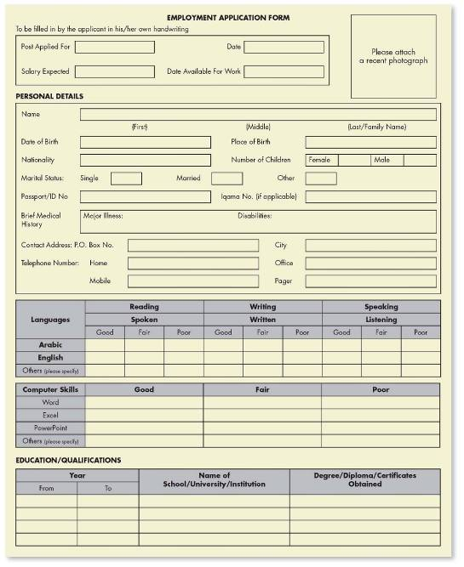
FIGURE 5-9
Employment
Application
Notes:
Source: www.kingabdullahcity.com/en/Downloads/EmploymentApplicationForm.doc, accessed October 12, 2011.

Slide 55
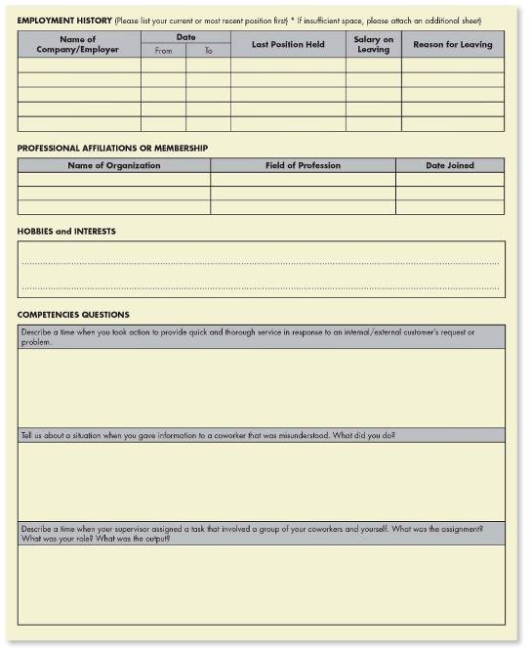
FIGURE 5-9
Employment
Application
(cont)
55
Notes:
Source: www.kingabdullahcity.com/en/Downloads/EmploymentApplicationForm.doc, accessed October 12, 2011.

Slide 56
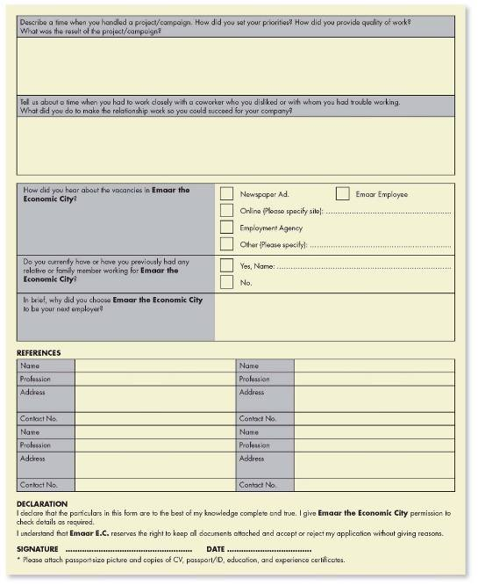
FIGURE 5-9
Employment
Application
(cont)
56
Notes:
Source: www.kingabdullahcity.com/en/Downloads/EmploymentApplicationForm.doc, accessed October 12, 2011.

Slide 57
Strategic Human Resource Management
    The linking of HRM with strategic goals and objectives in order to improve business performance and develop organizational cultures that foster innovation and flexibility
      Involves formulating and executing HR systems – HR policies and activities – that produce the employee competencies and behaviors that the company needs to achieve its strategic aims

Slide 58
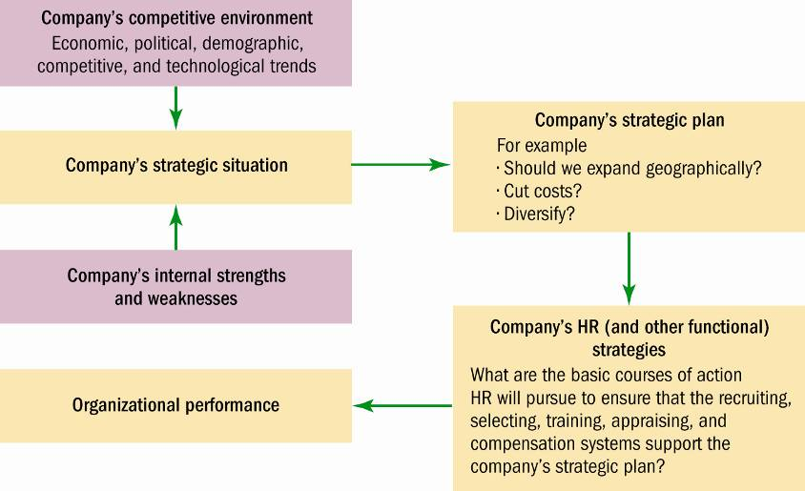
FIGURE 3-5 Linking Company-Wide and HR Strategies
Notes:
Source: © Gary Dessler, Ph.D., 2007.

Slide 59
Strategic Human Resource Challenges
Basic Strategic Challenges
Corporate productivity and performance improvement efforts
Expanded role of employees in the organization’s performance efforts
Increased HR team involvement in design of strategic plans

Slide 60
Human Resource Management’s Strategic Roles
Strategic Planning Roles
Strategy Execution
Role
Strategy Formulation Role

Slide 61
Creating the Strategic Human Resource
Management System
Components of a Strategic HRM System
Human Resource Professionals
Human Resource Policies and Practices
Employee Behaviors and Competencies
61

Slide 62
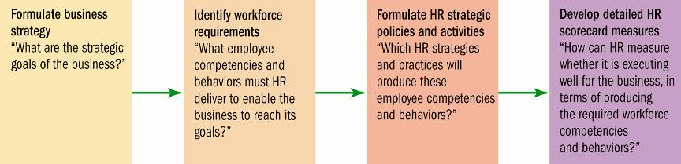
FIGURE 3-7 Basic Model of How to Align HR
Strategy and Actions with Business Strategy
Notes:
Source: Adapted from Garrett Walker and J. Randal MacDonald, “Designing and Implementing an HR Scorecard,” Human Resources Management 40, no. 4, 2001, p. 370.

Slide 63
After studying this chapter, you should be able to:
Discuss the nature of job analysis, including what it is and how it’s used.
Use at least three methods of collecting job analysis information, including interviews, questionnaires, and observation.
Write job descriptions, including summaries and job functions, using the internet and traditional methods.
Write job specifications using the internet as well as your judgment.
Explain job analysis in a ‘jobless’ world, including what it means and how it’s done in practice.

Slide 64
Types of Information Collected
Work
activities
Human requirements
Human behaviors
Information Collected via Job Analysis
Job
context
Machines, tools, equipment, and work aids
Performance standards

Slide 65
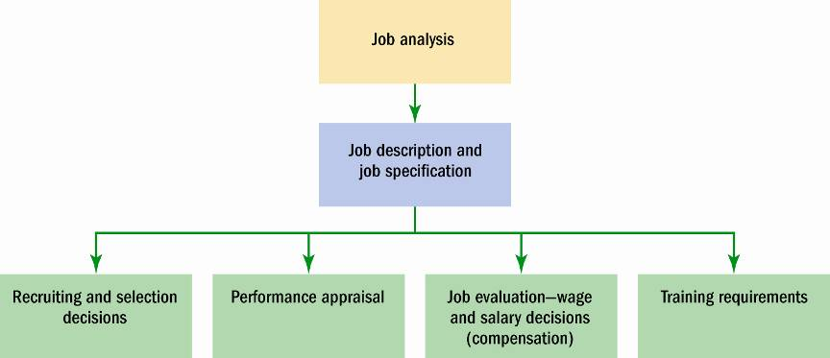
FIGURE 4-1 Uses of Job Analysis Information

Slide 66
Steps in Job Analysis
Steps in doing a job analysis:
1
Decide how to use the information.
2
Review relevant background information.
3
Select representative positions.
4
Analyze the job.
5
Verify the job analysis information.
6
Develop a job description and job specification.

Slide 67
Methods of Collecting Job Analysis Information: The Interview
Information Sources
    Individual employees
    Groups of employees
    Supervisors with knowledge of the job
Interview Formats
    Structured (checklist)
    Unstructured (open-ended)
Advantages
    Quick, direct way to find overlooked information
Disadvantages
    Distorted information

Slide 68
Job Analysis: Interviewing Guidelines
The job analyst and supervisor should work together to identify the workers who know the job best.
Quickly establish rapport with the interviewee.
Follow a structured guide or checklist: one that lists open-ended questions and provides space for answers.
Ask the worker to list his or her duties in order of importance and frequency of occurrence.
Review and verify the data after completing the interview.

Slide 69
Methods of Collecting Job Analysis Information: Questionnaires
Information Source
    Have employees fill out questionnaires to describe their job-related duties and responsibilities
Questionnaire Formats
    Structured checklists
    Open-ended questions
Advantages
    Quick and efficient way to gather information from large numbers of employees
Disadvantages
    Expensive and time-consuming to prepare and test the questionnaire

Slide 70
Methods of Collecting Job Analysis Information: Observation
Information Source
    Observing and noting the physical activities of employees as they go about their jobs
Advantages
    Provides first-hand information
    Reduces distortion of information
Disadvantages
    Time-consuming
    Difficult to capture entire job cycle
    Of little use if job involves a high level of mental activity

Slide 71
Methods of Collecting Job Analysis Information: Participant Diary/Log
Information Source
    Workers keep a chronological diary/ log of what they do and the time spent on each activity
Advantages
    Produces a more complete picture of the job
    Employee participation
Disadvantages
    Distortion of information
    Depends on employees accurately recalling earlier activities (without dictating machines/pagers)

Slide 72
Writing Job Descriptions
Job
Identification
Job
Specifications
Job
Summary
Sections of a Typical Job Description
Working Conditions
Responsibilities and Duties
Standards of Performance
Authority of Incumbent

Slide 73
The Job Description
Job Identification
    Job title
    Preparation date
    Preparer
Job Summary
    General nature of the job
    Major functions/activities
Relationships
    Reports to:
    Supervises:
    Works with:
    Outside the company:
Responsibilities and Duties
    Major responsibilities and duties (essential functions)
    Decision-making authority
    Direct supervision
    Budgetary limitations
Standards of Performance and Working Conditions
    What it takes to do the job successfully
73

Slide 74
Writing Job Specifications
“What human traits and experience are required to do this job well?”
Specifications for Trained Versus Untrained Personnel
Specifications Based on
Judgment
Specifications Based on Statistical Analysis

Slide 75
Competency-Based Job Analysis
Competencies
    Demonstrable characteristics of a person that enable the performance of a job
Reasons for Competency-Based Job Analysis
    To support a high-performance work system
    To create strategically-focused job descriptions
    To support the performance management process in fostering, measuring, and rewarding:
      General competencies
      Leadership competencies
      Technical competencies

Slide 76
Competency-Based Job Analysis (cont)
How to Write Job Competencies-based Job Descriptions:
      Interview job incumbents and their supervisors.
      Ask open-ended questions about job responsibilities and activities.
      Identify critical incidents that pinpoint success on the job.

Slide 77
Key Terms
competencies
competency-based job analysis
dejobbing
diary/log
job analysis
job description
job enlargement
job enrichment
job rotation
job specifications
organization chart
performance management
position analysis questionnaire (PAQ)
process chart
reengineering

Slide 78

www.midocean.ae
The human resource responsibilities of line and staff (HR) managers is very crucial.
HR’s role in formulating and executing company strategy.
Chapter
10
Conclusion:

Slide 79


Thank You

