Slide 1
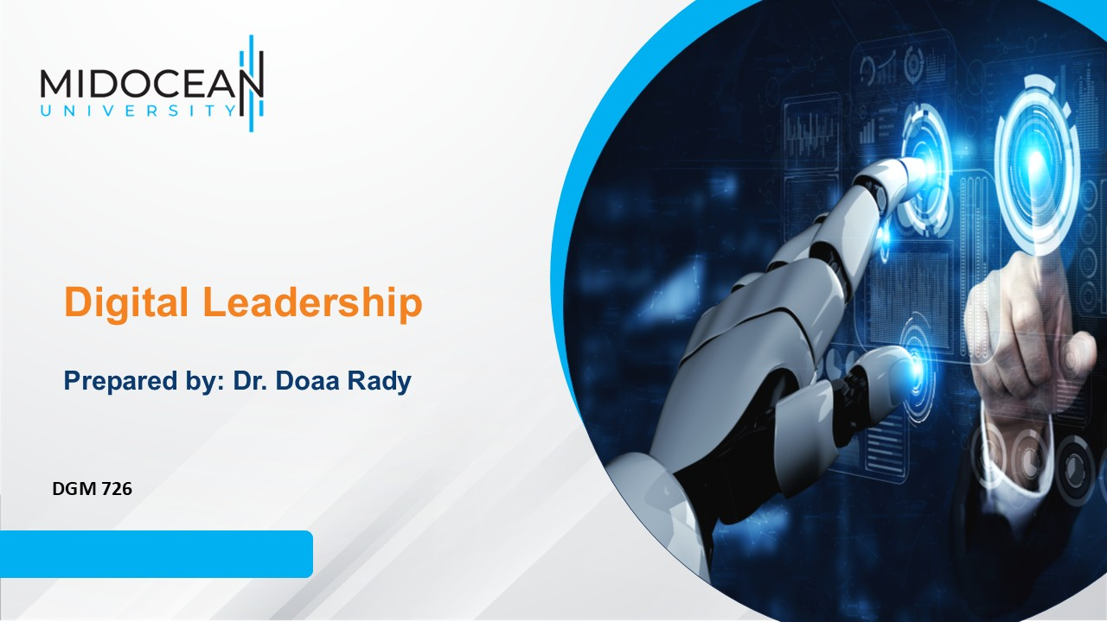
Lecture 10
Using Artificial Intelligence
in Digital Leadership

Slide 2

Lec.10
Last Lecture, we leaned about
  Digital Media and Social Media
    Digital Media Ethics
  Leaders and Social Media
    The six dimensions of social-media-literate leadership
      The leader as producer
      The leader as distributor
      The leader as recipient
      The leader as adviser and orchestrator
      The leader as architect
      The leader as analyst
  Ethical leadership
    Components of ethical leadership
    Cross-Cultural Versus Diversity
    Innovation and Leadership in the Media Industry

Slide 3
Lec.10
Lecture outline
Today’s Lecture we will Know about
  Defining AI in Digital Leadership
  Key Roles of AI in Digital Leadership
  Ethics of Using AI in Digital Leadership
  Core Competencies of the AI-Era Digital Leader
  Developing a Plan for Building Leadership
  Building Leadership 11 Steps
  How to Develop a Personal Leadership Philosophy?

Slide 4
Lec.10
Learning Outcomes
Understanding the concept, roles, ethical considerations, and required competencies of AI in shaping effective digital leadership in the modern era.
Developing a Plan for Building Leadership
Building Leadership 11 Steps
Developing a Personal Leadership Philosophy

Slide 5
Introduction
"Leadership is the key driver of best practices, innovation and productivity. It's not surprising that there is strong correlation between leadership development and how companies perform."
Your leadership philosophy is how you view yourself in the role of a leader. It’s a role many of us take in a variety of different capacities, whether at work or at home.
But, regardless of the type of leader you are or how many people you lead, your leadership philosophy is actually a very personal viewpoint.
Creating one requires clarity and a depth of character that allows for quiet contemplation and looking inward at your own personal values, beliefs, skills and assumptions.
It requires you are being honest about your weaknesses and proud of your unique attributes and strengths. And, once you create your leadership philosophy, you can use it to guide you as you manage your day-to-day life.
In the digital age, leadership no longer depends only on charisma or traditional management skills. It increasingly relies on:
  • Data and analytics to support decision-making
  • Predictive insights through machine learning
  • AI tools for communication, project management, and HR support
  • Managing remote and hybrid teams through digital platforms
Lec.10

Slide 6


Lec.10
Defining AI in Digital Leadership

Slide 7
Lec.10
Defining AI in Digital Leadership
AI in digital leadership refers to the use of data-driven intelligent systems and tools to support decision making, team management, performance analysis, strategy development, and organizational communication, while maintaining human responsibility and ethical oversight.”
Key dimensions:
• Decision support: AI systems process large datasets, uncover patterns, and present possible scenarios for leaders.
• Team management: AI-enhanced platforms help coordinate tasks, monitor progress, and provide feedback to virtual teams.
• Performance analytics: dashboards and metrics powered by AI provide insights into individual and organizational performance.
• Strategic development: AI helps forecast trends, customer behavior, and potential risks.
• Organizational communication: AI assists in drafting messages, summarizing information, and analyzing stakeholder responses.

Slide 8
Lec.10
Key Roles of AI in Digital Leadership

Slide 9
Lec.10
Key Roles of AI in Digital Leadership (Five Pillars)
1) AI for Strategic Vision
How AI supports strategic visioning:
  • Analyzing digital trends in markets and media ecosystems.
  • Predicting audience behavior and content consumption patterns.
  • Mapping competitors’ strategies through content and campaign monitoring tools.
  • Enabling scenario-based strategic planning using AI simulations and predictive models.

Slide 10
Lec.10
Key Roles of AI in Digital Leadership (Five Pillars)
2) AI in Decision Making
AI can significantly improve the quality and speed of leadership decisions by:
• Processing large volumes of data and extracting key indicators and hidden patterns.
• Comparing strategic options (platforms, channels, content types) according to well-defined criteria.
• Predicting risks and opportunities using predictive analytics.
• Supporting strategic choices while keeping the leader “in the loop” and accountable.

Slide 11
Lec.10
Key Roles of AI in Digital Leadership (Five Pillars)
3) AI in Leading Virtual Teams
AI-enabled tools can transform how leaders manage virtual and hybrid teams:
  • Structuring work through AI-enhanced project management systems that prioritize tasks and identify bottlenecks.
  • Monitoring performance with dashboards showing task completion, deadlines, and engagement levels.
  • Allocating tasks based on competencies, workload, and previous performance.
  • Evaluating productivity and collaboration patterns in distributed teams.

Slide 12
Lec.10
Key Roles of AI in Digital Leadership (Five Pillars)
4) AI in Leadership Communication
AI can enhance leadership communication in several ways:
  • Drafting clear, persuasive leadership messages (emails, speeches, announcements) with language models and then adapting them to the organization’s culture.
  • Producing performance reports and executive summaries that translate complex data into actionable insights.
  • Supporting crisis communication by monitoring social media conversations, detecting sentiment, and suggesting initial responses for human review.
  • Analyzing communication patterns within teams (tone, engagement, inclusiveness) to identify potential issues.

Slide 13
Lec.10
Key Roles of AI in Digital Leadership (Five Pillars)
5) AI in Diversity, Equity, and Inclusion (DEI) Leadership
AI can both support and threaten DEI goals; leaders must understand both sides:
• Reducing bias in recruitment by focusing on skills and experience rather than sensitive personal attributes, when systems are designed and audited responsibly.
• Analyzing employee surveys and engagement data to reveal underrepresented or marginalized groups.
• Monitoring patterns in promotions, pay, and task distribution to detect inequities.
• Supporting ethical decision making by assessing the impact of decisions on different stakeholder groups.

Slide 14
Lec.10
Ethics of Using AI in Digital Leadership

Slide 15
Lec.10
Ethics of Using AI in Digital Leadership
Key ethical concerns to discuss:
  • Algorithmic bias:
    AI systems trained on biased data may reproduce and amplify discrimination in hiring, evaluation, or content distribution.
  • Privacy and surveillance:
    Collecting and analyzing personal data from employees or audiences without adequate consent or transparency.
  • Over-reliance on technology:
    Leaders risk deferring too much to algorithms and losing critical thinking and moral courage.
  • Erosion of independent leadership thinking:
    Heavy use of generative AI for writing and analysis can weaken core leadership skills over time.

Slide 16
Lec.10
Core Competencies of the AI-Era Digital Leader

Slide 17
Lec.10
Core Competencies of the AI-Era Digital Leader
Research highlights several essential competencies for leaders in AI-intensive environments:
  1. Data literacy: understanding metrics, dashboards, and asking the right questions of data and AI experts.
  2. Strategic thinking: connecting AI-generated insights to long-term organizational goals.
  3. Virtual team leadership: designing flexible digital structures, managing performance remotely, and nurturing trust and belonging.
  4. Intelligent decision making: combining data-driven recommendations with intuition, experience, and stakeholder input.
  5. Ethical leadership: ensuring that AI use aligns with principles of fairness, dignity, and social responsibility.

Slide 18
Lec.10
AI Tools for Digital Leaders
1) Content Creation Tools
•ChatGPT/ DeepSeek /Perplexity: Generates speeches, strategic messages, and leadership content ideas quickly.
•Canva: Creates professional presentations, visuals, and branded social-media graphics easily.
•Runway ML: Produces AI-enhanced leadership videos and short explanatory visual messages.
•Descript: Edits video and voice content by editing text transcripts efficiently.
2) Content Distribution & Publishing Tools
•Hootsuite: Schedules and manages leadership communication across multiple platforms centrally.
•Buffer: Optimizes posting schedules using engagement timing recommendations.
•Later: Plans visual social-media calendars with strong Instagram-focused scheduling features.

Slide 19
Lec.10
AI Tools Digital Leaders
3) Social Listening & Information Monitoring Tools
•Feedly: Tracks trends and strategic topics using AI-filtered news monitoring.
•Google Alerts: Sends real-time alerts about mentions of leaders, institutions, or key issues.
•Talkwalker: Analyzes public sentiment and detects emerging digital reputation risks early.
4) Collaboration & Decision-Support Tools
•Notion AI: Organizes institutional knowledge and supports structured team decision workflows.
•Microsoft Copilot: Assists with reports, meeting summaries, and data-driven leadership insights.
•Slack: Facilitates real-time coordination and communication across digital leadership teams.

Slide 20
Lec.10
AI Tools Digital Leaders
5) Strategy Design & Digital Architecture Tools
•Miro: Builds strategy maps and collaborative digital transformation planning boards.
•Lucidchart: Designs organizational communication flows and decision frameworks visually.
•Figma: Supports user-experience planning for institutional digital platforms.
6) Data Analytics & Performance Intelligence Tools
•Tableau: Transforms complex datasets into strategic dashboards for leadership decisions.
•Power BI: Integrates institutional data sources into real-time performance insights.
•Google Analytics: Measures audience behavior and evaluates digital communication impact.

Slide 21
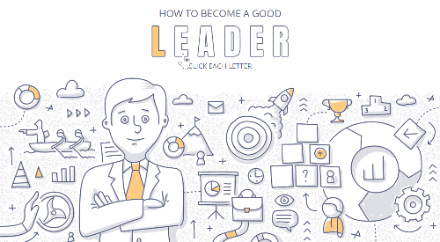
Lec.10
Developing a Plan for
Building Leadership

Slide 22
Lec.10
Developing a Plan for Building Leadership
Why do you need a plan for
building leadership?
A plan will get you where you want to go.
A simple leadership plan is just a list of leadership development goals, with a timeline and some actions for accomplishing the goals.
When do you develop a plan?
At the very beginning.
If you haven't done it already, do it now.
Every person needs to continue learning and growing in order to meet the challenges around them.

Slide 23
Lec.10
Developing a Plan for Building Leadership
How do you develop a plan?
Envision your leadership team.
Set leadership development goals for your group or organization.
Pick your methods:
  Teaching as you lead
  Mentoring
  Exchange programs
  Orientations
  Workshops & training sessions
  Retreats
  Leadership groups

Slide 24
Lec.10
Developing a Plan for Building Leadership
How do you develop a plan?
Set individual leadership development goals
  Expect people to act like leaders.
  Consider what individual skills you need in your group.
  Invest in each person.
  Write individual leadership plans.
Recruit new people to lead.
Develop yourself as a leader.

Slide 25

Lec.10
Building Leadership
11 Steps

Slide 26
Building Leadership: 11 Steps
Lec.10
1. Become engaged as a leader.
  Develop and communicate a personal vision.
  Indicate how will you listen to people.
  How will you take responsibility for your community?
  Set goals.
  How will you serve individuals in the group?
  How will you serve the group as a whole?
  Propose specific changes in how you will lead others.
  How will you get the work done?
  How will you recruit and prepare others to become leaders?

Slide 27
Building Leadership: 11 Steps
Lec.10
2. Assess your own competence in core tasks of leadership, and plan for improvement. Consider your ability for each task and how you will enhance your own competency in each of the nine core tasks:
    Envisioning goals
    Affirming values
    Motivating
    Managing
    Achieving workable unity
    Explaining
    Serving as a symbol
    Representing the group
    Renewing

Slide 28
Building Leadership: 11 Steps
Lec.10
3. Assess your group's competence in core tasks of leadership and plan for improvement. Consider abilities of the group's leaders and members for each of the eight core tasks below and note how your group's competence will be enhanced in:
    Envisioning goals
    Affirming values
    Motivating
    Managing
    Achieving workable unity
    Explaining
    Serving as a symbol
    Representing the group

Slide 29
Building Leadership: 11 Steps
Lec.10
4. Envision the leadership of the group:
    Identify the core tasks of leadership needed for this work (e.g., your project)
    Indicate how many leaders are needed (or wanted) on the team
    Specify what skills are needed for this work.
    Indicate who needs to be included to reflect the community and its interests.
    Describe how the leadership team will support one another and what additional supports are available to them.
    Indicate what commitment there is to working together in common purpose.

Slide 30
Building Leadership: 11 Steps
Lec.10
5. Set leadership development goals for the group and its members:
    Indicate the strengths of the group, noting what should be enhanced.
    Indicate gaps between the current situation and the ideal team, and how these will be addressed through recruitment or development.
    Based on differences between the leadership team and those served, indicate in what ways, if any, that diversity of the team should be enhanced.
    Indicate specific goals for leadership development and priorities to be addressed.

Slide 31
Building Leadership: 11 Steps
Lec.10
6. Select methods for developing leadership.
Indicate how you (your team) will:
    Teach as you lead through modeling.
    Arrange workshops and training.
    Provide access to more experienced mentors or coaches.
    Form learning networks and leadership support groups.
    Use retreats to reflect on the work and to restore members for continuing the work.

Slide 32
Building Leadership: 11 Steps
Lec.10
7. Recruit new people to lead.
Indicate how you (your group) will:
    Attract new members to serve as leaders of the group.
    Determine together how they will be involved.
    Enhance diversity or abilities, experience, relationships, and cultural competence in the team.
    Prepare new generations of leadership for this work.

Slide 33
Building Leadership: 11 Steps
Lec.10
8. Enhance collaboration within and across groups.
Consider how you will:
    Serve as a catalyst of change.
    Lead the process, not the people.
    Know the leadership context.
    Facilitate the work among partners
    Motivate.
    Be flexible and persistent.
    Distribute credit.

Slide 34
Building Leadership: 11 Steps
Lec.10
9. Promote leadership as service.
Consider how you will encourage group members to:
    Act as one among equals.
    Use power legitimately.
    Do the necessary work.
    Listen to and care for those served.
    Start where people are.
    Challenge others.
    Adapt to fit the situation.
    Inspire others to answer the call of service.

Slide 35
Building Leadership: 11 Steps
Lec.10
10. Promote adaptation to new situations.
Consider how you will:
    Identify the adaptive challenge.
    Keep the level of stress within a tolerable range.
    Focus attention on ripening issues.
    Give the work back to the people.
    Protect the voices of leadership without authority.

Slide 36
Building Leadership: 11 Steps
Lec.10
11. Indicate how you will build a great group with strong leadership. Communicate how you will:
    Find and attract talented people.
    Create a situation in which people can apply their talents.
    Get great projects in which people can work together.
    Assure that the right people are in the right jobs.
    Protect members from distractions and demands of the broader environment.
    Build bridges to those people and resources that can help.
    Prompt reflection on the meaning of the work.
    Maintain a climate of optimism in the group.

Slide 37

Lec.10
How to Develop a Personal
Leadership Philosophy?

Slide 38
Lec.10
How to Develop a Personal Leadership Philosophy?
A personal leadership philosophy refers to an individual's beliefs, principles and sentiments that they use to lead a company or organization. Your own personal leadership philosophy is determined by your character and beliefs. It helps keep you on course and guides how you evaluate information and react during various circumstances and to various people.

Slide 39
Lec.10
How to Develop a Personal Leadership Philosophy?
The four key components of your personal leadership philosophy are defined as follows:
Theory: This refers to how you define leadership.
Attitude: This refers to your feelings about approaching leadership.
Guiding principles: Your guiding principles refer to your personal beliefs and values you consider when leading others.
Behavior: Your behavior refers to the way you conduct yourself to ultimately reach a favorable outcome.

Slide 40
Lec.10
How to Develop a Personal Leadership Philosophy?
Why is a personal leadership philosophy important?
A personal leadership philosophy is important for several reasons, regardless of your company size. Here are the three benefits of having a personal leadership philosophy:
Defines your character: Having a personal leadership philosophy will help you understand your character. This is important because your character affects how you interact with others and in various situations.
Provides consistency: When you have a personal leadership philosophy, you're more apt to be consistent with your actions and behaviors.
Fosters collaboration: This type of philosophy also helps foster meaningful collaboration. Once your employees understand why you act the way you do, they'll be more apt to collaborate with you because they're aware and comfortable with your leadership style.

Slide 41
Lec.10
How to Develop a Personal Leadership Philosophy?
How to develop a personal leadership philosophy?
If you're wanting to create a personal leadership philosophy, consider the following steps:
Consider what you value.
Determine your goals.
Start writing your personal leadership philosophy.
Reflect on your leadership philosophy.

Slide 42
Lec.10
How to Develop a Personal Leadership Philosophy?
1. Consider what you value
Before you begin writing your personal leadership philosophy, it's important to consider what values you hold and what values you think make a good leader.
These are the values you'll highlight in your philosophy.
It's also important to determine your strengths and values when it comes to your behavior and what you value. Focus on the specific values that you believe will make you a good leader and influence your decisions.
If it helps, make a list of your past achievements and failures. This will help you define both your values and your priorities.

Slide 43
Lec.10
How to Develop a Personal Leadership Philosophy?
2. Determine your goals
When writing your personal leadership philosophy, it's also important to consider what you hope to achieve and what outcomes you want to see come to fruition as a leader.
Identify these goals, determine how you'll achieve them, what achieving them will accomplish and find out how long it will take you to reach these goals.
Consider how the values you selected in the previous step will help you reach or impact these goals.

Slide 44
Lec.10
How to Develop a Personal Leadership Philosophy?
3. Start writing your personal leadership philosophy
Next, begin writing your personal leadership philosophy. If you write your philosophy, it will help you gather your thoughts and ensure you state all you want to. Doing so will also keep you accountable.
Use the four components of a personal leadership philosophy mentioned previously as you write. This includes theory, attitude, principles and behavior.

Slide 45
Lec.10
How to Develop a Personal Leadership Philosophy?
4. Reflect on your leadership philosophy
Once you've written your personal leadership philosophy, evaluate how you've held true to it over time. If you don't feel as though you've been behaving or acting upon what you planned in your philosophy, let it guide you back to being the leader you strive to be.
Consider what actions you've taken that have strayed you from your leadership philosophy as well as which you've stayed committed to.
Ultimately, reflecting on your leadership philosophy will help you understand the areas where you can improve or the parts of your philosophy that are no longer within reach.

Slide 46
Lec.10
How to Develop a Personal Leadership Philosophy?
Here are some examples of a personal leadership philosophy:
Example 1
Leadership is about inspiring and encouraging others every step of the way. It's about building a positive environment where employees can thrive and use the skills to the best of their ability. My support for others will foster healthy communications and innovative ideas. Leadership is about motivating others and providing them with the confidence they need to see their full potential.
As a leader, it's important to be considerate of others' feelings and use everyone's passion for good. I value the opinion of others, respect their beliefs and listen to their concerns with an open mind. I care about leading with heart and using my leadership platform to cultivate a positive place for growth. Ultimately, leadership is about being a strong leader that others can depend on.

Slide 47
Lec.10
How to Develop a Personal Leadership Philosophy?
Here are some examples of a personal leadership philosophy:
Example 2
I believe being an effective leader relies on their passion for commitment and innovation. To build a strong company, a leader should be focused on reaching goals and creating advanced strategies that could propel the company forward. Leadership involves being determined to see everything through to completion and having the creativity to inspire new ways of thinking. I care about making an impact by doing what's needed for the company as a whole. I value dedication and persistence and listen to the needs of others along the path toward goal completion. I strive to be a leader that inspires others to do the same.

Slide 48
Conclusion
Lec.10
We learned about
  Defining AI in Digital Leadership
  Key Roles of AI in Digital Leadership
  Ethics of Using AI in Digital Leadership
  Core Competencies of the AI-Era Digital Leader
  Developing a Plan for Building Leadership
  Building Leadership 11 Steps
  How to Develop a Personal Leadership Philosophy?

Slide 49


References
Lec.10
Hossain, S., Fernando, M., & Akter, S. (2025). Digital leadership: Towards a dynamic managerial capability perspective of artificial intelligence. Journal of Leadership & Organizational Studies. Advance online publication. https://doi.org/10.1177/15480518251319624
Ingaldi, M. (2025). The role of AI in digital leadership. BazTech. https://discovery.researcher.life/article/the-role-of-ai-in-digital-leadership-new-competencies-of-leaders/ba25c6cea36c3974a2568900f8e15cc1
Rabinowitz, P. (n.d.). Leadership and Management chapter 13:16. Community Tool Box. Retrieved January 4, 2023, from https://ctb.ku.edu/en/table-of-contents
Bli-Group-Wp. (2011). Leadership Course material. Amideast Egypt. Business Intelligence, Training & Consulting, http://bli-group.com/
Indeed Editorial Team. (2022, June 25). What is a personal leadership philosophy? . indeed.com. Retrieved March 25, 2023, from https://www.indeed.com/career-advice/career-development/personal-leadership-philosophy
Alford, C. (2023, February 9). How to develop a compelling leadership philosophy. Young and the Invested. Retrieved March 25, 2023, from https://youngandtheinvested.com/develop-a-leadership-philosophy/
7 ways to build stronger leadership skills. BDC.ca. (2023, February 7). Retrieved March 25, 2023, from https://www.bdc.ca/en/articles-tools/entrepreneurial-skills/be-effective-leader/leadership-skills-strategies-advice

Slide 50


Thank You

