Slide 1


Project Quality
Management
Prepared by Dr. Ehab Mahmoud

Slide 2



Project Quality
Management
Lecture 7
PMG354
Initiating the project
Prepared by
Dr. Ehab Mahmoud

Slide 3

Objectives
Lecture
07
At the end of this lecture, we expect to acquire a knowledge about the project initiation phase and all related activities that have been carried out in order to be able to plan for the project.

Slide 4

Lecture
Contents
07
Project Management Knowledge Areas
The Project Documents
Project Initiation
The Statement of Work (SOW)
The Project Charter
Project Scope Statement
Project Assumptions
Identify Stakeholders
The Project Team
Summary and conclusion

Slide 5
Project Management Knowledge Areas
No. | Knowledge Area | Definition
1 | Project Integration Management | includes the processes and activities to identify, define, combine, unify, and coordinate the various processes and project management activities within the Project Management Process Groups.
2 | Project Scope Management | includes the processes required to ensure that the project includes all the work required, and only the work required, to complete the project successfully
3 | Project Schedule Management | includes the processes required to manage the timely completion of the project.

Slide 6
Project Management Knowledge Areas
No. | Knowledge Area | Definition
4 | Project Cost Management | includes the processes involved in planning, estimating, budgeting, financing, funding, managing, and controlling costs so the project can be completed within the approved budget.
5 | Project Quality Management | includes the processes for incorporating the organization’s quality policy regarding planning, managing, and controlling project and product quality requirements, in order to meet stakeholders’ expectations.
6 | Project Resource Management | includes the processes to identify, acquire, and manage the resources needed for the successful completion of the project

Slide 7
Project Management Knowledge Areas
No. | Knowledge Area | Definition
7 | Project Communications Management | includes the processes required to ensure timely and appropriate planning, collection, creation, distribution, storage, retrieval, management, control, monitoring, and ultimate disposition of project information.
8 | Project Risk Management | includes the processes of conducting risk management planning, identification, analysis, response planning, response implementation, and monitoring risk on a project.
9 | Project Procurement Management | includes the processes necessary to purchase or acquire products, services, or results needed from outside the project team.

Slide 8
Project Management Knowledge Areas
No. | Knowledge Area | Definition
10 | Project Stakeholder Management | includes the processes required to identify the people, groups, or organizations that could impact or be impacted by the project, to analyze stakeholder expectations and their impact on the project, and to develop appropriate management strategies for effectively engaging stakeholders in project decisions and execution.

Slide 9
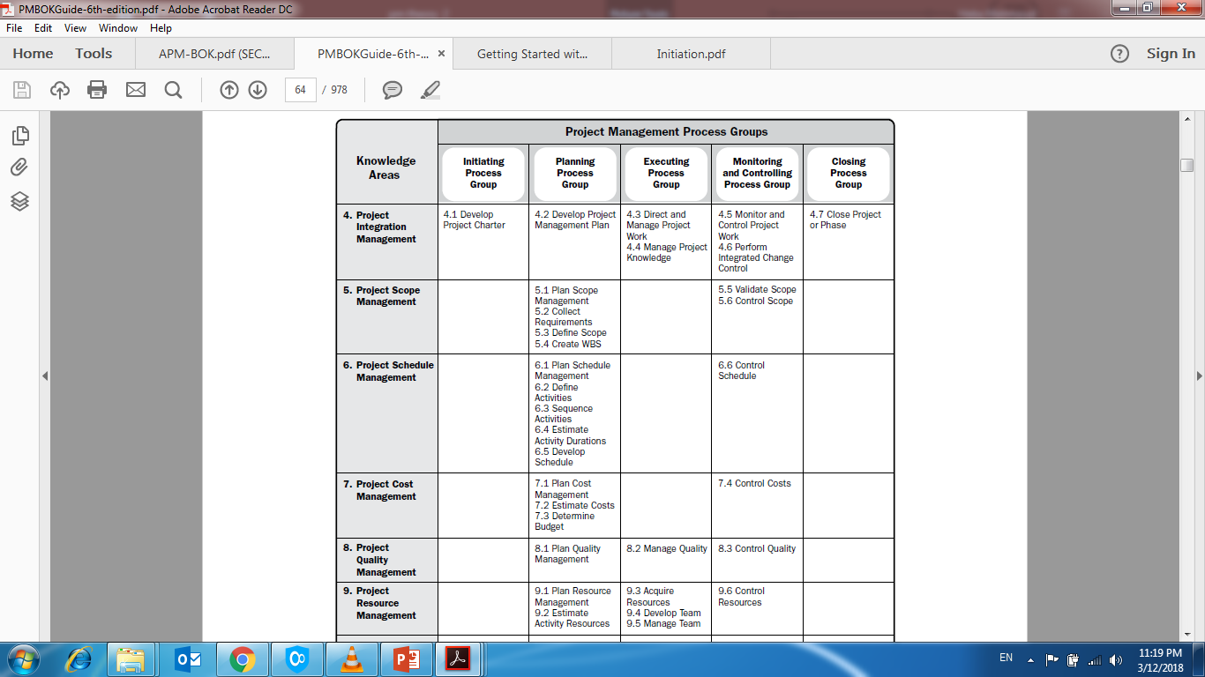

Slide 10
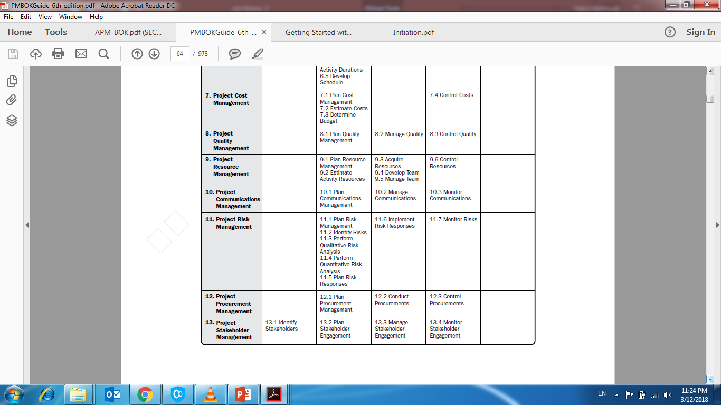

Slide 11
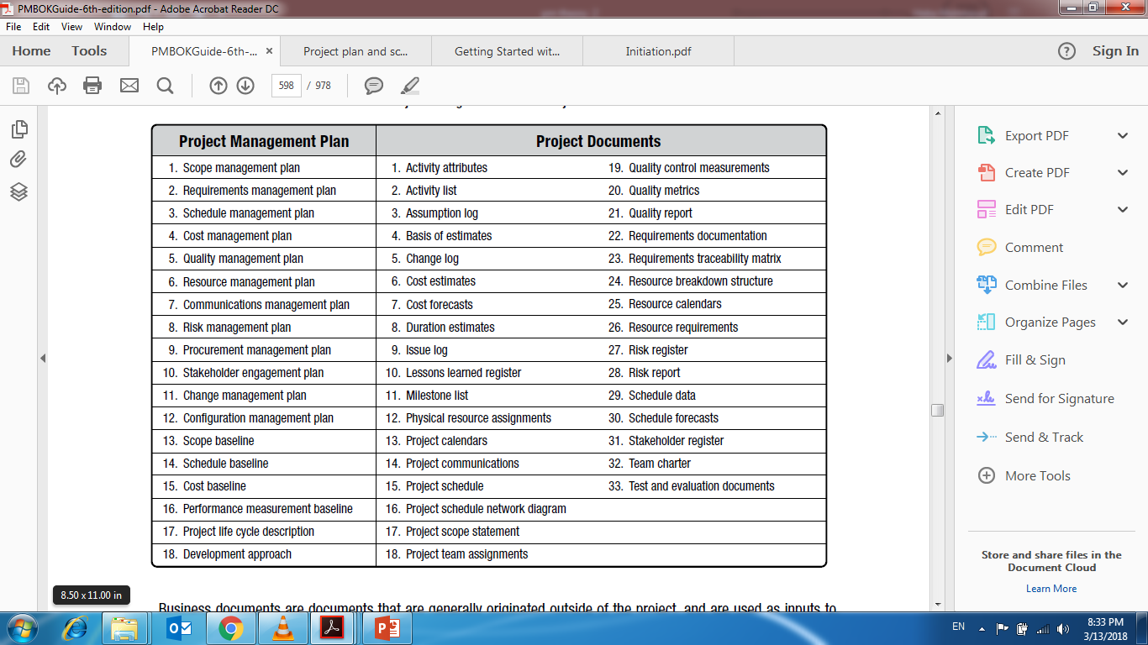

Slide 12
Project Initiation
Start
Project objectives and Feasibility
Project mandate
Requirements
Project manager assignment
Preliminary cost, time and schedule
gathering & Gap analysis
Stakeholders declaration
Project Charter

Slide 13
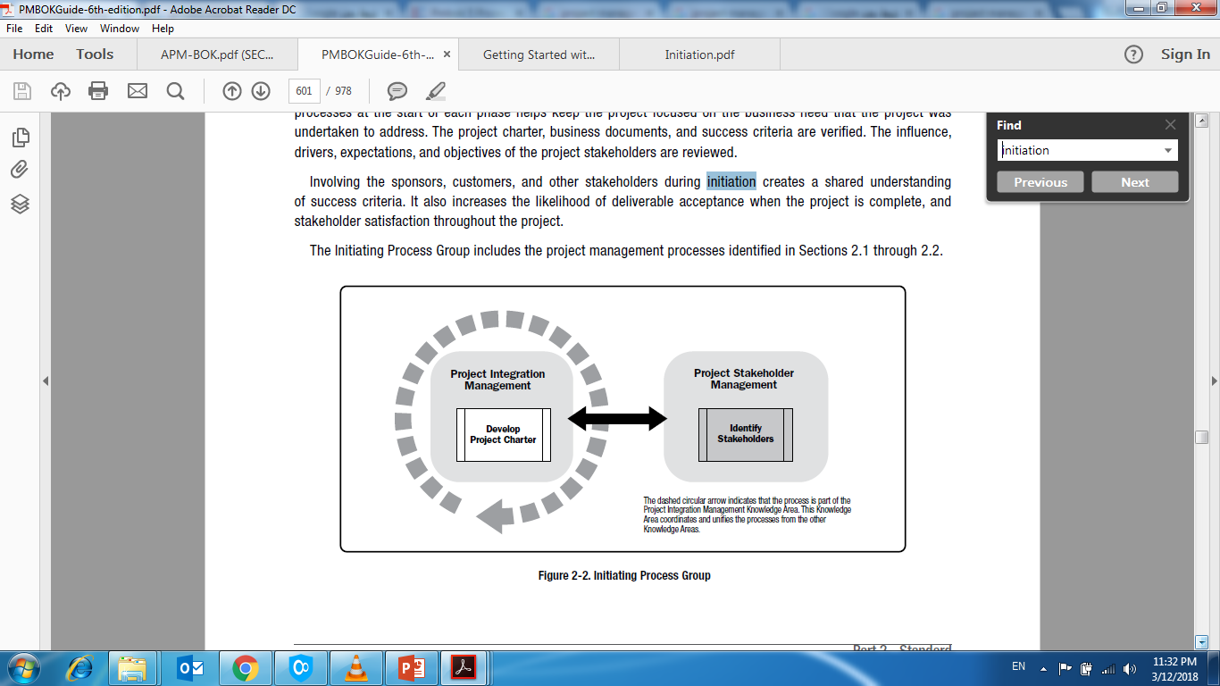
Initiating a project:
1) Develop Project Charter 2) Identify Stakeholders

Slide 14
The Initiation Phase
Before you begin the planning process, you need to clearly identify the project and the work involved.
Clearly stating the work involved in a project helps the stakeholders to understand what needs to be accomplished to meet the project’s objectives; and with a clear scope statement, you will enable all participants and stakeholders to focus on the true goals of the project.

Slide 15
The Statement of Work (SOW)
The Statement of Work (SOW) (issued by the customer) describes the work that will be performed in the project.
It includes mainly the project definition elements and may include other elements:
  Milestone lists and delivery schedules
  Specifications for each deliverable and milestone
  Narrative descriptions of each project task
  Assumptions or constraints

Slide 16
The Project Charter
The Project Charter is an official document that the project is backed by – and funded by – the organization; usually, the Project Charter is signed and published by the project’s sponsor.
The Project Charter may be a short memo or a multi-page document, but should contain:
  Project name and description.
  Project Goals and Objectives.
  Name of the project manager.
  Authorization for using organizational resources.

Slide 17
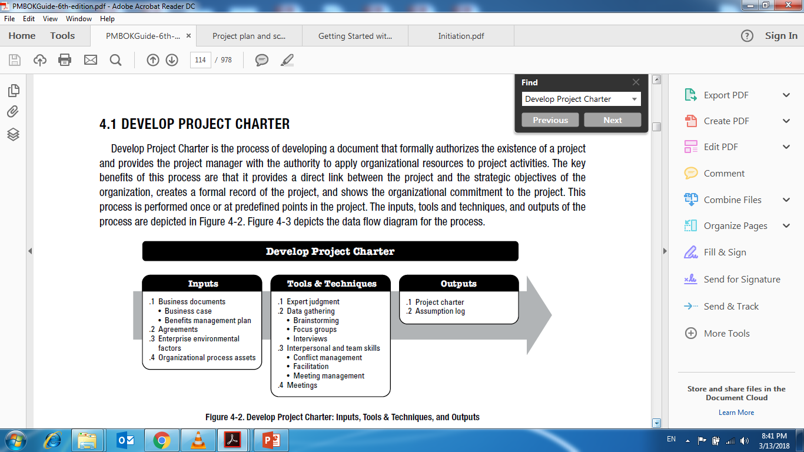
Develop Project Charter

Slide 18
Develop Project Charter Output
The Project Charter : is an output from the develop project charter process.
  It is a document that makes the project official and includes : Project purpose, project objectives
  High level project requirements
  Authorization for a project manager
  An initial set of schedule milestones(High level)
  Summary budget of the project

Slide 19
Develop Project Charter

Slide 20
Develop Project Charter Output
Assumption Log:-
  High Level Strategic and operational assumptions and constraints are normally identified in the business case before the project is initiated and will flow into the project charter
  Lower Level activity and task assumptions are generated through out the project such as defining technical specifications, estimates, the schedule, risks, etc.
  The assumption log is used to record all assumptions and constraints through out the project life cycle.

Slide 21
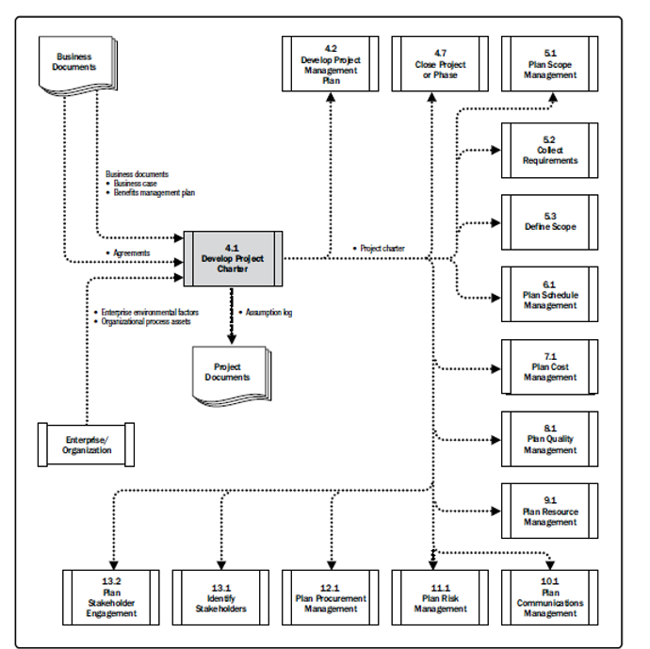
Develop Project Charter-Data Flow Diagram

Slide 22
Guidelines to Develop a Project Charter
Use a corporate template.
Include the project and authority identification information.
Include a clear, concise description of the business need, opportunity, or threat that the project is intended to address.
Consider any legal requirements associated with the project.
Include summary descriptions of the product or service of the project.
Include a description of the project’s relationship to the business need it is intended to address.
Consider any known constraints and/or assumptions.
Ensure the person with the required knowledge and authority signs the project charter.
Distribute the signed project charter to the appropriate project stakeholders.

Slide 23
Project Scope Statement
A Project Scope Statement: explains what is included – and what is not included – in your project.
Document any assumptions or constraints that may limit what your project can accomplish.
Use your Project Scope statement to avoid Scope Creep (Additional tasks that are added to the project and that make it difficult to achieve project goals).

Slide 24
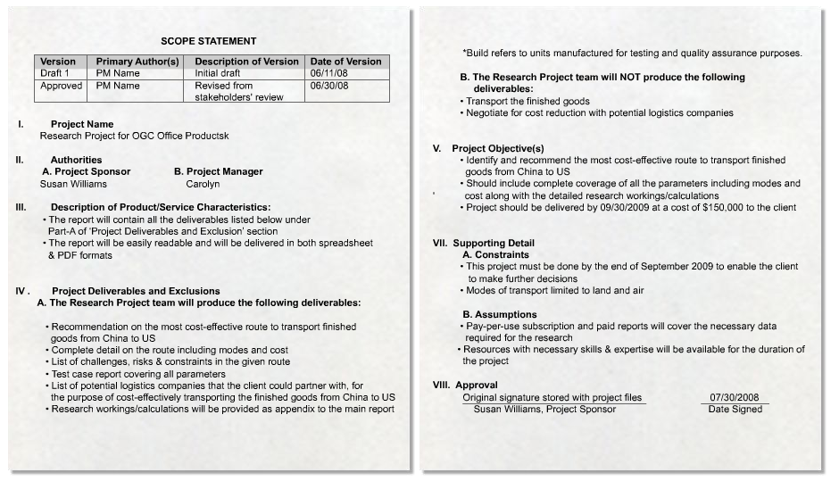
Scope Statement (Cont.)
Project Exclusions
Project Outcome
Project Deliverables

Slide 25
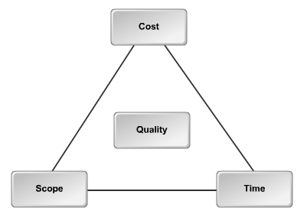
Constraining Factors
Are factors that limit the way a project can be approached.
Scope, cost, and time are three major constraining factors in projects.
The constraints triangle

Slide 26
Project Assumptions
Project Assumptions: are statements that must be taken to be true in order for the project planning to begin.
A the project progresses, assumptions have to be reviewed and reworked to decide if they prove to be true (ex: project staff resources will be available as and when they are needed.)

Slide 27
Project Goals and Objectives
Project goals and objectives are the target your project needs to be achieved.
They should include enough details (and in general they should be SMART!):
  Specific: Objectives should specify what they want to achieve
  Measurable: in terms of time, cost, and quality. .
  Achievable: Are the objectives you set achievable and attainable?
  Realistic: Can you achieve the objectives with the resources you have?
  Time: When do you want to achieve the set objectives?

Slide 28
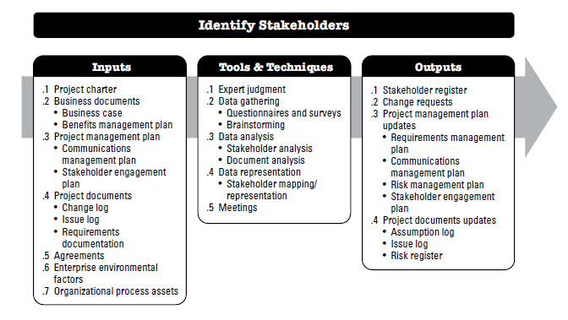
Identify Stakeholders

Slide 29
Guidelines to Identify Stakeholders
Review the project charter for the scope, boundaries, deliverables, and outcomes to get a sense of who may be affected.
Set up a meeting and use the stakeholder analysis techniques to determine who has an interest in the project.
Identify the stakeholder and the support they might provide.
Use a classification model to organize your stakeholders.
Develop a stakeholder register to record all pertinent information for each stakeholder.

Slide 30
The Project Team
While initiating the project, you must think in people; People make projects happen!
You may be a superstar project manager, but you’re not going to succeed if you can’t put the right players on your team.
Naturally, you want the best people in the organization to work on your project, but they may not all be available all of the time.

Slide 31
The Project Team
A Project Team: is a group of individuals who collectively have the skills required to complete a project.
The project team is headed by a project manager who is often selected by the stakeholders; usually, project teams work together only for a defined period.

Slide 32
The Project Team
Most projects require a multi-disciplined team to perform the tasks required to accomplish the objectives.
Building the project team is one of the most difficult challenges for project manager, starting with team member selection and continues on through the life of the project.

Slide 33
The Core Team Members
During the initiation stage, a core team is selected.
The Core Team Members: are key individuals who work on the major activities that the team will undertake during the project
The core team helps the project manager plan and select implementation team members.

Slide 34
The Core Team Members
In many projects, the core team is selected by the stakeholders.
The project manager may be able to add individuals, but it is often politically difficult to remove individuals who were selected by the stakeholders.
Frequently, core team members report directly to other managers (ex: Purchasing, marketing) rather than to the project manager.

Slide 35
The Project Implementation Team
Project Team Members: (Implementation team) who help to carry out activities planned by the project manager the core team.
Implementation team membership grows during the implementation phase.
Some implementation team members may stay with the team for short time, while others may stay throughout the entire Implementation Phase.

Slide 36
The Project Implementation Team
During the close-out phase, only those team members who are responsible for hand-off activities remain on the implementation team.

Slide 37
Virtual Project Team
Virtual Project Team: a team not located in the same geographical area; but still be a part of the project team by communicating through tools such as the phone, instant messaging, online meeting, and Voice over Internet connections.
A virtual team may face risks such as lack of proper interaction between the team members, time zone differences, misinterpretation due to differences in language, and technological incompatibility.

Slide 38



Thank You

