Slide 1




HCIA Big Data
Hive — Distributed Data Warehouse
Eng. Hagar Muhammed
Lecture 4

Slide 2


Database Overview
Components of DBMS
Use cases of DBMS
Data warehouse Overview
Data warehouse use cases
Hive

Slide 3
Lecture
04
Database Overview
A database stores real-time information about one particular part of your business: its main job is to process the daily transactions that your company makes.

Slide 4
Lecture
04
Database Overview
Databases use Online Transactional Processing (OLTP) to delete, insert, replace, and update large numbers of short online transactions quickly. This type of processing immediately responds to user requests, and so is used to process the day-to-day operations of a business in real-time. For example, if a user wants to reserve a hotel room using an online booking form, the process is executed with OLTP.

Slide 5
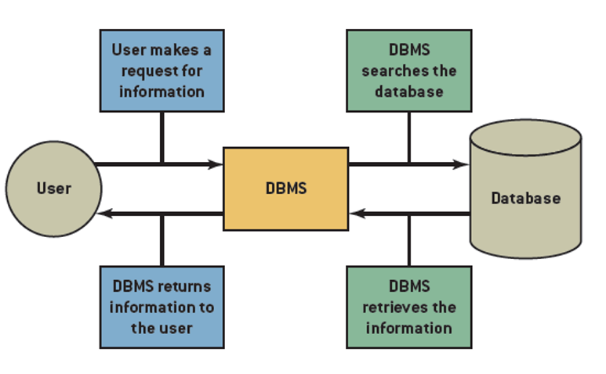
Lecture
04
Database Management Systems
Internet and Information Technology - ITC202

Slide 6
Database Overview
Components of DBMS
Use cases of DBMS
Data warehouse Overview
Data warehouse use cases
Hive

Slide 7
Lecture
04
Components of DBMS
Data Definition Language (DDL):
  DDL is used to define the structure and schema of the database. It includes commands to create, modify, and delete database objects such as tables, indexes, and views.
Data Manipulation Language (DML):
  DML allows users to interact with the data stored in the database. It includes commands like SELECT, INSERT, UPDATE, and DELETE for querying and modifying data.

Slide 8
Lecture
04
Components of DBMS
3.Data Query Language (DQL):
  DQL is a subset of DML and is specifically used for querying data. It primarily consists of the SELECT statement to retrieve data from the database.
4.Data Control Language (DCL):
  DCL is used to control access to the database and its objects. It includes commands to grant and revoke permissions, ensuring data security and integrity.

Slide 9
Lecture
04
Components of DBMS
5. Backup and Recovery Manager:
  The backup and recovery manager is responsible for creating and managing database backups, allowing data restoration in case of failures or data loss.
6. Data Dictionary:
  The data dictionary, also known as the metadata repository, stores information about the database's structure, data types, constraints, and relationships. It acts as a reference for the DBMS to understand the database's organization.

Slide 10
Database Overview
Components of DBMS
Use cases of DBMS
Data warehouse Overview
Data warehouse use cases
Hive

Slide 11
Lecture
04
Use cases of DBMS
Databases process the day-to-day transactions in an organization. Some examples of database applications include:
An ecommerce website creating an order for a product it has sold
An airline using an online booking system
A hospital registering a patient
A bank adding an ATM withdrawal transaction to an account

Slide 12
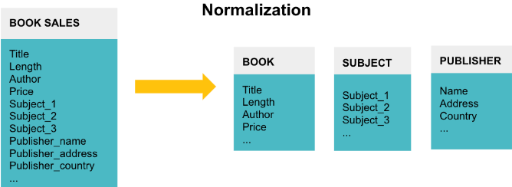
Lecture
04
Data Structure
The data in databases are normalized. The goal of normalization is to reduce and even eliminate data redundancy, i.e., storing the same piece of data more than once. This reduction of duplicate data leads to increased consistency and, thus, more accurate data as the database stores it in only one place

Slide 13
Database Overview
Components of DBMS
Use cases of DBMS
Data warehouse Overview
Data warehouse use cases
Hive

Slide 14
Lecture
04
Data Warehouse Overview
A data warehouse : is a system that pulls together data from many different sources within an organization for reporting and analysis. The reports created from complex queries within a data warehouse are used to make business decisions.
A data warehouse stores historical data about your business so that you can analyze and extract insights from it. It does not store current information, nor is it updated in real-time.
Internet and Information Technology - ITC202

Slide 15
Lecture
04
Data Warehouse Overview
Data warehouses use Online Analytical Processing (OLAP) to analyze massive volumes of data rapidly. This process gives analysts the power to look at your data from different points of view. For example, even though your database records sales data for every minute of every day, you may just want to know the total amount sold each day. To do this, you need to collect and sum the sales data together for each day. OLAP is specifically designed to do this and using it for data warehousing 1000x faster than if you used OLTP to perform the same calculation.
Internet and Information Technology - ITC202

Slide 16
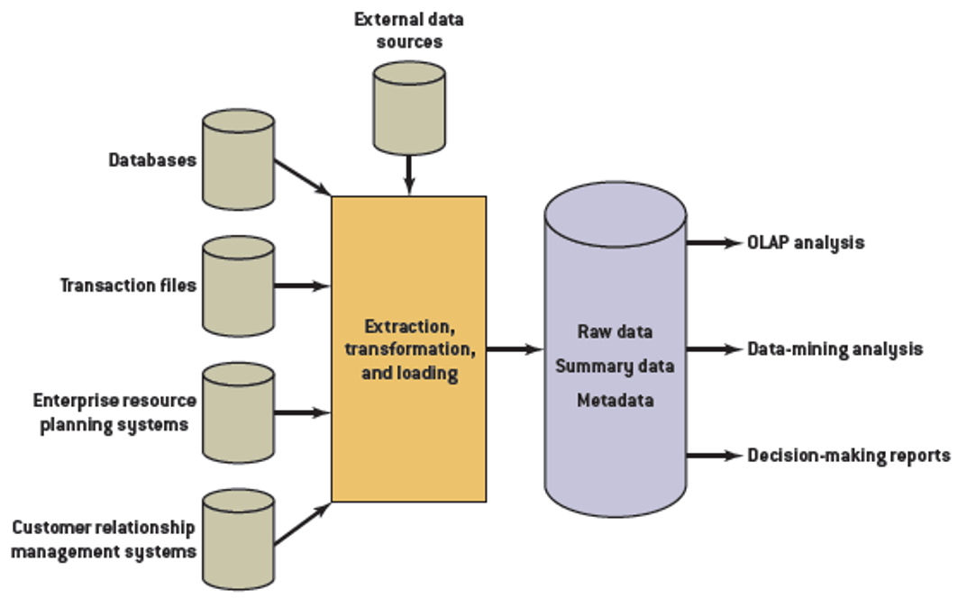
Lecture
04
Data Warehouse Overview
Internet and Information Technology - ITC202

Slide 17
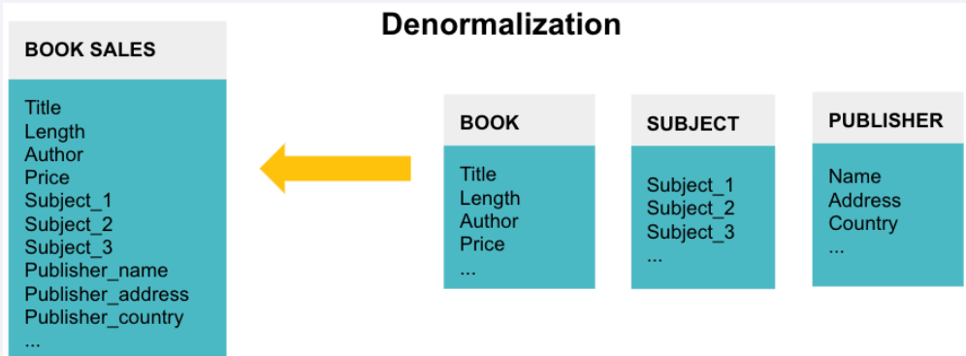
Lecture
04
Data Structure
Normalizing data ensures the database takes up minimal disk space and so it is memory efficient. However, it is not query efficient. Querying a normalized database can be slow and cumbersome. Since businesses want to perform complex queries on the data in their data warehouse, that data is often denormalized and contains repeated data for easier access.
Internet and Information Technology - ITC202

Slide 18
Database Overview
Components of DBMS
Use cases of DBMS
Data warehouse Overview
Data warehouse use cases
Hive

Slide 19
Data warehouse use cases:
Lecture
Business Intelligence and Reporting: This enables organizations to generate comprehensive and accurate reports, dashboards, and visualizations for better insights into business performance.
Data Analysis and Analytics: With historical and current data readily available in a data warehouse, data analysts and data scientists can perform in-depth analysis, identify trends, and make data-driven predictions to support strategic decision-making.
Customer Analysis: Data warehouses can help businesses gain a deeper understanding of their customers by consolidating data from different touchpoints. This allows for segmentation, profiling, and personalized marketing campaigns.

Slide 20
Data Mart
Data mart
  Smaller version of data warehouse
  Used by single department or function
More limited scope than data warehouses

Slide 21
Database vs Data Warehouse
Lecture
Aspect | Database | Data Warehouse
Purpose | Store and manage operational data | Store and manage analytical data
Data Type | Real-time transactional data | Historical and aggregated data
Usage | Day-to-day operations and transactions | Decision-making and analysis
Schema Design | Normalized for data integrity | Denormalized for query efficiency
Data Volume | Smaller data sets | Large volumes of data
Performance | Optimized for read/write operations | Optimized for complex queries
Transaction Types | Small, frequent transactions | Fewer, longer analytical queries
Time Span | Short-term data storage | Long-term historical storage
Example Use Cases | Online banking, inventory tracking | Business intelligence, trends analysis

Slide 22
Database Overview
Components of DBMS
Use cases of DBMS
Data warehouse Overview
Data warehouse use cases
Hive — Distributed Data Warehouse

Slide 23
Hive Overview
Hive is a data warehouse tool that runs on Hadoop and supports PB-level distributed data query and management.
Hive features:
  Flexible extract, transform, load (ETL)
  Support for multiple compute engines, such as Spark
  Direct access to HDFS files and HBase
  Easy to use and program

Slide 24
Use Cases of Hive
Data mining
User behavior analysis
Interest partition
Area display
Non-real-time
data analysis
Log analysis
Text analysis
Data summarization
Daily/weekly user clicks
Traffic Statistics
Data warehouse
Data extraction
Data loading
Data conversion
Notes:
Hive is built on Hadoop for static batch processing. Hadoop has long latency and consumes a large number of resources during job submission and scheduling.
Hive does not support quick query of data in a large-scale data set. For example, Hive has minutes of latency when querying data on a dataset of hundreds of MB. Therefore, Hive is inapplicable for scenarios that require low latency, for example, online transaction processing (OLTP).
Hive is not designed for OLTP. Therefore, it does not support real-time query and row-based data update. Hive is most applicable to batch processing jobs of large data sets, for example, network log analyses.

Slide 25
Hive vs. Traditional Data Warehouses
 | Hive | Traditional Data Warehouse
Storage | HDFS is used to store data. Theoretically, infinite expansion is possible. | Clusters are used to store data, which has a capacity upper limit. With the increase of capacity, the computing speed decreases sharply. Therefore, data warehouses are applicable only to commercial applications with small data volumes.
Execution engine | The default execution engine is Tez. | More efficient algorithms can be selected to perform queries and more optimization measures can be taken to speed up the queries.
Usage | HQL (SQL-like) | SQL
Flexibility | Metadata storage is independent of data storage, decoupling metadata and data. | Low flexibility. Data can be used for limited purposes.
Analysis speed | Computing depends on the cluster scale and the cluster expands easily. In the case of a large amount of data, computing is much faster than that of a conventional data warehouse. | When the data volume is small, the data processing speed is high. When the data volume is large, the speed decreases sharply.

Slide 26
Hive vs. Traditional Data Warehouses
 | Hive | Traditional Data Warehouse
Usability | Application models need to be self-developed. The flexibility is high, but the usability is low. | Integrates a set of mature report solutions to facilitate data analysis.
Reliability | Data is stored in HDFS, implementing high data reliability and fault tolerance. | Reliability is low. If a query fails, the task needs to be started again. The data fault tolerance depends on hardware.
Environment dependency | Low dependency on hardware, applicable to common machines | Highly dependent on high-performance business servers
Price | Open source | Expensive

Slide 27
Advantages of Hive
Advantages of Hive
High reliability and fault tolerance
SQL-like
Scalability
Multiple APIs
1. Cluster deployment of HiveServer
2. Double MetaStores
3. Timeout retry mechanism
1. SQL-like syntax
2. Large number of built-in functions
1. User-defined storage format
2. User-defined function
1. Beeline
2. JDBC
3. Thrift
4. ODBC
1
2
3
4
Notes:
Main process for HiveServer Hive to provide SQL services for external systems.
MetaStore Hive is a process that provides metadata information and can be invoked by components such as HiveServer, SparkSQL, and Oozie.
Beeline: Hive CLI client
JDBC: Java unified database interface
Thrift is a serialization and communication protocol.
Python is a dynamic language.
ODBC is a standard database interface based on C/C++.

Slide 28
Hive Architecture
Hive
JDBC
ODBC
Web
Interface
Thrift Server
Driver
(Compiler, Optimizer, Executor)
MetaStore
Tez
MapReduce
Spark
Notes:
MetaStore: stores metadata such as tables, columns, and partitions.
Driver: manages the lifecycle of HQL execution and participates in the entire Hive job execution.
Compiler: translates HQL statements into a series of interdependent Map or Reduce jobs.
Optimizer: is classified into logical optimizer and physical optimizer to optimize HQL execution plans and MapReduce jobs, respectively.
Executor: runs Map or Reduce jobs based on job dependencies.
ThriftServer: functions as the servers of JDBC and ODBC, provides Thrift APIs, and integrates Hive and other applications.
Clients: include command line interface Beeline,and JDBC/ODBC interfaces, and provide interfaces for user access.
Hive statements are ultimately executed on Tez, MapReduce, or Spark.

Slide 29
Hive Running Process
A client submits HQL commands.
Tez executes queries.
YARN allocates resources to applications in the cluster and authorizes Hive jobs in the YARN queue.
Hive updates data in HDFS or the Hive data warehouse based on table type.
Hive returns the query result.
HQL statement
Hive
Tez (default)
YARN
HDFS

Slide 30
Data Storage Model of Hive
Database
Table
Table
Bucket
Bucket
Partition
Partition
Skewed data
Normal data
Bucket
Bucket
Notes:
Database: If the database is not specified when a table is created, the default database is used.
Table: corresponds to a directory on HDFS.
Partition: corresponds to a subdirectory in the directory where the table is located.
Bucket: corresponds to a file under the path where a table or a partition resides.
Skewed data: scenarios where data is converged in some field values, for example, when data is classified by city, 80% of data comes from a big city.
Normal data: Skewed data does not exist.

Slide 31
Hive Partition and Bucket
Partition: Data tables can be partitioned based on the value of a certain field.
  Each partition is a directory.
  The number of partitions is not fixed.
  Partitions or buckets can be created within partitions.
Notes:
Hive can organize tables or partitions to buckets, that is, buckets are divided by smaller data ranges.
A column can be bucketed using Hive. Hive hashes the column value and divides the value by the number of buckets to determine the bucket where the record is stored. Buckets make query and sampling more efficient.
Bucketing applies to the following scenarios: (1) Data sampling; (2) Improving the efficiency of some query operations, such as mapside join.
When a table contains a large amount of data, you can partition the table to facilitate local data query. For example, you can partition the table by time or region and store data with the same property to the same disk block, improving the query efficiency.
Partition table: CREATE TABLE invites (foo INT, bar STRING) PARTITIONED BY (ds STRING);

Slide 32
Hive Partition and Bucket
Bucket: Data can be stored in different buckets.
  Each bucket is a file.
  The number of buckets is specified when creating a table. The buckets can be sorted.
Notes:
Hive can organize tables or partitions to buckets, that is, buckets are divided by smaller data ranges.
A column can be bucketed using Hive. Hive hashes the column value and divides the value by the number of buckets to determine the bucket where the record is stored. Buckets make query and sampling more efficient.
Bucketing applies to the following scenarios: (1) Data sampling; (2) Improving the efficiency of some query operations, such as mapside join.
When a table contains a large amount of data, you can partition the table to facilitate local data query. For example, you can partition the table by time or region and store data with the same property to the same disk block, improving the query efficiency.
Partition table: CREATE TABLE invites (foo INT, bar STRING) PARTITIONED BY (ds STRING);

Slide 33
Hive Data Storage Model: Managed and External Tables
Hive can create managed and external tables.
  After a Hive table is created, Hive moves data to the data warehouse directory.
  If all processing is performed by Hive, you are advised to use managed tables.
  If you want to use Hive and other tools to process the same data set, you are advised to use external tables.
 | Managed Table | External Table
DROP | Metadata and data are deleted together. | Only metadata is deleted.
Notes:
When creating an internal table, Hive moves data to the path to which the data warehouse points. If an external table is created, only the data path is recorded and the data location is not changed.
When a table is deleted, the metadata and data of an internal table are deleted together. However, for an external table, only the metadata is deleted. In this way, external tables are more secure, data organization is more flexible, and source data can be shared easily.

Slide 34
Functions Supported by Hive
Built-in Hive functions
  Mathematical functions, such as round(), floor(), abs(), and rand().
  Date functions, such as to_date(), month(), and day().
  String functions, such as trim(), length(), and substr().
User-defined functions (UDFs)
Notes:
round: round off; floor: round down; abs: absolute value; rand: random number
to_data: returns date. month: returns the month in the date; day: returns date.
hive> select day('2011-12-08 10:03:01') from dual;8
If built-in functions do not meet users' requirements, Hive supports user-defined functions.
UDFs are used to meet the requirement of one-to-one mapping.

Slide 35
Hive SQL Overview
DDL-Data Definition Language:
  Creates tables, modifies tables, deletes tables, partitions, and data types.
DML-Data Management Language:
  Imports and exports data.
DQL-Data Query Language:
  Performs simple queries.
  Performs complex queries such as Group by, Order by, and Join.
Notes:
DDL is short for data definition language. DDL operations are performed on metadata. The following operations are involved:
Create/Drop/Alter Database;
Create/Drop/Truncate Table;
Alter Table/Partition/Column;
Create/Drop/Alter View;
Create/Drop Index;
Create/Drop Function;
Show;
Describe

Slide 36
DDL Operations
  -- Create a table:
  -- Describe a table:
  -- Modify a table:
hive> CREATE TABLE table_name (col1 data type, col2 data type);
hive> DESCRIBE table_name;
hive> ALTER TABLE table_name RENAME TO new_table_name;
hive> ALTER TABLE table_name ADD COLUMNS (new_col data type);
Notes:
hive> ALTER TABLE events RENAME TO 3koobecaf;
hive> ALTER TABLE pokes ADD COLUMNS (new_col INT);

Slide 37
DML Operations
  -- update data to a table:
  -- delete data:
hive> update Table_name
Set new_value
Where condition;
hive> Delete from Table_name
Where condition;
Notes:
hive> ALTER TABLE events RENAME TO 3koobecaf;
hive> ALTER TABLE pokes ADD COLUMNS (new_col INT);
Exporting data to HDFS

Slide 38
DQL Operations
  --SELECTS and FILTERS
  --GROUP BY
hive> SELECT column_name FROM table_name WHERE condition;
hive> SELECT column_name, count(*) FROM table_name GROUP BY column_name;
Notes:
hive> ALTER TABLE events RENAME TO 3koobecaf;
hive> ALTER TABLE pokes ADD COLUMNS (new_col INT);
Exporting data to HDFS

Slide 39
Lecture
Lecture
04
Hive is a data warehousing and SQL-like query language system that facilitates the management and querying of large datasets in a distributed computing environment, commonly associated with the Apache Hadoop ecosystem. It was initially developed by Facebook and later open-sourced as part of the Apache Software Foundation. The primary goal of Hive is to provide a high-level, familiar interface for analysts and data scientists to interact with big data stored in distributed file systems, like Hadoop's HDFS

Slide 40


