Slide 1
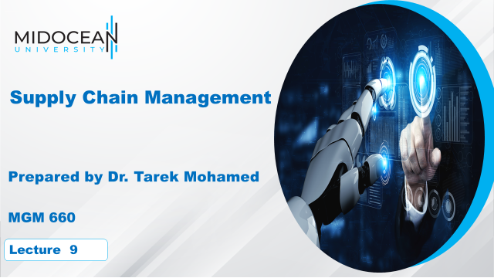

Slide 2
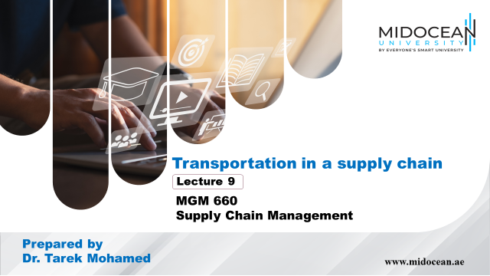

Slide 3


Learning Objectives
Understand the role of transportation in a supply chain
Evaluate the strengths and weaknesses of different modes of transportation
Discuss the role of infrastructure and policies in transportation
Identify the relative strengths and weaknesses of various transportation network design options
Identify trade-offs that shippers need to consider when designing a transportation network
www.midocean.ae

Slide 4
The Role of Transportation in a Supply Chain
Transportation refers to the movement of product from one location to another as it makes its way from the beginning of a supply chain to the customer.
Transportation is an important supply chain driver because products are rarely produced and consumed in the same location.
Transportation is a significant component of the costs incurred by most supply chains.
The role of transportation is even more significant in global supply chains.
Any supply chain’s success is closely linked to the appropriate use of transportation.
www.midocean.ae

Slide 5
The Role of Transportation in a Supply Chain
Example,
IKEA home furnishings retailer, has built a global network, with about 350 stores in 42 countries, primarily on the basis of effective transportation.
IKEA’s sales for the year ending August 2013 reached 29.2 billion euros. Its strategy is built around providing good-quality products at low prices—in fact, its goal is to cut prices by 2 to 3 percent each year. As a result, IKEA works hard to find the least expensive global source for each of its products. Modular design of its furniture allows IKEA to transport its goods worldwide much more cost effectively than a traditional furniture manufacturer.
www.midocean.ae

Slide 6
The Role of Transportation in a Supply Chain
Seven-Eleven Japan is another firm that has used transportation to achieve its strategic goals. The company has a goal of carrying products in its stores to match the needs of customers as they vary by geographic location or time of day.
To help achieve this goal, Seven-Eleven Japan uses a responsive transportation system that replenishes its stores several times a day so the products available match customers’ needs. Products from different suppliers are aggregated on trucks according to their required temperature to help achieve frequent deliveries at a reasonable cost.
www.midocean.ae

Slide 7
The Role of Transportation in a Supply Chain
Supply chains also use responsive transportation to centralize inventories and operate with fewer facilities.
For example,
Amazon relies on package carriers and the postal system to deliver customer orders from centralized warehouses.
McMaster-Carr uses ground transportation and package carriers to provide next-day delivery of a wide variety of MRO products to about 90 percent of U.S. businesses from five distribution centers.
The location of its distribution centers along with an effective transportation network allows McMaster to be very responsive while using a low-cost mode of transportation.
www.midocean.ae

Slide 8
Transportation Infrastructure and Policies
Governments generally take full responsibility or played a significant role in building and managing infrastructure elements
Without a monopoly, deregulation and market forces help create an effective industry structure.
Pricing should reflect the marginal impact on the cost to society
www.midocean.ae

Slide 9
Transportation Infrastructure and Policies
Transportation infrastructures often require government ownership or regulation because of their inherently monopolistic nature. In the absence of a monopoly, deregulation and market forces help create an effective industry structure.
When the infrastructure is publicly owned, it is important to price usage to reflect the marginal impact on the cost to society. If this is not done, overuse and congestion result because the cost borne by a user is less than the user’s marginal impact on total cost.
www.midocean.ae

Slide 10
Design Options for a
Transportation Network
The design of a transportation network affects the performance of a supply chain by establishing the infrastructure within which operational transportation decisions regarding scheduling and routing are made.
A well-designed transportation network allows a supply chain to achieve the desired degree of responsiveness at a low cost.
www.midocean.ae
Notes:
Notes:

Slide 11
Design Options for a
Transportation Network
When designing a transportation network
Should transportation be direct or through an intermediate site?
Should the intermediate site stock product or only serve as a cross-docking location?
Should each delivery route supply a single destination or multiple destinations (milk run)?
Based on the answers to these questions, the supply chain ends up with a variety of transportation networks.
www.midocean.ae
Notes:
Notes:

Slide 12
Direct Shipment Network to Single Destination
With the direct shipment network to a single destination option, the buyer structures the transportation network so that all shipments come directly from each supplier to each buyer location.
With a direct shipment network, the routing of each shipment is specified, and the supply chain manager needs to decide only the quantity to ship and the mode of transportation to use.
The major advantage of a direct shipment transportation network is the elimination of intermediate warehouses and its simplicity of operation and coordination. The shipment decision is completely local, and the decision made for one shipment does not influence others.
www.midocean.ae

Slide 13
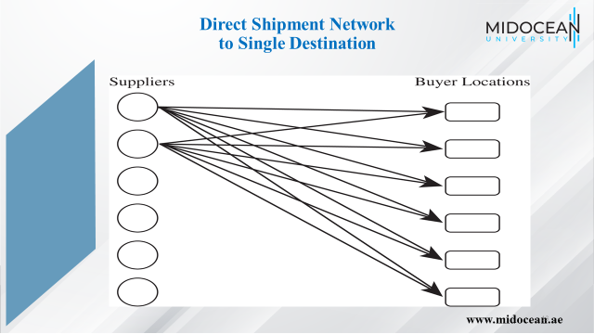

Slide 14
Direct Shipping with Milk Runs
A milk run is a route on which a truck either delivers product from a single supplier to multiple retailers or goes from multiple suppliers to a single buyer location.
In direct shipping with milk runs, a supplier delivers directly to multiple buyer locations on a truck or a truck picks up deliveries destined for the same buyer location from many suppliers.
When using this option, a supply chain manager has to decide on the routing of each milk run.
www.midocean.ae

Slide 15
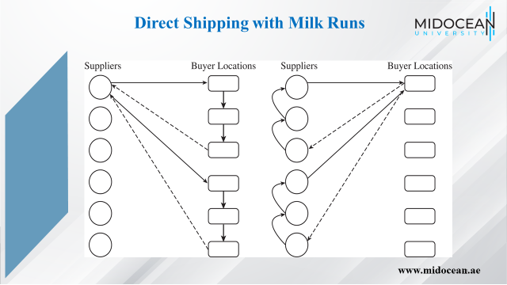

Slide 16
All Shipments via Intermediate Distribution
Center with Storage
Under this option, product is shipped from suppliers to a central distribution center, where it is stored until needed by buyers when it is shipped to each buyer location.
Storing product at an intermediate location is justified if transportation economies require large shipments on the inbound side or shipments on the outbound side cannot be coordinated.
In such a situation, product comes in large quantities into a DC, where it is held in inventory and sent to buyer locations in smaller replenishment lots when needed.
www.midocean.ae

Slide 17
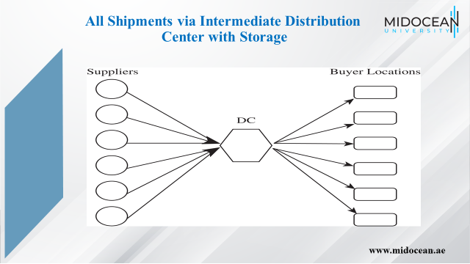

Slide 18
All Shipments via Intermediate Transit Point with Cross-Docking
Under this option, suppliers send their shipments to an intermediate transit point (which could be a DC), where they are cross-docked and sent to buyer locations without storing them.
The product flow is similar to the previous Figure except that there is no storage at the intermediate facility.
When a DC cross-docks product, each inbound truck contains product from suppliers for several buyer locations, whereas each outbound truck contains product for one buyer location from several suppliers.
www.midocean.ae

Slide 19
Shipping via DC Using Milk Runs
Milk runs reduce outbound transportation costs by consolidating small shipments.
For example, Seven-Eleven Japan cross-docks deliveries from its fresh-food suppliers at its DCs and sends out milk runs to the retail outlets because the total shipment to a store from all suppliers does not fill a truck. The use of cross-docking and milk runs allows Seven- Eleven Japan to lower its transportation cost while sending small replenishment lots to each store.
The use of cross-docking with milk runs requires a significant degree of coordination and suitable routing and scheduling.
www.midocean.ae

Slide 20
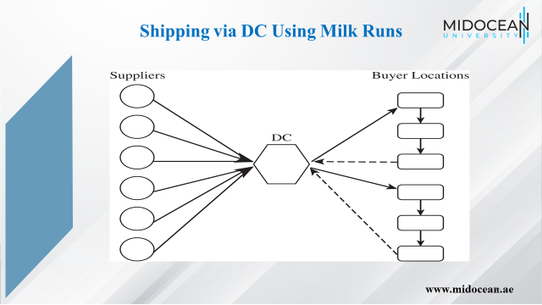

Slide 21
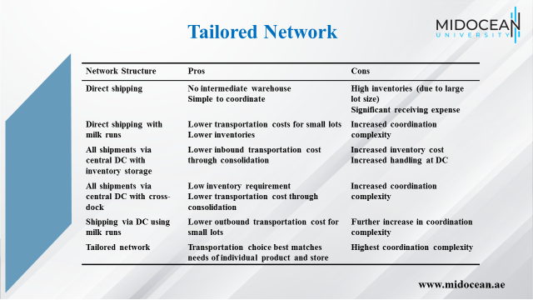

Slide 22
Selecting a Transportation Network
Eight stores, four supply sources
Truck capacity = 40,000 units
Cost $1,000 per load, $100 per delivery
Holding cost = $0.20/year
www.midocean.ae

Slide 23
Selecting a Transportation Network
Annual sales = 960,000/store Direct shipping
Batch size shipped from each supplier to each store = 40,000 units
Number of shipments/yr from each supplier to each store = 960,000/40,000 = 24
Annual trucking cost for direct network= 24 x 1,100 x 4 x 8 = $844,800
Average inventory at each store for each product = 40,000/2 = 20,000 units
Annual inventory cost for direct network = 20,000 x 0.2 x 4 x 8 = $128,000
Total annual cost of direct network = $844,800 + $128,000 = $972,800
www.midocean.ae

Slide 24
Selecting a Transportation Network
Annual sales = 960,000/store Milk runs
Batch size shipped from each supplier to each store = 40,000/2 = 20,000 units
Number of shipments/yr from each supplier to each store = 960,000/20,000 = 48
Transportation cost per shipment per store (two stores/truck) = 1,000/2 + 100 = $600
Annual trucking cost for direct network = 48 x 600 x 4 x 8 = $921,600
Average inventory at each store for each product = 20,000/2 = 10,000 units
Annual inventory cost for direct network = 10,000 x 0.2 x 4 x 8 = $64,000
Total annual cost of direct network = $921,600 + $64,000 = $985,600
www.midocean.ae

Slide 25
Selecting a Transportation Network
Annual sales = 120,000/store Direct shipping
Batch size shipped from each
supplier to each store = 40,000 units
Number of shipments/yr from
each supplier to each store = 120,000/40,000 = 3
Annual trucking cost
for direct network = 3 x 1,100 x 4 x 8 = $105,600
Average inventory at each
store for each product = 40,000/2 = 20,000 units
Annual inventory cost
for direct network = 20,000 x 0.2 x 4 x 8 = $128,000
Total annual cost of
direct network = $105,600 + $128,000 = $233,600
www.midocean.ae

Slide 26
Selecting a Transportation Network
Annual sales = 120,000/store Milk runs
Batch size shipped from each
supplier to each store = 40,000/4 = 10,000 units
Number of shipments/yr from
each supplier to each store = 120,000/10,000 = 12
Transportation cost per shipment
per store (two stores/truck) = 1,000/4 + 100 = $350
Annual trucking cost
for direct network = 12 x 350 x 4 x 8 = $134,400
Average inventory at each
store for each product = 10,000/2 = 5,000 units
Annual inventory cost
for direct network = 5,000 x 0.2 x 4 x 8 = $32,000
Total annual cost of
direct network = $134,400 + $32,000 = $166,400
www.midocean.ae

Slide 27
Trade-offs in Transportation Design
All transportation decisions made by shippers in a supply chain network must take into account their impact on inventory costs, facility and processing costs, the cost of coordinating operations, and the level of responsiveness provided to customers.
For example,
Amazon’s use of package carriers to deliver products to customers increases transportation cost but allows Amazon to centralize its facilities and reduce inventory costs. If Amazon wants to reduce its transportation costs, the company must either sacrifice responsiveness to customers or increase the number of facilities and resulting inventories to move closer to customers.
www.midocean.ae

Slide 28
Trade-offs in Transportation Design
Mode | Cycle Inventory | Safety Inventory | In-Transit Cost | Transportation Time | Transportation Cost
Rail | 5 | 5 | 5 | 2 | 5
TL | 4 | 4 | 4 | 3 | 3
LTL | 3 | 3 | 3 | 4 | 4
Package | 1 | 1 | 1 | 6 | 1
Air | 2 | 2 | 2 | 5 | 2
Water | 6 | 6 | 6 | 1 | 6
www.midocean.ae

Slide 29
Trade-offs When Selecting Transportation Mode
Demand = 120,000 motors, Cost = $120/motor,
Weight = 10 lbs/motor, Lot size = 3,000,
Safety stock = 50% ddlt
Carrier | Range of Quantity Shipped (cwt) | Shipping Cost ($/cwt)
AM Railroad | 200+ | 6.50
Northeast Trucking | 100+ | 7.50
Golden Freightways | 50–150 | 8.00
Golden Freightways | 150–250 | 6.00
Golden Freightways | 250+ | 4.00
www.midocean.ae

Slide 30
Trade-offs When Selecting Transportation Mode
Cycle inventory = Q/2 = 2,000/2 = 1,000 motors
Safety inventory = L/2 days of demand
= (6/2)(120,000/365) = 986 motors
In-transit inventory = 120,000(5/365) = 1,644 motors
Total average inventory = 1,000 + 986 + 1,644
= 3,630 motors
Annual holding cost using AM Rail = 3,630 x $30 = $108,900
Annual transportation cost using AM Rail = 120,000 x 0.65 = $78,000
The total annual cost for inventory and transportation using AM Rail= $186,900
www.midocean.ae

Slide 31
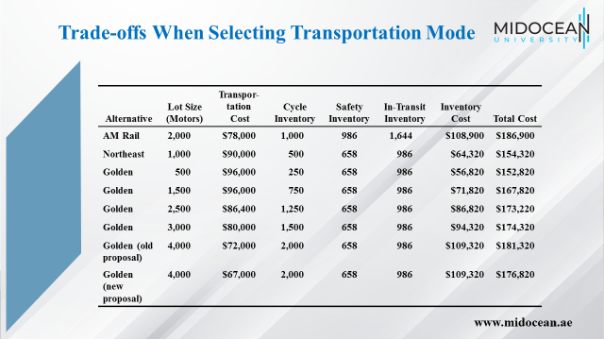

Slide 32
Tradeoffs When
Aggregating Inventory
Inventory aggregation decisions must account for inventory and transportation costs. Inventory aggregation decreases supply chain costs if the product has a high value-to-weight ratio, high demand uncertainty, low transportation cost, and customer orders are large.
If a product has a low value-to-weight ratio, low demand uncertainty, large transportation cost, or small customer orders, inventory aggregation may increase supply chain costs.
Option A. Keep the current structure but replenish inventory once a week rather than once every four weeks
Option B. Eliminate inventories in the territories, aggregate all inventories in a finished-goods warehouses, and replenish the warehouse once a week
www.midocean.ae

Slide 33
Tradeoffs When
Aggregating Inventory
 | Aggregate | Disaggregate
Transport cost | Low | High
Demand uncertainty | High | Low
Holding cost | High | Low
Customer order size | Large | Small
www.midocean.ae

Slide 34
Trade-off Between Transportation Cost and Responsiveness
The transportation cost a supply chain incurs is closely linked to the degree of responsiveness the supply chain aims to provide.
If a firm has high responsiveness and ships all orders within a day of receipt from the customer, it will have small outbound shipments, resulting in a high transportation cost.
If it decreases its responsiveness and aggregates orders over a longer time horizon before shipping them out, it will be able to exploit economies of scale and incur a lower transportation cost because of larger shipments.
www.midocean.ae

Slide 35
Trade-off Between Transportation Cost and Responsiveness
Temporal aggregation is the process of combining orders across time.
Temporal aggregation decreases a firm’s responsiveness because of shipping delay, but also decreases transportation costs because of economies of scale that result from larger shipments.
Thus, a firm must consider the trade-off between responsiveness and transportation cost when designing its transportation network
www.midocean.ae

Slide 36
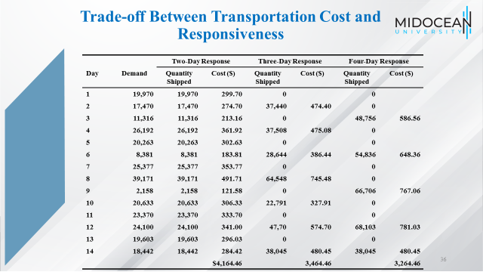

Slide 37
Tailored Transportation
The use of different transportation networks and modes based on customer and product characteristics
Factors affecting tailoring
  Customer density and distance
  Customer size
  Product demand and value
www.midocean.ae

Slide 38
Tailored Transportation
 | Short Distance | Medium Distance | Long Distance
High density | Private fleet with milk runs | Cross-dock with milk runs | Cross-dock with milk runs
Medium density | Third-party milk runs | LTL carrier | LTL or package carrier
Low density | Third-party milk runs or LTL carrier | LTL or package carrier | Package carrier
www.midocean.ae

Slide 39
Tailored Transportation
Product Type | High Value | Low Value
High demand | Disaggregate cycle inventory. Aggregate safety inventory. Inexpensive mode of transportation for replenishing cycle inventory and fast mode when using safety inventory. | Disaggregate all inventories and use inexpensive mode of transportation for replenishment.
Low demand | Aggregate all inventories. If needed, use fast mode of transportation for filling customer orders. | Aggregate only safety inventory. Use inexpensive mode of transportation for replenishing cycle inventory.
www.midocean.ae

Slide 40
Role of IT in Transportation
The complexity of transportation decisions demands use of IT systems
IT software can assist in:
  Identification of optimal routes by minimizing costs subject to delivery constraints
  Optimal fleet utilization
  GPS applications
www.midocean.ae

Slide 41
Risk Management in Transportation
Three main risks to be considered in transportation are
  Risk that the shipment is delayed
  Risk of disruptions
  Risk of hazardous material
Risk mitigation strategies
  Decrease the probability of disruptions
  Alternative routings
  In case of hazardous materials the use of modified containers, low-risk transportation models, modification of physical and chemical properties can prove to be effective
www.midocean.ae

Slide 42
Making Transportation
Decisions in Practice
Align transportation strategy with competitive strategy
Managers should ensure that a firm’s transportation strategy supports its competitive strategy. They should design functional incentives that help achieve this goal. Historically, the transportation function within firms has been evaluated based on the extent to which it can lower transportation costs. Such a focus leads to decisions that lower transportation costs but hurt the level of responsiveness provided to customers and may raise the firm’s total cost.
Consider both in-house and outsourced transportation
Managers should consider an appropriate combination of company-owned and outsourced transportation to meet their needs. This decision should be based on a firm’s ability to handle transportation profitably as well as the strategic importance of transportation to the success of the firm. In general, outsourcing is a better option when shipment sizes are small, whereas owning the transportation fleet is better when shipment sizes are large and responsiveness is important
www.midocean.ae

Slide 43
Making Transportation
Decisions in Practice
Use technology to improve transportation performance
Managers must use information technology to decrease costs and improve responsiveness in their transportation networks. Software helps managers do transportation planning and modal selection and build delivery routes and schedules. Real-time tracking allows carriers to communicate with each vehicle and identify its precise location and contents. These technologies help carriers lower costs and become more responsive to changes.
Design flexibility into the transportation network
When designing transportation networks, managers should take into account uncertainty in demand as well as availability of transportation. Ignoring uncertainty encourages a greater use of inexpensive and inflexible transportation modes that perform well when everything goes as planned.
www.midocean.ae

Slide 44
Summary of Learning Objectives
Understand the role of transportation in a supply chain
Evaluate the strengths and weaknesses of different modes of transportation
Discuss the role of infrastructure and policies in transportation
Identify the relative strengths and weaknesses of various transportation network design options
Identify trade-offs that shippers need to consider when designing a transportation network
www.midocean.ae

Slide 45
Essential Reference
Chopra, S., & Meindl, P. (2016). Global Edition. Pearson Education Limited
Chapter 14.
www.midocean.ae

Slide 46



Thank You

