Slide 1

CCNA (200-301) Cisco Certified Network Associate
Prepared by Eng. Taghreed Elsayed
Lecture 6
OSPF

Slide 2

Chapter
03
OSPF (open shortest path first)
Information About OSPF Support for Fast Hello Packets OSPF
Hello Interval and Dead Interval
OSPF hello packets are packets that an OSPF process sends to its OSPF neighbors to maintain connectivity with those neighbors. The hello packets are sent at a configurable interval (in seconds). The defaults are 10 seconds for an Ethernet link and 30 seconds for a non broadcast link. Hello packets include a list of all neighbors for which a hello packet has been received within the dead interval. The dead interval is also a configurable interval (in seconds), and defaults to four times the value of the hello interval.

Slide 3
Chapter
03
OSPF (open shortest path first)
The value of all hello intervals must be the same within a network. Likewise, the value of all dead intervals must be the same within a network. These two intervals work together to maintain connectivity by indicating that the link is operational. If a router does not receive a hello packet from a neighbor within the dead interval, it will declare that neighbor to be down.
OSPF Fast Hello Packets
OSPF fast hello packets refer to hello packets being sent at intervals of less than 1 second. To understand fast hello packets, you should already understand the relationship between OSPF hello packets and the dead interval. See the section OSPF Hello Interval and Dead Interval.

Slide 4
Chapter
03
OSPF (open shortest path first)
OSPF fast hello packets are achieved by using the ip OSPF dead-interval command. The dead interval is set to 1 second, and the hello-multiplier value is set to the number of hello packets you want to send during that 1 second, thus providing sub second or "fast" hello packets.
When fast hello packets are configured on the interface, the hello interval advertised in the hello packets that are sent out this interface is set to 0. The hello interval in the hello packets received over this interface is ignored.
The dead interval must be consistent on a segment, whether it is set to 1 second (for fast hello packets) or set to any other value. The hello multiplier need not be the same for the entire segment as long as at least one hello packet is sent within the dead interval.

Slide 5
Chapter
03
OSPF (open shortest path first)
Configuring OSPF Fast Hello Packets SUMMARY STEPS
enable
configure terminal
interface type number
ip OSPF dead-interval minimal hello-multiplier multiplier
end
show ip OSPF interface [interface-type interface-number]

Slide 6
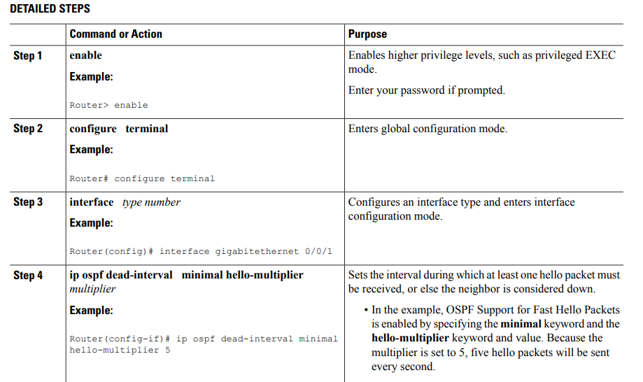
Chapter
03
OSPF (open shortest path first)

Slide 7
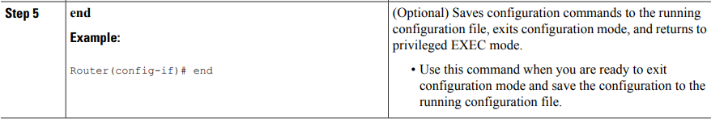
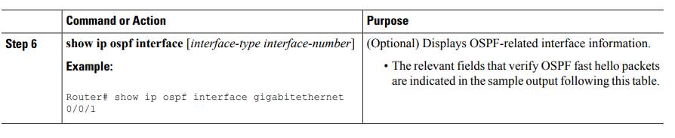
Chapter
03
OSPF (open shortest path first)

Slide 8
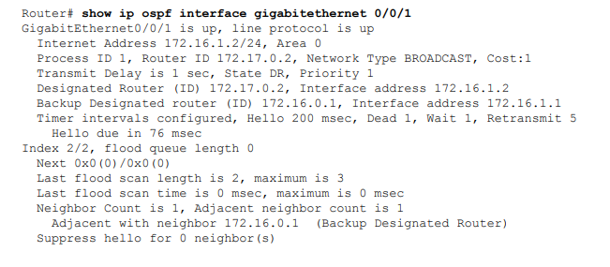
Chapter
03
OSPF (open shortest path first)
Examples
The following sample output verifies that OSPF Support for Fast Hello Packets is configured. In the line that begins with "Timer intervals configured," the hello interval is 200 milliseconds, the dead interval is 1 second, and the next hello packet is due in 76 milliseconds

Slide 9
Chapter
03
OSPF (open shortest path first)
OSPF Neighbor States
When OSPF forms adjacency with neighbors, the connection goes through several states before the routers are fully adjacent with each other, this section describes each state in detail. Following are the OSPF States we'll be examining:
1.Down state
2.Attempt state
3.Init state
4.2-Way state
5.Exstart state
6.Exchange state
7.Loading state
8.Full state

Slide 10
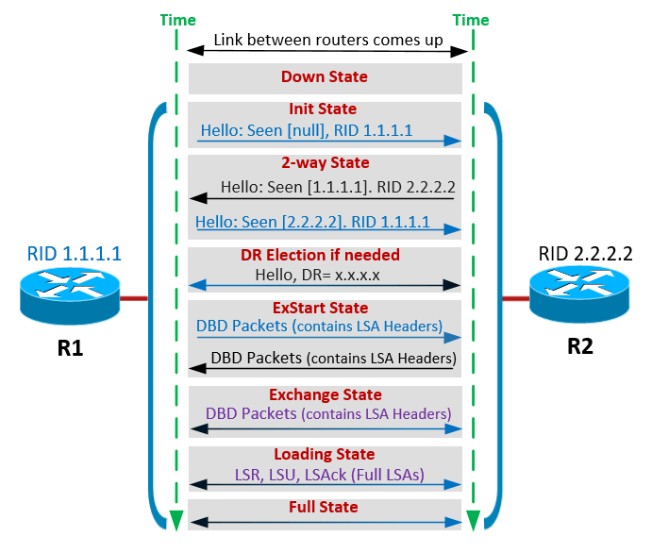
Chapter
03
OSPF (open shortest path first)

Slide 11
Chapter
03
OSPF (open shortest path first)
DOWN STATE
The Down State is the first OSPF neighbor state and means no Hello packets have been received from a neighbor. In an already established OSPF adjacency, an OSPF state will transition from a FULL or 2-Way State to the Down State when the router Dead Interval Timer expires (4 x Hello Interval timer), which means OSPF has lost communication with its neighbor and is now considered non-reachable or dead.
This is a special state used only for manually configured neighbors in a Non-Broadcast
Multi-access (NBMA) network, it indicates that the router is sending Hello packets to its neighbor in a Non-Broadcast Multi-access (NBMA) environment via unicast but no reply is received within the Dead Interval (4 x Hello Interval).

Slide 12
Chapter
03
OSPF (open shortest path first)
2WAY STATE
This state indicates that a Hello packet was received from a neighbor router but the receiving Router’s ID wasn’t listed in the Hello packet. When a router receives a Hello packet from a neighbor, it should list the sender's Router ID as an acknowledgment that it previously received a valid Hello packet.
This state describes the Bi-Directional communication state, Bi- Directional means that each router has received the other’s Hello packet and that each router can see its own Router ID included within the Hello packet’s neighbor field.
On broadcast media (e.g LAN) and Non-Broadcast Multi-access (NBMA) networks (e.g Frame Relay, ATM, X.25), a router becomes full state (analyzed below) only with the Designated Router (DR) and the Backup Designated Router (BDR). It will, however, stay in the 2-way state with all other neighbors.

Slide 13
Chapter
03
OSPF (open shortest path first)
EXSTART STATE
This state specifies that DR and BDR have been elected and master-slave relation is determined. An initial sequence number for adjacency formation is also selected. The router with the highest router ID becomes the master and begins to exchange Link State data. Only the Master router is able to increment the sequence number.
EXCHANGE STATE
In this state, OSPF routers exchange Database Descriptor (DBD) packets. These contain Link State Advertisement (LSA) headers describing the content of the entire Link State Database (LSD). The contents of the Database Descriptor (DBD) received by the router are compared with its own Link State Database (LSD) to check if changes or additional link-state information is available from its neighbor.

Slide 14
Chapter
03
OSPF (open shortest path first)
LOADING STATE
In this state, routers exchange full Link State information based on Database Descriptor (DBD) provided by neighbors, the OSPF router sends Link State Request (LSR) and receives Link State Update (LSU) containing all Link State Advertisements (LSAs).
Link State Updates (LSU) actually act as an envelope that contains all the Link State Advertisements (LSAs) – that have been sent to neighbors with new changes or new networks learned.

Slide 15
Chapter
03
OSPF (open shortest path first)
FULL STATE
Full state is the normal operating state of OSPF that indicates everything is functioning normally. In this state, routers are fully adjacent with each other and all the router and network Link State Advertisements (LSAs) are exchanged and the routers' databases are fully synchronized.
For Broadcast and NBMA media, routers will achieve the Full State with their DR and BDR router only, while for Point-to-point and Point-to-multipoint networks a router should be in the Full State with every neighboring router.
This article analyzed the states OSPF routers go through during OSPF neighbor discovery and adjacency process. We examined in detail each OSPF State including: Down state, Attempt state, Init state, 2-way state, Exstart state, Exchange state, Loading state and Full state.

Slide 16
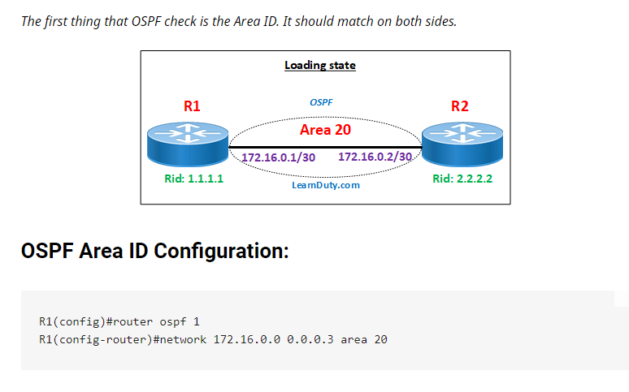
Chapter
03
OSPF (open shortest path first)
OSPF Neighbor relationship conditions
When the routers received Hello from other router and processed the Hello, the routers checked the following conditions
1.The routers must use the same IP subnet and subnet mask on the link between them.
2.They must have the Area ID.

Slide 17
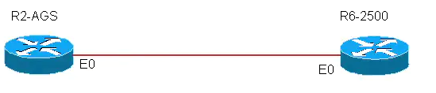
Chapter
03
OSPF (open shortest path first)
3.Use the same authentication types:
Null (no authentication)
Simple authentication (no encryption)
MD5 authentication (Message Digest)
4.Use the same Hello and Dead times
5.Use the same password if authentication used.

