Slide 1
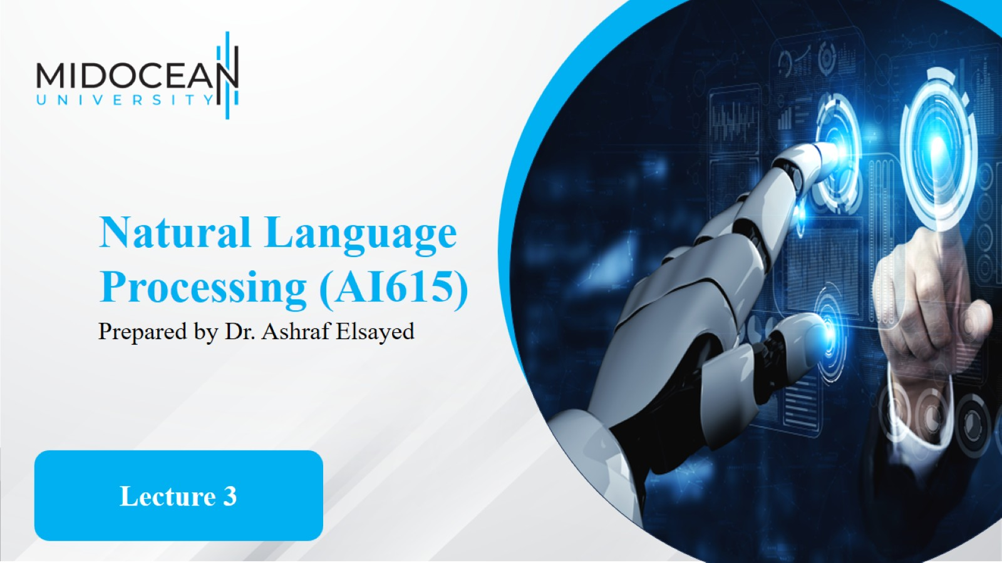

Slide 2


Slide 3
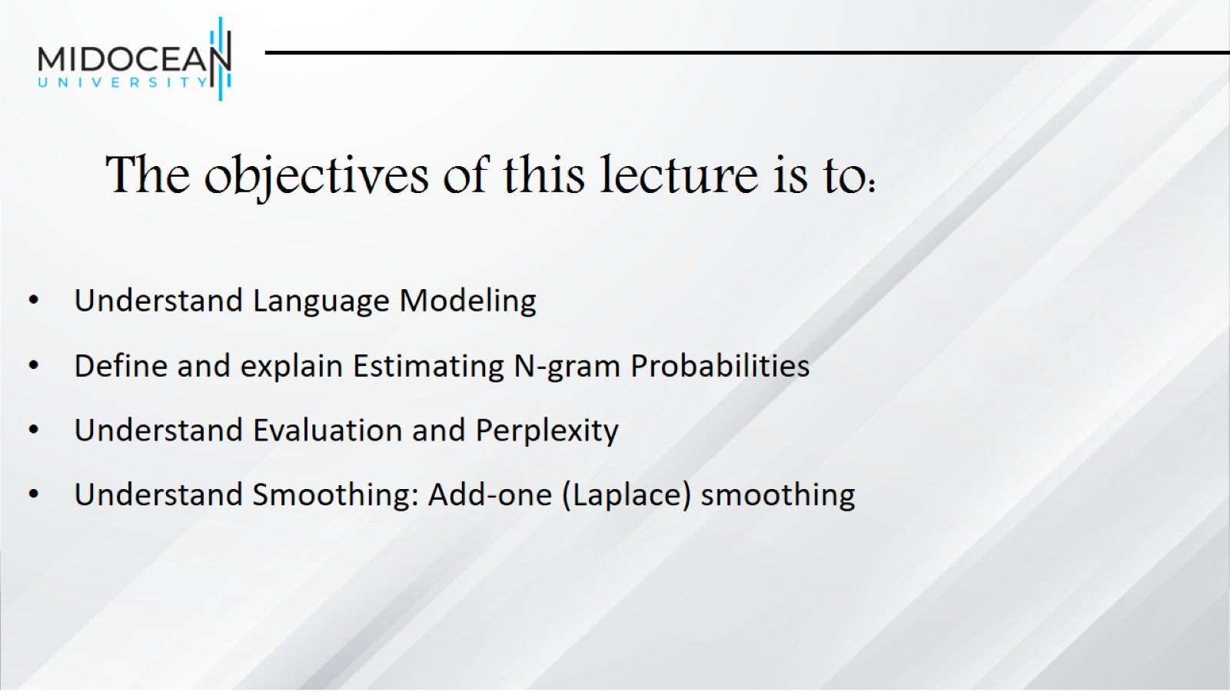
The objectives of this lecture is to:

Slide 4
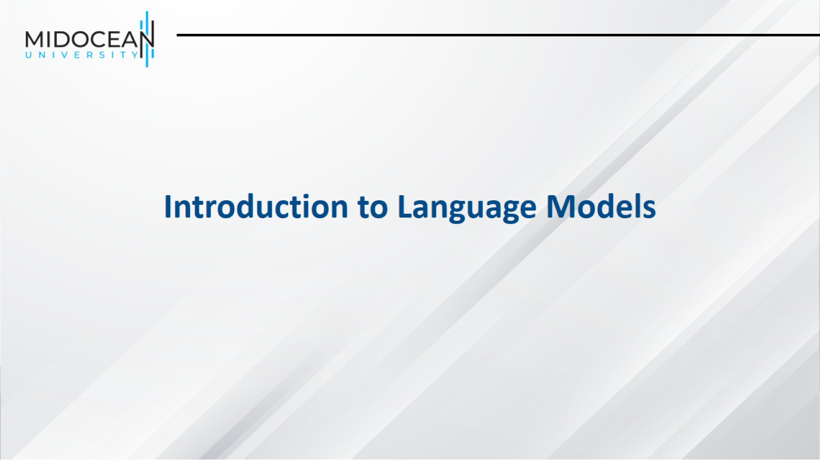

Slide 5
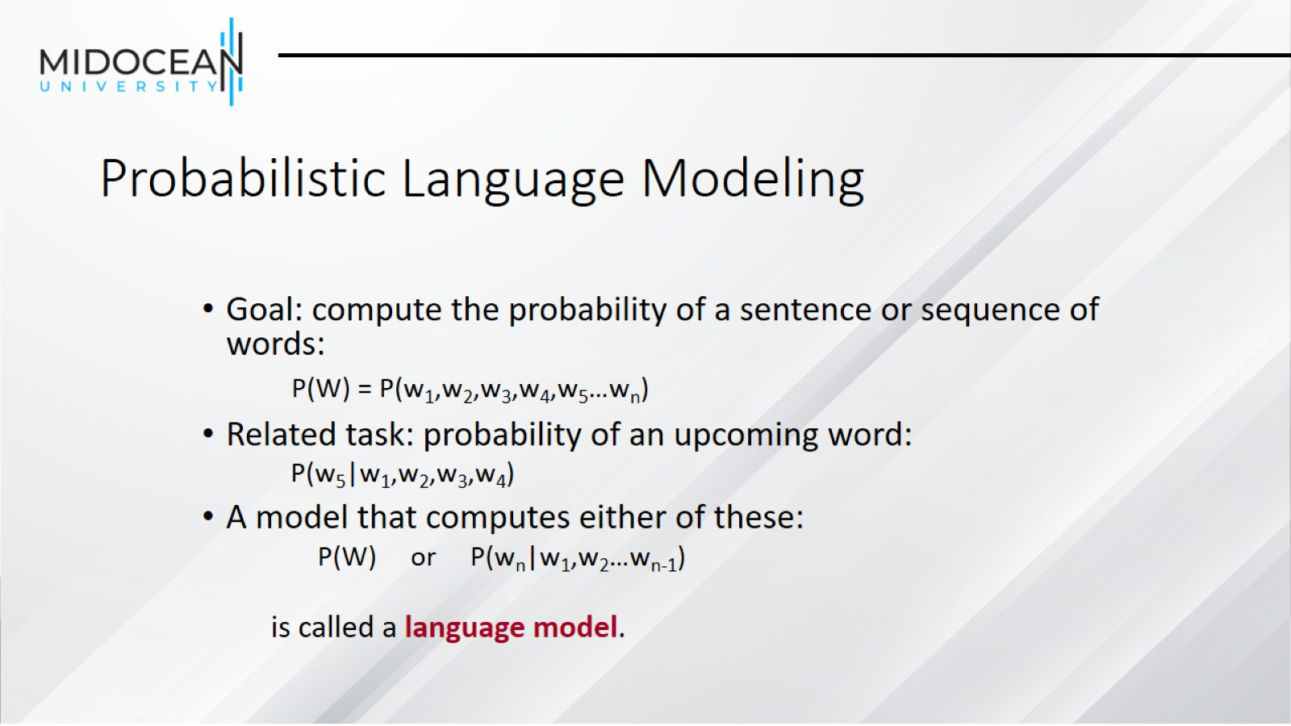
Probabilistic Language Modeling

Slide 6
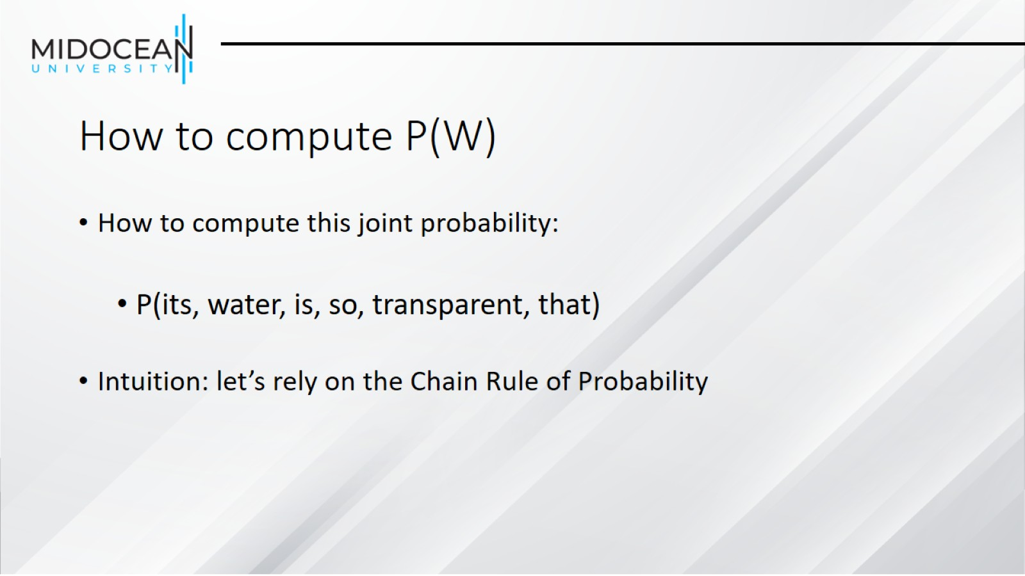
How to compute P(W)

Slide 7
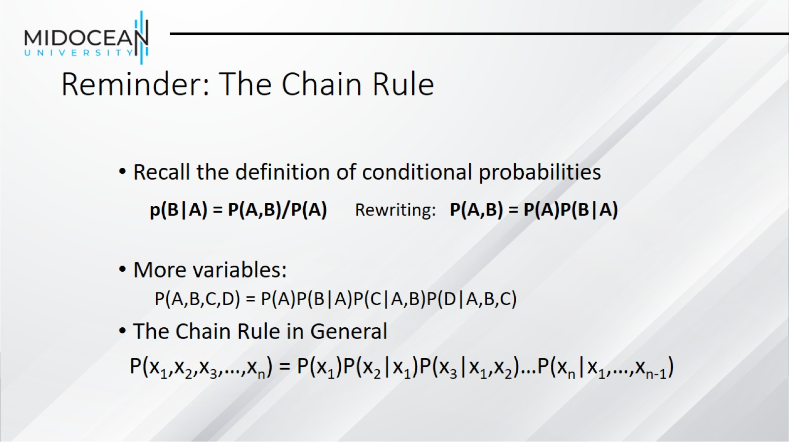
Reminder: The Chain Rule

Slide 8
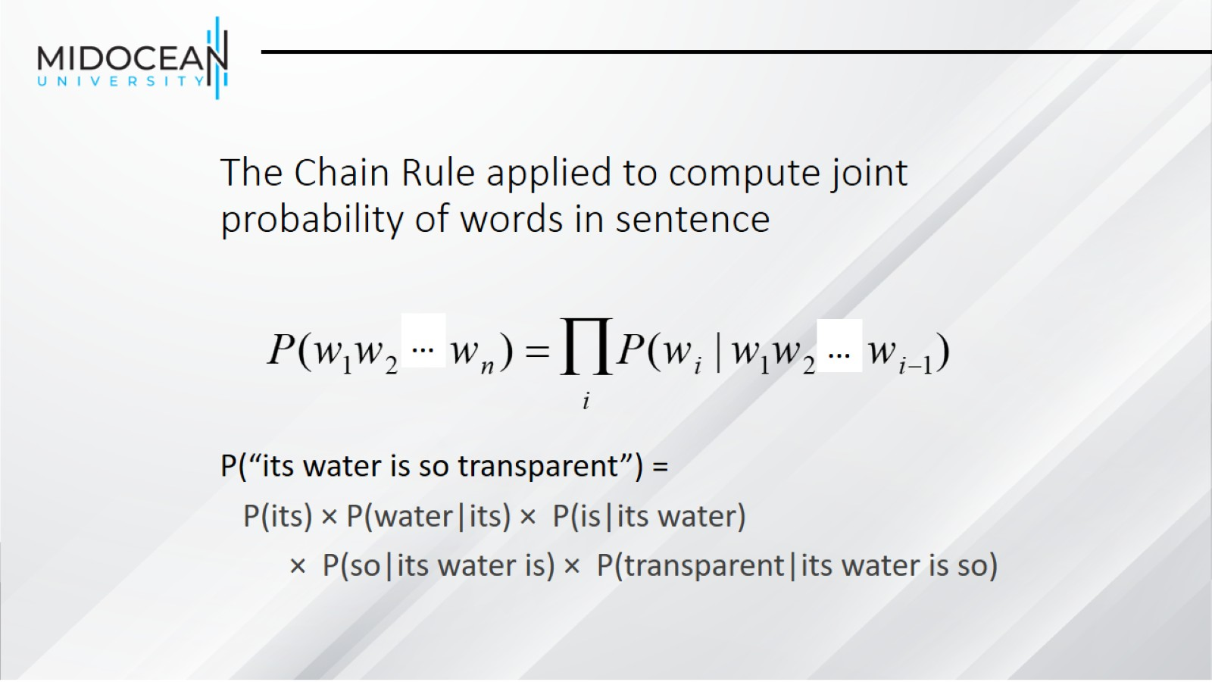
The Chain Rule applied to compute joint probability of words in sentence

Slide 9
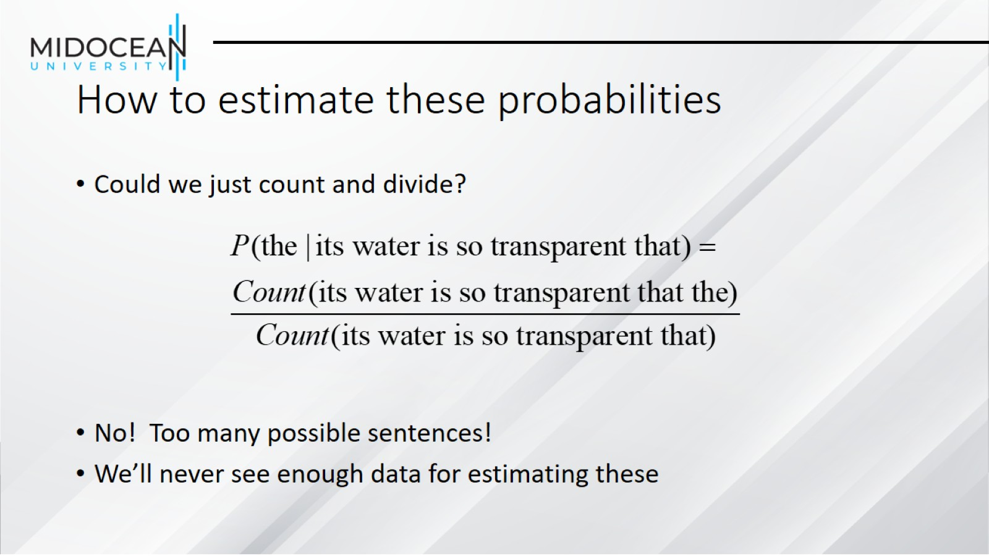
How to estimate these probabilities

Slide 10
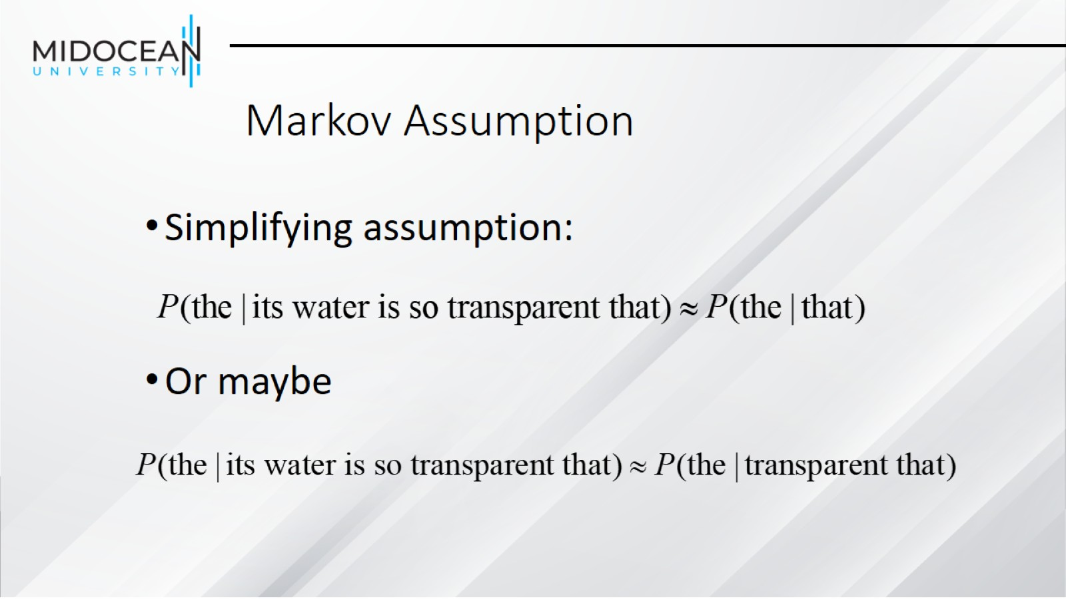
Markov Assumption

Slide 11
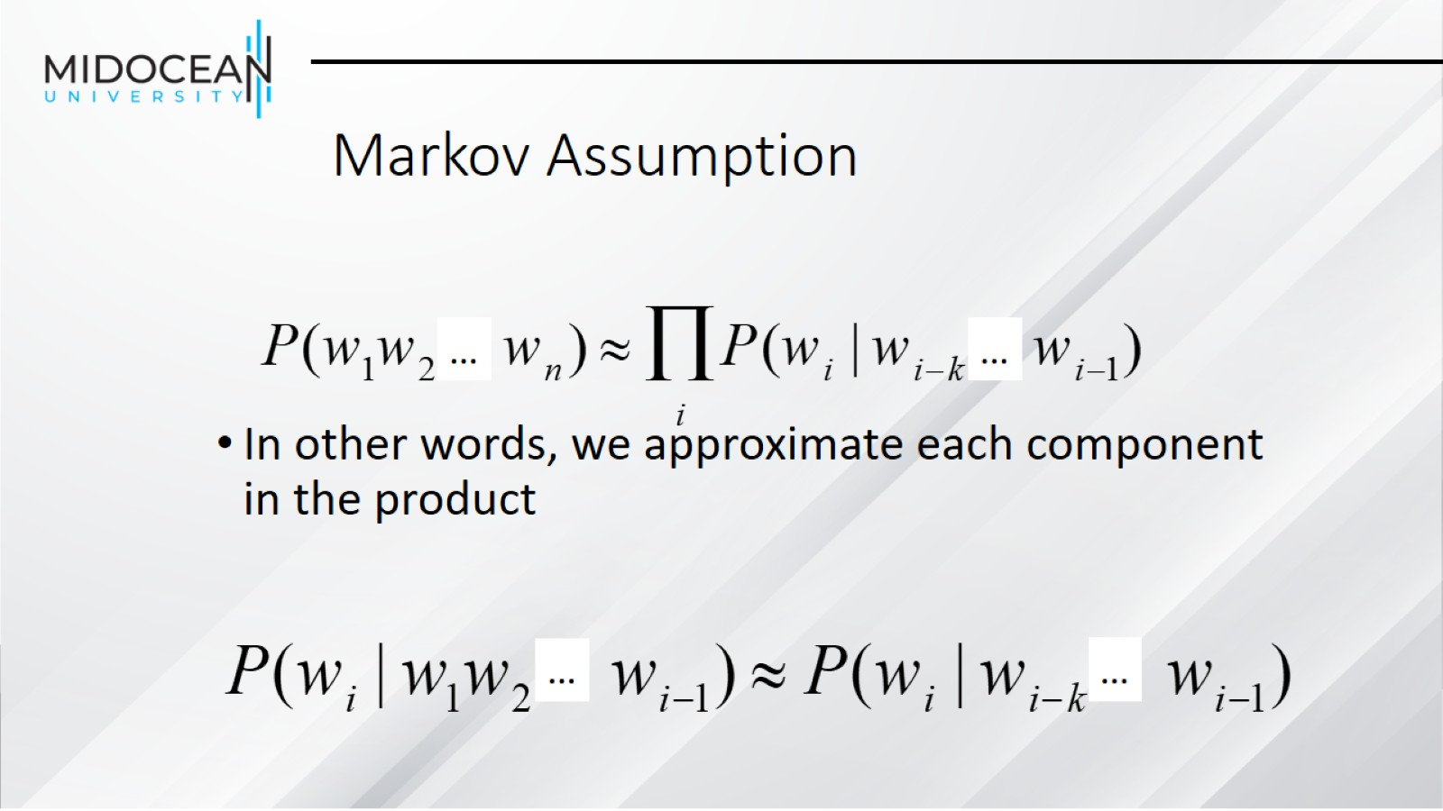
Markov Assumption

Slide 12
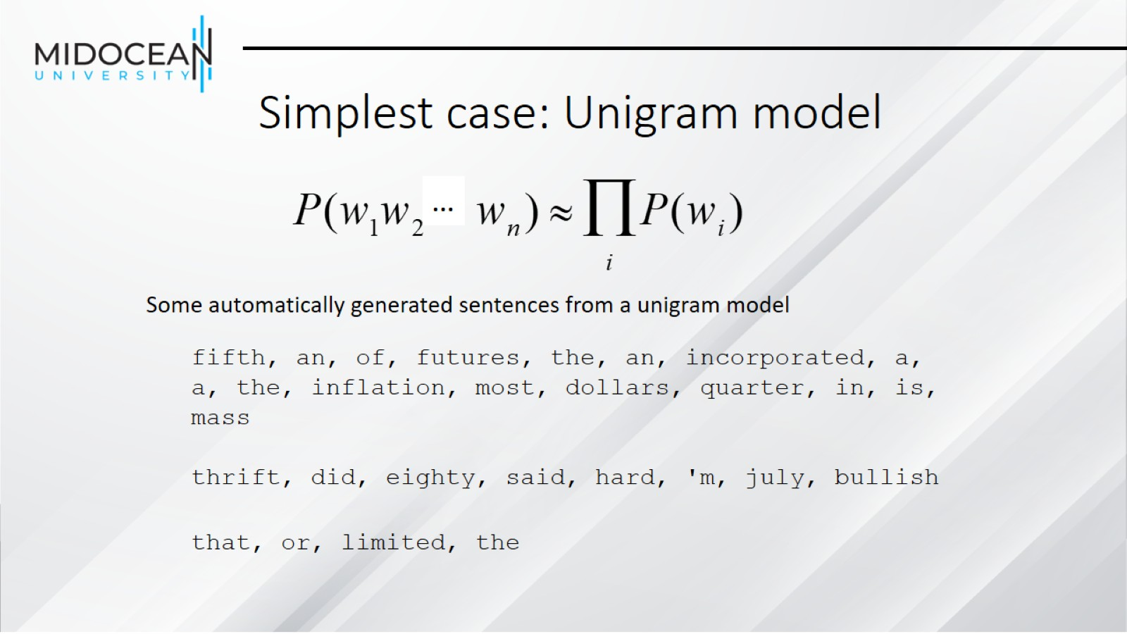
Simplest case: Unigram model

Slide 13
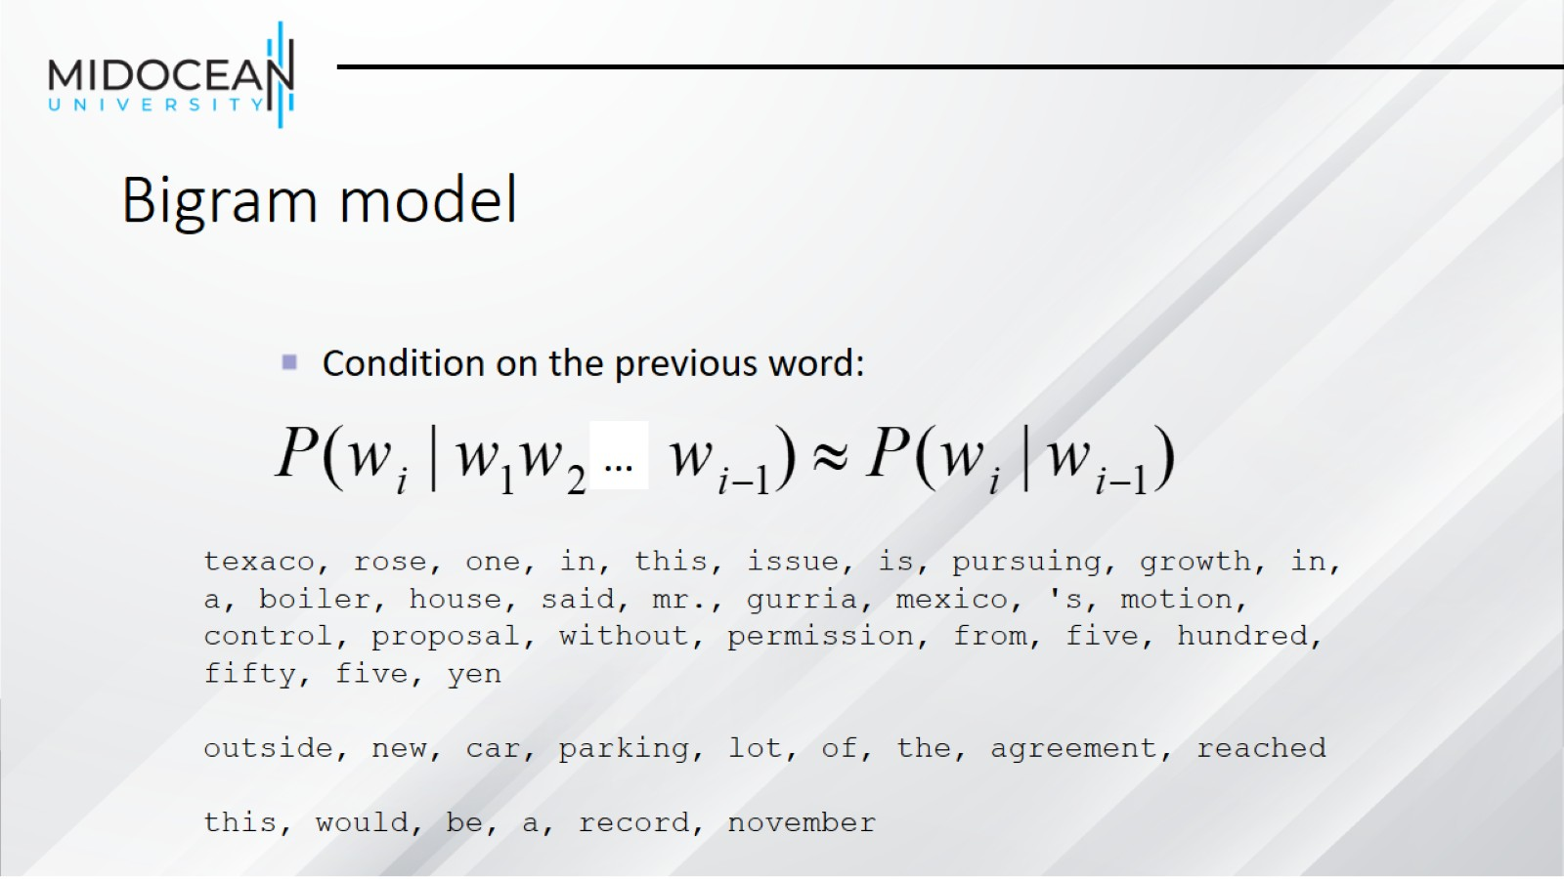
Bigram model

Slide 14
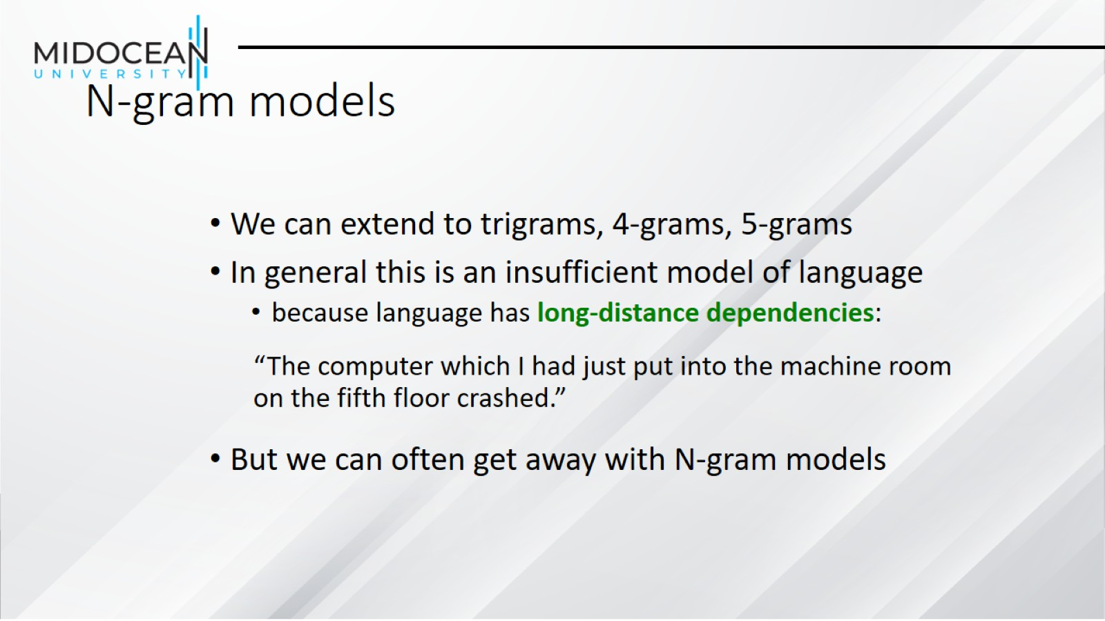
N-gram models

Slide 15
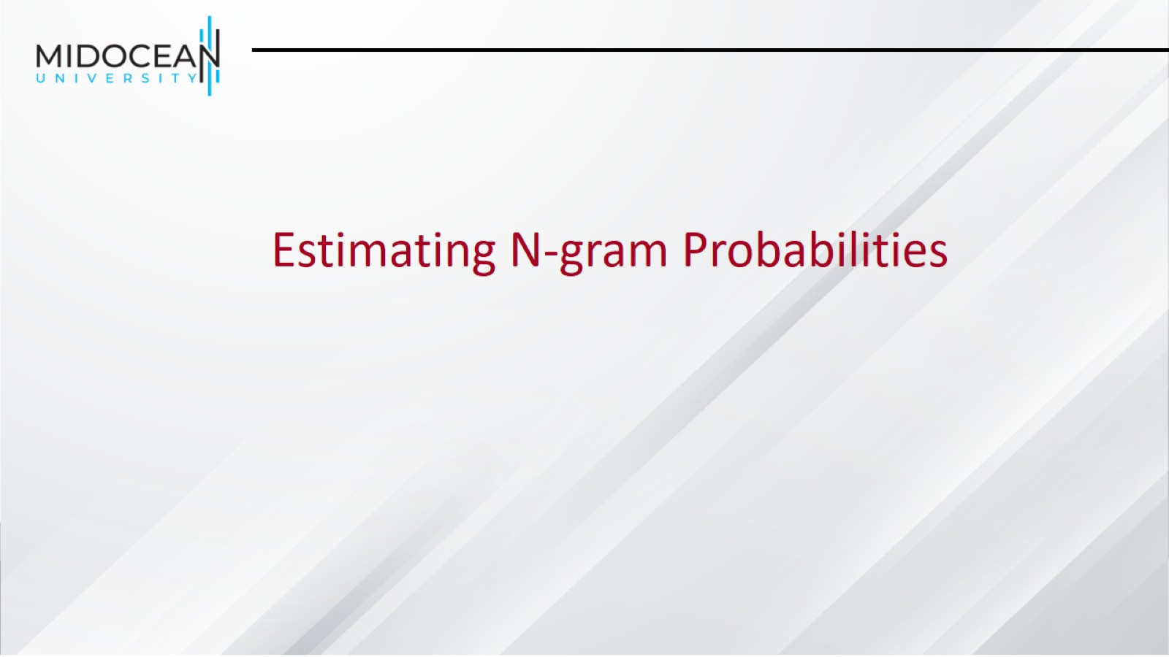

Slide 16
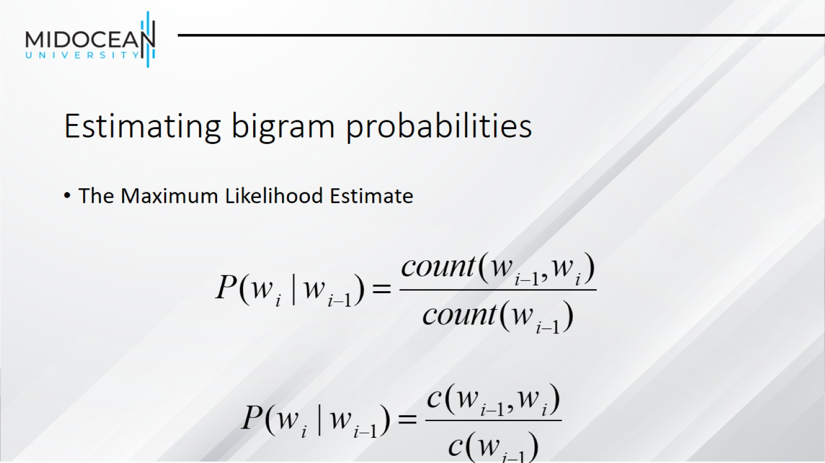
Estimating bigram probabilities

Slide 17
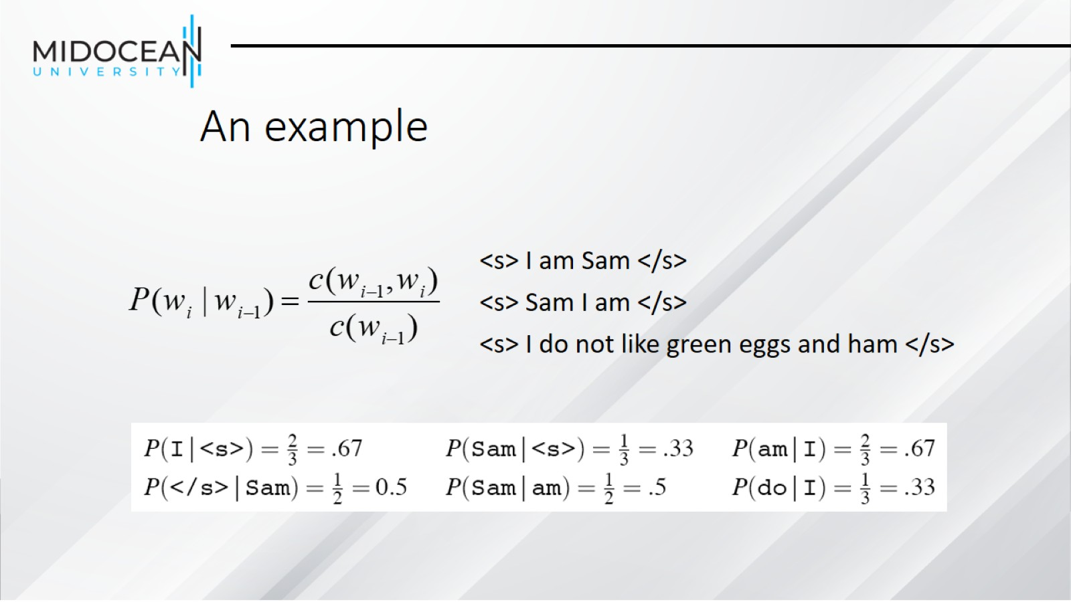
An example

Slide 18
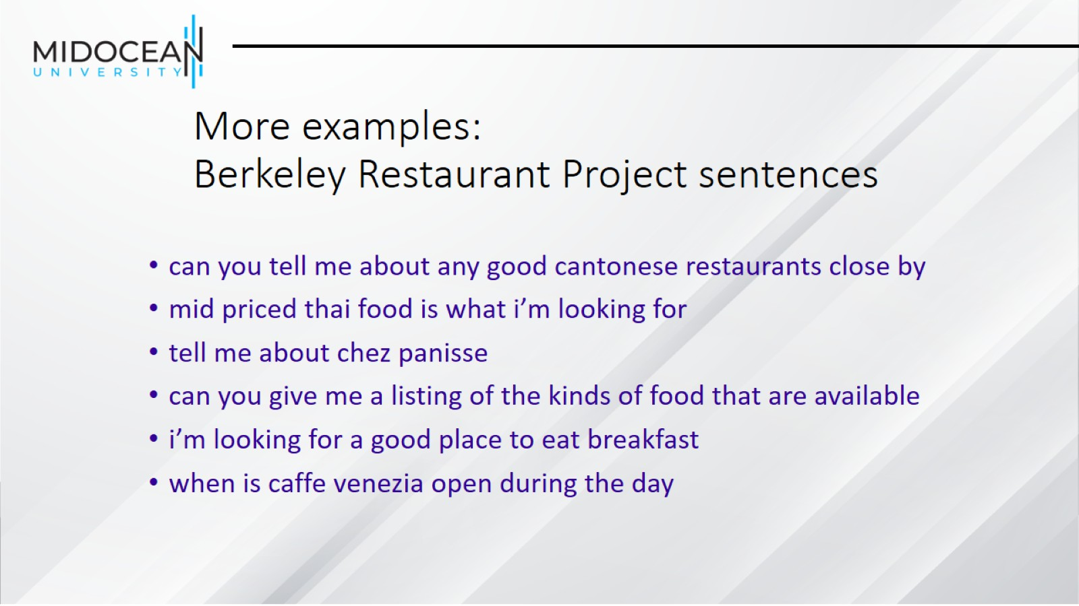
More examples:
Berkeley Restaurant Project sentences

Slide 19
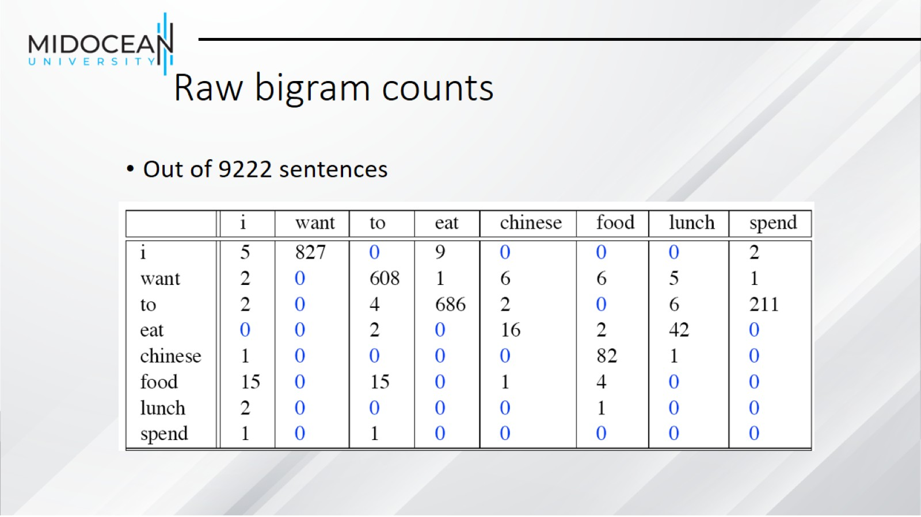
Raw bigram counts

Slide 20
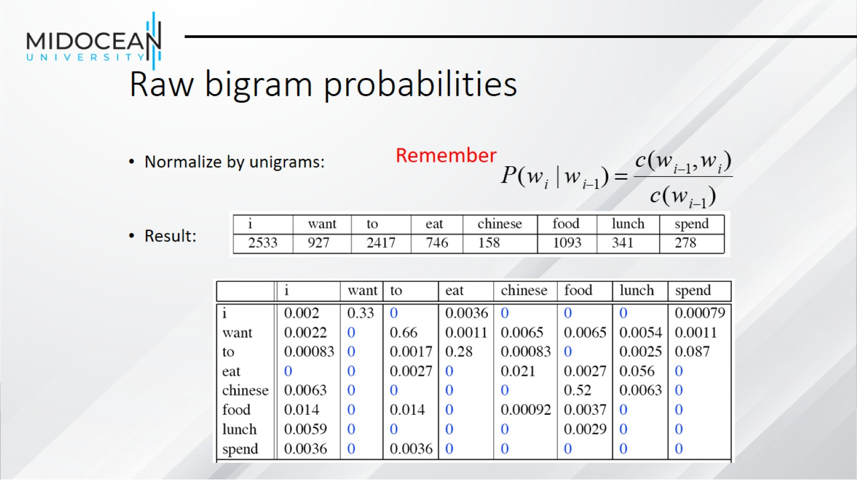
Raw bigram probabilities

Slide 21
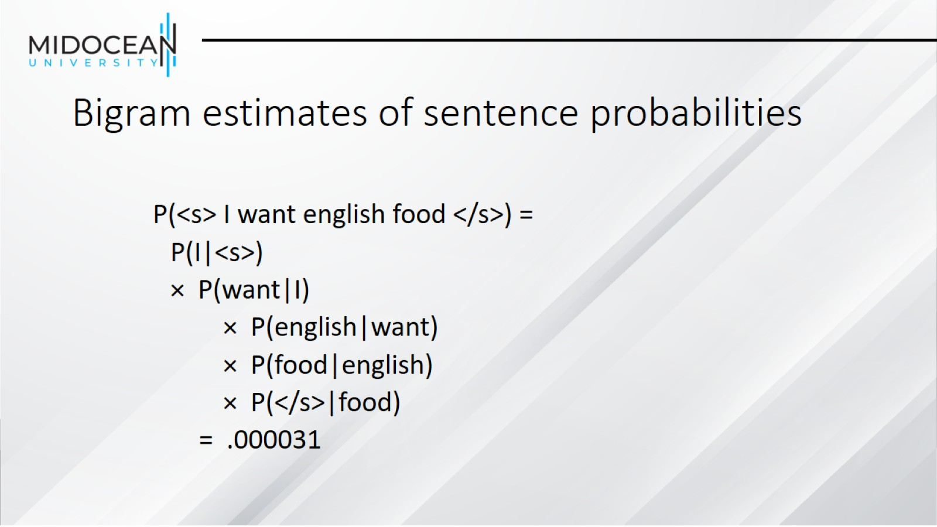
Bigram estimates of sentence probabilities

Slide 22
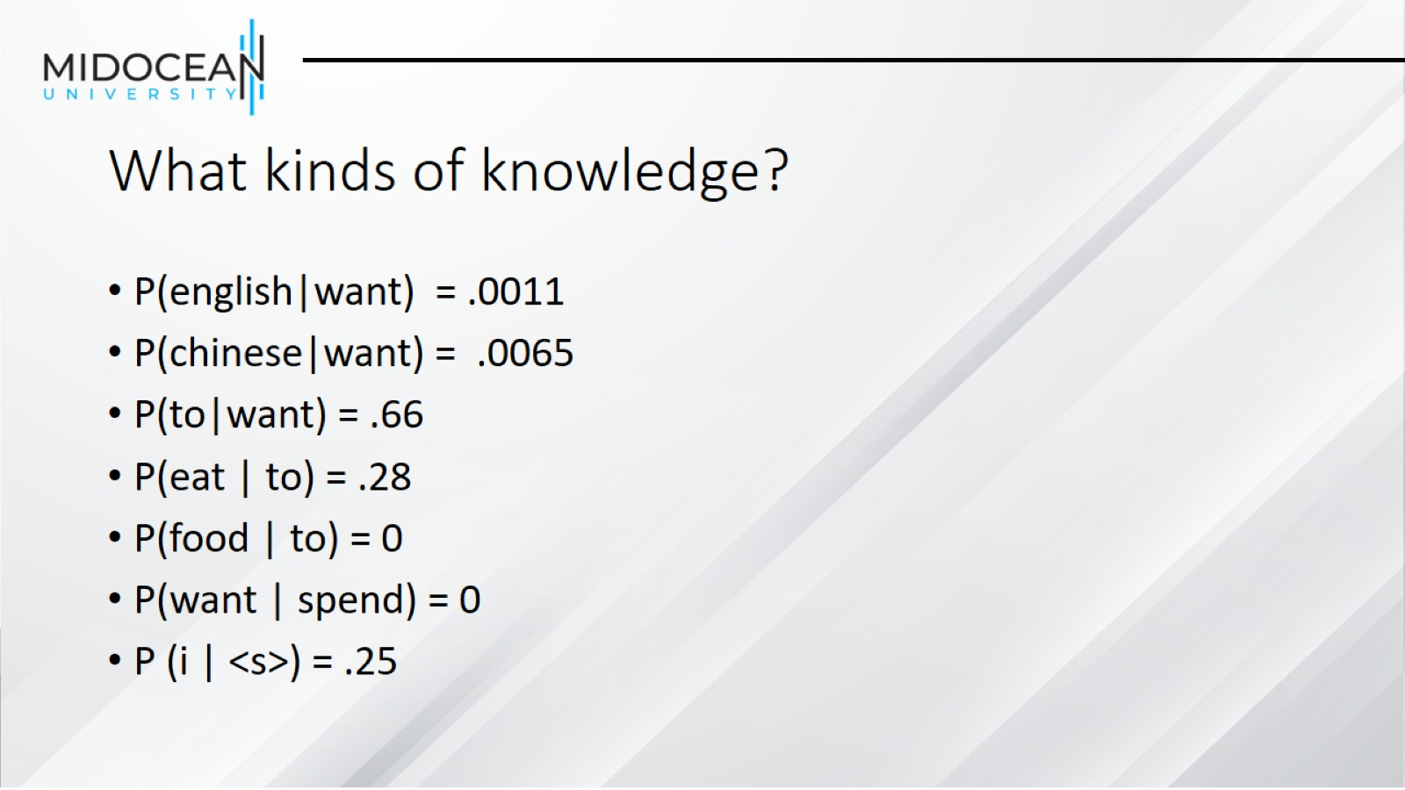
What kinds of knowledge?

Slide 23
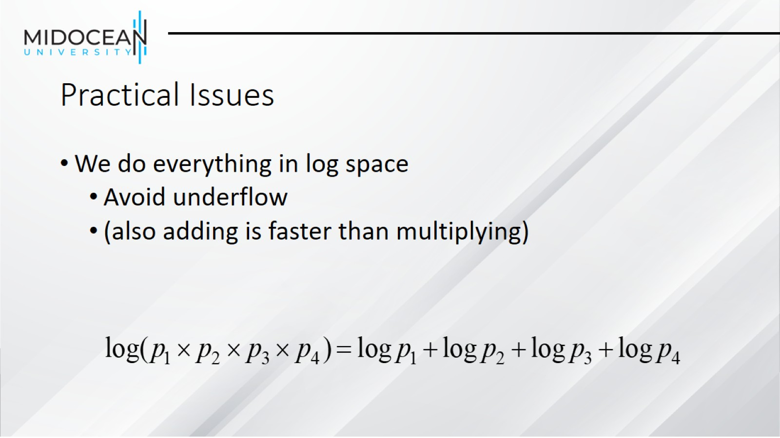
Practical Issues

Slide 24
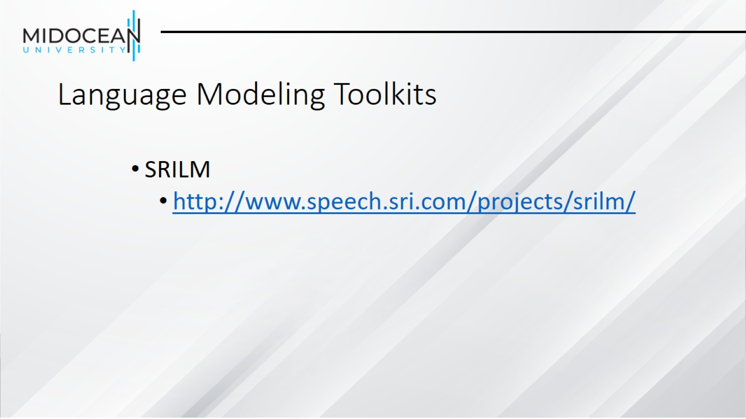
Language Modeling Toolkits

Slide 25
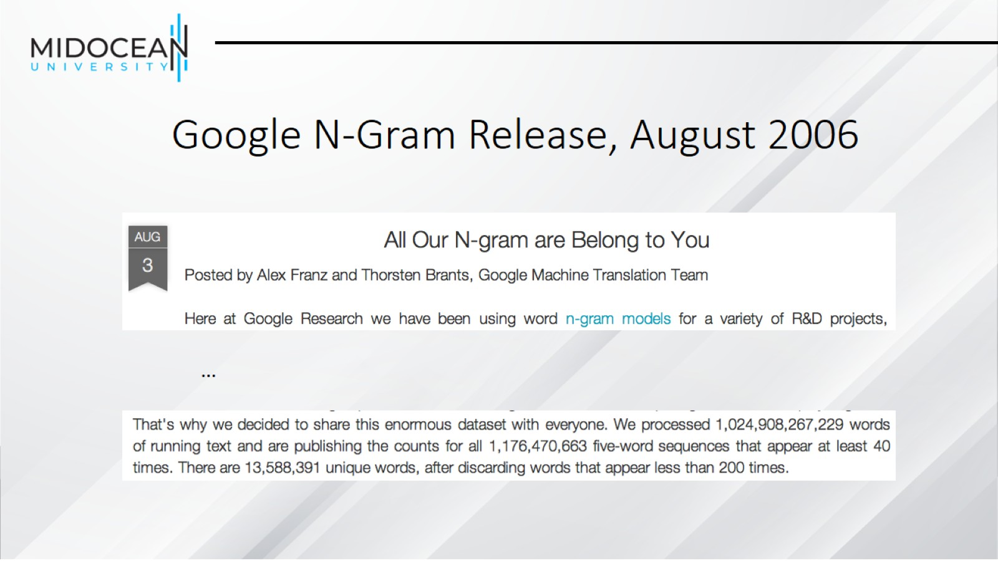
Google N-Gram Release, August 2006

Slide 26
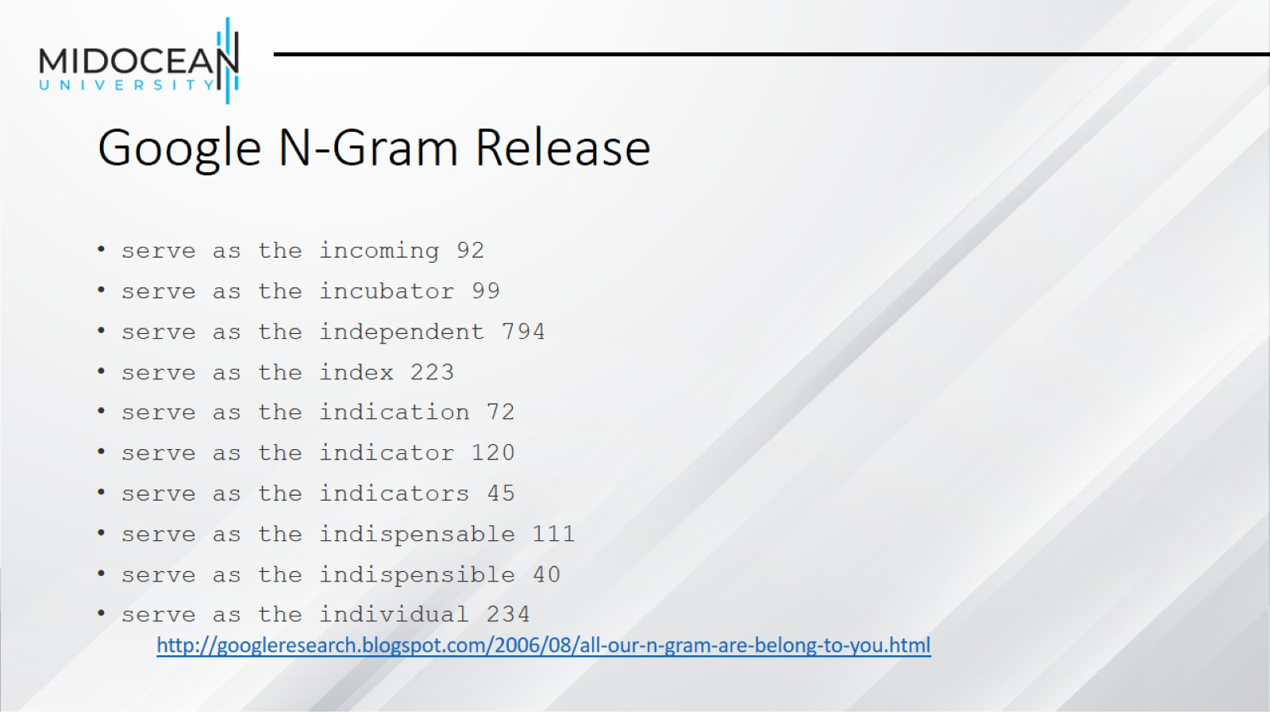
Google N-Gram Release

Slide 27
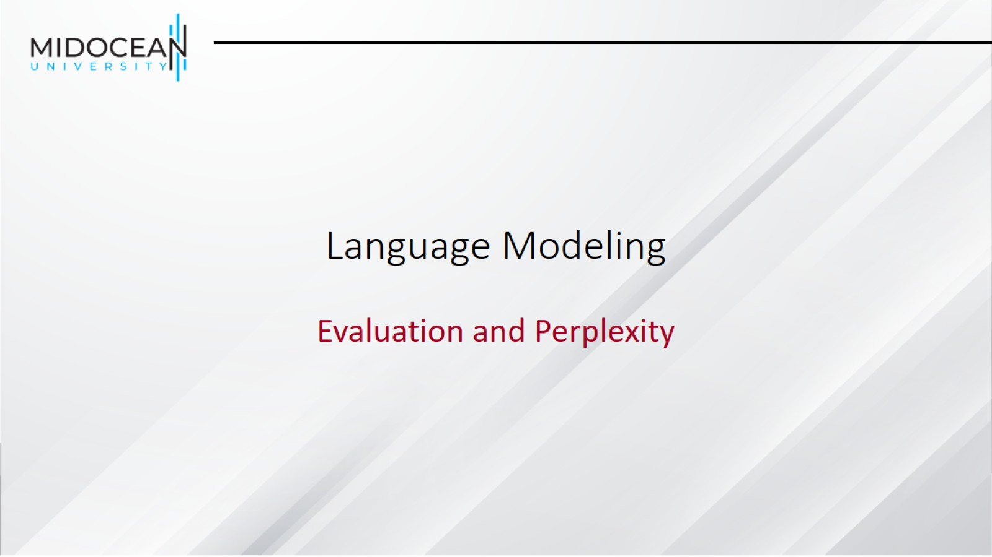
Language Modeling

Slide 28
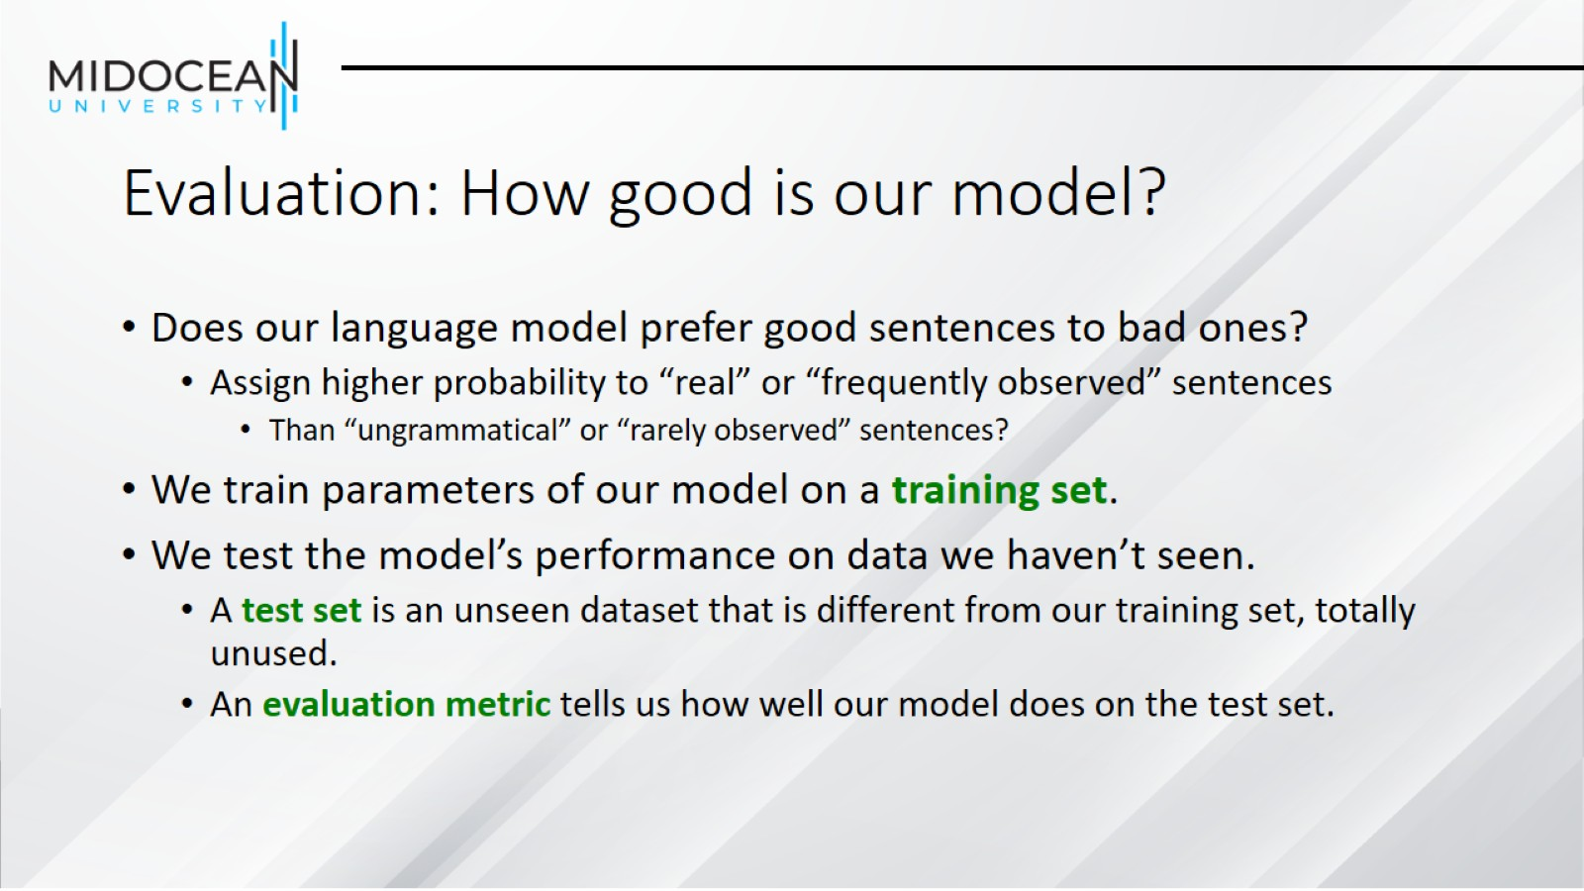
Evaluation: How good is our model?

Slide 29
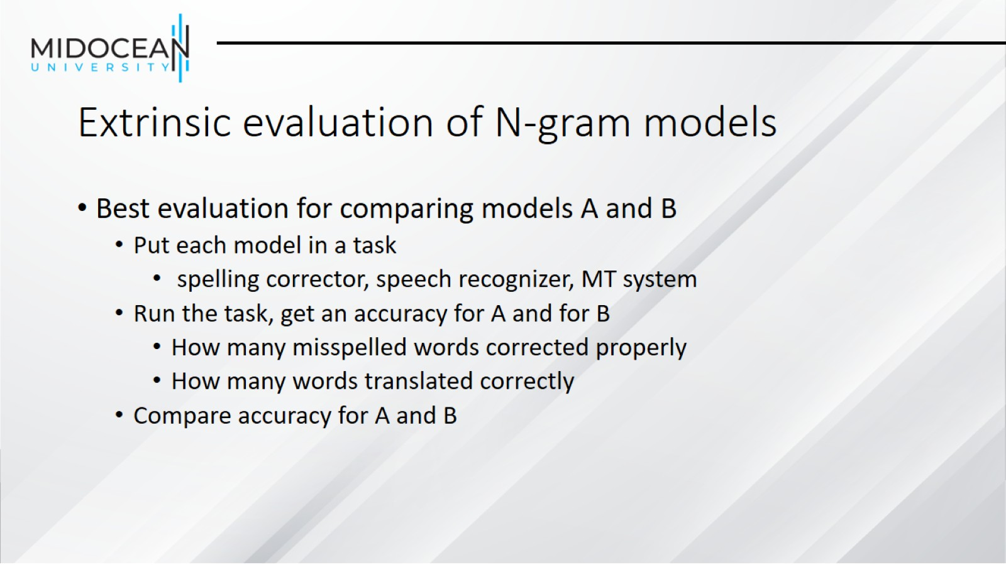
Extrinsic evaluation of N-gram models

Slide 30
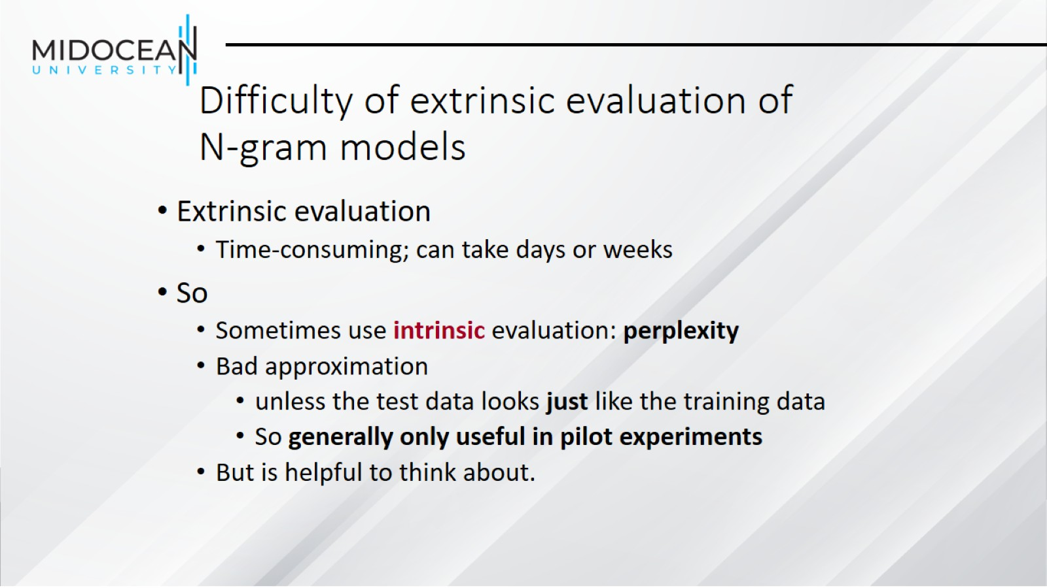
Difficulty of extrinsic evaluation of N-gram models

Slide 31
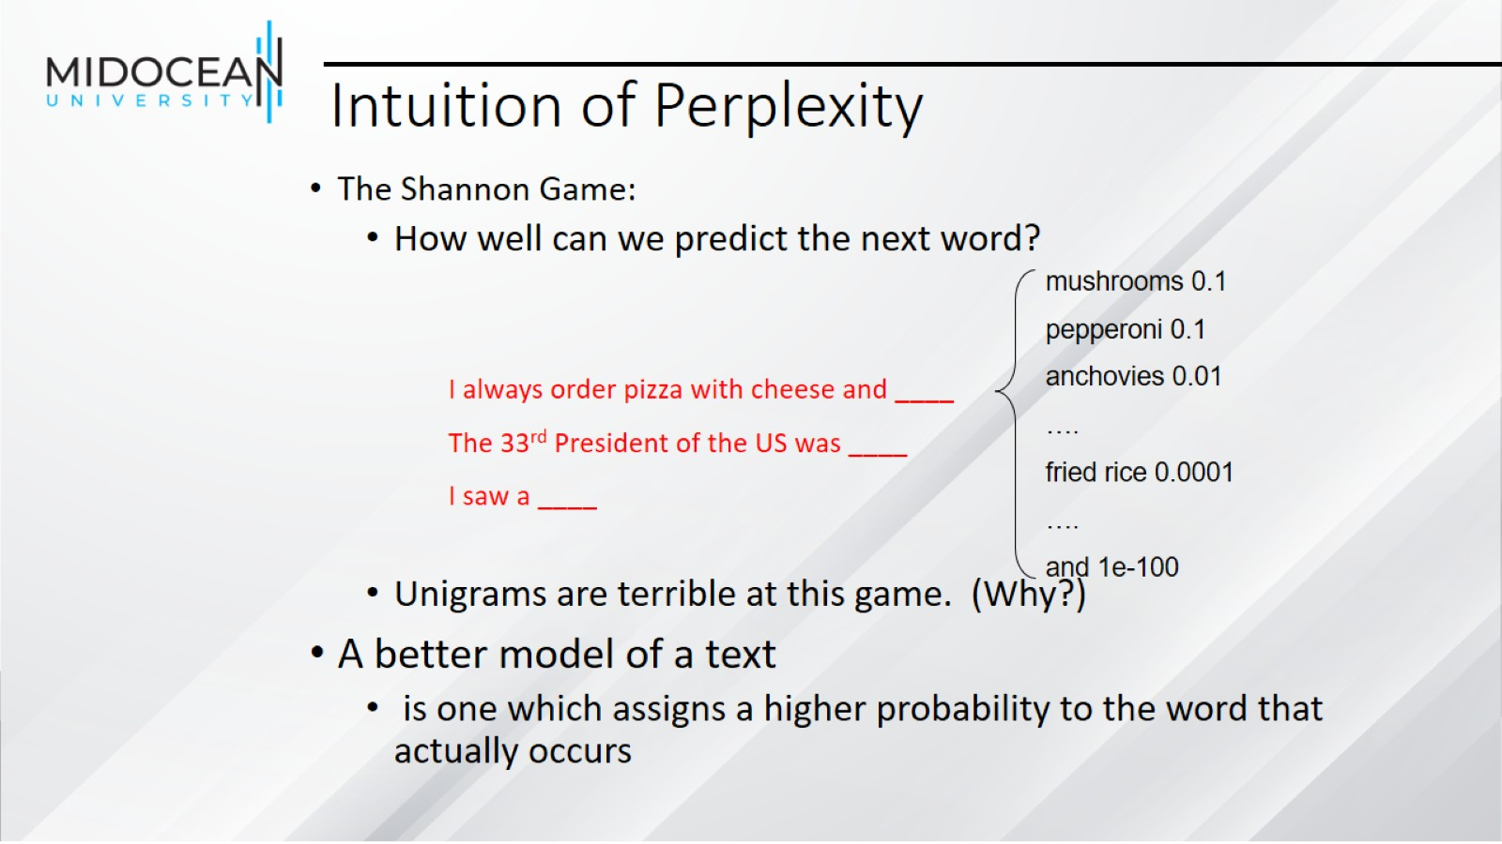
Intuition of Perplexity

Slide 32
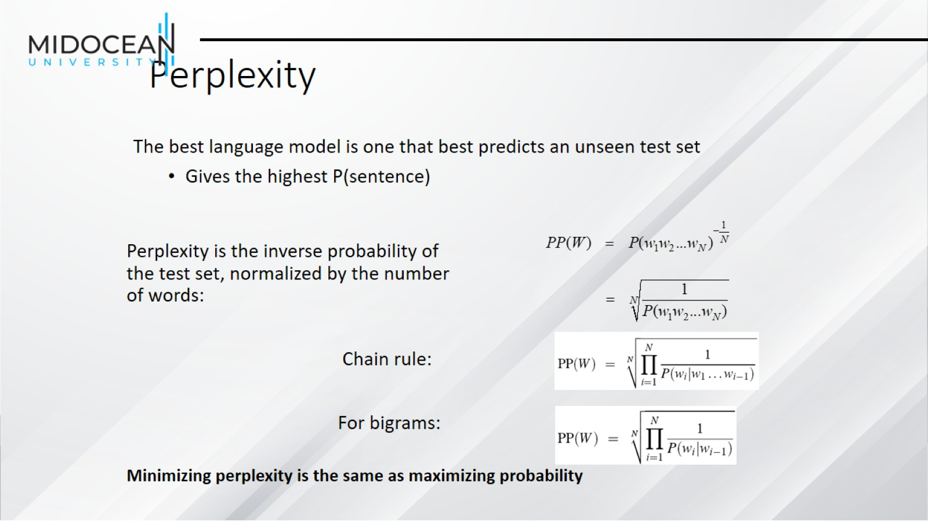
Perplexity

Slide 33
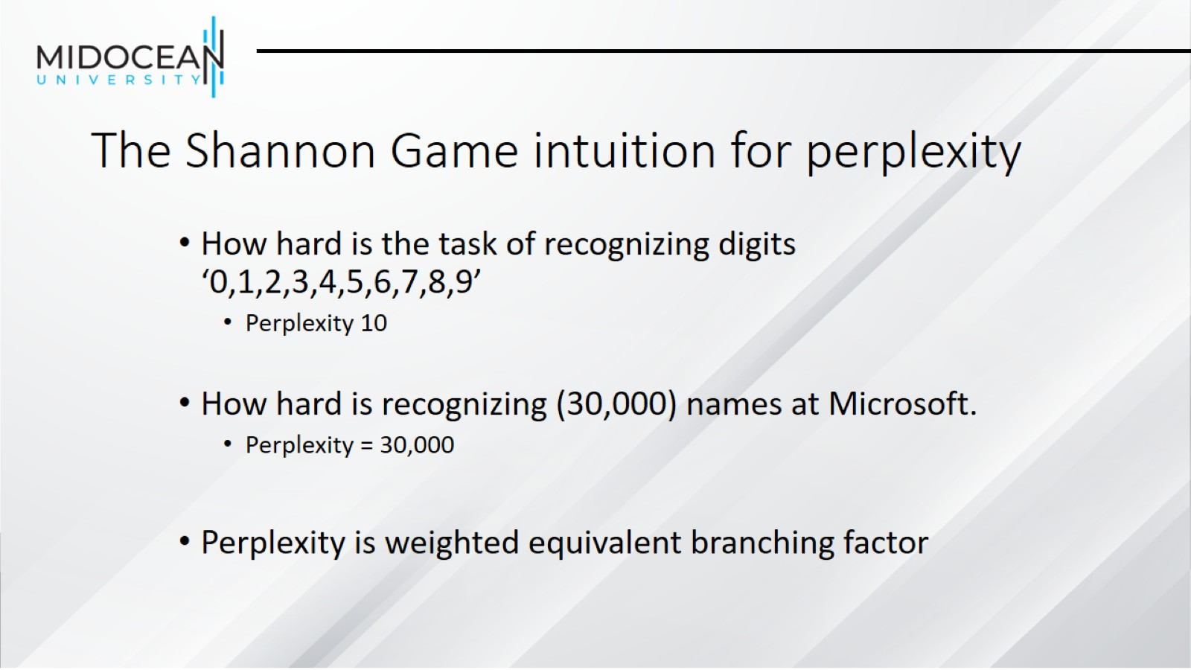
The Shannon Game intuition for perplexity

Slide 34
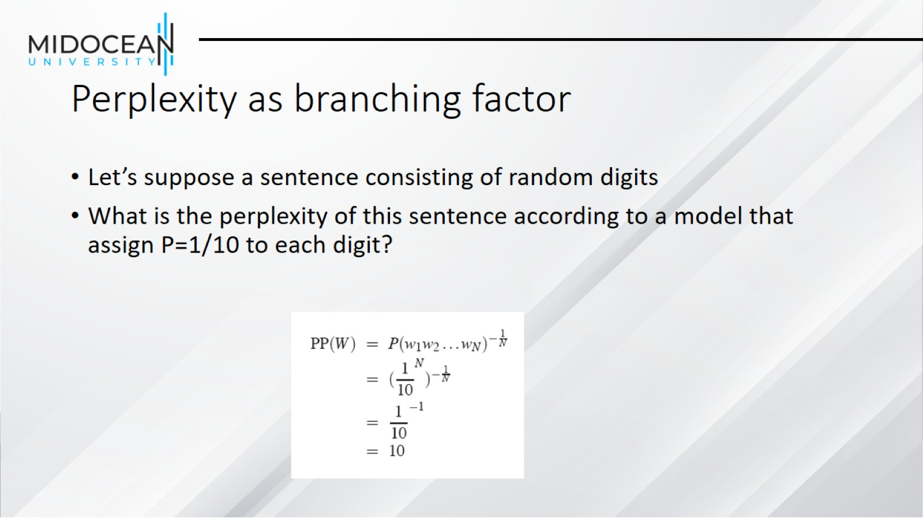
Perplexity as branching factor

Slide 35
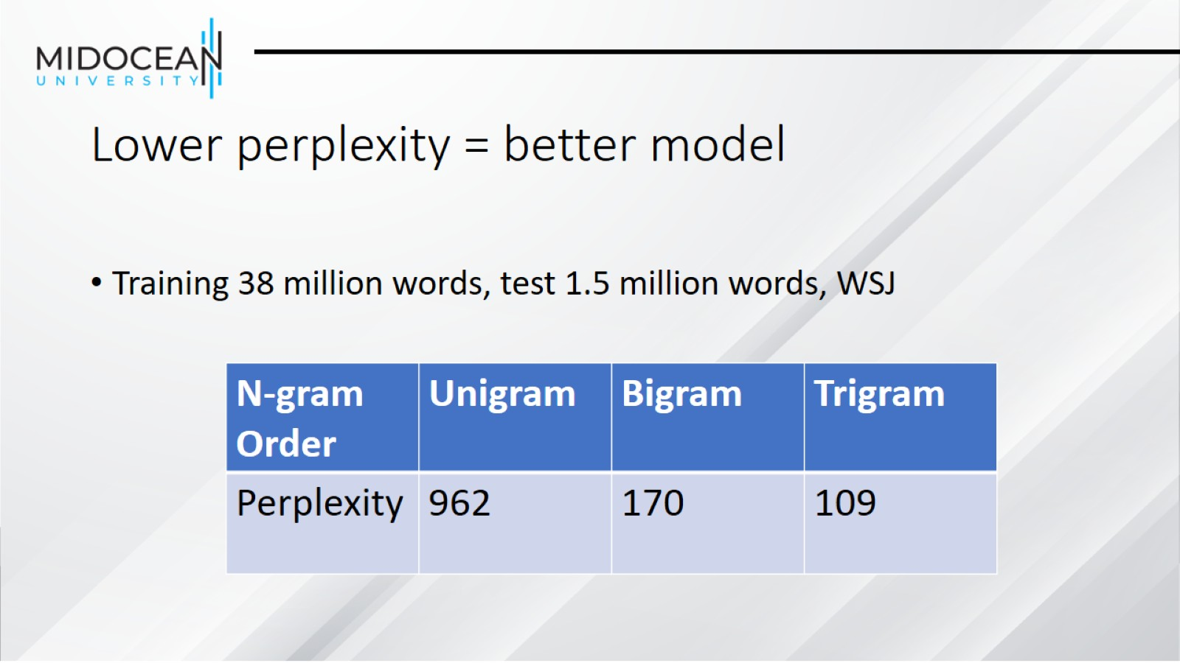
Lower perplexity = better model

Slide 36
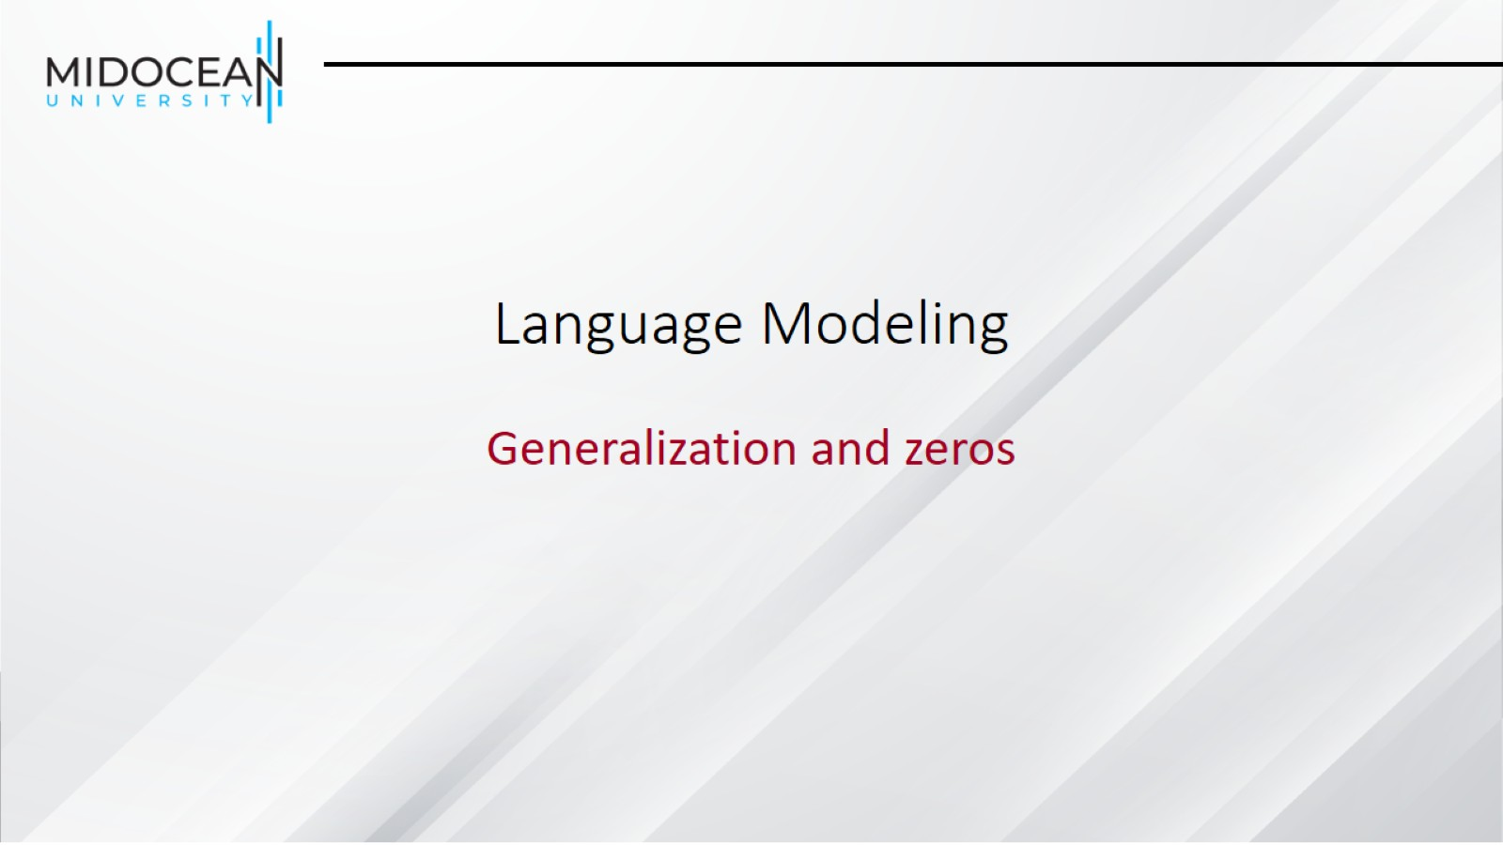
Language Modeling

Slide 37
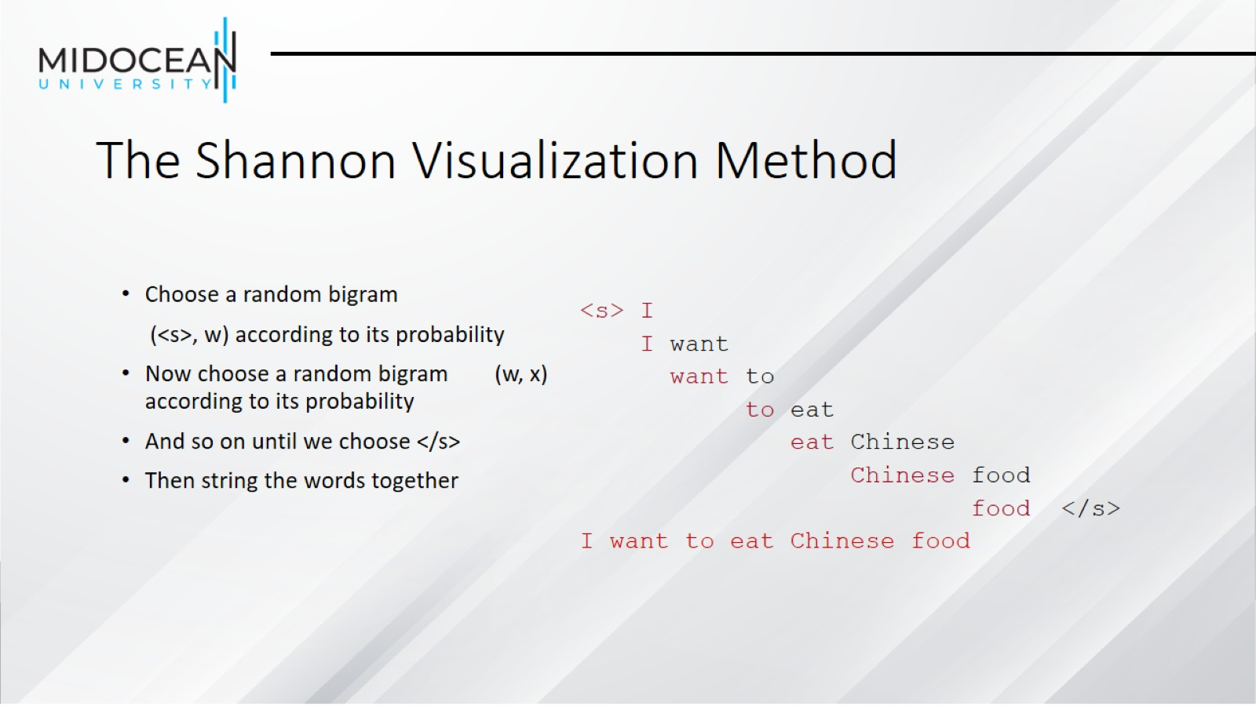
The Shannon Visualization Method

Slide 38
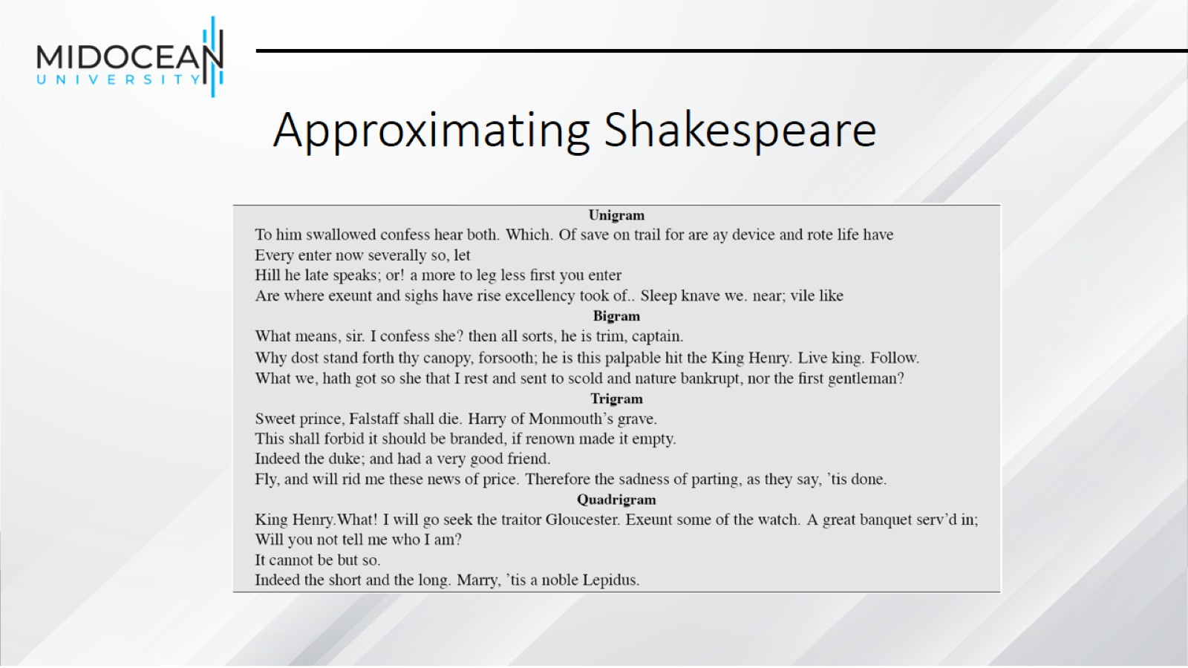
Approximating Shakespeare

Slide 39
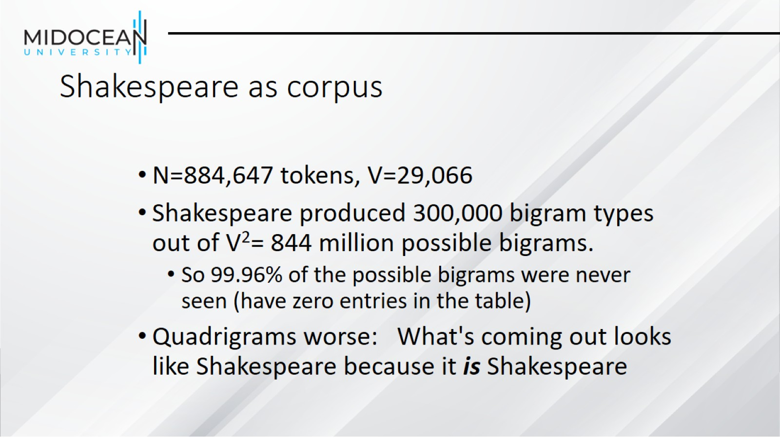
Shakespeare as corpus

Slide 40
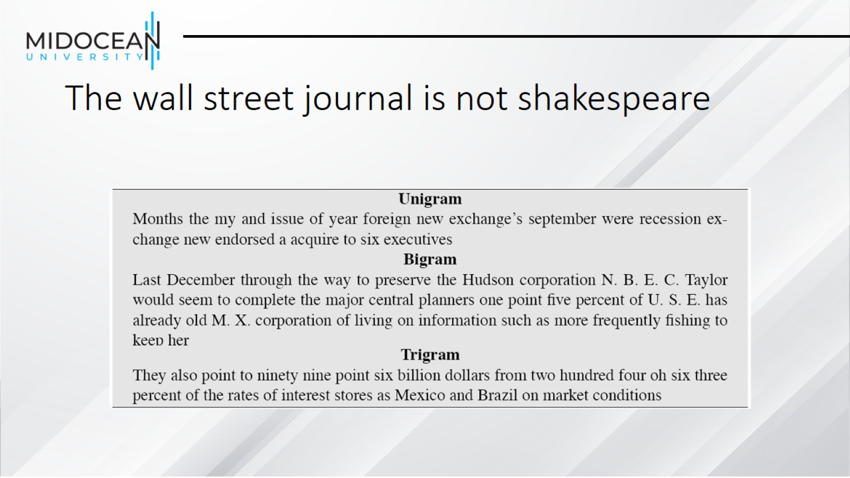
The wall street journal is not shakespeare

Slide 41
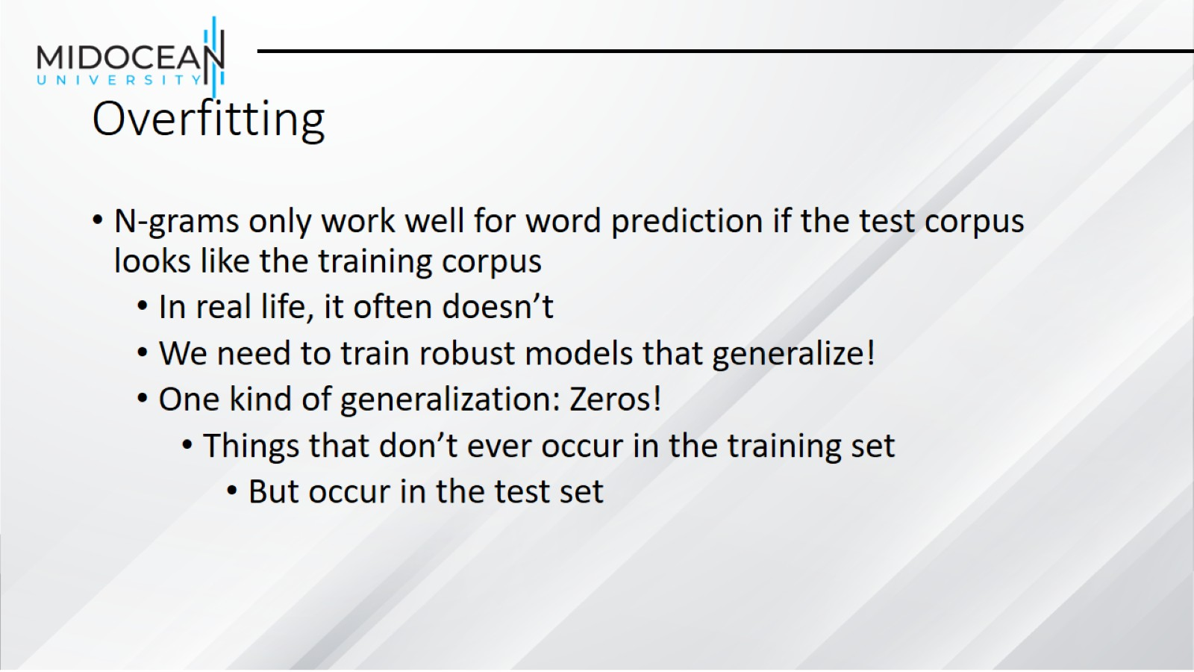
Overfitting

Slide 42
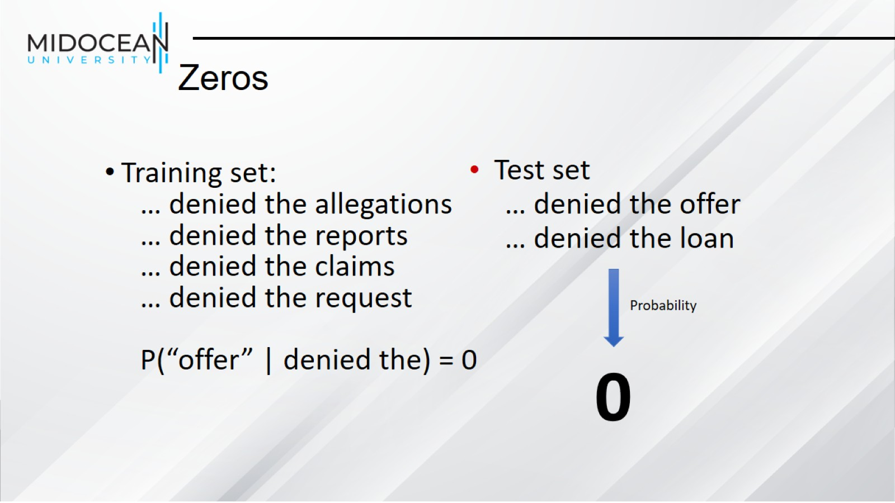
Zeros

Slide 43
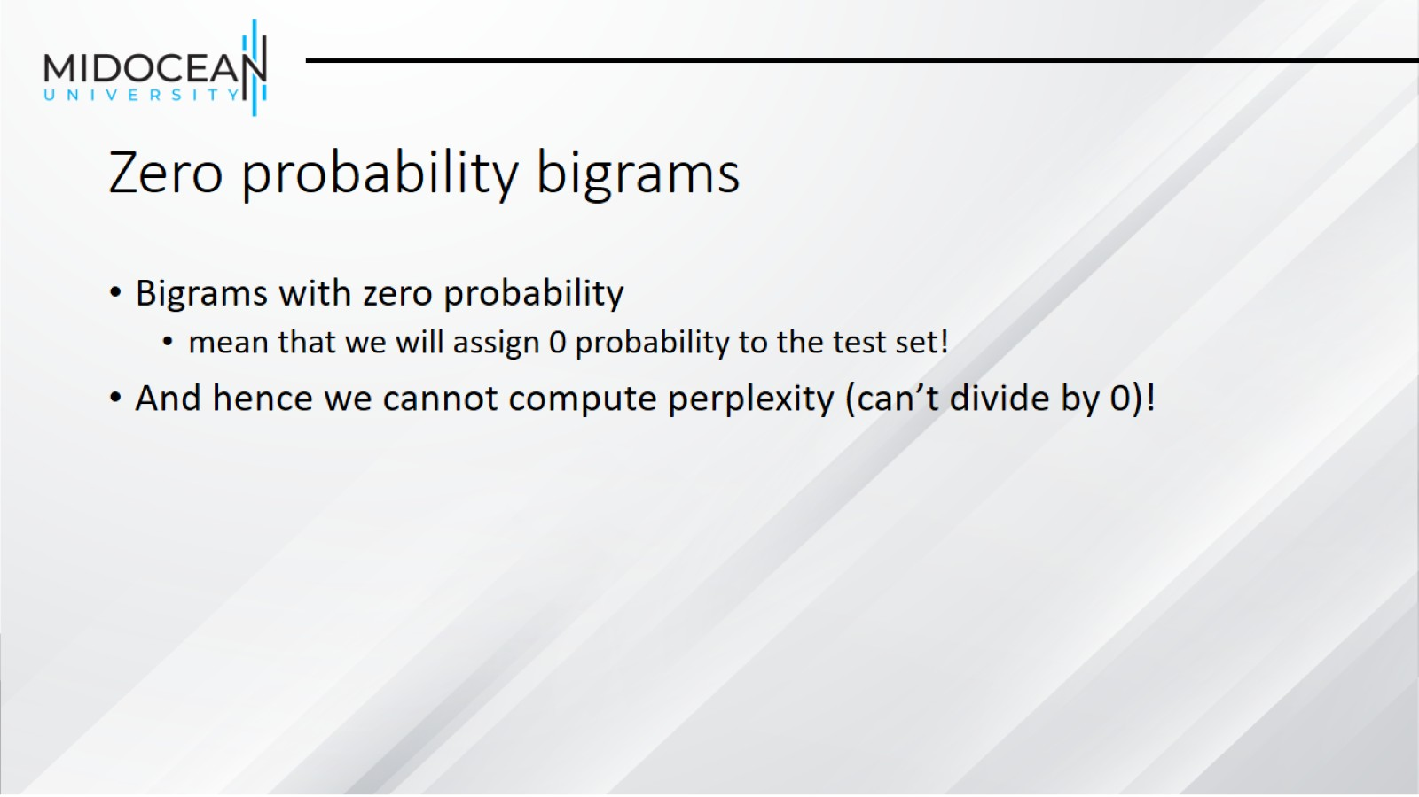
Zero probability bigrams

Slide 44
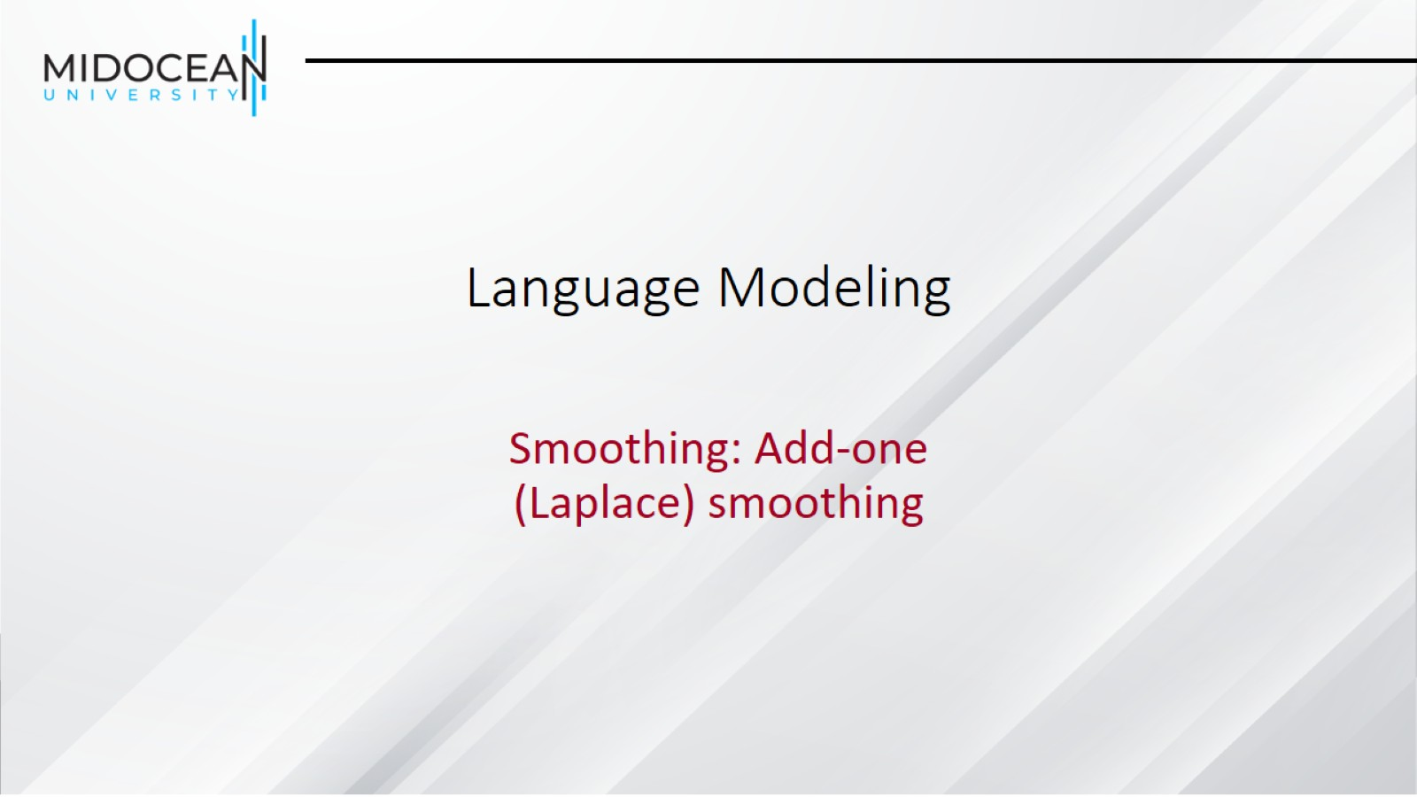
Language Modeling

Slide 45
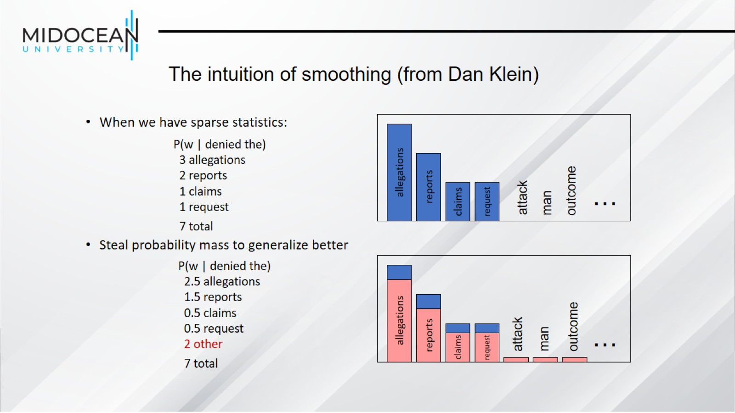
The intuition of smoothing (from Dan Klein)

Slide 46
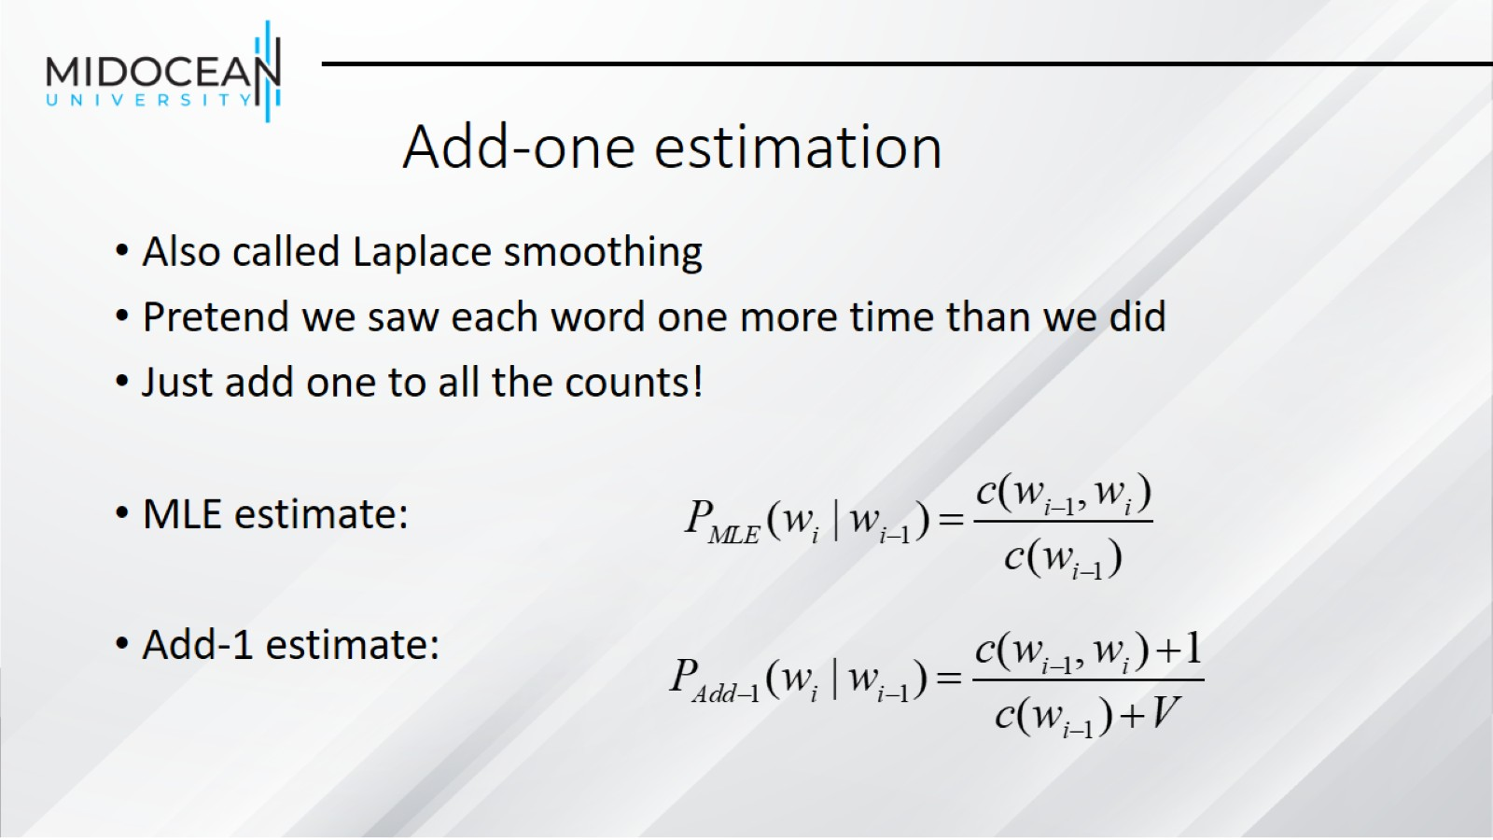
Add-one estimation

Slide 47
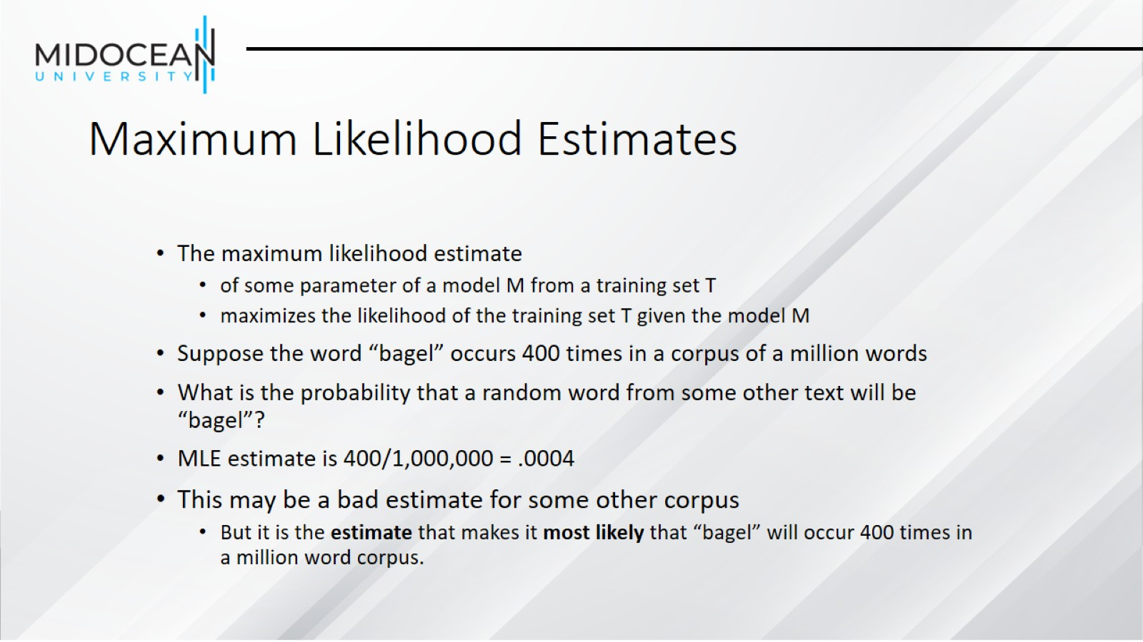
Maximum Likelihood Estimates

Slide 48
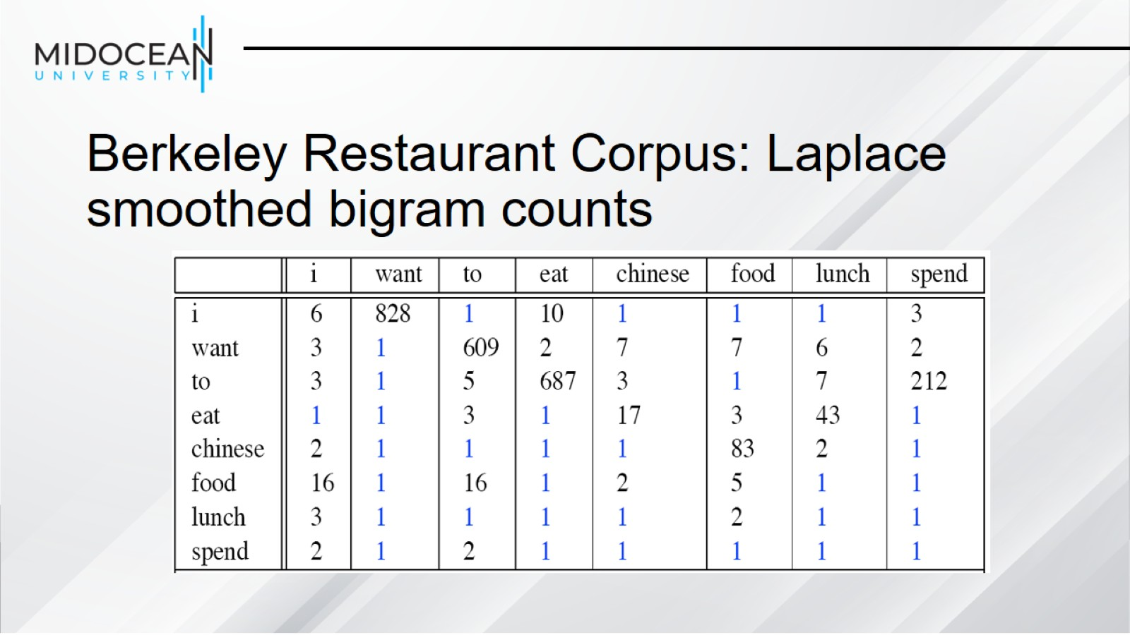
Berkeley Restaurant Corpus: Laplace smoothed bigram counts

Slide 49
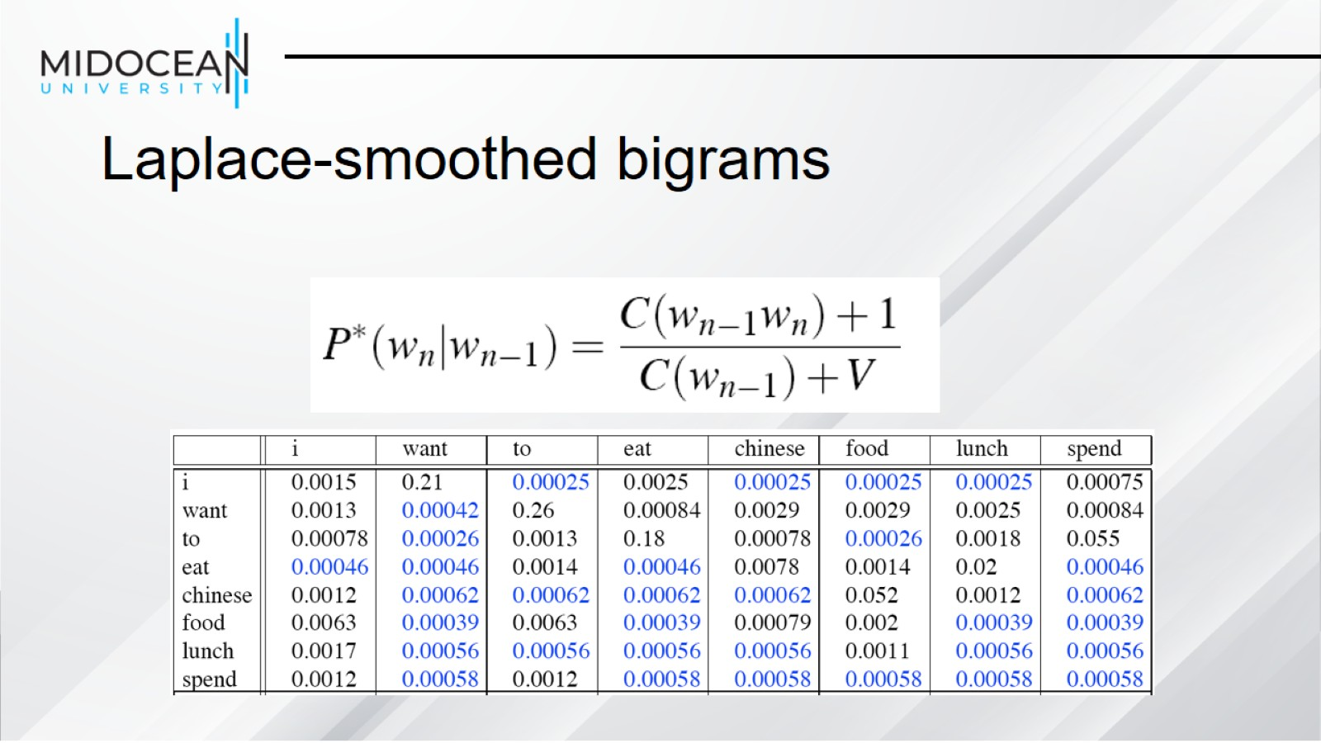
Laplace-smoothed bigrams

Slide 50
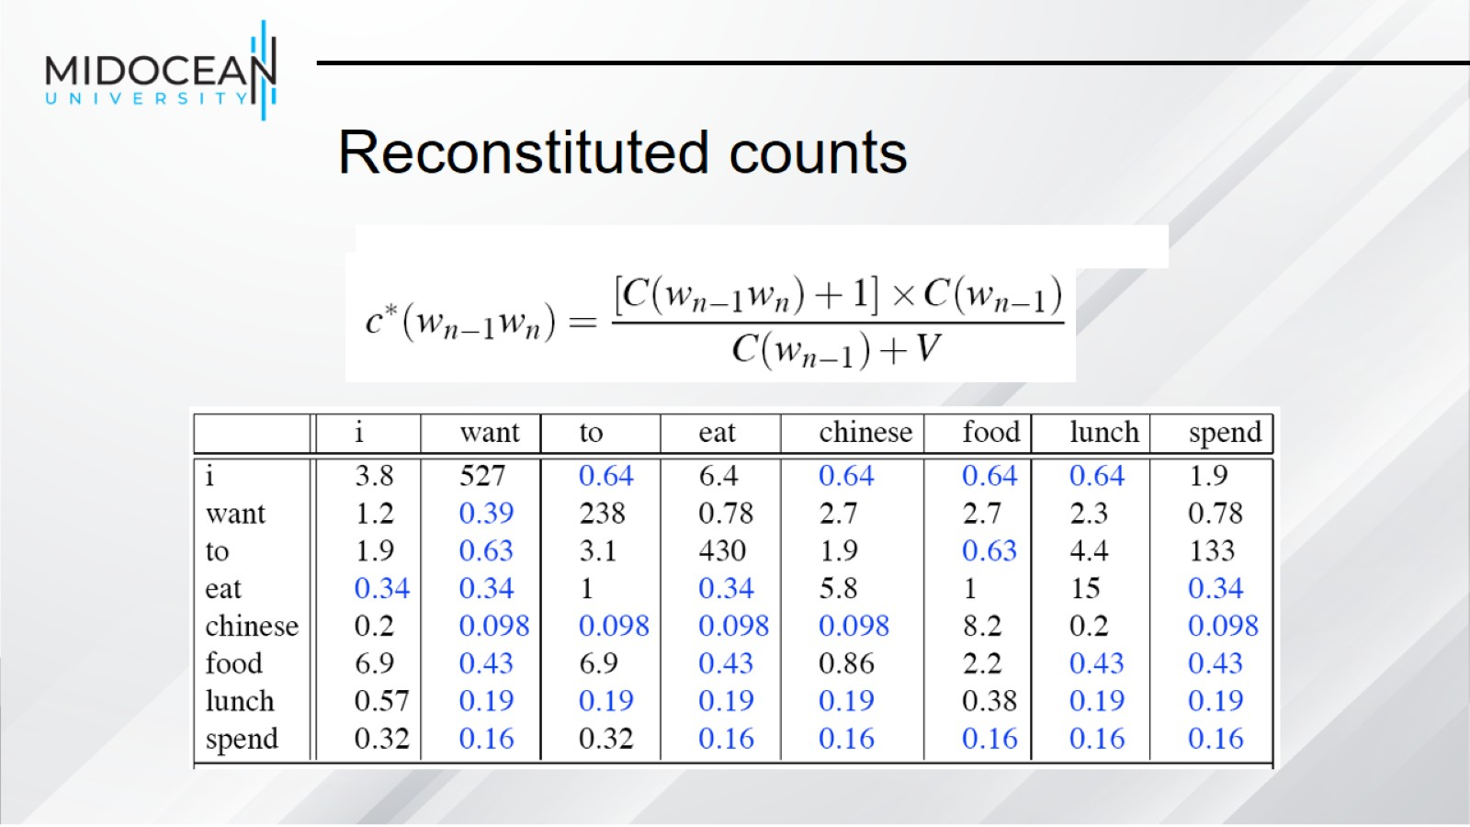
Reconstituted counts

Slide 51
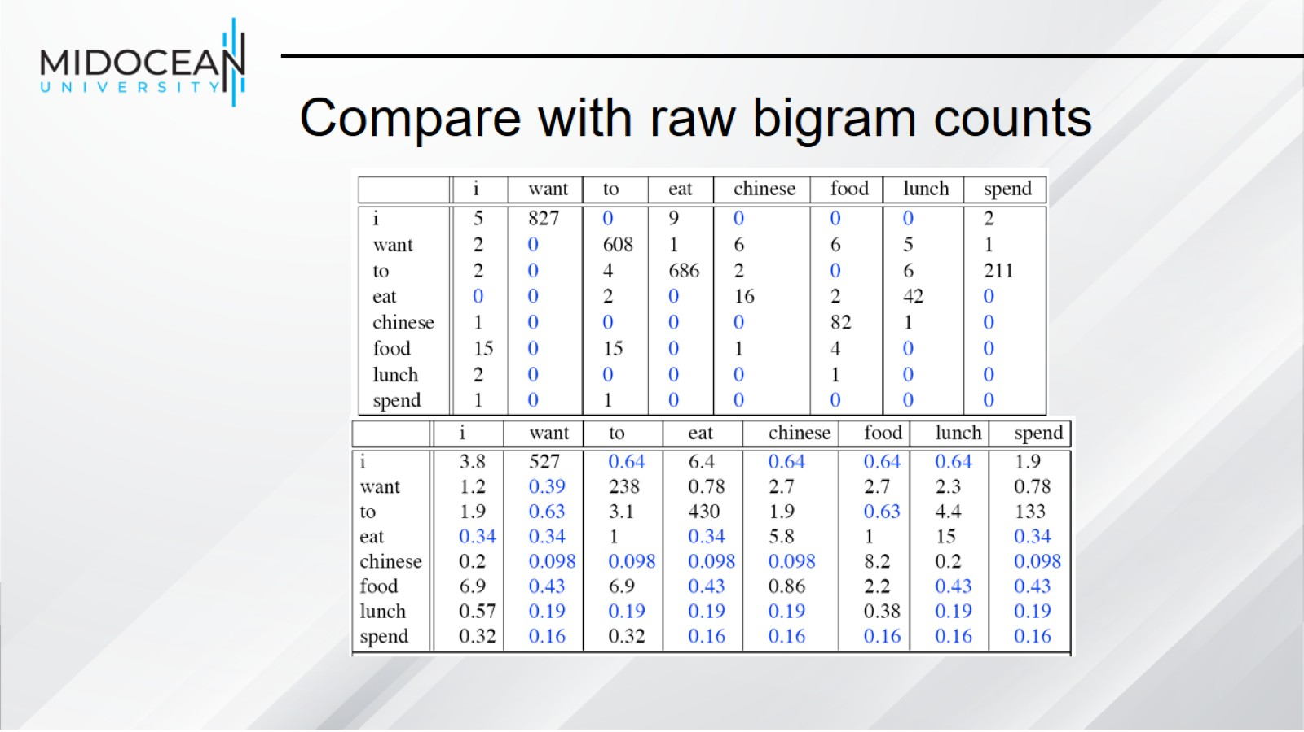
Compare with raw bigram counts

Slide 52

Add-1 estimation is a blunt instrument

Slide 53


