Slide 1



Machine Learning
Prepared by Dr. Yasser Abdelhamid
DS 620
Machine Learning
Lecture 7

Slide 2

Outline
Decision trees

Slide 3
Decision trees
A decision tree is a supervised classification algorithm that implements divide and conquer strategy in building a tree structure for the training set.
Decision trees vs rule-based Expert systems.
  Nodes represent features/attributes upon which a decision to be taken
  Arcs represent different rules.
  leaf nodes represent output variable classes.

Slide 4
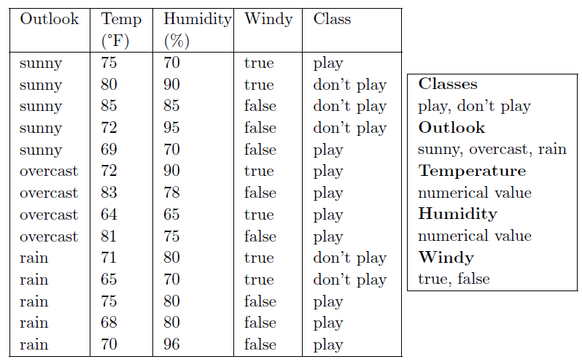
Example
If tomorrow the values of Outlook, Temperature, Humidity and Windy were sunny, 74°F, 77% and false respectively, what would the decision be?

Slide 5
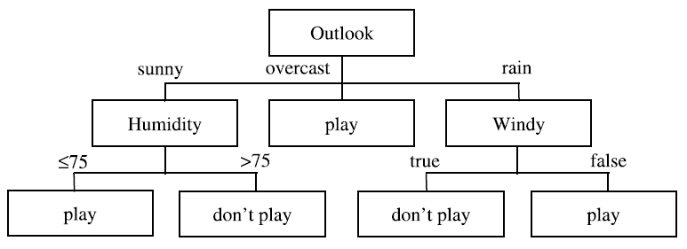
Example
If tomorrow the values of Outlook, Temperature, Humidity and Windy were:
  sunny,
  74°F,
  77% and
  false respectively,
what would the decision be?

Slide 6
Basic Terminology
Objects/Instances, Attributes, and Classes.
Splitting on attributes:
  Testing the value of an attribute and then creating a branch for each of its possible values.
Splitting on categorical and continuous attributes.
Splitting continues until each branch can be labelled with just one classification.
Decision trees as an alternative concise representation of the dataset.
Decision trees as a generalization to predict the class of unseen instances.

Slide 7
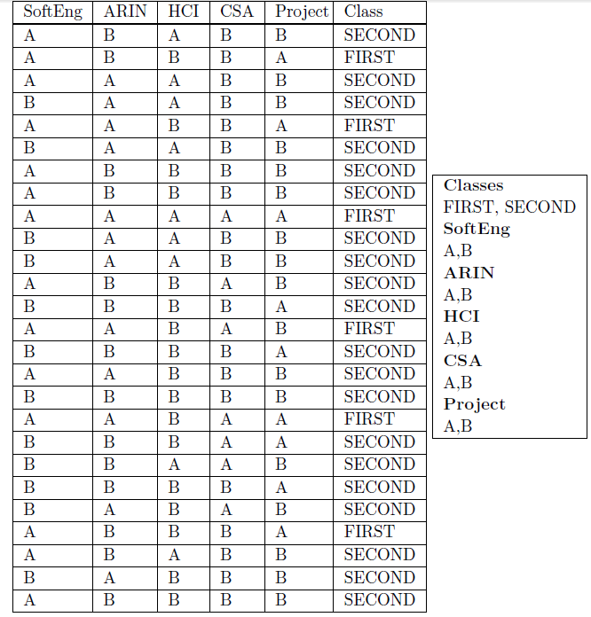
Example 2

Slide 8
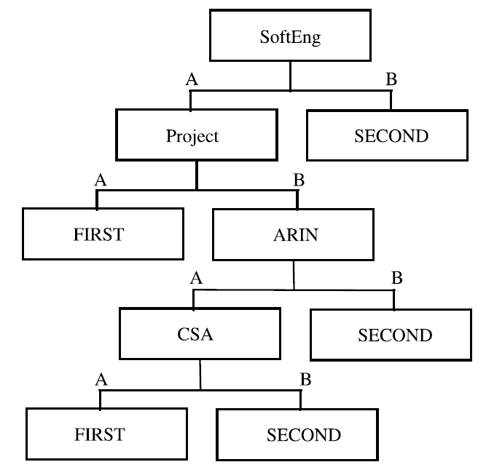
Example 2
Think of the root node as corresponding to the original training set.
All other nodes correspond to a subset of the training set.
A branch is a path from root node to one of the leaf nodes.
There are five leaf nodes and hence five branches.
Each branch corresponds to a classification rule.

Slide 9
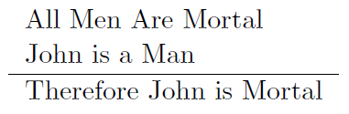
Types of reasoning
Deduction : Making an inference based on accepted facts or premises.
if premises are true then actions are true.

Slide 10
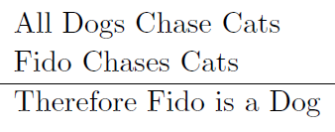
Types of reasoning
Abduction: making a probable conclusion from what you know.
Conclusion is consistent with the truth of the premises, but it may not necessarily be correct.

Slide 11
Types of reasoning
Induction: Making an inference based on an observation.
A generalization is based on repeated observations.
Example: After many observations of x and y occurring together, learn the rule
if x then y
Example: if I see 1,000 dogs with four legs I might reasonably conclude that “if x is a dog then x has 4 legs”

Slide 12
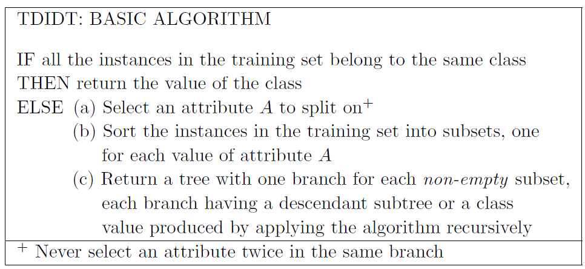
Tdidt
(Top Down Induction on Decision Trees)
Decision trees are generated by repeatedly splitting on the values of attributes.
This process is known as recursive partitioning.

Slide 13
tdidt(Cont.)
The maximum possible length for a branch is M (Number of attributes), hence the algorithm is guaranteed to terminate.
No two instances with the same values of all the attributes may belong to different classes (Adequacy Condition).
The algorithm does not specify the method of selecting an attribute for split.
Making a good choice of attributes to split on at each stage is crucial to the success of the TDIDT approach.

Slide 14
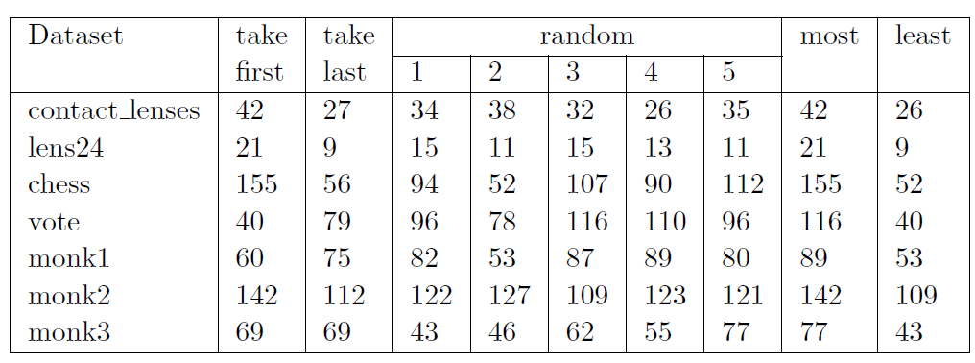
Attribute Selection
Is it feasible to look for the best selection of attributes?

Slide 15
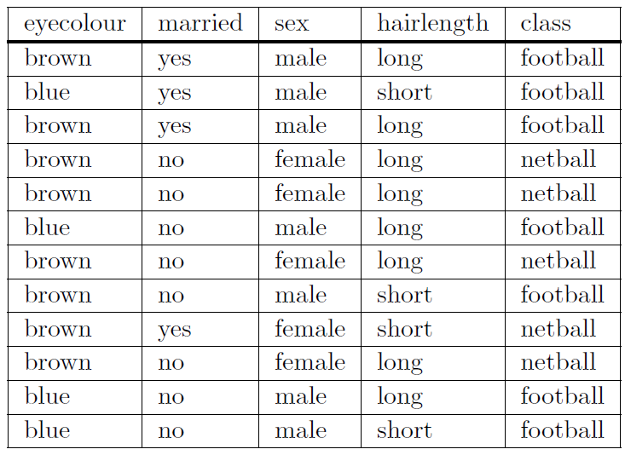
Example
Using this dataset can you make a set of generalization rules to decide whether a person will play Football or Netball

Slide 16
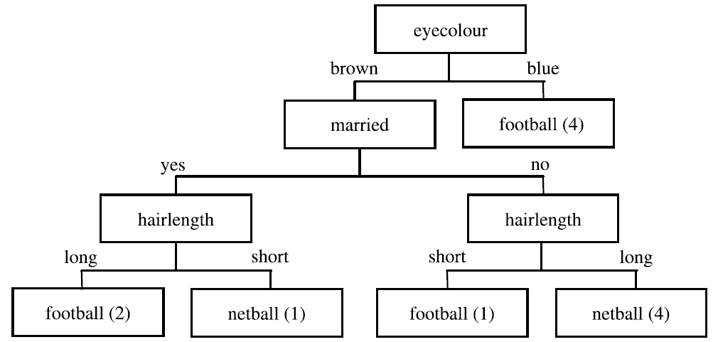
Solution 1
Five branches ( rules )

Slide 17
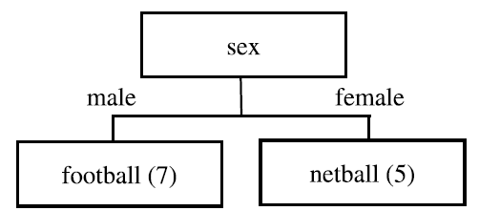
Solution 2
Only two rules
The only way to know which one gives better results for unseen data is to use them both and compare the results.

Slide 18
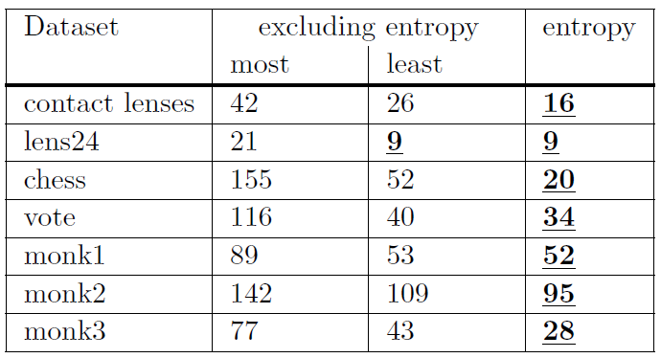
Selection using entropy and information gain
Select the attribute that minimizes the value of entropy, thus maximizing the information gain.
There is no guarantee that using entropy will always lead to a small decision tree
Experience shows that it generally produces trees with fewer branches.
Experience also shows that small trees tend to give more accurate predictions than large ones, although there is certainly no guarantee of infallibility.

Slide 19
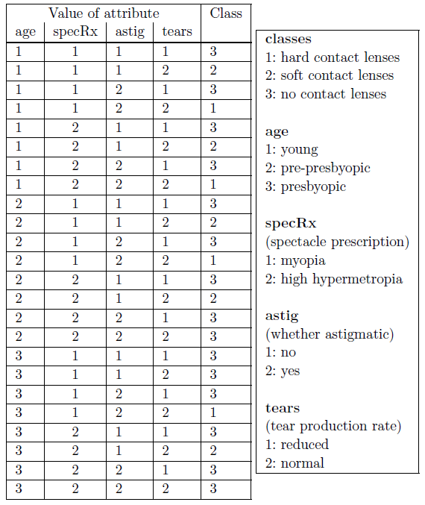
Example
Lenses dataset
24 instances
3 classes

Slide 20
entropy
Entropy is a measure of the ‘uncertainty’ contained in a training set, due to the presence of more than one possible classification.

Slide 21

entropy
Let K = number of classes.
p_{i} for i = 1 to K is the number of occurrences of class i divided by the total number of instances, which is the probability of the class i.
E is the entropy of the training set, it is measured in ‘bits’ of information, where p_{i} not equal 0.

Slide 22
entropy
The value of −p_{i} log2 p_{i} is positive for values of p_{i} greater than zero and less than 1.
When p_{i} = 1 the value of −p_{i} log₂ p_{i} is zero.
E is positive or zero for all training sets.
E is zero if all the instances belong to the same class.
E takes its maximum value when the instances are equally distributed amongst the K possible classes.

Slide 23
Entropy of Lenses dataset
Total instances is 24.
4 instances with classification 1
5 instances with classification 2
15 instances with classification 3
p₁ = 4/24,
p₂ = 5/24 and
p₃ = 15/24.
E_{start} is the entropy of the whole dataset regardless to any attributes.
E_{start} = −(4/24) log2(4/24) − (5/24) log2(5/24) − (15/24) log2(15/24)
= 0.4308 + 0.4715 + 0.4238 = 1.3261 bits

Slide 24
Using Entropy for Attribute Selection
Partition the initial training set into smaller training sets repeatedly using attributes, until the entropy of each of these subsets becomes zero.
Splitting on any attribute has the property that the average entropy of the resulting subsets will be less than (or occasionally equal to) to that of the previous training set.

Slide 25
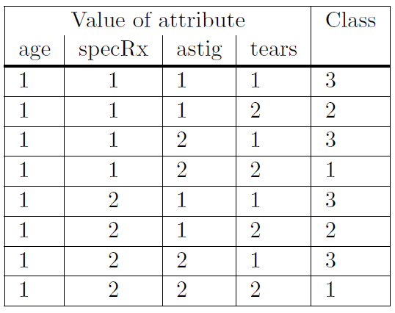
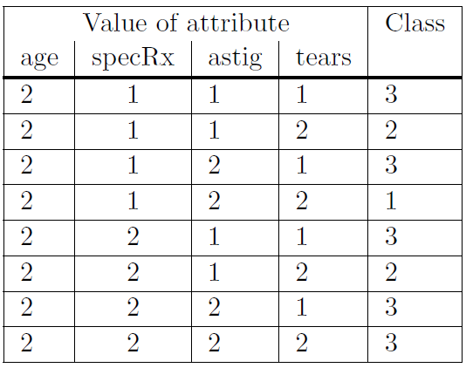

splitting on age
Age=1
Age=2
Age=3

Slide 26
entropy of age attribute
Training set 1 (age = 1)
  Entropy E1 = −(2/8) log₂(2/8) − (2/8) log₂(2/8) − (4/8) log₂(4/8)
  = 0.5 + 0.5 + 0.5 = 1.5
Training set 2 (age = 2)
  Entropy E2 = −(1/8) log₂(1/8) − (2/8) log₂(2/8) − (5/8) log₂(5/8)
  = 0.375 + 0.5 + 0.4238 = 1.2988
Training Set 3 (age = 3)
  Entropy E3 = −(1/8) log₂(1/8) − (1/8) log₂(1/8) − (6/8) log`(6/8)
  = 0.375 + 0.375 + 0.3113 = 1.0613

Slide 27
Average entropy
Average entropy of the three training sets produced by splitting on attribute age is
E_{new} = (8/24)E₁+(8/24)E₂+(8/24)E₃ = 1.2867 bits
Information Gain = E_{start} − E_{new}
Information gain from splitting on attribute age is
  1.3261 − 1.2867 = 0.0394 bits

Slide 28
Average entropy
Notice that when the average entropy becomes smaller, the information gain becomes larger, and vice versa.
To conclude, we need to maximize information gain (or minimize attribute average entropy).

Slide 29
Maximizing Information Gain
We have four candidate attributes to split on in our dataset, age, specRx, astig and tears.
Splitting on age attribute generates average entropy of
1.2867, hence Information Gain = 1.3261 − 1.2867 = 0.0394 bits
Splitting on specRx attribute generates average entropy of 1.2866 hence Information Gain = 1.3261 − 1.2866 = 0.0395 bits
Splitting on astig attribute generates average entropy of
0.9491 hence Information Gain = 1.3261 − 0.9491 = 0.3770 bits
Splitting on tears attribute generates average entropy of 0.7773 hence Information Gain = 1.3261 − 0.7773 = 0.5488 bits
Which attribute shall we select?

Slide 30
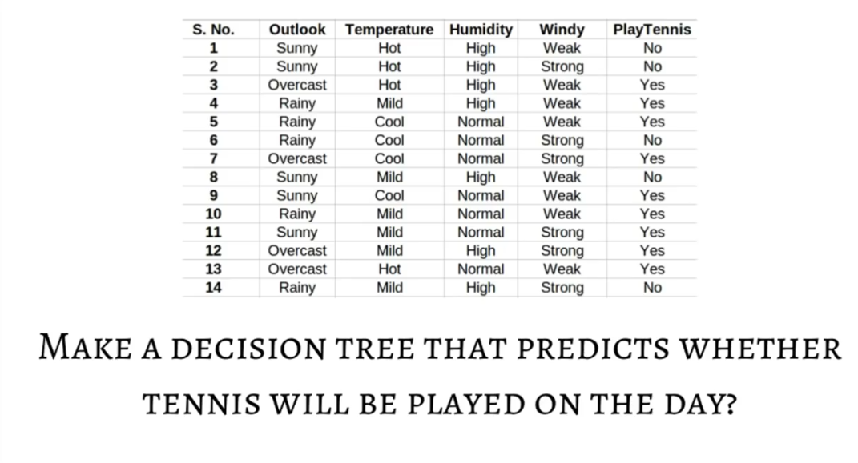
Example

Slide 31
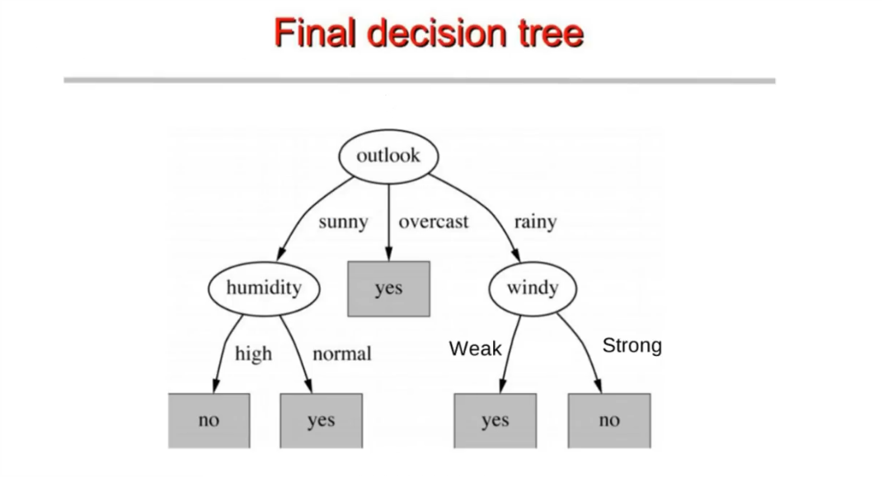

Slide 32
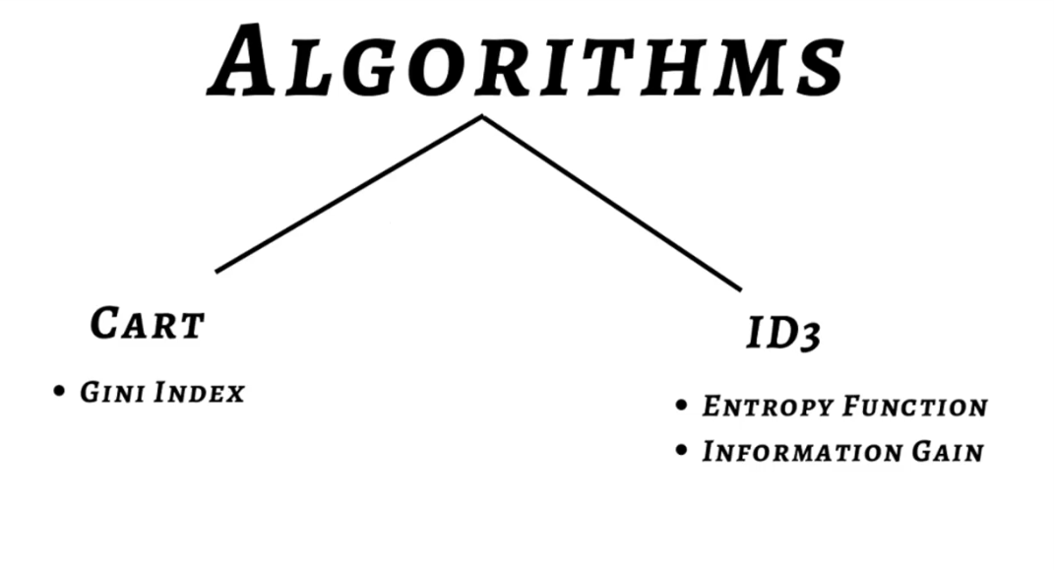
algorithms

Slide 33
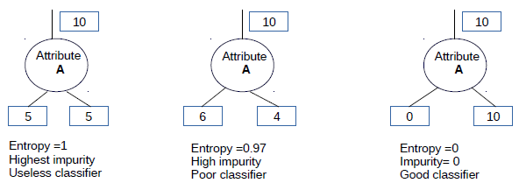
Entropy
Given a binary (two-class) classification, C, and a set of examples, S, the class distribution at any node can be written as (p0 , p1 ), where p1 =1 - p0 , and the entropy, of S is the sum of the information:
Info(S) = - p0 log₂ p0 - p1 log₂ p1

Slide 34

General form
In the general case, the target attribute can take on m different values (multi-way split) and the entropy of S relative to this m-wise classification is given by:

Slide 35

Information gain
Information gain is an attribute selection measure.
It measures how much information a given attribute X tells us about the Class Y.
According to this measure, we select the attribute with the highest information gain score.
Other notations:
  Info_{X}(Y).
  I(X).
  Info(Y |X=v_{j}).

Slide 36

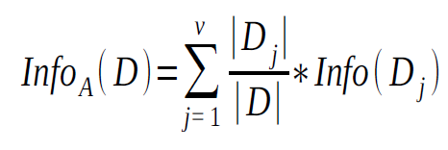

Information gain
Let p_{i} be the probability that an arbitrary tuple in D (a data set) belongs to class C_{i}, estimated by |C_{i,D}|/|D|
Expected information (entropy) needed to classify a tuple in D:
Information needed (after using attribute A to split D into v partitions) to classify D:
Information gained by branching on attribute A

Slide 37
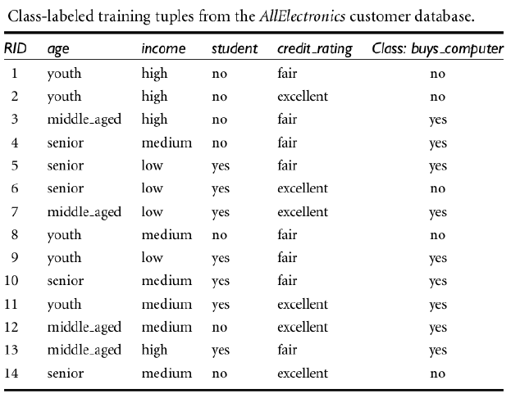
Example

Slide 38
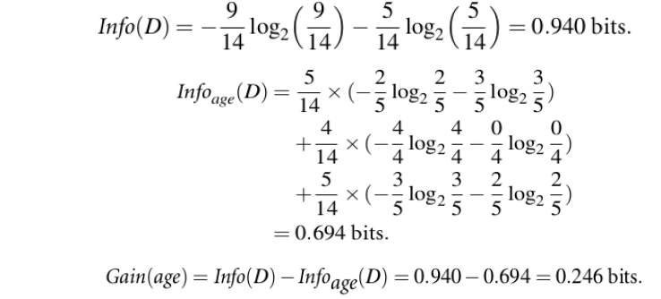
Example
Gain(age) = 0.246 bits (Highest Information Gain)
Gain(student) = 0.151 bits
Gain(credit rating) = 0.048 bits
Gain(income) = 0.029 bits

Slide 39
SUmmary
Decision trees

Slide 40


Thank You

