Slide 1

RHSA (Admin 1) Red Hat Enterprise Linux 8 Essentials
Prepared by Eng. Taghreed Elsayed
Lecture 8
SYSTEM LOG ARCHITECTURE

Slide 2

Chapter
10
SYSTEM LOG ARCHITECTURE
SYSTEM LOGGING
Processes and the operating system kernel need to be able to record a log of events that happen.
These logs can be useful for auditing the system and troubleshooting problems.
By convention, the /var/log directory is where these logs are persistently stored. A standard logging system based on the Syslog protocol is built into Red Hat Enterprise Linux.
Many programs use this system to record events and organize them into log files. In Red Hat Enterprise Linux 7, syslog messages are handled by two services, systemd-journald and rsyslog.

Slide 3
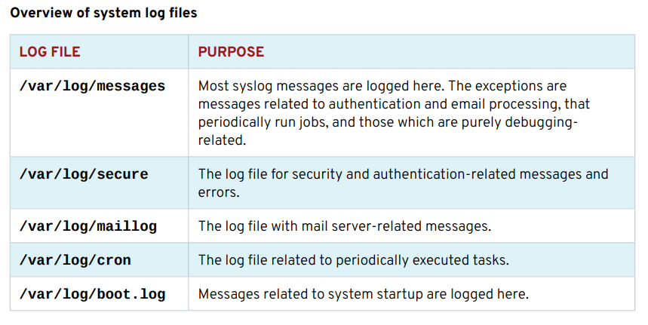
Chapter
10
SYSTEM LOG ARCHITECTURE
The rsyslog service then sorts the syslog messages by type (or facility) and priority, and writes them to persistent files in the /var/log directory.
The /var/log directory holds various system- and service-specific log files maintained by rsyslog:

Slide 4
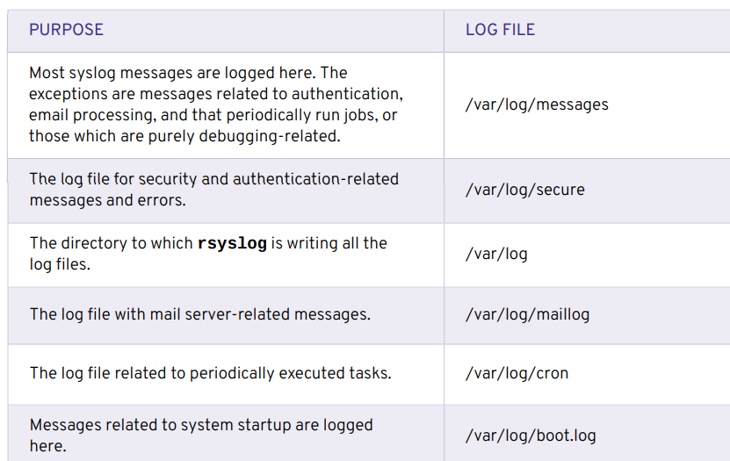
Chapter
10
SYSTEM LOG ARCHITECTURE

Slide 5
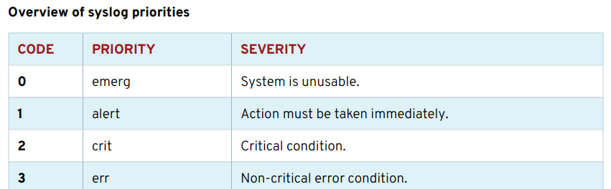
Chapter
10
SYSTEM LOG ARCHITECTURE
SYSLOG FILES
Many programs use the syslog protocol to log events to the system. Each log message is categorized by a facility (the type of message) and a priority (the severity of the message).
The facilities which are available are documented by the rsyslog.conf(5) man page. The eight priorities are also standardized and ranked as follows:

Slide 6
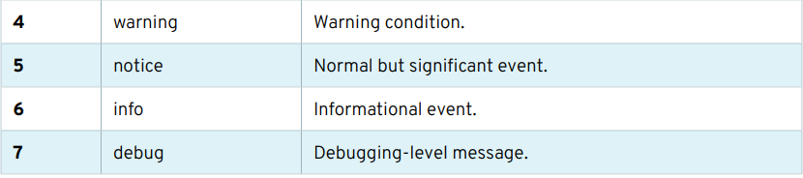
Chapter
10
SYSTEM LOG ARCHITECTURE
The rsyslogd service uses the facility and priority of log messages to determine how to handle them.
This is configured by the file /etc/rsyslog.conf and by *.conf files in /etc/ rsyslog.d. Programs and administrators can change rsyslogd configuration in a way that will not be overwritten by updates to rsyslog by putting customized files with a .conf suffix in the / etc/rsyslog.d directory.

Slide 7
Chapter
10
SYSTEM LOG ARCHITECTURE
The #### RULES ####
section of /etc/rsyslog.conf contains directives that define where log messages are saved.
The left side of each line indicates the facility and severity of the log message the directive matches.
The rsyslog.conf file can contain the character * as a wild card in the facility and severity field, where it either stands for all facilities or all severities.
The right side of each line indicates what file to save the log message in.
Log messages are normally saved in files in the /var/log directory.
A message handled by rsyslog can appear in multiple different log files.

Slide 8
Chapter
10
SYSTEM LOG ARCHITECTURE
To prevent that, the severity field can be set to none, which means that none of the messages directed to this facility are added to the specified log file.
Instead of logging syslog messages to a file, they can be printed to the terminals of all logged-in users.
In the default rsyslog.conf file, this is done for all messages that have "emerg" priority.
SAMPLE RULES SECTION OF rsyslog.conf

Slide 9
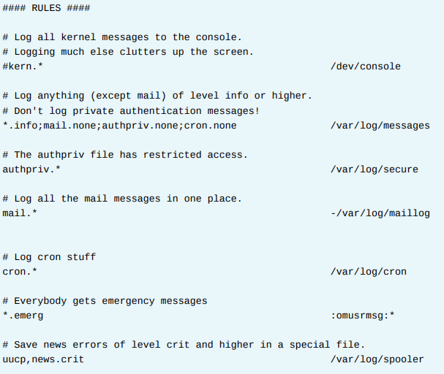
Chapter
10
SYSTEM LOG ARCHITECTURE

Slide 10
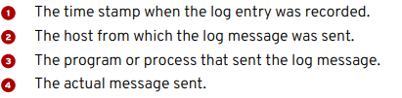
Chapter
10
SYSTEM LOG ARCHITECTURE
ANALYZE A SYSLOG ENTRY
The system logs written by rsyslog start with the oldest message on top and the newest message at the end of the log file.
All log entries in log files managed by rsyslog are recorded in a standard format.
The following example will explain the anatomy of a log file message in the /var/ log/secure log file:

Slide 11
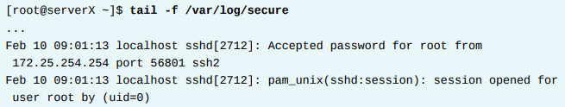
Chapter
10
SYSTEM LOG ARCHITECTURE
MONITOR A LOG FILE WITH tail
It is especially helpful for reproducing problems and issues to monitor one or more log files for events.
The tail -f /path/to/file command outputs the last 10 lines of the file specified and continues to output new lines as they get written to the monitored file.
To monitor for failed login attempts on one terminal, run ssh as user root while a user tries to log in to the serverX machine:

Slide 12
Chapter
10
SYSTEM LOG ARCHITECTURE
FINDING LOG ENTRIES, you will reconfigure rsyslog to write specific messages to a new log file.
OUTCOMES The rsyslog service writes all messages with priority debug to the /var/log/messagesdebug log file for temporary troubleshooting purposes.
1. Configure rsyslog on serverX to log all messages with severity debug, or higher, for any service into a newly created log file /var/log/messages-debug by adding the rsyslog configuration file /etc/rsyslog.d/debug.conf. Verify that a generated debug log message with the logger command arrives in the /var/log/messages-debug log file. 1.1. Change the rsyslog configuration to log all messages with severity debug to /var/log/messages-debug on serverX by adding the /etc/rsyslog.d/ debug.conf file.

Slide 13

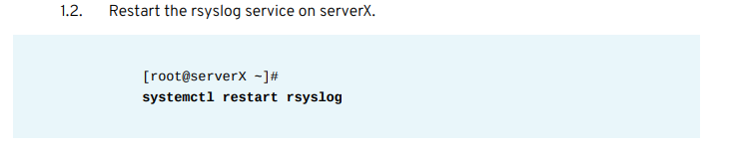
Chapter
10
SYSTEM LOG ARCHITECTURE
2. Generate a debug log message with the logger command and verify that the message gets logged to the log file /var/log/messages-debug with the tail command on serverX.
2.1. Monitor the /var/log/messages-debug with the tail command on serverX.

Slide 14


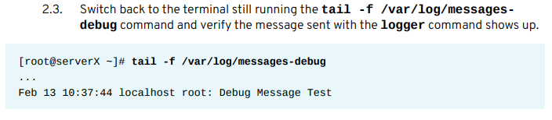
Chapter
10
SYSTEM LOG ARCHITECTURE
2.2. On a separate terminal window, use the logger command to generate a debug message on serverX.

Slide 15
Chapter
10
SYSTEM LOG ARCHITECTURE
Configuring a remote logging solution
To ensure that logs from various machines in your environment are recorded centrally on a logging server, you can configure the Rsyslog application to record logs that fit specific criteria from the client system to the server.
1. The Rsyslog logging service
The Rsyslog application, in combination with the systemd-journald service, provides local and remote logging support in Red Hat Enterprise Linux.
The rsyslogd daemon continuously reads syslog messages received by the systemd-journald service from the Journal. rsyslogd then filters and processes these syslog events and records them to rsyslog log files or forwards them to other services according to its configuration.

Slide 16
Chapter
10
SYSTEM LOG ARCHITECTURE
The rsyslogd daemon also provides extended filtering, encryption protected relaying of messages, input and output modules, and support for transportation using the TCP and UDP protocols.
In /etc/rsyslog.conf, which is the main configuration file for rsyslog, you can specify the rules according to which rsyslogd handles the messages.
Generally, you can classify messages by their source and topic (facility) and urgency (priority), and then assign an action that should be performed when a message fits these criteria.
In /etc/rsyslog.conf, you can also see a list of log files maintained by rsyslogd. Most log files are located in the /var/log/ directory. Some applications, such as httpd and samba, store their log files in a subdirectory within /var/log/.

Slide 17
Chapter
10
SYSTEM LOG ARCHITECTURE
How to Set Up Remote Logging on Linux Using Rsyslog
Logs are a critical component of any software or operating system. Logs usually record user’s actions, system events, network activity and so much more, depending on what they are intended for. One of the most widely used logging systems on Linux systems is rsyslog.
Rsyslog is a powerful, secure and high-performance log processing system which accepts data from different types of source (systems/applications) and outputs it into multiple formats.
It has evolved from a regular syslog daemon to a fully-featured, enterprise level logging system. It is designed in a client/server model, therefore it can be configured as a client and/or as a central logging server for other servers, network devices, and remote applications.

Slide 18
Chapter
10
SYSTEM LOG ARCHITECTURE
Testing Environment
For the purpose of this guide, we will use the following hosts:
Server: 192.168.241.140
Client: 172.31.21.58
How to Install and Configure Rsyslog Server
Most Linux distributions come with the rsyslog package preinstalled.
In case it’s not installed, you can install it using your Linux package manager tool as shown.

Slide 19

Chapter
10
SYSTEM LOG ARCHITECTURE
Once rsyslog installed, you need to start the service for now, enable it to auto-start at boot and check it’s status with the systemctl command.
The main rsyslog configuration file is located at /etc/rsyslog.conf, which loads modules, defines the global directives, contains rules for processing log messages and it also includes all config files in /etc/rsyslog.d/ for various applications/services.

Slide 20
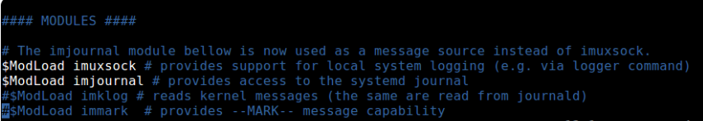
Chapter
10
SYSTEM LOG ARCHITECTURE
By default, rsyslog uses the imjournal and imusock modules for importing structured log messages from systemd journal and for accepting syslog messages from applications running on the local system via Unix sockets, respectively.

Slide 21

Chapter
10
SYSTEM LOG ARCHITECTURE
To configure rsyslog as a network/central logging server, you need to set the protocol (either UDP or TCP or both) it will use for remote syslog reception as well as the port it listens on.
If you want to use a UDP connection, which is faster but unreliable, search and uncomment the lines below (replace 514 with the port you want it to listen on, this should match the port address that the clients send messages to, we will look at this more when configuring a rsyslog client).

Slide 22

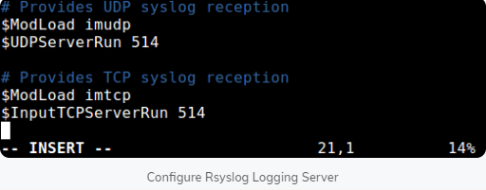
Chapter
10
SYSTEM LOG ARCHITECTURE
To use TCP connection (which is slower but more reliable), search and uncomment the lines below.
In this case, we want to use both UDP and TCP connections at the same time.

Slide 23
Chapter
10
SYSTEM LOG ARCHITECTURE
Next, you need to define the ruleset for processing remote logs in the following format.
Where:
facility: is type of process/application generating message, they include auth, cron, daemon, kernel, local0..local7. Using * means all facilities.
severity_level: is type of log message: emerg-0, alert-1, crit-2, err-3, warn-4, notice-5, info-6, debug-7. Using * means all severity levels and none implies no severity level.
destination: is either local file or remote rsyslog server (defined in the form IP:port).

Slide 24

Chapter
10
SYSTEM LOG ARCHITECTURE
We will use the following ruleset for collecting logs from remote hosts, using the RemoteLogs template. Note that these rules must come before any rules for processing local messages, as shown in the screenshot.

Slide 25
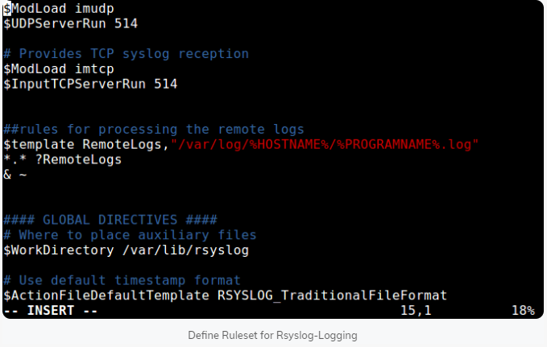
Chapter
10
SYSTEM LOG ARCHITECTURE

Slide 26
Chapter
10
SYSTEM LOG ARCHITECTURE
Looking at the above ruleset, the first rule is “$template RemoteLogs,”/var/log/%HOSTNAME%/%PROGRAMNAME%.log””.
The directive $template tells rsyslog daemon to gather and write all of the received remote messages to distinct logs under /var/log, based on the hostname (client machine name) and remote client facility (program/application) that generated the messages as defined by the settings present in the template RemoteLogs.
The second line “*.* ?RemoteLogs” means record messages from all facilities at all severity levels using the RemoteLogs template configuration.

Slide 27
Chapter
10
SYSTEM LOG ARCHITECTURE
The final line “& ~” instructs rsyslog to stop processing the messages once it is written to a file.
If you don’t include “& ~”, messages will instead be be written to the local files.
There are many other templates that you can use, for more information, see the rsyslog configuration man page (man rsyslog.conf) or refer to the Rsyslog online documentation.
That’s it with configuring the rsyslog server.
Save and close the configuration file. To apply the recent changes, restart rsyslog daemon with the following command.

Slide 28
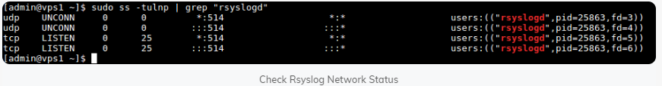
Chapter
10
SYSTEM LOG ARCHITECTURE
Now verify the rsyslog network sockets. Use the ss command (or netstat with the same flags) command and pipe the output to grep to filter out rsyslogd connections.

Slide 29

Chapter
10
SYSTEM LOG ARCHITECTURE
If the system has firewall enabled, you need to open port 514 to allow both UDP/TCP connections to the rsyslog server, by running.

Slide 30

Chapter
10
SYSTEM LOG ARCHITECTURE
How to Configure Rsyslog Client to Send Logs to Rsyslog Server
Now on the client system, check if the rsyslog service is running or not with the following command.
If it’s not installed, install it and start the service as shown earlier on.

Slide 31
Chapter
10
SYSTEM LOG ARCHITECTURE
Once the rsyslog service is up and running, open the main configuration file where you will perform changes to the default configuration.
To force the rsyslog daemon to act as a log client and forward all locally generated log messages to the remote rsyslog server, add this forwarding rule, at the end of the file as shown

Slide 32
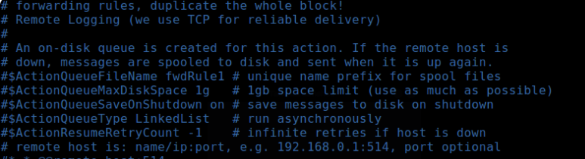
Chapter
10
SYSTEM LOG ARCHITECTURE
Save the changes and close the configuration file. To apply the above settings, restart the rsyslog daemon.

Slide 33

Chapter
10
SYSTEM LOG ARCHITECTURE
How to Monitor Remote Logging on the Rsyslog Server
The final step is to verify if the rsyslog is actually receiving and logging messages from the client, under /var/log, in the form hostname/programname.log.
Run a ls command to long listing of the parent logs directory and check if there is a directory called ip-172.31.21.58 (or whatever your client machine’s hostname is).

Slide 34
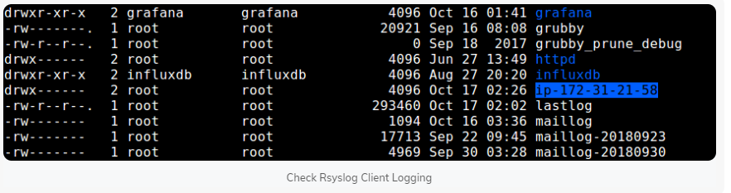
Chapter
10
SYSTEM LOG ARCHITECTURE
If the directory exists, check the log files inside it, by running.

Slide 35
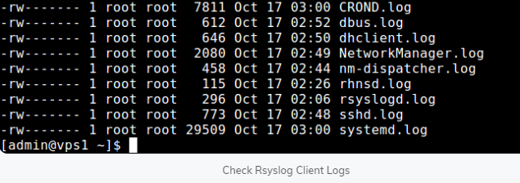
Chapter
10
SYSTEM LOG ARCHITECTURE

Slide 36
Chapter
10
SYSTEM LOG ARCHITECTURE
What is a Firewall?
Firewall is a network security system that filters and controls the traffic on a predetermined set of rules. This is an intermediary system between the device and the internet.
A firewall is a set of rules. When a data packet moves into or out of a protected network space, its contents (in particular, information about its origin, target, and the protocol it plans to use) are tested against the firewall rules to see if it should be allowed through. Here’s a simple example:

Slide 37
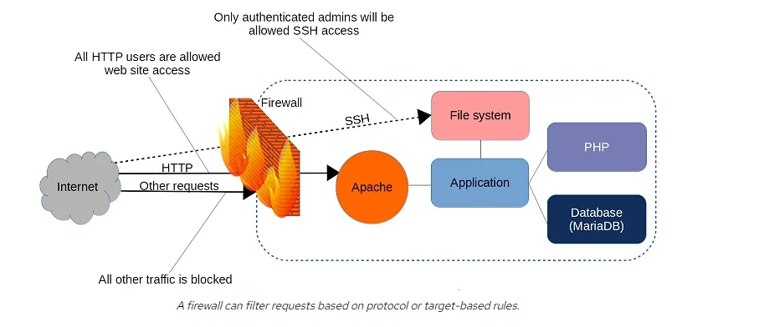
Chapter
10
SYSTEM LOG ARCHITECTURE

Slide 38
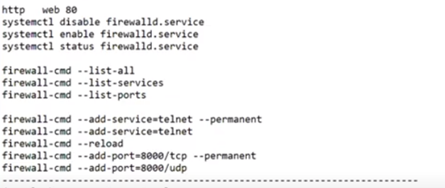
Chapter
10
SYSTEM LOG ARCHITECTURE

Slide 39
Chapter
10
SYSTEM LOG ARCHITECTURE
Configure HTTP access using firewalld
As you might have guessed from its name, firewalld is part of the systemd family. Firewalld can be installed on Debian/Ubuntu machines, but it’s there by default on Red Hat and CentOS. If you’ve got a web server like Apache running on your machine, you can confirm that the firewall is working by browsing to your server’s web root. If the site is unreachable, then firewalld is doing its job.
You’ll use the firewall-cmd tool to manage firewalld settings from the command line. Adding the –state argument returns the current firewall status:

Slide 40

Chapter
10
SYSTEM LOG ARCHITECTURE
By default, firewalld will be active and will reject all incoming traffic with a couple of exceptions, like SSH.
That means your website won’t be getting too many visitors, which will certainly save you a lot of data transfer costs.
As that’s probably not what you had in mind for your web server, though, you’ll want to open the HTTP and HTTPS ports that by convention are designated as 80 and 443, respectively.
firewalld offers two ways to do that.

Slide 41

Chapter
10
SYSTEM LOG ARCHITECTURE
One is through the –add-port argument that references the port number directly along with the network protocol it’ll use (TCP in this case). The –permanent argument tells firewalld to load this rule each time the server boots:

Slide 42

Chapter
10
SYSTEM LOG ARCHITECTURE
The –reload argument will apply those rules to the current session:
# firewall-cmd –reload
Curious as to the current settings on your firewall? Run –list-services:

