Slide 1
MS ACCESS DATABASE

Slide 2
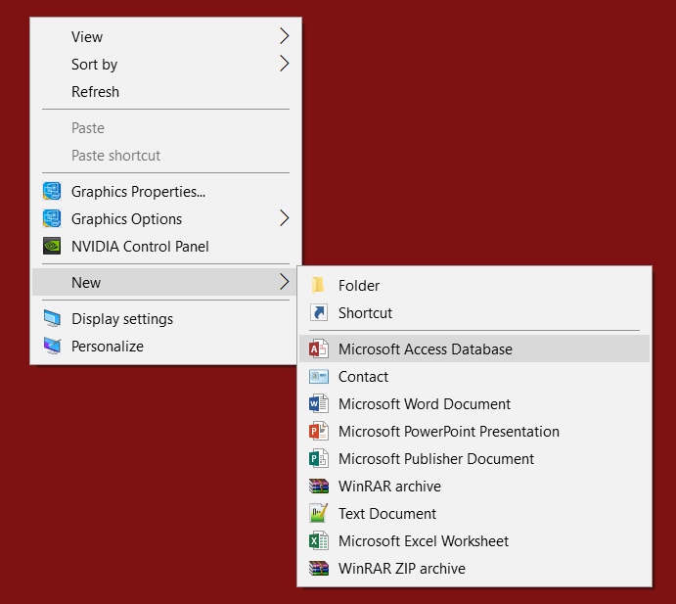
OPENING THE PROGRAM
1- Right Click anywhere on your Desktop 2- Choose New
3- Choose Microsoft Access Database

Slide 3
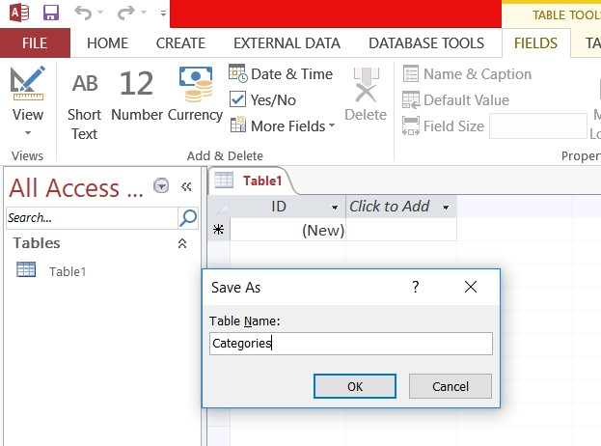
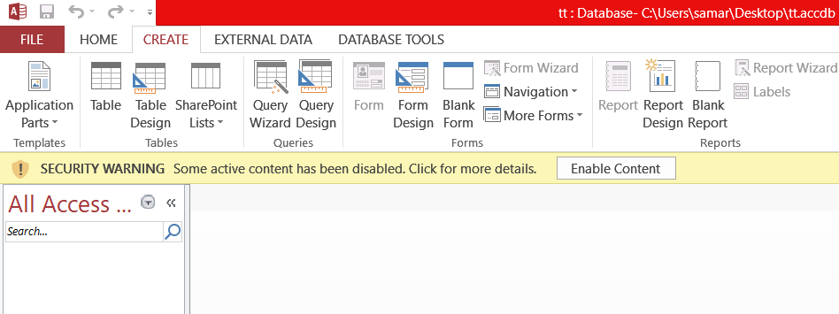
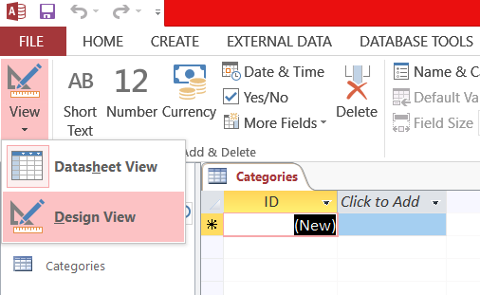
TABLE CREATING
1- Click on the CREATE tab then Choose Table 2- Press Ctrl+S to save the table and Name it.
3- Click on the View icon and Choose Design View
1
3
2

Slide 4
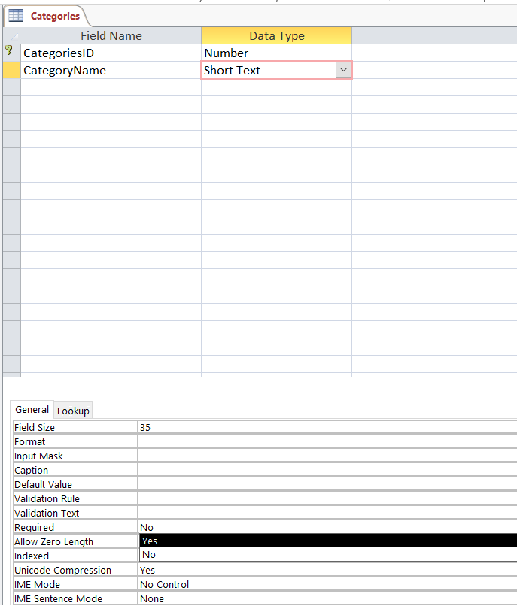
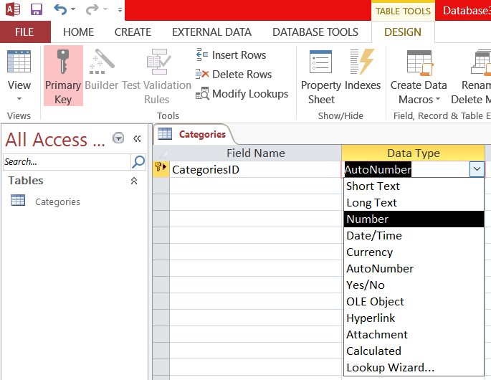
ADDING ATTRIBUTES
Name the attribute below Field Name Column
Choose its type below Data Type Column
Change the Field Size and Required from Field
Properties, the General tab below
1 2
3

Slide 5
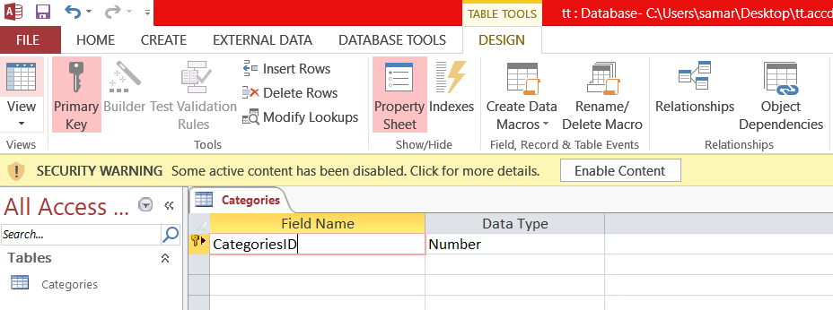
PRIMARY KEY
3- A small yellow key would appear beside thee chosen row
1- Choose the field
*Make sure the first field is the Primary Key*
2- Click on the Primary Key under the DESIGN tab
2
1
3

Slide 6
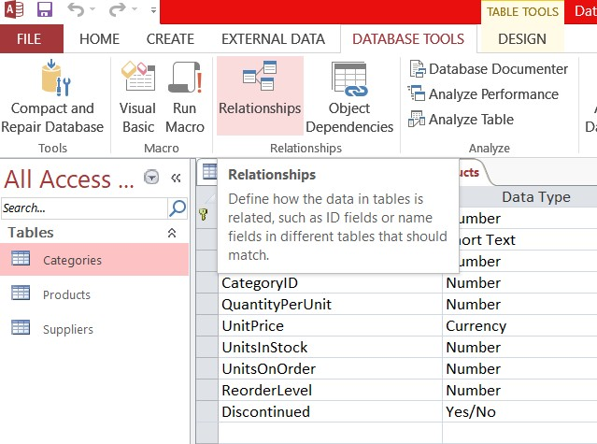
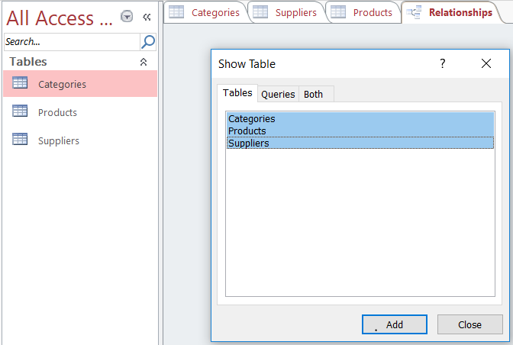
RELATIONSHIP CREATING
Click on DATABASE TOOLS tab then choose Relationships
Choose the tables you want to put in the relation then click Add
1
2

Slide 7
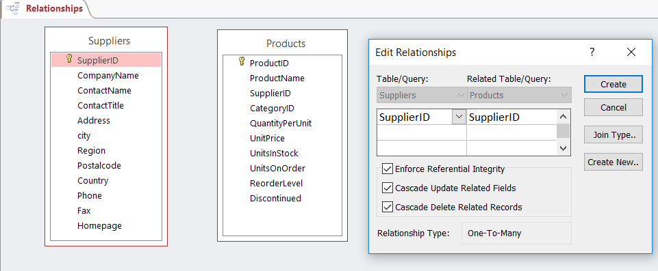
3
4
Match the Primary key in each table with its foreign one
Check the Integrity Boxes and then click Create

Slide 8
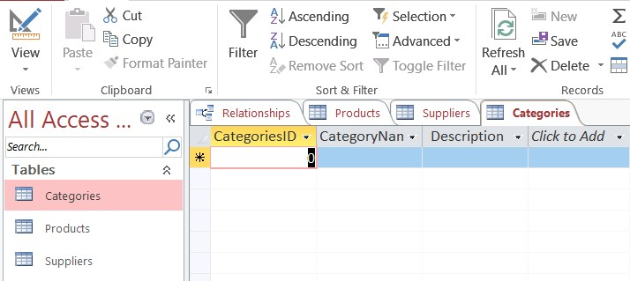
INSERTING DATA
1- Double Click on the table you want to insert data in. 2- Fill in the each row fields with the data of one record.
1
2

Slide 9
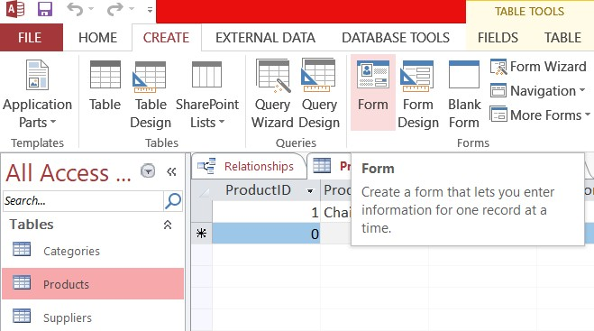
FORM CREATING
1- Choose the table you want to create a form for 2- Click on the CREATE tab
3- Choose Form
2
3
1

Slide 10
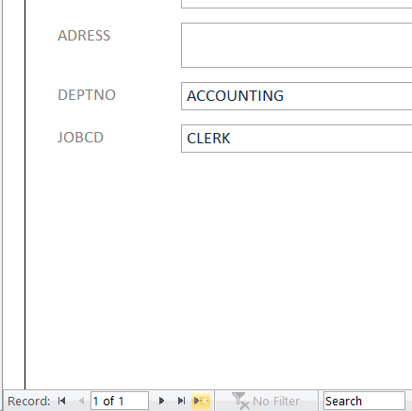
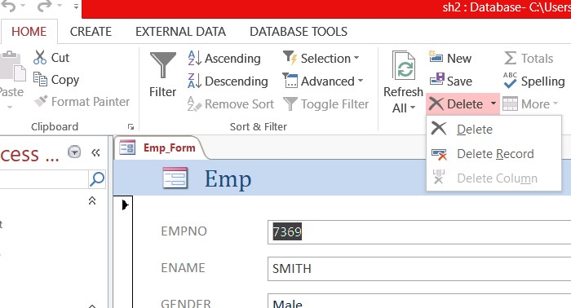
FORM USING
Choose Form View from View icon above:
Adding a New Record: Click on the yellow star below
Delete a Record: Click on HOME tab, click on the arrow beside and choose Delete Record 3- Update data: Just type the new values after choosing the record .
2
1

Slide 11
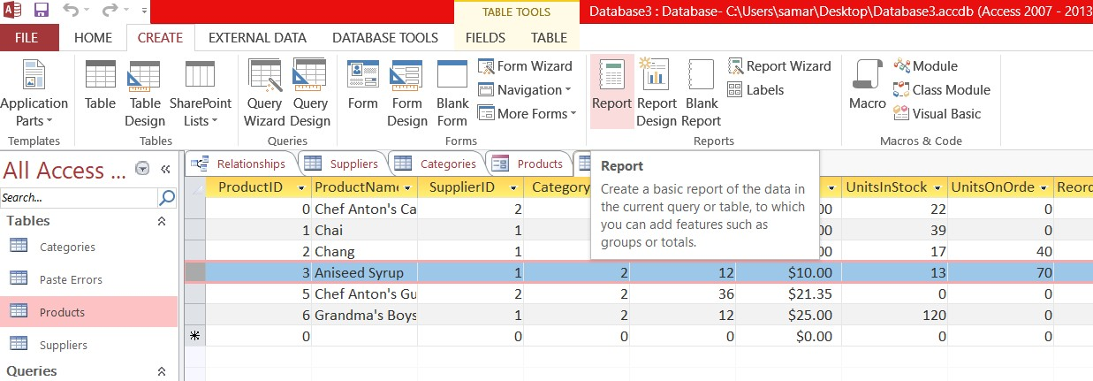
REPORT CREATING
Choose the table you want to report and make sure it’s on the Datasheet View
Click CREATE→ Report
2
1

Slide 12
3- A Suggested report would appear Click on View→ Layout View to adjust it as you want.
3

Slide 13
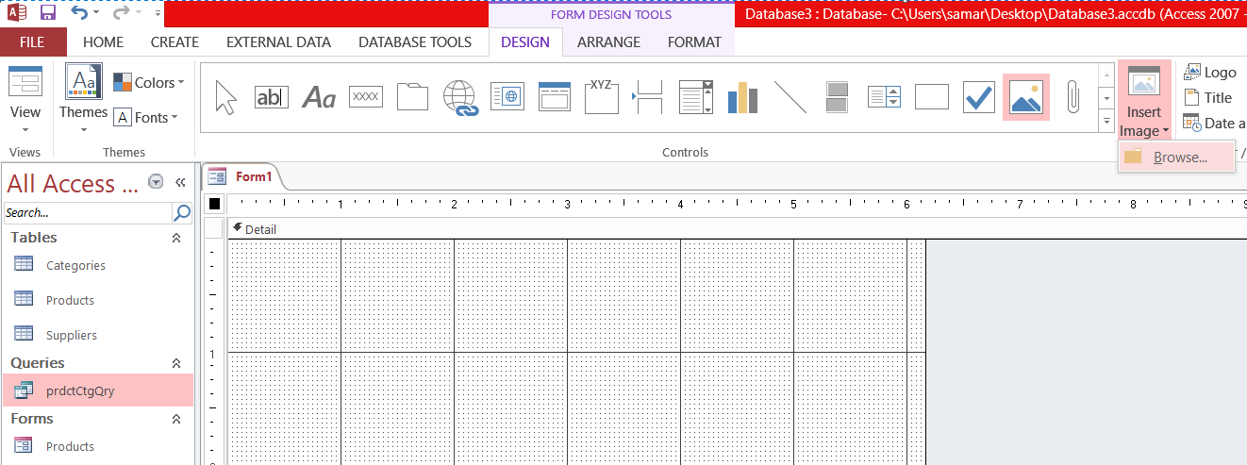
MAIN MENU
○ Main Menu is a simple form that you can create by clicking CREATE → Form Design and then manipulate its elements 1- To insert an image click to Insert Image and then browse its location on your computer
To insert a label click on Aa then resize it and write.
To insert a Button click on the xxx icon → Draw your button → Close the wizard → Double click on it to name it
3
2
1

Slide 14
GOOD LUCK!

