Slide 1

Introduction to Information Systems IT111
Prepared by Dr. Youssef Ntefeh
Lecture 10
Python Programming Language

Slide 2

Python
What is Programming?
Just like we humans can understand a few languages (Arabic, English, etc.), so is the case with computers.
Computers understand instructions that are written in a specific syntactical form called a programming language.
Simply, programming is a way to tell computers to do a specific task.
Some of the popular Programming languages are Python, C, C++, Java, etc

Slide 3
Python
What is Python?
Python is a popular programming language. It was created by Guido van Rossum, and released in 1991.
It is used for:
  web development (server-side),
  software development,
  system scripting.

Slide 4
Python
Why Python?
Python works on different platforms (Windows, Mac, Linux, Raspberry Pi, etc).
Python has a simple syntax similar to the English language.
Python has syntax that allows developers to write programs with fewer lines than some other programming languages.

Slide 5
Python
Python Syntax compared to other programming languages
Python was designed for readability and has some similarities to the English language with influence from mathematics.
Python uses new lines to complete a command, as opposed to other programming languages which often use semicolons or parentheses.
Python relies on indentation, using whitespace, to define scope; such as the scope of loops, functions and classes. Other programming languages often use curly-brackets for this purpose.

Slide 6
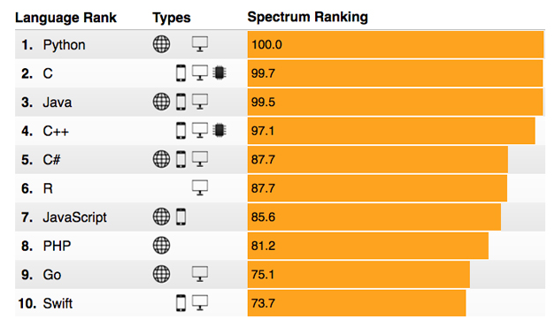
Python
High-Level Languages Python Success
From IEEE spectrum 2017: programming languages ranking

Slide 7
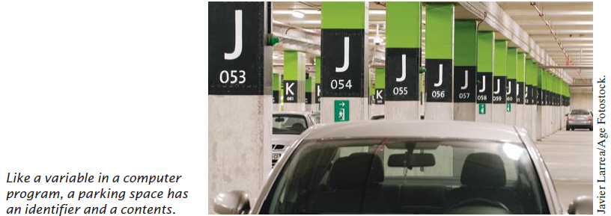
Variables
Python
Variables
In a Python program, variables are used to store values.
A variable is a storage location in a computer program. Each variable has a name and holds a value
A variable is similar to a parking space in a parking garage. The parking space has an identifier (as “J 053”), and it can hold a vehicle.

Slide 8
Variables
Python
Variables
Variable Names
A variable is defined when you give it a name that explains its purpose.
Variable Name must follow a few simple rules:
  Names must start with a letter or the underscore (_) character, and the remaining characters must be letters, numbers, or underscores
  Cannot use other symbols such as ? or %.
  Spaces are not permitted inside names either.
Names are case sensitive, that is, canVolume and canvolume are different names.
You cannot use reserved words such as if or class as names; these words are reserved exclusively for their special Python meanings

Slide 9
Assignment statements
Python
Variables
The left-hand side of an assignment statement consists of a variable.
The right-hand side is an expression that has a value. That value is stored in the variable.
Example: cansPerPack = 6 here a variable name canPerPack will be equal to 6 after running this assignment statement
The first time a variable is assigned a value, the variable is created and initialized with that value.

Slide 10
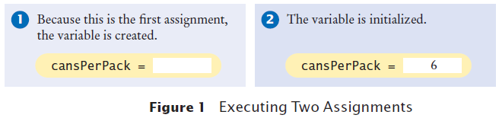
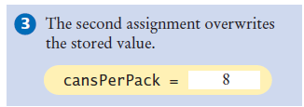
Assignment statements
Python
Variables
After a variable has been defined, it can be used in other statements. E.g., print(cansPerPack)
It will print the value stored in the variable cansPerPack
If an existing variable is assigned a new value, that value replaces the previous contents of the variable. Example:
cansPerPack = 8

Slide 11
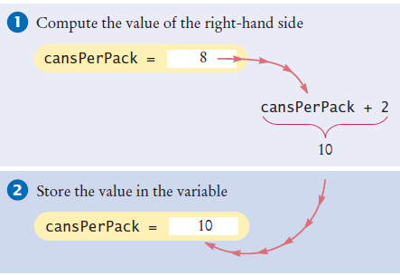
Assignment statements
Python
Variables
Consider this example:
cansPerPack = cansPerPack + 2
This statement means to look up the value stored in the variable cansPerPack, add 2 to it, and place the result back into cansPerPack.

Slide 12
Assignment statements
Python
Variables
Assignment Statement for multiple variables:
a, b, c = 5, 3.2, "Hello“
>>> a
5
>>> b
3.2
>>> c
'Hello'

Slide 13
Python
Data Types
Computers manipulate data values that represent information, and these values can be of different types.
Each value in a Python program is of a specific type.
The data type of a value determines how:
  The data is represented in the computer
  What operations can be performed on that data.

Slide 14
Python
Data Types
Integer Data Type (wrote as int in Python)
Represents an integral value without a fractional part.
For example, there must be an integer number of cans in any pack of cans—you cannot have a fraction of a can.
Floating Data Type (wrote as float in Python)
Represents a fractional part is required.
For example, number 0.355 is a floating number.
String Data Type (wrote as str in Python)
A sequence of characters enclosed in quotation marks “Hello, World!” is called a string. The message has to be enclosed by either by single (‘…‘) or double (“…”)

Slide 15
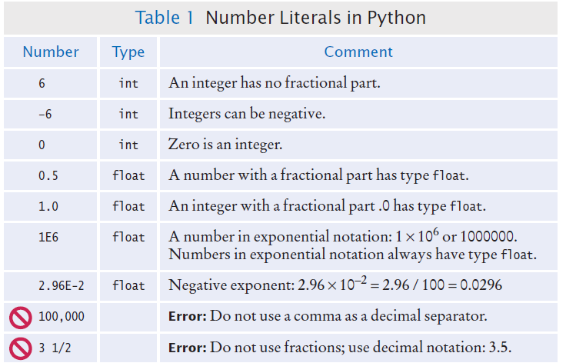
Python
Data Types

Slide 16
Python
Data Types
print("Hello") # would print this message Hello
A string can be stored in a variable
greeting = “Hello”
print(greeting) # would print this message Hello

Slide 17
Python
Constants
whose value should not be changed after it has been assigned an initial value.
Python leaves it to the programmer to make sure that constants are not changed
it is common practice to specify a constant variable with the use of all capital letters for its name.
BOTTLE_VOLUME = 2.0
MAX_SIZE = 100
Notes:
Some languages provide an explicit mechanism for marking a variable as a constant and will generate a syntax error if you
attempt to assign a new value to the variable. Python leaves it to the programmer to make sure that constants are not changed.

Slide 18


Python
Input and Output Variables
Input
When a program asks for user input, it should first print a message that tells user which input is expected. Such a message is called a prompt.
input function can only obtain string of text from user.
In Python, displaying a prompt and reading the keyboard input is combined in one operation. For example:
first = input("Enter your first name: ")
Notes:
Most interesting programs ask program user to provide input values, then programs produce outputs that depend on user input.

Slide 19
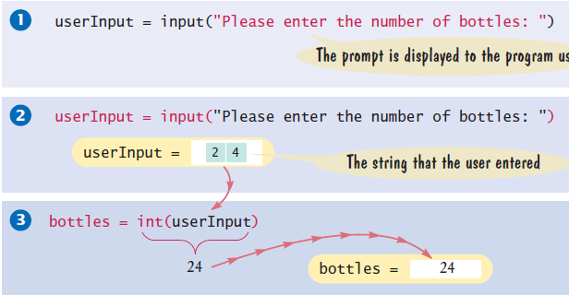
Python
Input and Output Variables
To read an integer value, first use the input function to obtain the data as a string, then convert it to an integer using the int function. For example:
userInput = input("Please enter the number of bottles: ")
bottles = int(userInput)
Notes:
userInput is a temporary variable that is used to store the string representation of the integer value. After the input string is converted to an integer value and stored in bottles, userInput is no longer needed.

Slide 20
Python
Input and Output Variables
To read a floating-point value from the user, the same approach is used, except the input string has to be converted to a float.
userInput = input("Enter price per bottle: ")
price = float(userInput)
The previous examples could be written as
bottles = int( input("Please enter the number of bottles: ") )
price = float( input("Enter price per bottle: ") )
Notes:
userInput is a temporary variable that is used to store the string representation of the integer value. After the input string is converted to an integer value and stored in bottles, userInput is no longer needed.

Slide 21
Python
Input and Output Variables
Output
Is used to display messages and results to the user.
print("Hello, world“) # display Hello, world
print(2+3) # display 5
print("2+3=", 2+3) #display 2+3= 5

Slide 22
Arithmetic operators
Python
Basic Arithmetic Operators
Addition + (5 + 2 = 7)
Subtraction - (5 - 2 = 3)
Multiplication * (5 * 2 = 10)
Float Division / (5 / 2 = 2.5)
Integer Division // (5 // 2 = 2) (floor division)
Power ** (5 ** 2 = 25)
Reminder % (5 % 2 = 1)

Slide 23

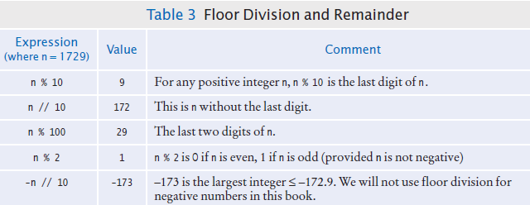
Basic Arithmetic operators
Python

Slide 24
Python
Operators' precedence
Operator | Description
( ) | Parenthesis
** | Exponentiation
* , / | Multiplication, Float Division
+, - | Sign positive, sign negative

Slide 25
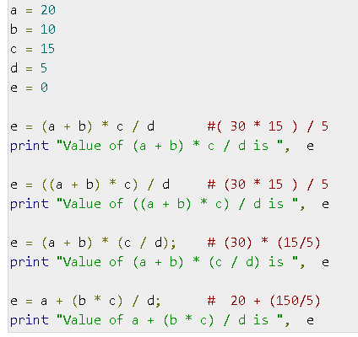
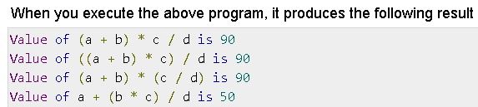
Python
Operators' precedence
Notes:
https://www.tutorialspoint.com/python/operators_precedence_example.htm

Slide 26
Strings
Python
A string is a sequence of characters. For example, the string "Hello" is a sequence of five characters.
print(“Hello”) String is “Hello”
greeting = “Hello” String is “Hello”
print(greeting) will print “Hello”
We use double quotation marks “ ” around strings because this is a common convention in many other programming languages. However, interactive Python interpreter displays strings with single quotation mark ‘ ‘

Slide 27

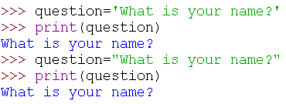
Strings
Python
A string literal denotes a particular string (such as "Hello“). In Python,
String literals are specified by enclosing a sequence of characters within a matching pair of either single or double quotes.

Slide 28



Strings
Python
Length, concatenation and repetition:
Number of characters in a string is called the length of the string. For example, the length of "Harry" is 5
In Python, use + operator to concatenate two strings. For example,
You can produce a string that is the result of repeating a string multiple times.
  For example, suppose you need to print a dashed line. Instead of specifying a literal string with 10 dashes, you can use the * operator to create a string that is comprised of the string "-" repeated 10 times. For example

Slide 29
Strings
Python
Length, concatenation and repetition:
What if you’d like the first and last name separated by a space?
name = firstName + " " + lastName
This statement concatenates three strings: first Name, the string literal " ", and lastName.
The result is Harry Morgan
A string of any length can be repeated using the * operator. For example, the statements
message = "Echo..."
print(message * 5)
The result is
Echo...Echo...Echo...Echo...Echo...

Slide 30




Strings
Python
Access Characters within Strings
Strings are sequences of Unicode characters. You can access the individual characters of a string based on their position within the string. This position is called the index of the character.
For example:

Slide 31
Python
Math Library
Python contains a standard library that can be used to create powerful programs.
A library is a collection of code that has been written and translated by someone else, ready for you to use in your program.
A standard library is a library that is considered part of the language and must be included with any Python system.
Python’s standard library is organized into modules. Related functions and data types are grouped into the same module.

Slide 32
Python
Math Library
Python’s math module includes a number of mathematical functions. To use any function from this module, you must first import the function.
To include all functions defined in math, write import math at the top of the python code.
Or, to include certain function inside math (as sqrt), write from math import sqrt
To call sqrt function, write y = sqrt(x)

Slide 33
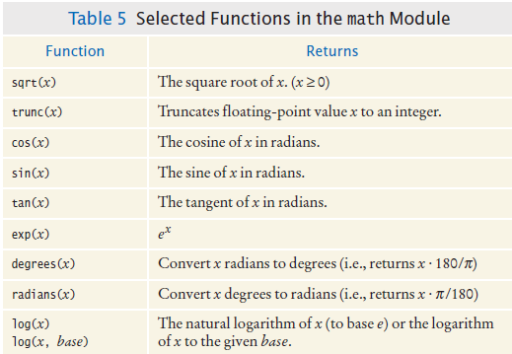
Math Library
Python

Slide 34
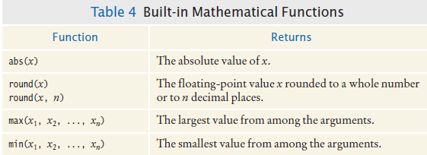
Math Library
Python

Slide 35
Math Library
Python
Math Library
Y= 𝑥 + 1 ∗ import math x=10
𝑥 + 2 ∗ 𝑥 + 3
y=math.sqrt(x+1)* math.sqrt(x+2)* math.sqrt(x+3)
print("y=",y)

Slide 36
Thank you

