Slide 1


Financial Risk Management
Prepared by Dr. Walaa Mohamed
PMG 633
Managing Banks (part two)
Introductory lecture
Lecture Four

Slide 2
Lecture 4
Lecture Outline
Asset and Liability Management
Corporate Governance

Slide 3
Lecture 4
Key Learning Points
Banks manage their assets and liabilities with the overall objective of reducing risks while maximizing returns to shareholders.
Bank corporate governance refers to the framework banks use to manage their operations and deal with the often conflicting interests of bank stakeholders.

Slide 4
Lecture 4
Asset and Liability Management
Banks face two additional key risks that have not yet been discussed: interest rate risk and liquidity risk.
Interest rate risk refers to the potential loss in value of an asset due to changes in interest rates. For example, a bank pays one interest rate to its depositors and receives another from its debtors. If interest rates change, the profitability of the bank changes as well. Interest rate risk affects both the banking book and the trading book.

Slide 5
Liquidity risk refers to the potential inability of a bank to meet its payment obligations when they are due. In particular, a bank must manage its ability to pay its depositors interest and to repay depositors seeking to withdraw any part of their money. Liquidity risk is also called funding liquidity risk.

Slide 6
The liquidity discussed in this section is different from another type of liquidity, the ability to trade in markets without significant price concessions, which will be discussed in Chapter 6.
The bank’s asset and liability management (ALM) function manages both the interest rate risk in the bank’s banking book and liquidity risk. In particular, the ALM function in a bank focuses on:
Maintaining liquidity for the bank
Analyzing the shape and structure of the bank’s balance sheet
Maintaining a stable net interest margin

Slide 7
1. Interest Rate Risk
Interest rate risk in the banking book refers to a possible monetary loss caused by adverse changes in interest rates affecting the underlying structure of the bank’s business: its lending and deposit-taking activities. The dangers of not managing interest rate risk in the banking book were highlighted by the savings and loan crisis that affected the United States during 1980s and 1990s.
In managing the bank’s assets and liabilities, the ALM function has to consider and balance several factors simultaneously:

Slide 8
The bank’s balance sheet is a dynamic portfolio of loans and deposits. As new loans are extended, as existing loans mature, and as new deposits arrive, existing deposits may be withdrawn.
The interest rate on liabilities and assets. Some will be fixed, but the interest rate on other liabilities and assets will change periodically according to market rates, resulting in fluctuations in the value of floating-rate liabilities and assets.

Slide 9
Timing differences between changes in market rates and in the interest rates on retail products such as bank loans to customers.
The bank’s current liquidity needs. The current market interest rates for all maturities and competition among banks determine the interest rates offered on deposit products.
Commercial (e.g., corporate loans) and retail (e.g., home mortgage loans) products. Both allow for the early termination of the loans, but the terms and conditions can be widely different among individual commercial or retail loans, as well as between commercial and retail loans in general.

Slide 10
To manage interest rate risk in the banking book, banks consider the impact of interest rate changes on both their assets and liabilities, and the particular features of their assets and liabilities, including, among other things, terms and timing. How well the bank manages its assets and liabilities, the revenues from its assets, and the costs of its liabilities has a direct impact on the net interest margin of the bank.

Slide 11
2. Liquidity Risk
Liquidity is defined by the Basel Committee as the ability of a bank to fund increases in assets and meet obligations as they come due, without incurring unacceptable losses. Liquidity risk has been given much greater attention by standard setters and regulators, and by banks themselves, since the global financial crisis of 2007–2009, when many banks faced severe liquidity difficulties. At that time banks were facing both asset liquidity risk (inability to liquidate large holdings of collateralized debt obligations) and funding liquidity risk (inability to obtain funds from the interbank, or indeed any other, market).

Slide 12
From both a bank’s and its regulator’s point of view, the structure of the bank’s assets and its related liquidity needs may highlight potential weaknesses over time. Liquidity corresponds to the bank’s ability to make payments to its customers punctually. Ultimately, its ability, or inability, to make these payments in a timely manner will directly affect the banking institution’s solvency, or its ability to pay its debts with available cash.
Solvency refers to an enterprise's capacity to meet its long-term financial commitments. Liquidity refers to an enterprise's ability to pay short-term obligations—the term also refers to a company's capability to sell assets quickly to raise cash.

Slide 13
Solvency is different from a bank’s ability to make a profit. A bank can be solvent (have more assets than liabilities) and not make a profit if its expenses are greater than its revenues. A solvent bank may be able to generate cash to make payments by selling off assets, but if these transactions are at a loss, then the sale of its assets could erode the bank’s solvency, leading to insolvency. A bank can be profitable without being solvent if its revenues are greater than its expenses but its assets are worth less than its liabilities.

Slide 14
As with interest rate risk, banks model how their liquidity requirements may change over time in a wide array of circumstances. Banks have several tools at their disposal to assess their liquidity. Among these tools, scenario analysis and stress testing play a chief role in enabling a bank to examine its liquidity in a variety of adverse situations.
Scenario analysis, or what-if analysis, analyzes the potential outcome of various scenarios by setting up several possible situations and analyzing the potential outcomes of each situation. Scenario analysis often includes multiple steps and complex programming.

Slide 15
Example: Bank A considers a scenario in which it loses its main depositor, a large car manufacturer. When the ALM department conducts a scenario analysis, it models how the bank would meet its liquidity needs without the car manufacturer’s funds. The ALM department also conducts a stress test whereby it analyzes the potential impacts on its liquidity should a large number of its loans default and a substantial number of smaller depositors withdraw their deposits at once, while the bank cannot secure funding elsewhere.
Stress testing analyzes the potential outcome of a specific change to a risk model parameter (e.g., asset correlations and volatility) or to the business and operating environment that is fundamental, material, and adverse.

Slide 16
Volatility is defined as the rate at which the price of an asset rises, or falls, given a particular set of returns. If an asset's price fluctuates quickly within a short timeframe, then it is considered highly volatile.
Asset correlation is a measure that shows how prices of two securities move in relation to each other. It's a powerful tool that is used in portfolio management. By including low or negatively correlated assets to a portfolio, the investor increases diversification and lowers risk.

Slide 17
EXAMPLE
In September 2007, Northern Rock, a British bank, found itself in a liquidity crisis. In prior years, mortgage lending in the United States to subprime borrowers (that is, less qualified borrowers who may make either little or no down payment on their home loans) had grown considerably. As the U.S. housing market slowed in early 2007, the rate of subprime mortgage defaults increased sharply, leading to considerable losses to the banks and financial institutions that owned these loans. Because of the U.S. subprime crisis, financial institutions globally became nervous about lending to mortgage banks.

Slide 18
EXAMPLE (continued)
As a large mortgage lender, in mid-2007 Northern Rock suddenly found it very difficult to obtain the short-term loans from other banks or other funding sources it needed to repay its depositors. After the news was released publicly in mid-September 2007 that the bank had a liquidity problem and needed immediate assistance from the Bank of England, depositors rushed to withdraw their funds, further exacerbating its predicament.
At the time, the UK government’s deposit protection scheme covered only up to GBP 31,700 (100% of the first GBP 2,000 in deposits and 90% of the next GBP 33,000 in deposits), possibly contributing to depositor anxiety. Subsequent to these events, in October 2008, UK deposit insurance was temporarily increased to GBP 50,000. By January 2008, Northern Rock had borrowed in excess of GBP 25 billion from the Bank of England. In February 2008, it was announced that the British government would nationalize the bank, taking it over to protect the depositors and assure that it would be able to fulfill its obligations.

Slide 19
Banks, including central banks, often provide support to each other to meet short-term liquidity needs through repurchase agreements. A repurchase agreement (also known as a repo) allows one party to sell an asset for cash with the understanding, supported by a legal repurchase agreement, that it will be repurchased at a later date at an agreed-on price (usually higher than the sales price).
Example:
Atlas Bank needs USD 10 million for five days. It enters into a repurchase agreement with Capital Bank, whereby it sells to Capital Bank a USD 10 million bond for USD 10 million and agrees to repurchase it for USD 10,005,000. At the end of the five days, Atlas Bank pays Capital Bank USD 10,005,000 and receives the bond back. Atlas Bank has increased its liquidity for five days at a cost of USD 1,000 for each day. Figure 2.15 shows the flow of money between the two banks involved in this repurchase agreement transaction.

Slide 20
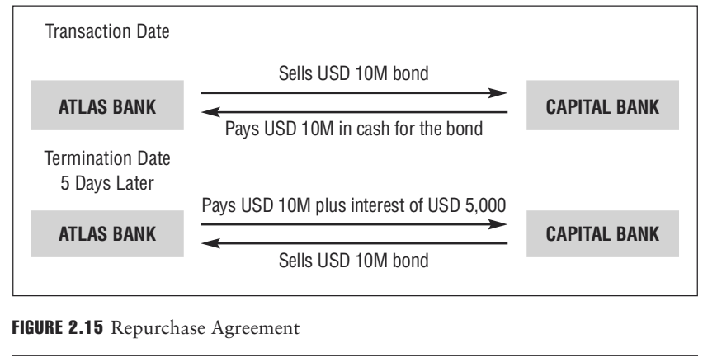

Slide 21
In a repo transaction, the actual ownership of the security passes to the buyer from the seller. The repo markets are a major source of funding for the liquidity needs of banks around the globe.
In addition to the liquidity needs described above, bank supervisors often require banks to maintain a minimum holding of either cash or assets that can be readily turned into cash in case the bank encounters an unexpected cash demand. Highly liquid assets generally include the bank’s deposits held at the central bank and domestic government debt held by the bank.

Slide 22
Finally, since the collapse of Herstatt Bank (see Section 3.3.1 for further details), bank supervisors have also been concerned with banks’ ability to meet their obligations to each other. A particular concern for regulators are the ripple effects of a bank owing money to other banks as a result of its position in a payments system (e.g., a check clearing system or a government bond payment and delivery system).
If a bank’s customers who use these payment systems default, the bank may not have sufficient cash to be able to pay its banking counterparties on behalf of their customers (the other banks). To counter this risk, banks often rely on collateral, usually high-quality government bonds and other securities.

Slide 23
Collateral is an asset(s) pledged by a borrower to secure a loan or other credit and to act as a guarantee to the lender in the event of a default. If the borrower is unable or unwilling to repay the debt, the lender has the option to accept the collateral as full or partial payment of the loan's principal, accrued interest, fees, and expenses. (The role of collateral will be explained further in Section 4.4.5.)

Slide 24
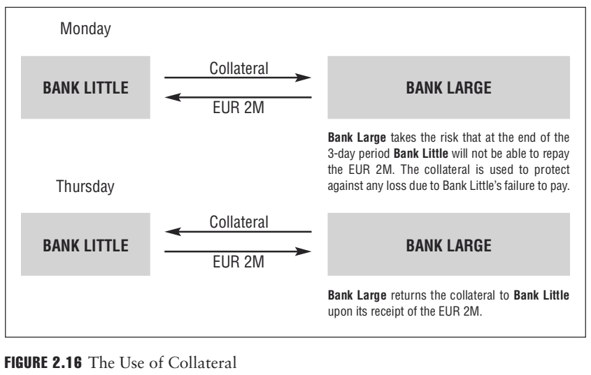

Slide 25
3. Liquidity Standards in Basel III
Typically, bank failures are due to the combination of substantial credit losses and limited or disappearing liquidity to adequately fund assets during times of stress. Consequently, regulators have considered access to adequate funding and liquidity levels crucial for the long-term stability of each bank. Prior to the Basel III Accord, international banking regulations did not have global liquidity standards, or consistent regulatory monitoring in cross-border supervisory oversight. (The Basel III Accord will be explained further in Section 3.3.9.)

Slide 26
Under the new regulatory framework, the new short-term liquidity coverage ratio, to be implemented starting in 2015, focuses on the ability to maintain adequate liquidity coverage for extreme stress conditions of up to 30 days. This will be complemented by a longer-term structural net stable funding ratio, to be implemented by 2018, that relates the long-term and stable sources of funding to the liquidity characteristics of on- and off-balance-sheet items.

Slide 27
Corporate Governance
A bank is required to consider the often conflicting requirements of its individual customers, borrowers, depositors, investors, employees, shareholders, regulators, and the public, collectively called stakeholders. All stakeholders have an interest in the future success of the bank. For instance, if the bank is successful, customers benefit from continued business relationships, depositors have continued access to their money, and employees have jobs and receive salaries.
Banks attempt to balance the conflicting interests of all its stakeholders, yet recognize that ultimately all decisions should increase the value of the bank and wealth of the owners of the bank, the shareholders.

Slide 28
Shareholders elect the board of directors that supervises management that controls the day-to-day operations of the bank. Corporate governance, the set of relationships between the board of directors, shareholders, and other stakeholders of a company, is a framework banks use to enhance their success. Corporate governance is the system by which companies are directed and controlled.
Corporate governance creates a relationship structure that helps management to:
Set corporate and strategic business objectives and run daily operations
Consider the interests of all its stakeholder groups, separately as well as jointly
Manage the bank in a safe and sound manner
Comply with relevant laws and regulations
Protect the interests of its depositors

Slide 29
1. Corporate Governance Structures
The structure of a bank’s corporate governance depends on its host country’s legal system, business customs, and the historical development of the bank. Although there is no single structure that can be prescribed as ideal, there are generally accepted governance concepts and ideas that have been shown to support an adequately functioning governance system. Good corporate governance seeks to establish rules that help corporations, such as banks, create internal processes that benefit both the bank and its stakeholders.

Slide 30
Several national and international organizations, agencies, corporations, and institutions have attempted to define what creates good corporate governance. Some of the elements identified are described in this section. The board of directors has the ultimate responsibility for the management and performance of a company and is responsible for its governance. The board of directors should do the following:
Set the overall strategic direction of the bank, including the establishment of the bank’s risk tolerance levels
Advise on recruitment and human resources (HR); oversee, guide, and review the performance of senior management; and set senior management compensation
Monitor the performance of the bank, and review regular financial and risk reports

Slide 31
Be qualified, both personally and professionally, to act as directors with integrity and in the interest of shareholders
Meet regularly with senior management and internal auditors to establish and approve policies
Review reporting lines, authority, and responsibilities of the bank’s senior management

Slide 32
In particular, outside directors should be independent of internal and external influences and provide sound advice without participating in the daily management of the bank.
Outside directors are not executives at the company. They are independent individuals selected for their experience and expertise in the relevant industry or sector. Furthermore, outside directors serve only one role – they are not company managers – and are thus considered the more objective members of the board.
Specialized committees support the overall work of the board and allow board members to oversee specific areas. These committees will cover areas such as risk management, audit, compensation, and board nominations. Particularly in smaller banks, a board-level committee can be tasked to review major loan decisions.

Slide 33
When the board of directors establishes the bank’s strategy and risk tolerance levels, it effectively decides what types of assets the bank should primarily underwrite. Essentially, any bank can choose between pursuing a low-risk strategy and a high-risk strategy.
A low-risk strategy entails underwriting high-quality bonds (in particu-lar, government bonds) and loans with stringent underwriting standards (Chapter 4), including collateral demands. These assets are considered conservative, with little risk of default. Chapter 6 will discuss bonds.
A high-risk strategy entails underwriting lower-quality bonds (in particular, lower-rated corporate bonds) and loans with less stringent under-writing standards. All these assets are considered risky, having a greater risk of default.

Slide 34
Whether a bank pursues a low-risk strategy or a high-risk strategy, the board of directors has to determine how prudently, or conservatively, the bank should be managed. A prudent bank closely monitors the loans it underwrites, has more than adequate liquidity, and generally has stringent internal controls on all aspects of its operations. From a regulatory perspective, a prudently managed bank that pursues a low-risk strategy is optimal. A bank that is not prudently managed and pursues a high-risk strategy usually causes considerable concern to regulators.

Slide 35
A bank’s organizational structure is determined by the board and directed by the CEO. The board has oversight responsibilities, with day-to-day decision-making lying in the hands of the CEO and senior management.
At the head of the organization is the board of directors. Immediately below the board of directors is the company’s CEO or president, who oversees the senior management. The senior managers, in turn, oversee the activities of business units, junior managers, and employees. This hierarchical structure ensures that corporate activities are coordinated across the various businesses.

Slide 36
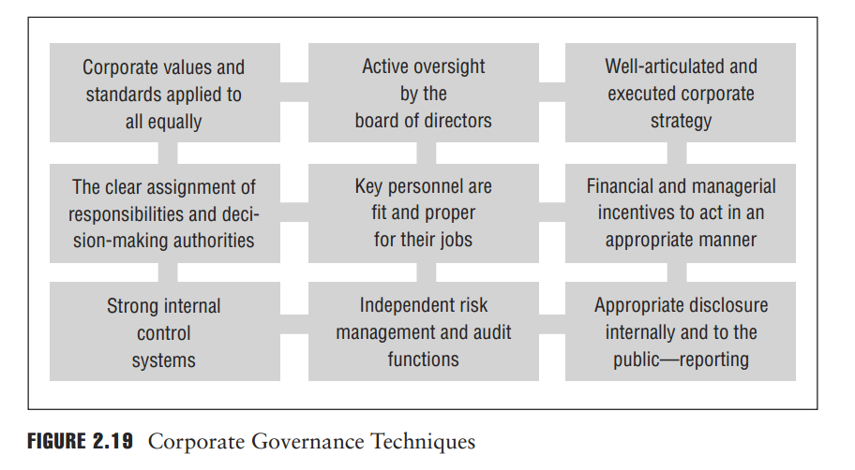
2. Corporate Governance Techniques
The structure of corporate governance in banks varies depending on local customs, legal restraints, and the historical development of each bank. Figure 2.19 lists techniques typically adopted by a bank to implement good corporate governance.

Slide 37
3. Senior Management and Corporate Strategies
Senior management has comprehensive oversight of managers (managers are held directly responsible for the development of a specific line of business or operational function). An important task for senior managers is to communicate the responsibilities and ensure the performance of each staff member. Senior management also has a key role in the setting and implementation of a bank’s strategic objectives. A bank that does not have strategic objectives will find it difficult to manage its activities, as there will be a lack of focus in the use of its resources.

Slide 38
Values and Culture
It is important for a bank to have a strong corporate culture. By establishing a corporate culture, a bank will be able to conduct its business according to clearly defined values. Equally important is the communication of such policies to all areas of the bank.
The company’s set of values should be applied to all areas of the bank, including the board of directors. They should encourage the reporting of problems in a timely fashion and prohibit corruption and bribery both internally and externally. These values should be supported by policies to prevent situations that can challenge the operation of good corporate governance. An example would be a clear policy setting out a procedure for employees to follow if their work creates a conflict of interest with their out-side interests. A clear policy reinforces a bank’s values in dealing with such situations.

Slide 39
5. Financial Incentives
It is important that the board of directors develops a compensation policy that reflects the bank’s culture, objectives, strategy, and control environment. The board should set the compensation for senior management and other key personnel. Any such compensation scheme should ensure that it does not create an imbalance between risks and rewards, as it is important to align pay and bonus structures with long-term risk management.
Compensation schemes should encourage individuals to consider long-term issues over short-term revenue generation, while attracting and retaining talent. The compensation scheme should be designed to motivate senior management to act in the best interests of the bank. It should discourage short-term performance measures that may leave the bank exposed to long-term risks. Salary scales should be set so that personnel are not overly dependent on short-term performance in relation to their total remuneration package.

Slide 40
6. Internal and External Auditors
Internal and external auditors validate the information provided by senior management to the board of directors, regulators, and the public. Both internal and external auditors play a central role in corporate governance. The board of directors supports and protects the auditors’ interaction in the following ways:
The board supports auditor independence by engaging auditors to pre-pare an unbiased assessment of the company’s financial position based on accepted standards and to report the findings directly to the board.
Boards engage external auditors to judge the effectiveness of the company’s internal controls.
Boards should review, in a timely and effective manner, the auditors’ findings and recommendations and require prompt correction by senior management of problems identified by auditors.

Slide 41
7. Transparency
Transparency helps stakeholders, investors, the public, and regulators to evaluate the performance of the bank and how effectively senior management and the board fulfill their responsibilities. The degree of transparency relates to the degree of disclosure. At a minimum, public disclosure should include:
The size and qualifications of the board of directors and its subcommittees.
The structure, qualifications, and responsibilities of the company’s senior management.
Information about the bank’s basic organizational structure, including its legal structure.
Information regarding senior employee incentive structure and compensation policy (typically restricted to a few senior and well-compensated employees).
The nature and extent of transactions with affiliates and related parties.

Slide 42
Main reference:
Foundations of Financial Risk.
An Overview of Financial Risk and Risk-Based Regulation.
Richard Apostolik
Christopher Donohue
Chapter 2

