Slide 1


Project Risk Management
Prepared by Dr. Usama Al-Fendi
PMG 510
Project Risk Management
Lecture 1

Slide 2

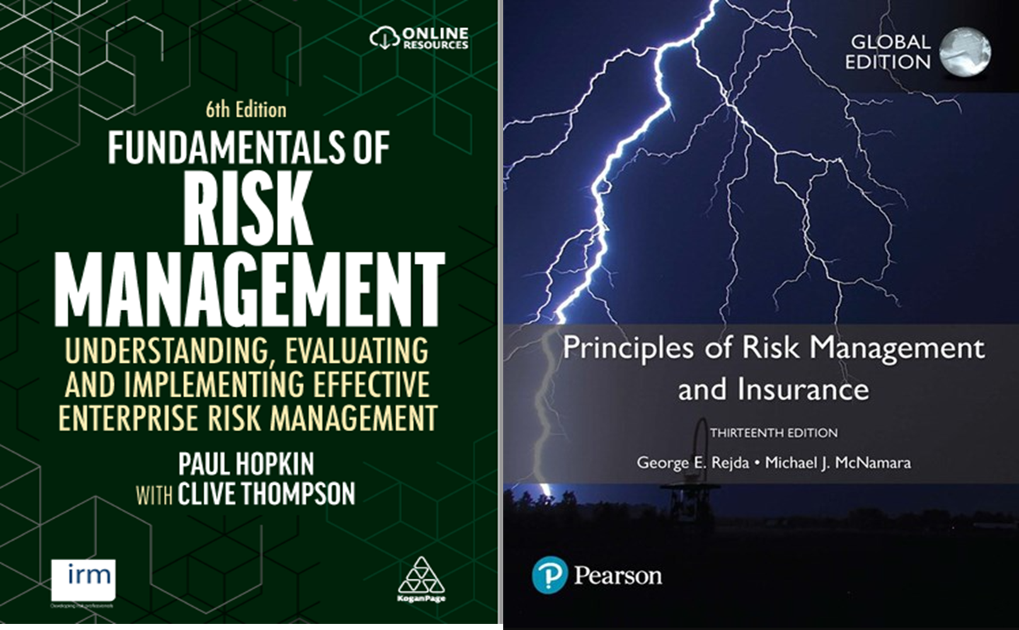
Lecture
Main References
1

Slide 3
Lecture
Course Outlines
1
Approaches to defining risk | Risk management standards
Impact of risk on organizations | establishing the context
Types of risks | enterprise risk management
Scope of risk management | Alternative approaches
Principles and aims of risk management | Risk assessment considerations

Slide 4
Lecture
Course Outlines
1
Importance of Risk Management
Different Definitions of Risk
Chance of Loss (Probability of Occurrence)
Impact of Loss (Severity of Loss)
Peril and Hazard
Classification of Risk
Major Personal Risks and Commercial Risks
Burden of Risk on Society
Techniques for Managing Risk

Slide 5
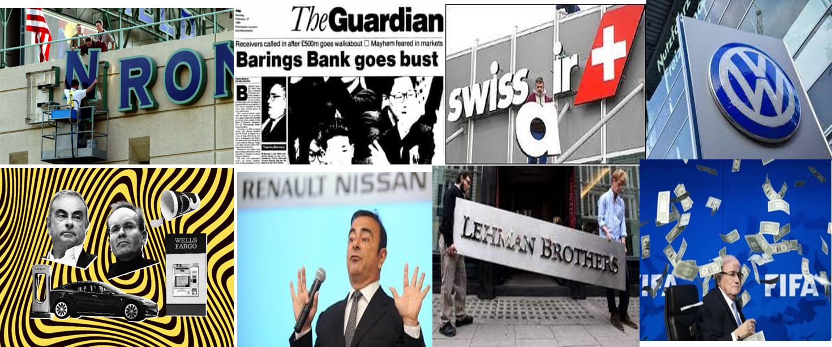
Lecture
Why Risk Management
1

Slide 6
Lecture
Different definitions of Risk
1
Risk: Uncertainty concerning the occurrence of a loss
Loss Exposure: Any situation or circumstance in which a loss is possible, regardless of whether a loss occurs.
Probability that that the actual outcome will deviate from expected.
Volatility of returns above and below average expected level.

Slide 7
Lecture
Different definitions of Risk
1
Objective Risk vs. Subjective Risk
  Objective risk is defined as the relative variation of actual loss from expected loss
    It can be statistically calculated using a measure of dispersion, such as the standard deviation.
    We can quantify and measure it quantitatively and without personal biased.

Slide 8
Lecture
Different definitions of Risk
1
Objective Risk vs. Subjective Risk
  Subjective risk is defined as uncertainty based on a person’s mental condition or state of mind
    Two persons in the same situation may have different perceptions of risk
    High subjective risk often results in conservative behavior
    Have personal biased.

Slide 9
Lecture
Chance of Loss
1
Chance of loss: The probability that an event will occur.
Probability of Occurrence.
Likelihood of happening.
It can be quantified as a number between zero and one.
Best way to measure it objectively is through historical actual frequency data.

Slide 10
Lecture
Impact of Loss
1
Impact of loss: The dollar value of loss that will result if the probable event occur.
Loss severity.
It can be quantified through the size of loss exposure.
Example: for car insurance companies, loss exposures are the dollar value of the insured car ($10,000, $50,000, $100,000)
.

Slide 11
Lecture
Peril and Hazard
1
A peril is defined as the cause of the loss
  In an auto accident, the collision is the peril, earth quick the damage is the peril.
A hazard is a condition that increases the chance of loss.
Example: during winter icy roads can increase the frequency of car accident occurrence.

Slide 12
Lecture
Types of Hazard
1
  Physical hazards are physical conditions that increase the chance of loss (icy roads, defective wiring, unstable areas)
  Moral hazard is dishonesty or character defects in an individual, that increase the chance of loss (faking accidents, inflating claim amounts)

Slide 13
Lecture
Types of Hazard
1
  Attitudinal Hazard (Morale Hazard) is carelessness or indifference to a loss, which increases the frequency or severity of a loss (leaving keys in an unlocked car)
  Legal Hazard refers to characteristics of the legal system or regulatory environment that increase the chance of loss (large damage awards in liability lawsuits)

Slide 14
Lecture
Classification of Risk
1
Pure and Speculative Risk
  A pure risk is one in which there are only the possibilities of loss or no loss (earthquake, car accident, fire in the warehouse) which is insurable.
  A speculative risk is one in which both profit or loss are possible (gambling, investing in stocks)

Slide 15
Lecture
Classification of Risk
1
Diversifiable Risk and Undiversifiable Risk
  A diversifiable risk affects only individuals or small groups, or a company alone or one sector in the economy (car theft, resign of a CEO, increase the price of raw material). It is also called nonsystematic or particular risk.

Slide 16
Lecture
Classification of Risk
1
Diversifiable Risk and Undiversifiable Risk
  An undiversifiable risk affects the entire economy or large numbers of persons or groups within the economy (hurricane, interest rate change by central bank, wars, pandemics like COVID19). It is also called systematic risk or fundamental risk. Government assistance may be necessary to insure undiversifiable risks.

Slide 17
Lecture
Classification of Risk
1
Enterprise risk encompasses all major risks faced by a business firm, which include: pure risk, speculative risk, strategic risk, operational risk, and financial risk
  Financial Risk refers to the uncertainty of loss because of adverse changes in commodity prices, interest rates, foreign exchange rates, and the value of money.

Slide 18
Lecture
Classification of Risk
1
Enterprise Risk Management combines into a single unified treatment program all major risks faced by the firm:
  Pure risk
  Speculative risk
  Strategic risk
  Operational risk
  Financial risk
  Compliance Risk

Slide 19
Lecture
Common Types of Risk
1
Credit Risk: the risk that the borrower will not be able to payback his obligation on a timely manner.
Market risk: the risk that occur due to changes in market variables.
Operational risk: the risk of loss resulting from inadequate or failed internal processes, people and systems or from external events

Slide 20
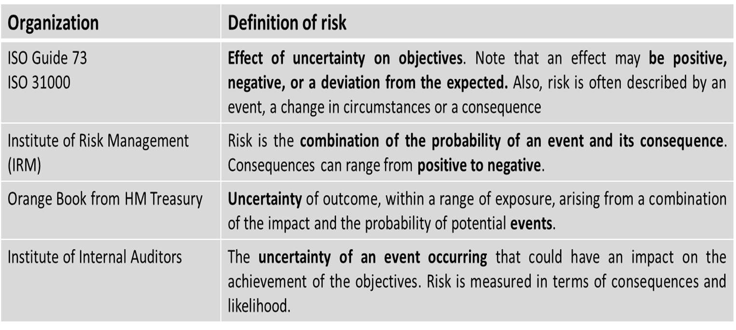
Lecture
Organizational definitions of Risk
1

Slide 21
Lecture
Major Personal Risks and Commercial Risks
1
Personal risks involve the possibility of a loss or reduction in income, extra expenses or depletion of financial assets:
  Premature death of family head
  Insufficient income during retirement
    Most workers are not saving enough for a comfortable retirement

Slide 22
Lecture
Major Personal Risks and Commercial Risks
1
Personal risks
Poor health (catastrophic medical bills and loss of earned income)
  Involuntary unemployment

Slide 23
Lecture
Major Personal Risks and Commercial Risks
1
Personal risks
Property risks involve the possibility of losses associated with the destruction or theft of property:
  Physical damage to home and personal property from fire, tornado, vandalism, or other causes

Slide 24
Lecture
Major Personal Risks and Commercial Risks
1
Personal risks Direct loss vs. indirect loss
  A direct loss is a financial loss that results from the physical damage, destruction, or theft of the property, such as fire damage to a home

Slide 25
Lecture
Major Personal Risks and Commercial Risks
1
Personal risks Direct loss vs. indirect loss
  An indirect loss results indirectly from the occurrence of a direct physical damage or theft loss, such as the additional living expenses after a fire to a home. These additional expenses would be a consequential loss

Slide 26
Lecture
Major Personal Risks and Commercial Risks
1
Personal risks
Liability risks involve the possibility of being held liable for bodily injury or property damage to someone else
  There is no maximum upper limit with respect to the amount of the loss
  A lien can be placed on your income and financial assets
  Defense costs can be enormous

Slide 27
Lecture
Major Personal Risks and Commercial Risks
1
Commercial Risks
  Firms face a variety of pure risks that can have serious financial consequences if a loss occurs:
    Property risks, such as damage to buildings, furniture and office equipment
    Liability risks, such as suits for defective products, pollution of the environment, and sexual harassment

Slide 28
Lecture
Major Personal Risks and Commercial Risks
1
Commercial Risks
    Loss of business income, when the firm must shut down for some time after a physical damage loss
    Other risks to firms include crime exposures, human resource exposures, foreign loss exposures, intangible property exposures, and government exposures

Slide 29
Lecture
Burden of Risk on Society
1
The presence of risk results in three major burdens on society:
  In the absence of insurance, individuals would have to maintain large emergency funds
  The risk of a liability lawsuit may discourage innovation, depriving society of certain goods and services
  Risk causes worry and fear

Slide 30
Lecture
Techniques for Managing Risk
1
There are Four major methods for managing risk
  Avoidance
  Acceptance or Retention
  Loss control or Mitigate
  Transfers

Slide 31
Lecture
Techniques for Managing Risk
1
  Risk Avoidance:
Prevents the organization from entering into a risk-rich situation or environment. For example, when choosing a vendor for a service, the organization could choose to accept a vendor with a higher-priced bid if the lower-cost vendor does not have adequate references.
Example: A company decided not to invest in X country due to the high political instability.

Slide 32
Lecture
Techniques for Managing Risk
1
  Risk acceptance or Retention
  Based on the comparison of the risk to the cost of control, management could accept the risk and move forward with the risky choice.
    (An individual or firm retains all or part of a given risk)

Slide 33
Lecture
Techniques for Managing Risk
1
Example: There is the risk an employees will burn themselves if the company installs new coffee makers in the break room. The benefit of employee satisfaction from new coffee makers outweighs the risk of an employee accidentally burning themselves on a hot cup of coffee, so management accepts the risk and installs the new appliance.

Slide 34
Lecture
Techniques for Managing Risk
1
  Risk acceptance or Retention
    Active retention means that an individual is consciously aware of the risk and deliberately plans to retain all or part of it
    Passive retention means risks may be unknowingly retained because of ignorance, indifference, or laziness
    Self Insurance is a special form of planned retention by which part or all of a given loss exposure is retained by the firm

Slide 35
Lecture
Techniques for Managing Risk
1
  Risk control or mitigate
Mitigating risks involves implementing action plans and controls that reduce the likelihood of the risk and/or the impact it would have if the risk were realized.

Slide 36
Lecture
Techniques for Managing Risk
1
  Risk control or mitigate
For example, if an organization allows employees to work from home, there is a risk of data leakage due to the transmission of data across the public internet. To mitigate this risk, management might implement a VPN service and have remote users access the business network through VPN only. This would reduce the likelihood of data leakage, thereby mitigating the risk.

Slide 37
Lecture
Techniques for Managing Risk
1
  Risk control or mitigate
An other example, when the bank impose a segregation of duties to the operations deliver and prevent one single employee form having more than one process in the transactions.
This technique will be the most important one in the risk mitigation stage.

Slide 38
Lecture
Techniques for Managing Risk
1
  Risk or Loss control
    Loss prevention refers to activities to reduce the frequency of losses
    Loss reduction refers to activities to reduce the severity of losses

Slide 39
Lecture
Techniques for Managing Risk
1
    Loss prevention refers to activities to reduce the frequency of losses
  Example: speed cameral controls, strict regulations for not smoking in the gas stations, segregations of duties, applying good fundamental analysis before investments in foreign currencies.

Slide 40
Lecture
Techniques for Managing Risk
1
    Loss reduction refers to activities to reduce the severity of losses
  Example: seat belt, placing fire extinguishers along the building, emergency exits in the buildings, concentration limit for investments in foreign currencies.

Slide 41
Lecture
Techniques for Managing Risk
1
  Risk Transfer
Transferring the risk means shifting the risk to another organization. The three most common means for transferring are outsourcing, warrantees and insuring.

Slide 42
Lecture
Techniques for Managing Risk
1
  Risk Transfer
When outsourcing, management cannot completely transfer the responsibility for controlling risk. Insuring against the risk ultimately transfers some of the financial impacts of the risk to the insurance company.

Slide 43


Thank You

