Slide 1



DIGITAL MARKETING
APPLICATIONS
Prepared by Dr. HEBA ZIAD
COURSE CODE - MKT720
lecture 2

Slide 2
Online marketplace analysis:
micro-environment
Chapter at a glance
Main topics
Situation analysis for digital marketing
The digital marketing environment
Understanding how customers interact with digital markets
Consumer choice and digital influence
Customer characteristics
Competitors
Suppliers
New channel structures
Lecture 2
COURSE CODE - MKT720

Slide 3



Course Description
The demands on marketers who are responsible for planning digital marketing strategies are growing significantly as they work out how to manage commercial contributions, the complexities of the competitive marketplace, digital social communities and innovative technologies The growth in use of digital media and technology has led to new paths-to-purchase that are highly complex as purchase decisions are potentially influenced by many touchpoints. In the online marketplace, purchase decisions are influenced by many sources of information (e.g. search results, customer reviews, online word-of-mouth, social media conversations and company websites). Additionally, potential customers are using multiple devices (sometimes simultaneously) to garner information that will inform their purchase decisions - for example, using smartphones or tablets, while watching TV. This process is known as multi-screening The digital influences are also supplemented by exposure to traditional communications such as TV, print or radio advertising.
E-WOM (electronic word of mouth):- digital dialogues, comments and conversations in consumer markets. Digital marketing practitioners often use social media networks and blogs to engage their target audience in e-WOM conversations. E-WOM An extension of traditional face-to-face word-of- mouth, whereby communication exchanges between individuals take place in digital environments.
Online marketplace Exchanges of information and commercial transactions between consumers, businesses and governments completed through different forms of online presence such as search. engines, social networks, comparison sites and destination sites.

Slide 4

What is the path to purchase?
The path to purchase is your journey from this moment – the instant you become aware of a problem or a need to the moment you take action to solve it. This purchasing journey will be different for every customer, and will depend on numerous factors such as: demographics, previous experiences, buying behavior ,The type of product or service they’re looking for ,The channels they use to research products and make purchases And which brands they trust the most.
Stages in the consumer path to purchase
The Awareness stage The awareness stage is where a user becomes aware of a solution to a particular problem they’re having. What is the buyer doing during the awareness stage ? The buyer is experiencing a problem or symptoms of a pain, and their goal is to alleviate it. They may be looking for informational resources to more clearly understand, frame, and give a name to their problem.
chapter2
A path to purchase analysis is a research method used to understand how customers discover and select products. It involves tracking customer behavior from the moment they become aware of a need or want all the way through to when they make a purchase.

Slide 5
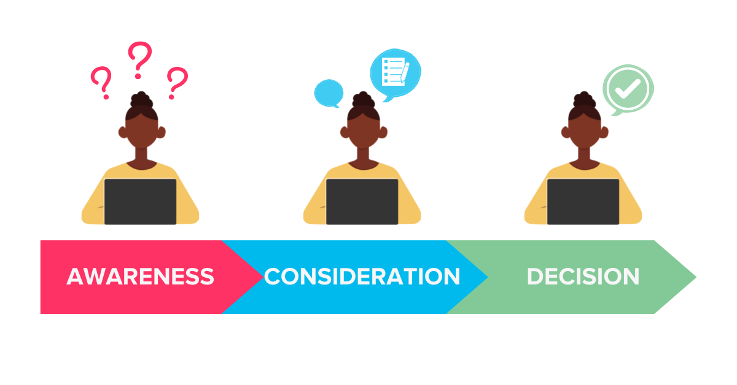
Stages in the consumer path to purchase
  The Consideration stage:- In this stage, the user knows what the solution is but they’re considering and evaluating multiple options. our marketer knows they need a marketing attribution solution. So, they search things like ‘best marketing attribution tools’. we would want to be found in this search (whether on our own content or featured in others).
  What is the buyer doing the consideration stage ? The buyer will have clearly defined and given a name to their problem, and they are committed to researching and understanding all of the available approaches and/or methods to solving the defined problem or opportunity.
Decision or purchase stage Once the user is happy with their final choice, they will take the plunge and purchase.
    This is the final stage of the funnel. You could encourage these actions using review sites for example. Of course, this is a simplified version of what really happens. Especially for businesses that need to generate leads first, there are probably intermediary stages as they book a demo and become a lead etc.
    What is the buyer doing during the decision stage? The buyer has decided on their solution strategy, method, or approach. Their goal now is to compile a list of available vendors, make a short list, and ultimately make a final purchase decision.
chapter2

Slide 6
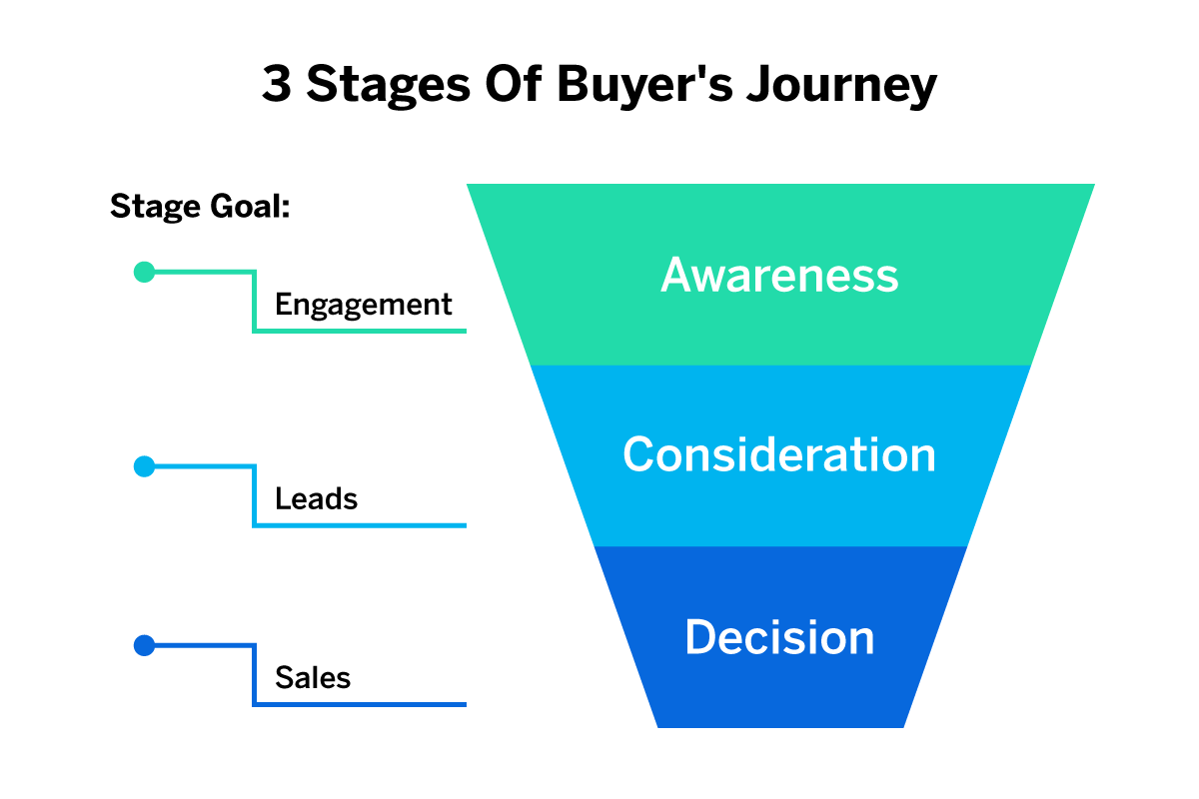
There are a few different ways to conduct a path to purchase analysis:
Survey customers at various points along their journey such as after they've made a purchase or left a review.
Interview customers about their purchase journey.
Track brand awareness metrics like website traffic and conversion rates.
Analyze customer behavior data from platforms like Google Analytics.
At minimum you should be tracking metrics like click through conversions bounce rates and time on site. This data will give you insights into where customers are dropping off so you can make changes to your website or marketing strategy accordingly.
Why do you need to track the path to purchase?
Tracking the path to purchase – both holistically and on a granular level will help understand how your marketing drives new leads and sales. With proper tracking in place, marketer can understand the role of channels and campaigns play when it comes to starting, driving or ending customer journeys.
chapter2

Slide 7

The situation analysis digital marketing needs to describe the context in which your digital marketing will take place. It should include an analysis of your business' internal (micro) and external (macro) environments.
Internal factors include your:
Customers .Digital marketing propositions and communications should be based around the customer-their characteristics, technology usage, behavior's, needs and wants.
market, and any trends in this. Including intermediaries, influencers and potential partners. This involves identifying and reviewing the main online influences on purchase behavior. There are many influences to consider, including search engines, publisher media sites, blogs, review sites and social networks. Marketplace analysis also involves reviewing opportunities and threats from digital media and technology, including new business and revenue models
Competitors. It is essential to understand how organizations compete in a particular marketplace; benchmarking customer propositions and communications activities against direct and indirect competitors and out-of-sector businesses can identify opportunities for new approaches and digital marketing activities that need to be improved
Internal review. Another major part of the situation involves an inward-looking, internal review of the effectiveness of existing digital marketing approaches. This will include reviewing current results from digital marketing by review of key performance indicators (KPIs) and dashboards and the organizational capabilities and processes used to manage digital marketing, summarized as strengths and weaknesses.
Customer value :is the perceived benefit that a customer gets from buying and using your product or service.
value proposition: which is the unique combination of benefits that you offer to your target customers. Your value proposition should answer the question: why should customers choose you over your competitors?
benchmarking criteria:the specific metrics or indicators that use to measure and compare your customer value. Depending on industry, product, and market, such as customer satisfaction, customer retention rate, customer acquisition cost, customer loyalty, or customer feedback. You should select the criteria that are most relevant and important for your business goals and customer expectations.

Slide 8

External factors could be: (wider macro –environment) These are the broader strategic influences we cover
social - how changing consumer attitudes could affect your approach
legal - complying with digital marketing laws, such as data protection
environmental - making sure your approach is ethical and sustainable
political - how local or national government could impact on your plan
technological - how advances in technology could affect your marketplace
situation analysis can provide : top reasons to conduct situation analysis on a regular basis:
*Better understanding of your industry *Targeting the right audience
*More information about your general competition *The ability to identify new opportunities
*A deeper understanding of consumer needs *Improved communication with customers
chapter2
Situation analysis :collection and review of information about an organization's external environment and processes in order to refine its strategy

Slide 9


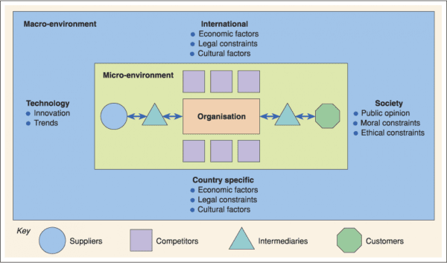
THE DIGITAL MARKETING ENVIRONMENT
Just like a natural environment, the digital marketing environment is built upon a delicate ecosystem that can become unbalanced if the wrong elements are added or removed from it. This will determine whether or not a firm’s strategy will be successful or if it will diminish. In the digital marketing environment it consists of two main ecosystems, the macro and the micro-environment. These environments are built up by a number of different components which will directly impact an organization's strategic decision making. The image to the right provides a visual representation of the digital marketing environment.

Slide 10


The digital marketing environment
it is important to understand how firms operate in different contexts. While digital has become mainstream and the distinction between on and offline has been eroded, it is important to recognize that not all organizations are fully digitally engaged and the importance of digital channels differs between industry sectors. Therefore, each organization has its own unique space within the online and offline world, which should be considered when analyzing its marketing environment and planning a digital marketing strategy. Understanding the nuances of this space is key to defining how to interact within their own business, with competing businesses and the wider forces shaping the marketing environment.
The (digital) marketing environment involves two major elements:
micro-environment and - macro-environment. The micro-environment is known as the operating environment, and focuses on the players that shape the immediate trading environment. These players include the customers whose needs and wants are to be satisfied, along with the competitors, intermediaries and suppliers. These groups of players shape the online marketplace and a digital marketer needs to understand their behavior and interpret this correctly in order to build and adapt an efficient and effective digital marketing strategy.
The macro-environment, sometimes known as 'the remote environment', consists of external forces that can significantly affect success. These forces originate from the marketplace that is largely beyond the immediate control of an organization (e.g. economic conditions, changes to international trade legislation, technological developments and innovations, social change and political interventions).

Slide 11
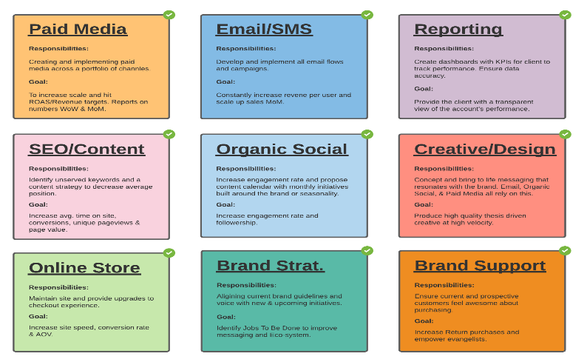
It is important to note the growing influence of social media networks, which are increasing the capacity of digital channels to inform and shape opinion on a global scale.
The marketing environment can have a profound impact on performance; consequently, an organization should continually monitor both micro and macro influences.
This process is called environmental scanning in traditional marketing and online.
Marketplace analysis helps to:-
define the nature of the digital competitive market, Major online players such as Facebook and Amazon have developed their own infrastructure or online market ecosystems that connect websites through data exchange, giving opportunities to enhance the customer experience and extend the firms' reach and influence.
For example, Facebook uses APIs (e.g. Graph and Marketing) which enable companies to create audience profiles and run digital marketing campaigns.
The various functions of these APIs are
to facilitate greater levels of automated interactions between Facebook users' news feeds, and profile pages. Google has developed its own ecosystem related to search marketing and mobile and is utilizing the proliferation of new digital devices owned by individuals and firms: Google Home devices offer hands-free commands that can control various smart home devices
As part of marketplace analysis, companies should evaluate the relative importance of these ecosystems, the required resources and the integration of their online services.
A digital ecosystem is a group of interconnected information technology resources that can function as a unit. Digital ecosystems are made up of suppliers, customers, trading partners, applications, third-party data service providers and all respective technologies. Interoperability is the key to the ecosystem's success.

Slide 12


UNDERSTANDING HOW CUSTOMERS INTERACT WITH DIGITAL MARKETS
In the physical world‘ going to the shops is a well-understood concept, but less is known about the range of triggers and influences that can shape a shopper's journey and inform their ultimate purchase decision In the digital world, the same basic principles are true, but the online customer encounters many more touchpoints' (digital triggers and influences). which influence their decision making (e.g., websites, social media content and blogs), With increasingly widespread use of digital technology, the digital touchpoints extend beyond digital channels and can influence purchase decisions before, during and after a shopping encounter. It is the modern marketer's job
to make the best investments to feature their brands and
provide relevant content to support this decision-making process at every stage of the customer journey, especially as customers are interacting with brands in commercial and social contexts across multiple touchpoints.
To help understand customers' interactions with physical and digital touchpoints, triggers and influences, journeys maps are increasingly used to model behavior of different types of target audiences.
chapter 2

Slide 13
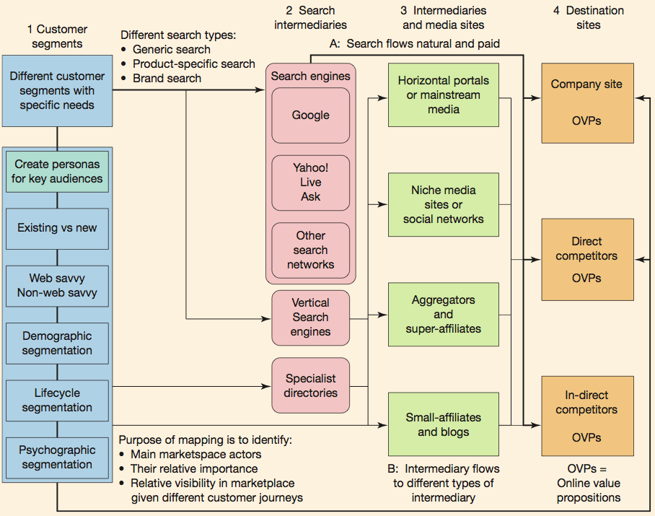
UNDERSTANDING HOW CUSTOMERS INTERACT WITH DIGITAL MARKETS
chapter2

Slide 14

UNDERSTANDING HOW CUSTOMERS INTERACT WITH DIGITAL MARKETS
To help understand the influences on online customer journeys it is useful to produce an online marketplace map, which summarizes how target customer segments might be influenced by different types of digital sites.
The main elements of the online marketplace map are:
Customer segments. The marketplace analysis helps :-
identify and outline different target segments, which have implications for digital marketing,
helps to understand the target group's online media consumption, behavior and relevant types of digital content.
In a digital campaign or website design project, personas can be used to help understand the preferences, characteristics and online behaviors of different target markets
Aggregators An alternative term to price-comparison sites. Aggregators include product, price and service information comparing competitors within a sector such as financial services, retail or travel. Their revenue models commonly include affiliate revenues (CPA), pay-per-click advertising (PPC) and display advertising (CPM).
Affiliates Companies promoting a merchant typically through a commission-based arrangement either direct or through an affiliate network.
chapter 2

Slide 15

Search intermediaries. The main search engines are typically Google, Yahoo!, Bing™ and Ask™, but others are important too There are companies that provide specialist audience data to enable a digital marketer to discover the relative importance of particular search engines (and other types of site) in different countries. Search engines have become so significant that their search trends are used to predict future sales volume & levels of spending. Search engines (Google Trends data) are often correlated with various economic indicators and may be useful for short-term economic predictions'. data can be useful for predicting the present: now casting. The relevance to digital marketers is
the capacity to understand and identify specific purchasing triggers, which can influence economic performance.
it is important for firms to use reliable sources of search analytics such as customer search data, rankings and links between sites.
Companies should know which sites are effective in harnessing search traffic and either partner with them or try to obtain a share of the search traffic using the search engine marketing and affiliate marketing techniques.
Well-known, trusted brands that have developed customer loyalty are in a good position to succeed online since a common consumer behavior is to go straight to the site through entering a URL or from a bookmark or email. Alternatively, they may search for the brand or URL.
By evaluating the type and volume of phrases used to search for products in a given market, it is possible to calculate the total potential opportunity and the current share of search terms for a company. Share of search can be determined from web analytics reports from the company site, which indicate the precise key phrases used by visitors to actually reach a site from different search engines
chapter 2

Slide 16
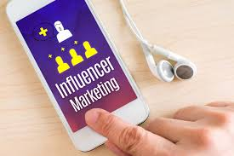
Intermediaries, influencers and media or publisher sites. Media sites and other intermediaries such as individual influencers, social networks, aggregators and affiliates are often successful in attracting visitors via customer search or direct to their websites. Companies need to assess potential online media and distribution partners
Mainstream news media sites or portals:-These include traditional or pure play (like Google News).
Niche/vertical media sites:- are in a business-to-business niche in marketing
Social networks. For example, Facebook, Instagram, Twitter, LinkedIn.
Price-comparison sites (also known as aggregators). For example, Google Shopping
Super-affiliates. Affiliates gain revenue from a merchant they refer traffic to by being paid commission based on a proportion of the sale or a fixed amount. They are important in e-retail markets, accounting for tens of percent of sales.
Niche affiliates for bloggers. These are often individuals, but they may be very influential. Smaller affiliates and bloggers can be important Fundamentals engage collectively. With the growth in readership and social interactions on blogs, identifying key online influencers within a market is important to help reach and e target audiences.
chapter 2

Slide 17

UNDERSTANDING HOW CUSTOMERS INTERACT WITH DIGITAL MARKETS
Destination sites and platforms. These are the sites that the marketer is trying to attract visitors to, including transactional sites by retail, financial service, travel, manufacturers and other companies or non-transactional sites like brand or relationship-building sites. Destination sites also include presence on other social sites such as Facebook and Twitter or mobile apps.
OVP or 'online value proposition', which is a summary of the unique features offered by brands in their online services and presences The OVP is a key aspect to consider within planning-marketers should evaluate their OVPs against competitors and think about how they can refine them to develop a unique online experience
Key online influencers
Celebrities, individuals well known in their niche, or publishers to whom an online target audience listens to and interacts with. Online influencer outreach or blogger outreach' can help companies reach and engage a wider audience. Recently video bloggers ('vloggers' or 'YouTubers') have become popular among teenage audiences.
Unique visitors Individual visitors to a site measured through cookies or IP addresses on an individual computer.

Slide 18

Customer analysis to understand the digital consumer
In the digital world, customer actions are highly trackable and quantifiable, so digital marketers should know how to measure customer behavior in relation to marketing objectives in highly precise ways. These ideas are equally applicable in consumer, business and not-for-profit markets settings, although the specific measurement and analysis tools will vary depending on the desired marketing outcomes. From the micro-environment perspective, customers are important players in a company's immediate trading environment, and analysis of their behavior is central to understanding of the trading situation and, ultimately, digital planning,
Customer behavior analysis can be considered from two perspectives:
Demand and gap analysis This involves understanding the potential and actual volume of visitors to an online presence and the extent to which prospects convert to tactical and strategic outcomes, e.g. lead generation and sales.
Digital consumer behavior. Here a marketer wants to understand the needs, characteristics and digital experiences or behavior's of target consumers. These variables are often collectively referred to as customer insight Based on this analysis, customer segments can be created that will be used to develop targeting approaches as part of strategy and planning
chapter 2
Customer behavior analysis In digital markets, this type of analysis involves research into the motivations, media consumption preferences and selection processes used by consumers as they use digital channels together with traditional channels to purchase online products and use other online services.
Customer insight Knowledge about customers' needs, profile, preferences and digital experiences from analysis of qualitative and quantitative data. Specific insights can be used to inform marketing tactics directed at groups of customers with shared characteristics
.Customer segments Groups of customers sharing similar characteristics, preferences and behaviors that are meaningful in terms of various market propositions, and which are defined as part of target marketing strategy and planning.

Slide 19

DEMAND ANALYSIS AND CONVERSION MARKETING
Demand analysis and conversion marketing Digital marketing managers should understand current trends and levels of use of the Internet and different online services and how they relate to services and products the organization wishes to deliver online. Additionally, marketers need to be aware of factors that affect how customers actively use the digital services on offer This evaluation process is called demand analysis. The benefits of this form of analysis are that companies can identify opportunities for influencing and delivering sales online based on actual use of digital media by individuals in the company's target market. Assessing demand for digital services is done by looking at generic factors that enable marketers to set realistic strategic objectives for each target segment.
digital marketer also needs to assess the volume and share of customers who:
have access to the digital channel
use specific online services that may affect the purchase decision, such as price comparison sites, social networks and specialist blogs
are influenced by using the digital channel but purchase using another channel as part of the multichannel buyer behavior
purchase or use other services using the digital channel.
Using information sources and tools plus any primary research a company decides to carry out, a digital marketer should be able to develop a sound understanding of the characteristics, needs and wants of the individuals (and/or companies) in the target market and their propensity to engage with digital channels. Once this foundation level of understanding is developed, it is possible to consider how to achieve marketing goals and objectives through the use of digital communications.
chapter 2
Demand analysis Quantitative determination of the potential use and business value from online customers of an organization. Qualitative analysis of perceptions of online channels is also assessed
Conversion marketing: using marketing communications to maximize conversion of potential customer to actual customer

Slide 20

IMPLICATIONS FOR MARKETING PLANNING CONVERSION MODELS
As part of situation analysis and objective setting, experienced digital marketers build conversion models of the efficiency of their web marketing Using this approach, the total potential online demand for a service in a particular market can be estimated and then the success of the company in achieving this market determined Conversion marketing tactics can be used to convert as many potential site visitors into actual visitors and then convert these into leads, customers and repeat customers.
MULTICHANNEL CONVERSION MODELS
Multichannel conversion models In reality, conversion modelling is complex because it needs to take into account both online and offline behavior
Conversion marketing: using marketing communications to maximize conversion of potential customer to actual customer
chapter 2

Slide 21

CONSUMER CHOICE AND DIGITAL INFLUENCE
Consumer choice and the subsequent decision making are crucial to the purchasing process (online and offline) but digital media (and especially Mobile digital media) now plays an increasingly important role in buying decisions. Many buyers visit online first to find information that will inform what they buy, so the web and social media are a vital part of the research process, as Internet users now spend longer researching products online, used at every stage of the research process from the initial scan to the more detailed comparison and final checking of specifications before purchase.
The result of this change in behavior means that buyers are more informed, and refer to a multiplicity of sources to find information that will inform their final purchasing decision, e.g. brand websites, social media, review sites, traditional print media and personal recommendations. Digital sources of information now play important role in shaping purchase decisions. So, companies have to think carefully how they can maximize the value of positive comments and reviews and reinforce consumer perceptions through product quality, and service experiences both on and offline. The implications of this growth in the use of information in digital channels in the selection process means that it is important to ensure that products and services are well-represented in the digital channels used by target customers
chapter 2

Slide 22
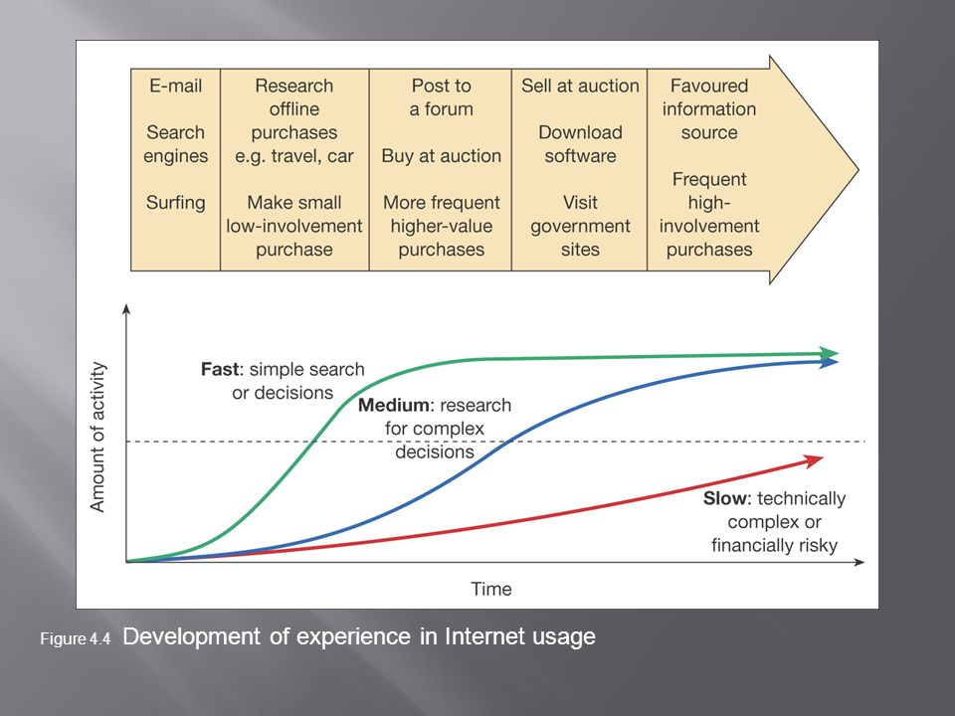
The demand for information is likely to continue to intensify with the rise in significance of mobile and social networking channels. when consumers first use the web they tend to limit its use to searching for product information, but as they become more confident they likely to increase the value of the products they buy and the frequency with which they make purchases. Developing an understanding of the processes involved in customer choice should enable marketers to identify how to tailor services to meet the needs of the customers so that they move to the transaction dimension.
The proportion of Internet users who will purchase different types of products online varies based on the characteristics and demographic profile of the consumers, the product category and the past experiences of the shopper. Convenience remains the biggest driver for online shoppers. influences on consumer purchasing.. By understanding the dimensions that affect how consumers interact with online trading environments, digital marketers can identify key points where they can seek to manage conversion
chapter 2

Slide 23

When assessing online customer demand and characteristics for business-to-business products and services, there are additional considerations. The B2B market is different to business-to-consumer markets in so far as variation in online demand or research in the buying process will occur according to different types of organization and people within the buying unit in the organization. We need to profile business demand according to:
Variation in organization characteristics:
size of company - employees or turnover
industry sector and products
organization type- private, public, government, not-for-profit
application of service - which business activities do purchased products and services support?
country and region.
Role of the target individual in an organization:
role and responsibility - job title, function or number of staff managed
role in buying decision - purchasing influence
department
product interest
demographics - age, sex and possibly social group. So far, we have considered influences on customer choice and conversion models.
chapter 2

Slide 24

Customer characteristics
it has become increasingly important to precisely identify target markets. Research suggests a fruitful place to begin identifying consumer target markets is to consider:
Demographic variables. such as age, gender, race , income, education and lifestyle cultural and social make-up that influences online behavior
Psychographic and behavioral variables. Any aspect of a consumer's perceptions, beliefs and attitudes that might influence online behavior, and in particular a consumer's intention to shop, can be defined as a psychographic/ behavioral variable.
By studying the variables that influence the consumer experiences in the online environment it becomes possible to analyze their future intentions to continue to use digital services and to shop online the impact of consumers' personal experiences of convenience, site design and security might affect their overall satisfaction with a particular website .
Another important point is that by studying variables associated with a consumer's experiences, digital marketers begin to understand how to increase loyalty and trust through websites and online services
customer interactions with an organization's website creates opportunities for positive experiences that can lead to long-term relationship building
An important point to consider is that past experiences will provide the basis for future evaluations.

Slide 25
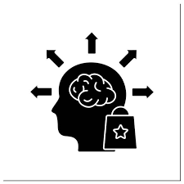
the antecedents or background to the online experience consist of an important list of concepts that can positively or negatively influence or motivate the consumer to engage with a digital offer
Information processing (IP). This is important as it shapes how a consumer deals with available data and information that will shape their future behavior. IP involves the mental processes and senses an individual uses to interpret the world they inhabit
Perceived ease-of-use. the easier a website or mobile site is to use, the more likely a customer will have a positive online
experience Perceived usefulness. This refers to the extent to which the digital offer fits with the customer's daily life - for instance, shopping, online booking train tickets, banking . It is here that the digital marketer can really start to develop a path to consumer benefits.
Perceived benefits. If a customer feels they will be rewarded in some positive way by engaging with a digital offer, this is likely to generate support for an online brand
Perceived control. If a customer is a skilled user of the digital technology in question then they will feel they are able to function successfully in this environment.
CUSTOMER CHARACTERISTICS

Slide 26

Skill. This refers to the customer ability to use the technology to achieve their desired goals. It has been found that individuals learn by doing in the Internet environment and so build their skill set over time - for example, the more frequent the visitor is to a website the greater their exposure and the higher their ability to engage with this digital content.
Trust and risk. Both play an important role in how a customer behaves online. Inexperienced Internet users can feel vulnerable and fear the unknown. Customers should be able to achieve their buying goals with or without feeling they are exposed to undue risk. Marketers should seek to find ways to limit the risk of engaging with their online offer and seek to build trust through developing online relationships
Enjoyment. This is an outcome of a positive online experience.
CUSTOMER CHARACTERISTICS
chapter 2

Slide 27
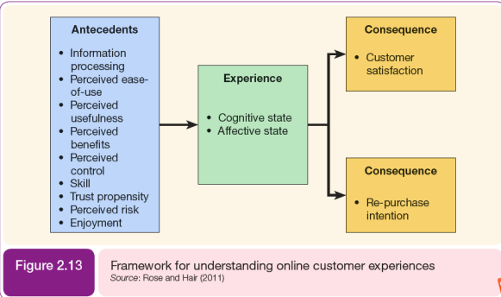
CUSTOMER CHARACTERISTICS
chapter 2

Slide 28

SOCIAL MEDIA AND EMOTIONS
It is also important to consider that social media is increasingly influential for capturing and sharing consumer experiences and is a major conduit through which consumers share, recommend and feedback on their product and service, choices and experiences . Social media networks are giving access to personalized recommendations in real time, based on individual personal experiences, which can be highly influential (both positive and negative depending on the nature of the recommendations).
The use of social media networks, such as Facebook, Instagram, Twitter and LinkedIn, have risen substantially since 2008. Social media has become important as a means of communicating and interacting online and also as a source of peer recommendations. The capacity of social media networks to display our personal feelings is extensive.
chapter 1
SOCIAL MEDIA MARKETING

Slide 29
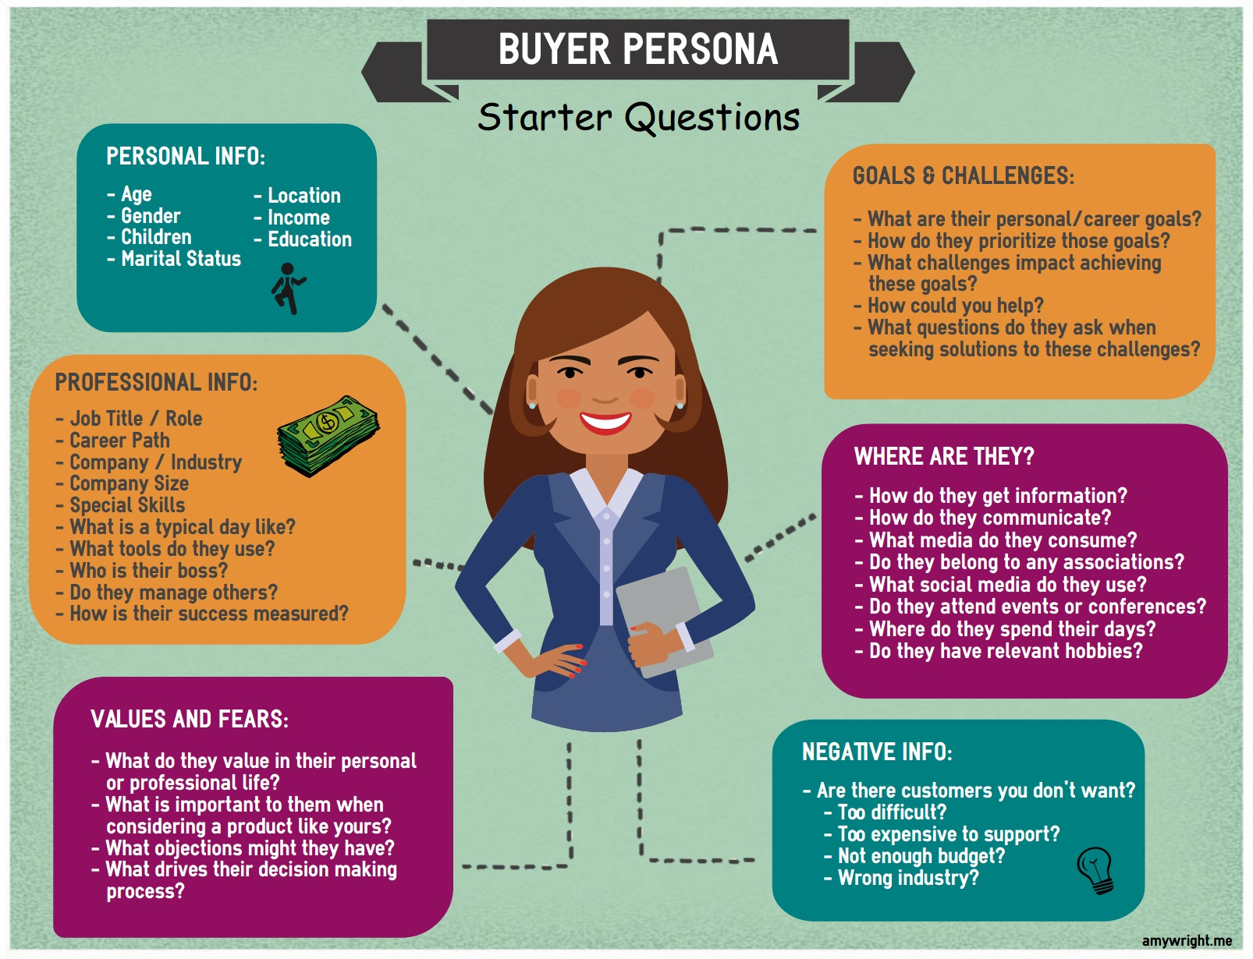
CONSUMER PERSONAS
Consumer personas are fictional profiles that represent a particular target audience. Personas are a tool, which can help understand online customer characteristics and behavior and then create communications more relevant to your audience. Creating personas is a powerful technique for developing customer-centered online strategies, company presences and campaigns and forms part of marketplace analysis. Personas are essentially a 'thumbnail' description of a type of person. They have been used for a long time in research for segmentation and advertising, but in recent years have also proved effective for improving website design by companies that have applied the technique. For an example of the application of personas,
chapter 1
SOCIAL MEDIA MARKETING

Slide 30
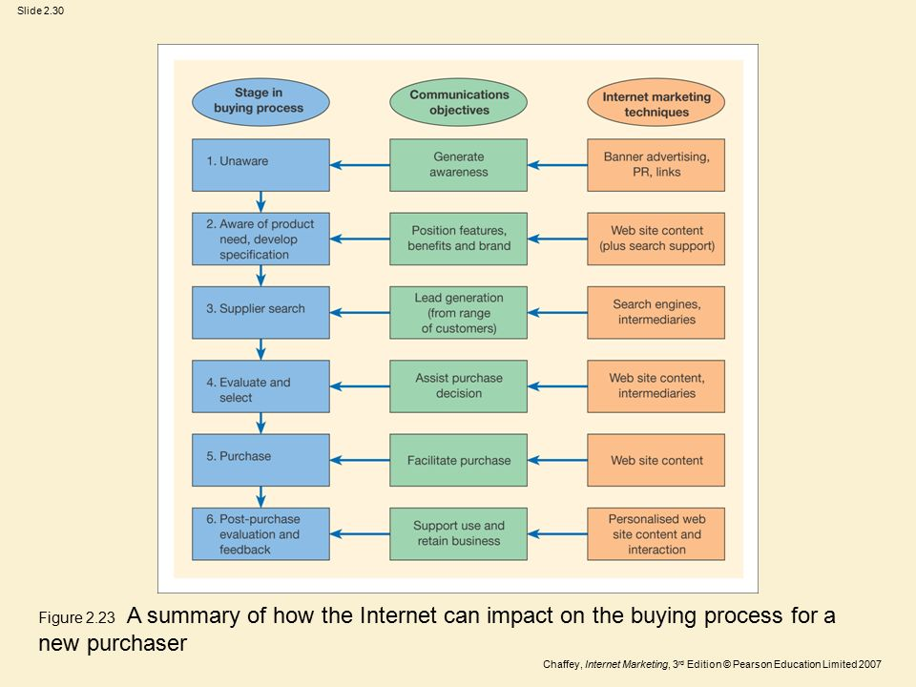
DIGITAL MEDIA SUPPORT THE CONSUMER BUYING PROCESS AS FOLLOWS
THE BUYING PROCESS
chapter 2

Slide 31
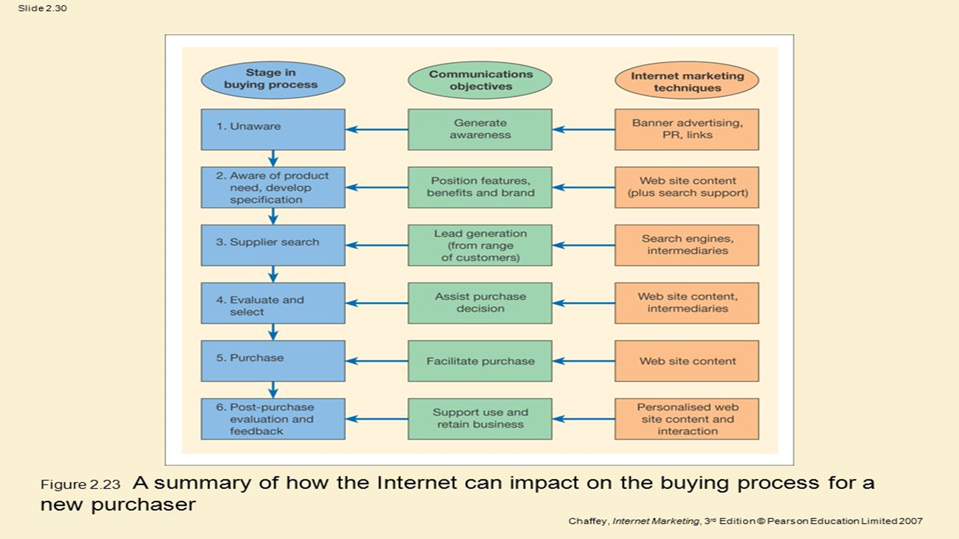
Consumer : unaware. company generate awareness
(of need for product and service)
Consumer :aware of need, develop specification. company: position features , benefits and brand
Consumer : suppliers search . Company : generate leads
(engage and capture interest )
Consumer :evaluate and select . Company :assist purchase decision
Consumer :purchase . Company : facilitate purchase
Consumer : post-purchase evaluation and feedback. company :support product use and retain business
The buying process
chapter 1

Slide 32
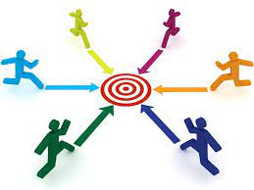
COMPETITORES
THE SHAPE AND NATURE OF ONLINE COMPETITIVE MARKETS
BARGAINING POWER OF BUYERS
BARGAINING POWER OF SUPPLIERS
THREAT OF SUBSTITUTE PRODUCTS AND SERVICES
THREAT OF NEW ENTRANT
INTENSITY OF RIVALRY
competitors
chapter 1

Slide 33

Bargaining power of buyers
This force is important in both B2C and B2B trading situations. From a B2C perspective, the bargaining power of the retail shopper is greatly increased when they are buying through digital channels such as the Internet as they are able to evaluate products and compare prices. This is particularly true for standardized products where offers from different
suppliers can be readily compared through online intermediaries such as search engines and price comparison sites,.
The Internet has not only opened up opportunities for more customers (in both B2C and B2B sectors) to take advantage of comparing prices but has also extended the scope to commodities products. Furthermore, smart-connected products are increasing opportunities for differentiation The information provided through product connectivity enables manufacturers to know more about how customers actually use their products and services and this insight enables the creation of better-value goods and services. This knowledge can be used to become more efficient, alter distribution channels and become increasingly responsive to changes in market demand. More tailored and personalized products and services give firms the opportunity to provide more services to their customers and ultimately to generate more profits.
Bargaining power of buyers
chapter 2

Slide 34

Bargaining power of suppliers
traditional trading relationships are being challenged in the digital marketplace. Leading tech brands, e.g. Google, Apple, AT&T, have developed specific capabilities and resources, which they can deploy especially when the demand for connected products and services increases. This gives these firms high bargaining power, especially as the features of smart products become more universal The fundamental change that is occurring is that the basis of competition shifts away from a single product (from a single firm) towards a wider product system (multiple firms)
Bargaining power of suppliers
chapter 1

Slide 35
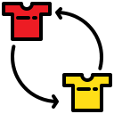
Threat of substitute products and services
This threat can occur from established or new companies. Smart digital products and services are creating new opportunities for substitution as they can offer increased product capabilities. As a result, smart products can offer superior performance.
Threat of substitute products and services
chapter 1

Slide 36

Threat of new entrants
In the past it was argued that new entrants could benefit from low operating costs and therefore were able to challenge the market. The logic behind the argument is that these new entrants have been able to enter the market rapidly since they do not have the cost of developing and maintaining a distribution network to sell their products and these products do not require a manufacturing base. However, to succeed, new entrants need to be market leaders in executing marketing and customer service. These are sometimes described as barriers to success or hygiene factors rather than barriers to entry. But new entrants in the digitally connected world are now being challenged by high costs associated with developing complex connected and integrated products and services. barriers to entry increase when highly agile tech firms are able to leverage first-mover advantage (based on their superior capabilities and resources). But barriers can go down when completely new digital products and services bypass the existing incumbents in a market.
chapter 2
Threat of new entrants

Slide 37

Intensity of rivalry
The nature of the rivalry between the companies trading online is largely determined by the number of players in a market and their relative sizes, the structure of costs and pricing, the switching costs customers will encounter if they change, strategic objectives and exit barriers. The flexibility and scope for smart digital products creates opportunities for firms to differentiate from the competition and to offer a greater range of value-added services, which heats up the intensity of the rivalry. Tailored and specialized goods and services can also increase the opportunity to delight target customers and again cause friction between firms providing similar products. Smart-connected products often span traditional product boundaries and firms can find themselves competing in completely new markets.
By using the five forces model for analyzing the structure and nature of the competition, digital marketers can gain insights into how firms compete in a particular marketplace. However, it is important to be aware that actions have consequences - for example, the introduction of a new feature or service may stimulate a response from a competitor. Therefore, the next step for the digital marketer is to develop understanding of their competitors and how they might respond. But this is becoming a complex exercise as the boundary lines between products services and firms are blurring. the competitive boundaries are expanding to encompass sets of related products as a consequence the 'basis of competition thus shifts from the functionality of a discrete product to the performance of a broader product system'. But these authors also remind us that it is important not to lose sight of the end user-for example, adding functionality that buyers don't want to pay for doesn't add value.
chapter 2
Intensity of rivalry

Slide 38


Thank You

