Slide 1

E-Commerce
Prepared by Dr. Adam Yagoub
Lecture 7
MGM 212
E-marketing.

Slide 2
Lecture 7
Course Outline
Lecture 1: Introduction to e-business and e-commerce.
Lecture 2: E-commerce fundamentals.
Lecture 3: E-business infrastructure.
Lecture 4: - E-environment.
Lecture 5: E-business strategy.
Lecture 6: E-procurement.
Lecture 7: E-marketing.
Lecture 8: Customer relationship management.
Lecture 9: Analysis and design.
Lecture 10: Implementation and maintenance.

Slide 3
Lecture 7
Lecture Outline
1. Introduction.
2. What is e-marketing?
3. E-marketing planning.
4. Situation analysis.
5. Objective setting.
6. Strategy.
7. Characteristics of new-m Focus on edia marketing communications.
8. Tactics.
9. Online branding.
10. Actions.
11. Control.

Slide 4
Lecture 7
Learning Outcomes
After completing this chapter the student should be able to:
1. Assess the need for separate e-business and e-marketing strategies.
2. Create an outline e-marketing plan intended to implement the e- marketing strategy.
3. Distinguish between marketing communication characteristics of traditional and new media.

Slide 5
Lecture 7
E-marketing.
1. Introduction:
In this chapter we examine e-marketing strategy and planning separately since in many organizations, a distinct e-marketing plan will often be developed by the marketing or e-commerce team. The e-marketing or Internet marketing plan will help define specific e-marketing objectives and develop strategies to ensure that resources are deployed to take advantage of the marketing opportunities provided by the Internet, and to counter its threats.

Slide 6
Lecture 7
E-marketing.
E-marketing is focused on how a company and its brands use the web and other digital media such as e-mail and mobile media to interact with its audiences in order to meet its marketing goals. Figure 8.1 shows that there are three main operational processes involved in e-marketing. These are:

Slide 7
Lecture 7
E-marketing.
1. Customer acquisition. Attracting visitors to a web site or promoting a brand through reaching them via search engines or advertising on other sites.
2. Customer conversion. Engaging site visitors to achieve the outcomes the site owner seeks such as leads, sales or browsing of other content. Developing a satisfactory customer experience is vital to this.
3.Customer retention and growth. Encouraging repeat usage of digital channels and for transactional sites, repeat sales.

Slide 8
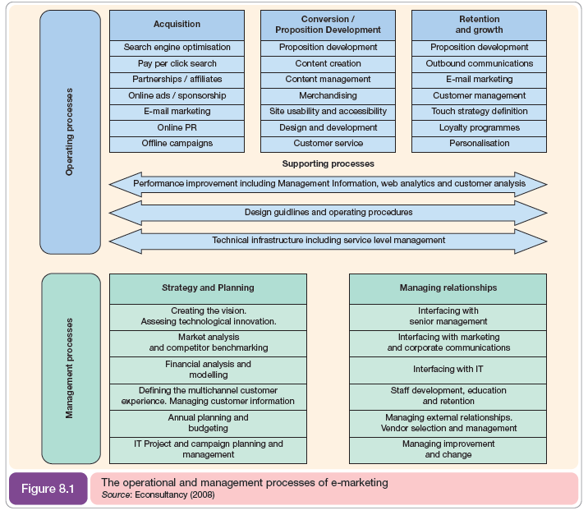

Slide 9
Lecture 7
E-marketing.
2. What is e-marketing?
Internet marketing has been described simply as ‘achieving marketing objectives through applying digital technologies’. This succinct definition helps remind us that it is the results delivered by technology that should determine investment in Internet marketing, not the adoption of the technology! These digital technologies include Internet media such as web sites and e-mail as well as other digital media such as wireless or mobile and media for delivering digital television such as cable and satellite.

Slide 10
Lecture 7
E-marketing.
- Marketing defined
As with many terms with the ‘e’ prefix, we need to return to an original definition of the topic to more fully understand what e-marketing involves. The definition of marketing by the UK’s Chartered Institute of Marketing is:
the management process responsible for identifying, anticipating and satisfying customer requirements profitably.

Slide 11
Lecture 7
E-marketing.
- E-marketing defined
The term 'Internet marketing’ tends to refer to an external perspective of how the Internet can be used in conjunction with traditional media to acquire and deliver services to customers. An alternative term is ‘e-marketing’ which can be considered to have a broader scope since it refers to any use of technology to achieve marketing objectives and has an external and an internal perspective. This is more consistent with the concept of e-business which involves managing both internal and external communications.

Slide 12
Lecture 7
E-marketing.
- Distinguishing between e-marketing, e-business and e-commerce
Given that the marketing concept implies a broad meaning for marketing, how can we distinguish between e-business and e-marketing? We can use a similar device to that to help distinguish between them. The options are:

Slide 13
Lecture 7
E-marketing.
1. Electronic business has some degree of overlap with electronic marketing. From the discussion of the marketing concept above we can reject this since both e-business and e-marketing are broad topics.
2. Electronic business is broadly equivalent to electronic marketing. This is perhaps more realistic, and indeed some marketers would consider e-business and e-marketing to be synonymous.

Slide 14
Lecture 7
E-marketing.
3. Electronic marketing is a subset of electronic business. It can be argued that this is most realistic since e-marketing is essentially customer-oriented and it has less emphasis on supply chain and procurement activities in comparison with e-business.

Slide 15
Lecture 7
E-marketing.
What Are the Types of E-commerce Marketing?
E-commerce marketing spans virtually all digital marketing channels as well as some offline, traditional ones:
1. Search engines.
2. Social media.
3. Email marketing.

Slide 16
Lecture 7
E-marketing.
4. SMS.
5. On-site.
6. Owned media like blogs.
7. Non-owned online publications and podcasts.
8. Offline marketing e.g. print, TV spots.

Slide 17
Lecture 7
E-marketing.
3. E-marketing planning:
An e-marketing plan is needed in addition to a broader e-business strategy to detail how the sell-side specific objectives of the e-business strategy will be achieved through marketing activities such as marketing research and marketing communications. Since the e-marketing plan is based on the objectives of the e-business or business strategy there is overlap between the elements of each approach, particularly for environment analysis, objective setting and strategic analysis. Figure 8.2 shows how e-marketing activities will inform the e-business strategy which, in turn, will inform the e-marketing plan.

Slide 18
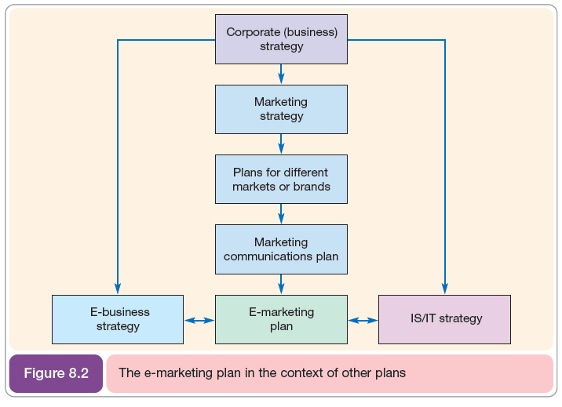
Lecture 7
E-marketing.

Slide 19
Lecture 7
E-marketing.
4. Situation analysis:
The aim of situation analysis is to understand the current and future environment in which the company operates in order that the strategic objectives are realistic in light of what is happening in the marketplace. Figure 8.5 shows the inputs from situation analysis that inform the e-marketing plan. These mainly refer to a company’s external environment.

Slide 20
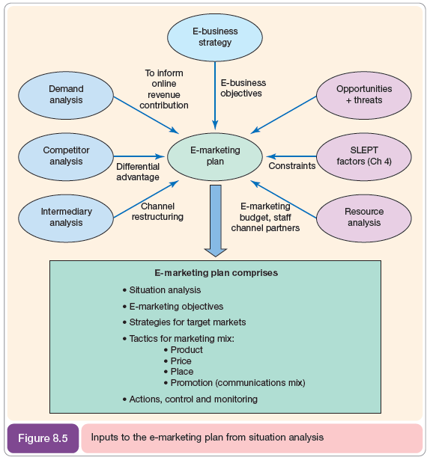
Lecture 7
E-marketing.

Slide 21
Lecture 7
E-marketing.
- Demand analysis
A key factor driving e-marketing and e-business strategy objectives is the current level and future projections of customer demand for e-commerce services in different market segments. This will influence the demand for products online and this, in turn, should govern the resources devoted to different online channels. Demand analysis examines current and projected customer use of each digital channel and different services within different target markets.

Slide 22
Lecture 7
E-marketing.
- Qualitative customer research
It is important that customer analysis not be restricted to quantitative demand analysis. Variani and Vaturi, point out that qualitative research provides insights that can be used to inform strategy. They suggest using graphic profiling, which is an attempt to capture the core characteristics of target customers, not only demographics, but also their needs and attitudes and how comfortable they are with the Internet.

Slide 23
Lecture 7
E-marketing.
- Competitor analysis
Competitor analysis or the monitoring of competitor use of e-commerce to acquire and retain customers is especially important in the e-marketplace due to the dynamic nature of the Internet medium. This enables new services to be launched and promotions changed much more rapidly than through print communications.

Slide 24
Lecture 7
E-marketing.
Benchmarking of competitors’ online services and strategy is a key part of planning activity and should also occur on an ongoing basis in order to respond to new marketing approaches such as price or promotions. According to Chaffey et al, competitor benchmarking has different perspectives which serve different purposes:
1. Review of internal capabilities: such as resourcing, structure and processes vs external customer facing features of the sites.
2. From core proposition through branding to online value proposition (OVP). The core proposition will be based on the range of products offered, price and promotion.

Slide 25
Lecture 7
E-marketing.
3. Different aspects of the customer lifecycle: customer acquisition, conversion to retention.
4. Qualitative to quantitative: from qualitative assessments by customers through surveys and focus groups through to quantitative analysis by independent auditors of data across customer acquisition.

Slide 26
Lecture 7
E-marketing.
5. In-sector and out-of-sector: benchmarking against similar sites within sector and reviewing out of sector to sectors which tend to be more advanced.
6. Financial to non-financial measures. Through reviewing competitive intelligence sources such as company reports or tax submissions additional information may be available on turnover and profit generated by digital channels.
7. From user experience to expert evaluation. Benchmarking research should take two alternative perspectives, from actual customer reviews of usability to independent expert evaluations.

Slide 27
Lecture 7
E-marketing.
5. Objective setting:
Effective e-marketing plans are based on clearly defined objectives since these will inform the strategies and tactics and help in communicating the strategic aims to the workforce and investors.
Strategies are agreed to be most effective when they support specific business objectives. A useful technique to help align strategies and objectives is to present them together in a table together with the insight developed from situation analysis which may have informed the strategy.

Slide 28
Lecture 7
E-marketing.
6. Strategy:
The strategy element of an e-marketing plan defines how e-marketing objectives will be achieved. Strategy definition has to be tightly integrated into the e-marketing planning process since e-marketing planning is an iterative process from situation analysis to objective setting to strategy definition.

Slide 29
Lecture 7
E-marketing.
Another perspective on e-marketing strategy is provided by Econsultancy who explain that the output from the digital strategy will often be a series of strategic e-commerce initiatives in the key areas of customer acquisition, conversion or retention such. These e-commerce initiatives will typically be prioritized and placed as part of a long-term e-commerce ‘roadmap’ defining required developments over a longer period of 18 months to three years.

Slide 30
Lecture 7
E-marketing.
7. Characteristics of new-media Focus on marketing communications:
In this section, we explore the main differences between marketing communications in the traditional media such as TV, print and radio and new digital media such as web sites, interactive TV and mobile commerce. A useful summary of the differences between the new media and traditional media has been developed by McDonald and Wilson as the ‘6 Is’ of e-marketing:

Slide 31
Lecture 7
E-marketing.
1. Interactivity.
2. Intelligence.
3. Individualization.
4. Integration.
5. Industry restructuring.
6. Independence of location.

Slide 32
Lecture 7
E-marketing.
8. Tactics:
Marketing tactics to implement strategies and objectives are traditionally based around the elements of the marketing mix. There are other methods for approaching tactics that are detailed in further sections. One approach is to use customer-driven tactics that affect both the design and services provided by an e-commerce site.

Slide 33
Lecture 7
E-marketing.
9. Online branding:
What comprises a successful online brand? Is it an e-commerce site with high levels of traffic? Is it a brand with good name recognition? Is it a profitable brand? Or is it a site with more modest sales levels, but one that customers perceive as providing good service? Although sites meeting only some of these criteria are often described as successful brands, we will see that a successful brand is dependent on a wide range of factors.

Slide 34
Lecture 7
E-marketing.
Erdem et al. noted in their study into the impact of brand credibility on consumer price sensitivity, that a credible brand signal helps to generate customer value by:
(1) reducing perceived risk.
(2) reducing information search costs.
(3) creating a favorable, trustworthy perception of the organization. This shows the importance of online branding since web sites must give the impression of trust and deliver a favorable experience to encourage first-time and repeat sale.

Slide 35
Lecture 7
E-marketing.
10. Actions:
The actions component of e-marketing planning refers to activities conducted by managers to execute the plan. Questions that need to be resolved when specifying actions include:
- What level of investment in the Internet channel is sufficient to deliver these services?
- What will be the payback?

Slide 36
Lecture 7
E-marketing.
- What training of staff is required?
- What new responsibilities are required for effective Internet marketing?
- Are changes in organizational structure required to deliver Internet-based services?
- What activities are involved in creating and maintaining the web site?

Slide 37
Lecture 7
E-marketing.
11. Control:
The control element of the e-marketing plan can be achieved through a combination of traditional techniques such as marketing research to obtain customer views and opinions and novel techniques such as analysis of web-server log files that use technology to monitor whether objectives are achieved.

Slide 38

Lecture 7
E-marketing.
References:
E-Business and E-Commerce Management : strategy, implementation and practice, fourth edition.
By: dave chaffey.
Chapter 8

