Slide 1




Social Media and Crises
Lecture 7
DGM 730
Digital Activism & Monitoring Tools
Prepared by
Dr. Doaa Rady

Slide 2

Lecture
07
Lecture outline
Digital activism & Monitoring tools
What is digital activism? and who are digital activists?
How to respond to ‘radicalised’ customers or stakeholders
Prevent/Reduce Radicalisation
Social Media Escalation Plans
  Avoiding appearing as a remote and inflexible organization
Monitoring tools
  The importance of monitoring
  6 Monitoring tools: 1. Social listening, 2. Social Media Sentiment Analysis, 3. Web analytics, 4. Social Media Impression VS Reach VS Engagement, 5. Social media retention, 6. Conversation analysis
  Handle Negative Publicity on Social Media Forums

Slide 3

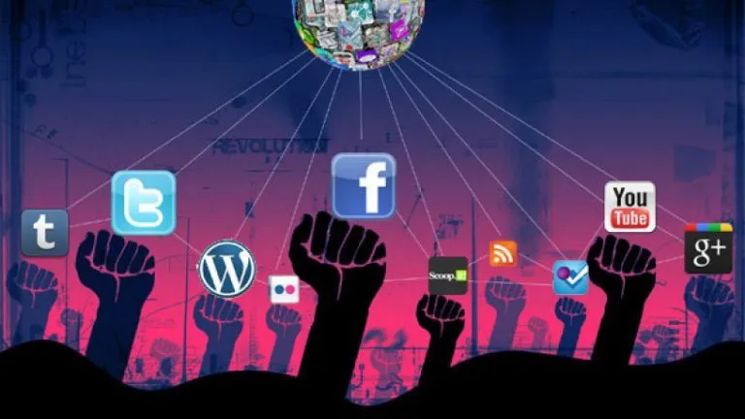
What is digital activism? and
who are digital activists?

Slide 4
Lecture
07
What is digital activism? and
who are digital activists?
Smart mobs
is a large group of people mobilized by social media to meet in a public place typically for the purpose of social or political protest.
From the early experiments of the 1980s to the modern “smart mobs” and blogs, activists and computer specialists have approached digital networks as a channel for action.
Initially, online activists used the Internet as a medium for information distribution, given its capacity to reach massive audiences across borders instantaneously.
A more-developed undertaking of digital activism used the World Wide Web as a site of protest that mirrors and amplifies off-line demonstrations. Some forms of digital activism are e-mail and social-media campaigning, virtual sit-ins, and “hacktivism” (disrupting Web sites).

Slide 5
Lecture
07
What is digital activism? and
who are digital activists?
Grassroots
is a type of movement or campaign that attempts to mobilize individuals to take some action to influence an outcome, often of a political nature.
Digital activism, also known as cyberactivism, form of activism that uses the Internet and digital media as key platforms for mass mobilization and political action.
Digital activism (D.A.) refers to political activism on the internet or political movements relying on it.
Digital activism has proved to be a powerful means of grassroots political mobilization and provides new ways to engage protesters. Additionally, online actions can be important in countries where public spaces are highly regulated or are under military control. In such cases, online actions are a better option than possibly physically dangerous “live” actions. E.G. The Arab Spring
Cyberactivism is the process of using Internet-based socializing and communication techniques to create, operate and manage activism of any type.;
social media for social change refers to social software applications

Slide 6
Lecture
07
What is digital activism? and
who are digital activists?
Although much digital activism falls into the category of electronic civil disobedience, some activists ask that such online political gestures always represent a communal interest and not an individual agenda and that their motifs and agents be public knowledge so as to dissociate them from acts of cyberterrorism or criminal hacking.
Different digital tactics entail diverse uses of electronic networks. Text-based practices include e-mail campaigns, text messaging, Web postings, and online petitions to advocate for a specific cause. In Web defacing or “cybergraffiti”, a more-complex text-based online practice, hacktivists alter the home page of an organization.

Slide 7
Lecture
07
What is digital activism? and
who are digital activists?
More-performative actions, such as virtual sit-ins and e-mail bombs, provoke a concrete disruption of the servers’ functionality through the concerted action of participants around the world. Virtual sit-ins are a form of online demonstration in which a networked community gathers on one or several sites to carry out an act of digital dissent.
The action is undertaken through a Web-based program that sends repetitive requests to the targeted Web pages. The protesters’ automated “clickings,” simultaneously enacted from multiple computers around the world, provoke such an excess of traffic that the targeted site’s server is unable to handle it. By clogging the bandwidth, the action slows down the site and eventually causes it to shut down.

Slide 8
Lecture
07
What is digital activism? and
who are digital activists?
Independent activists over the world are using the internet and digital tools to build their community, connect with other similar-minded people outside their physical surroundings as well as lobby, raise funds and organise events.
D.A. includes research and documentation activities. These may be used by activists as a precursor to information dissemination and may consist of any type of human rights abuse documentation or citizen reporting, directly (for instance via mobile phones)
While an online post does not in itself carry significant risks, activists have been persecuted based on their online activities, (e.g. Arab Spring, Hong Kong protests, …). As such, the consequences of clicking do carry physical risks, although these may appear somewhat later than is the case with live street protests.

Slide 9
Lecture
07
What is digital activism? and
who are digital activists?
The tools used by digital activists are vast and changing constantly as technology evolves.
Online petitions. Websites such as Change.org, ipetitions.org, Avaaz.org are hubs of online activism, where people can communicate with others worldwide regarding their cause.
Social networks. Sites with high usage numbers such as Facebook and YouTube have proven beneficial in spreading a message, garnering support, shining information on a subject that might otherwise be overlooked by mainstream media. Protests in 2011 in Tunisia and Egypt against their respective governments were in part organised and promoted via Facebook. Social media also played a role in mobilising people in Hong Kong’s pro-democracy protests in 2019.

Slide 10
Lecture
07
What is digital activism? and
who are digital activists?
Blogs. Essentially a form of citizen journalism for the masses, blogs provide an effective means of non-filtered communication with an audience about any topic and have been used in numerous online campaigns.
Micro-blogging. Micro-blogging sites such as Twitter are used to help spread awareness of an issue or activist event. Twitter’s hashtag function, which allows people to have their tweets contribute to a multi-user conversation by typing a keyword or phrase preceded by a hashtag, is used frequently as a digital tool for spreading a message. The Chinese equivalent to Twitter is Weibo.

Slide 11
Lecture
07
What is digital activism? and
who are digital activists?
Proxy servers. As means of circumventing government intervention when it comes to online protesting, many people employ proxy servers, which act as intermediaries between a user and a site.
Crowdsourcing platforms. Using the internet to distribute problem-solving and resource acquisition, these platforms help individuals and initiatives to mobilize a global community and create collaboration opportunities between groups of (otherwise) unconnected people. Wikipedia is a good example, as well as popular collective funding platforms such as Kickstarter and Indiegogo.

Slide 12

How to respond to ‘radicalised’ customers or stakeholders?

Slide 13
Lecture
07
How to respond to ‘radicalised’ customers or stakeholders?
Radicalisation is the process by which a person comes to support terrorism and extremist ideologies. If you are worried someone close to you is becoming radicalised act early and seek help. The sooner you reach out, the quicker the person you care about can be protected from being groomed and exploited by extremists.
Radicalisation as a concept does not mean the same to everyone and to every institution or country, and does not impact individuals in the same way either. It is therefore a challenge to design effective public policies which address the issue in a consistent manner and ensure safety and security for all.

Slide 14
Lecture
07
How to respond to ‘radicalised’ customers or stakeholders?
To define radicalization: It is a process by which individuals or groups come to embrace attitudes, or engage in actions, that support violence in the pursuit of extremist causes.
It is a profoundly social phenomenon. It focuses on environments in which radicalisation messages are found, rather than terrorist events or individuals. Its focus is not individual profiles and trajectories but the process and meaning of engagement with radicalisation for individuals (in context). It envisages radicalisation as a phenomenon that is complex (not linear); situational (emerging as the outcome of interaction, including choice); emotional (as well as ideological); dynamic (spatially and temporally); and also looks at online radicalisation, which is the most common outcome of encounters/engagement with radical ideology.

Slide 15
Lecture
07
How to respond to ‘radicalised’ customers or stakeholders?
What can trigger someone to become radicalised?
Sometimes there is a significant event or incident that can trigger a person and make them more receptive to extreme views. It can take multiple forms and include:
A personal crisis like losing a job
Not getting a job
The feeling of being left behind, alienated or apart from everyone else
Or it can be triggered by an outside event, like a terror attack here or in another country

Slide 16
Lecture
07
How to respond to ‘radicalised’ customers or stakeholders?
Radicalisation as a four-stage process
1) Pre-radical: The person joins or identifies with a group or organisation
2) Self-identify: The person believes and accepts the beliefs and views held by the group or organization
3) Indoctrination: The person is groomed by the group or organisation pulling them further down the pathway
4) Terrorism: The person becomes involved in committing terrorist acts

Slide 17
Lecture
07
How to respond to ‘radicalised’ customers or stakeholders?
Propaganda and extremist content online
Radicalisers are using the internet to target, persuade and recruit vulnerable people. They do this by posting extreme and often violent images, messages, speeches and videos on social media, private messaging platforms, gaming platforms and forums.
They use a number of tactics to recruit people including actively spreading fake news, which has been created to exploit people’s worries and insecurities. They will also look to distort news stories about unemployment or homelessness for example, and start to build their own narrative around it.

Slide 18
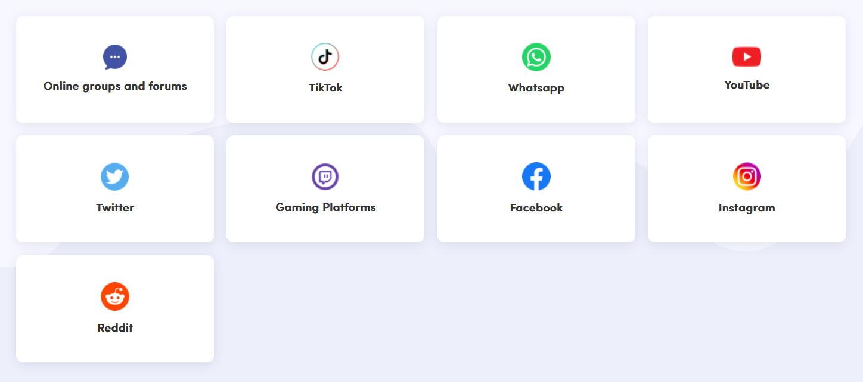
Lecture
07
How to respond to ‘radicalised’ customers or stakeholders?
What online channels are used to target vulnerable people online?
Extremists use lots of different channels to try to connect with someone who they think could be vulnerable and persuadable. They will look at posts/tweets, likes and shares and social media profiles and friend lists to identify people to target.

Slide 19

Prevent/Reduce Radicalisation

Slide 20
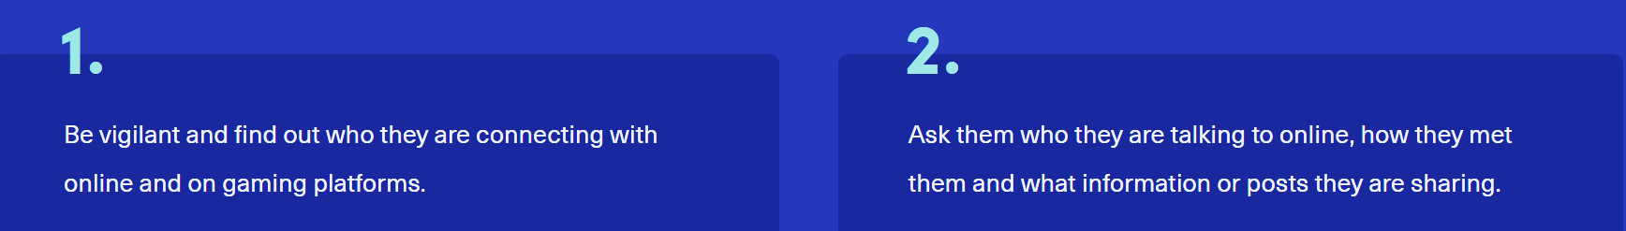
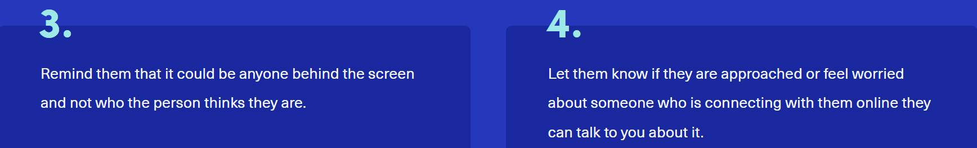
Lecture
07
Prevent/Reduce Radicalisation
How can you reduce the risk of someone becoming radicalised?
Radicalisers try to create a bubble of social isolation, so no one can contradict the narrative they are telling the person. But there are steps you can take to help stop them from being drawn in.

Slide 21
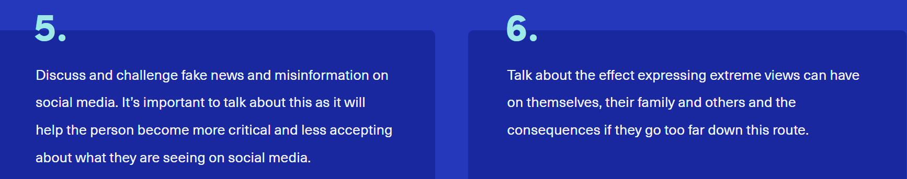
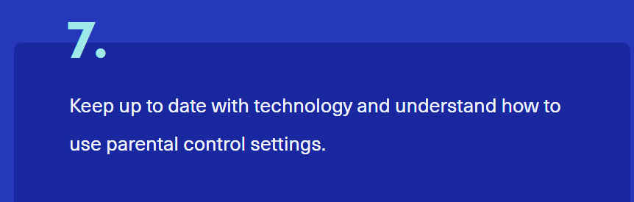
Lecture
07
Prevent/Reduce Radicalisation
How can you reduce the risk of someone becoming radicalised?

Slide 22
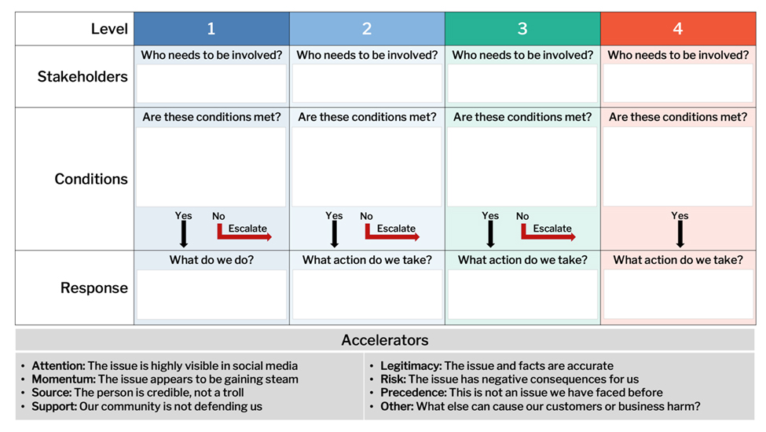
Social Media Escalation Plans

Slide 23
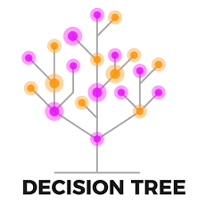
Lecture
07
Social Media Escalation Plans
The purpose of a Social Media Escalation plan is to determine when an issue has reached a point where it needs to be addressed with more gravity.
It is an important decision-making mechanism to document so that everyone has a shared understanding of how to respond quickly when different issues arise.
While issue management is not new, marketers often need to create escalation plans for social media given how influential comments and posts can be on brand reputation. Escalation plans align teams on the conditions that need to be met to involve more senior stakeholders for greater authority and support. Social Media Escalation plans can be created using different formats, including decision trees. Use the format this is most clear and relevant for you.

Slide 24
Lecture
07
Social Media Escalation Plans
How do we address urgent issues in social media?
  Steps
Meet with senior stakeholders to identify the types of issues that represent the highest levels of risk for your organization. What may cause long-term harm? These issues will be unique to your organization.
Explore how these ‘hot button’ issues may manifest themselves in social media. What might be posted or shared? Assign a level of severity to each of these issues and group together. These represent Levels.
Review the issues for each Level and discuss the response(s) that you should take. Determine the threshold for when you need to involve more senior stakeholders for even greater authority or support.

Slide 25
Lecture
07
Social Media Escalation Plans
How do we address urgent issues in social media?
  Steps
Capture the Stakeholders, Conditions, and Response for each Level in your Plan. Consider how any of the issue Accelerators listed below may change how you respond or escalate the specific issue.
Review the final Social Media Escalation Plan with all stakeholders for final feedback and alignment. Consider stress-testing your plan by running a few practice drills to see if escalation can be properly supported.

Slide 26
Lecture
07
How to respond to ‘radicalised’ customers or stakeholders?
Avoiding appearing as a remote and inflexible organization
Deep Learning (DL) has the potential to improve social media analysis in crises situations because of its ability to learn patterns from unlabelled data. This property has enabled DL to produce breakthroughs in the domain of image, text and speech recognition.
Social media has become an open crises communication medium. There is no doubt that valuable, high throughput data is produced on social media only seconds after a crisis occurs. However, processing and inferring valuable knowledge from such data are difficult for several reasons. The messages are typically brief, informal, and heterogeneous (mix of languages, acronyms, and misspellings) with varying quality, and it is often required to know the context of the message to understand its meaning.

Slide 27
Lecture
07
How to respond to ‘radicalised’ customers or stakeholders?
Avoiding appearing as a remote and inflexible organization
  Supervised learning
In order to classify a social media message as part of one particular crisis event, several features related to the message need to be used, including the nature of the message (factual, emotional or subjective), the information provided, the information source, credibility, time and location.
From the message examples, the supervised learning algorithm learns a predictive function (representing the relation between the features and particular crisis) so that it can classify any new unknown message as part of one of the categories of crises. As example, the tag \breaking news" and \news" can be used to identify breaking news tweets

Slide 28
Lecture
07
How to respond to ‘radicalised’ customers or stakeholders?
Avoiding appearing as a remote and inflexible organization
  Unsupervised learning
Unsupervised methods are used to identify patterns in unlabelled data. They are most useful when the information seekers do not know specifically what information to look for in the data - which is the case in many crises situations. An example is grouping tweets into stories (clusters of tweets) after a keyword filter.
  Deep Learning
Imitating the efficiency of the human brain has been a huge challenge for the artificial intelligence field. The emergence of DL has fueled a paradigm shift and made it a more achievable goal. DL is a machine learning technique with its roots in Neural Networks that allows learnt models composed of multiple processing layers so that the knowledge state has several layers of abstraction.

Slide 29
Lecture
07
How to respond to ‘radicalised’ customers or stakeholders?
Avoiding appearing as a remote and inflexible organization
  Social Media Analysis
This is an approach to improve the social media analysis in crises situations to achieve better understanding and decision support during a crisis. The approach consists of moving from low to high level of abstraction. We plan to proceed from: Using DL to transform non-standard words into their canonical form (1). Then, understand the semantic of the text (2). Finally, provide an overview of a crisis development (3).

Slide 30
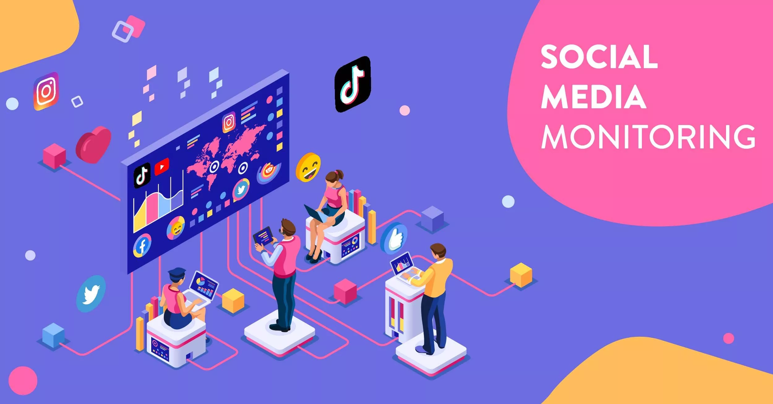
Monitoring Tools

Slide 31
Lecture
07
Monitoring Tools
The importance of monitoring
There is no denying that social media can be used for both virtuous and dreadful things.
What must be kept in perspective is that these technological tools can be used as defensive tactics just as they can be used in an offensive manner. Organizations familiar with the use of these social media sites are aware that these new channels of communication have unlimited capability in monitoring the communication of an organization internally as well as externally.

Slide 32
Lecture
07
Monitoring Tools
The importance of monitoring
1. Build a strong brand
  Media monitoring helps you to see what people think about your brand. Media monitoring enables you to spot any misconceptions so you can take action to correct them.
2. Manage your reputation and respond to crisis situations
  The monitoring tool will notify you as soon as your brand is mentioned in journalistic or social media. You can even set up app notifications for certain words that would indicate a crisis.
3. Elevate your brand with key opinion leaders
  Key Opinion Leaders (KOLs) are thought leaders whose opinions are valued in a specific industry. Cooperation with the right influencer can skyrocket your brand awareness and boost your sales.
  Media monitoring helps you to follow the experts, bloggers, “gurus” and advocacies in your business and find the best fit for your brand.
Guru is a person that is generally recognized as a leader or teacher. from gurū, a word in Hindi

Slide 33
Lecture
07
Monitoring Tools
The importance of monitoring
4. Know your industry and competitors
  Media monitoring is a way to find out about the latest developments in your industry: recognize future trends and predict possible spikes in demand for your products and services. Also, it lets you discover who your competitors are and what they are doing useful in your own brand work.
5. Measure the effectiveness of your communications
  Media monitoring is a great strategic tool to measure and improve the effectiveness of your communications. Media monitoring data works as a reliable source for decision-making.
6. Find ideas for new content
  It’s important to create fresh content constantly. Media monitoring helps you stay inspired. Set up a monitor of your industry to see what topics are trending on a general level. If you already have a topic in your mind, try following related keywords. You can also use your opponents’ ideas as a source of inspiration or as a warning for what doesn’t work.

Slide 34
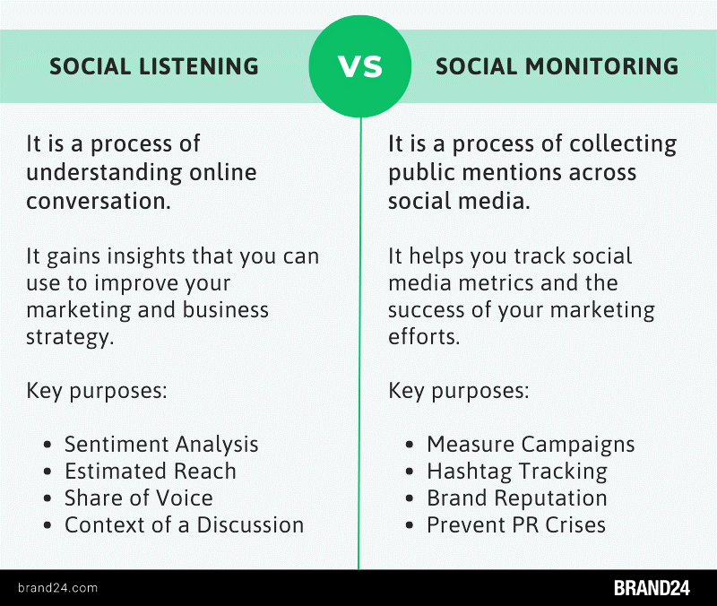
Lecture
07
1. Social listening
The social media monitoring based on using the right tool that allow companies to track and analyze conversations initiated by their audience on social media.
Social media monitoring tools even give businesses chance to win back lost customers. The quicker you respond in a meaningful way, the more likely it is that you’ll turn unhappy clients into brand advocates.

Slide 35
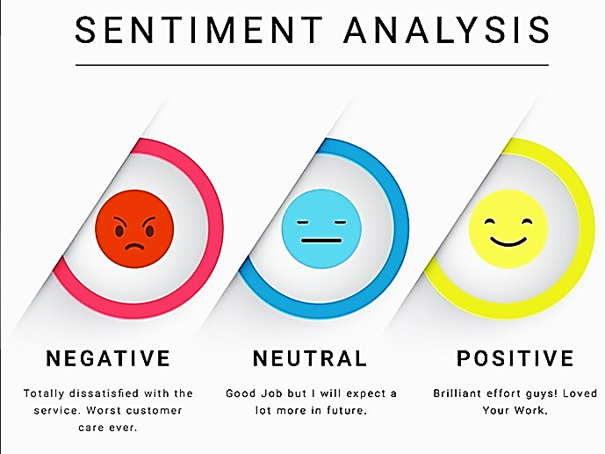
Lecture
07
2. Social Media Sentiment Analysis
Social media sentiment analysis is a process of interpreting a customer’s feeling toward a brand, product, or service, by usually done by using sentiment analysis tools.
Social sentiment analysis involves tracking brand mentions and analyzing the collected text data.
Sentiment analysis is an artificial intelligence (AI)-based capability that uses machine learning to recognize sentiments and assess the emotional content of texts and images.

Slide 36

Lecture
07
3. Web analytics
Web analytics is the process of analyzing the behavior of visitors to a website. This involves tracking, reviewing and reporting data to measure web activity, including the use of a website and its components, such as webpages, images and videos.
Web analytics is the collection, reporting, and analysis of website data.
The focus is on identifying measures based on your organizational and user goals and using the website data to determine the success or failure of those goals and to drive strategy and improve the user’s experience.

Slide 37
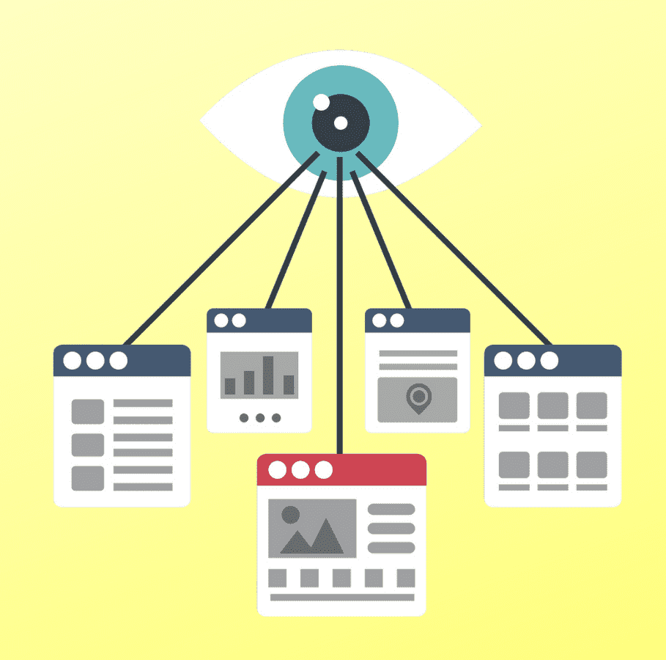
Lecture
07
4. Social Media Impression VS Reach VS Engagement
Social Media Impression
The total number of times your content or ad is displayed is called ‘impressions.’ ‘Impressions’ don’t count the number of people who have interacted with or clicked on the content. It just measures the number of times that the ad or content gets displayed on someone’s social media.
For example, you could run a Facebook video ad campaign. It doesn’t even have to start playing for Facebook to count your video ad as an impression. It only needs to appear in someone’s feed, even if the user scrolls right past it.

Slide 38
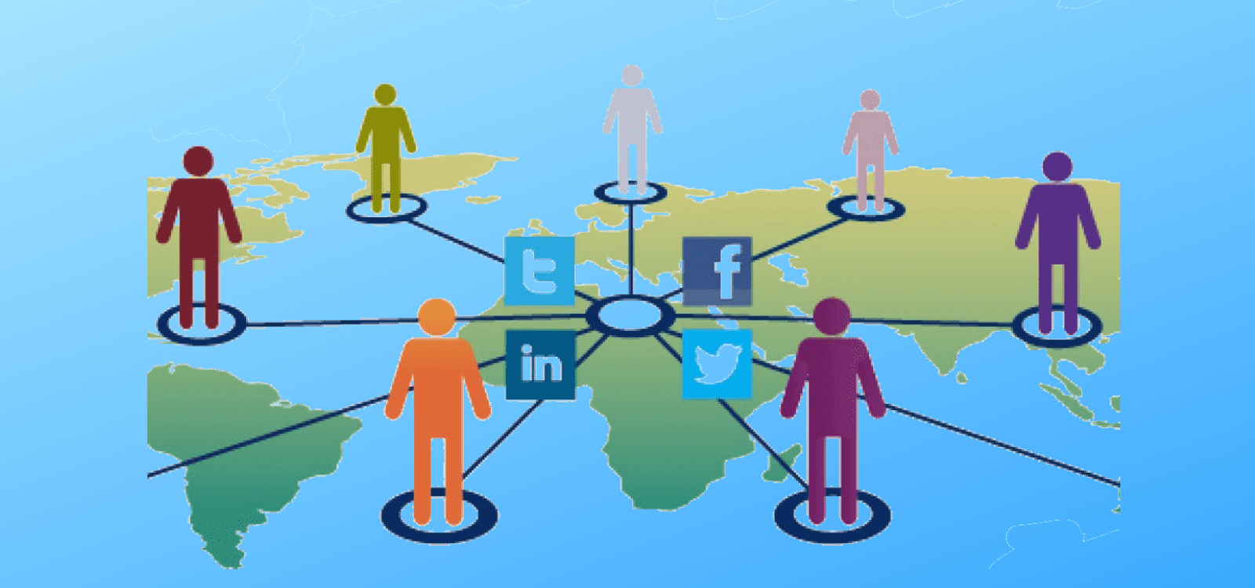
Lecture
07
4. Social Media Impression VS Reach VS Engagement
Social Media Reach
The total number of people who see your content is known as ‘reach.’ Consider ‘reach’ to be the number of distinct people who see your content. If 100 people have seen your ad, it has a total ‘reach’ of 100.
The reach of an advertisement will always be equal to or less than the number of impressions. Assume you have an ad shown to 300 users 500 times on a screen. Your reach would be 300 people. Some of those users may have seen your advertisement only once, while others may have seen it several times.

Slide 39
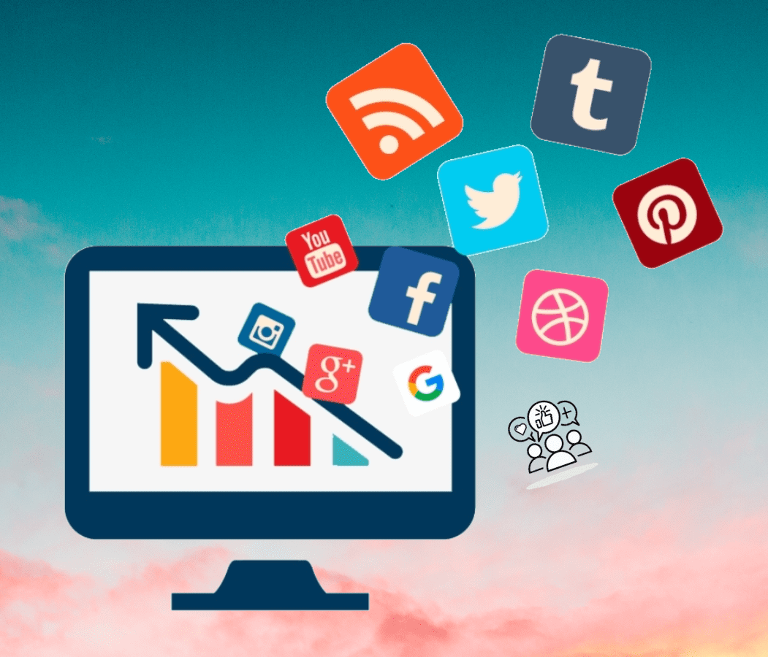
Lecture
07
4. Social Media Impression VS Reach VS Engagement
Social Media Engagement
Engagement outshines impressions and reaches in how valuable a piece of content is. The amount of time people spend interacting with your social media accounts and content is known as social media engagement. It calculates the number of public shares, likes, and comments received by your company’s social media efforts.
As you can see, engagement is the only metric that indicates a user is interacting with a piece of content.

Slide 40
Lecture
07
4. Social Media Impression VS Reach VS Engagement
What should you prioritize: impressions, reach, or engagement?
When running your social media strategies, you should monitor all three metrics: impressions, reach, and engagement. Why?
Impressions show that your ad is running smoothly and that the network believes it is appropriate to show to the users you’re targeting.
Reach enables you to determine how many times users must see your ads before acting on them.
Engagement indicates whether or not your content is being received favorably by users.

Slide 41

Lecture
07
5. Social media retention
Retention
Customer retention is the process of engaging existing customers to continue doing business with you and stop switching to your competitor.
Social media retention rate is the percentage of customers who continue to buy from you or interact with you over a given period of time, as influenced by your social media activities. It reflects how well you retain and engage your social media audience.
Social media customer lifetime value (CLV) is the estimated net profit that a customer generates for your business over their entire relationship with you, as influenced by your social media activities.

Slide 42
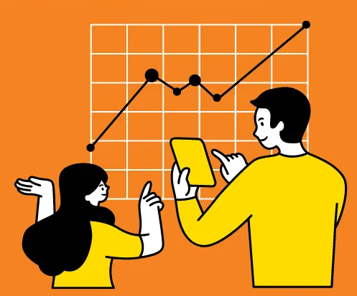
Lecture
07
6. Conversation analysis
Social Media Conversation analysis
We analyse the conversations online users have on social media. By examining people’s interactions online, we can gain valuable insights into their perception of a brand or a social issue, for example.
Conversational analysis usually happens through the use of AI, natural language processing, machine learning, and algorithms.
While social listening monitors mostly opinions and sentiment, the conversational analysis focuses on interpreting the data. E.G. Understand the reasons behind negative or positive comments.

Slide 43

Lecture
07
Handle Negative Publicity on Social Media Forums
Handle Negative Publicity on Social Media Forums
Be sincere and transparent
Correct any false Information
Interact directly with your customers
Make yourself available and visible
Use social media management software (CRM: customer relationship management)
Utilise social media listening to get ahead
Address the situation
Use Positive PR to regain your audience’s trust

Slide 44
Lecture
07
Conclusion
Digital activism & Monitoring tools
What is digital activism? and who are digital activists?
How to respond to ‘radicalised’ customers or stakeholders
Prevent/Reduce Radicalisation
Social Media Escalation Plans
  Avoiding appearing as a remote and inflexible organization
Monitoring tools
  The importance of monitoring
  6 Monitoring tools: 1. Social listening, 2. Social Media Sentiment Analysis, 3. Web analytics, 4. Social Media Impression VS Reach VS Engagement, 5. Social media retention, 6. Conversation analysis
  Handle Negative Publicity on Social Media Forums

Slide 45
Lecture
07
Recommended Reference
Joyce, M. (2010). Digital Activism decoded: The New Mechanics of Change. Open Society Foundations. https://www.opensocietyfoundations.org/publications/digital-activism-decoded-new-mechanics-change
Lazreg, M., Goodwin, M., & Granmo, O.-C. (2016). Deep learning for social media analysis in crises situations - liu. The 29th Annual Workshop of the Swedish Artificial Intelligence Society (SAIS). https://ep.liu.se/ecp/129/004/ecp16129004.pdf
Wedlock, B. C. (2012, May). (dissertation). The diffusion of social media in public relations: Use of social media in crisis response strategies. ProQuest. Retrieved May 2023, from https://www.researchgate.net/publication/295547824_The_Diffusion_of_Social_Media_in_Public_Relations_Use_of_Social_Media_In_Crisis_Response_Strategies.
Katarzyna. (2023, February 10). What is social listening? Quick, Easy Guide for 2023: Brand24. Brand24 Blog. https://brand24.com/blog/what-is-social-listening/
Social Monitoring. Sprout Social. (2022, June 29). https://sproutsocial.com/glossary/social-monitoring/
Prevent radicalisation. Discovery College. (2020, November 25). https://discoverycollege.co.uk/prevent/
Georgina. (2019, July 23). Radicalisation in a new light: From Security to Social Inclusion and equality. European Network Against Racism. https://www.enar-eu.org/radicalisation-in-a-new-light-from-security-to-social-inclusion-and-equality/
Admin. (2021, August 22). Radicalisation and the internet . ACT: Action Counters Terrorism. https://actearly.uk/radicalisation/online-safety/
Fuentes, M. A. (n.d.). Digital Activism. Encyclopædia Britannica. https://www.britannica.com/topic/digital-activism
Rees, A. (2013, June 8). Digital and online activism. RESET.ORG. https://en.reset.org/digital-and-online-activism/
Bergan, D. E. (2023, June 5). Grassroots. Encyclopædia Britannica. https://www.britannica.com/topic/grassroots
Social Media Escalation. Kickframe Toolbox. (2023). https://www.kickframetoolbox.com/framework/social-media-escalation
6 reasons why media monitoring is important for your business. LianaTech.com. (2022, April 4). https://www.lianatech.com/resources/blog/6-reasons-why-media-monitoring-is-important-for-your-business.html
Oliveri, S. (2023, June 20). What is social sentiment analysis and why is it important?. NetBase Quid. https://netbasequid.com/blog/what-is-social-sentiment-analysis/
Braoulias, N. (2023, July 10). What is social media sentiment analysis and how to do it?. Mentionlytics. https://www.mentionlytics.com/blog/social-media-sentiment-analysis/
Department of Health and Human Services. (2013, October 8). Web analytics basics. Usability.gov. https://www.usability.gov/what-and-why/web-analytics.html
Socinator, T. (2023, June 28). Social Media Impression vs reach vs engagement. Socinator. https://socinator.com/blog/social-media-impression-vs-reach-engagement/
www.linkedin.com. (n.d.). How do you measure the Social Media Customer Lifetime Value (CLV) and retention rate?. Social Media Measurement. https://www.linkedin.com/advice/0/how-do-you-measure-social-media-customer
Mincheva, M. (2022, October 11). How to use conversation analysis to improve your (social) media listening efforts. A Data Pro. https://adata.pro/blog/how-to-use-conversation-analysis-to-improve-your-social-media-listening-efforts/

Slide 46


Thank You

