Slide 1


leadership
Chapter 2
Everyone’s Smart
University
MGM111
Principle of Management

Slide 2

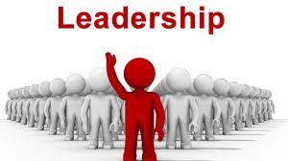
Learning Outcomes
Explain the meaning of leader ship.
IMPORTANCE OF LEADERSHIP
ROLE OF A LEADER
Types of Leadership Style
Change Leadership
Theories of Leadership
Factors Affecting Style
Characteristics of a Leader

Slide 3

Leadership
“Management is doing things right, leadership is doing the right things”
(Warren Bennis and Peter Drucker)

Slide 4

LEADERSHIP
NO EFFORT FOR QUALITY IMPROVEMENT CAN SUCCEED WITHOUT COMMITMENT OF TOP MANAGEMENT

Slide 5
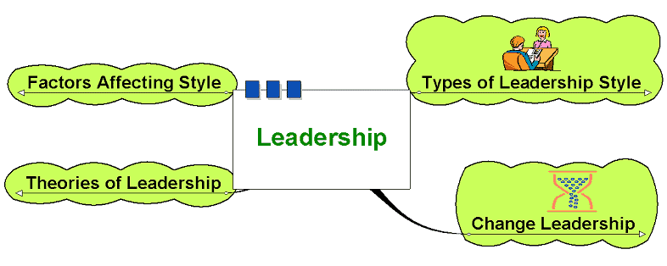
leadership

Slide 6

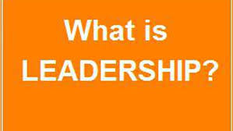
DEFINITION
“ Leadership is shifting of own vision to higher sights, the raising of man’s performance to higher standards, the building of man’s personality beyond its normal limitations.” ( Drucker)

Slide 7


WHO IS A LEADER......?
One that leads or guides.
One who is in charge or in command of others.
One who heads a political party or organization.
One who has influence or power, especially of a political nature.

Slide 8

Examples of Leaders
Leaders can be found in every day life. They range from people in charge of businesses and schools, to the people that are running our government.

Slide 9

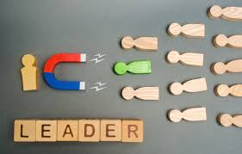
IMPORTANCE OF LEADERSHIP
Initiates action
Motivation
Providing guidance
Creating confidence
Co-ordination
Effective planning
Inspiration & motivation

Slide 10

ROLE OF A LEADER
A Leader’s role is always to ensure his/her team achieves the task in hand, but an effective leader will also ensure they meet more subtle requirement

Slide 11
leadership

Slide 12
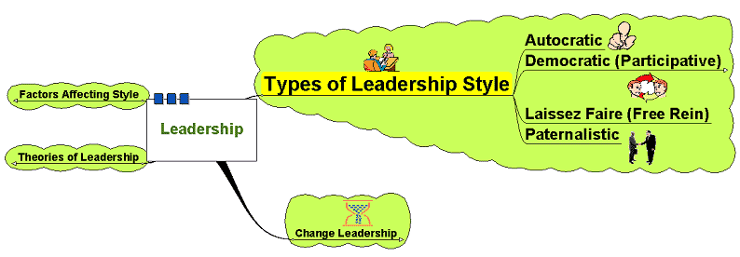
Types of Leadership Style

Slide 13


Types of Leadership Style
Autocratic:
  Leader makes decisions without reference to anyone else.
  High degree of dependency on the leader.
  Can create de-motivation and alienation
  of staff.
  May be valuable in some types of business where decisions need to be made quickly and decisively.

Slide 14

Types of Leadership Style
Democratic:
Encourages decision making
from different perspectives – leadership may be emphasised throughout
the organisation
  Consultative: process of consultation before decisions are taken
  Persuasive: Leader takes decision and seeks to persuade others that the decision
  is correct

Slide 15

Types of Leadership Style
Democratic:
  May help motivation and involvement
  Workers feel ownership of the firm and its ideas
  Improves the sharing of ideas
  and experiences within the business
  Can delay decision making

Slide 16

Types of Leadership Style
Laissez-Faire:
  ‘Let it be’ – the leadership responsibilities
  are shared by all
  Can be very useful in businesses
  where creative ideas are important
  Can be highly motivational,
  as people have control over their working life
  Can make coordination and decision making
  time-consuming and lacking in overall direction
  Relies on good team work
  Relies on good interpersonal relations

Slide 17
Types of Leadership Style
Paternalistic:
Leader acts as a ‘father figure’
Paternalistic leader makes decision but may consult
Believes in the need to support staff

Slide 18
Using all
A good leader uses all three styles, depending on what forces are involved between the followers, the leader, and the situation.
Examples:
  Using an authoritarian style on a new employee who is just learning the job.
  Using a participative style with a team of workers who know their job.
  Using a delegative style with a worker who knows more about the job than you.
  Using all three: Telling your employees that a procedure is not working correctly and a new one must be established (authoritarian). Asking for their ideas and input on creating a new procedure (participative). Delegating tasks in order to implement the new procedure (delegative).

Slide 19
Forces
These are some of the forces that influence the style to use:
  How much time is available.
  Are relationships based on respect and trust or on disrespect?
  Who has the information - you, your employees, or both?
  How well your employees are trained and how well you know the task.
  Internal conflicts.
  Stress levels.
  Type of task. Is it structured, unstructured, complicated, or simple?

Slide 20
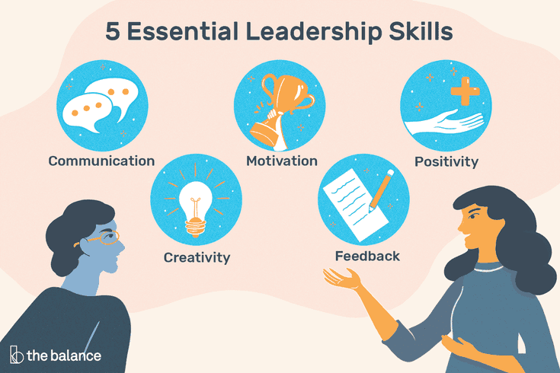

Slide 21


Slide 22
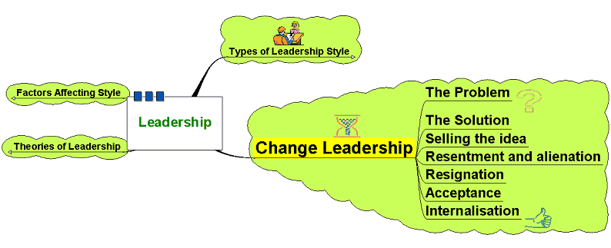
Change Leadership

Slide 23
Change Leadership
- The most challenging aspect of business is leading and managing change
-The business environment is subject to fast-paced economic and social change
-Modern business must adapt
and be flexible to survive
-Problems in leading change stem mainly from human resource management
-Leaders need to be aware of how change impacts on workers

Slide 24

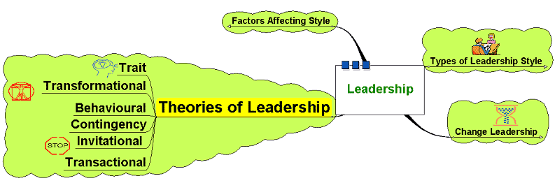
Theories of Leadership

Slide 25


Theories of Leadership
Trait theories:
Is there a set of characteristics
that determine a good leader?
  Personality?
  Dominance and personal presence?
  Charisma?
  Self confidence?
  Achievement?
  Ability to formulate a clear vision?

Slide 26

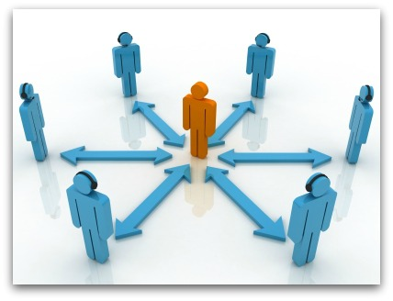
Theories of Leadership
Trait theories:
  Are such characteristics
  inherently gender biased?
  Do such characteristics
  produce good leaders?
  Is leadership more than
  just bringing about change?
  Does this imply that leaders are born not bred?

Slide 27

Theories of Leadership
Behavioural:
Imply that leaders can be trained – focus on the way of doing things
  Structure based behavioural theories – focus on the leader instituting structures – task orientated
  Relationship based behavioural theories – focus on the development and maintenance of relationships – process orientated

Slide 28
Theories of Leadership
Contingency Theories:
- Leadership as being more flexible – different leadership styles used at different times depending on the circumstance.
- Suggests leadership is not a fixed series of characteristics that can be transposed into different contexts

Slide 29

Theories of Leadership
May depend on:
  Type of staff
  History of the business
  Culture of the business
  Quality of the relationships
  Nature of the changes needed
  Accepted norms within the institution

Slide 30

Theories of Leadership
Transformational:
  Widespread changes
  to a business or organisation
Requires:
  Long term strategic planning
  Clear objectives
  Clear vision
  Leading by example – walk the walk
  Efficiency of systems and processes

Slide 31
Theories of Leadership
Invitational Leadership:
  Improving the atmosphere and message sent out by the organisation
  Focus on reducing negative messages
  sent out through the everyday actions of the business both externally and, crucially, internally
  Review internal processes to reduce these
  Build relationships and sense of belonging and identity with the organisation –
  that gets communicated to customers, etc.

Slide 32

Theories of Leadership
Transactional Theories:
  Focus on the management
  of the organisation
  Focus on procedures and efficiency
  Focus on working to rules
  and contracts
  Managing current issues
  and problems

Slide 33
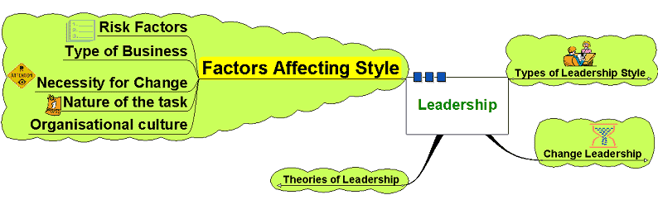
Factors Affecting Style

Slide 34

Factors Affecting Style
Leadership style may be dependent
on various factors:
  Risk - decision making and change initiatives
  based on degree of risk involved
  Type of business – creative business
  or supply driven?
  How important change is –
  change for change’s sake?
  Organisational culture – may be long embedded
  and difficult to change
  Nature of the task – needing cooperation? Direction? Structure?

Slide 35

Characteristics of a Leader
Honesty - Display sincerity, integrity, and candor in all your actions. Deceptive behavior will not inspire trust.
Competent - Your actions should be based on reason and moral principles. Do not make decisions based on childlike emotional desires or feelings.
Forward-looking Set goals and have a vision of the future. The vision must be owned throughout the organization. Effective leaders envision what they want and how to get it. They habitually pick priorities stemming from their basic values.
Inspiring - Display confidence in all that you do. By showing endurance in mental, physical, and spiritual stamina, you will inspire others to reach for new heights. Take charge when necessary.

Slide 36

Characteristics of a Leader
Straightforward - Use sound judgment to make a good decision at the right time.
Imaginative - Make timely and appropriate changes in your thinking, plans, and methods. Show creativity by thinking of new and better goals, ideas, and solutions to problems. Be innovative!

Slide 37
Managerial Leadership influences the organization in the following ways:
• Leading affects Morale
• Leading is key to effective Communication
• Leading effectively contributes more to the bottom line

Slide 38
A Leadership Story
* A group of workers and their leaders are set a task
of clearing a road through a dense jungle on a remote island to get to the coast where an estuary provides
a perfect site for a port.
* The leaders organise the labour into efficient units and monitor the distribution and use of capital assets – progress is excellent. The leaders continue to monitor and evaluate progress, making adjustments along the way to ensure the progress is maintained and efficiency increased wherever possible.
*Then, one day amidst all the hustle and bustle and activity, one person climbs up a nearby tree. The person surveys the scene from the top of the tree.

Slide 39
A Leadership Story
* And shouts down to the assembled group below…
* “Wrong Way!”
(Story adapted from Stephen Covey (2004) “The Seven Habits of Highly Effective People” Simon & Schuster).
* “Management is doing things right, leadership is doing the right things”
(Warren Bennis and Peter Drucker)

Slide 40


