Slide 1

The Cultures of New Media
Prepared by
Dr. Mohamed Owies
Lecture No.5
The Cultures of New Media

Slide 2


Lecture 5
The content of Lecture 5
The lecture 5 sheds light on a number of important topics, including the following:
The Concept of Imagined communities.
Third Places
Online versus offline community
Human Webs
Network Society
Online Social Networks
The Individual at the centre
Networked individualism

Slide 3
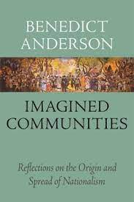
Lecture 5
The Concept of Imagined communities.
The Concept of Imagined communities:
An imagined community is a concept developed by Benedict Anderson in his 1983 book Imagined Communities to analyse nationalism. Anderson depicts a nation as a socially-constructed community, imagined by the people who perceive themselves as part of a group.

Slide 4
Lecture 5
Imagined communities
Benedict Anderson (1983) famously wrote about nations as ‘imagined communities’ and thereby wanted to underline that a sense of community relies largely on people ‘imagining’ — as in feeling, thinking, and talking about — their communities into existence.
The point he made, and one to underline here, is that the strength of a community is derived from the ways in which its members maintain the sense of their community through symbols and language.

Slide 5
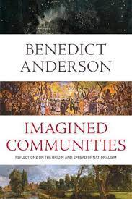
Lecture 5
Imagined communities
Anderson focuses on the way media creates imagined communities, especially the power of print media in shaping an individual's social psyche.
Anderson analyzes the written word, a tool used by authors, and media companies (notably books, newspapers, and magazines), as well as governmental tools such as the map, the census, and the museum. These tools were all built to target and define a mass audience in the public sphere through dominant images, ideologies, and language.

Slide 6
Lecture 5
Imagined communities
As most community members will never know of most of the other members, and are even less likely to meet them in person, community mainly exists in people’s minds. Social reality tends to be quite messy, but we are disposed to imagine that communities are more clearly delimited and bounded than they really are.

Slide 7

Lecture 5
Third Places
In the early 1980s sociologists Ramon Oldenburg and Dennis Brissett introduced the notion of ‘the third place’. They defined the home as people’s ‘first place’ and their workplace as the ‘second place’.
They argued that there was a decreasing range of arenas for social participation in society, and that people were stuck in an everyday loop of flitting back and forth between the two places. They wrote that: ‘Neither place, nor even the two together, seems to provide satisfying experiences and relationships for people’ (Oldenburg & Brissett 1982: 266).

Slide 8
Lecture 5
Third Places

Slide 9
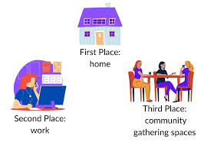
Lecture 5
Third Places
Oldenburg and Brissett (1982: 267) felt that people were in need of ‘third places’ — places outside the home and the workplace that could provide people ‘with a larger measure of their sense of wholeness and distinctiveness’.
Such third places could be, for example, coffee-houses, barber shops, gyms, libraries, parks, or streets. Oldenburg and Brissett emphasised that a simple escape from the demands of family and work — something that might historically be easier for men than for women to achieve — was not the main point for the use of these places. Rather, the goal of using third places is that they are primarily about socialising with each other. They are based on what Simmel (1950: 43) called ‘sociation’.

Slide 10
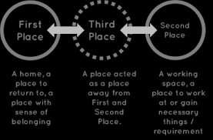
Lecture 5
Third Places
He wrote that:
Certainly, specific needs and interests make [wo]men band together in economic associations. Yet in addition to their specific contents, all these sociations are also characterized, precisely, by a feeling, among their members, of being sociated and by the satisfaction derived from this.

Slide 11
Lecture 5
Third Places
Oldenburg and Brissett (1982: 278) describe third places as creating a free space for expression. While we are taught that conflict does not belong in the family, and that we must stay balanced and professional at work, third places ‘encourage and, indeed, thrive on emotional expressiveness’. Furthermore, third places have an unpredictability and diversity Third Places In the early 1980s sociologists Ramon Oldenburg and Dennis Brissett introduced the notion of ‘the third place’. They defined the home as people’s ‘first place’ and their workplace as the ‘second place’. They argued that there was a decreasing range of arenas for social participation in society, and that people were stuck in an everyday loop of flitting back and forth between the two places. They wrote that: ‘Neither place, nor even the two together, seems to provide satisfying experiences and relationships for people’ (Oldenburg & Brissett 1982: 266).

Slide 12
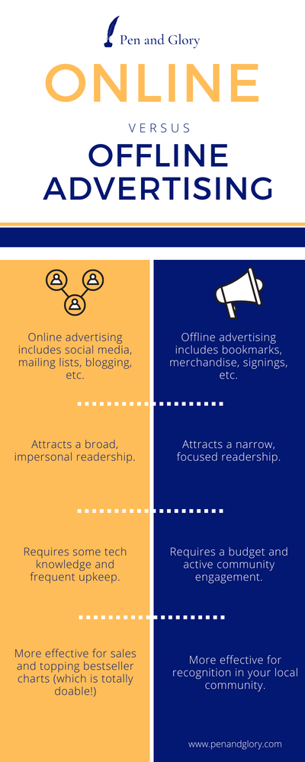
Lecture 5
Online versus offline community
Critics of theories of online communities have argued that many such perspectives are too much focused on what happens online. Because of this, the critics argue, they fail to see that most interaction that happens on the internet involves both an online and an offline component.
For example, some research has shown that while participating on the internet and in social media can increase the feeling of community online, it does not necessarily compensate for the lack of offline community (Kendall 2011: 320–321). While online communities can bring together people who share a common interest, they do not make it any easier for people to get to know others ‘in the multiplicity of their different identities’ (Calhoun 1998: 392).

Slide 13
Lecture 5
Online versus offline community
To get a complete picture, one must look at how interactions on the internet fit together with all the other parts of people’s lives. This is because computer-mediated communication does not happen in a separate reality. Rather, we bring with us all of our social baggage — our gender, our socio-economic status, our cultural resources, our age, our offline connections with others, etc. — to our online interaction with others.

Slide 14
Lecture 5
Online versus offline community
This complexity raises questions about whether ‘online community’ really is viable as a concept. On the other hand, perhaps part of the criticism fails to see what Rheingold emphasised already in 1993, that digital media breathes a new form of life into a new form of community. Perhaps digital media are not as good at resurrecting old forms of community as they are at giving rise to entirely new social forms. Some perceive online community as less ‘genuine’ than offline community, but maybe ‘our notions of the “genuine” are changing’ (Jones 1998a: 21).

Slide 15
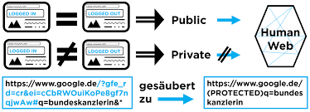
Lecture 5
Human Webs
social networks have been around as long as society has existed. This is because they are a product of the basic human desire to form various types of associations, or groups.
Historians J. R. and William McNeill (2003) have shown that ‘human webs’ have existed throughout the history of human life. First, in the form of exchange between hunter-gatherer tribes, and later, in the continuous local interaction between agricultural settlements, around 12000 years ago, and in the first metropolitan cultures, around 6000 years ago. Those connections were made through things like transportation, handling animals, and the exchange of goods.

Slide 16
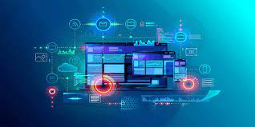
Lecture 5
Human Webs
In the last century and a half, the global web has been thickened with the increasing volume and velocity of communication and more efficient means of transport.
First, there was the evolution of a ‘mass society’ — marked by the mass audiences of early mass media — and later, a network society where the internet and social media are merely the latest technologies for making connections. Communications scholar Jan van Dijk (2006: 23) writes of this latest period of the human web:
It is no longer only quantitatively extending across the globe and becoming more voluminous, but it is also qualitatively changing the infrastructure and working of current societies. This comes to rest upon social and media networks of all kinds and at all levels of society

Slide 17
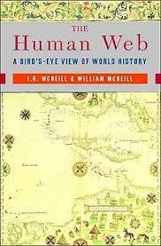
Lecture 5
Human Webs
Social network analysis as a theory and method started to gain momentum in the 1960s, and there has been a surge in such research in the last few decades. But generally, social networks are not new. Craig Calhoun (1998: 380) wrote:
The Internet is the latest wave of new communications technology to bring dramatic predictions of transformation in community and political activity. Its importance is unassailable, but we misunderstand it [...] if we exaggerate its novelty rather than situate it within a continuing series of transformations in communication and transportation capacities that have shaped the whole modem era.

Slide 18
Lecture 5
Human Webs
What Rainie and Wellman (2012) call the social network revolution is not a result of digital media. There has been a broader change in society, they argue, in how people relate to each other more generally. Throughout the last hundred years or so, people have become less and less restricted by things such as nation, village, and neighbourhood, as they gravitate more and more towards a multitude of different social networks.

Slide 19
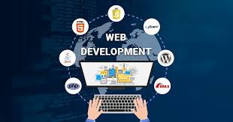
Lecture 5
Human Webs
Rainie and Wellman (2012: 22) write that group boundaries have weakened, and that ‘flexible manoeuvrable connectivity’ has increased. Once again, this is not about the internet and social media in particular. Rather, a number of things — such as wider-ranging travel, a growing number of mass media channels, secularisation, the transformation of work and the labour market, and demographic patterns (smaller families, fewer marriages, etc.) — have contributed to this transformation

Slide 20
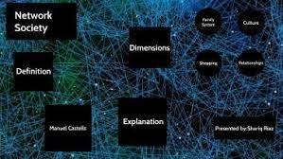
Lecture 5
Network Society
Taken together, it has led to a situation where clearly defined and bounded groups and organisations have been supplanted by informal networks of involvement that are more ad hoc. There has been a shift from group-centric societies, in which the majority of one’s friends are likely to know one another, to a network-centric society, where most of our network connections don’t know each other.

Slide 21
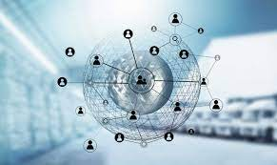
Lecture 5
Network Society
Sometimes we overlap the different networks of which we are part, and sometimes we handle things by keeping some of our relationships compartmentalized and apart from each other. Some scholars have seen this shift as being of equal importance to that of the shift from agrarian to industrial society. As you might remember from Chapter 1, Manuel Castells has popularised the notion that we live in a network society. His definition of the network society goes as follows:
A network society is a society whose social structure is made of networks powered by microelectronics-based information and communication technologies. By social structure, I understand the organizational arrangements of humans in relations of production, consumption, reproduction, experience, and power expressed in meaningful communication coded by culture. (Castells 2004: 3)

Slide 22
Lecture 5
Network Society
Even though, Castells argues, networks constitute the fundamental logic by which all kinds of life function, with technological change, and the evolution of communication technologies, networks have become more efficient than the ‘vertically organized command and control structures’ that dominated in the pre-digital age (2004: 5). According to Castells, it is because of computers and the internet that network society becomes fully realised.

Slide 23
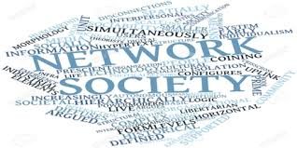
Lecture 5
Network Society
Previously, networks were an important part of social life, but now they have become the most important part. In Castells’ view, this goes way beyond a social network revolution where people start to connect in new ways. For him, it is about the whole of society. Industrialism, he writes, is ‘subsumed by informationalism’ — a new form of social organisation where all human activity, economy, politics, warfare, social movements, etc., follow a networked logic (2004:8).

Slide 24
Lecture 5
Network Society
And while the internet and computer-mediated communication shifts society into overdrive, none of it would have happened had it not been for a number of other social processes. In Castells’ description, the network society is the result of:
the accidental coincidence, in the 1970s, of three independent processes […]: the crisis and restructuring of industrialism […]; the freedom-oriented, cultural social movements of the late 1960s and early 1970s; and the revolution in information and communication technologies. (2004: 15)

Slide 25
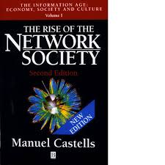
Lecture 5
Network Society
The network society, in Castells’ interpretation, is not only about the increasingly networked character of people’s social connections. It is also about a large-scale and complete transformation of how society is organised. Network society is organised around globally interdependent networks of production, consumption, business, politics, and so on. He writes of a ‘grid of networks organizing/dominating the planet’ that includes some individuals, groups, nations, or regions, while excluding others (2004: 24). Anyone who wants to exercise control over others in this world of networks must be able to command two basic mechanisms: the ability to ‘program’ (affecting the goals and modes of operation of networks), and the ability to ‘switch’ (connecting different networks to ensure their cooperation).

Slide 26
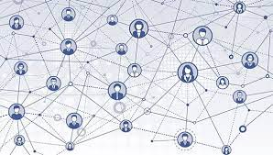
Lecture 5
Network Society
The real power-holders, however, are the networks themselves. Successful programming and switching will lead to the emergence of a new form of subject, which operates in ways similar to those theorised by philosopher of science Bruno Latour (2005: 46) in actor-network theory, the key point of which is that ‘an actor is what is made to act by many others’:
An ‘actor’ in the hyphenated expression actor-network is not the source of an action but the moving target of a vast array of entities swarming toward it.
Simply put, networks aggregate people’s actions thereby becoming a form of aggregated actors in their own right.

Slide 27
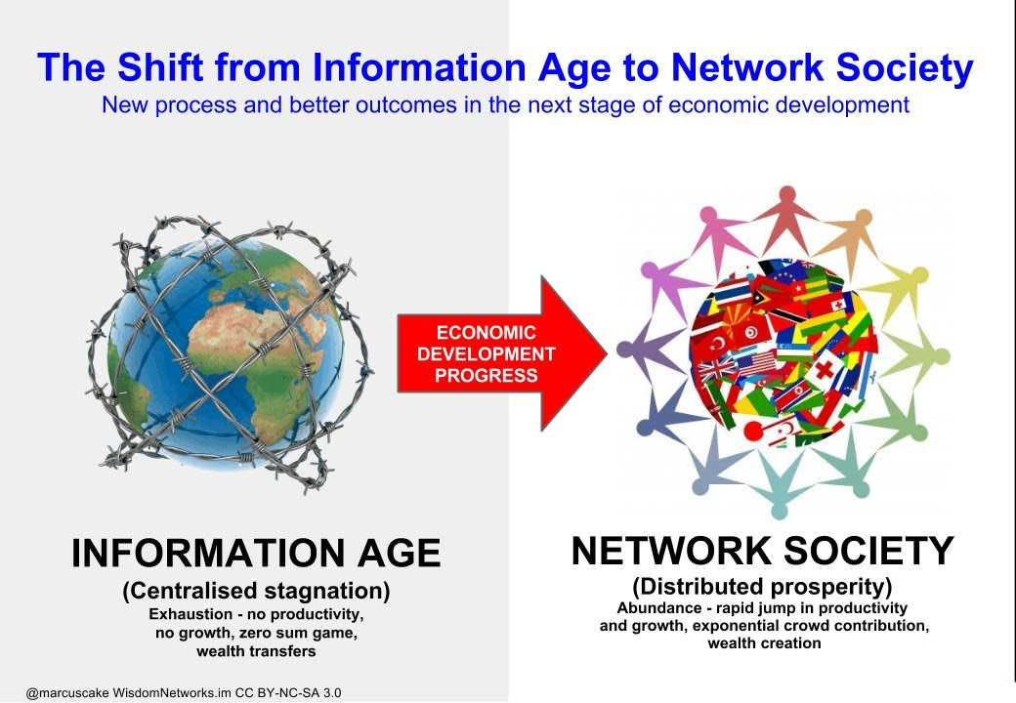
Lecture 5
Network Society

Slide 28
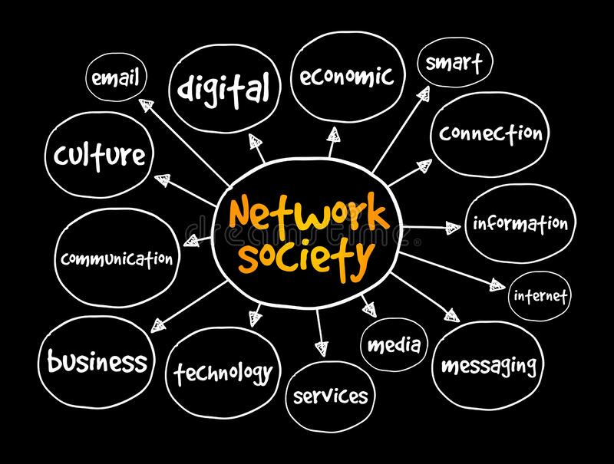
Lecture 5
Network Society

Slide 29
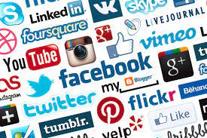
Lecture 5
Online Social Networks
Social networks were not invented together with the digitalization of society. But social networking demands some sort of mediation in order for our relationships to stretch beyond the local realm of connections that we can make and maintain through the medium of face-to-face speech. The written word, the telegraph, and the telephone are examples of media technologies that have been important for maintaining social networks since their invention and popularisation. The internet and social media obviously extend and amplify the reach of people’s connections. As internet researcher Steve Jones (1998b: xv) put it, the internet is ‘a “backbone” through which networks link up with each other’. Online networks that provide a material environment for social networks make new forms of sociality possible.

Slide 30
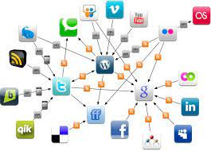
Lecture 5
Online Social Networks
In short: the internet supports social networks and social networking. The very point of the internet is that it consists of computers that are networked together. This makes for a suitable infrastructure for communication in social networks too. In the early days of the internet, computer-supported social networks were already emerging among individuals who were interacting through networked computers.

Slide 31
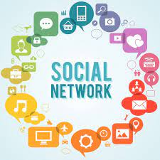
Lecture 5
Online Social Networks
In fact, Rheingold, a key theorist of online communities, wrote in the second edition of The Virtual Community, about Wellman, a key theorist of online social networks:
If I had encountered sociologist Barry Wellman and learned about social network analysis when I first wrote about cyberspace cultures, I could have saved us all a decade of debate by calling them ‘online social networks’ instead of ‘virtual communities’.(Rheingold 2000: 359)

Slide 32
Lecture 5
Online Social Networks
The networked character of online interaction became even more visible and pronounced with the major breakthrough of social network sites such as Friendster in 2002, LinkedIn and
MySpace in 2003, and Facebook in 2004 (see Chapter 2). In a seminal paper, Ellison and boyd (2007: 211) define social network sites as:
web-based services that allow individuals to (1) construct a public or semi-public profile within a bounded system, (2) articulate a list of other users with whom they share a connection, and (3) view and traverse their list of connections and those made by others within the system.

Slide 33
Lecture 5
Online Social Networks
These platforms make it possible for users to articulate their social networks and to make them visible to themselves and to other people, who may or may not be part of these networks. They call the sites social network sites — rather than social networking sites — as they argue that the primary activity is not to engage in networking to find new connections, but on simply self-presenting one’s already existing social network. Not everyone agrees with this but claim instead that people actually also do networking on the sites, initiating new relationships.

Slide 34
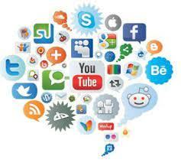
Lecture 5
Online Social Networks
Porter (2015: 166) argues that the socio-technical features of social network(ing) sites allow members to articulate and maintain as well as establish and extend Online Social Networks Social networks were not invented together with the digitalisation of society. But social networking demands some sort of mediation in order for our relationships to stretch beyond the local realm of connections that we can make and maintain through the medium of face-to-face speech.

Slide 35
Lecture 5
Online Social Networks
their network of relationships. This is because these platforms have both a ‘connection capability’ (to invite and be invited to networks) and a ‘communication capability’ (to provide, view, and manage content).
While social network(ing) sites have these specific characteristics, it is hard — and unnecessary — to maintain a distinction between these sites and online communities.
Indeed, many online communities are of a networked character, and in many social networks, at least in parts of them, a sense of community might be present. Porter argues that many online social networks, at least the ones that are sustainable, are becoming more and more community oriented. It seems that, like social bonds, sharing and mutuality is needed for online social networks to survive for longer periods of time.

Slide 36
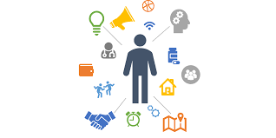
Lecture 5
The Individual at the Centre
The quantitative and qualitative evolution of the human web, together with the emergence of the internet and social media have brought about, Rainie and Wellman (2012) argue, a new social operating system. They use the metaphor of an operating system because, similar to computer systems, societies have networked structures for how people connect, communicate, and exchange information. These structures provide opportunities and constraints , procedures and rules, and through these, shape society.

Slide 37
Lecture 5
The Individual at the Centre
The operating system in mass society was concentrated around units like communities, households, and workgroups. The new social operating system by contrast, is personal. They call it networked individualism, as it puts the individual at the centre of the different networks that she or he draws on in different contexts, and for various uses and gratifications. Rainie and Wellman (2012: 12) write that:
people are not rugged individualists — even when they think they are. Many meet their social, emotional, and economic needs by tapping into sparsely knit networks of diverse
associates rather than relying on tight connections to a relatively small number of core associates.

Slide 38
Lecture 5
Networked individualism
Networked individualism, as defined by Lee Rainie and Barry Wellman (2012), reflects the social transformations which have taken place throughout the 20th and 21st centuries in the developed world, where people have increasingly shifted away from tightly knit communities. In networked individualism, each person sits at the centre of her or his own set of networks. Rather than being members of external entities such as a church or political organisation, networked individuals
command their own unique and egocentric networks.

Slide 39
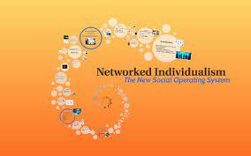
Lecture 5
Networked individualism
These networks are unique in the same way that every person’s experience of a social network site such as Facebook will be individualised in the form of a personal feed. If Facebook was a traditional community, all members would share the same space, and have the opportunity to interact with all others in the community.
Yet, in spite of the individual customisation, the content that any one individual sees on Facebook will largely overlap with what some others can see. Many connections are shared, but everyone is in the middle of their own networks. That the networks are egocentric — with the individual at the centre of a personalised set of networks — does not necessarily mean that people will act in egoistic ways.

Slide 40
Lecture 5
Thank You

