Slide 1


Principles of
Accounting
Prepared by
Dr. Hoda Metwally
MGM 227
Lecture 2

Slide 2


Principles of
Accounting
Lecture 2
Reading & Understanding Basic Financial Statements
MGM 227
Prepared by
Dr. Hoda Metwally
www.midocean.ae

Slide 3

Agenda
Purpose of financial statements
The Balance Sheet
The Income Statement
Statement of Retained Earnings
Statement of Cash Flows
Notes to the financial statements
Fundamental concepts and assumptions
Accrual vs. cash-basis accounting

Slide 4

Basic financial statements:
Balance Sheet
Income Statement
Statement of Retained Earnings
Statement of Cash Flows
Primary financial statements answer basic questions including:
  What is the company’s current financial status?
  What was the company’s operating results for the period?
  How did the company obtain and use cash during the period?

Slide 5
Balance sheet:
Summary of the financial position of a company at a particular date
Assets: cash, accounts receivable, inventory, land, buildings, equipment and intangible items
Liabilities: accounts payable, notes payable and mortgages payable, loan.
Owners’ Equity: net assets after all obligations have been satisfied

Slide 6
Balance Sheet answers these questions:
What are the resources of the company?
What are the company’s existing obligations?
What are the company’s net assets?

Slide 7
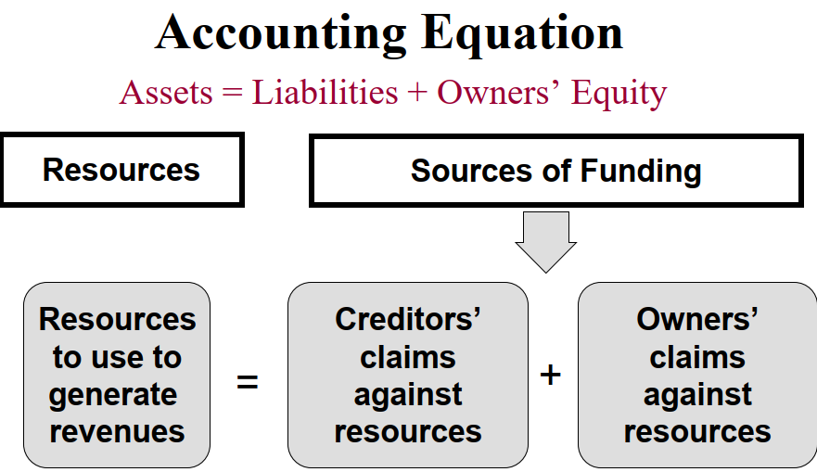

Slide 8
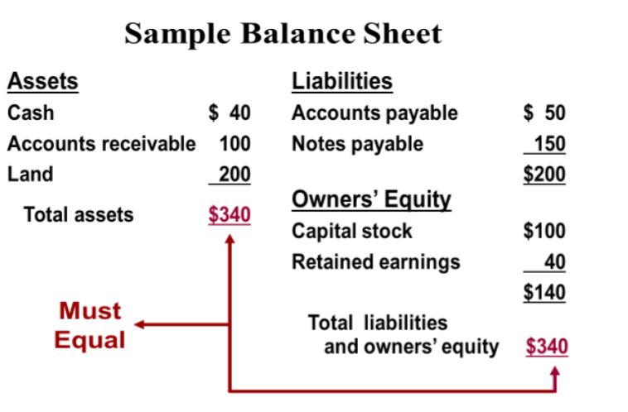

Slide 9
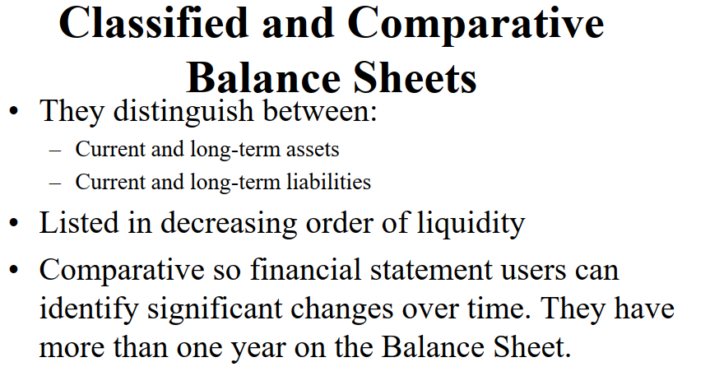

Slide 10
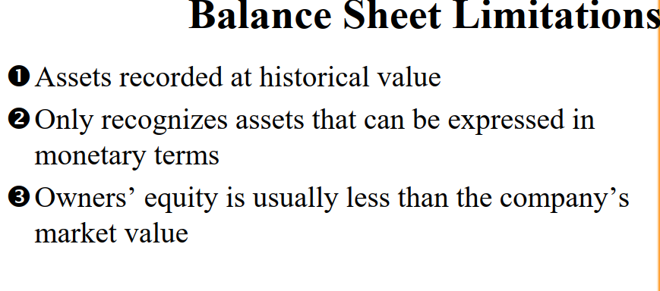

Slide 11
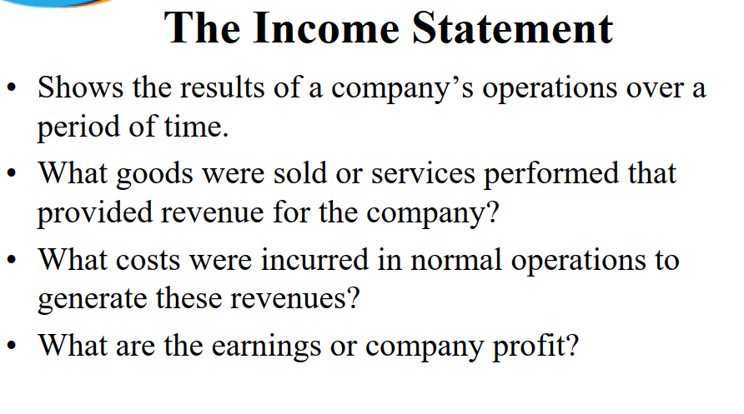

Slide 12

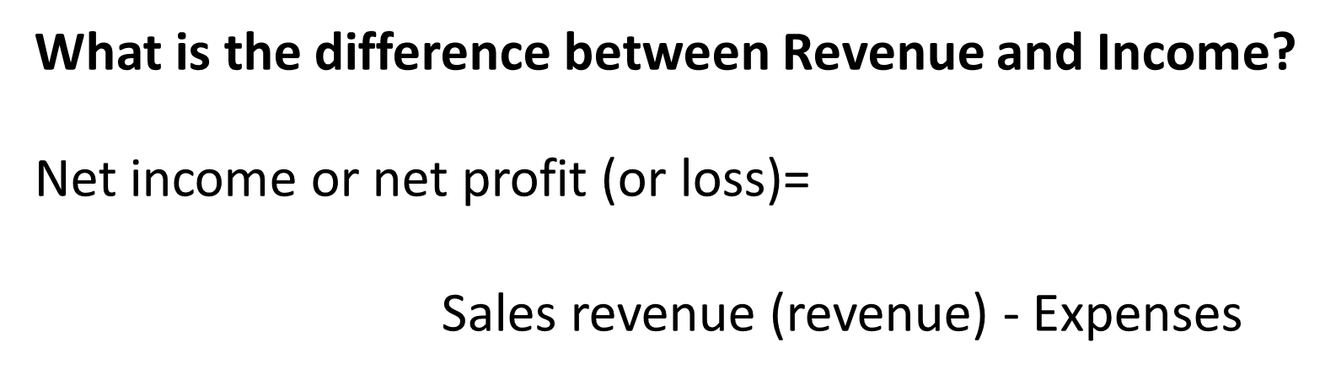

Slide 13
Income Statement:
Revenues
Assets (cash or Accounts Receivable) created through business operations
Expenses
Assets (cash or Accounts Payable ) consumed through business operations
Net Income or (Net Loss)
Revenues - Expenses

Slide 14
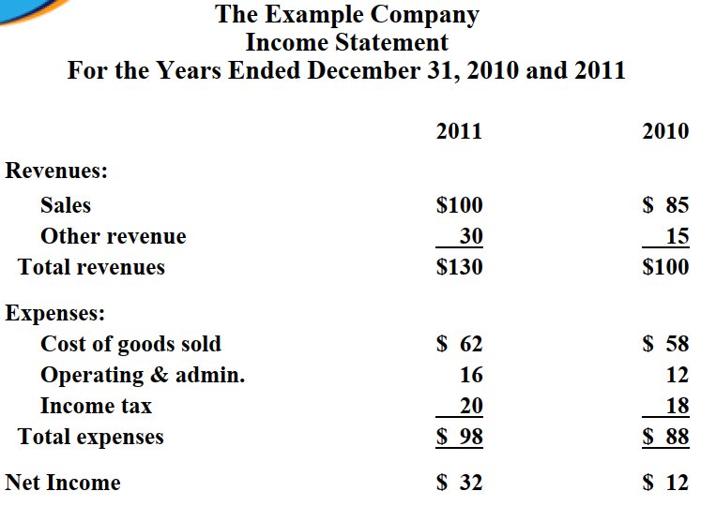

Slide 15
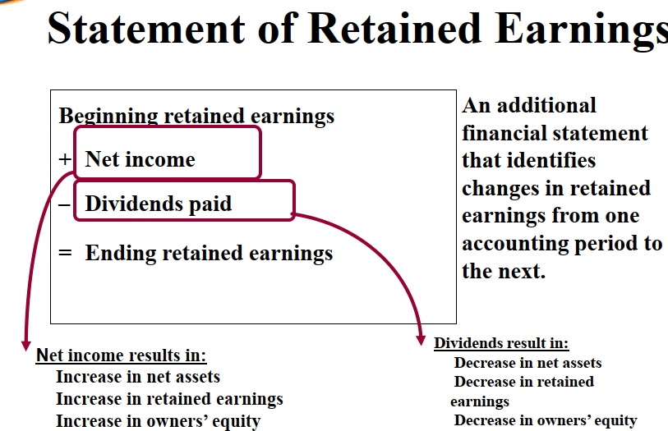

Slide 16
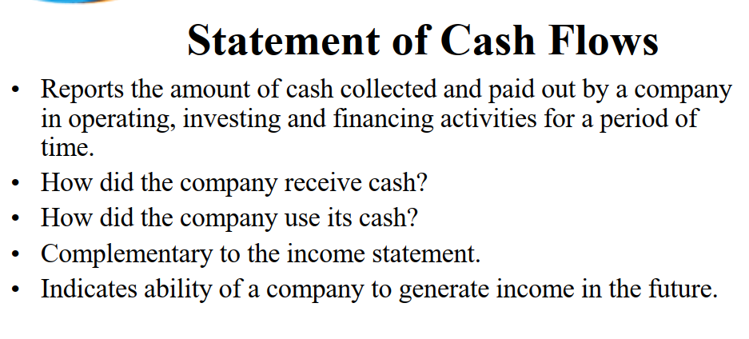

Slide 17
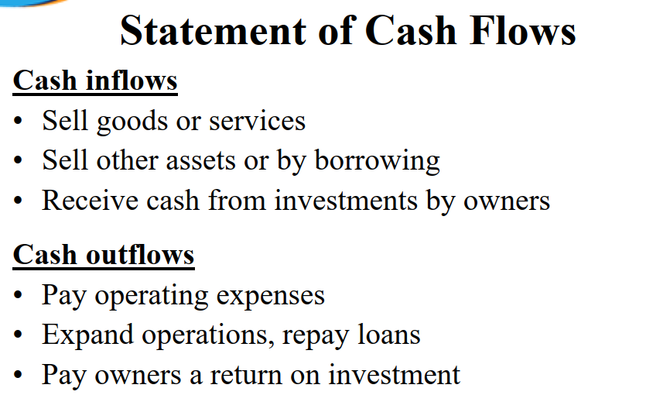

Slide 19
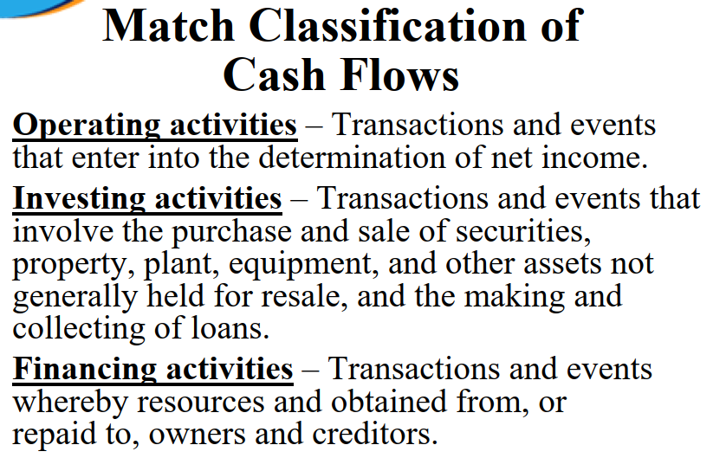

Slide 20
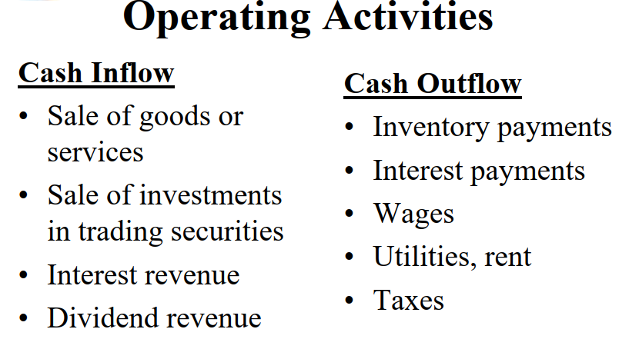

Slide 21
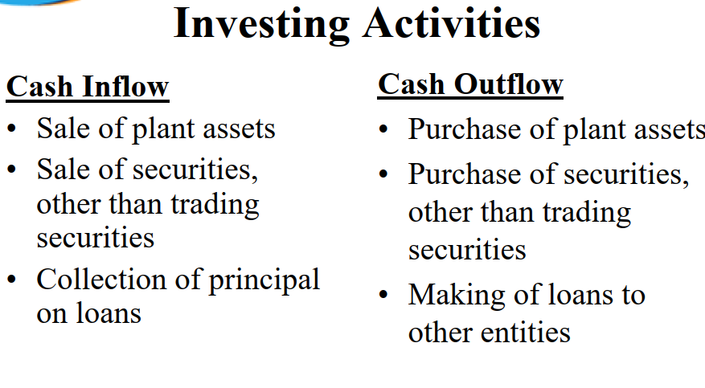

Slide 22
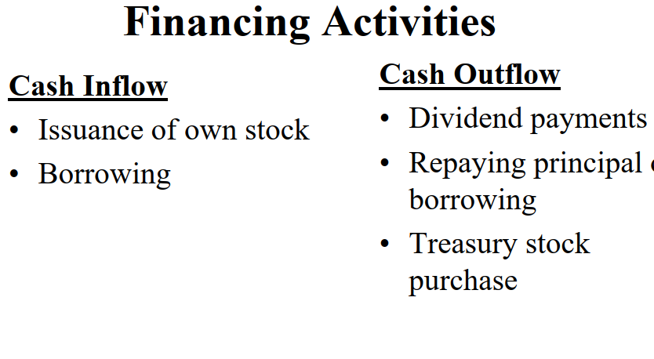

Slide 23
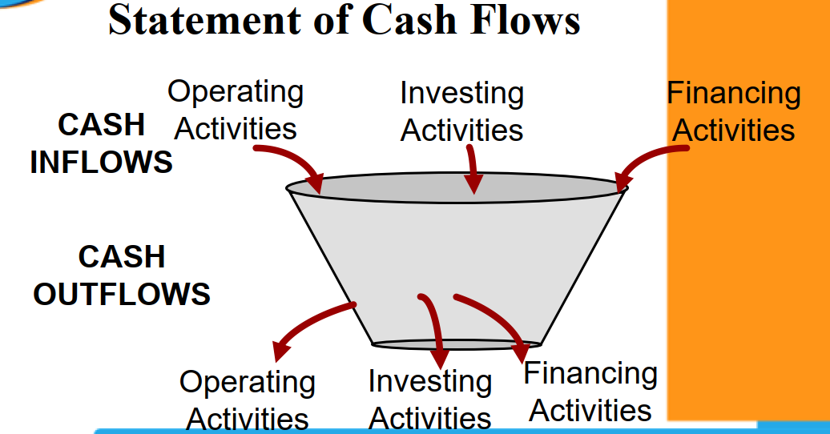

Slide 24
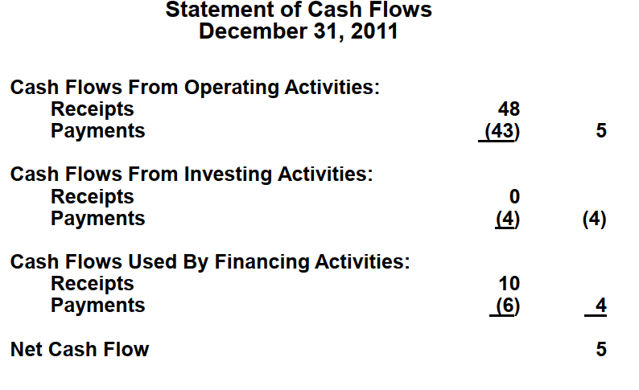

Slide 25
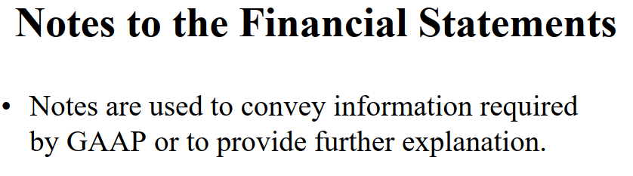

Slide 26
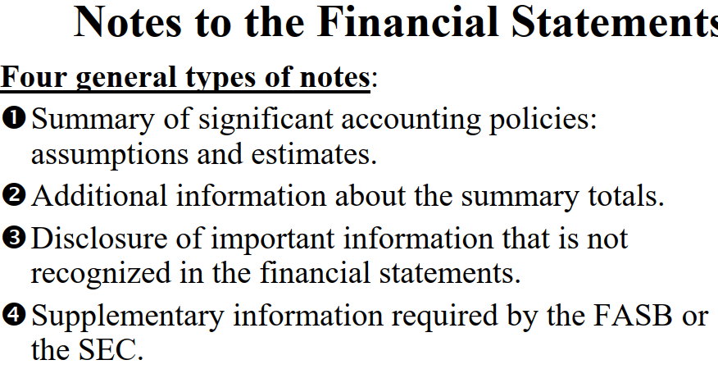

Slide 27
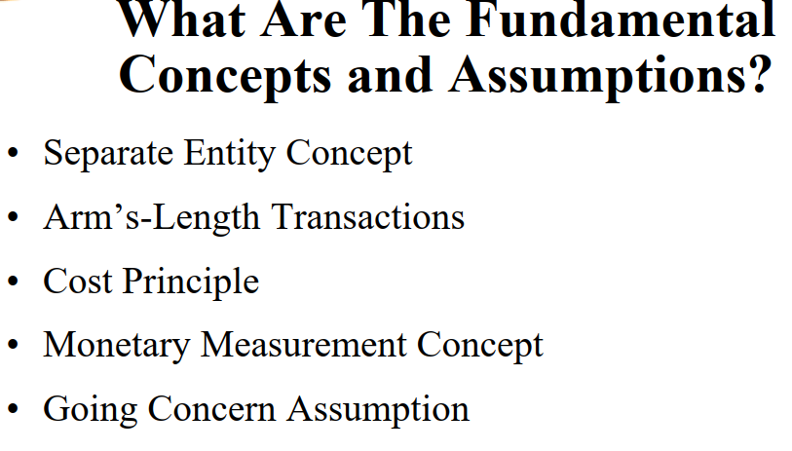

Slide 28
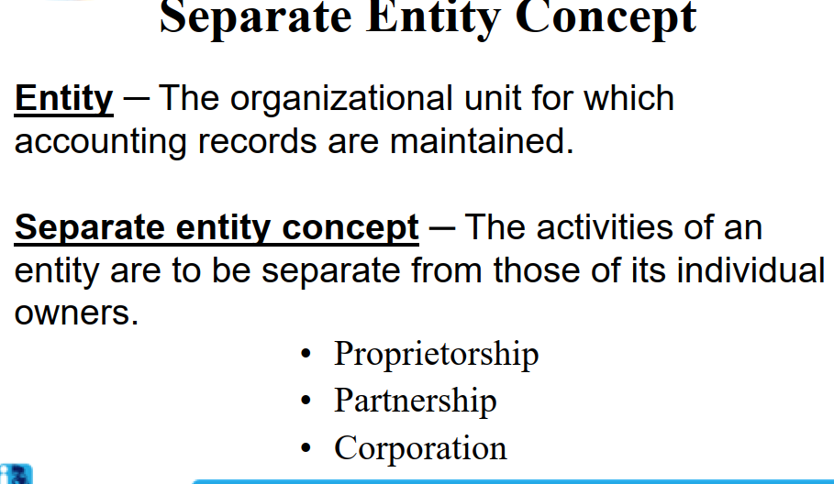

Slide 29
The Cost Principle
All transactions are recorded at historical cost.
Historical cost is assumed to represent the fair market value of the item at the date of the transaction because it reflects the actual use of resources by independent parties.

Slide 30
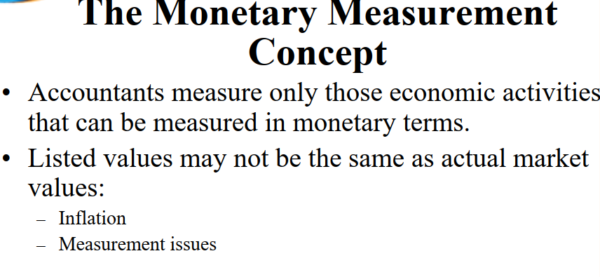

Slide 31
The Going Concern Assumption

Slide 32
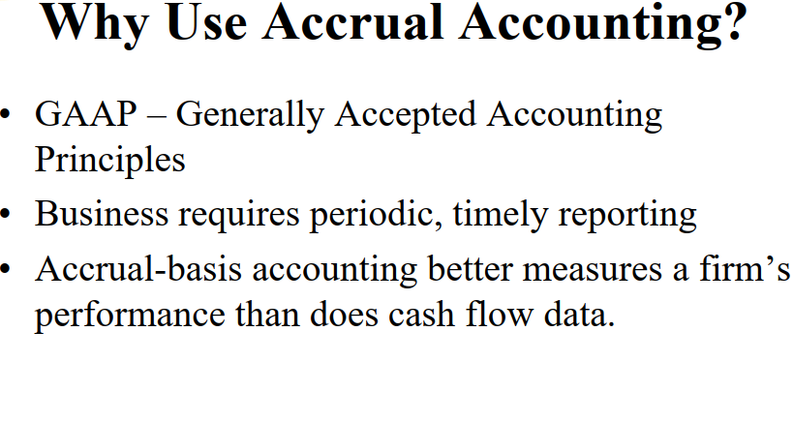

Slide 33
The Time Period Concept
The life of a business is divided into distinct and relatively short time periods so the accounting information can be timely, generally 12 months or less.

Slide 34
Define Accrual Accounting
A system of accounting in which revenues and expenses are recorded as they are earned and incurred, not necessarily when cash is received
or paid.
Provides a more accurate picture of a
company’s profitability.
Statement users can make more informed judgments concerning the company’s earnings potential

Slide 35
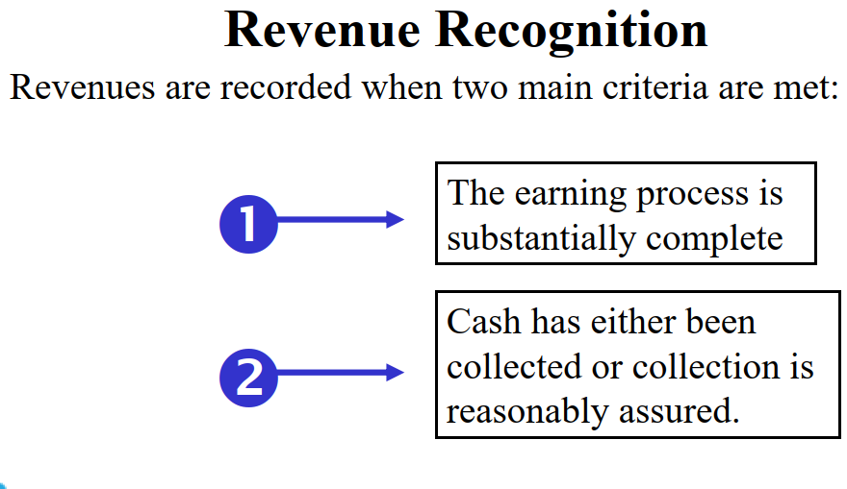

Slide 36
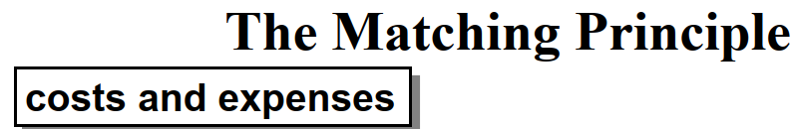

All costs and expenses incurred in generating revenues must be recognized in the same reporting period as the related revenues.
This process of matching expenses with recognized revenues determines the amount of net income reported on the income statement.

Slide 37
Cash-Basis Accounting
Revenues and expenses are recognized only when cash is received or payments are made.
Mainly used by small businesses.
Not an accurate picture of true profitability.

Slide 38
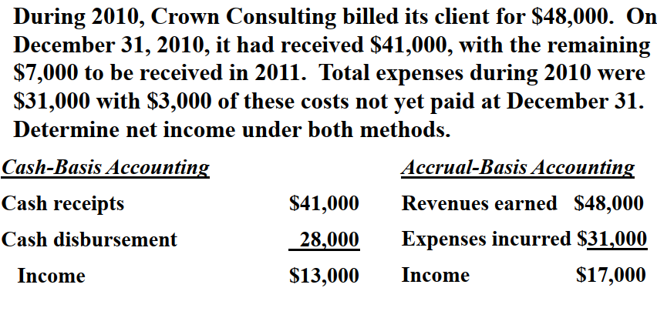
Accrual vs. Cash-Basis Accounting

Slide 39
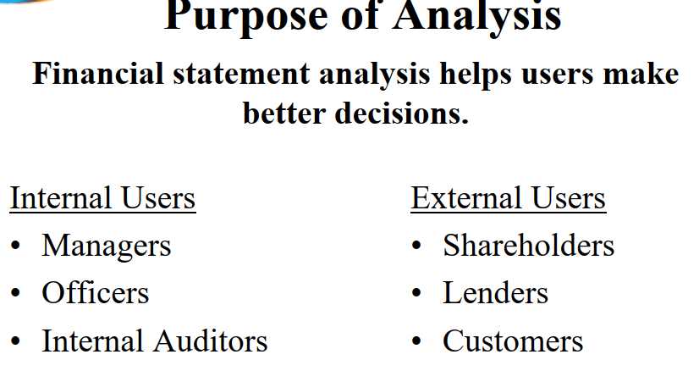

Slide 40


Thank You

