Slide 1


Project cost
management
Prepared by
Dr. Hoda Metwally
PMG 227
Lecture 6

Slide 2

Jobsite general conditions

Slide 3
Introduction
There are several different terms used to describe general conditions (GCs) in construction as well as different meanings for that term, including:
* American Institute of Architects (AIA) general conditions (contract document),
* Construction Specifications Institute (CSI) specification divisions ,
* Overhead costs,
* Indirect costs,
* General requirements,
* General and administrative costs,
* Distributable costs,
* Administrative costs, and
* Operational costs.

Slide 4
They do not all mean exactly the same thing to all of the built environment participants, so it is important for the construction project manager (PM) to be clear about the application for the term they are using. This chapter focuses on jobsite general conditions. For many, it is easiest to include the prefix jobsite or home office to differentiate these very important aspects of construction management and their relation to estimating, accounting, and financial management. As discussed in the last chapter on estimating, the major elements of a construction estimate, which are a subset of the revenue formula, include:

Slide 5
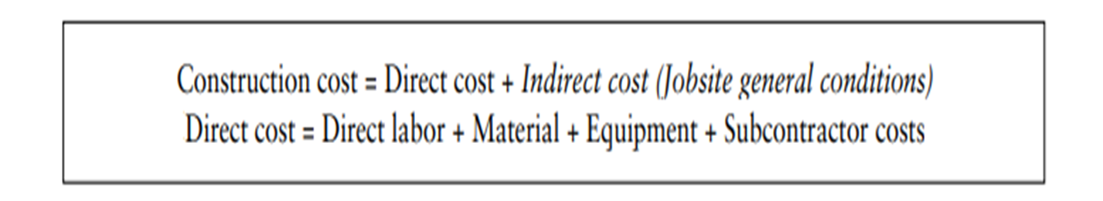

Slide 6
Direct costs reflect actual field construction, such as forming concrete footings, erecting structural steel, hanging and taping gypsum wall board, connecting light fixtures, and hundreds if not thousands of other activities necessary to complete a construction project. The results of these efforts, be they labor or material, are visible during the course of construction and/or when the project is completed. But the results of home office or jobsite general conditions are not directly visible or measurable in the project. These efforts are therefore aptly described as indirect costs and they are distributed over the course of all of the work.

Slide 7
This chapter will introduce many of the different elements of jobsite general conditions, the process for estimating each of those elements, and development of a complete jobsite general conditions estimate. There are strategies utilized by the contractor to develop that estimate as well as manage it. It is the contractor’s project manager and superintendent who are directly responsible for managing these costs. GCs at the jobsite level are very time-dependent; if the project lasts longer they cost more. Change orders and delays impact those costs but the impacts are sometimes difficult to quantify and are not always reimbursable.

Slide 8
Elements of jobsite general conditions
There are many different ways to determine the scope of jobsite general conditions for an estimate. It can be as simple as taking a previous estimate and making slight modifications for the new project. Although the term general is used when describing this work, every project is specific and the GCs estimate should also be project-specific. Sophisticated contractors have lengthy templates that they use to pick and choose items which apply to a specific project.
One of the first things the estimator will do is to scour the client’s contract and the front end of the specifications (CSI divisions 00 and 01) for management requirements that he or she must incorporate into this project. Different forms of contracts, as was introduced in Chapter 3, may have a significant impact on estimating and accounting. Jobsite conditions include laydown, security, and a hoisting plan and all have impacts on jobsite GCs.

Slide 9
Then by picking and choosing potential estimate items from a lengthy template, the estimator can begin the process of developing a customized cost estimate. There are typically four major categories in the GCs template. Eventually the estimate may be collapsed into an abbreviated single page or two, again job dependent, and these four categories may end up all grouped together. What follows is a list of the four categories and a few sample items which will be found within each. A complete four-page blank Excel GCs template is included on the resource.
1- Administrative expense:
a. Project manager’s wages,
b. Superintendent’s wages,
c. Project engineer’s wages,
d. Surveying (see Strategies section later),
e. Jobsite accountant’s wages (see Strategies section later), and others

Slide 10
2. Equipment:
a. Superintendent’s pickup truck,
b. Compressors and welders if not charged to the work,
c. Forklift,
d. Tower crane (if applicable),
e. Personnel and material hoist (if applicable), and others.
3. Temporary construction:
a. Jobsite office trailer,
b. Installation and maintenance of temporary site utilities,
c. Parking accommodations for craftsmen,
d. Temporary fencing, and others.

Slide 11
4. Operational costs:
a. Percentage add-ons and markups (if not on the summary estimate page),
b. Construction utility bills,
c. Drinking water and chemical toilets,
d. Flaggers (important for heavy-civil work),
e. Temporary cleanup,
f. Final cleanup (if not with subcontracts), and others

Slide 12
Some of these items may be included with the direct work portion of the estimate as described in the Strategies section later. Some of the items may be excluded from this specific project or may be provided by others such as the project owner. It is important not to eliminate any of the items from the template as then one would not know if they had been intentionally excluded or simply missed. Specifically excluded items should be left on the template and appropriately annotated. Rarely, if ever, would a construction loan and corresponding interest charges be included in the contractor's estimate. There is not a line item for loan interest in our template, but one could be added if the estimator felt it was required.

Slide 13
Development of jobsite general conditions estimates
After the project manager and chief estimator have customized the general conditions estimate template for their specific project, they can begin populating it with quantities and units and pricing. As shown in the Estimating Process in Figure 4.1, the GCs estimate is not started until most of the other detailed estimating work has been accomplished. Many of the items in the GCs estimate are time-dependent, so a construction schedule is necessary and will be developed as follows:
* Total all of the direct construction work hours,

Slide 14
* Superintendent will review the hours, and with estimated crew sizes, determine durations,
Subcontractor input on durations is very helpful.
A construction schedule should be developed, even if not required by the client’s request for quotation or request for proposal (RFQ or RFP), and The contractor’s total duration should be compared to that of the client’s if provided in the contract documents. It is not necessary to develop a fully detailed construction schedule at this time unless the contractor is the only one submitting a negotiated proposal and is very confident of award.

Slide 15
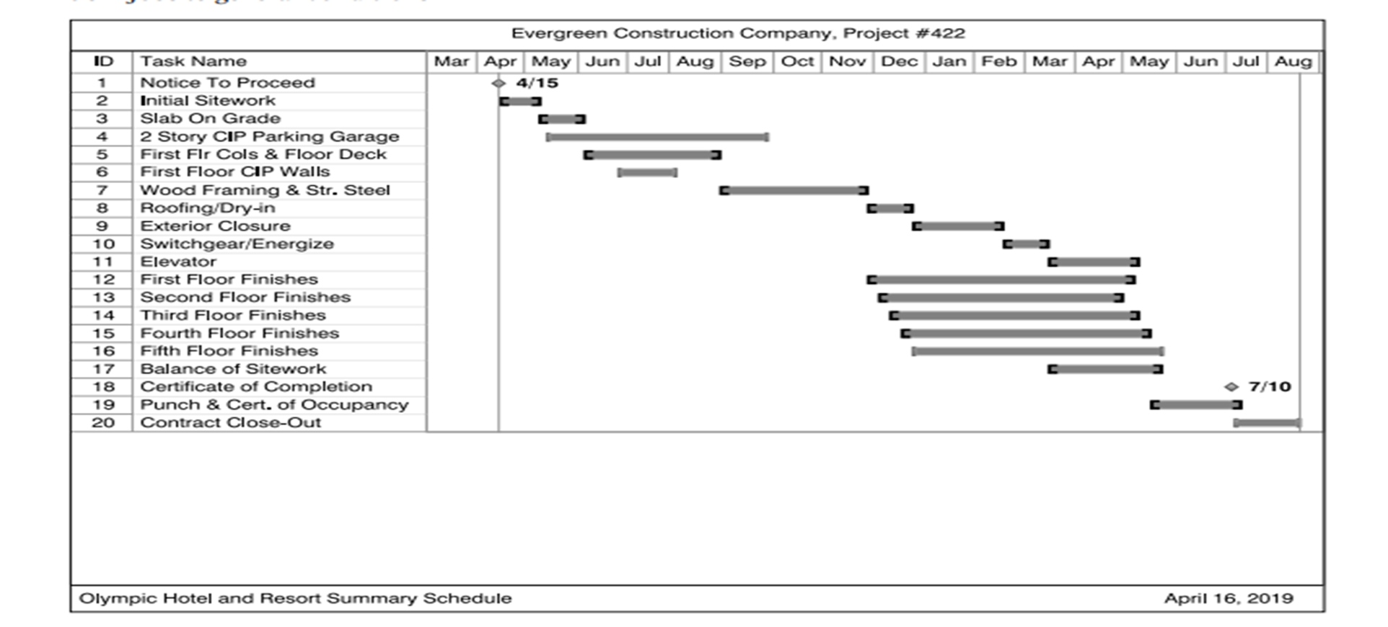

Slide 16
Figure 5.1 Summary schedule
After award in a competitive bid or negotiated scenario, then a detailed schedule will be necessary which will be in excess of 100 line items long if not closer to 1,000. A summary schedule is often requested with competitive bids and proposals and will be sufficient to develop the general conditions estimate. A summary schedule for the hotel case study is included here as Figure 5.1. A fully detailed schedule is included on the resource. Now that the estimator knows this is a 16-month project, many of the general conditions cost items can be calculated. For example, as it relates to our case study, the superintendent will be full time on the project and he earns a monthly salary of $10,000 per month.

Slide 17
The project manager and project engineer (PE) and administrative assistant will also be full time. The jobsite accountant will split her time between standard PE activities and cost engineering activities. The superintendent’s pickup truck and forklift and two jobsite trailers are all estimated for the full project duration as well as many other line items. An abbreviated GCs estimate for the case study has been included here as Figure 5.2. An expanded version is also available on the resource.

Slide 18
Other items in the general conditions estimate may be dependent on the cost of some elements of the work or on an anticipated cost of the entire project. An example is small tools which are not provided by the craftsmen but estimated at 5% of the direct labor estimate. This is another reason why the direct cost of the work was necessary to have been calculated before the GCs cost Figure 5.1 Summary schedule was developed. Other items, if applicable for this specific project and not included on the estimate summary, are calculated on a percentage of the total cost of the work.

Slide 19
Estimators do not typically prepare quantity take-offs for GCs as they will for direct work. Pricing should not be obtained from published estimating databases such as RS Means for general conditions. GCs need to be job-specific as stated earlier, but also are company-specific. One firm may pay their accountant $1,200 per week and another $1,500 per week. One firm may supply their superintendents with pickup trucks to take home at the end of the day and others may expect superintendents to provide their own trucks in turn for increased compensation included in their salaries

Slide 20
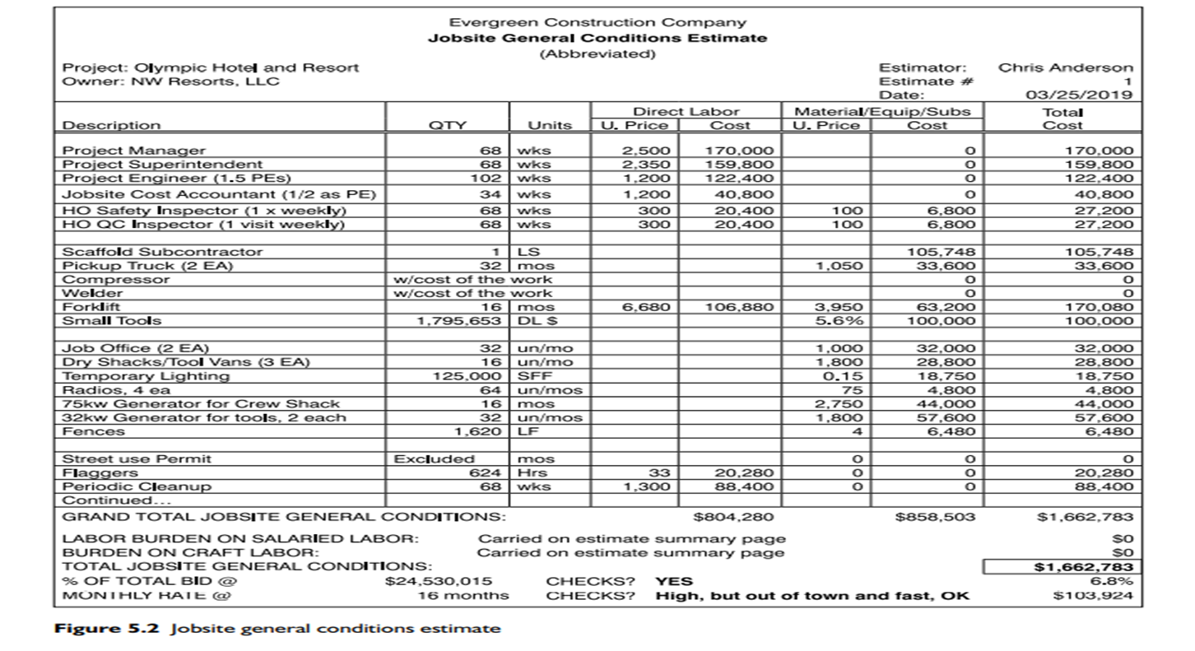

Slide 21
An experienced estimator will develop a quick general conditions estimate utilizing the processes described here, then print it out and let it sit for an hour or so. Then they take a red pen to it and mark it up and input the revisions and go through the editing process several additional times. Drafts of the estimate should be reviewed with the superintendent to get his or her buy-in. Some contractors allow their home office chief estimator to prepare the project-specific GCs estimate, but the PM and superintendent should play a major role, if not prepare it themselves. At a minimum they should review and approve the scope and time and pricing. There is no exact final figure the general conditions will total, but they generally range from 5% on larger projects to 10% on smaller projects. Residential projects and heavy-civil projects are on the higher end. The amount of direct work a contractor has, which requires more intense supervision and management, also affects the final cost. Negotiated open-book projects will have a higher GCs cost than closed-book bid projects.

Slide 22
The total percentage should be noted on the bottom of the GCs estimate page as well as alongside the GCs line item on the total estimate summary page as was shown in Figure 4.5. The GCs estimate for Evergreen Construction Company (ECC) on the Olympic Hotel and Resort case study project totaled 6.8% of total contract value. This may be a little on the high end, considering this is a $24.5 million project, but because of its out-of-town location, this is a very acceptable amount. Many estimators also relate general conditions cost to an average dollars per month calculation. Different types of projects have significant impacts on the monthly cost, for example if a tower crane or a personnel hoist is required.

Slide 23
This monthly average should also be noted on the GCs estimate. If an estimate is significantly higher or lower in either percentage or monthly cost compared to other past projects, the estimate should be re-visited and either modified or the estimator should understand the differences because of the unique aspects of this specific project. The estimator should independently audit his or her own work before finalizing and posting the GCs total to the estimate summary. An easy way to do this is to simply scan down the sheet and look at the largest and smallest items; do they appear correct?
Labor burden (labor taxes plus labor benefits) was introduced prior and will again be addressed with taxes and audits. There are different schools of thought about whether burden should be combined with the cost of direct wages and included above the subtotal line with the work, or below the line as a percentage markup.

Slide 24
In the case of a general conditions estimate, craft labor for scopes such as cleanup or equipment operation has been combined with indirect labor such as a safety officer and jobsite accountant. Salaried labor receives a much smaller burden markup than does craft labor, for example 30% compared to 50%, so they need to be calculated separately. Craft labor also varies depending upon union preferences. An experienced client may also ask for stipulated wage rates and labor burden markups on the bid form or in the proposal. Some estimators will include the labor burden for GCs on the GCs estimate page and others below the line on the estimate summary page. Regardless of the location, it is imperative that markup rates for craft and salaried labor burden be figured separately and that the burden is included in one location in the estimate, and not omitted, and not figured twice.

Slide 25
This discussion has been based upon the view that the contractor will prepare a detailed general conditions estimate and not just allow a percentage add-on, such as 8%, on top of the cost of the direct work including subcontractors. This would be the approach an estimator would take only with schematic budget estimates, but not detailed lump sum or guaranteed maximum price estimates prepared by experienced contractors. Smaller, less-sophisticated contractors may estimate GCs as a percentage add-on to the total estimate, but this is not reliable and not advised and cannot be monitored, controlled, and accounted for as is discussed later

Slide 26
Strategies
Contractors can take several different approaches to the way they estimate and manage both their home office and jobsite general conditions. It is a misconception to think of GCs as overhead especially at the jobsite level. Business analysts will discuss reductions in overhead to lower costs and improve profits. Although this may be true for contractor home office GCs, it does not necessarily apply to the jobsite. These administrative and operational expenses are necessary to support the field construction. Spending additional jobsite GCs can actually save direct field costs and improve fee, which improves profit. An example would be spending additional costs on weekly jobsite cleanup which improves site access, material handling, labor productivity, and site safety conditions. Design firms quote fees to their clients, which combines all of their overhead costs plus profit plus the cost of labor and material and equipment to prepare their design.

Slide 27
When clients and designers evaluate a general contractor’s jobsite GCs estimate, they think in terms of fee, but these expenses are not a fee. Some built environment participants believe contractors have hidden fees buried within their GCs estimates, but actually contractors tend to lose money on their GCs estimates, i.e. they spend more on management than what they estimated to support the field efforts, often due to schedule delays. Some construction project owners utilize a hybrid procurement system of requesting a lump sum fee (including home office overhead and profit) and jobsite GCs, along with customary RFP items such as resumes and company history. This is often the case with CM-at-risk or CM/GC delivery methods. Because of the focus contractors receive on their GCs estimates the percentage GCs amount to on top of the cost of direct work therefore becomes competitive. Contractors subsequently strategize on how GCs estimates are prepared and managed and develop ways to lower the estimate and potentially cost. Following are some of these strategies:

Slide 28
First, contractors will move home office GCs to jobsite costs wherever possible. Because fee equals home office overhead (HOOH) plus profits (Fee = OH&P), and the company’s total net profit is really their focus, any reduction in HOOH and shifting cost to the projects, all the while keeping the same fee, improves profit. Some costs are reimbursable and part of the job cost and some are non-reimbursable costs. A contractor may propose language changes or inserts to help move costs from the home office to the jobsite and have the client pay for them. Some examples of costs which could be shifted from the next chapter’s discussion on home office GCs to the jobsite would include:
* Assigning a senior project manager to the project as a PM;
* Charging the contractor-owned equipment repair and maintenance to the job;
* Locating the PM at the jobsite instead of the home office, along with his or her computer and automobile expenses or rent; and

Slide 29
4. General contractors will require their PMs to shift as much of their GCs activities to subcontractors as is possible. In order for this to happen, these transfers of responsibility and cost must be both feasible from a managerial perspective and contractually acceptable by the subcontractors. There are many examples of how this can happen, including:
Building envelope subcontractors provide their own scaffolding;
b. Roofing contractors (and other subcontractors working on the roof such as mechanical and electrical) provide their own hoisting;
c. Subcontractors provide their own forklifts;
d. Subcontractors provide their own dumpsters;

Slide 30
e. Include temporary heat in the heating, ventilation, and air conditioning subcontractor’s bid package;
f. Include temporary electrical power and lighting in the electrical subcontractor’s bid package;
g. Subcontractors typically already provide their own office trailers and tool vans
5. Another means the PM and superintendent have to reduce jobsite GCs costs include cost coding activities and expenses to direct work activities in lieu of GCs
6. If surveying is performed by the contractor’s in-house surveyors then this cost is included in the GCs as it is distributed over several activities.

Slide 31
Whereas if professional licensed surveyors are contracted as a subcontractor, then this cost can be grouped along with other subcontract costs. Final cleanup is also listed as an option on the GCs estimating template, but if a subcontractor is hired to do this work the estimator can also group those costs with other subcontractors such as painters and glaziers and not include the subcontractor cost in the GCs. Some general contractors will also subcontract out flagging, scaffolding, window cleaning, and site security services and not include them in the general conditions.

Slide 32
7. There are also several line items on the GCs estimating template from the operations section that can be placed on the estimate summary page and not with GCs such as insurance, permits, bonds, taxes, and others. Those items are generally referred to as ‘below-the-line’ markups and not part of the cost of the direct work which is shown ‘above-the-line’ on the estimate summary.
8. Because the estimate is time-dependent, the best way for a contractor to save money on its jobsite GCs estimate is to plan and estimate and facilitate a faster way to build the project. Saving one month from the client’s stated schedule in the request for quotation is one reason this author/estimator was the successful low-bidder on multiple occasions.

Slide 33
Accounting of jobsite general conditions
The project manager and the project superintendent are the two most ‘accountable’ parties on a construction project, especially from a general contractor’s perspective
The following are some of the steps that the jobsite team will go through when accounting for the GCs estimates:
1. The estimate must be corrected before it is submitted into the cost control system. From a jobsite GCs perspective this might involve changing the durations of time-dependent activities and personnel if it is discovered that the project takes a month longer or shorter.

Slide 34
2. If scopes are subcontracted or purchase orders are let then buyout values and cost codes from those documents must be entered into the accounting system. Some of the elements of jobsite GCs are subcontracted as discussed earlier.
3. During the course of construction, time sheets must be filled out on a weekly basis and cost codes assigned, both for craft labor performing indirect activities, such as the forklift operator, and indirect salaried labor such as the field administrative assistant. Wages for most jobsite salaried personnel will be journaled into the job cost history report by the home office accounting department.
4. Indirect material invoices must be cost coded on a weekly basis. It is imperative that the cost codes be accurately input on the invoices by the jobsite accountant or cost engineer and exactly match those set up in the cost control system.

Slide 35
5. Equipment rental invoices must also be cost coded on a monthly basis. This includes every thing from the pickup truck to the copy machine. A watchful eye must be kept on the maintenance cost of owned and rented equipment. In addition rental durations must be optimized: it is less expensive to rent a piece of equipment for a whole week than four days, the same for a month versus three weeks out of the month. Mobilization and demobilization costs can be expensive for equipment continually rotated in and out of the job.
6. Once monthly the PM will prepare a cost forecast for upper-management with the assistance of his or her cost engineer or jobsite accountant, along with input from the superintendent. In the case of jobsite GCs, this is again very time-focused. If the project has been spending $90,000 per month on GCs and there are five months left to go, then likely there is approximately $450,000 worth of GCs yet to spend, unless a specific item such as a tower crane is finished and has been demobilized.

Slide 36
7. There is not the same estimating risk of missing productivity rates or quantities with GCs as there is with direct labor and material. The largest risk in missing the GCs estimate is time. If the project is estimated for 16 months, but lasts 20 months, there is likely a 25% cost overrun. The PM and superintendent must keep a close eye on schedule control, as well as cost and quality and safety controls.
Some contracts have clauses that allow the contractor to recover specific general conditions items on a change by change basis, if those items can be substantiated. In this case it is advantageous for the contractor to have prepared a detailed construction schedule and a detailed GCs estimate and not an 8% add-on below-the-line estimate. But many contracts today have a no claim for delay clause which prohibits any of the construction team from recovering GCs cost if the project is delayed by the owner or designer, weather, or other means beyond the contractors’ control.

Slide 37
The contractor can receive extra time, or days on the schedule, but no additional general conditions costs or recovery for lost fee potential. The change order proposal summary page looks very much like an estimate summary page. See Figure 15.1. Very seldom will a client allow a percentage add-on for jobsite general conditions; and home office GCs are assumed to be included in the fee markup. Subcontractors, however, are more successful at receiving additional overhead on their change orders because the value of their work is less and the amount of direct labor they have, and associated risk, is more.

Slide 38



Thank You

